Slide 1
Using Spread Spectrum with Narrow Band Channels
George Elmasry, Raytheon’s System Engineering
June 21, 2026

Slide 2
Spread Spectrum for Wireless Channels
Spread spectrum has the advantages of:
Reducing detectability
Mitigating various forms of fading
Enhancing resilience to external and self-interference
Raytheon’s typical wireless radios use a combination of spread spectrum and frequency hopping to achieve resilience against eavesdropping and combat jamming
Spread spectrum is avoided for narrowband channels (10s of Hz) because the room (frequency band) for spreading is limited
Although needed, spread spectrum is avoided with narrow band channels

Slide 3
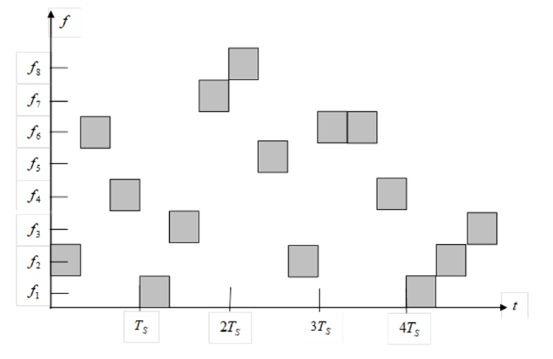
Reviews
The use of spread spectrum with frequency hopping
Mixing frequency hopping and spread spectrum offers resilience against eavesdroppers and jammers.
It is hard to synchronize with the frequency sub-band at any given moment.
Even if there is sync, spread spectrum makes the signal appear as background noise.
With a narrowband channel, there is no room for frequency hopping and spread spectrum

Slide 4
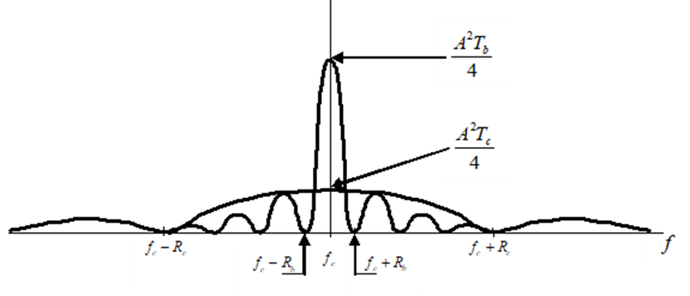
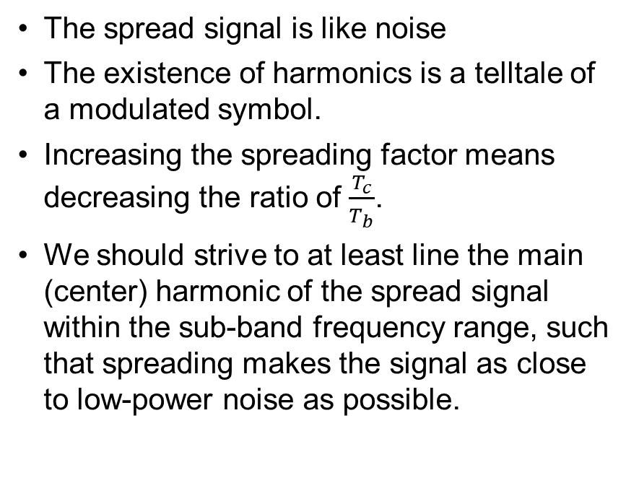
Reviews
Spread spectrum hides the RF signal
The spread signal is like noise
The existence of harmonics is a telltale of a modulated symbol.
Increasing the spreading factor means decreasing the ratio of $\frac{T_{c}}{T_{b}}$.
We should strive to at least line the main (center) harmonic of the spread signal within the sub-band frequency range, such that spreading makes the signal as close to low-power noise as possible.
Frequency domain Spread v non-spread signal
Maximizing spreading with the narrowband channel is needed

Slide 5
Review
Orthogonal Spread Codes
What to do with a narrow band channel?
Engineers strive to create orthogonal codes
This minimizes self-interference
If we transmit 2 signals at the same time using the same frequency sub-band, the two signals would not interfere with each other because the spreading codes are orthogonal to each other
Each is background noise to the other
The Hadamard matrix is a form of maximizing the number of orthogonal spreading codes for a given spreading factor
For a channel with a bandwidth in the range of 10s of Hertz, the spreading factor we can use is very small and can be meaningless
There is no room for frequency hopping
Alternatively, if we can increase the number of orthogonal spreading codes, we can hop (cycle) through spreading codes for evasion
If we can maximize the number of orthogonal spreading codes in the narrow band channel, we can compensate for the lack of combined frequency hopping and spread spectrum by cycling through spreading codes

Slide 6
The Challenge
Maximize spread spectrum with narrowband channels
It will allow us to leverage the advantages of spread spectrum
Signal hiding
Mitigate self and external interference
It will allow us to hop between spreading codes for evasion
Some solutions generate a single polynomial or a limited number of known polynomials, given the channel’s parameters:
For example, Kasami generator polynomial can produce a small set of Kasami sequences (primitive polynomial of degree n=6)
The polynomials are Known -- the signal can be discovered
No room for mitigating self and external interference
Not enough entries for evasion
We need to maximize the spreading capability beyond the known limits

Slide 7
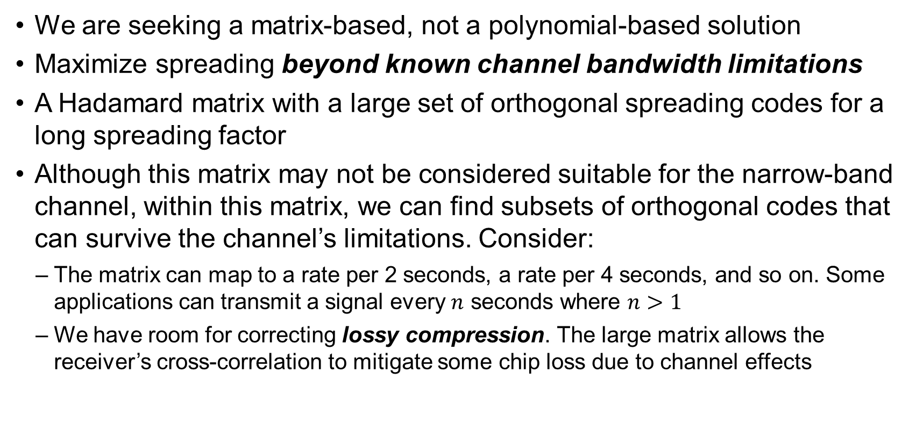
The Solution
We are seeking a matrix-based, not a polynomial-based solution
Maximize spreading beyond known channel bandwidth limitations
A Hadamard matrix with a large set of orthogonal spreading codes for a long spreading factor
Although this matrix may not be considered suitable for the narrow-band channel, within this matrix, we can find subsets of orthogonal codes that can survive the channel’s limitations. Consider:
The matrix can map to a rate per 2 seconds, a rate per 4 seconds, and so on. Some applications can transmit a signal every $n$ seconds where $n>1$
We have room for correcting lossy compression. The large matrix allows the receiver’s cross-correlation to mitigate some chip loss due to channel effects
We want to go beyond the channel rate in bits/sec and beyond known max spreading by considering lossy compression

Slide 8
The Experimental Solution
We used MATLAB to generate a large Hadamard matrix
We spread the signal beyond the channel's per-second bitrate limitations
We experimented with the entries of this matrix. We were able to:
Identify a subset of spreading codes that can’t survive the channel even when the channel doesn’t introduce noise (noiseless channel).
This subset is discarded since it can’t survive the channel’s lossy compression
Assign to the rest of the entries in the matrix a rank based on each entry’s ability to survive the channel’s bandwidth limitation and a given signal-to-noise ratio (SNR)
This means that if we know the channel’s SNR, the transmitter and receiver can switch (hop) between all the orthogonal spreading codes that can survive the channel’s SNR
The main aspects of the solution are:
(1) The consideration of lossy compression,
(2) The consideration of signal harmonics, and
(3) Invoking Set Theory (dynamic sets)

Slide 9
The Sought Solution
Just as Hadamard matrices are known and can be found in MATLAB for given parameters, the solution should be implementable in MATLAB, where it defines:
Hadamard matrices with large spreading factors
Maximize spreading, to increase the pool of usable spread codes
The channel’s bandwidth (Harmonics and lossy compression)
A given SNR range
SNR is dynamic, making the available pool of spreading codes dynamic
Other parameters, such as fading
That solution will identify the suitable subset from the large Hadamard matrix and how the available pool of spreading code varies with SNR.

Slide 10
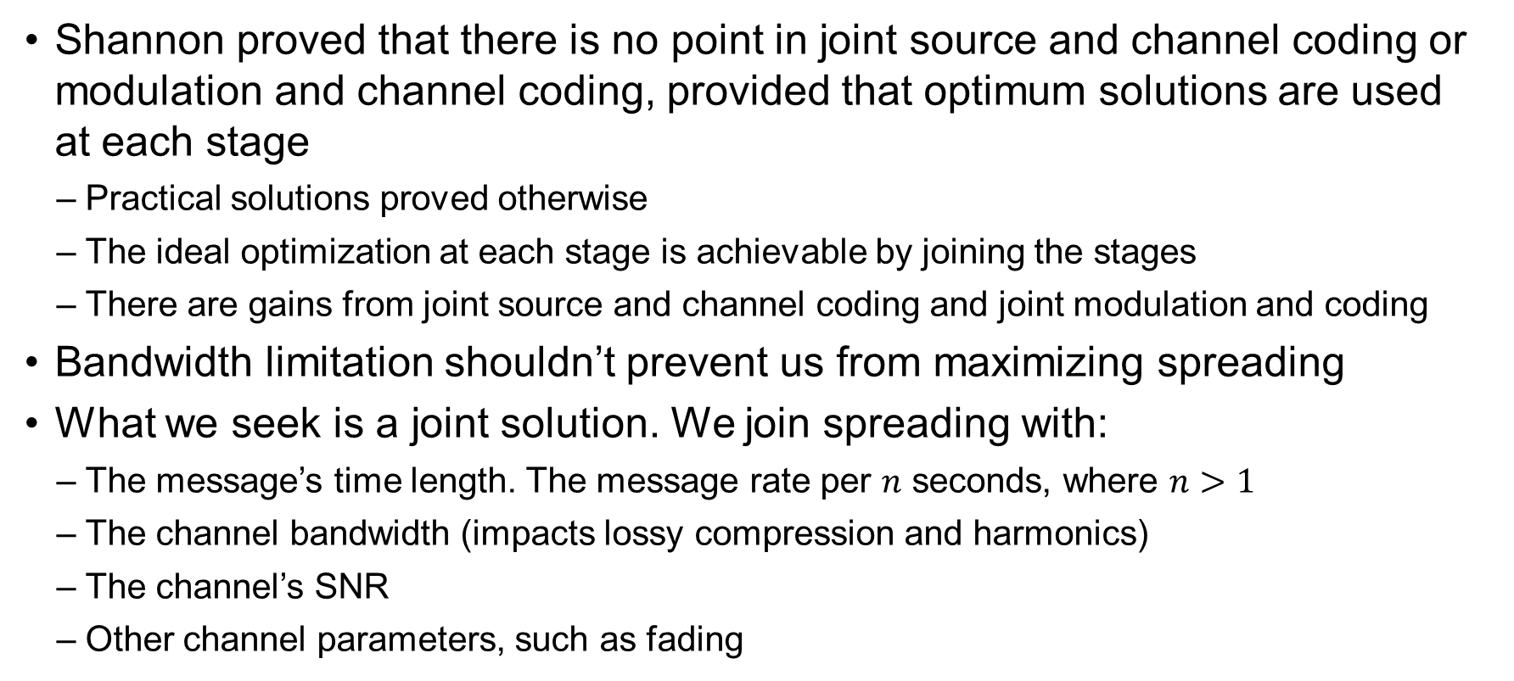
Analogy
Shannon proved that there is no point in joint source and channel coding or modulation and channel coding, provided that optimum solutions are used at each stage
Practical solutions proved otherwise
The ideal optimization at each stage is achievable by joining the stages
There are gains from joint source and channel coding and joint modulation and coding
Bandwidth limitation shouldn’t prevent us from maximizing spreading
What we seek is a joint solution. We join spreading with:
The message’s time length. The message rate per $n$ seconds, where $n>1$
The channel bandwidth (impacts lossy compression and harmonics)
The channel’s SNR
Other channel parameters, such as fading
This is merely and analogy

Slide 11
Hadamard Transformation
The solution may lie with the Hadamard transformation
Hadamard transformation is related to the Fourier Transformation
Lower harmonics in the Hadamard transformation are lower harmonics in the Fourier Transformation
Hadamard Transformation is already amended by:
Walsh Ordering: Rows are reordered by increasing frequency
Dyadic/Paley Ordering: Rows are ordered based on the binary Gray code
Aspect 1: Account for lossy compression in the channel:
Mapping the Walsh ordering to a channel bandwidth creates a set of usable codes for our channel
That set size can increase, considering how the receiver’s cross-correlation recovers additional entries
This leads to using a larger Hadamard matrix than was originally thought for the given channel
We can refer to Aspect 1 as joint lossy compression, Hadamard coding, and channel coding (inner error control coding)

Slide 12
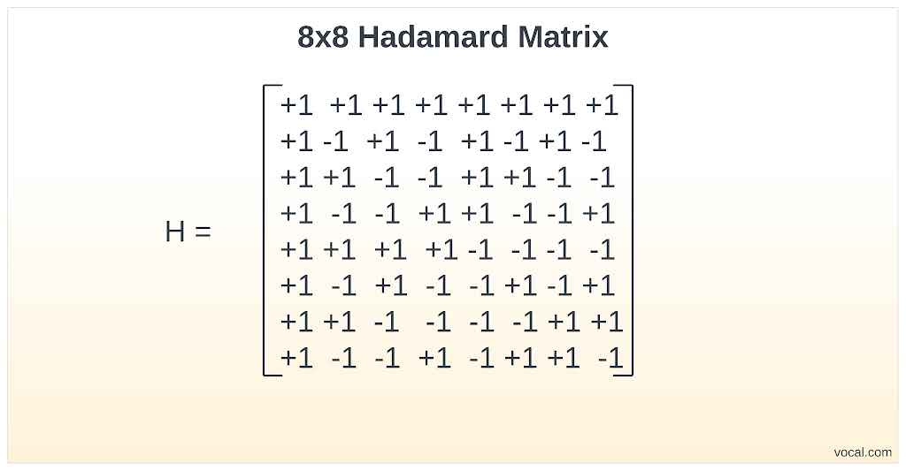
Hadamard Matrix
No Harmonics
Low Harmonics
Distance of 4

Slide 13
What is in the literature, and what is missing
In the literature | Need complement
Mapping a set of low harmonics entries to a narrow band channel | Consider the impact of lossy compression and cross-correlation on additional entries
Finding sets with distance limits | Relating the distance/Gray code to lossy compression recovery and SNR
Aspect 2: Invoke Set Theory
The ideal channel/no noise set
High SNR set
Lower SNR set
We can refer to Aspect 2 as joint Set Theory and maximizing the Hadamard matrix size
Lowest SNR set

Slide 14
Summary
There is a need to maximize spread spectrum with narrow band channels
The road to this maximization is to join:
Lossy compression of the channel
Hadamard transformation with respect to channel harmonics
Replace channel coding (inner error control coding) with increased chip rate
Invoke Set Theory
It is possible to assume digital binary phase shift keying modulation
This will not impact the ability to create the desired joint solution
We desire the solution to be:
Dynamic sets so that channel feedback can result in changes to the usable set
implemented in MATLAB

