Slide 1

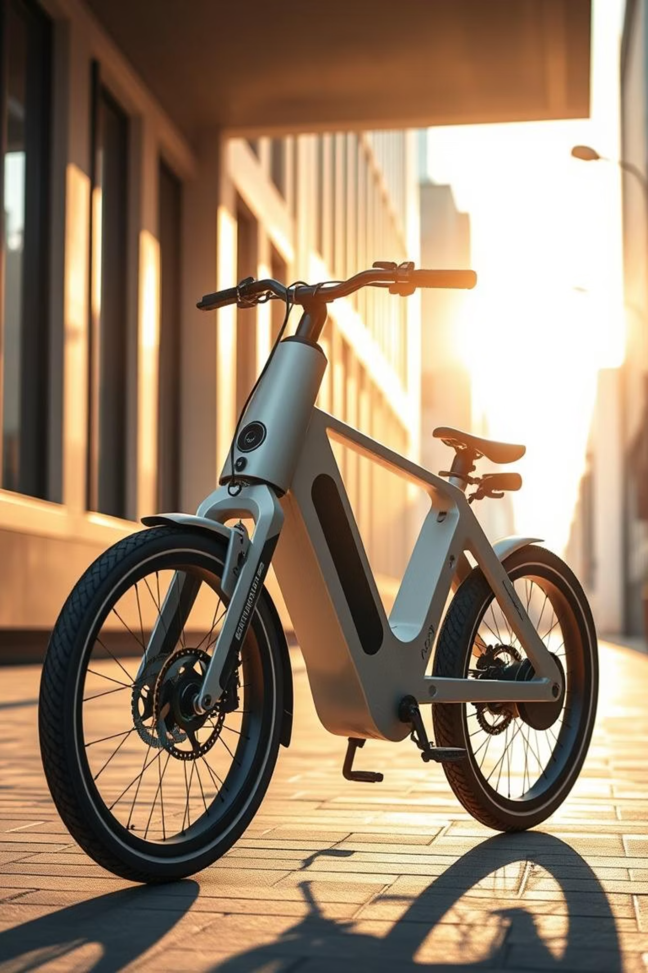
ELECTRIC CYCLE
CASE STUDY -1
The proposed product is a next-generation electric bicycle combining eco-friendly transportation with advanced smart features, designed to meet the growing needs of urban commuters, students, and environmentally conscious riders.
This E-Bike (Smart Pedalling with Electric Drive) integrates multiple innovations

Slide 2





FEATURES OF E-CYCLE
Smart Pedaling
Tri mode charging
Integrated GPS
Enhanced Safety
Convenient Storage

Slide 3
CUSTOMER STATEMENTS
I want an e-bike that is lightweight but sturdy.
It should allow me to ride smoothly without much effort.
I need to charge it even without access to electricity.
It should have good braking for safety.
I want to track my bike in case it gets stolen.
I prefer detachable storage.
I want minimal maintenance needs.
I want it to be suitable for both city and campus rides.
I need an easy-to-read display
I want it to be stylish and modern looking.
I want parts to be easily replaceable
I want both pedal assist and throttle mode.

Slide 4
CUSTOMER STATEMENTS
It should carry my backpack or groceries.
I prefer detachable storage.
It should have low running costs.
I want minimal maintenance needs.
I want it to be stylish and modern looking.
I want an affordable price point.
I prefer a silent motor.
It should be easy to park and store.
I want the battery to last long on a single charge.
I need an easy-to-read display.
I want safety lights integrated.
I want it to be suitable for both city and campus rides.
It should not overheat in the sun.
I want custom speed limits for safety.
I want parts to be easily replaceable.

Slide 5
Market Study:
Existing Products, Features, Costs
Product | Market share
Hero Lectro EHX20 (India) | ~ 70% in Indian market,<1% globally
EMotorad | ~12-13% in Indian market,<1% globally
Merida eBig.Nine 400 | <3% in India,7-8% globally (imported india)
Giant Explore E+ 2 | 6-8% in India,18-20% globally
Rad Power Bikes RadCity 5 Plus (US) | <1% in India, 5-6% globally

Slide 6
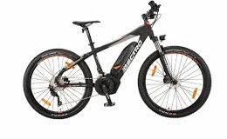
Hero Lectro EHX20 (India)
Features: Pedal assist, removable battery, front suspension
Cost: ₹30,000-1,30,000
Limitations: No solar charging, no GPS, basic storage

Slide 7
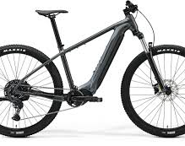
Merida eBig.Nine 400
• Features: Mid-drive motor, hydraulic brakes, long battery life
• Cost: ₹2,80,000
• Limitations: No solar charging, no detachable storage, no GPS

Slide 8
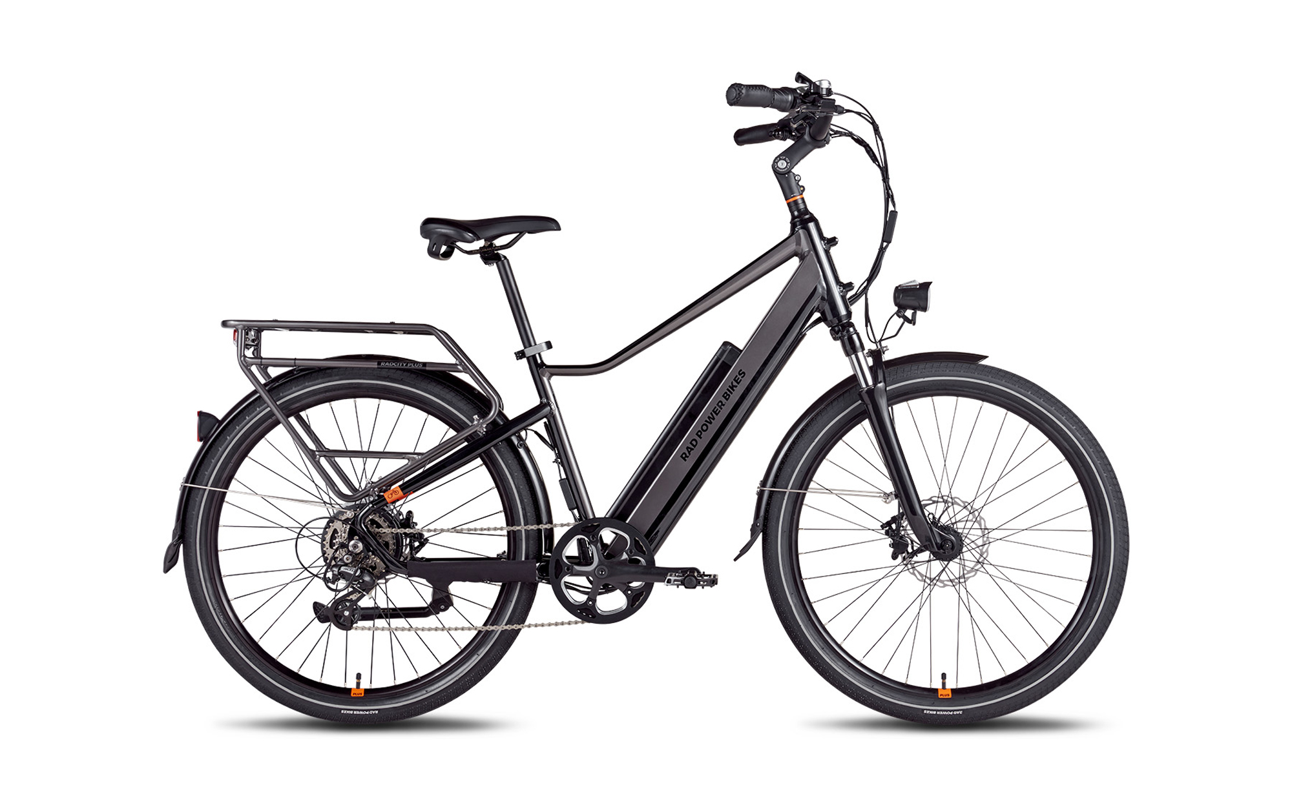
Rad Power Bikes RadCity 5 Plus (US)
• Features: Pedal assist, LCD display, puncture-resistant tyres
• Cost: ₹1,65,000
• Limitations: No solar charging, no GPS tracker

Slide 9
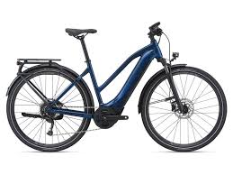
Giant Explore E+ 2
• Features: Pedal assist, integrated lights, long-range battery
• Cost: ₹2,25,000
• Limitations: No torque + cadence sensor combo, no solar charging, no detachable storage

Slide 10
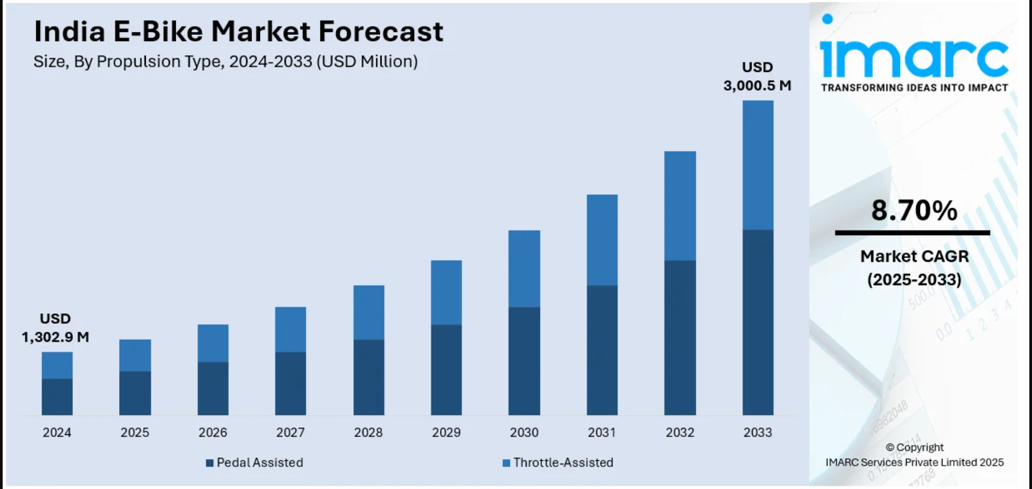
E-Bike Market Trends & Competitors
Market Growth (2024-2033)
• Global e-bike market growth: CAGR of ~10% from 2019 to 2024.
• In India, market size grew from ₹500 Cr in 2019 to ~₹1200 Cr in 2024, driven by urban commute demand and rising fuel prices.
• Current adoption barriers: charging infrastructure gaps, high cost, theft concerns, and limited storage and different mode of charging feature solutions.

Slide 11
Opportunity Gap & Desired Features
Opportunity Gap
Desired Features
Most existing e-bikes lack multi charging system
integrated GPS tracking
smart torque + cadence control
built-in storage.
affordiblity
Tri mode charging: fast electric + solar + pedal to charge mode.
GPS tracking & navigation
Integrated torque & cadence sensors for intelligent pedal assist
Lightweight alloy frame
Puncture-resistant tyres

Slide 12
Our Comprehensive Development Plan
01
02
03
Idea & Concept
Design & Prototype
Testing & Refinement
Identify gaps, brainstorm features, assess feasibility.
modeling, alpha & beta prototype development.
Performance, safety tests, user trials, feedback integration.
04
05
Production & Launch
Post-Launch & Improve
Supply chain setup, manufacturing, targeted marketing.
Monitor sales, customer feedback, continuous upgrades.

Slide 13
Opportunity Evaluation & Potential Projects Potential projects
• Develop a solar panel integration kit for other e-bikes
• GPS anti-theft app subscription service
• Student commuter package with EMI options.
• Rising fuel costs leading to a shift towards e-mobility and Increased interest in renewable energy and self-sustaining products.
• Growth in cycling as an urban commute trend.

Slide 14
Mission & Vision for our e-cycle
Mission Statement:
To deliver affordable, eco-friendly, and technologically advanced mobility solutions that empower urban riders to travel smarter, safer, and more sustainably.
Vision Statement:
To be the most trusted and innovative brand in smart e-mobility, driving the global shift towards renewable-powered transportation.

Slide 15
Business Goals
1. Capture 15% of the Indian e-bike market within five years of launch.
2. Maintain product affordability with the base model priced under ₹50,000-1,00,000.
3. Integrate 100% renewable charging capabilities across all future product lines.
4. Expand operations into at least five international markets by 2030.
5. Establish a subscription-based smart services model for GPS tracking and ride analytics.

Slide 16
ELECTRIC CYCLE
CASE STUDY -2
The proposed product is a next-generation electric bicycle combining eco-friendly transportation with advanced smart features, designed to meet the growing needs of urban commuters, students, and environmentally conscious riders.
This E-Bike (Smart Pedalling with Electric Drive) integrates multiple innovations

Slide 17
Customer Needs & Features of product
Customer statement
Product features
I want an e-bike that is lightweight but sturdy.
It should allow me to ride smoothly without much effort.
I need to charge it even without access to electricity.
It should have good braking for safety.
I want to track my bike in case it gets stolen.
I prefer detachable storage.
I want minimal maintenance needs.
I want it to be suitable for both city and campus rides.
I need an easy-to-read display
I want it to be stylish and modern looking.
Lightweight alloy frame (≤ 20 kg), weatherproof components, and a lifespan of ≥ 5 years.
Torque + cadence sensors, pedal assist + throttle, programmable controller, brushless silent motor.
Dual charging via solar and plug-in with fast charging ≤ 3 hrs. Added pedal-to charge mode enables on ride regeneration
Hydraulic disc brakes with short stopping distance. Puncture-resistant, durable tyres.
GPS tracker + mobile app integration.
Modular detachable storage (5–10 L).
Modular replaceable parts, energy-efficient system, product warranty.
suspension, multipurpose tyres.
Digital LCD/LED display with speed, battery, GPS.
Sleek modern design with aerodynamic frame.

Slide 18
Customer Needs vs. Competitors
Customer Need | Hero Lectro EHX20 | Merida eBig.Nine 400 | RadCity 5 Plus | Giant Explore E+2 | Our Smart E-Bike
Lightweight, durable | Medium | Medium | Medium | High | High (≤20 kg alloy frame)
Pedal-to charge / regeneration | No | No | Partial | No | Yes
Pedal assist + throttle | Assist only | Yes | Yes | Yes | Full hybrid (assist + throttle)
Solar charging | No | No | No | No | Yes (dual charging)
Fast charging | No | Partial | No | Partial | Yes (≤3 hrs)
GPS tracking | No | No | No | No | Yes
Braking safety
Mechanical | Hydraulic | Mechanical | Hydraulic | Hydraulic
Puncture-resistant tyres | No | No | Yes | No | Yes
Storage | Basic | None | None | None | Detachable 5–10 L
Comfort for long rides | Average | Good | Good | Good | Good
Affordability | ₹1.3 L | ₹2.8 L | ₹1.65 L | ₹2.25 L | ₹0.5–1.0 L

Slide 19
Benchmarking on Metrics
Metric | Hero Lectro EHX20 | Merida eBig.Nine 400 | RadCity 5 Plus | Giant Explore E+2 | Our Smart E-Bike
Battery Range (km) | 60–70 | 100+ | 70–80 | 100+ | 100-150
Charging Time (hrs) | 5–6 | 4–5 | 6 | 4–5 | 3-4
Motor Power (W) | 250 | 350 | 250 | 350 | 350
Regen availability | No | No | No | No | Yes (pedal + brake + stand)
Net pedal-charge power | No | No | No | No | 100–150 W
Added range from 30 min pedal-charge | No | No | No | No | 5–8 A at 36–48 V
GPS | No | No | No | No | Yes
Solar Charging | No | No | No | No | 30–40 km/day
Storage (L) | Basic | None | None | None | Detachable 5–10 L
Price | ₹1.3 L | ₹2.8 L | ₹1.65 L | ₹2.25 L | ₹0.5–1.0 L

Slide 20
Problem Clarification & Sub-Problems
Sub-Problems | Marginal Specification | Ideal Specification
Power | 80 km range; plug-in charging only | 150 km range; solar + plug-in dual charging
Drive | 250 W motor; pedal assist only | 350 W silent motor; assist + throttle; torque sensors
Safety | Mechanical brakes; basic tyres | Hydraulic brakes; puncture-proof tyres; lights
Smart | Phone GPS only | Built-in GPS with anti-theft; mobile app
Pedal-to-charge (regen) | Brake-only regen; ≤ 80 W avg; simple on/off | Pedal + brake + stand modes; 100–150 W continuous, 200–250 W peak; efficiency ≥ 75%; user-selectable resistance; BMS with dynamic regen current limit
Utility | Basic carrier | Modular detachable storage (5–10 L)
Comfort | Average saddle | Ergonomic saddle + suspension
Cost | ≥ ₹1.3 L | ≤ ₹1.0 L

Slide 21
Need–Metric Analysis
Customer Need | Engineering Metric | Marginal Value | Ideal Value
Long battery life | Range (km/charge) | ≥ 80 | ≥ 150
Solar charging | Solar output (km/day) | ≥ 10 | ≥ 40
Smooth riding | Sensor response (ms) | ≤ 200 | ≤ 100
Charge while pedalling / stationary | Net pedal-charge power (W); Energy in 30 min (Wh); Added range per 30 min (km) | ≤30% | 100–150 W; 50–70 Wh; 3–7 km; ≥ 75%
Safety braking | Stopping distance (m @25 km/h) | ≤ 5 | ≤ 3
Theft protection | GPS accuracy (m) | ≤ 10 | ≤ 5
Storage capacity | Volume (L) | ≥ 3 | ≥ 10
Comfort | Ergonomic rating | Standard | High
Display | Visibility rating (1–5) | ≥ 3 | ≥ 5
Affordability | Price (₹) | ≤ 1.3 L | ≤ 1.0 L

Slide 22
External & Internal Search
External Search:
Competitor benchmarking (Hero Lectro, Merida, RadCity, Giant).
Supplier research: solar panels, GPS modules, regen lithium-ion batteries.
Customer surveys: urban commuters, students, delivery riders.
Literature: global e-bike adoption trends (CAGR ~10%).
Internal Search:
Brainstorming and modelling of frame + solar integration + pedal to charge .
Existing know-how in alloy frame design and lightweight systems.
Prototyping with modular storage, display and GPS app.
Supplier collaboration for motor, tyres, and brakes.

