Slide 1


PODUCT DESIGN - CASE STUDY 3
ECO-RIDE ELECTRIC CYCLE
NAME - LAWANYA
EN NUMB.-BT23CME042
Contact no. - 8540957302

Slide 2

PROBLEM CLARIFICATION AND BREAKDOWN
Poor ergonomics and weight distribution for daily commuting.
Absence of modular storage and connectivity features.
1
2
3
4
Lack of integrated solar or regenerative charging systems.
High cost of premium models limiting accessibility.

Slide 3
Combining Sub-Solutions into Subsystems
1. Structural Frame Subsystem –
Material Option | Key Features | Pros | Cons | Rank
Aluminium Alloy 6061-T6 | Lightweight, corrosion-resistant | Good strength–weight ratio, low cost | Moderate fatigue resistance | 1
Carbon Fiber Composite | Ultra-light, high stiffness | Excellent weight reduction | Expensive, complex manufacturing | 2
Chromoly Steel (Cr–Mo) | Strong and durable | Very tough and long-lasting | Heavier than aluminium | 3
Magnesium Alloy | Lighter than aluminium | High shock absorption | Corrosion-prone, costly | 4
Titanium Alloy | High-end, corrosion-free | Excellent durability | Very high cost | 5

Slide 4
Combining Sub-Solutions into Subsystems
2. Drive and Motor Subsystem
Motor Type | Key Features | Pros | Cons | Rank
Brushless DC (Hub Motor) | Integrated wheel drive | Low maintenance, quiet | Moderate torque, less flexible | 1
Mid-Drive BLDC Motor | Center-mounted | High torque, natural feel | Higher cost, complex chain | 2
Geared Hub Motor | Internal gear reduction | Better hill climbing | Slight noise, more wear | 3
Brushed DC Motor | Simple & cheap | Easy to replace | High maintenance, low efficiency | 4

Slide 5
Combining Sub-Solutions into Subsystems
3. Battery and Power Subsystem
Battery Type | Voltage / Capacity | Pros | Cons | Rank
Lithium-Ion (18650 / 21700 cells) | 36–48 V, 10–15 Ah | High energy density, rechargeable | Needs BMS protection | 1
Lithium Iron Phosphate (LiFePO₄) | 36–48 V, 12 Ah | Long life, thermally stable | Slightly heavier | 2
Lead Acid (Sealed) | 24–36 V, 20 Ah | Very low cost | Heavy, low cycle life | 3
Solid-State Battery | 48 V, 10 Ah | Ultra safe, compact | Not yet affordable | 4

Slide 6
Combining Sub-Solutions into Subsystems
4. Control and Connectivity Subsystem
System Option | Features | Pros | Cons | Rank
Smart MCU + LCD Display + Bluetooth App | Real-time speed, battery, GPS | User-friendly, low cost | Limited advanced analytics | 1
IoT Cloud Module (4G/Wi-Fi) | Remote monitoring | Advanced data access | Expensive, needs SIM/internet | 2
Basic LED Panel Only | Battery + speed | Cheap, simple | Lacks connectivity | 3
Touchscreen Dashboard | Color display, GPS map | Premium appeal | High power draw | 4

Slide 7
Combining Sub-Solutions into Subsystems
5. Ergonomic and Safety Subsystem
Component / Design | Pros | Cons | Rank
Hydraulic Disc Brakes (Front & Rear) | High braking power, safe | Slightly higher cost | 1
Mechanical Disc Brakes | Inexpensive, easy to service | Less efficient under load | 3
Drum Brakes | Low maintenance | Heavy, poor cooling | 4
V-Brakes | Cheap and simple | Poor wet performance | 5
Adjustable Seat + Handleba | Fits all riders | Slightly heavier | 2
Fixed Geometry | Lightweight | Not adaptable | 6

Slide 8
Combining Sub-Solutions into Subsystems
6. Storage and Utility Subsystem
Storage Option | Pros | Cons | Rank
Detachable Rear Box (Plastic/FRP) | Lightweight, waterproof | Limited volume | 1
Integrated Cargo Rack (Metal) | Strong, load-bearing | Adds weight | 2
Soft Side Panniers (Fabric) | Flexible, inexpensive | Not weatherproof | 3
Under-Seat Compartment | Compact | Small capacity | 4
TOTAL NUMBER OF DESIGN POSSIBLE =7680

Slide 9
Selection Matrix
Criteria | C1 | C2 | C3 | C4 | C5 | C6 | C7 | C8 | C9 | C10 | C11 | C12 | C13 | C14
Aluminium Alloy | + | + | + | + | - | - | - | - | - | - | - | - | + | -
Carbon Fiber | - | - | - | - | + | + | - | - | - | - | - | - | - | -
Chromoly Steel | - | - | - | - | - | - | - | - | - | + | + | - | - | -
MagnesiumAlloy | - | - | - | - | - | - | - | - | + | - | - | + | - | +
TitaniumAlloy | - | - | - | - | - | - | + | + | - | - | - | - | - | -
BrushlessDC | - | - | + | + | + | + |  | - | - | + | - | - | + | -
BLDCMotor | + | + | - | - | - | - |  | - | - | - | - | - | - | +
GearedHubMotor | - | - | - | - | - | - | + | - | + | - | - | + | - | -
BrushedDCMotor | - | - | - | - | - | - |  | + | - | - | + | - | + | -
Smart MCU | + | + | + | - | + | + |  | - | - | - | - | - | - | +
IoT Cloud | - | - | - | + | - | - | + | - | + | - | - | - | - | -
HydraulicDiscBrakes | + | - | + | - | + | + |  | + | - | + | + | - | + | -
MechanicalDiscBrakes | - | + | - | + | - | - | + | - | + | - | - | + | - | +
Detachable Rear Box | + | + | + | - | - | - | + | - | - | - | - | - | + | -
Integrated Cargo Rack | - | - | - | + | + | - | - | + | + | - | - | + | - | +
SELECTION | Y | Y | Y | Y | Y | Y | N | N | N | N | N | N | N | N

Slide 10
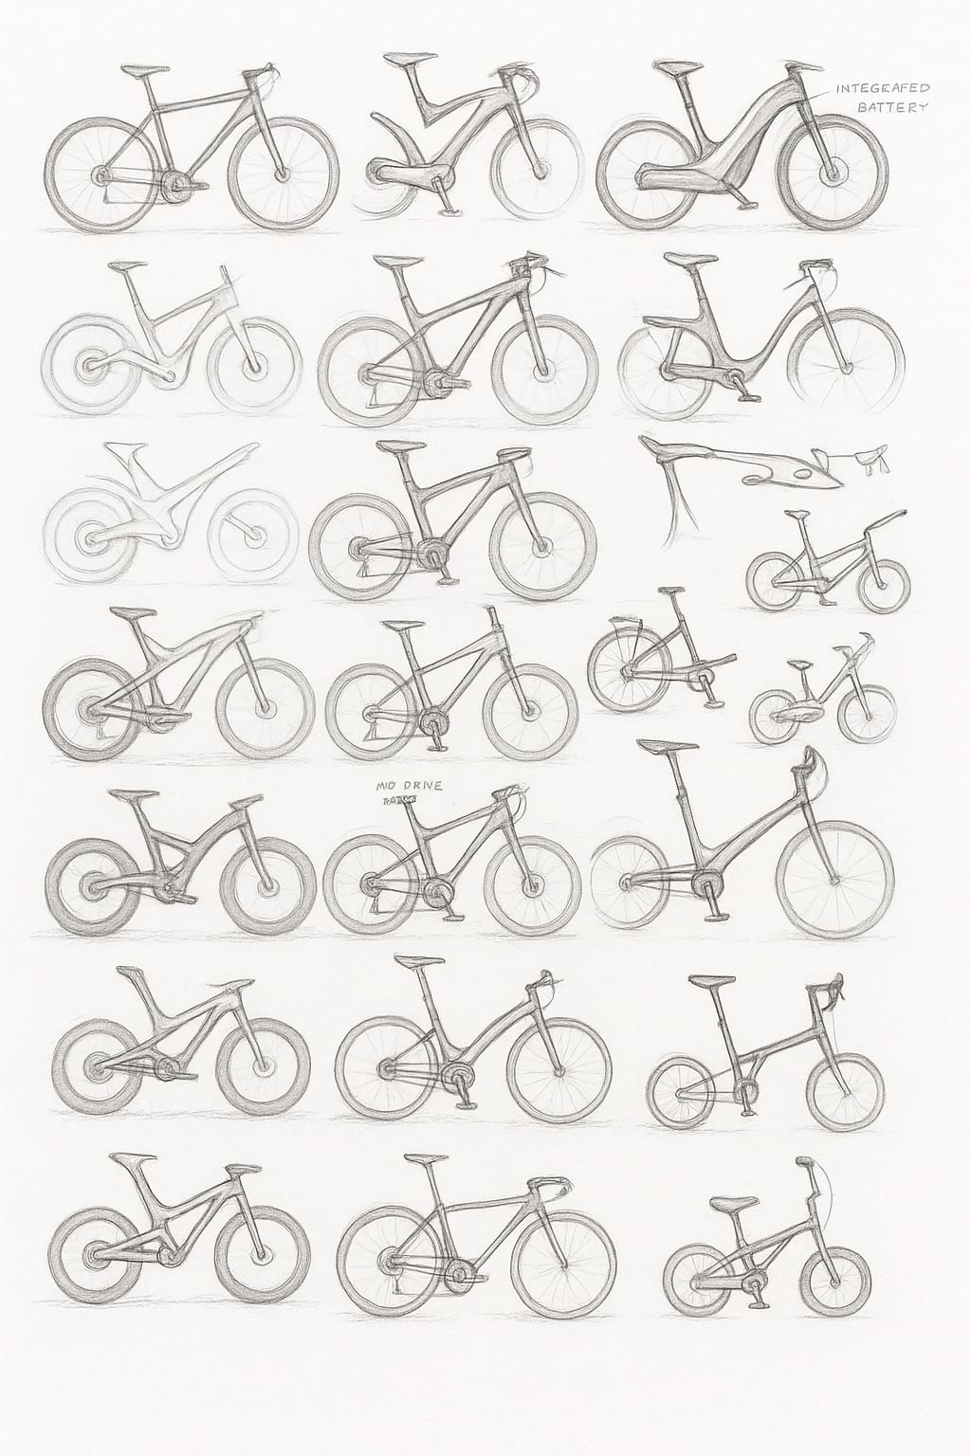

Slide 11
Concept Name and Selection criteria
Model Name | Reason for Selection/Rejection | Selection
Eco-Ride Lite 350 | Affordable & practical | YES
Eco-Ride Solar 350 S | Sustainable energy integration | YES
Eco-Ride X Swap | Modular & fleet-ready | YES
Eco-Ride Fold | Compact and ergonomic | YES
Eco-Ride Cargo | Utility and load handling | YES
Eco-Ride R Sport | Performance and innovation | YES
Ultra Ti 500 | Excessive cost | NO
Mag 300 | Material corrosion | NO
Metro Basic | Heavy, outdated | NO
Cloud X IoT | Overly complex, costly | NO
Urban 200 | Lacks smart features | NO
EcoMax | Fragile solar design | NO
Alpha Gear 350 | Weak braking, no regen | NO
City Com 250 | Poor tech integration | NO
Mini Fold+ | Structural overheating risk | NO

Slide 12
Concept Generation and Evaluation
Evaluation Criteria | Weight (%) | Concept 1 | Concept 2 | Concept 3 | Concept 4 | Concept 5 | Concept 6
Concept Name |  | Eco-Ride Lite | Eco-Ride Solar | Eco-Ride X Swap | Eco-Ride Fold | Eco-Ride Cargo | Eco-Ride R Sport
Lightweight, durable | 10 | 7 | 7 | 8 | 8 | 8 | 7
Pedal-to charge / regeneration | 22.7 | 8 | 0 | 8 | 7 | 8 | 7
Pedal assist + throttle | 13.3 | 7 | 6 | 9 | 9 | 8 | 8
Solar charging | 6 | 0 | 7 | 6 | 7 | 0 | 6
Replaceable battery | 10 | 7 | 8 | 8 | 6 | 8 | 8
GPS tracking | 6 | 6 | 6 | 7 | 5 | 6 | 8
Braking safety | 10 | 7 | 7 | 9 | 6 | 8 | 7
Puncture resistant tyres | 6 | 7 | 7 | 9 | 7 | 7 | 8
Storage | 6 | 4 | 4 | 6 | 8 | 0 | 0
Affordability | 10 | 9 | 7 | 8 | 7 | 9 | 7
Total | 100 | 68.6 | 51.38 | 79.93 | 71.06 | 69.6 | 71.73
Rank |  | 5th | 6th | 1st | 3rd | 4th | 2nd

Slide 13
CONCEPT DESIGN:
Concept 1 – Eco-Ride 350 Lite (Urban Basic Edition)
User focus: Budget commuters, students, short-range users
Pros
Cheapest model; easy to service
Ideal for college or campus use
Cons
No regenerative or solar capability
Moderate range (~70 km)
Rationale
Scores high in affordability (9) and lightweight design (7). No solar or regen keeps cost low.
Key Features
Lightweight aluminium frame (≤18 kg) for daily urban mobility
Pedal-assist and throttle combo (350 W motor)
Fixed battery (36 V 12 Ah) with plug-in charging only
Basic GPS tracking and LED dashboard
Puncture-resistant tyres and mechanical disc brakes

Slide 14
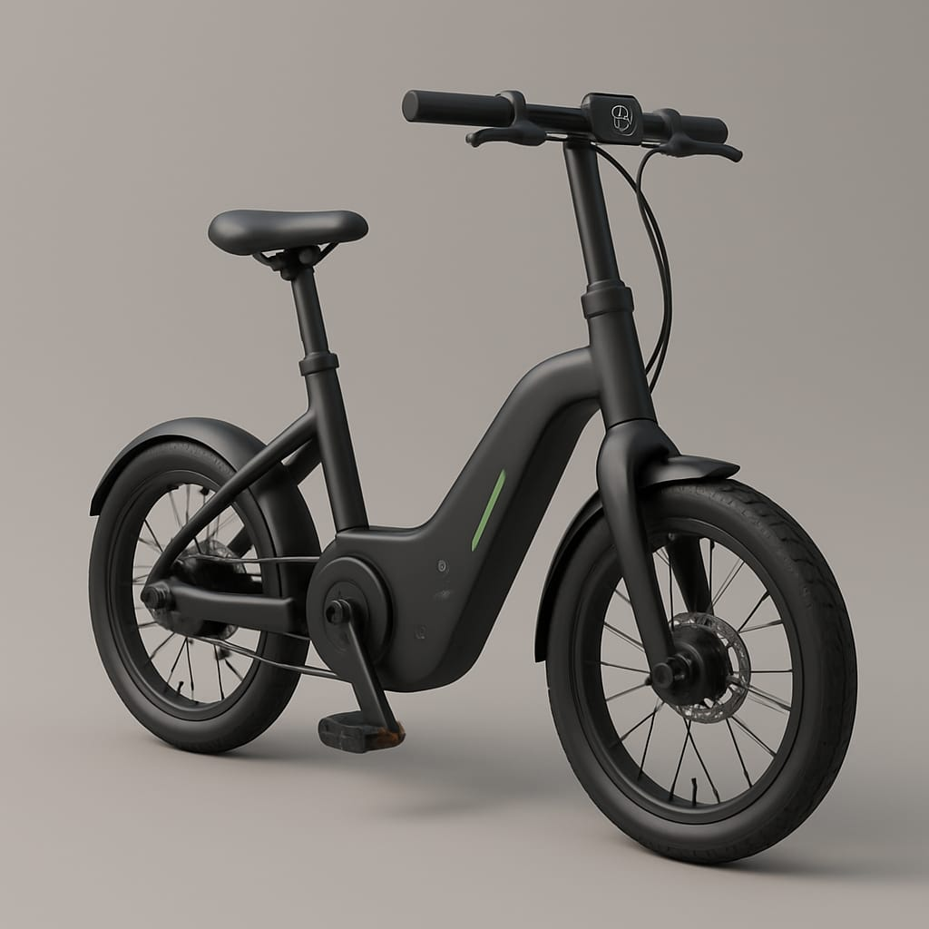
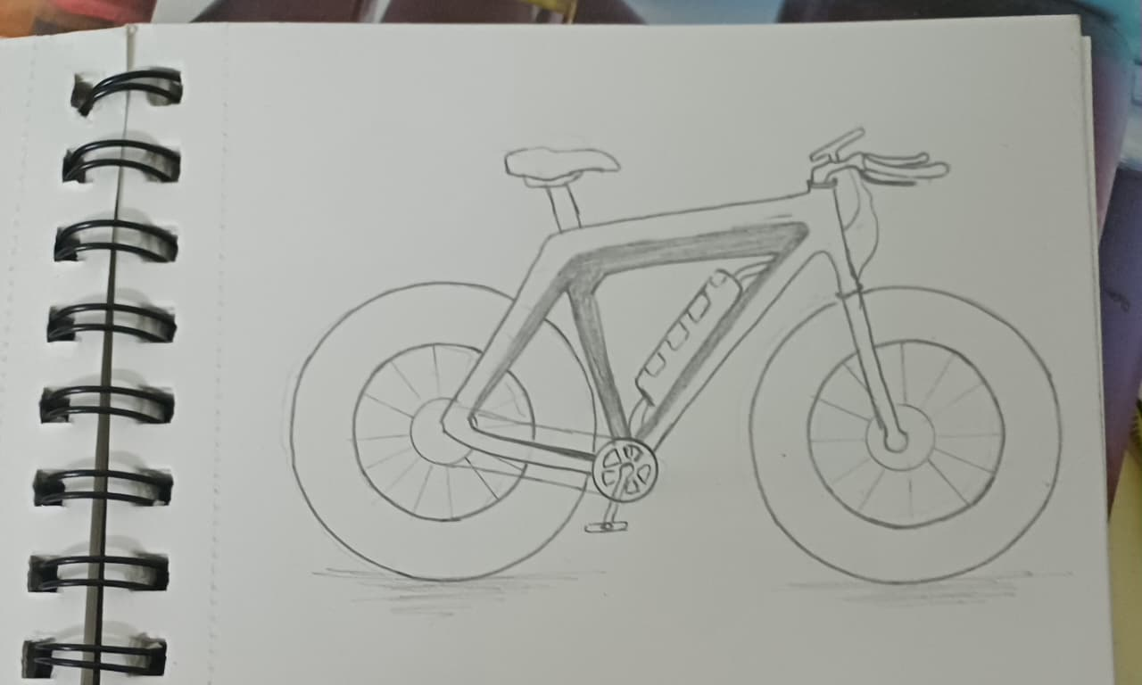
Concept 1 – Eco-Ride 350 Lite (Urban Basic Edition)
Notes:
Lightweight aluminium frame (≤18 kg) for daily urban mobility Pedal-assist and throttle combo (350 W motor)Fixed battery (36 V 12 Ah) with plug-in charging only

Slide 15
CONCEPT DESIGN:
Concept 2 – – Eco-Ride Solar 350 S (Eco-Premium Edition)
User focus: Environment-friendly riders, off-grid users
Pros
Solar recharge adds 10–15 km/day
Lower running cost, ideal for eco-conscious buyers
Cons
Slightly higher price (solar integration cost)
Heavier by ~1.5 kg
Rationale
High solar-charging score (7) and strong eco-identity.
Key Features
Flexible solar film integrated on rear box (≈30 W)
Plug + solar dual charging system
Standard 350 W BLDC motor with pedal-assist + throttle
GPS + regenerative controller
LED dashboard with solar status indicator

Slide 16
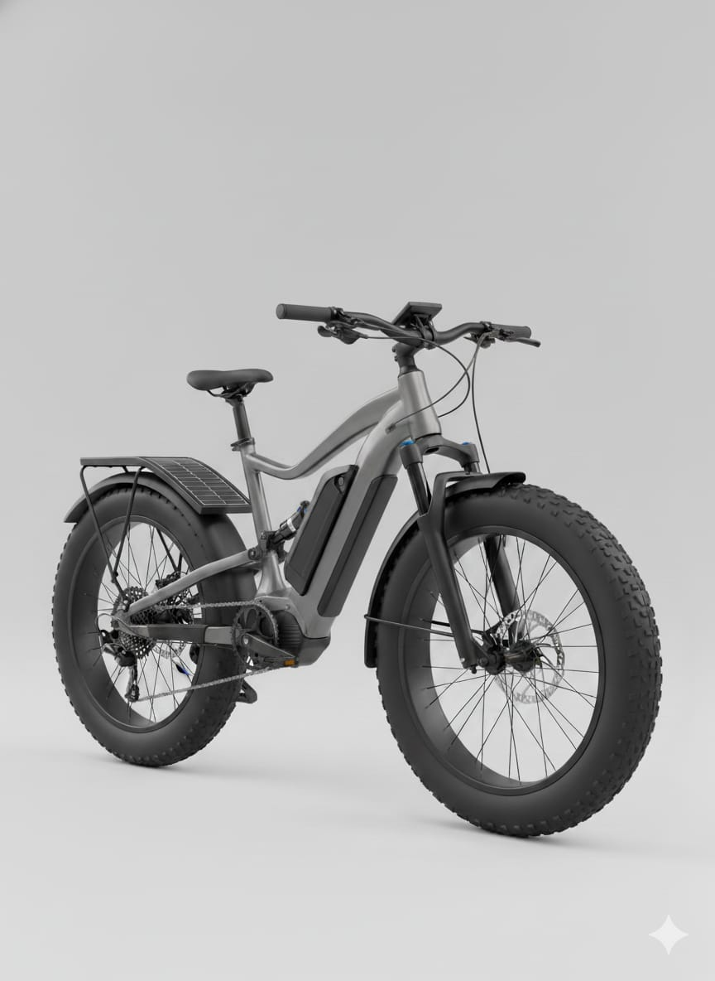
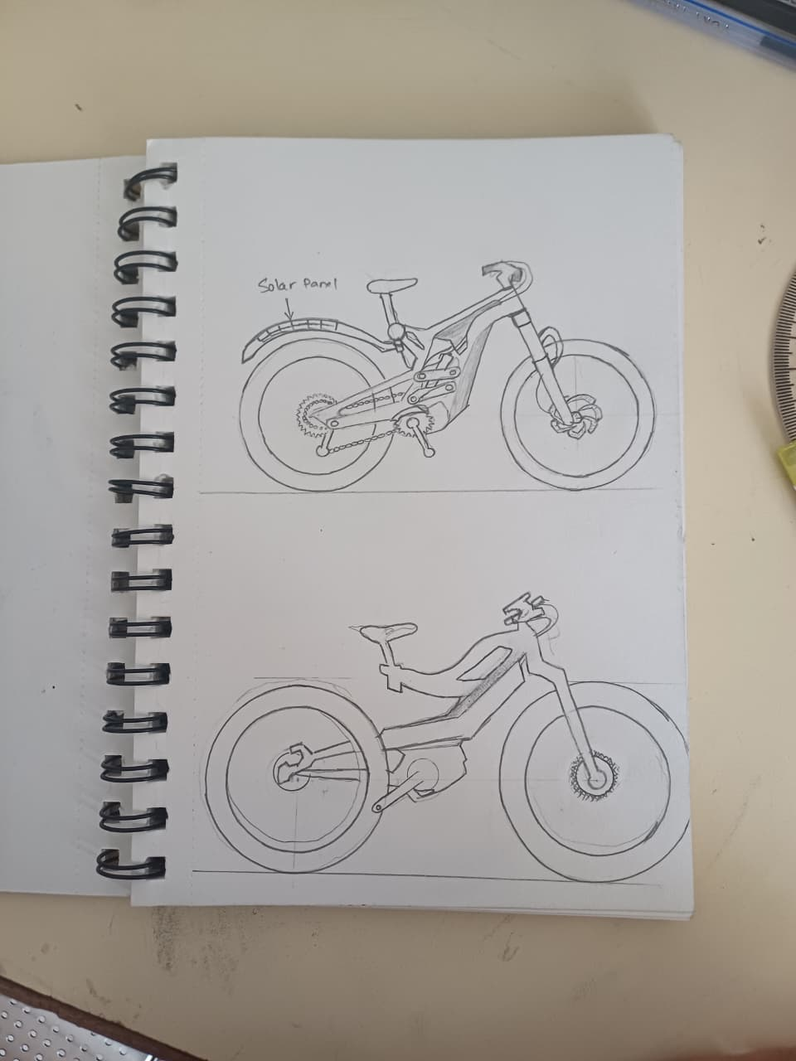
Concept 2 – – Eco-Ride Solar 350 S (Eco-Premium Edition)
Notes:
Flexible solar film integrated on rear box (≈30 W) Plug + solar dual charging system

Slide 17
CONCEPT DESIGN:
Concept 3 – Eco-Ride X Swap (Swappable-Battery Fleet Edition)
User focus: Delivery, rental, or heavy-use riders
Rationale
Top scores in replaceable battery (8), regen (8), and safety (9).
Pros
Continuous use with battery swapping
Best for delivery or rental applications
Cons
Heavier frame (~22 kg)
Complex battery mechanism increases cost
Key Features
Replaceable 48 V 15 Ah battery (slide-out drawer)
Regenerative braking + throttle assist
500 W hub motor (higher torque for load)
Dual-disc hydraulic brakes with brake-cut sensor
GPS-enabled tracking for fleet management

Slide 18
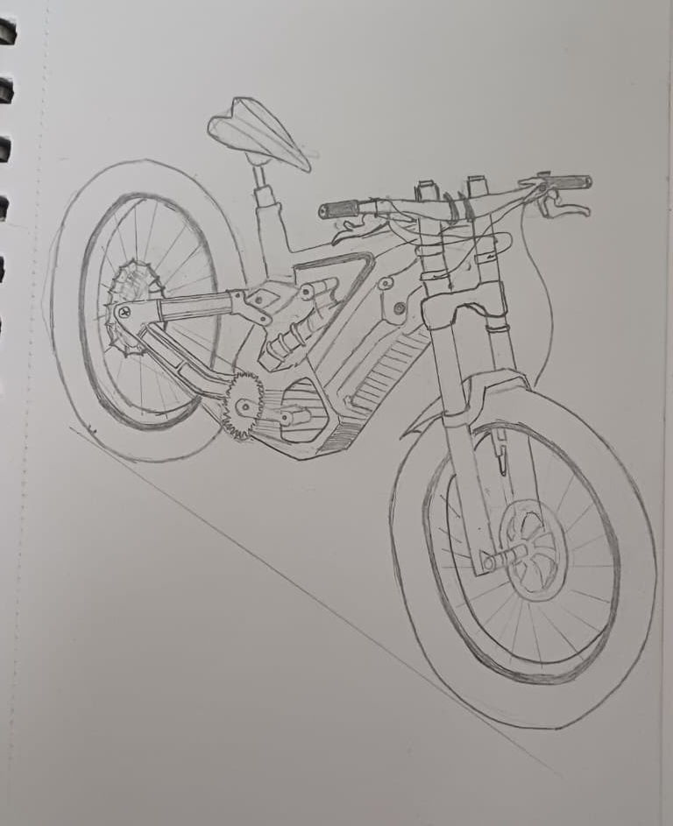
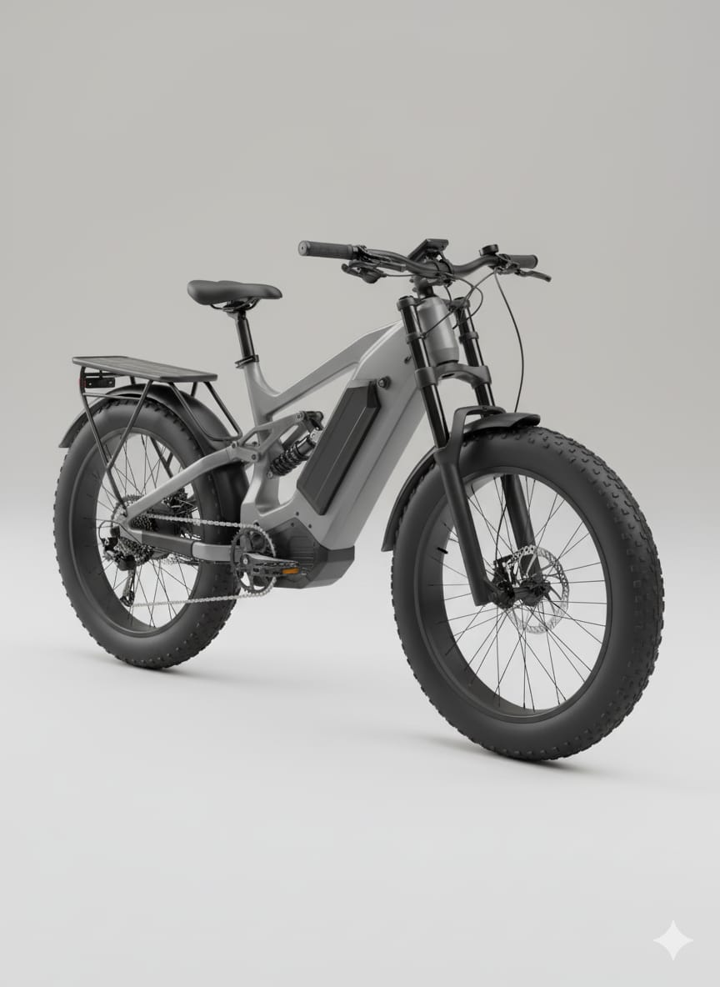
Concept 3 – – Eco-Ride Solar 350 S (Eco-Premium Edition)
Notes:
Regenerative braking + throttle assist GPS-enabled tracking for fleet management

Slide 19
CONCEPT DESIGN:
Concept 4 – Eco-Ride Fold 350
Rationale
Excels in storage (8) and compact design (8); balanced all-rounder.
User focus: Apartment dwellers, train/metro commuters
Pros
Portable, light (≤18 kg folded)
Perfect for short mixed transport routes
Cons
Moderate braking power (score 6)
Limited range (~60–70 km)
Key Features
Quick-fold alloy frame (fold in 20 s)
Pedal-assist + throttle; small 350 W motor
Integrated storage box (8 L) under seat
Optional solar lid for trickle charging
Soft-grip ergonomics and adjustable seat

Slide 20
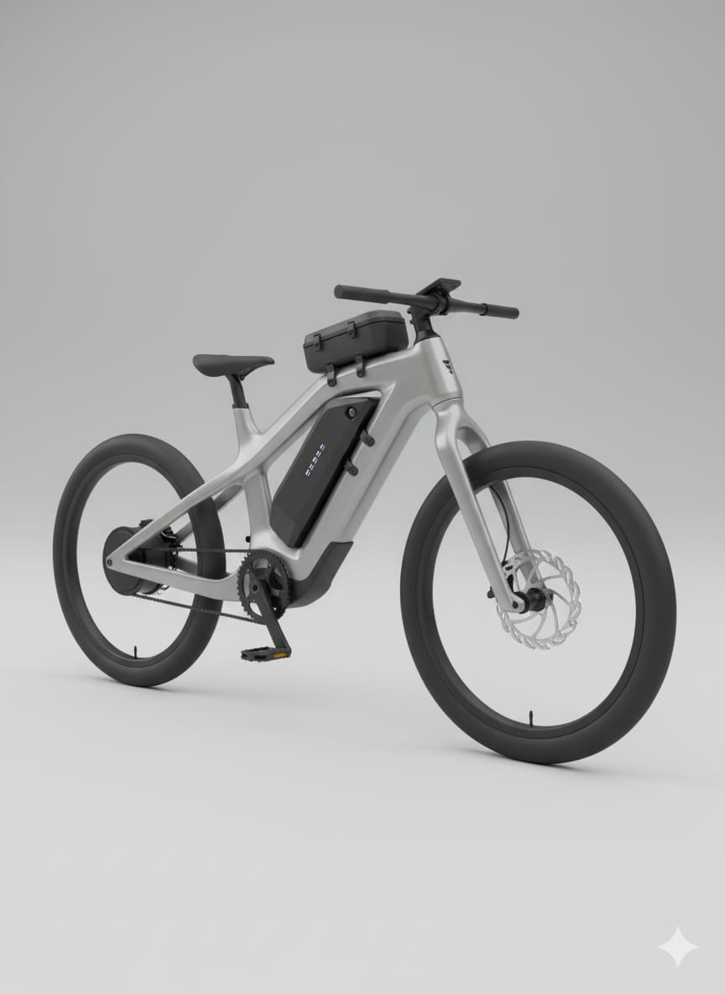
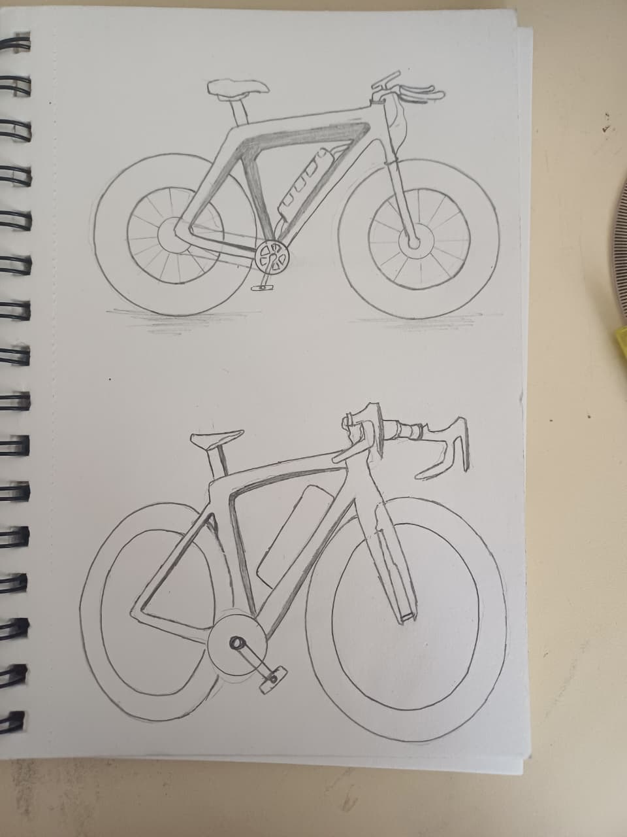
Concept 4 – Eco-Ride Fold 350
Notes:
Quick-fold alloy frame Moderate braking power Perfect for short mixed transport routes

Slide 21
CONCEPT DESIGN:
Concept 4 – Eco-Ride Cargo 350 C
Rationale
Strong scores in regen (8), battery (8), and braking (8).
User focus: Delivery workers, campus logistics, shop owners
Pros
Powerful torque; great for cargo applications
Long range (100–130 km combined mode)
Cons
Heavy (~25 kg)
Not ideal for everyday commuting
Key Features
Reinforced frame; load capacity up to 180 kg
500 W motor with regenerative braking
Dual-battery option for longer operation
Extended rear rack with modular cargo box
Hydraulic brakes + puncture-resistant tyres

Slide 22
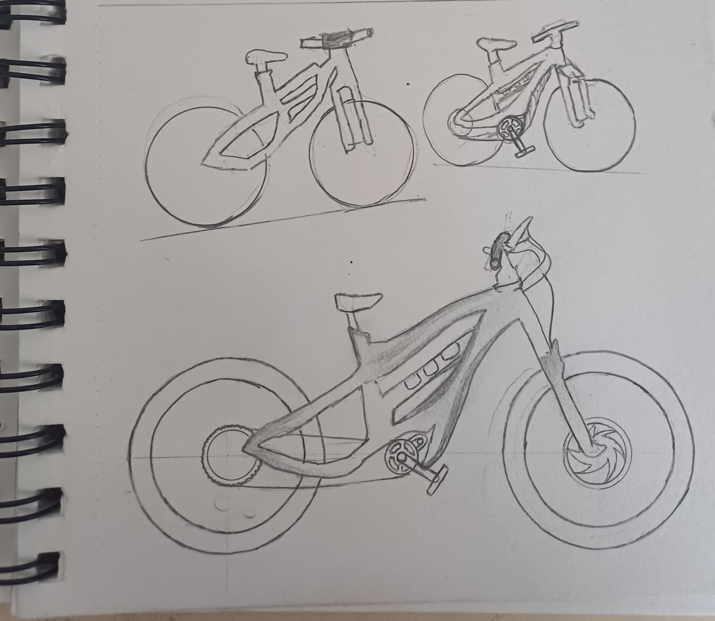
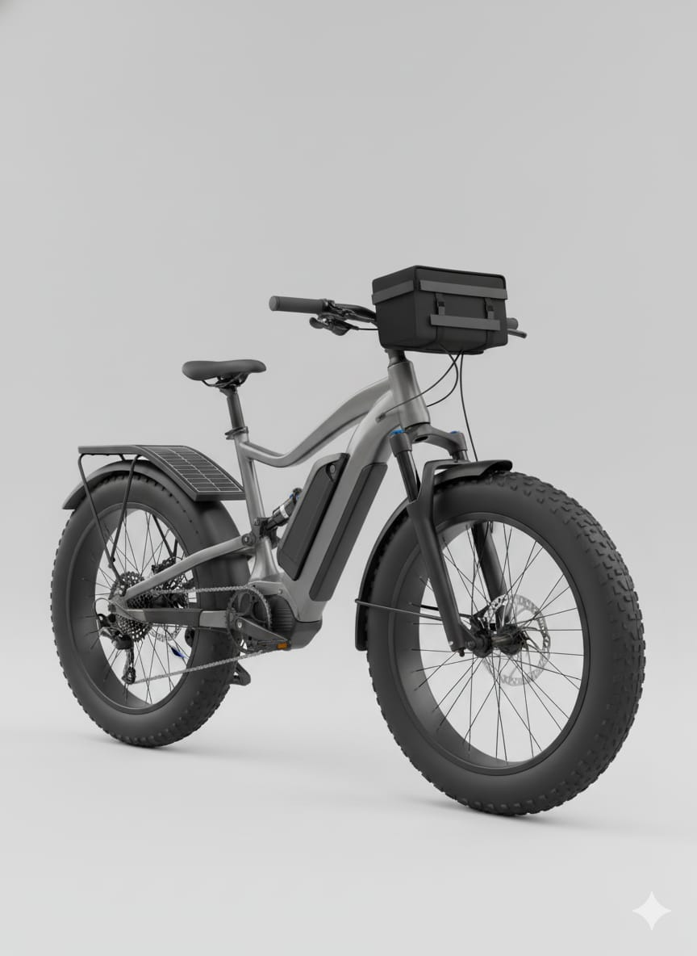
Concept 4 – Eco-Ride Cargo 350 C

Slide 23
CONCEPT DESIGN:
Concept 6 – Eco-Ride R Sport (Performance Edition)
User focus: Enthusiasts and premium buyers
Rationale
Strong scores in regen (8), battery (8), and braking (8).
Pros
High performance, 35–40 km/h top speed
Attractive, sporty design
Cons
Costlier
Slightly heavier motor assembly
Key Features
500 W mid-drive motor with torque + cadence sensor
Regenerative braking, swappable battery, throttle-assist
TFT display with app connectivity and GPS
Streamlined carbon-composite frame
Dual hydraulic disc brakes, sporty suspension

Slide 24
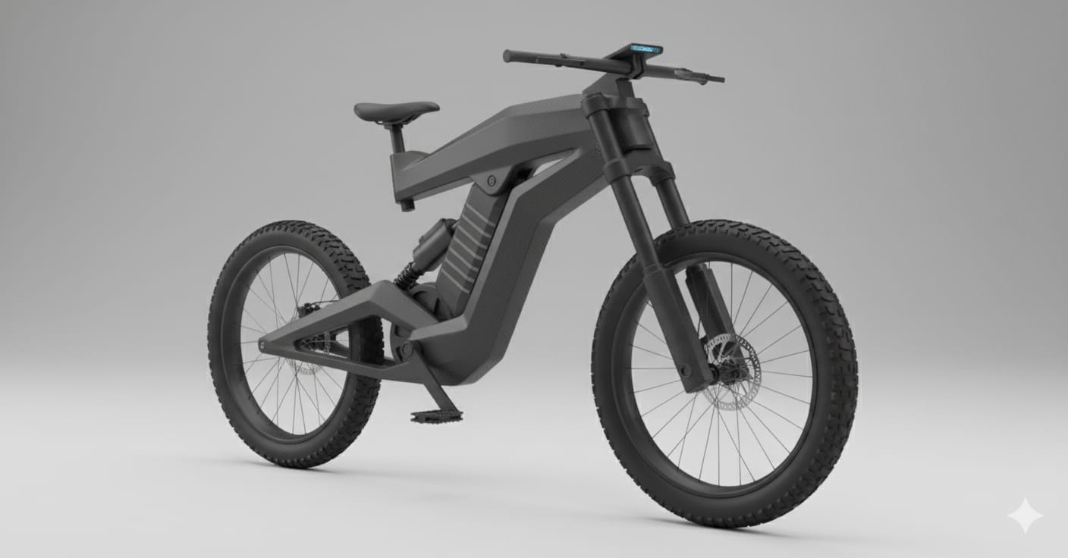
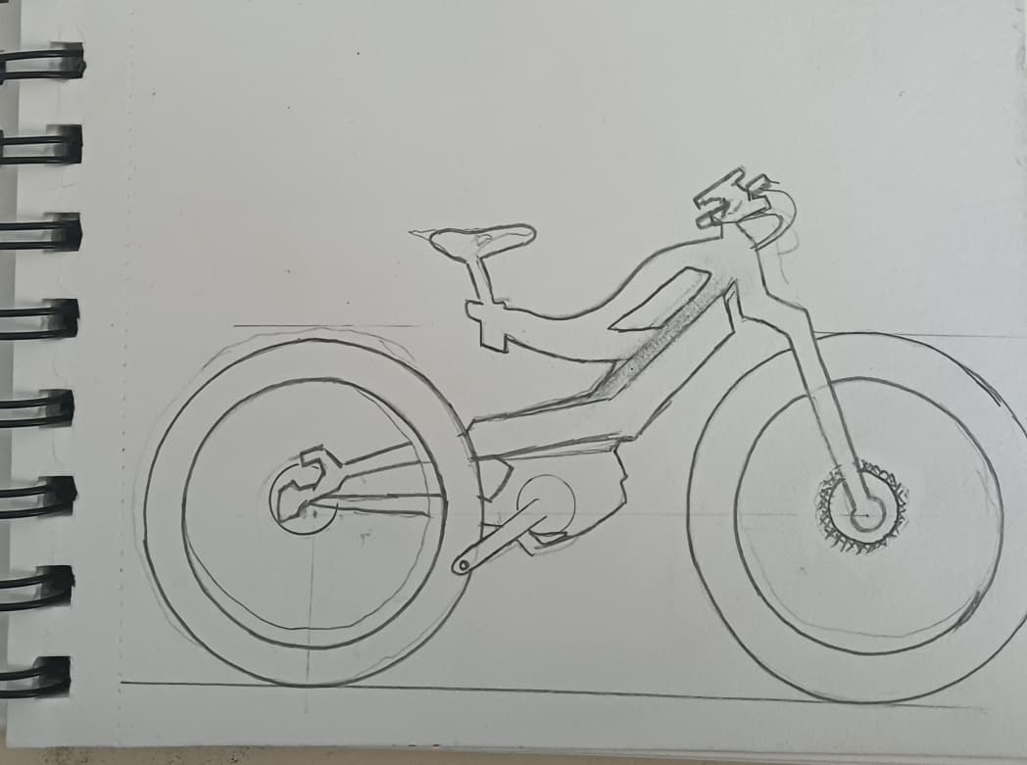
Concept 6 – Eco-Ride R Sport (Performance Edition)

Slide 25
Benefits and Limitations of Each Concept
Model | Benefits | Limitation
Eco-Ride Lite | Lightweight ,Low cost ,Easy maintenance, Simple motor ,Safe tyres | No regen, No solar, Short range, Few smart features
Eco-Ride Solar | Solar charging, Eco-friendly, Dual charging ,Premium look, Sustainable | Weather dependent, Heavier, Costly, Low regeneration
Eco-Ride X Swap | Swappable, battery Regenerative, braking, GPS tracking, High safety, Fleet-friendly | High cost, Heavy frame, Complex wiring, Needs infrastructure
Eco-Ride Fold | Foldable, Compact, Portable, Ergonomic, Easy storage | Lower range, Less stability, Weak brakes, High maintenance
Eco-Ride Cargo | Heavy-duty, High load, Dual battery, Strong brakes, Durable frame | Very heavy, Less efficient, Expensive Bulky design
Eco-Ride R Sport | High power, Stylish design, Smart display GPS + App Fast charging | Expensive, Complex system, Niche market, Hard maintenance

Slide 26
Concept Improvement and Refinement
Concept 3 (Swappable) is selected as the base for final design improvement due to its modularity and broad usability.
Improvements include adopting the solar charging system (from Concept 2), enhancing frame aesthetics (from Concept 6), and introducing compact folding features (from Concept 4). The final optimized concept achieves high range, flexibility, and user comfort while remaining cost-effective.
Subsystem | Best Solution | Reason for Selection
Structural Frame | Aluminium Alloy | Light, strong, low cost
Drive & Motor | BLDC Hub Motor | Efficient, low maintenance
Battery & Power | Li-ion (18650) | High density, reliable
Control & Connectivity | MCU + LCD + App | Modern,affordable,connected
Ergonomic & Safety | HydraulicBrakes + AdjustableSeat | Safe, comfortable
Storage & Utility | Detachable FRP Box | Light, modular, weatherproof

Slide 27
Product Testing Suggestions for Eco-Ride Subsystems
1. Frame Testing – Static and dynamic load tests up to 150 kg.
2. Motor & Drive – Efficiency and regenerative braking tests over 100 cycles.
3. Battery System – Thermal and endurance tests (charge–discharge over 500 cycles).
4. Solar Module – Exposure and efficiency testing under various irradiance levels.
5. Ergonomic Assessment – Rider posture trials across height range (150–190 cm).
6. Brake & Safety – Stopping distance ≤3 m at 25 km/h; fatigue test over 1000 stops.
7. App & GPS – Real-time tracking latency and reliability test.
8. Folding and Assembly – 500-cycle fatigue test on joints and hinges.

Slide 28

THANK YOU
VISIT US

Slide 29
PODUCT DESIGN - CASE STUDY 4
ECO-RIDE ELECTRIC CYCLE
NAME - LAWANYA
EN NUMB.-BT23CME042

Slide 30
Objective and Scope
Shape & Contour: Replacing angular tube connections with continuous curves for a flowing frame silhouette.
Proportion & Balance: Optimizing mass between front and rear; refined height–length ratio for stability.
Unity & Style: Maintaining consistent design cues across the Eco-Ride family—headlight shape, logo band, and frame arc.
Contrast: Matte aluminium body with gloss-accent zones on battery housing and display panel.
Color: Functional color coding—each variant has its own visual identity (Eco-green, Cargo-black, Sport-red, etc.).
Texture: Mixing brushed metal and matte polymer for tactile richness and durability.

Slide 31
Aesthetic Principle Application to Subsystems
Principle | Applied Feature | Expected Visual Outcome
Shape & Contour | Smooth S-curve spine and curved battery cover | Light, streamlined body flow
Proportion & Mass | Lower frame thicker; slim top-tube for lightness | Stable, grounded form
Unity & Style | Shared Eco-Ride headlight, LCD cluster, and logo band | Family identity maintained
Line & Direction | Diagonal flow from head tube to rear axle | Dynamic, forward motion
Contrast | Dual finish zones—matte body & gloss details | Depth and visual sophistication
Color & Finish | Variant-specific tones; neutral base + accent highlights | Market distinction
Texture | Matte metallic + anti-slip grip textures | Technical realism & comfort

Slide 32
Functional Attributes Expressed Through Aesthetics
Functional Aspect | Aesthetic Integration | Intended Design Effect
Battery Housing | Semi-flush curved enclosure with color trim | Seamless integration, reduced bulk
Motor & Drive | Metallic ring around hub motor | Emphasizes strength and performance
Solar Module | Curved film following rear rack contour | Expresses sustainability
Display & Controls | Compact LCD with recessed bezel | Organized and modern interface
Lighting | Linear LEDs on handle and rear rack | Visual rhythm and brand unity
Ergonomics | Sculpted seat & angled bars | Communicates comfort visually

Slide 33
Concept-Wise Aesthetic Focus (C1–C5)
Concept | Aesthetic Theme | Functional / Visual Expression
Eco-Ride Lite | Minimalistic urban design; silver–cyan dual tone. | Lightweight geometry, smooth frame curve; dark base shows stability.
Eco-Ride X Swap | Industrial precision; modular style. | Slide-out battery drawer outlined in orange; strong structural stance.
Eco-Ride Fold | Youthful and sleek; diagonal flow. | Hidden fold hinges, slim silhouette; lime-blue colors.
Eco-Ride Cargo | Power and utility aesthetics. | Extended frame with reinforced lines; black-silver scheme, matte texture.
Eco-Ride R Sport | Futuristic athletic form; aerodynamic unity. | Carbon-fiber style frame, red-black gloss contrast, LED speed lines.

Slide 34
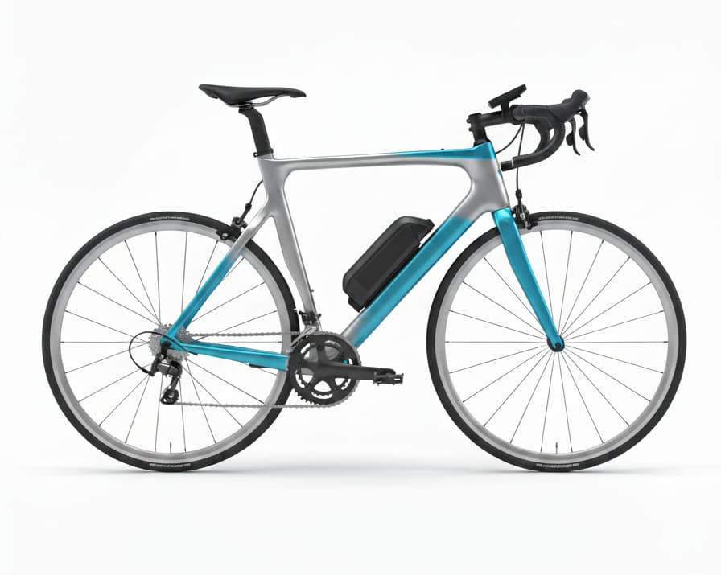
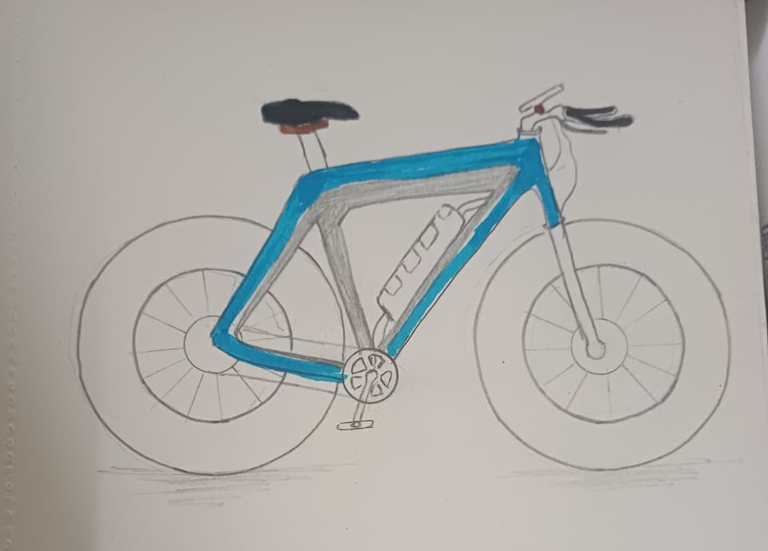
Eco-Ride Lite:
Visual Theme: Simple, lightweight, and minimalistic form emphasizing clean urban mobility.
Rendering Focus: Soft frame curvature, silver–cyan color contrast, slim tyres, compact geometry.
Key Highlight: Streamlined aluminium frame with matte finish and subtle cyan highlights.
Type of Customer Focused: Students, office commuters, and first-time e-bike users seeking affordability and simplicity.

Slide 35
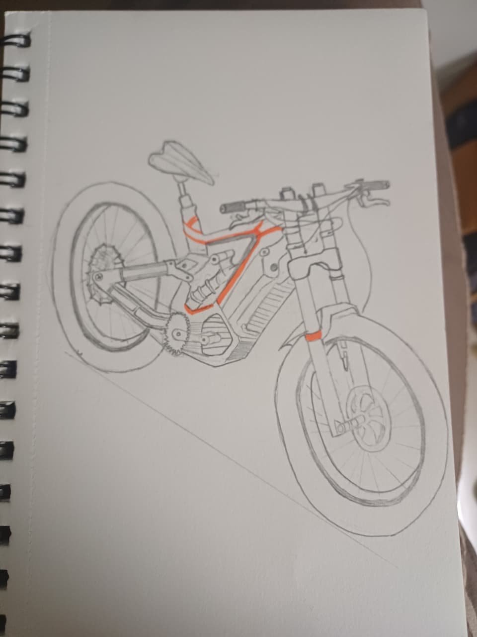
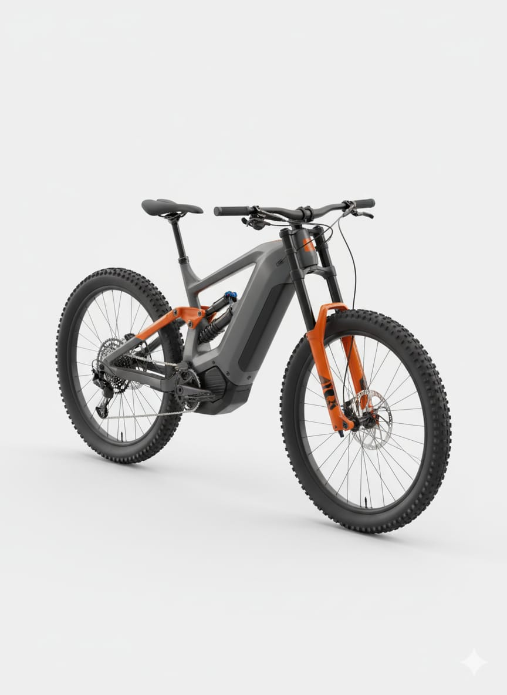
Eco-Ride X Swap (Final )
Visual Theme: Robust, industrial-tech aesthetic; modular structure with high visual weight.
Rendering Focus: Sharp orange trims on grey frame, exposed power hub motor, battery drawer highlights.
Key Highlight: Slide-out battery housing with ergonomic handle and locking mechanism accent band.
Type of Customer Focused: Delivery personnel, fleet operators, shared mobility services requiring modular reliability.

Slide 36
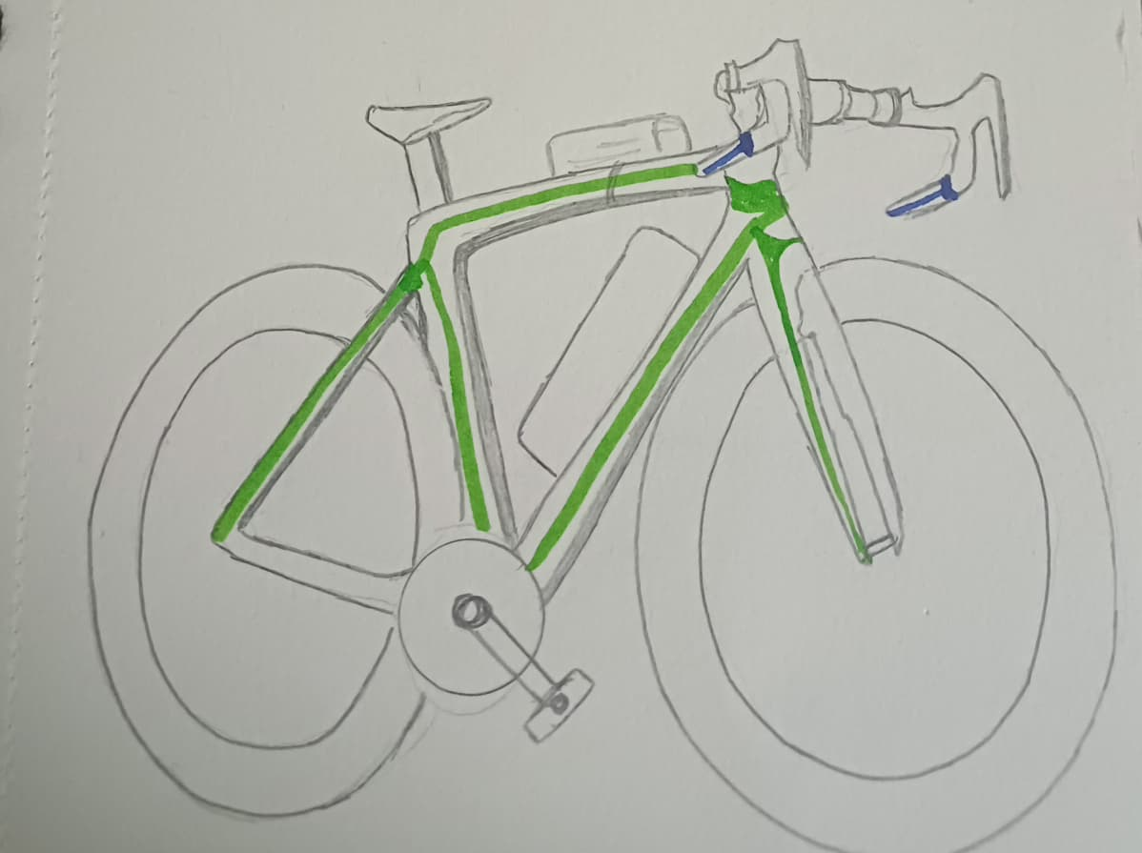
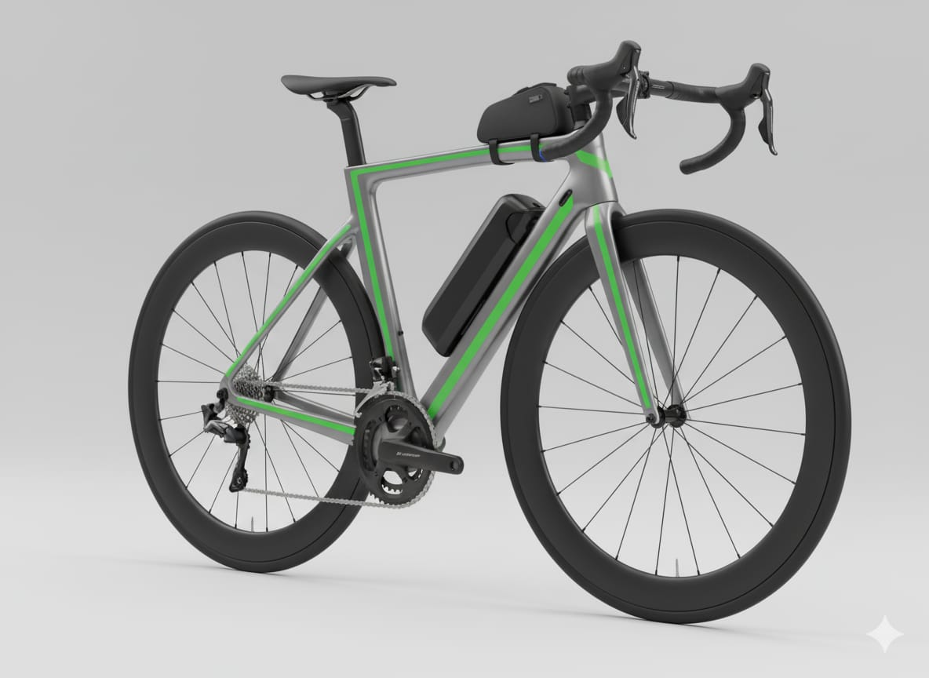
Eco-Ride Fold
Visual Theme: Urban compactness and playful minimalism; design expresses mobility and portability.
Rendering Focus: Diagonal folding line, smooth hinge joints, bright youthful colors (lime/blue).
Key Highlight: Hidden fold mechanism under continuous body curve with compact folded stance.
Type of Customer Focused: Apartment dwellers, metro commuters, and young professionals needing portable transport

Slide 37
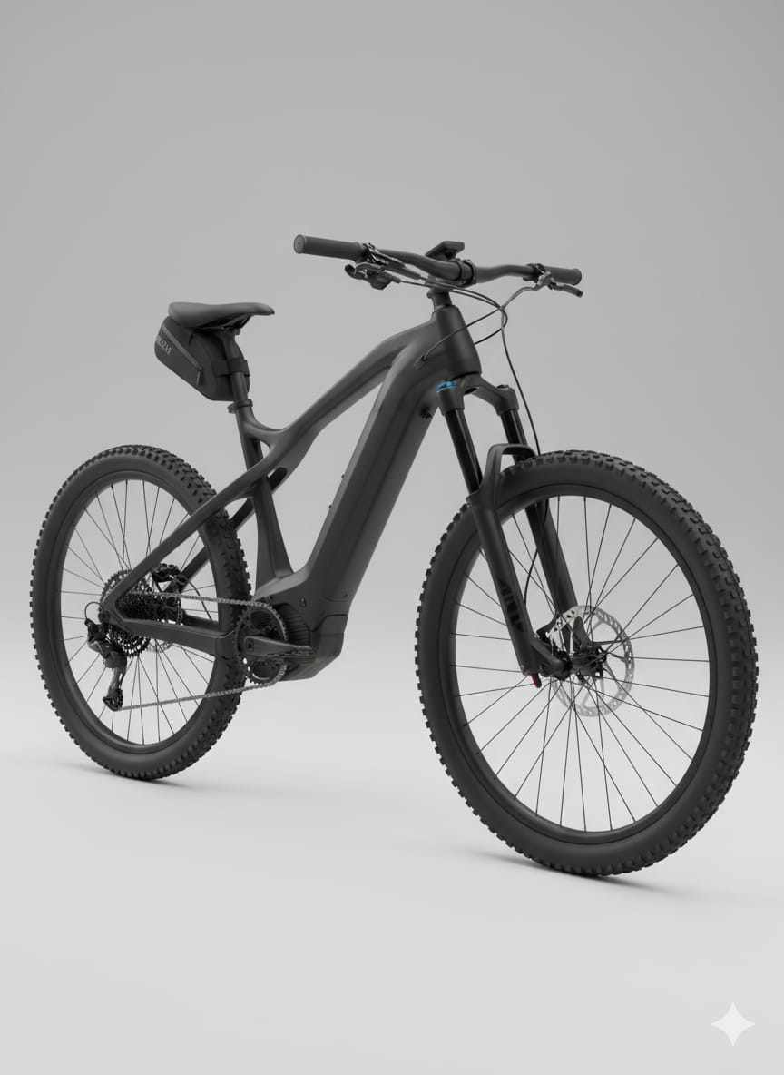
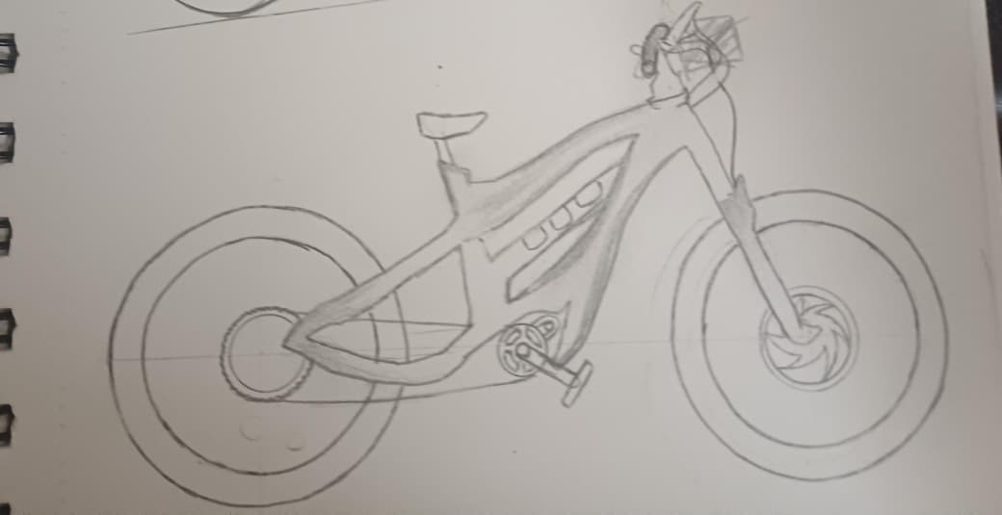
Eco-Ride Cargo
Visual Theme: Functional power; heavy-duty character with balanced proportions and stability.
Rendering Focus: Strong frame lines, extended rear section, dual-disc brakes, matte black industrial texture.
Key Highlight: Reinforced aluminium frame with detachable FRP cargo box and integrated LED tail line.
Type of Customer Focused: Small business owners, campus transport, delivery workers, and logistic operators.

Slide 38
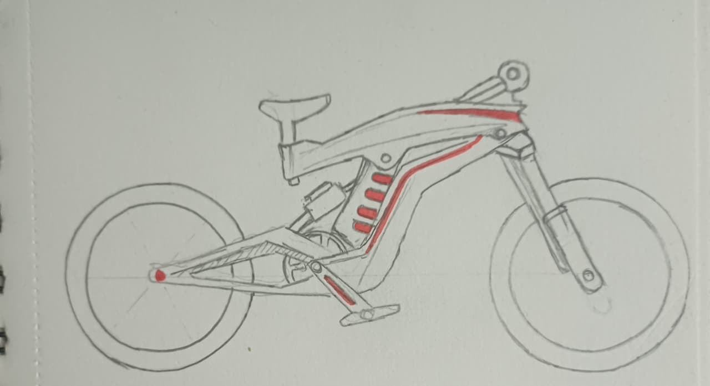
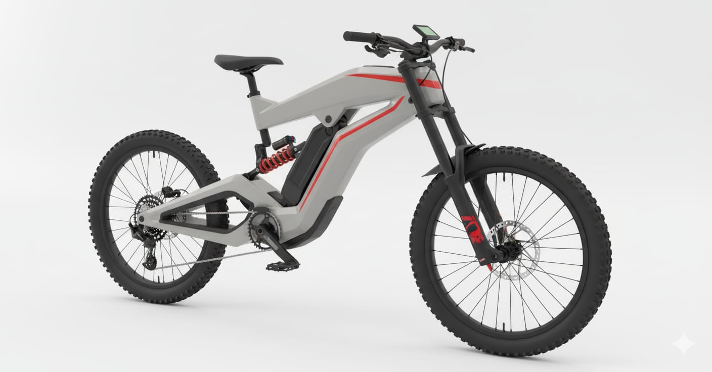
Eco-Ride R Sport
Visual Theme: Futuristic sport aesthetic with aerodynamic surfaces and racing-inspired stance.
Rendering Focus: Carbon-fiber texture, red gloss accents, LED edge strips, muscular mid-drive zone.
Key Highlight: Mid-drive BLDC motor with illuminated logo band and aggressive frame geometry.
Type of Customer Focused: Enthusiasts, fitness riders, and premium segment users valuing performance and tech styling.

Slide 39
Comparative Summary of Aesthetic Focus
Design Attribute | C1 | C2 | C3 | C4 | C5
Proportion | High | Very High | High | Very High | Very High
Contrast & Color Depth | Medium | High | Medium | Medium | Very High
Form Complexity | Low | Medium-High | Medium | Medium | High
Visual Weight Balance | Excellent | Excellent | Strong | Strong | Excellent
Market Appeal | Medium | Fleet / Smart | Urban | Utility | Premium Flagship

Slide 40
Evaluation of Refined Concepts
Parameter | Best Performing Concepts | Remarks
Unity & Style | C3, C5 | Consistent lines, dynamic character
Colour & Contrast | C2, C3, C5 | Clear identity through tone separation
Proportion & Balance | C1, C4 | Visual stability maintained
Innovation Appeal | C2, C3, C5 | Solar + swappable + performance focus
Market Attractiveness | C5>C2>C4 | R Sport gains highest visual desirability
Concept Improvement and Integration Strategy
Source Concept | Refined Feature | Final Concept (C6X)
C1 | Lightweight minimal design | Reduced visual weight
C2 | Modular swappable base | Functional flexibility
C3 | Compact geometry | Fold-portable potential
C4 | Strengthened dual-brake look | Stability and safety
C5 | Aerodynamic sport styling | High visual energy and flow

Slide 41
Final Hybrid Concept – Eco-Ride R-X Hybrid Performance Solar Edition:
Key Refinements Introduced
Form Harmony: Unified curved spine from C1 + aerodynamic flow from C3.
Visual Lightness: Concealed cables, compact hubs, and integrated lights.
Material Blending: Matte carbon-polymer body with gloss trims.
Aesthetic Energy Flow: Thin red LED strips accentuate motion.
Proportion Re-tuning: Shorter tail geometry for balanced weight.
Ergonomic Enhancement: Adjustable seat-handle ratio optimized for sporty posture.
Color Philosophy:
  Professional Sport: Graphite / Red
  Eco Hybrid: Green / Black
  Urban Limited: Silver / Blue
Concept Theme: Performance meets Sustainability — merging speed, technology, and eco-design in one unified aesthetic form.

Slide 42
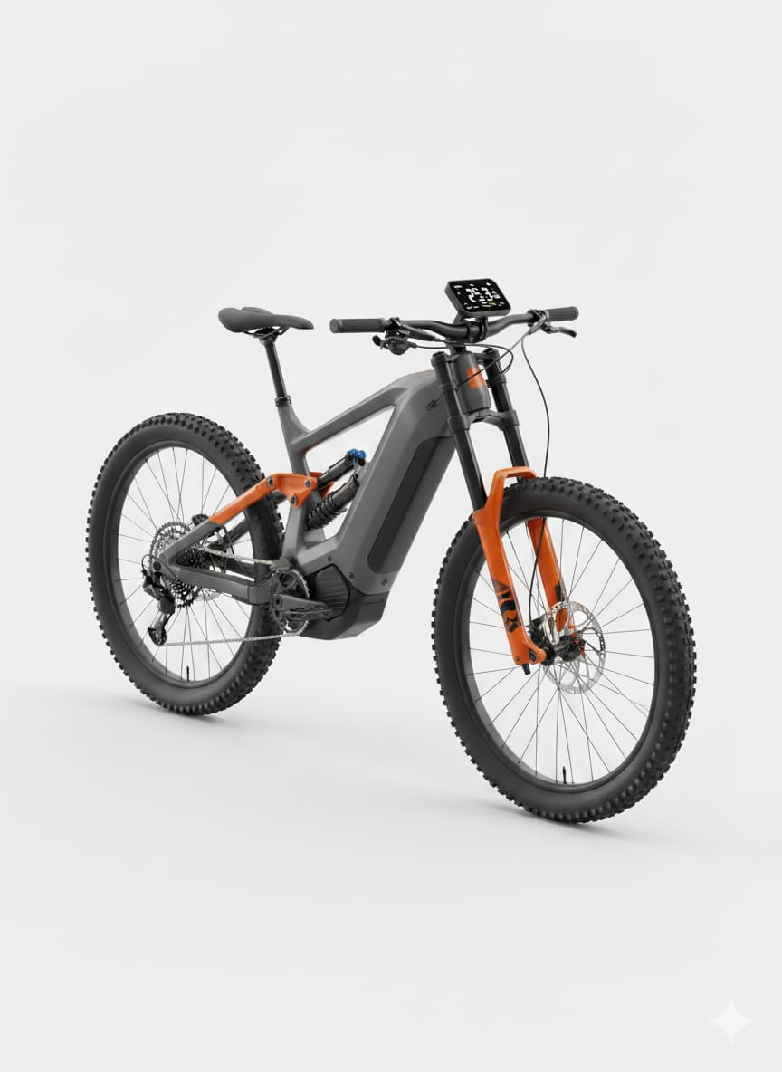
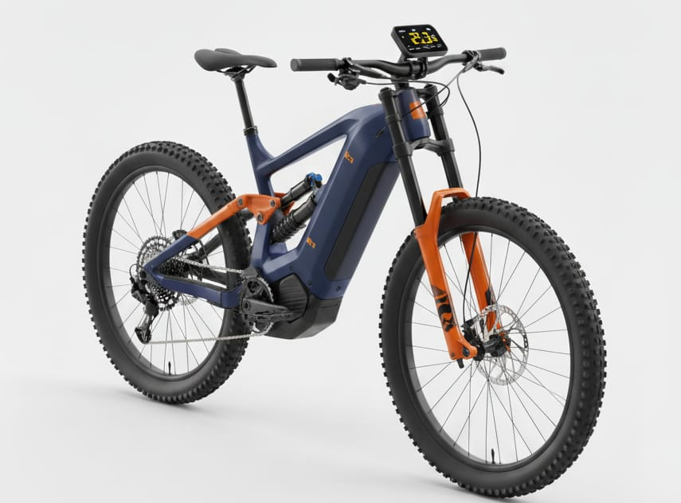
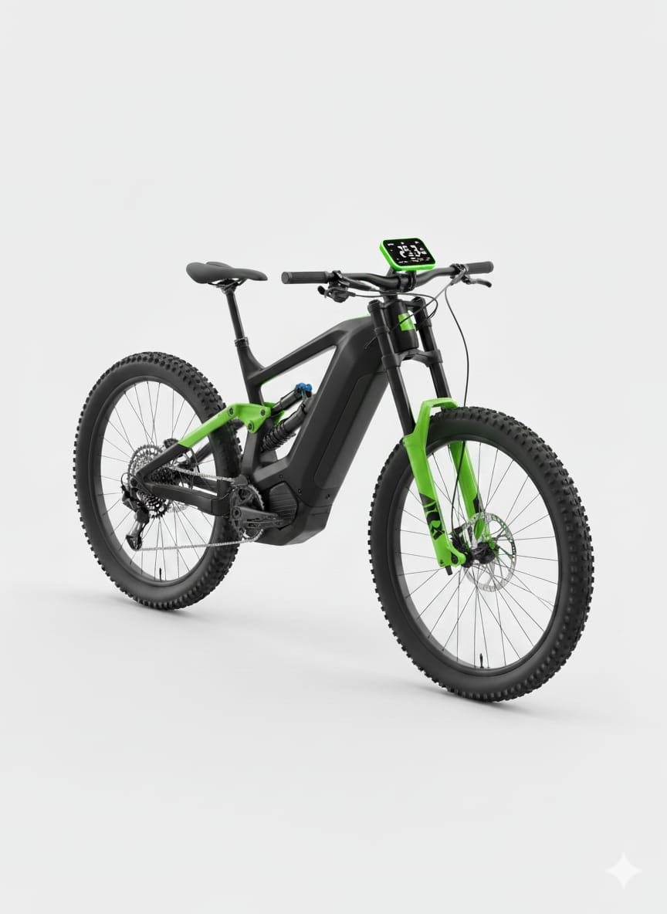
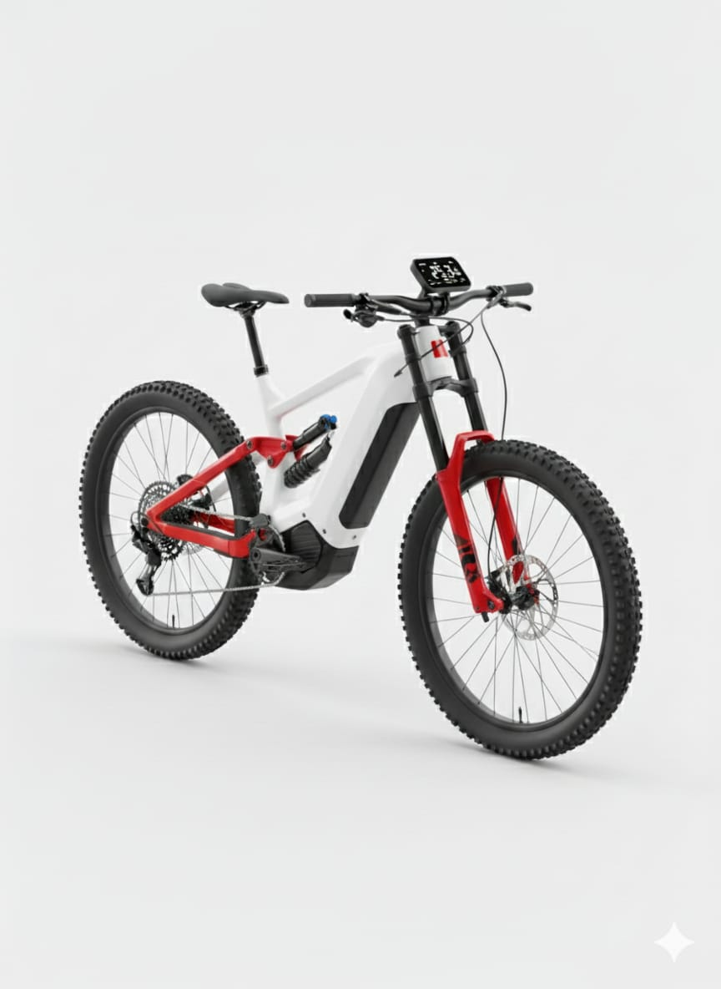

Slide 43
Conclusion
The Eco-Ride Smart Electric Cycle aesthetic refinement integrates technical engineering with emotional design appeal.
By systematically applying mass, unity, proportion, balance, contrast, and color, the six models now communicate their unique identities while belonging to a unified brand family.
The final Eco-Ride R-X Hybrid Solar Edition demonstrates the fusion of performance, sustainability, and form harmony, representing the pinnacle of the Eco-Ride design evolution.

Slide 44
THANK YOU
VISIT US

