Slide 1
Group Project presentation 343
Team 13, Bug-Captures'

Slide 2


Group 13 members
Lawi Mwirigi
Atef Halawi

Slide 3
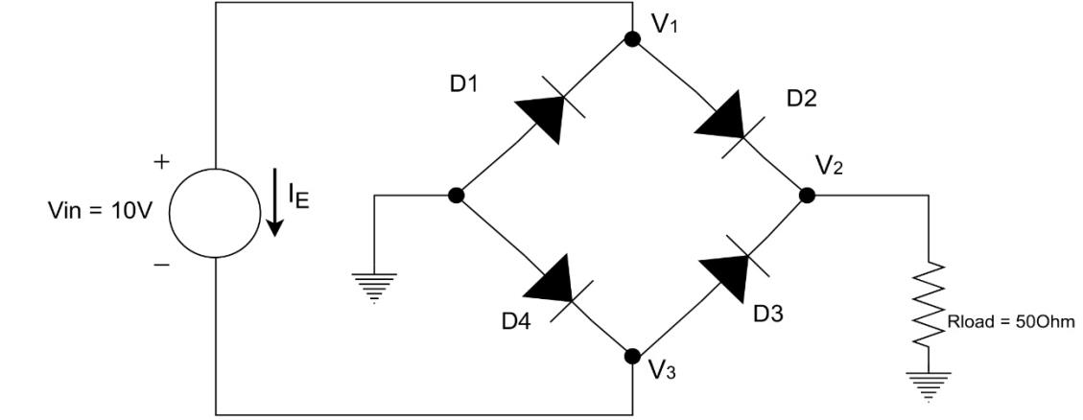
Introduction
Full wave rectifier circuit
Objectives
Teamwork and Responsibility
𝑭(𝑿) = 𝑮 𝑿 + 𝒈(𝑿) − 𝑼 = 0

Slide 4
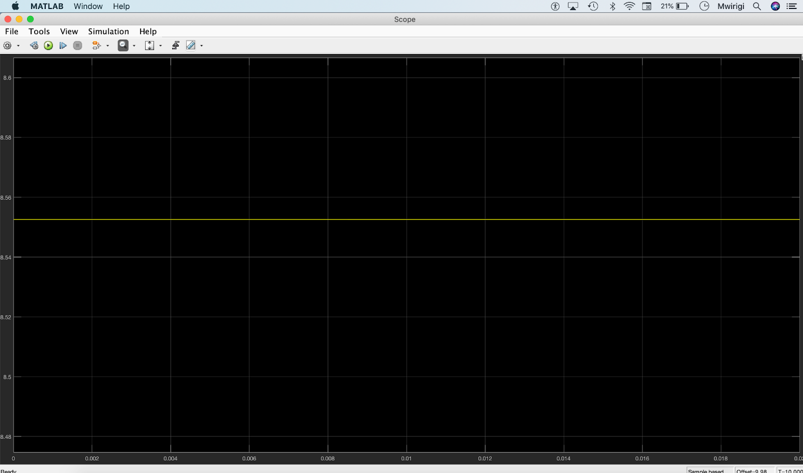
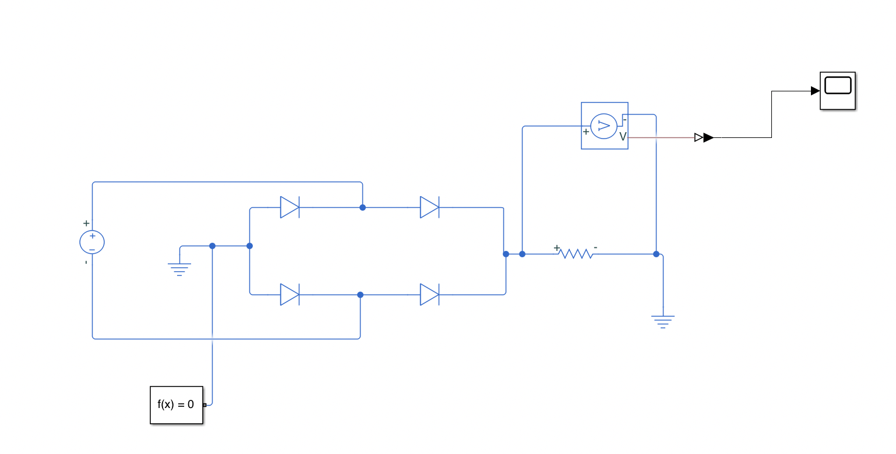
Part 1
Non linear function method
Solve built in Matlab function
Speed
Accuracy Relative error: 0.4535%
[F,J] = nonlinearFunc(X)
X(2) = solve(f,x).x2
5.432195 seconds
Simulink

Slide 5
Part 2
Non linear function method
Newton-Raphson method
Speed
Accuracy Relative error: 0.4535%
[F,J] = nonlinearFunc(X)
function [X_final] =NewtonRaphson(Xguess,tol)
0.606159 seconds
Simulink

Slide 6
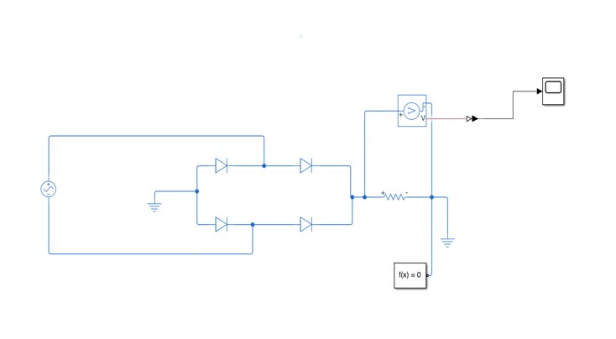
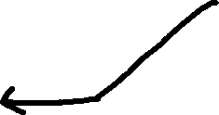
Part3 METHODS EXPLANATION
AC source
5 * sin(377*t)
Non linear function method updates on U(4,1)
Newton-Raphson method
Speed 0.490326 seconds
function [X_final] = NewtonRaphson(Xguess, tol,t)​
Simulink equivalent circuit ​
AC source

Slide 7
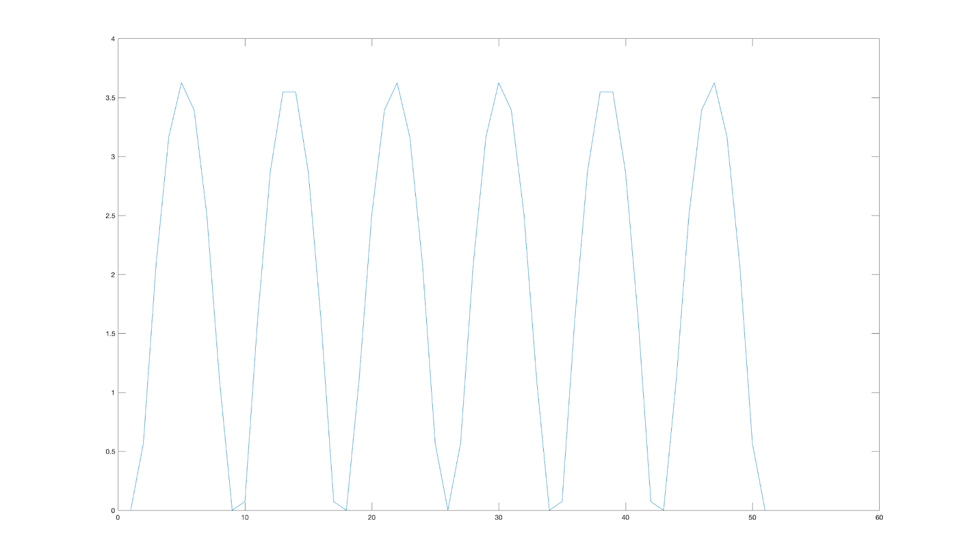
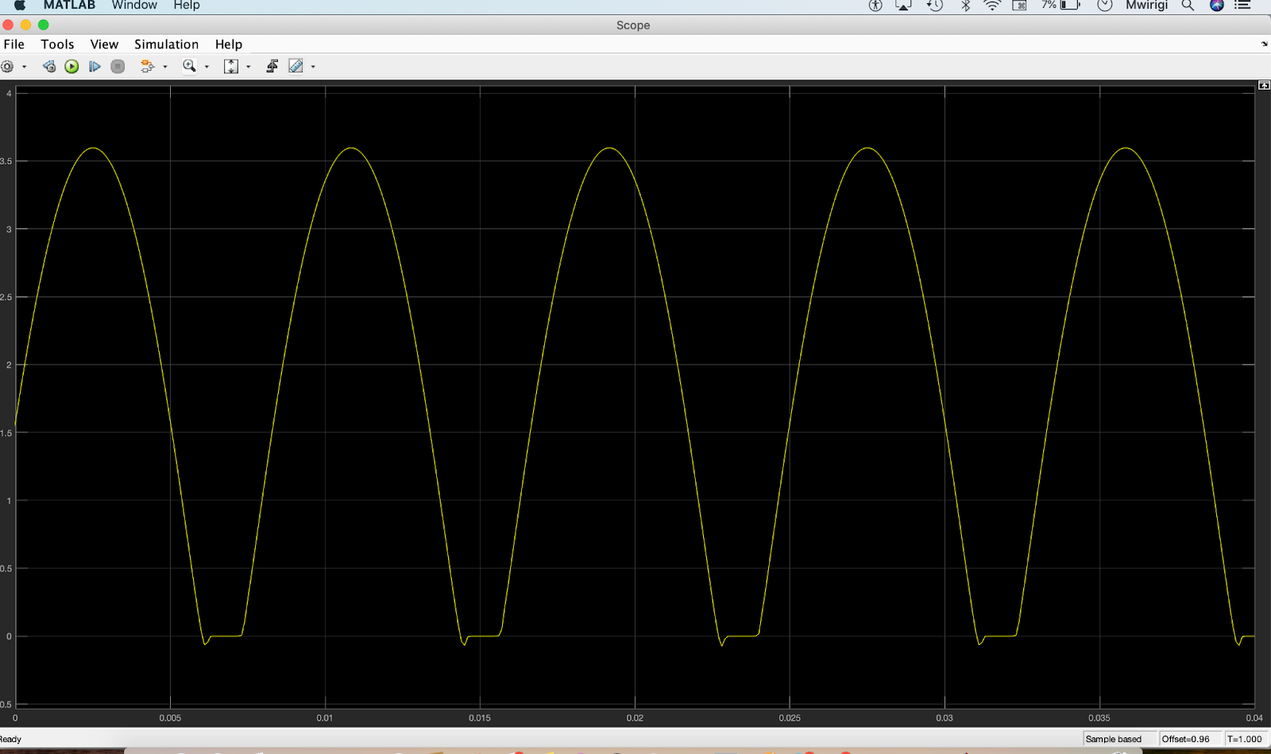
Accuracy Discussion OF pART 3
Matlab output value of v2
Simulink Value of v2

Slide 8
Conclusion

