Slide 1
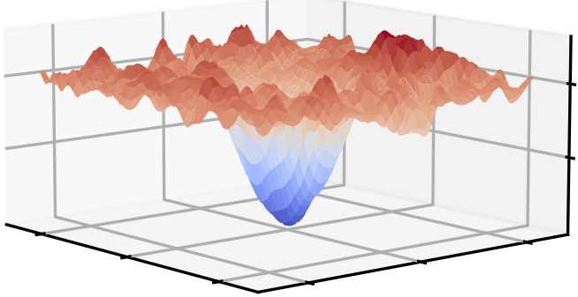
Lawler Research Group

