Slide 1
Star Wars Survey
An analysis of target market demographic

Slide 2
Purpose of Test
In coordination with a marketing team, this analysis of a survey taken on star wars fans is designed to assist in honing in on the best marketing demographic.
Several tested marketing styles have been shown to be more favorable to various groups of people (male vs female, age 18-24 vs over 60, etc).
In anticipation of upcoming star wars franchise developments, this study is designed to support the efforts of a marketing team in identifying their best strategies for a successful marketing campaign.
*Note: as this is a practice study, I am assuming that all data was randomly collected, and that the normal conditions/independence conditions are all met.

Slide 3
Data Collected
The survey utilized in this study involved 1,186 participants, who were asked (relevant to this study) if they had seen any of the Star Wars films, and if they were fans.
They were then asked various questions about their demographic information - gender, age range, education level, income level, geographical location.
From this, we now analyze the respondents according to these various attributes to identify which groups are most positively receptive to the Star Wars franchise.

Slide 4
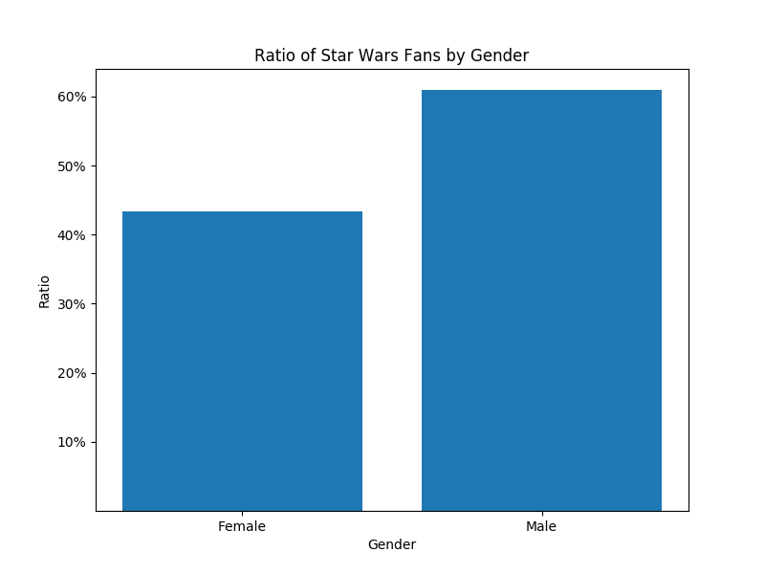
Results - Star Wars Fan by Gender
Of the respondents to the survey, 549 were women and 497 were men.
About 43% of the women surveyed identified themselves as Star Wars fans.
A significantly higher ratio of male respondents identified as fans, at almost 61%.
Based on this survey study, we estimate a between 11% and 23% higher ratio of fans among men than women.

Slide 5
Results - Breakdown of fans by Age and Gender
Age ranges in this survey were broken down into the following categories: -18-29 -30-44 -45-60 -60+
Comparisons of age groups are illustrated in both men and women to identify which age groups and genders perform best.
Unsurprisingly based on previous findings, the ratio of male fans almost universally outperform women in all age groups.
The highest ratio of fans were found in men ages 18-29 and 30-44, performing significantly higher at 71% and 70% responding as fans respectively.

Slide 6
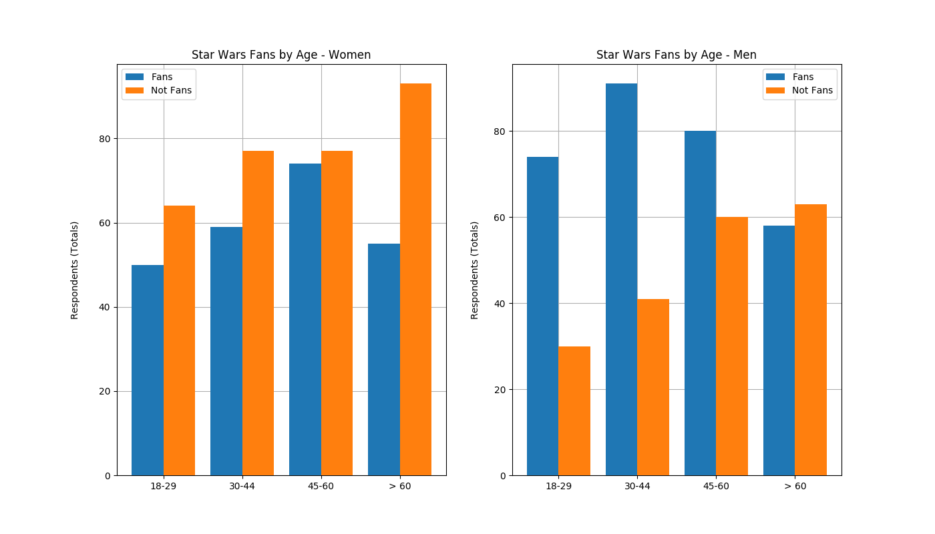
Results - Breakdown of fans by Age and Gender

Slide 7
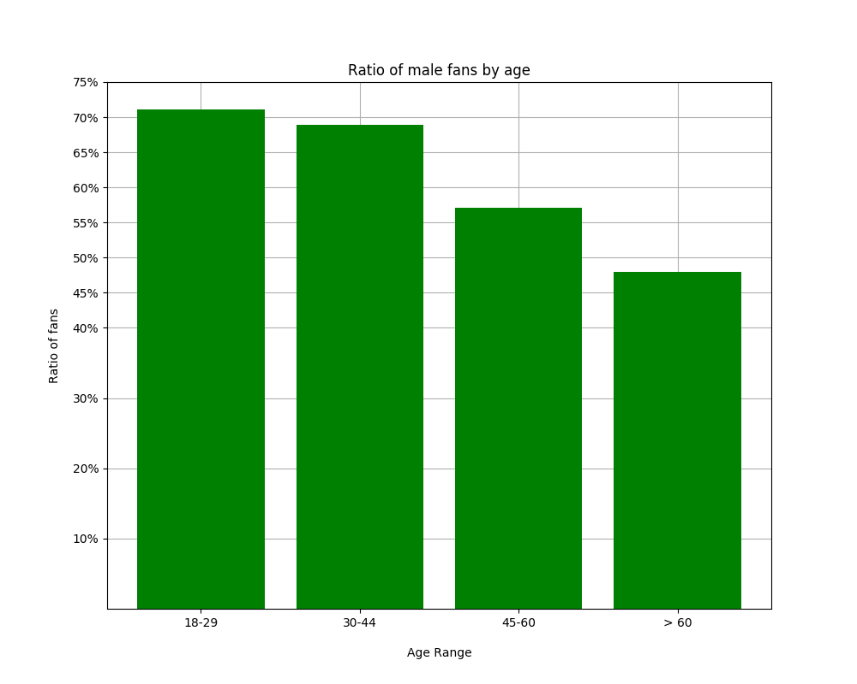
Ratio of Male Fans
As seen here, the highest ratio of fans are found in men in the 18-29 and 30-44 age ranges, who performed significantly higher at around 70%.
The study did not find a significant difference between these age groups, and it can be reasonably concluded that both the 18-29 and the 30-44 year old male age group are likely equally among the most favorable demographic to the Star Wars franchise.

Slide 8
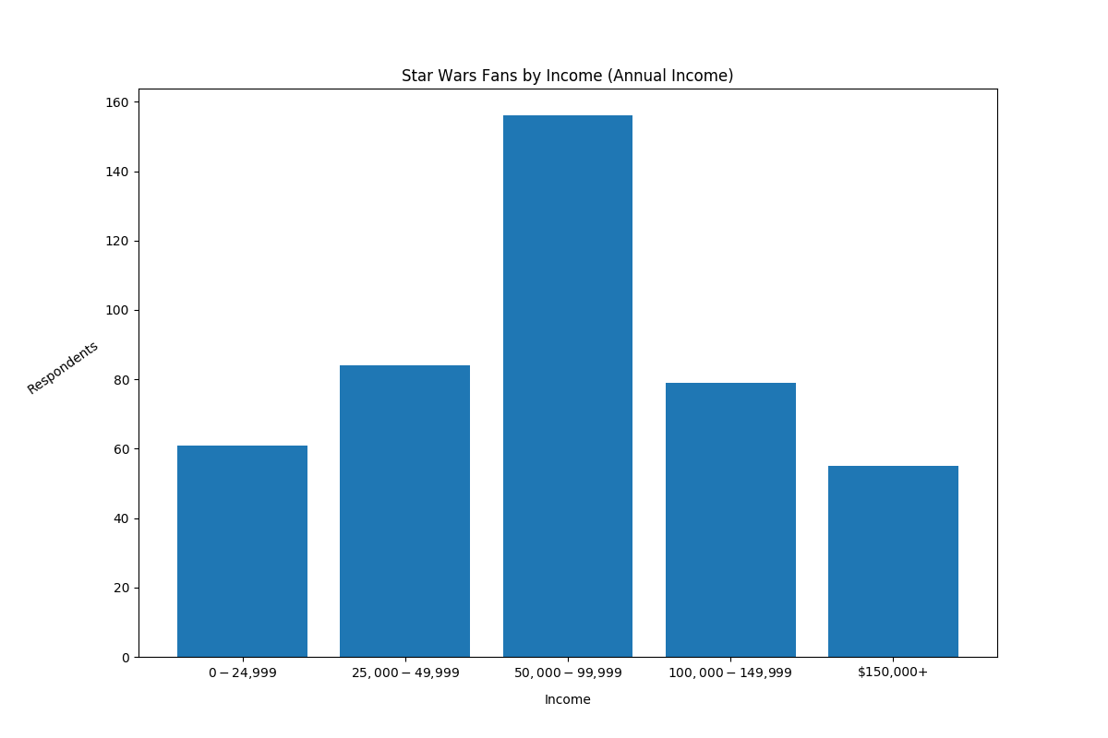
Results - Breakdown of fans by Income levels
-An analysis of income levels, ranging from under $25,000 to over $150,000 annually.
-Inference from the survey seems to indicate that Star Wars fans are not uniformly distributed among these income levels, and that a majority of fans will be $50,000 - $99,999 range annually.
-The 95% confidence interval of the proportion of fans in this income bracket is between about 32% - 40% of fans.

Slide 9
Results - Breakdown of fans by Education Level
-The distribution of fans is also analyzed by their respective education levels, separated into 4 categories: less than a high school degree, received a high school degree, completed a bachelor’s degree, and graduate level and above.
-Around 88% of fans either completed a bachelor’s degree or have a graduate degree, with about 42% having a bachelor’s alone.
-As men have already been identified as a target demographic, they were compared by themselves and shown to follow the same pattern. It appears that a majority of fans will have a bachelor’s degree or higher.

Slide 10
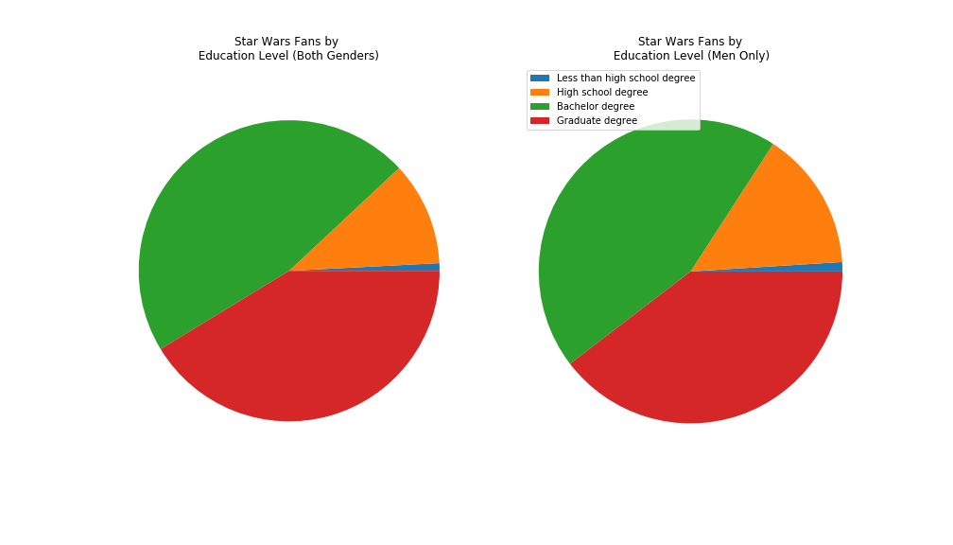
Results - Breakdown of fans by Education Level

Slide 11
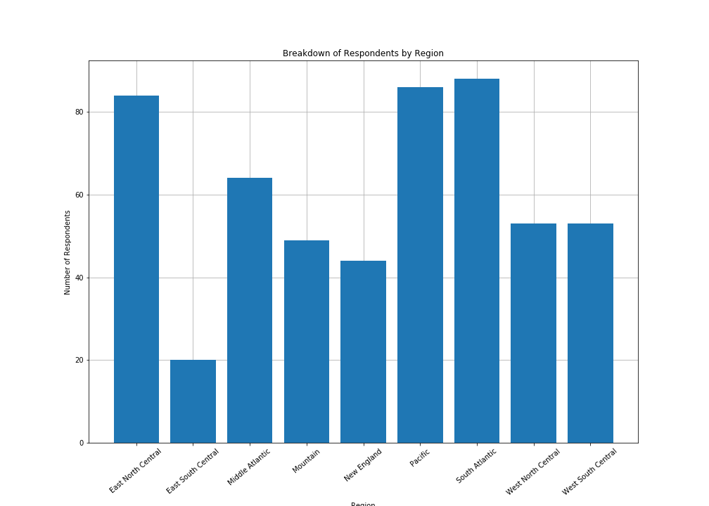
Results - Breakdown by U.S. Region
-The survey data preliminarily suggests that Star Wars fans are not distributed evenly in the U.S. population.
-The highest number of fans were found in the East North Central,South Atlantic, and Pacific Regions, each representing between around 13% - 19% of fans.
-The East South Central Region demonstrated the lowest number of fans.

Slide 12
Who shot first - Han or Greedo?
A popular and ongoing debate among Star Wars fans is the simple question of “who shot first” in an infamous scene of the first movie made in the franchise. Because of the popularity of this scene among fans, it has a strong potential to be utilized for favorable response in advertisements.
The questions when considering this possible marketing direction are 1) Who do most people think shot first? And 2) Is this meme really as popular as some fans seem to think it is?

Slide 13
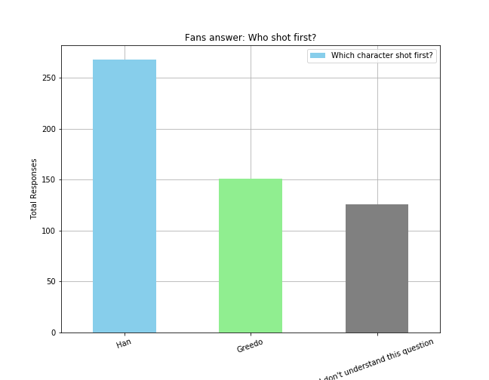
Results - Who shot first?
When considering the entire survey sample, there were not significantly more people who favored one response vs people who were not even aware of this question as a meme. As a result, advertisements directed at initiating those unfamiliar with Star Wars would likely not effectively utilize this strategy.
Among fans, significantly more people believe that Han shot first (an estimated interval of between 45% - 53% of Star Wars fans are of this opinion).

Slide 14
Summary of findings
Significantly more men responded as fans of the Star Wars franchise at 61% of the men polled, compared to women at 43% of respondents being fans.
Close to 70% of men age 18-44 consider themselves to be fans of the Star Wars franchise, which is the highest ratio of fans in all age groups for both genders.
The majority of fans fell within the income range of $50,000 - $99,000 annual income, representing an estimated range of 32% - 40% of fans.
88% of fans received at least a bachelor’s degree (or higher) level of education.
The East North Central, South Atlantic and Pacific Regions had the most fans.

Slide 15
Recommendations
Implementing marketing strategies to the demographics outlined will likely produce favorable effects, as it reflects the most positively responding groups.
Conducting a A/B test with an ad targeting this demographic against a more “general” ad is expected to produce a higher favorable response with an appropriately targeted ad campaign. Further consultation to discuss previous ad campaign success and desired increase in ad response will be advised to select appropriate sample sizes. With such tests, we can conclude definitively if marketing adjustments will prove viable in a cost/benefit analysis.

