Slide 1







Exploring Salary Trends in the Tech Industry: An Analysis of Age, Gender, and Compensation

Slide 2



OUTLINE
Executive Summary
Introduction
Methodology
Results
Visualization – Charts
Dashboard
Discussion
Findings & Implications
Conclusion
Appendix

Slide 3

EXECUTIVE SUMMARY
Data Collection:
The dataset had an initial 11,552 entries with details like respondents’ employment, compensation, coding experience, etc. After cleaning, 1,008 rows remained.
Key Insights:
The median annual salary is $52,704, with an average of $59,883.
Outliers were detected, but only salaries between $24,060 and $85,574 were analyzed further.
A weak positive correlation between age and salary (0.40 correlation).
The median age of respondents is 29 years.

Slide 4

INTRODUCTION
Objective of the Analysis
Dataset Overview
Key Features of the Data
Importance of the Analysis
Scope of the Analysis
Limitations

Slide 5

METHODOLOGY
Data Collection
retrieve dataset
Preprocess data
Data Cleaning
Duplicate removal
Handling missing values
Normalization of compensation data
Data Transformation
Creation of normalized annual compensation column
Identification and exclusion of outliers
Data Wrangling and Exploratory Analysis
Descriptive statistics (median and mean values)
Correlation analysis between factors
Data Visualization
Generation of charts and graphs
Visualization of salary distributions and outliers
Dashboard Visualization
Interactive dashboards created using Looker Studio
Key insights on compensation trends, job satisfaction, and coding experience

Slide 6
RESULTS
General Data Overview:
-Initial dataset contained 11,552 respondents.
-After data cleaning (removal of duplicates and rows with missing values), 1,008 respondents remained for final analysis.
Demographics:
Compensation Insights:
Median annual salary across all respondents is $52,704.
Average salary: $59,883.
50% of respondents earn between $24,060 and $85,574
Outliers: $209,698 and above were removed for clearer analysis.
Gender-Specific Insights:
The median salary for female respondents is $57,708, closely matching the overall dataset's median.
No significant salary gap was observed between male and female respondents.
Age and Salary Correlation:
A positive correlation between age and salary was identified (0.40 correlation).
Younger respondents (ages 25–35) see steady salary growth, peaking in the 30s.
After age 50, salary growth appears to plateau.
Key Salary Statistics:
Salary Distribution:
25th percentile: $24,060.
50th percentile (Median): $52,704.
75th percentile: $85,574.
Most salaries cluster around the median with large variance, reflected in a standard deviation of $43,394.
Median age of respondents is 29 years, with an age range between 16 and 99 years.
Gender distribution skewed heavily towards men (10,480 men).

Slide 7
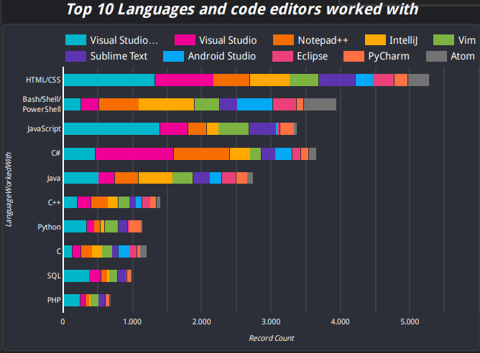
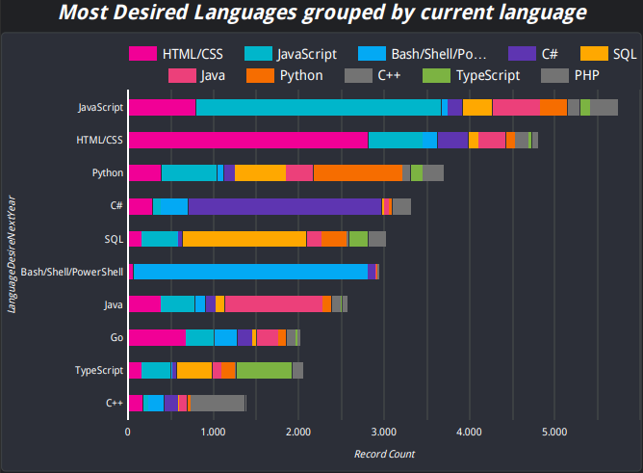
PROGRAMMING LANGUAGE TRENDS
Current Year
Next Year

Slide 8
PROGRAMMING LANGUAGE TRENDS - FINDINGS & IMPLICATIONS
Findings on Technology Usage
Implications
Top languages:
HTML/CSS, Bash/Shell/PowerShell, JavaScript and Python
Visual Studio Code is the most popular code editor across all languages
Future Trends:
Desired languages for next year: JavaScript, Python, TypeScript
JavaScript remains crucial
Growing demand for Python and TypeScript
Go is emerging as a key language
JavaScript: Key for web development and full-stack roles; mastering it ensures high employability.
TypeScript & Go: Growing demand for performance and strongly typed languages; upskilling in these improves backend opportunities.
Python: Versatility across web, data science, and automation keeps it in demand across multiple sectors

Slide 9
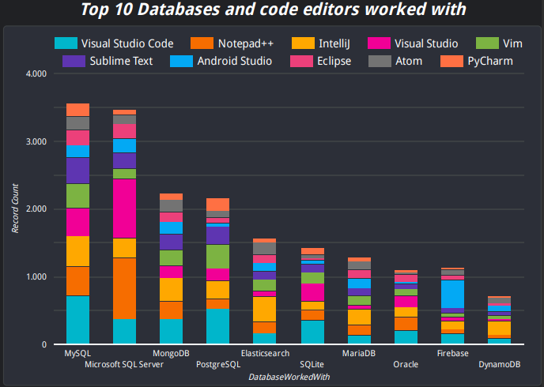
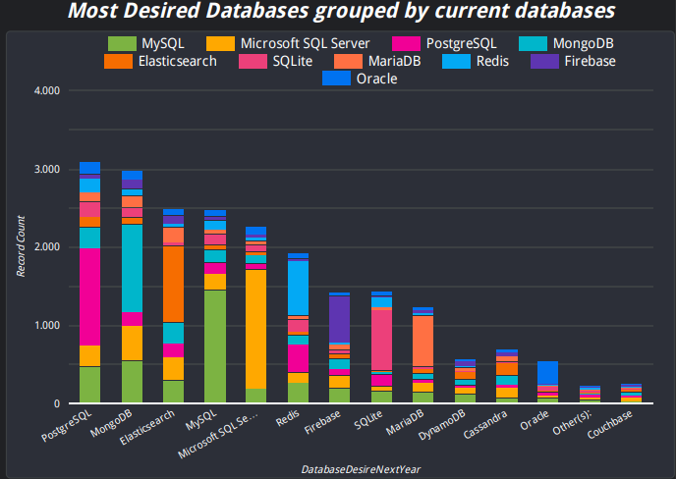
DATABASE TRENDS
Current Year
Next Year

Slide 10
DATABASE TRENDS - FINDINGS & IMPLICATIONS
Current Database Usage:
Top 3 databases currently worked with: MySQL, Microsoft SQL Server, MongoDB.
PostgreSQL and Elasticsearch also widely used but slightly lower in popularity.
Code editors like Visual Studio Code, Notepad++, and IntelliJ are used across the board for most databases.
Most Desired Databases (Next Year):
PostgreSQL and MongoDB are the most desired databases for future work, with a significant lead over others.
Elasticsearch, MySQL, and Redis show strong demand in the future.
Cassandra and Couchbase are less desired compared to others, indicating niche use.
Database Skills Demand:
PostgreSQL and MongoDB will remain highly valuable, indicating the need for developers to enhance their proficiency with these databases.
Elasticsearch and Redis are gaining traction, suggesting increased demand for developers skilled in search and caching technologies.
Familiarity with MySQL and Microsoft SQL Server remains important but may plateau as newer technologies like PostgreSQL gain ground.
Specialization in Niche Databases:
Lesser-used databases like Cassandra and Couchbase might still provide opportunities in specialized sectors, but broader demand is limited compared to mainstream databases.

Slide 11


DASHBOARD
https://lookerstudio.google.com/s/uuW9w-kMkRk

Slide 12
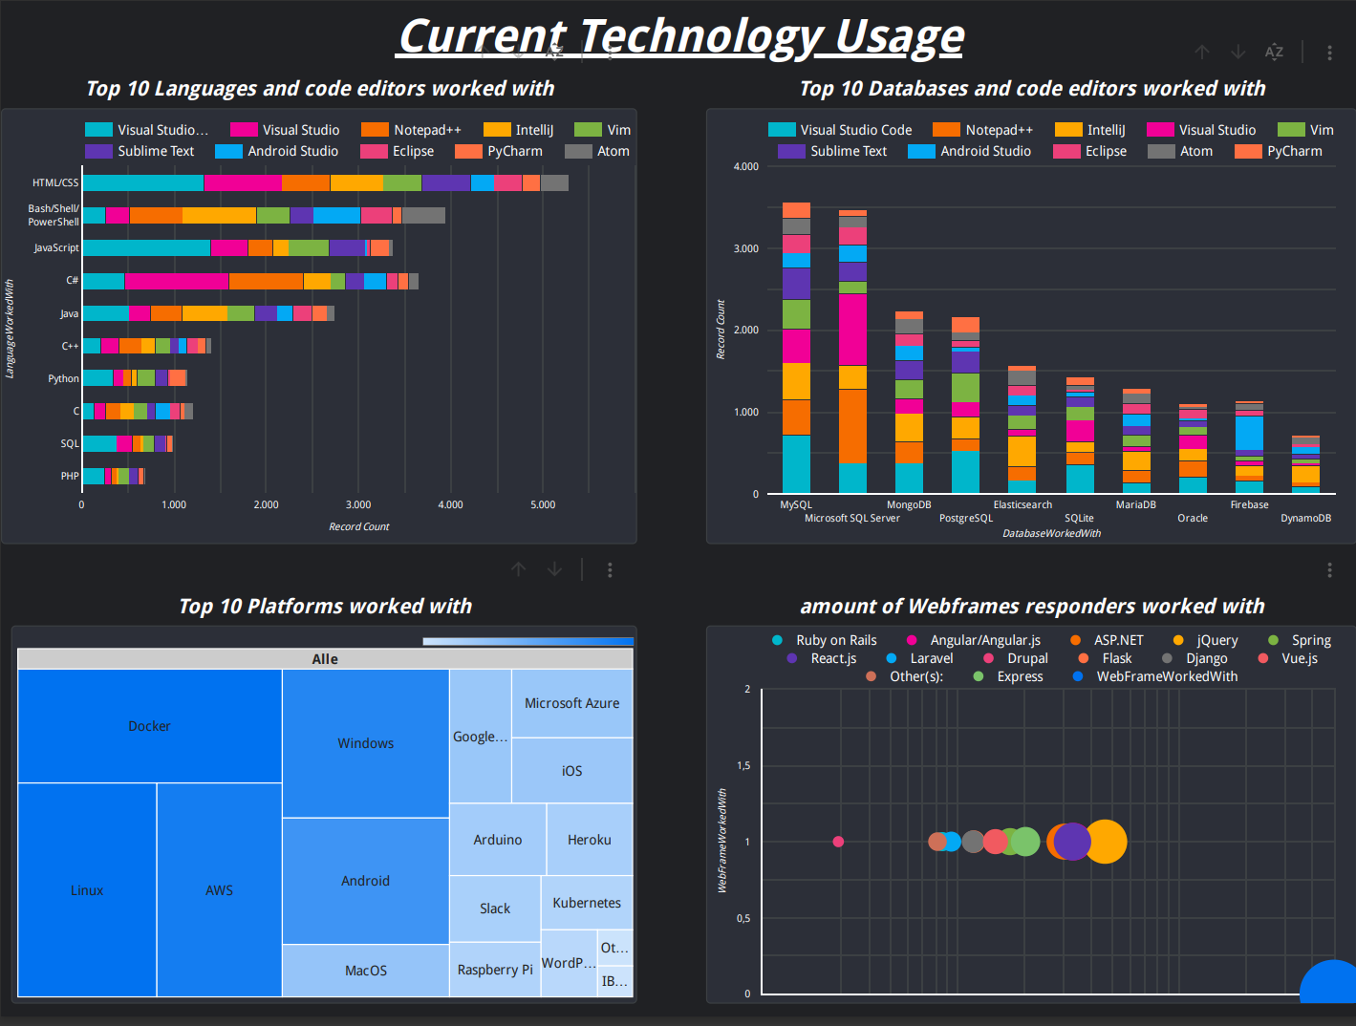
Current Technology Usage

Slide 13
Future Technology Usage

Slide 14
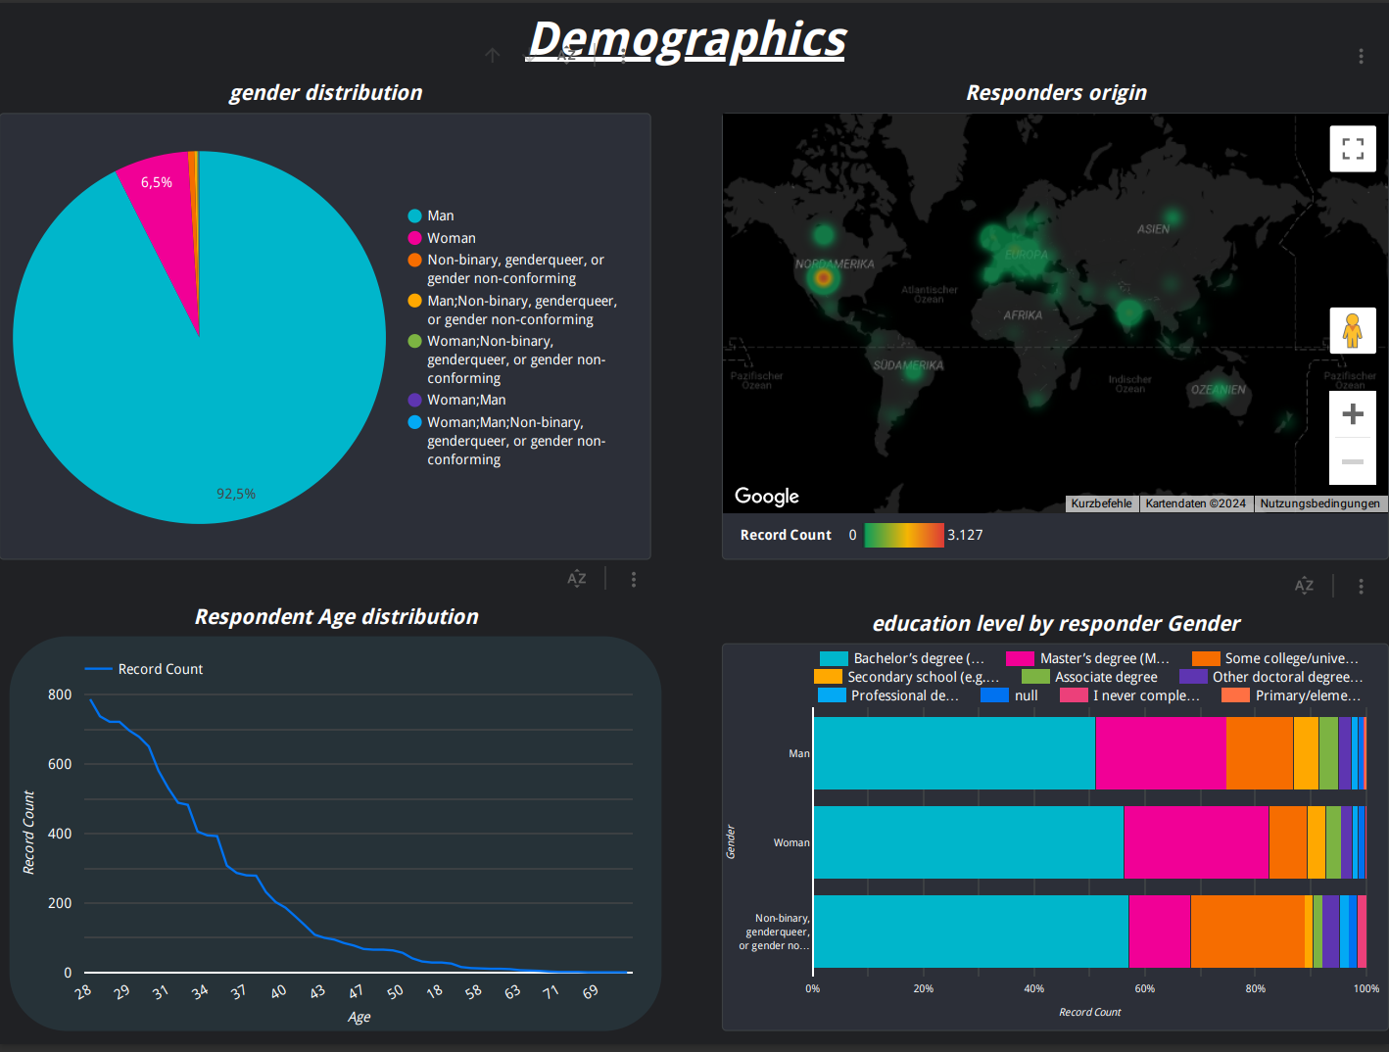
Responders Demographic

Slide 15
DISCUSSION
Shift in Database Preferences:
PostgreSQL and MongoDB are seeing significant growth in popularity. This shift might be driven by:
PostgreSQL’s reliability and robust feature set for complex queries and data integrity.
MongoDB’s flexibility with unstructured data, making it a top choice for NoSQL databases in the age of big data.
Emerging Role of Search and Caching Technologies:
The rise in demand for Elasticsearch and Redis suggests a growing need for:
Real-time search and analytics capabilities, especially in data-intensive applications.
In-memory caching for performance optimization in high-traffic web applications.
Declining Interest in Legacy Databases:
Traditional databases like Microsoft SQL Server and Oracle are still relevant, but their growth has slowed, likely due to:
The rise of open-source alternatives like PostgreSQL and MySQL.
The high cost and maintenance overhead associated with proprietary systems.

Slide 16
OVERALL FINDINGS & IMPLICATIONS
Demographics & Compensation:
Median Age of respondents is 29 years, with a significant portion of the workforce aged between 25 and 35 years.
Median annual salary is $52,704, with 50% of respondents earning between $24,060 and $85,574.
A positive correlation between age and salary (0.40), indicating that experience tends to lead to higher compensation.
Minimal salary gap between male and female respondents, but the dataset is heavily skewed towards men.
Programming Language Trends:
Current top languages: HTML/CSS, Bash/Shell/PowerShell, and JavaScript.
Most desired languages for next year: JavaScript, Python, and TypeScript.
Go is gaining momentum as an emerging language, signaling a demand for more performance-oriented backend solutions.
Platform Usage:
Docker, Linux, and AWS dominate current usage, reflecting the trend towards containerization and cloud-native development.
Kubernetes is expected to see increased usage as companies prioritize scalability and orchestration of cloud services.
Interest in Google Cloud Platform and Arduino highlights growing demand in multi-cloud environments and IoT development.
Database Trends:
Current top databases: MySQL, Microsoft SQL Server, and MongoDB.
PostgreSQL and MongoDB are the most desired databases for next year, with increased interest in Elasticsearch and Redis for search and caching needs.
There is a shift towards open-source and NoSQL databases, driven by the need for scalability and flexibility in data management.

Slide 17

CONCLUSION
Tech Workforce & Compensation:
The data reflects a maturing tech workforce, with experience driving higher salaries,
Gender diversity remains an issue in the tech industry, but salary discrepancies between genders are minimal in this dataset.
Programming Languages and Database Trends:
JavaScript, Python, and TypeScript will continue to be the backbone of modern development, with JavaScript solidifying its place as the most in-demand language
Go is an emerging language to watch, particularly in backend systems where performance and scalability are priorities.
The rise of NoSQL databases highlights a shift towards handling large, unstructured datasets, particularly in industries focused on big data and IoT.
Final Thoughts:
The analysis underscores the growing complexity of the tech landscape, where developers must be adaptable, with a balanced skill set spanning modern programming languages, cloud infrastructure, and database management.
Organizations should focus on fostering diverse, highly skilled teams capable of leveraging these technologies to stay ahead in a rapidly evolving industry.

Slide 18
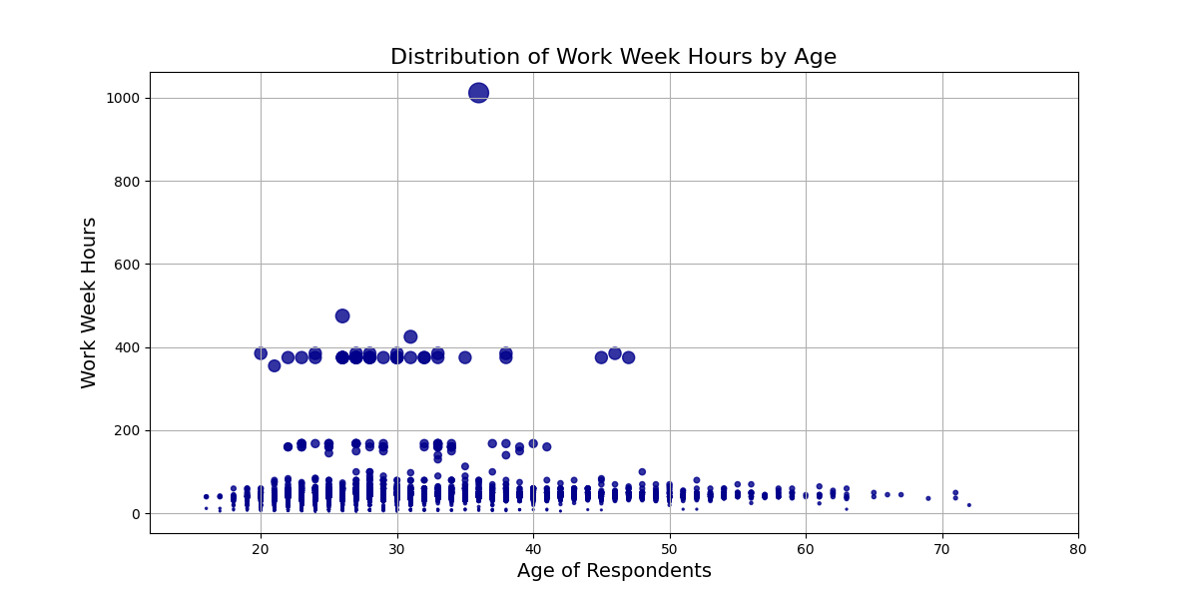
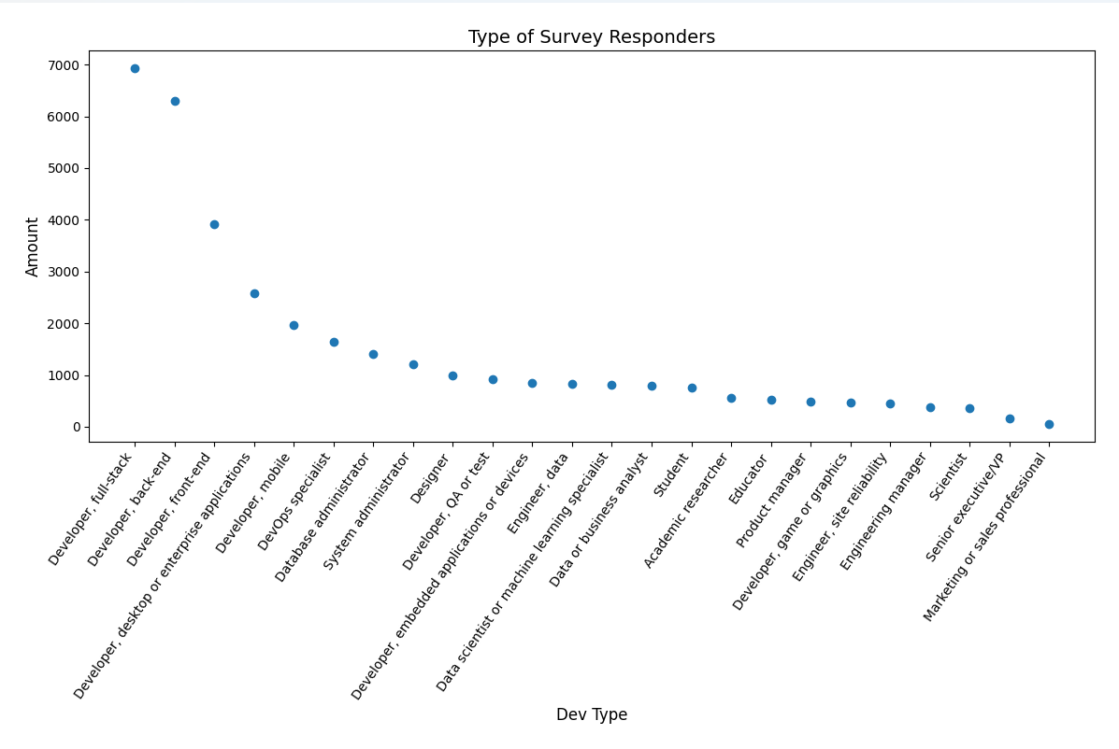
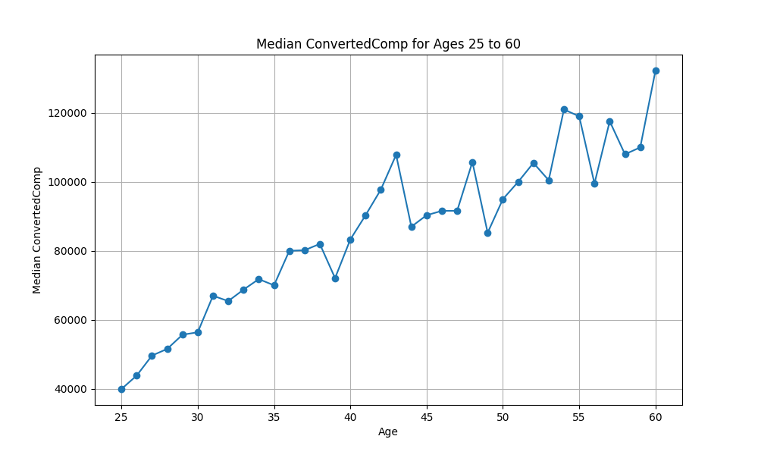
APPENDIX

Slide 19
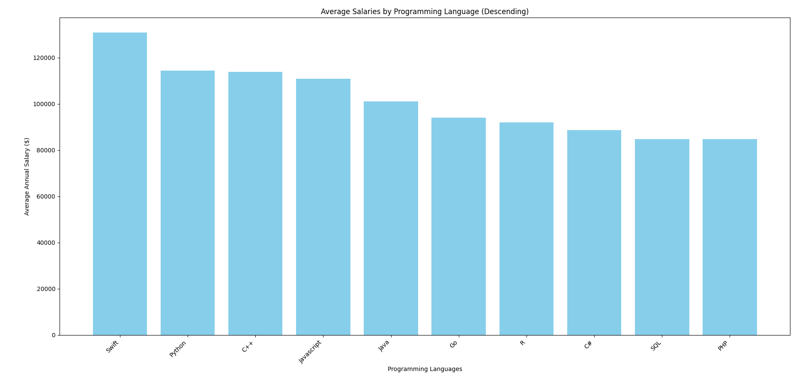
Market POSTINGS on Salaries by Programming language

