Slide 1

Applicant Day
Activity
Weather App

Slide 2
Learning Outcomes
By the end of this session, you will be able to:
  write a simple weather app in HTML and JavaScript.

Slide 3
Introduction
This activity is an illustration of what you might do on Level 4 of your course.

Slide 4
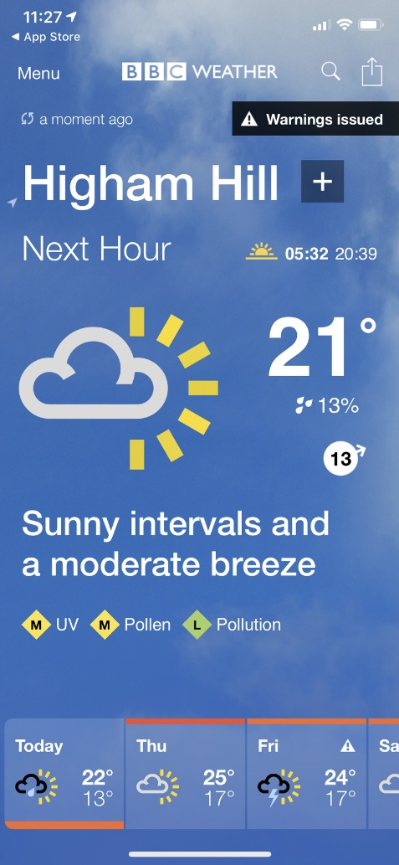

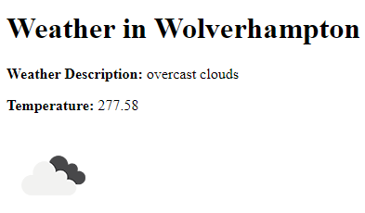
Introduction
We are going to create a simple weather app.
Our simple web app will look like this.
API
Messages over HTTP (JSON or XML)
Platform-independent
Agreed interface
Web Service
Your app / service

Slide 5



Activity
Student
Activity
Let’s work through the workbook!
We will learn a bit about web apps…
…and have some fun!!!

Slide 6
Download Workbook
https://tinyurl.com/mr3znr88
Notes:
https://livewlvac-my.sharepoint.com/:b:/g/personal/t_hartley2_wlv_ac_uk/EdeMQl_2o3NFpAbVXB-583UBzbGQq_DluCQnN0W6pcOgLw?e=xlIVde

Slide 7
API Id
Please use this API id in your weather app:
9deb b2ca 677d ba67 a70e e71a a3b2 6061
Do not include the spaces.

Slide 8
Summary
By the end of this session, you will be able to:
  write a simple weather app in HTML and JavaScript.
Any questions?
Learning Outcomes?

