Slide 1
Oracle RAC and Docker: The Why and How
Seth Miller
Senior Principal Software Engineer

Slide 2

About Me
Senior Principal Software Engineer at Veritas
Oracle DBA since 2005
Independent Oracle Users Group (IOUG) Board of Directors

Slide 3

Download Presentation

Slide 4
Why?

Slide 5
Why Oracle in Containers?
Resource reduction
# of VMs
Memory & disk
Time reduction
Provision
Configure
Storage Deduplication
Operating system
Oracle Binaries

Slide 6
Considerations
NOT
FOR
PRODUCTION
…at least not yet
Bleeding edge
Lack of vendor support
Not certified
Off-label
No published images
Automation

Slide 7
Contradictions
Shared nothing architecture
Split brain isolation
High availability
Full node control
Privileged access

Slide 8
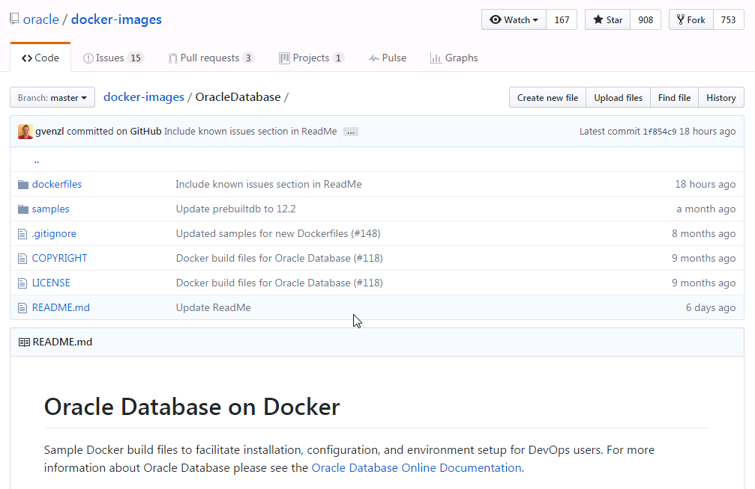
Single Instance vs. Cluster
Database in container = easy
Single container
No privileged access
No extra networking
No supporting processes
https://github.com/oracle/docker-images/tree/master/OracleDatabase

Slide 9
Single Instance vs. Cluster
Cluster in containers = hard
At least 2 containers
Privileged access
Multiple networks
Needs init/systemd
Runs processes as root

Slide 10
What are Containers?
Containers are not VMs
User space
Host kernel
Linux capabilities — capabilities(7)
CHOWN, DAC_OVERRIDE, FSETID, FOWNER, MKNOD, NET_RAW, SETGID, SETUID, SETFCAP, SETPCAP, NET_BIND_SERVICE, SYS_CHROOT, KILL, AUDIT_WRITE
Networking
Virtual network adapters
Storage
Images
Containers

Slide 11
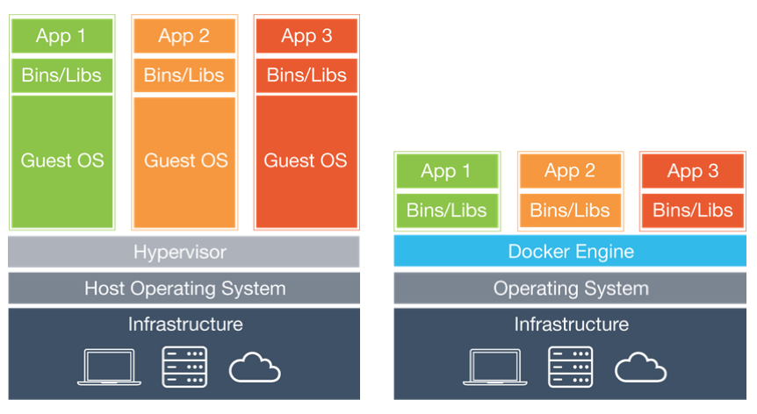
Containers vs VMs
Notes:
http://www.solidfire.com/blog/containers-vs-vms

Slide 12
What are Containers?
Containers are not VMs
User space
Host kernel
Linux capabilities — capabilities(7)
CHOWN, DAC_OVERRIDE, FSETID, FOWNER, MKNOD, NET_RAW, SETGID, SETUID, SETFCAP, SETPCAP, NET_BIND_SERVICE, SYS_CHROOT, KILL, AUDIT_WRITE
Networking
Virtual network adapters
Storage
Images
Containers

Slide 13
Container Process Capabilities
ppid pid name command capabilities
10392 5957 root systemd full
5957 815 root init.tfa full
5957 5206 root init.ohasd full
5957 5997 root systemd-journal chown, dac_override, dac_read_search, fowner, setgid, setuid, sys_ptrace, sys_admin, audit_control, mac_override, syslog, wake_alarm, block_suspend, audit_read
5957 6042 root systemd-udevd full
5957 6110 root smartd full
5957 6111 81 dbus-daemon audit_write +
5957 6138 root rsyslogd full
5957 6140 root systemd-logind chown, dac_override, dac_read_search, fowner, kill, sys_admin, sys_tty_config, audit_control, mac_admin, wake_alarm, block_suspend, audit_read
5957 6159 root gssproxy full
5957 6265 root sshd full
5957 6276 root crond full
5957 6323 root rhnsd full
5957 6392 root ohasd.bin full
...
Notes:
https://github.com/Seth-Miller/12c-rac-docker/blob/master/viewcap.sh

Slide 14
What are Containers?
Containers are not VMs
User space
Host kernel
Linux capabilities — capabilities(7)
CHOWN, DAC_OVERRIDE, FSETID, FOWNER, MKNOD, NET_RAW, SETGID, SETUID, SETFCAP, SETPCAP, NET_BIND_SERVICE, SYS_CHROOT, KILL, AUDIT_WRITE
Networking
Virtual network adapters
Storage
Images
Containers

Slide 15
Virtual Network Adapters
docker0: <BROADCAST,MULTICAST,UP,LOWER_UP> state UP
link/ether 02:42:5d:3b:cc:3e brd ff:ff:ff:ff:ff:ff
inet 172.17.0.1/16 scope global docker0
...
vethd67c304@if32: <BROADCAST,MULTICAST,UP,LOWER_UP> master docker0 state UP
link/ether c6:7a:0e:0d:a3:76 brd ff:ff:ff:ff:ff:ff
...

Slide 16
What are Containers?
Containers are not VMs
User space
Host kernel
Linux capabilities — capabilities(7)
CHOWN, DAC_OVERRIDE, FSETID, FOWNER, MKNOD, NET_RAW, SETGID, SETUID, SETFCAP, SETPCAP, NET_BIND_SERVICE, SYS_CHROOT, KILL, AUDIT_WRITE
Networking
Virtual network adapters
Storage
Images
Containers

Slide 17
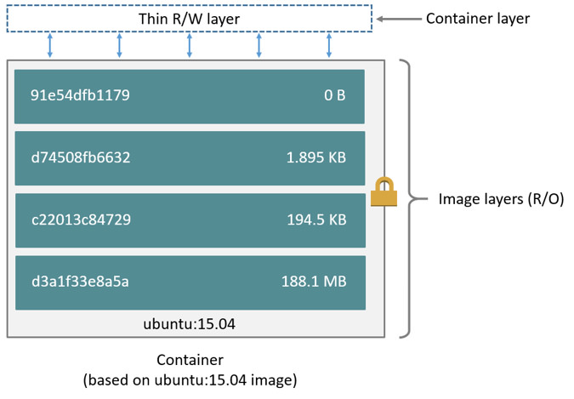
Storage
Notes:
https://docs.docker.com/engine/userguide/storagedriver/imagesandcontainers/

Slide 18
How?

Slide 19
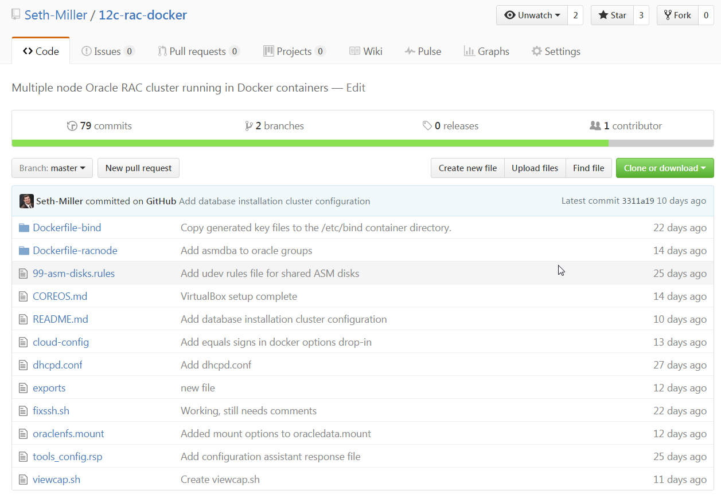
https://github.com/Seth-Miller/12c-rac-docker
Notes:
https://github.com/Seth-Miller/12c-rac-docker

Slide 20
Oracle Grid Infrastructure Networking
1 public network per node
1 public static IP per node
1 public virtual IP per node
3 public SCAN virtual IPs per cluster
1 public GNS virtual IP per cluster
1 private network per node
1 private static IP per node
2 node cluster = 10 IPs
Static vs DHCP
DNS vs GNS

Slide 21
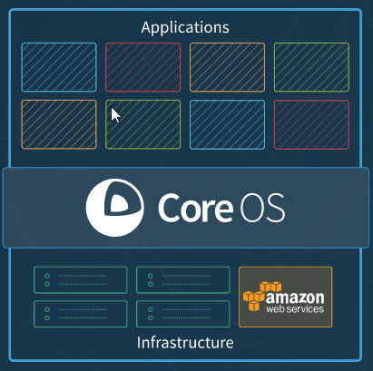
Platform - CoreOS
Built for containers
Built for cloud
Automated
Secure
Lean
Docker and rkt ready
Preconfigured
Notes:
https://coreos.com/why/

Slide 22
Oracle RAC in Docker
Host preparation
Platform
Storage
Image preparation
IPs and DNS
Virtual Networks
Storage
OS
Clusterware and database binaries
Containers
Volumes
Shared memory
Networking
Communication
Grid infrastructure configuration
Notes:
https://github.com/Seth-Miller/12c-rac-docker

Slide 23
Cloud Config
#cloud-config
ssh_authorized_keys:
- ssh-rsa AAAAB3NzaC1yc2EAAAABJQAAA...
coreos:
units:
- name: docker.service
drop-ins:
- name: 10.docker_opts.conf
content: |
[Service]
Environment="DOCKER_OPTS=--storage-driver=devicemapper \
--storage-opt=dm.thinpooldev=/dev/mapper/docker-thinpool \
--storage-opt=dm.use_deferred_removal=true\
--storage-opt=dm.basesize=25G"
Notes:
https://github.com/coreos/coreos-cloudinit/blob/master/Documentation/cloud-config.md
https://github.com/Seth-Miller/12c-rac-docker/blob/master/COREOS.md
https://github.com/Seth-Miller/12c-rac-docker/blob/master/cloud-config

Slide 24
Storage
ext4 + overlayfs (previously Btrfs) by default
Changed to xfs + direct-lvm devicemapper storage
Uses LVM2 and thin pools
Configured on first boot with cloud config and systemd
core@mycoreos ~ $ docker info
…
Storage Driver: devicemapper
Pool Name: docker-thinpool
Pool Blocksize: 524.3 kB
Base Device Size: 26.84 GB
Backing Filesystem: xfs
…
Notes:
https://coreos.com/releases/#561.0.0
https://lwn.net/Articles/627232/

Slide 25
Storage
Additional storage
Grid infrastructure and database binaries
Uses LVM2 and ext4 filesystems
ASM disk devices
Configured on first boot with cloud config and systemd
NAME SIZE TYPE MOUNTPOINT
sdc 100G disk
|-data-oracledata 30G lvm /oracledata
sdd 16G disk
sde 16G disk
sdf 16G disk
Notes:
lsblk | awk '{printf "%-20s %-5s %-5s %s\n", $1, $4, $6, $7}'

Slide 26
Oracle RAC in Docker
Host preparation
Platform
Storage
Image preparation
IPs and DNS
Virtual Networks
Storage
OS
Clusterware and database binaries
Containers
Volumes
Shared memory
Networking
Communication
Grid infrastructure configuration
Notes:
https://github.com/Seth-Miller/12c-rac-docker

Slide 27
DNS and DHCP
BIND container for DNS
DHCPD container for DHCP
Dynamic DNS updates
Only bind and dhcpd containers receive static IPs
core@mycoreos ~ $ dig example.com. @10.10.10.10 axfr
example.com. 86400 IN SOA example.com. root.example.com. example.com. 86400 IN NS localhost.
rac1.example.com. 3600 IN A 10.10.10.134
rac2.example.com. 3600 IN A 10.10.10.135
...
Notes:
https://github.com/Seth-Miller/12c-rac-docker/tree/master/Dockerfile-bind
https://github.com/Seth-Miller/12c-rac-docker/blob/master/dhcpd.conf

Slide 28
Virtual Networks
docker network create --subnet=10.10.10.0/24 pub
docker network create --subnet=11.11.11.0/24 priv

Slide 29
Image Preparation
Install packages
Create OS users and groups
Change OS user passwords
Modify security limits
Add udev rules for ASM disks
$ docker exec rac1 ls -l /dev/sd[d-f]
brw-rw----. 1 root oinstall 8, 48 Oct 17 16:49 /dev/sdd
brw-rw----. 1 root oinstall 8, 64 Oct 17 16:49 /dev/sde
brw-rw----. 1 root oinstall 8, 80 Oct 17 16:49 /dev/sdf
$ docker exec rac1 ls -ld /dev/asmdisks/
drwxr-xr-x. 2 root root 100 Oct 17 16:49 /dev/asmdisks/
$ docker exec rac1 ls -l /dev/asmdisks/
total 0
lrwxrwxrwx. 1 root root 6 Oct 17 16:49 asm-clu-121-DATA-disk1 -> ../sdd
lrwxrwxrwx. 1 root root 6 Oct 17 16:49 asm-clu-121-DATA-disk2 -> ../sde
lrwxrwxrwx. 1 root root 6 Oct 17 16:49 asm-clu-121-DATA-disk3 -> ../sdf
Notes:
https://github.com/Seth-Miller/12c-rac-docker/tree/master/Dockerfile-racnode
https://github.com/Seth-Miller/12c-rac-docker/blob/master/99-asm-disks.rules

Slide 30
Image Preparation
Install grid infrastructure binaries
Install database binaries
Commit container to a new image

Slide 31
Oracle RAC in Docker
Host preparation
Platform
Storage
Image preparation
IPs and DNS
Virtual Networks
Storage
OS
Clusterware and database binaries
Containers
DNS & DHCPD
Volumes
Shared memory
Networking
Communication
Grid infrastructure configuration
Notes:
https://github.com/Seth-Miller/12c-rac-docker

Slide 32
Containers
Create the BIND container
docker create \
--interactive \
--tty \
--name bind \
--hostname bind \
--publish 53:53/tcp \
--publish 53:53/udp \
--volume /srv/docker/bind:/data \
--env WEBMIN_ENABLED=false \
sethmiller/bind \
-4
docker network connect \
--ip 10.10.10.10 pub \
bind
docker start bind
Notes:
https://github.com/Seth-Miller/12c-rac-docker/tree/master/Dockerfile-bind

Slide 33
Containers
docker create \
--interactive \
--tty \
--name dhcpd \
--hostname dhcpd \
--volume /srv/docker/dhcpd:/data \
--volume /srv/docker/bind/bind/etc:/keys \
--dns 10.10.10.10 \
networkboot/dhcpd
docker network connect --ip 10.10.10.11 pub dhcpd
docker network connect --ip 11.11.11.11 priv dhcpd
docker start dhcpd
Create the DHCPD container

Slide 34
Containers
Create the RAC node container
docker run \
--detach \
--privileged \
--name rac1 \
--hostname rac1 \
--volume /oracledata/stage:/stage \
--volume /sys/fs/cgroup:/sys/fs/cgroup:ro \
--dns 10.10.10.10 \
--shm-size 2048m \
giinstalled \
/usr/lib/systemd/systemd --system --unit=multi-user.target

Slide 35
Docker Networks
$ docker network ls
NETWORK ID NAME DRIVER
4ee6f9eb3bf0 bridge bridge
8bc52205f018 host host
eb82d0dad5c6 none null
60e3892778b4 priv bridge
21319f974244 pub bridge
Notes:
https://opsbot.com/advanced-docker-networking-pipework
https://github.com/jpetazzo/pipework

Slide 36
Containers
Add the additional virtual network adapters
Legend
Host level
Container level
ip link add name rac1-pub type veth peer name eth-pub
ip link set rac1-pub master <docker ‘pub’ network>
ip link set rac1-pub up
ip link set eth-pub netns <rac1 namespace PID>
ip netns exec <rac1 namespace PID> ip link set eth-pub up
ip link add name rac1-priv type veth peer name eth-priv
ip link set rac1-priv master <docker ‘priv’ network>
ip link set rac1-priv up
ip link set eth-priv netns <rac1 namespace PID>
ip netns exec <rac1 namespace PID> ip link set eth-priv up
Notes:
https://github.com/Seth-Miller/12c-rac-docker/blob/master/networks-rac1.sh

Slide 37
Containers
Create dhcp systemd services
[Service]
ExecStart=dhclient -d -H rac1 \
-pf /var/run/dhclient-eth-pub.pid eth-pub
ExecStop=dhclient -x eth-pub
[Service]
ExecStart=dhclient -d -H rac1-priv \
-pf /var/run/dhclient-eth-priv.pid eth-priv
ExecStop=dhclient -x eth-priv
Notes:
https://github.com/Seth-Miller/12c-rac-docker/blob/master/dhclient-rac1-eth-pub.service
https://github.com/Seth-Miller/12c-rac-docker/blob/master/dhclient-rac1-eth-priv.service

Slide 38
Containers
Start dhcp systemd services
docker exec rac1 systemctl start dhclient-rac1-eth-pub.service
docker exec rac1 systemctl start dhclient-rac1-eth-priv.service
Notes:
https://github.com/Seth-Miller/12c-rac-docker/blob/master/networks-rac1.sh

Slide 39
Containers
Create the second RAC node container
docker run \
--detach \
--privileged \
--name rac2 \
--hostname rac2 \
--volume /oracledata/stage:/stage \
--volume /sys/fs/cgroup:/sys/fs/cgroup:ro \
--dns 10.10.10.10 \
--shm-size 2048m \
giinstalled \
/usr/lib/systemd/systemd --system --unit=multi-user.target
sudo /srv/docker/scripts/networks-rac2.sh
Notes:
https://github.com/Seth-Miller/12c-rac-docker/blob/master/dhclient-rac2-eth-pub.service
https://github.com/Seth-Miller/12c-rac-docker/blob/master/dhclient-rac2-eth-priv.service
https://github.com/Seth-Miller/12c-rac-docker/blob/master/networks-rac2.sh

Slide 40
Containers - ./fixssh.sh rac1 rac2
Copies host keys
Copies root, oracle and grid SSH shared keys
Allows root, oracle and grid to SSH between hosts without passwords
Notes:
https://github.com/Seth-Miller/12c-rac-docker/blob/master/fixssh.sh

Slide 41
Configure Grid Infrastructure
Establish cluster communication
Start clusterware processes
Set up GNS
Assign IPs
Set up ASM and create first disk group
Set up SCAN and local listeners
Set up Grid Infrastructure Management Repository (GIMR) (optional)

Slide 42
Create Database
docker exec rac1 su - oracle -c ' \
/u01/app/oracle/product/12.1.0/dbhome_1/bin/dbca -createDatabase -silent \
-templateName General_Purpose.dbc \
-gdbName orcl \
-sysPassword <sys password> \
-systemPassword <system password> \
-storageType ASM \
-diskGroupName DATA \
-recoveryGroupName DATA \
-characterSet AL32UTF8 \
-nationalCharacterSet UTF8 \
-totalMemory 1024 \
-emConfiguration none \
-nodelist rac1,rac2 \
-createAsContainerDatabase True'

Slide 43
Future Plans
Fully Automated
Kubernetes
Support NFS files for ASM (ganesha NFS)
Run RAC nodes non-privileged
Lean out RAC node images
Install fests (RAC Attack)

Slide 44

github.com/Seth-Miller/12c-rac-docker
Seth Miller
sethmiller.sm@gmail.com

