Slide 1

Predictive Analysis of Customer Churn: A Data-Driven Retention Strategy
Group 5(Yupeng Ji, Khondoker Shaan Muhammad, Kinley Rabgay Penjor, Lawrence Paglinawan, Rojin Saru)
2026/04/14

Slide 2
Outline
01. Introduction
02. Background (The Dataset & Problem)
03. Exploratory Data Analysis (EDA)
04. Methodology (Preprocessing & Feature Selection)
05. Implementation (Modeling Approach)
06. Results and Evaluations
07. Business Strategy & Recommendations
08. Conclusions & Future Steps

Slide 3

Introduction
The Challenge: Telecommunications companies face significant revenue loss due to customer churn.
The Goal: Develop a predictive machine learning model to identify high-risk customers before they leave.
The Approach: Utilize historical customer data to uncover churning behaviors and design a proactive, data-driven retention strategy.
Leave
Stay

Slide 4
Background - The Dataset
Dataset Overview: Telco Customer Churn
Size
7,043 rows and 21 initial columns
Target Variable
Churn (Binary: Yes/No)
Feature Categories
Customer Demographics
Seniority, Partner, Dependents
Account Information
Contract type, Payment Method, Tenure, Charges
Services Subscribed
Internet Service, Streaming TV/Movies, Tech Support, Security

Slide 5

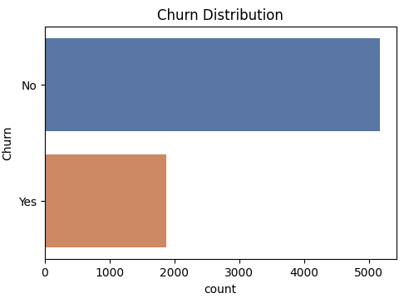
Exploratory Data Analysis (EDA) - Target Imbalance
Class Imbalance & Mitigation
Problem Identification The dataset shows a 3:1 imbalance favoring 'No Churn'.
Consequence Standard models will bias toward the majority class.
Proposed Solution Oversampling the minority class to achieve training parity.
Churn Class Distribution
countplot visualizing 'Yes' vs 'No' churn.

Slide 6
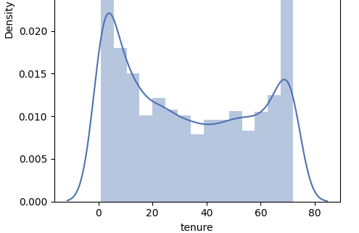
Exploratory Data Analysis (EDA) - Key Drivers
Highest churn is concentrated in specific customer segments:
Contracts
Month-to-Month contracts churn significantly more than 1 or 2-year contracts.
Tenure Distribution (Churn Drivers)
Services
Fiber Optic internet users churn more than DSL users. Customers without Tech Support, Online Security, or Device Protection are highly vulnerable.
Tenure & Pricing
Critical drop-off occurs within the first 1-5 months, particularly for customers charged $65-$105 monthly.
Density plot showing high churn risk in early months.

Slide 7
Methodology - Preprocessing & Selection
Data Preparation
Cleaning: Dropped 11 missing records in TotalCharges and converted to numeric. Outliers addressed using IQR method.
Feature Selection: Conducted Chi-Square tests to determine statistical significance for categorical variables.
Dimension Reduction
Logic: Features with p-values > 0.05 were entirely removed as they do not statistically influence churn.
Dropped: PhoneService (p=0.35) and gender (p=0.49).
Chi-Square Feature Significance (p-value)
Contract
OnlineSecurity
TechSupport
InternetService
PaymentMethod
OnlineBackup
DeviceProtection
StreamingMovies
StreamingTV
PaperlessBilling
Dependents
SeniorCitizen
Partner
MultipleLines
PhoneService
gender
P-value > 0.05 Threshold
(Statistically Insignificant)

Slide 8
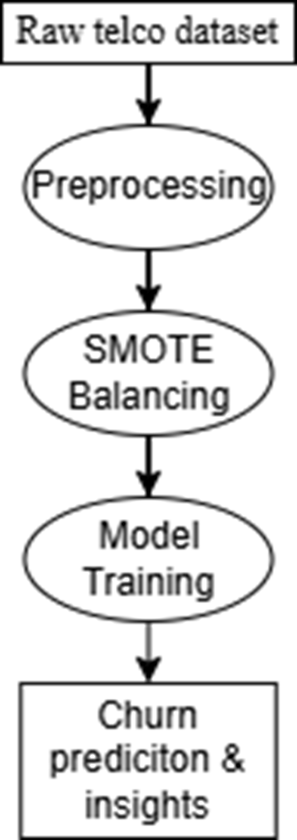
Methodology - Handling Imbalanced Data (SMOTE)
Data Leakage Prevention
Data Leakage Prevention: The dataset was split into Training (80%) and Testing (20%) sets before applying any sampling techniques.
SMOTE Implementation
Applied Synthetic Minority Over-sampling Technique (SMOTE) strictly on the training set only.
Impact
This greatly improved the model's ability to identify actual churners (our main KPI), with only a slight reduction in overall precision.

Slide 9
Implementation - Machine Learning Models
Predictive modeling task: Binary Classification (1 = Churn, 0 = No Churn)
Random Forest
Utilized as a robust baseline for comparison.
LightGBM
Gradient Boosting framework with high performance emphasis.
XGBoost
Boosting model used for strong overall classification performance.
SVC
Support Vector Classifier for high-dimensional data.
Hyperparameter Fine-tuning (SVC)
Conducted using GridSearchCV and Stratified K-Fold cross-validation.
Optimal Parameters:
C = 10 | gamma = 0.01 | kernel = rbf

Slide 10

Results and Evaluations
SVC (Chosen Final Model)
ROC-AUC Score: 82.51%
Overall Accuracy: 73.35%
Recall for Churn: 77%
Random Forest Baseline
ROC-AUC Score: 80.59%
Overall Accuracy: 76.69%
Recall for Churn: 57%
Although XGBoost had the highest ROC-AUC, SVC was chosen because it detected more real churners. Its 77% churn recall made it more useful for retention.

Slide 11
Business Strategy & Recommendations
Focus more on customers with month-to-month contracts These customers are more likely to leave, so the company should pay more attention to them.
Pay attention to customers in their first 1–5 months Many customers leave early, so the company should support them from the beginning.
Encourage services like Tech Support and Online Security Customers without these services were more likely to churn, so offering them may help customers stay.
Use the model to find risky customers early The model can help the company find customers who may leave, so the company can act before they churn.

Slide 12
Future Improvements & Next Steps
Model Enhancements
Implement Ensemble Stacking to leverage the combined strengths of SVC, XGBoost, and LightGBM.
Data Expansion
Utilize unstructured, reactive data sources such as customer service logs and direct complaints.
Retraining Caution
If a predicted churner is "saved" by our strategy, they will carry the characteristics of a churner but will have a "No Churn" label. This data contamination must be addressed when retraining the model in the future.

Slide 13
Thank You

