Slide 1

Mini-Project Presentation T.E. (Computer) Sem - VI
 | Agnel Charitie’s Fr.C.Rodrigues Institute of Technology, Vashi Computer Engineering Department
2022-23

Slide 2
KanBan Board Website
Group members:
Lawrence Rodriques
Rajdeep Sharma
Tanmay Singh
1020238
1020244
1020250

Slide 3
Presentation Outline
Abstract
Introduction
Literature survey
Existing Systems
Proposed System
Scope, Hardware & Software Requirements
Design
Implementation
Future Scope &Conclusion
References

Slide 4
ABSTRACT
The workflow of a project plays a very crucial role in the development of a project. We aim to create a user-friendly website that utilizes the Kanban board to manage ongoing projects. The website will visually represent work, enabling teams to track projects and tasks, identify inefficiencies, and workflow issues. The website will be having login and sign-in system with use of popular platforms such as Google and GitHub, with an advanced authentication system for security and privacy. Work items will be represented as rows and columns, with each column depicting a stage of the work process. Tasks can be easily moved using the drag and drop feature. Columns can be as simple as “To-Do”, “In-progress”, “Testing”, “Done”. Our website's interface will be designed to be user-friendly, allowing users to quickly add, delete, and edit tasks on the Kanban board. Additionally, our project will include a dashboard for scheduling meetings and an administration panel for managing users and projects. Our Kanban board, dashboard, and administration panel will provide users with a comprehensive set of tools for managing workflow, ensuring that projects are completed on time and within budget. Furthermore, our website will be designed with responsiveness in mind, ensuring that it can be easily accessed and used on both desktop and mobile devices. This will enable users to manage their workflow and stay up-to-date on project progress even when on the go.

Slide 5
INTRODUCTION
Background:
Kanban is a widely adopted framework for software development, known for its emphasis on real-time communication of capacity and full transparency of work. In this framework, work items are visually represented on a kanban board, enabling team members to easily monitor the status of every task. While kanban has become a staple for agile and DevOps software teams, the methodology of work has been in practice for over 50 years. In the late 1940s, Toyota began optimizing its engineering processes based on the same model used by supermarkets to stock their shelves. While the fundamental principles of the framework are timeless and applicable to almost any industry, software development teams have achieved remarkable success with the agile practice. Unlike physical implementations of kanban in a factory setting, which often involve substantial changes to existing processes and the addition of materials, software teams only require a virtual board and cards to adopt the framework.

Slide 6
INTRODUCTION
Motivation:
The reason we decided to work on this project is because we were recently introduced to the concept of Kanban and in piqued our interest. However, we thought that the scope of this Kanban method was extremely limited, because of its physical nature. We thought that instead of using physical Kanban boards, we could make a website to make it accessible digitally from multiple platforms. This would make collaborating on larger projects easier, making it such that even several people living in different places could work on the same project without hassle. This will increase efficiency and hence complement the working of the Kanban model.

Slide 7
INTRODUCTION
Aim & Objective:
The primary aim of this project is to develop a user-friendly and interactive website that utilizes the Kanban board to manage and control workflow for ongoing projects. The website will provide a visual representation of work, helping users gain a better understanding of their workflow and enabling more efficient organization and management. The objective is to create a platform that can accommodate different teams, projects, and tasks, allowing for easy collaboration and communication. Additionally, the website will incorporate a login and sign-in system through popular platforms such as Google and GitHub, as well as an advanced authentication system for security and privacy.
Another objective is to create a user-friendly website that utilizes the Kanban board to manage ongoing projects, providing users with a powerful tool for managing and organizing workflow.

Slide 8
LITERATURE SURVEY TABLE
Sr. No | Paper Name | Advantages | Disadvantages
1. | Software Project Management Systems Using Kanban Method in the CV. Primavisi Globalindo System. | -Increased collaboration and communication. -Streamlined project delivery. -Increased productivity and efficiency. | -Limited scalability -Lack of standardization. -Difficulty in managing complex projects.
2. | Implementing Scrum and Kanban Approaches for E-Commerce Web Application: An Agile Framework. | -Increased collaboration and flexibility. -Continuous improvement. -Enhanced Quality. | -Lack of structure. -Team Member availability. -Lack of documentation.
3. | Utilizing of the Trello API Within the Development of a Monitoring Information System Recording of Project Activities Using a Website-Based Kanban System | -Automation. -Integration. -Customization. -Scalability. -Collaboration. | -Complexity. -Limited. Functionality. -Cost. -Dependencies on third party applications.
4. | Lean Manufacturing Case Study with Kanban System Implementation | -creates a pull system to reduce excess inventory. -improves communication and coordination. | -difficult to manage and maintain.

Slide 9
EXISTING SYSTEM
Jira Software:
It provides your team with a project overview and ready-to-use work flows that are also customizable and repeatable for future similar projects. It also facilitates smooth project management.
Drawback: There is no timeline to track the project and user interface of Jira software is also very complicated. Even, Jira does not provide the collaboration features to communicate with team.
Stack field:
It allows custom workflows and collaboration feature among team members and information is also end-to-end encrypted.
Drawback: There is no third-party integrations with the popular communication applications.

Slide 10
EXISTING SYSTEM
WeKan:
It has built-in rules which allows you to set up triggers when taking actions on cards, checklists, and labels.
Drawback: There are only limited features. UI aren’t as aesthetic as of competitors. An unattractive or poorly designed UI can impact the user experience, making it difficult for users to navigate or understand the software. This can lead to frustration and lower adoption rates.
Asana:
It has very good UI and communication platform for team members. It can share project status with clients and easy to use on desktop and mobile.
Drawback: It is not user friendly to create project and cannot assign task to multiple people and cannot create private projects.

Slide 11
PROPOSED SYSTEM
The proposed system is a KanBan Board Website aimed at addressing the challenge of managing workflow effectively in software development projects. The current manual approach of using physical Kanban boards limits collaboration and communication among team members, resulting in delays and errors. Our project seeks to create a digital Kanban board that enhances project management by providing a visual representation of tasks, enabling team members to collaborate in real-time and track progress. The Kanban board will be divided into columns representing different stages of the product development process, and tasks will move through the columns until they are completed. Our system will include a date section for task completion and a drag-and-drop feature to facilitate task movement.
Our proposed system will have following advantages:
User friendly interface
Drag and Drop feature
Database Connectivity

Slide 12
SCOPE
Scope:
We can use this website to manage the workflow of the project. To assign task to the team members and view daily progress of the project.
Using Kanban board managing the workflow of the project can be done easily with better user interface.
To track the progress of the project.

Slide 13
HARDWARE REQUIREMENTS
Hardware Requirements:
A PC with Intel i3/i5 Processor with 4GB Ram and 256GB Storage
Windows XP, Windows 7 (32/64 bit) or higher.
10 GB available space on the hard disk

Slide 14
SOFTWARE REQUIREMENTS
Software Requirements:
React v 18.0
Redux v 4.2.0 with DirectX: Version 10
Tailwind CSS, DaisyUI
Firebase, Auth
React testing library v 13.4.0
Visual Studio Code IDE (1.61.1)

Slide 15
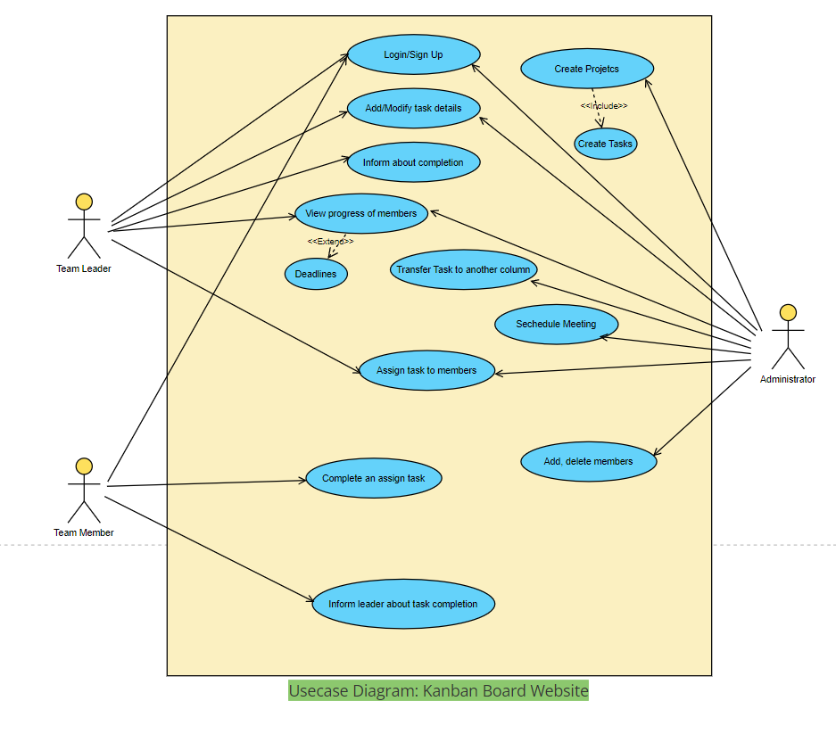
DESIGN
Use case diagram:

Slide 16
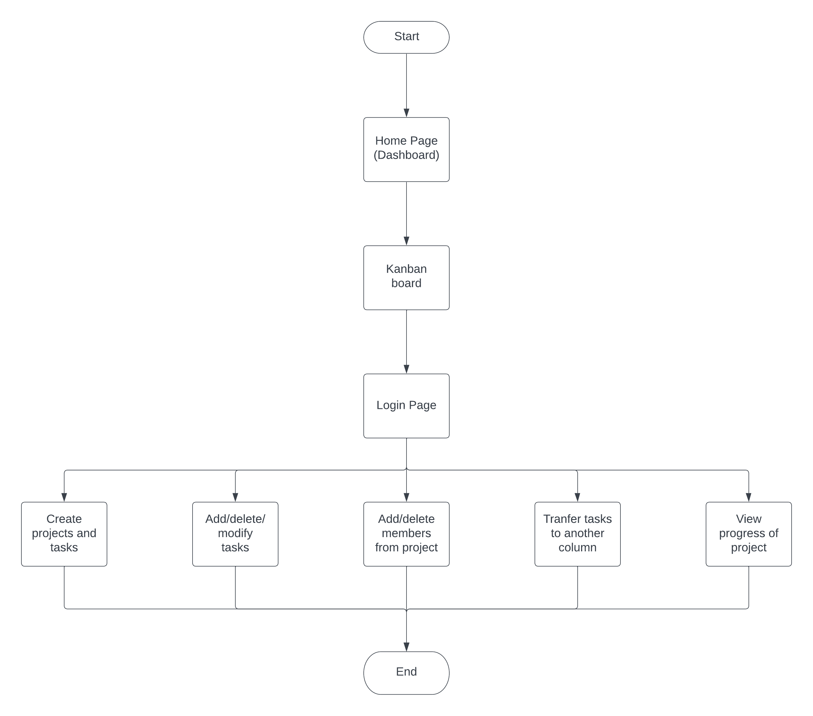
DESIGN
Flow Chart:

Slide 17
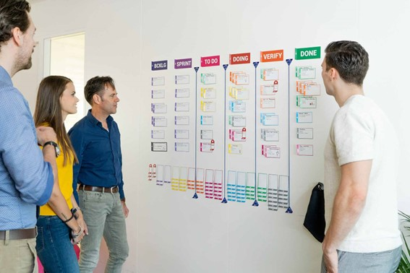
IMPLEMENTATION

Slide 18
IMPLEMENTATION
Website Link:
https://kanban-board-394d7.web.app/

Slide 19
FUTURE SCOPE
Future Scope:
In the future, the website could be enhanced with additional features such as integration with third-party project management tools, analytics and reporting, and chat/messaging functionality. The website could be linked with the user’s GitHub account’s so assigning tasks to the user is easy, we just have to enter user GitHub account name to assign him task. Create user roles like admin and members.

Slide 20
CONCLUSION
Conclusion:
In conclusion, the proposed Kanban board website is a valuable tool for managing projects and tasks efficiently. By providing an easy-to-use interface and enabling effective collaboration among members, the website helps to improve productivity and ensure timely completion of projects. The website's comprehensive dashboard makes it an ideal choice for project of all sizes.

Slide 21
REFERENCES
[1] Muhammad Aliyya Ilmi, Fajar Pradana, Widhy Hayuhardhika Nugraha Putra “Software Project Management Systems Using Kanban Method in the CV. Primavisi Globalindo System”, ResearchGate, 2020.
[2] P. Sahithi, M. Pradeep Kumar “Implementing Scrum and Kanban Approaches for E-Commerce Web Application: An Agile Framework”, ResearchGate, 2021.
[3] Rayhan Alya Chaerul, Widhy Hayuhardhika Nugraha Putra, Buce Trias Hanggara “Utilizing of the Trello API Within the Development of a Monitoring Information System Recording of Project Activities Using a Website-Based Kanban System”, JITeCS, 2021.
[4] Nor Azian Abdul Rahman, Sariwati Mohd Sharif, Mashitah Mohamed Esa “Lean Manufacturing Case Study with Kanban System Implementation”, ScienceDirect, 2013.
[5] https://www.atlassian.com/software/jira
[6] https://www.stackfield.com/
[7] https://wekan.github.io/
[8] https://www.asana.com/
[9] https://www.bocasay.com/kanban-method-it-development-projects/
[10] https://kanbanflow.com/

Slide 22
Thank You!

