Slide 1


Surveillance System with Human Intrusion Detection
 | Agnel Charities’ Fr. C. Rodrigues Institute of Technology, Vashi, Navi-Mumbai Department of Computer Engineering
Lawrence Rodriques 1020238
Swati Padmanabhan 1020266
Sumit Prasad 1020267
Neha Auti 1020268

Slide 2
Outline
Problem Statement
Introduction
Project Idea
Literature Survey
Existing Systems
Design
Hardware and Software Requirements
Implementation
Conclusion

Slide 3
Problem Statement:
Traditional CCTV surveillance systems in private spaces, notably warehouses, encounter significant obstacles in effective monitoring and security due to their dependence on human operators for footage analysis. The manual nature of this approach leads to time-consuming and less reliable processes, exacerbating the difficulty of distinguishing between authorized and unauthorized individuals and detecting potential intruders. With an increasing demand for more advanced security solutions, there is an urgent need to address these limitations. Our project focuses on enhancing CCTV systems by introducing real-time face recognition-based surveillance, utilizing machine learning and advanced technologies. The specific aim is to automate recognition processes, providing a timely and accurate identification of individuals, and promptly notifying security personnel of any unauthorized access.

Slide 4
Introduction
Background:
Security concerns in confidential or restricted areas are of paramount importance as they involve protecting sensitive information, assets, and personnel from unauthorized access, theft, sabotage, or espionage. These areas may include government facilities, corporate offices, research labs, financial institutions, and data centers, among others. In some areas like government or nuclear facilities, every department requires unique protocols for accessing, only a particular set of authorized persons should have entry, and in other cases, entry of every person into the particular department should be monitored. The state of surveillance cameras today has shown that there is still a great deal of potential for development in the fundamental ways that they work. Security cameras have always been employed as a monitoring system, even if they have never been used as an intrusion detecting and warning system.
Motivation:
To addresses critical security concerns in restricted areas by introducing a real-time face recognition-based surveillance system. Traditional security systems often struggle to authenticate individuals, leaving valuable assets vulnerable. Unlike unmonitored CCTVs, this system employs advanced face detection and recognition algorithms to promptly identify intruders. The timely alert mechanism, utilizing various communication channels, ensures a swift response from designated authorities.

Slide 5
Project Idea:
Our project focuses on enhancing CCTV systems by incorporating real-time face recognition-based surveillance. By leveraging the ArcFace algorithm for accurate face recognition and SCRFD for efficient face detection, the system aims to automate recognition processes. The primary goal is to develop an advanced system capable of autonomously detecting unauthorized human presence within predefined zones. This initiative aims to provide early alerts to administrators and security professionals, enabling prompt responses to potential security breaches. The proactive approach ensures the safety and integrity of restricted areas, contributing to an overall improvement in the safety and security of these spaces. The system will promptly notify security personnel through email/messages and calls upon detecting an intruder, significantly improving the efficiency and reliability of security measures in private spaces.

Slide 6
Objectives:
Establish a Dynamic Surveillance Platform: Develop an online platform that seamlessly integrates surveillance cameras with advanced machine learning algorithms. This platform will enable real-time analysis of CCTV footage, differentiating between routine activities and potential security threats.
Reduction of False Alarms: Integrate sophisticated image processing and machine learning algorithms to significantly reduce false alarms, allowing security personnel to concentrate on genuine security threats and critical events, thereby optimizing resource allocation and response effectiveness.
Real-time Detection and Immediate Response: Implement a system that delivers real-time detection of human intrusions and initiates immediate responses upon detection. The system will promptly alert security personnel and administrators through various channels, including email, messaging services, and direct phone calls, ensuring rapid reactions to potential security breaches.
Face Recognition API: Develop a versatile Face Recognition API with the objective of providing a scalable and interoperable solution, seamlessly integrable into multiple systems. The API aims to offer reliable and efficient facial recognition capabilities, enhancing security and user identification across diverse applications and platforms.

Slide 7
Literature Survey
Sr No. | Research Paper | Author | Technology Used | Advantage | Drawback
01 | CCTV Intelligent Surveillance on Intruder Detection | Arun Francis | Deep Learning | Rule-based notification system for predicting movements of intruders and kids at home predicts child’s movements before something goes wrong, and watch for suspicious behaviors. Detect the face within 20 meters distance. | The model works only in the day time it is doesn't detect intruders at night.

Slide 8
Literature Survey
Sr No. | Research Paper | Author | Technology Used | Advantage | Drawback
02 | Cloud Based Intruder Security System | Kajenthani Kanthaseelan ,Kavinga Yapa Abeywardena | Deep Learning | Leveraging the power of Convolutional Neural Networks (CNNs) and Deep Learning, the system transcends traditional security measures by providing real-time recognition and analysis of semantic objects in digital images and videos. | The research paper presents a compelling and forward-looking security system,it is important to recognize potential difficulties that may occur during implementation. The difficulty of integrating diverse technical elements, such as Cloud services, embedded systems, and IoT devices, is one major worry.

Slide 9
Literature Survey
Sr No. | Research Paper | Author | Technology Used | Advantage | Drawback
03 | IoT Based Human Intrusion Detection System using Lab View | Kalathiripi Rambabu | Computer Vision and Deep learning | It presents a sophisticated solution to the escalating concern of thefts and intrusions by introducing an innovative home intruder detection system. | Scaling up the system while maintaining its accuracy and responsiveness could pose challenges in terms of hardware requirements.

Slide 10
Literature Survey
Sr No. | Research Paper | Author | Technology Used | Advantage | Drawback
04 | Detection of Unauthorised Person in a Restricted Place using Deep Learning Algorithms | Mayur Said | Deep Learning | This system quickly identifies the presence of smoke, heat, or flames, triggering immediate alerts. Early Warning Provides occupants and emergency responders with crucial time to initiate evacuation or firefighting measures. | Privacy Concerns The use of biometric data, including facial features, raises privacy concerns and ethical considerations regarding the collection and storage of personal information.

Slide 11
Literature Survey
Sr No. | Research Paper | Author | Technology Used | Advantage | Drawback
05 | IoT-based Smart Video Surveillance with Motion Detection and Alert System | Ms.Meghala Murgesh, Mr.A.Gopalakishnan, R.Umamaheswar, M.S.Sabari | Internet of Things (IoT), Smart Security, Video Surveillance, Motion Detection | utilizes Raspberry Pi, USB Camera, Wi-Fi Module, and GSM Module. The system's main functionality includes motion detection, capturing images and videos upon motion detection, sending SMS and Gmail notifications to the user, and uploading snapshots to the cloud (Dropbox) for remote access. | Bandwidth, energy, and latency issues may arise when sending real-time media data. Traditional cloud-based architectures can be costly and have deployment challenges.

Slide 12
Existing Systems:
Intellicon :
Intellicon offers Intrusion Detection solutions which are robust and may also be combined with closed circuit television surveillance systems to automatically record the activities of intruders, and may interface to access control systems for electrically locked doors. Systems range from small, self-contained noisemakers, to complicated, multi-zoned systems with color-coded computer monitor outputs. Systems work without interruption for long periods and under extreme conditions.
Disadvantage:
High Costs of Implementation and Maintenance

Slide 13
Existing Systems:
Hikvision:
Hikvision offers a feature called Intrusion Detection. This feature is part of Hikvision’s AcuSense technology, which uses advanced algorithms and intelligent analytics. The Intrusion Detection feature can detect when a person or vehicle enters a predefined area, such as a restricted zone or a perimeter. It provides an added layer of security by alerting homeowners when there is unauthorized entry or movement in specific areas. Hikvision’s Intrusion Detection system can differentiate between normal movements, such as pets or tree branches swaying, and potential intrusions. This reduces false alarms and increases the system’s accuracy.
Disadvantage:
High Costs of Implementation and Maintenance
Complexity of Setup
Potential for False Alarms

Slide 14
Design

Slide 15
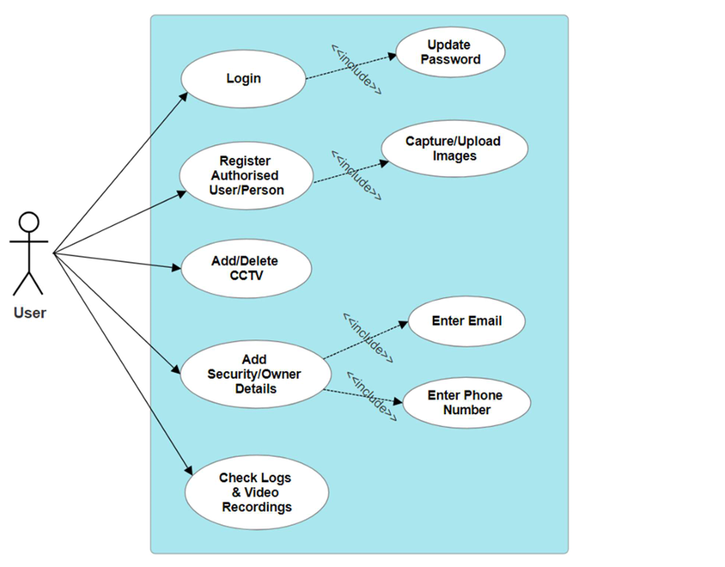
Fig 1: UseCase Diagram

Slide 16
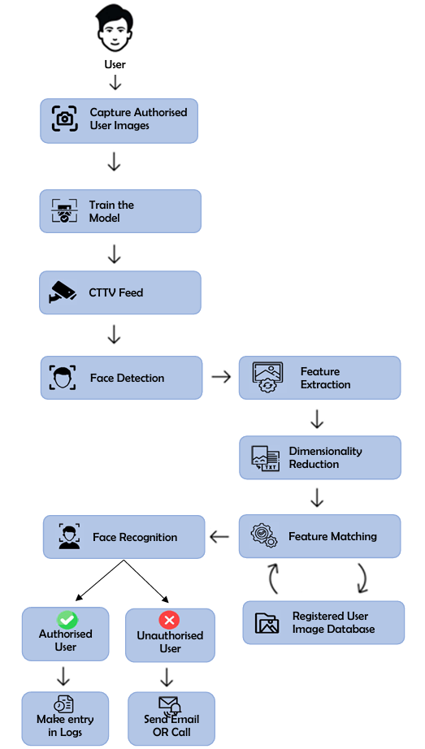
The flow of the flowchart goes like this: -
A CCTV will be used to record the video .
The system will then learn the facial features.
Once it has processed the features, it will try to detect the user’s face..
Once it is done, then the system will go through dimensionality reduction, i.e. it will try to reduce the number of features.
All the authorized person’s facial features will be stored in a database, thus allowing the system to recognize authorized and unauthorized person.
If an unauthorized person is detected, then an email will be sent to the security person.
Notes:
face acquisition - harcascade 1 sec 30 images
MTCNN face detect
face recognition - MTCNN ke saath saath facenet use kar rahe hai

Slide 17
Hardware and Software Requirements:
Hardware Requirements: -
Multi-core CPU or GPU
Memory (RAM): 8 GB or more
Webcam or Camera
Internet connection
Software Requirements: -
Operating System : Linux
Python, Twillo API
Development Frameworks and Libraries:–
Open CV
Flask
PyTorch
Database Management: MySQL
IDE(Integrated Development Environment): Visual Studio Code, PyCharm
Jupyter Notebook for coding and Model Training.

Slide 18
Implementation

Slide 20
Conclusion
The Surveillance System with Human Intrusion Detection project has effectively addressed the limitations of conventional security systems by introducing a real-time face recognition-based surveillance system. Through the utilization of advanced algorithms and the OpenCV Python library, the system ensures robust surveillance in restricted areas. Its distinguishing feature lies in its ability to differentiate between intruders and authorized individuals, thereby significantly enhancing the security and integrity of monitored zones. By integrating SCRFD and YOLO for face detection, complemented by ArcFace for recognition, the system has achieved an impressive accuracy rate surpassing 80-90%. However, it’s imperative to recognize that the accuracy is subject to the quality of the dataset and surveillance camera employed.
Future Scope:
Enhancing Accuracy
Three-Dimensional Surveillance

Slide 21
References
Akula Surya Teja, Ginni Chandra Mohini, Dannana Dhanunjay, Dr. P MManohar, ”Realtime Intrusion Detection System Using Open CV,” Journal of Survey in Fisheries Sciences, Visakhapatnam, India, 2023, pp. 2734-2740.
G. Mallikharjuna Rao, Haseena Palle, Pragna Dasari, Shivani Jannaikode, Dr. P M Manohar, ”Implementation of Low Cost IoT Based Intruder Detection System by Face Recognition using Machine Learning,” Turkish Journal of Computer and Mathematics Education, Vol. 12, No. 13, 2021, pp. 353-362.
K. S. Krishnendu, ”Analysis of Recent Trends in Face Recognition Systems,” 2023, arXiv:2304.11725.
Rehmat Ullah, Hassan Hayat, Afsah Abid Siddiqui, Uzma Abid Siddiqui, Jebran Khan, Farman Ullah, Shoaib Hassan, Laiq Hasan., ”A Real-Time Framework for Human Face Detection and Recognition in CCTV Images,” Mathematical Problems in Engineering, 2022, Hindawi.
Edwin Jose, Greeshma M, Mithun Haridas T. P, ”Face Recognition based Surveillance System Using FaceNet and MTCNN on Jetson TX2,” in Proceedings of the 5th International Conference on Advanced Computing & Communication Systems (ICACCS), 2019.[8] OpenCV Documentation, https://docs.opencv.org

