Slide 1
under_19_sports_countries_Tableau
File created on: 10/20/2019 8:28:45 PM

Slide 2
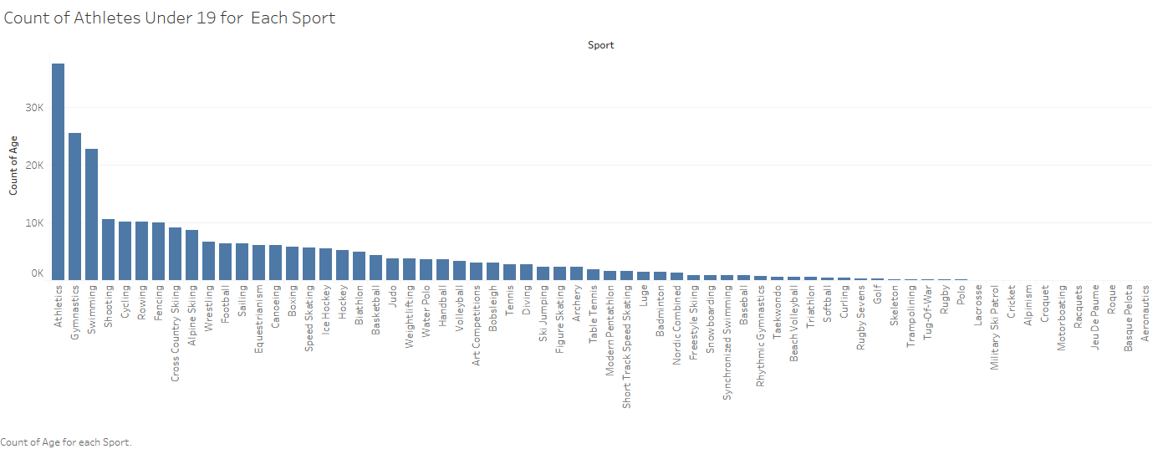

Slide 3
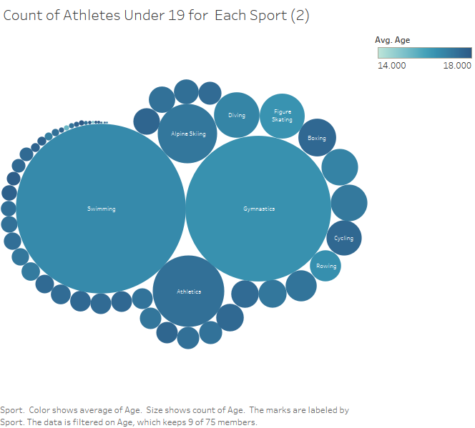

Slide 4
