Slide 1


Slide 2

Project Description
Bookid is mobile application that help the kids to read using smartphone.
Bookid is just like a book but more fordable and easy to access.
If you're not sure which book to pack, Bookid eliminate the need to choose one book over another to carry with you.
Usually the price of story books is 80 pesos why you need to buy a book while this application is completely free.

Slide 3
Overview
There's a whole new way to read your kids to sleep these days or to distract them while you are trying to get something done.
If you have a smartphone, you can use a Bookid app in no time. From short stories, moral stories, poem and animal stories.
Some children are even getting their first exposure to books on a digital device.

Slide 4
Overview
A problem reading books in smartphone is it can cause eye stain and we all know that we don’t want our children to expose their eyes is blue light that’s why we put blue light filter feature in our application so that you can read without hurting your eyes.
Paper books require careful care and maintenance. No matter how valuable a book is, it can still get destroyed by fire, humidity, dust, debris, and pests. Not possible with a digital copy.

Slide 5
Weekly System Progress

Slide 6
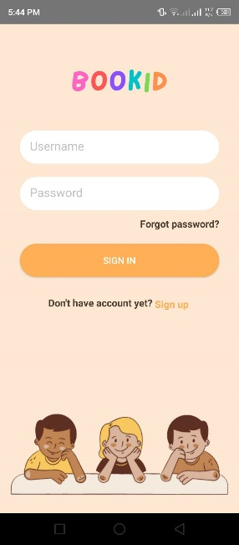
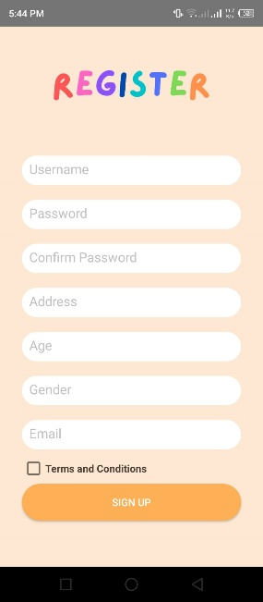
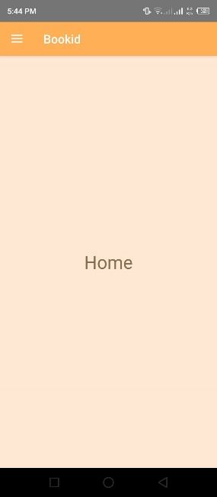
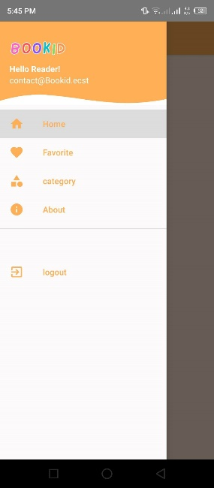
Week 1
FINISHED ACTIVITY: Log in, Sign up or Registration, Home and menu bar.
FRONT-END: (30%)
BACK-END: (10%) intent only

Slide 7
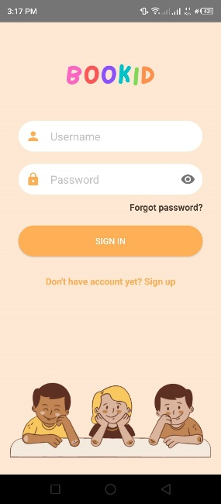
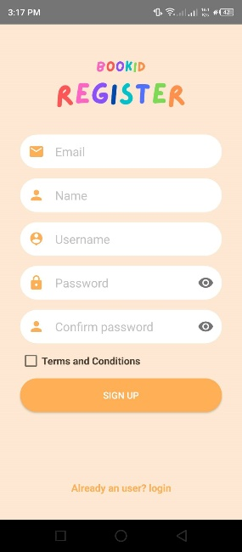
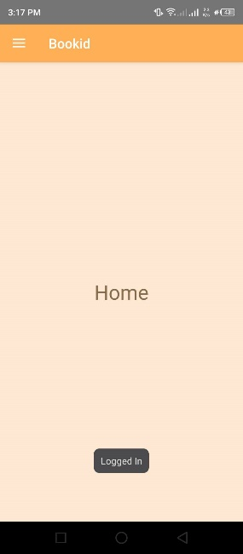
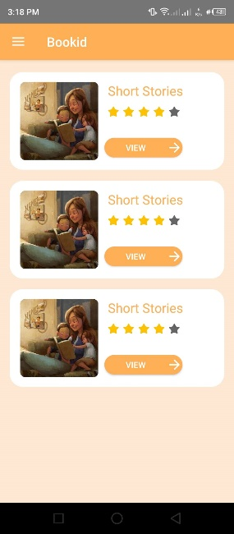
Week 2
FINISHED ACTIVITY: Log in with firebase, Sign up or Registration with firebase, Front end of categories (not complete). Put some icon and show password.
FRONT-END: (50%)

Slide 8
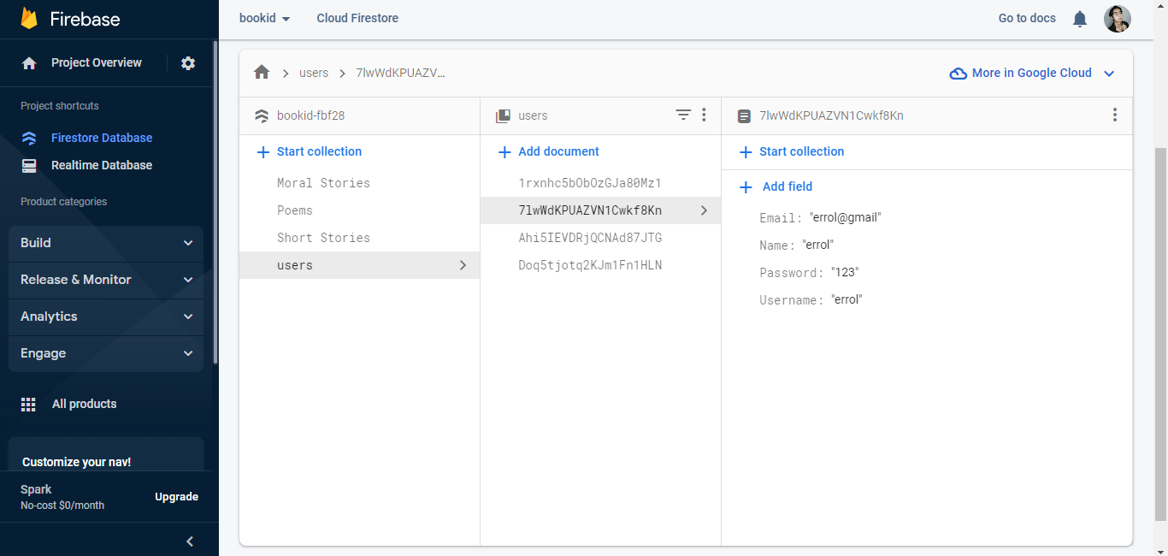
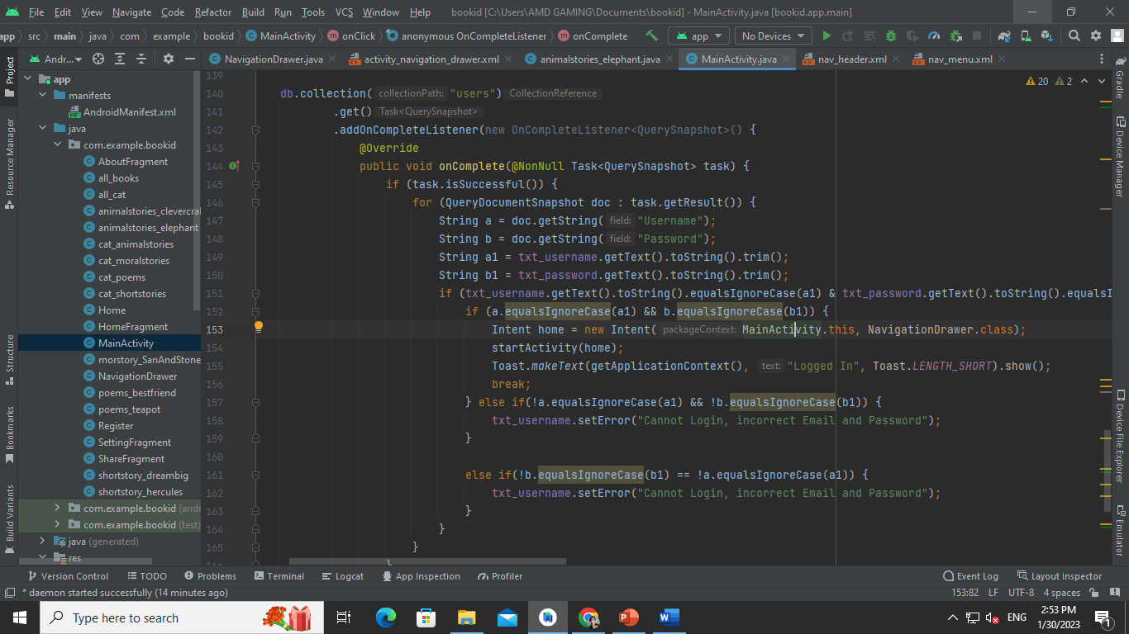
Week 2
FINISHED ACTIVITY: Login is connected to firebase
BACK-END: (30%)

Slide 9
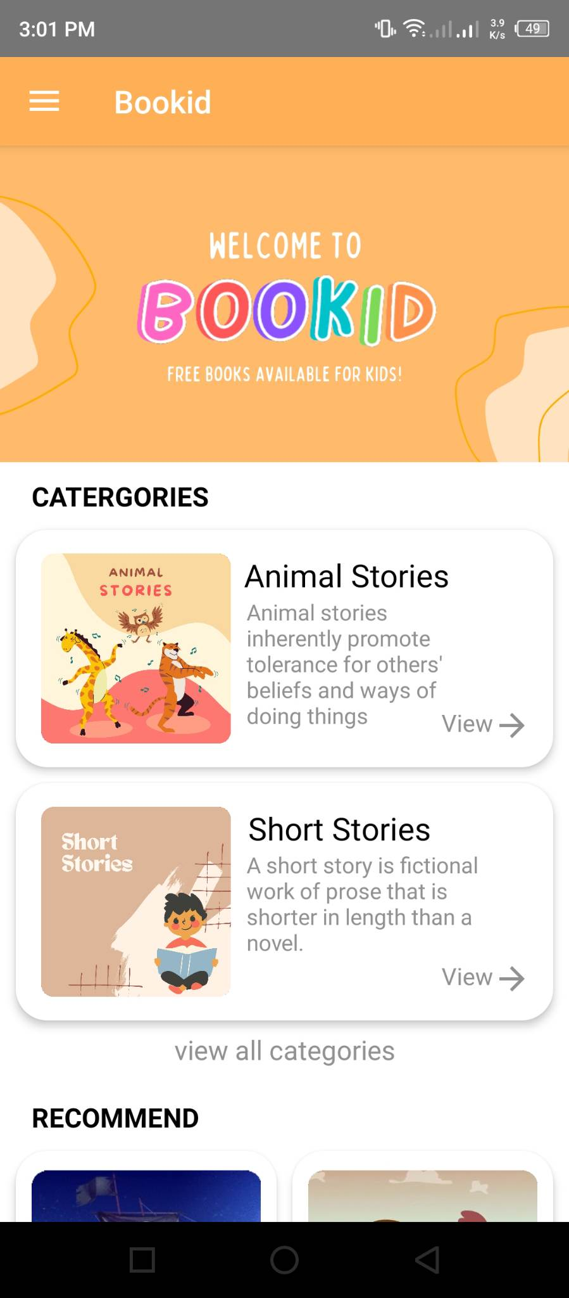
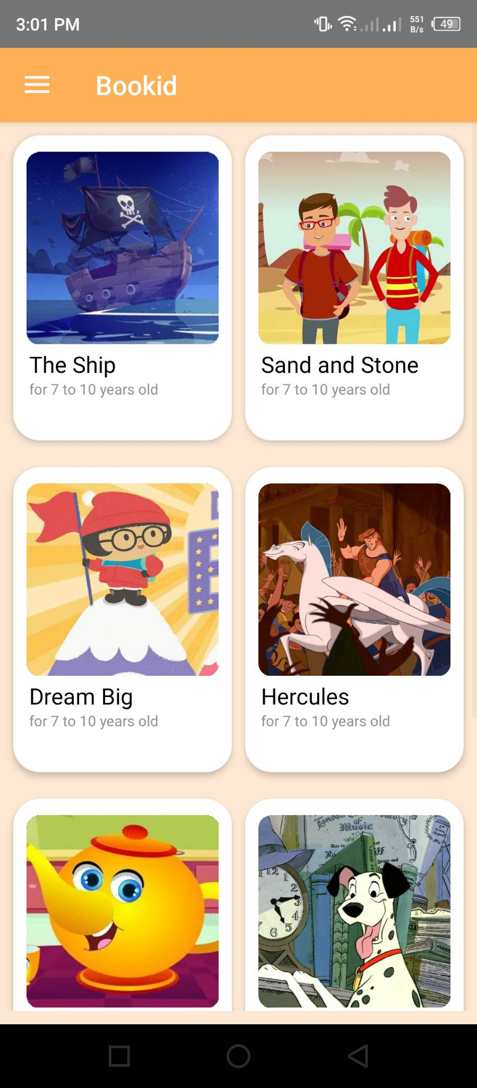
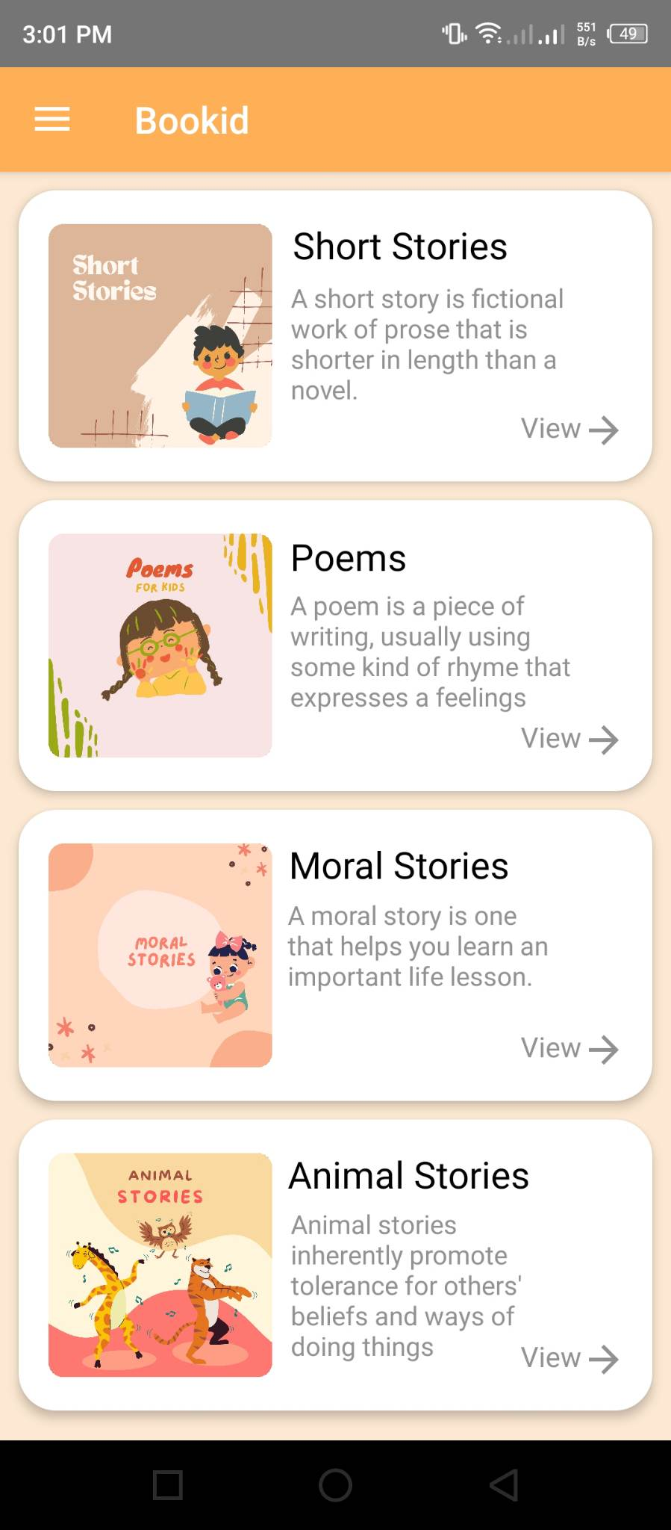
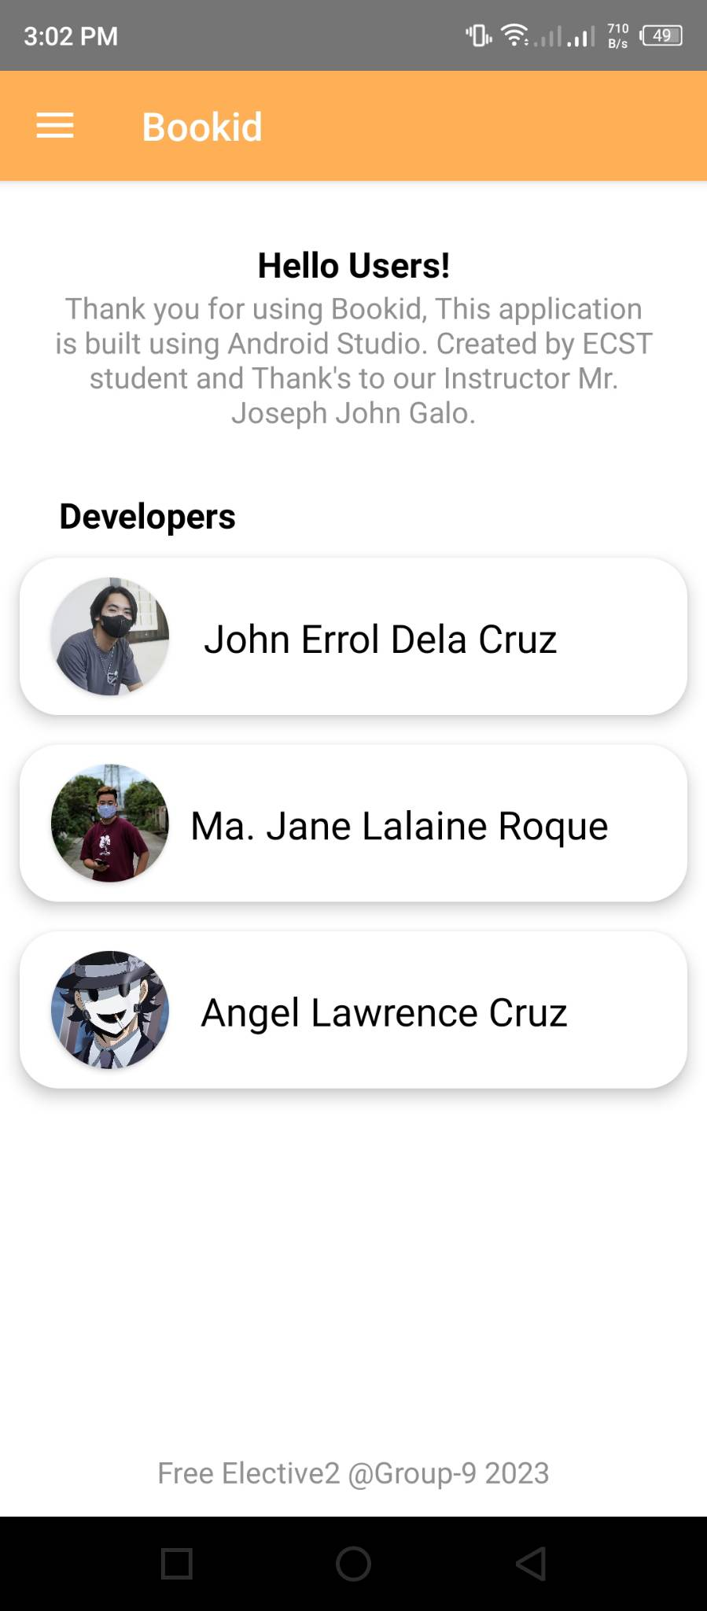
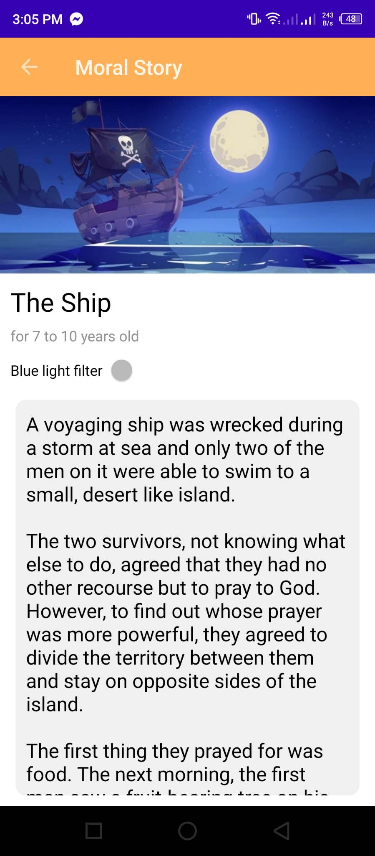
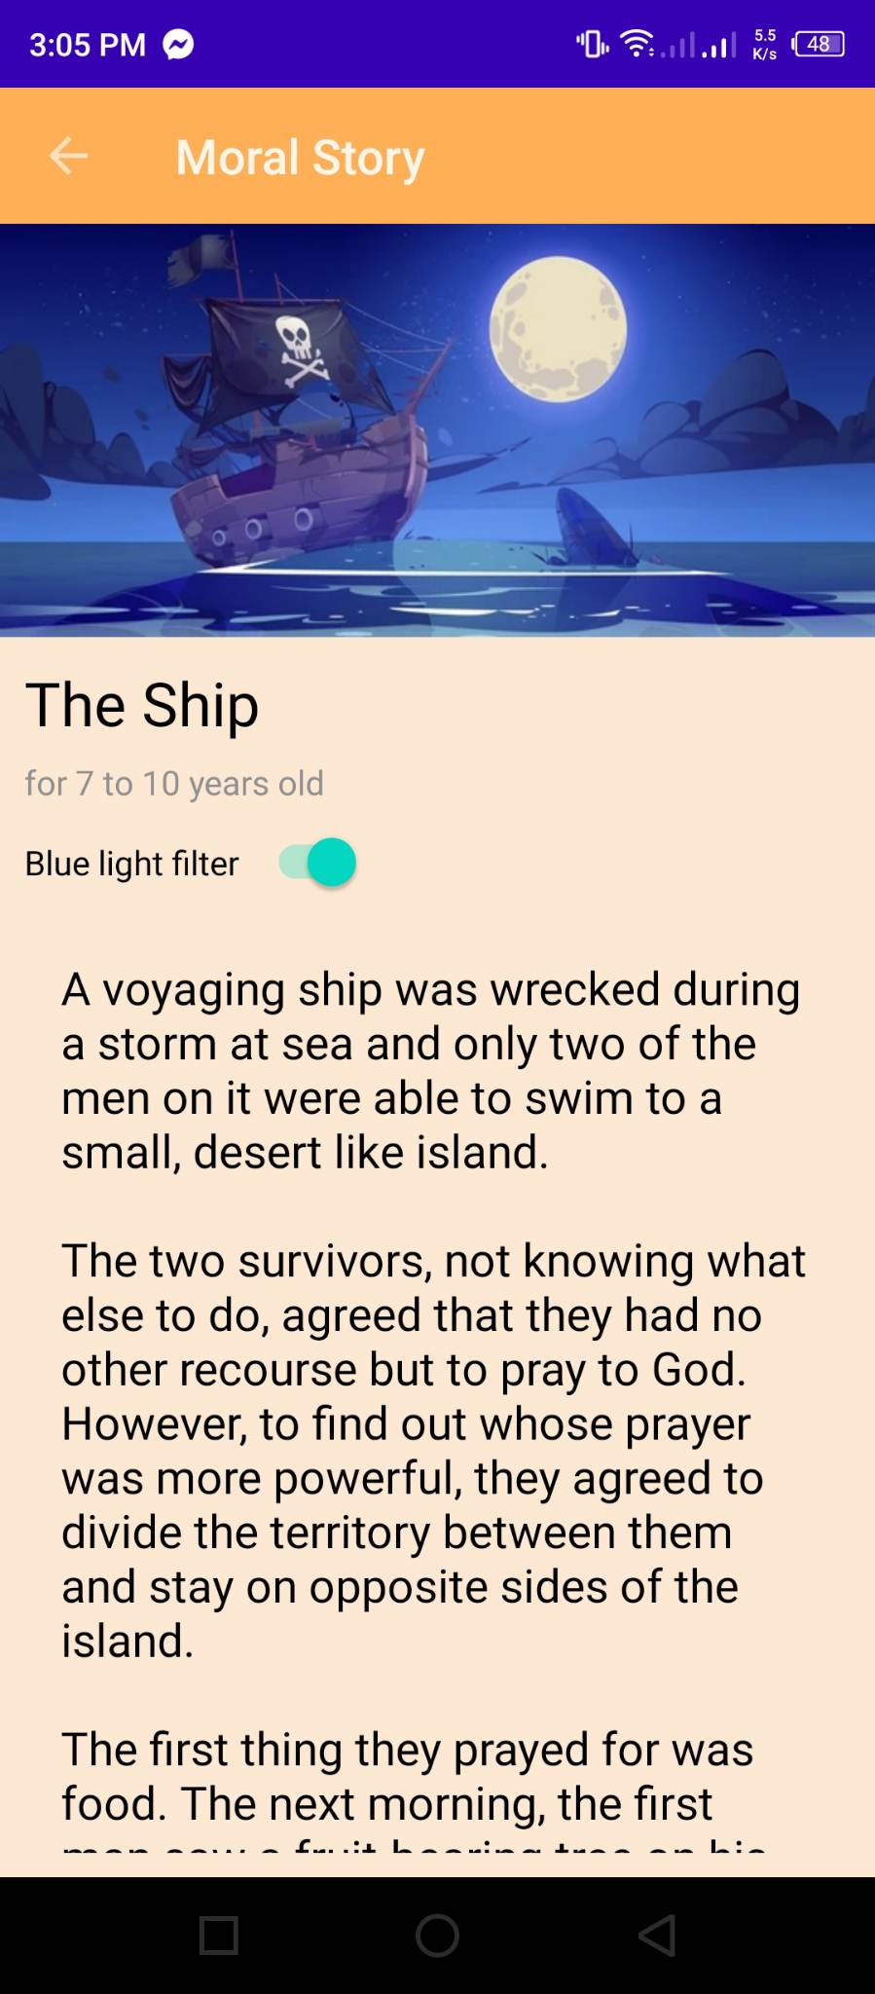
Week 3
FINISHED ACTIVITY: Home, Categories, Books and About is done
FRONT-END: (100%)

Slide 10
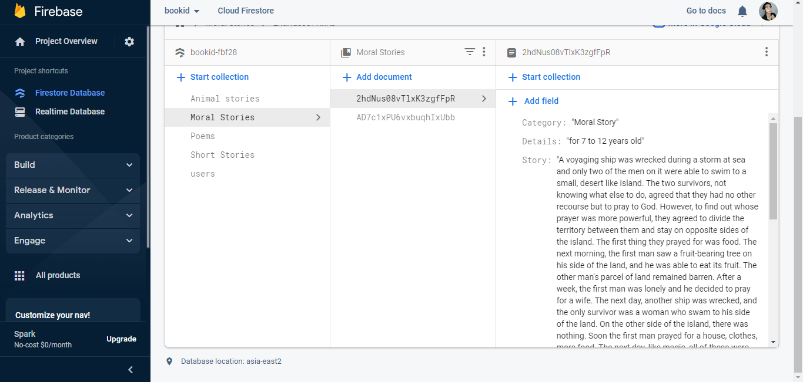
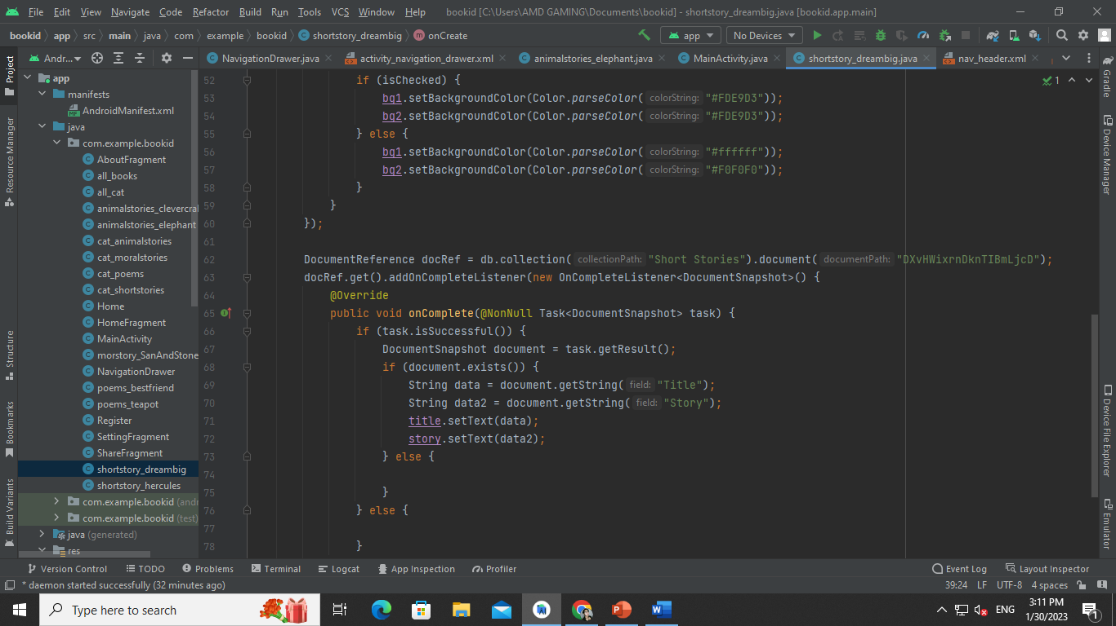
Week 3
FINISHED ACTIVITY: The story and Title is all connected in Firebase
BACK-END: (100%)

Slide 11
THANK YOU!

Slide 12
Group 9
LEADER
John Errol M. Dela Cruz
MEMBER:
Ma. Jane Lalaine Roque
Angel Lawrence Cruz

