Slide 1
College Costs
George Elia – 159003227
Lawrence Maceren - 158001833

Slide 2
Why Use College Costs?
Easy access to a database of thousands of schools across the country.
College Costs provides a simple interface to access information on college prices and financial aid.
Users can also find a list of schools based on specified criteria.
College Costs uses US census data to determine how affordable colleges can be for specific demographics.
Users can give their race, gender, major, and anticipated occupation. The program will show the prospective ability for the student to not have to live the rest of their lives paying off college debts.

Slide 3
Who Will Use College Costs?
Incoming college students who want to figure out what college and major they want to do
Students who want a quick checkup of their schools tuition, price, financial aid, and loans
Students who are interested in seeing how long it will take them to pay college fees
Students who are willing to see if college is worth it for their career
Users will likely recommend this site to their friends who are looking to plan their future education in a cost efficient way

Slide 4
Three Easy Tools
College Fact Checker
Quick and easy access to tuition and financial aid info for a school of your choice
College Finder
Filter your college selections based on criteria of your choice
College Attainability Tool
See how long it could take you to pay off your college debt with your career
All three tools are simple to use, but are extremely powerful in allowing the user to see if college is worth it for the career they want.

Slide 5
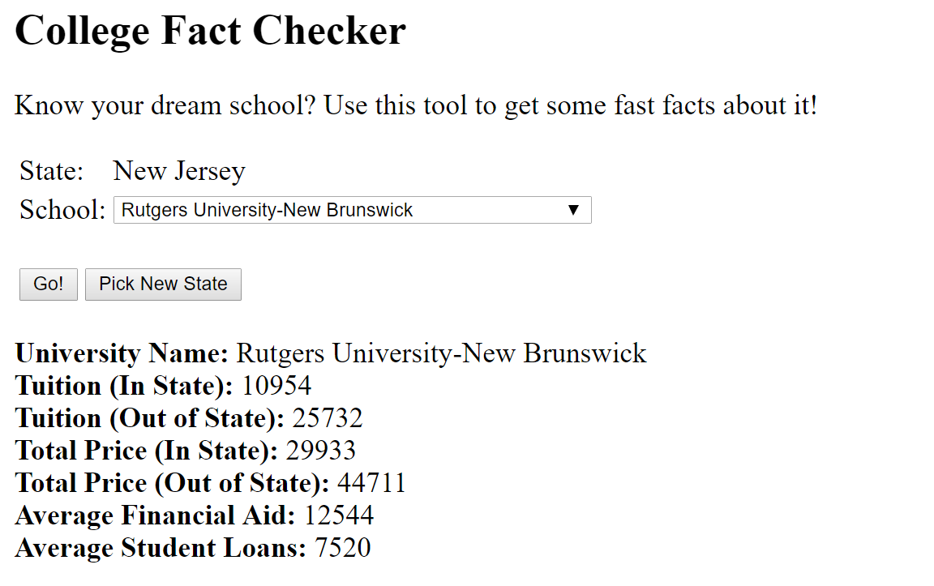
College Fact Checker
Useful if you know what school you are looking for
Pick state and school to look up fast facts about the school

Slide 6
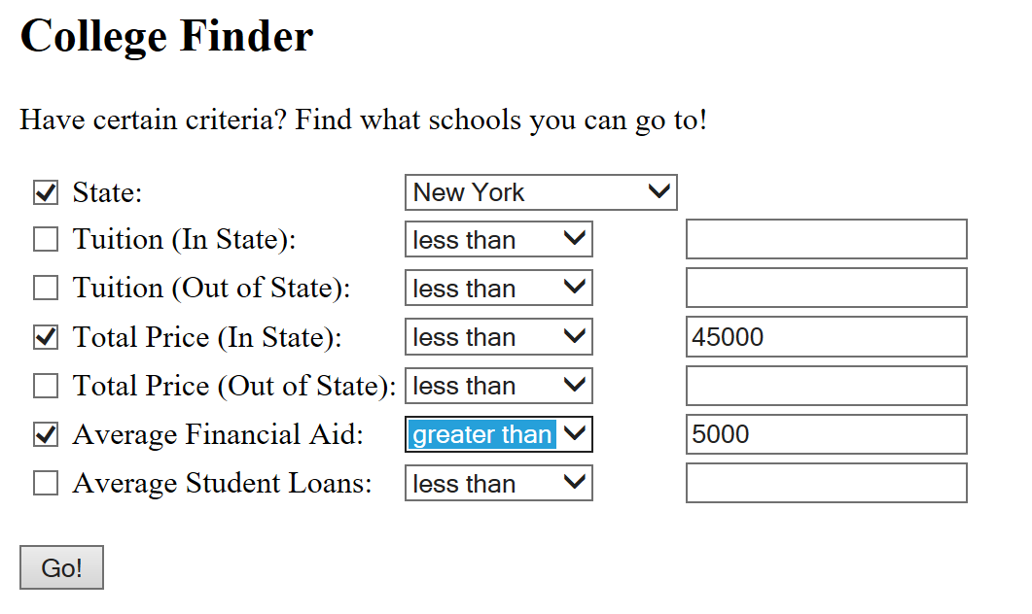
College Finder
Powerful filter tool for finding colleges based on your own criteria
Use checkboxes to pick what specifications you need

Slide 7
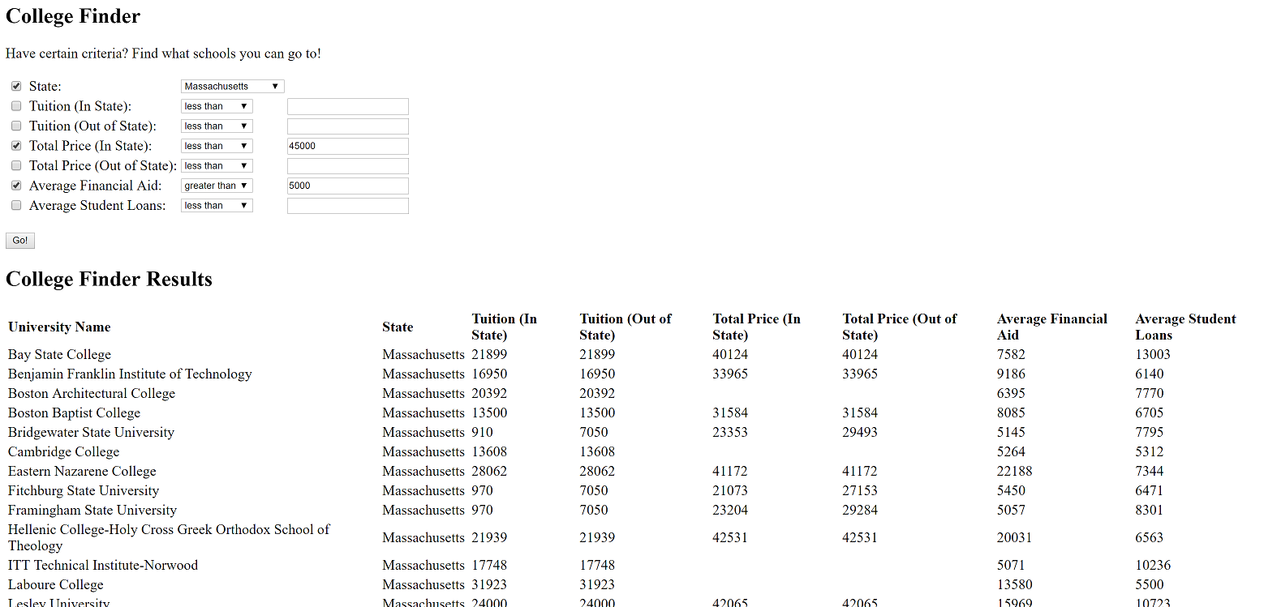
College Finder

Slide 8
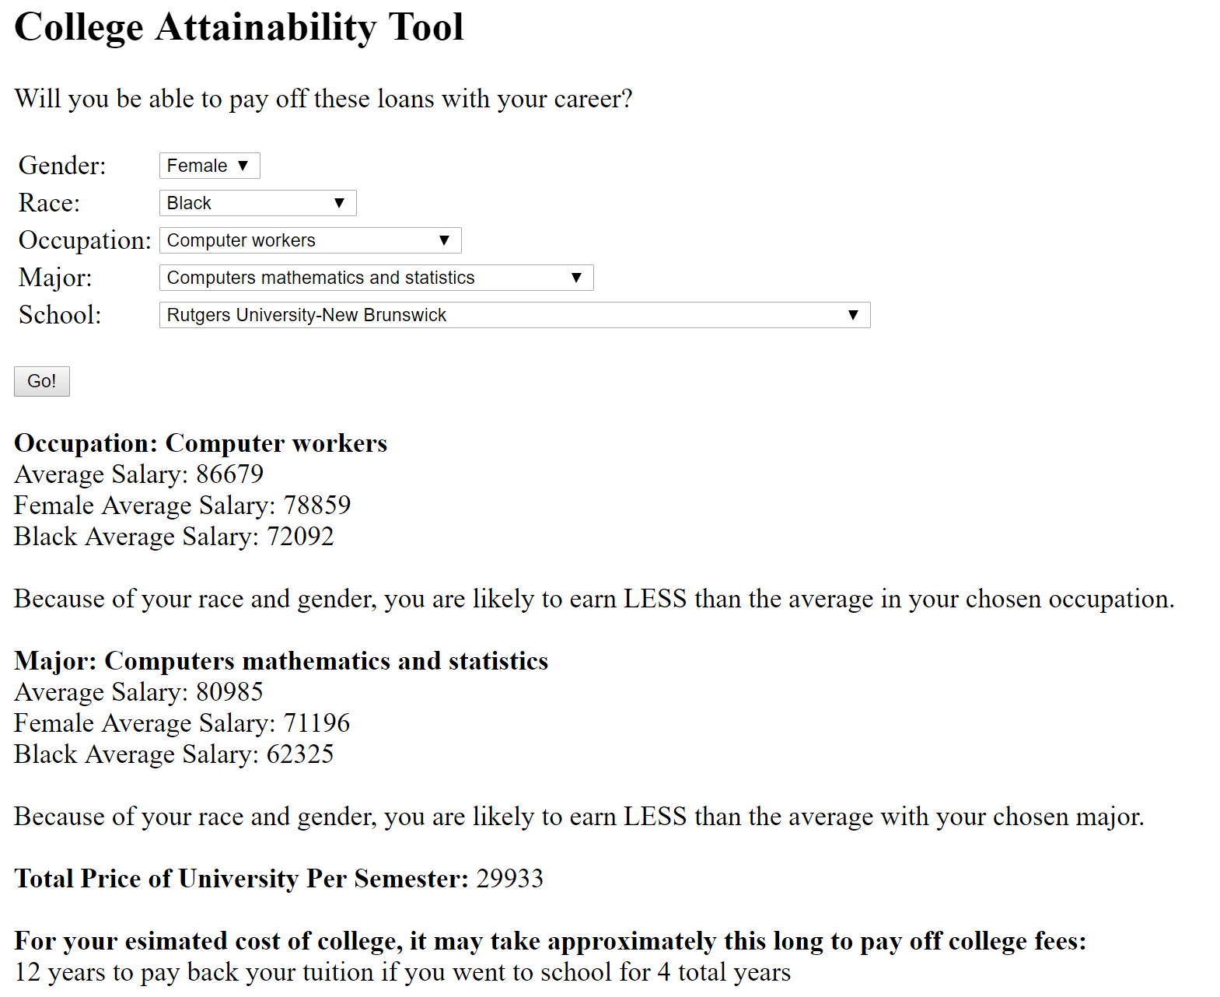
College Attainability Tool
Predicts the outcome of your post college career
Uses US census data to estimate how much money you are likely to make based on your demographics
Tells you how your salary may match compared to national averages
Calculates an estimate for how long it will take to pay off college fees

Slide 9
What Could You Gain From College Costs?
An easy place to see find out what to expect post college
Decide on a career that will pay off your college debts
Finding how affordable college is for your particular career
All of this data provided in a personalized manner for the user
Find out if college is worth it for you!

