Slide 1

NPAMS
National Public Asset Management System
Sponsor Summary for the PNG Immigration & Citizenship Authority
Prepared by LanFrame for the NPAMS Programme Office · 11 May 2026 · NPAMS-ICSA-2026-002
COMMERCIAL IN CONFIDENCE

Slide 2
Why NPAMS for ICSA
NPAMS Programme — ICSA Sponsor Summary
A single, auditable system of record for every ICSA asset — blank ePassport stocks, visa stickers, biometric workstations, secure printers, vehicles and the full estate at HQ and border posts.
Already live and multi-tenant. ICSA joins six Authorities already in production (PNGDF, RPNGC, IRC, Treasury, Customs, Ombudsman) with its own scoped data, branding and roles.
Designed for the PNG public sector by LanFrame: GIS over all 22 provinces, HMAC-SHA256 signed approvals, evidence-grade activity log, scope enforcement down to the facility.
No platform IP licence. ICSA pays only for onboarding, configuration, training, hosting and ongoing support — the subscription model is described in this deck.
Eight weeks from contract to Go-Live, with two further weeks of hyper-care.
LanFrame · NPAMS Programme Office
Commercial in Confidence

Slide 3
At a Glance
NPAMS Programme — ICSA Sponsor Summary
YEAR 1 TOTAL
RECURRING / YR
GO-LIVE
USERS INCLUDED
PGK 104,500
PGK 56,100
8 weeks
15
LIVE FEATURES
ROADMAP FEATURES
UPTIME SLA
SIGNED EVENTS
30
21
99.5%
HMAC-SHA256
Hosted in PNG-accessible cloud region · daily encrypted backups · TLS 1.2+ · AES-256 at rest
Built and supported by LanFrame for the NPAMS Programme Office
LanFrame · NPAMS Programme Office
Commercial in Confidence

Slide 4
What is Live Today
NPAMS Programme — ICSA Sponsor Summary
Asset Register & Stock
Workflow & Audit
Insight & Platform
Asset CRUD with auto-suggested asset tag (PNGICA-VEH-014)
Category short codes (BLD, VEH, ICT, OFF, MED, MCH, COM)
Per-facility stock balances and movement ledger
One-click reorder purchase request
Public QR verification page (no login)
Photos & documents in object storage
Asset transfers, lifecycle and prev/next stepper
Purchase request pipeline with approve / reject / receive
HMAC-SHA256 signed events on every state transition
Signed event timeline UI with re-verifiable hashes
Audit sessions scoped to province / district / facility
Field verification with camera + GPS
Maintenance scheduling with cost & downtime
Append-only activity log for the Auditor-General
Provincial and national dashboards (KPIs + charts)
Reports module with one-click CSV export
Notifications inbox with mark-read
Interactive GIS map of all 22 PNG provinces
Multi-tenant RBAC with scope enforcement
Tenant branding per Authority
Theme tokens with full dark-mode polish
30 capabilities live in production today.
LanFrame · NPAMS Programme Office
Commercial in Confidence

Slide 5
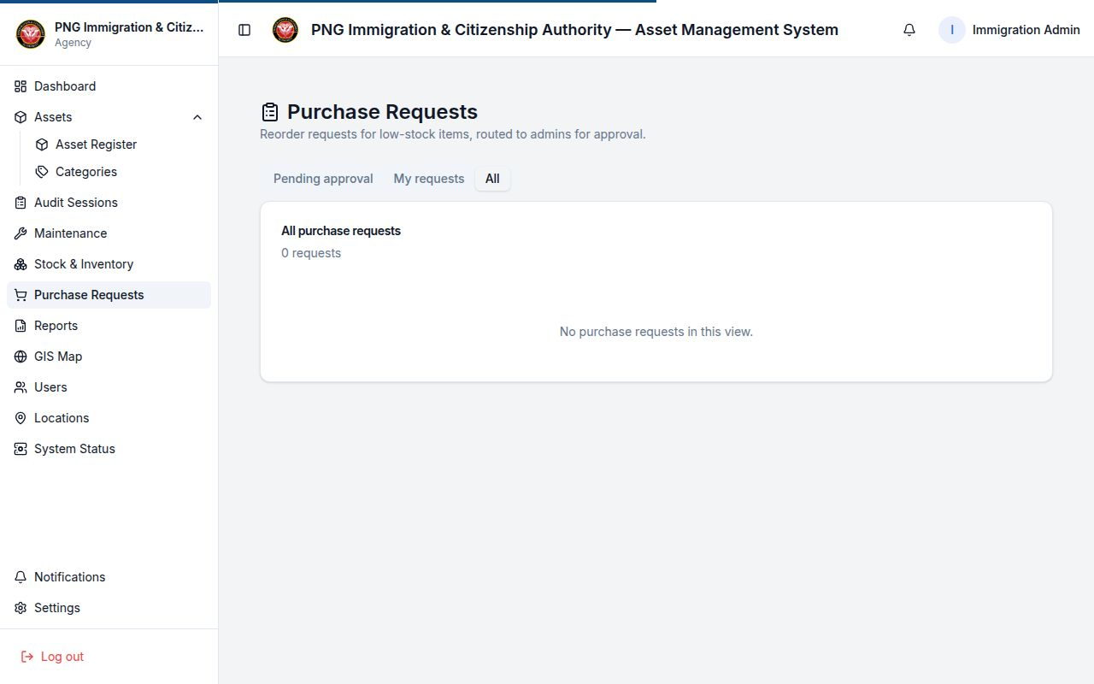
Tamper-Evident Procurement Workflow
NPAMS Programme — ICSA Sponsor Summary
Officer submits → scoped approver signs → goods receipt closes the loop.
Every state transition writes an immutable row with signed_name, signed_at and signed_hash.
signed_hash = HMAC-SHA256(server_secret, "v1|user|action|request|timestamp|name").
ICSA's Auditor can re-compute every hash from the documented input string and prove no event has been tampered with.
Live evidence today: PR-20260511-5092 carries verifiable submitted + approved signatures.
Live screenshot — Purchase Requests workflow
LanFrame · NPAMS Programme Office
Commercial in Confidence

Slide 6
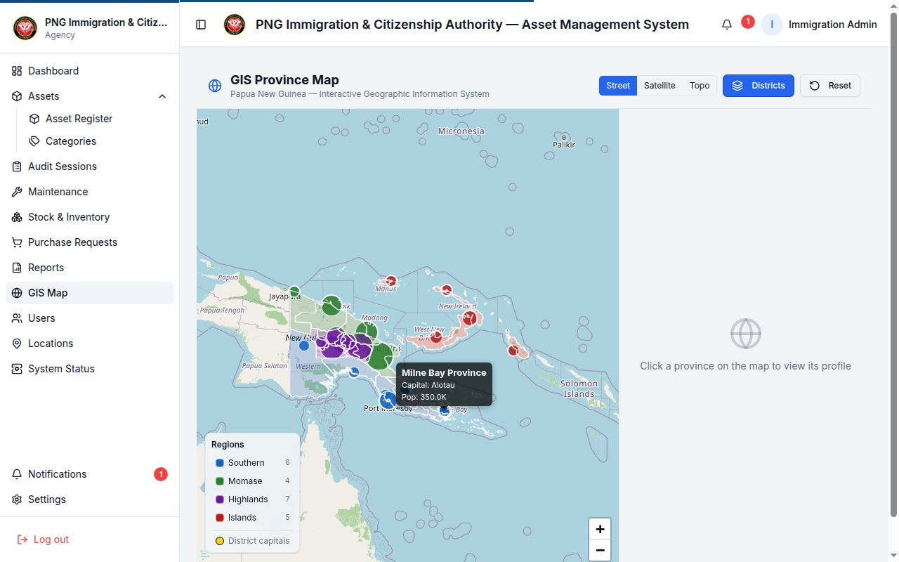
PNG-Specific GIS — All 22 Provinces
NPAMS Programme — ICSA Sponsor Summary
Interactive Leaflet map of every PNG province and district (GADM boundaries).
Street, Satellite and Topographic basemaps; province / district selection dims unrelated areas.
Pins for ICSA assets and stock locations across HQ, regional offices, sea ports and border posts.
Drives the location → asset → custodian drill-down used in the dashboards and reports.
Live screenshot — GIS Province Map
LanFrame · NPAMS Programme Office
Commercial in Confidence

Slide 7
Security & Compliance
NPAMS Programme — ICSA Sponsor Summary
Area | NPAMS control
Authentication | Bcrypt passwords; JWT (8h) + rotating refresh tokens stored as SHA-256
Authorisation | RBAC with scope at national / agency / province / district / facility
Digital signatures | HMAC-SHA256 on every PR state transition — verifiable & non-repudiable
Audit log | Append-only activity_logs and purchase_request_events
Data residency | PNG-accessible cloud region; daily encrypted backups (30 days)
In transit / at rest | TLS 1.2+ end-to-end · AES-256 at the storage layer
DR / SLA | RPO 24 h · RTO 8 h · 99.5% monthly uptime · P1 1 h, P2 4 h
Vulnerability mgmt | Monthly CVE scan, SAST every release, quarterly external pen-test summary
LanFrame · NPAMS Programme Office
Commercial in Confidence

Slide 8
Commercials — Year 1
NPAMS Programme — ICSA Sponsor Summary
# | Line item | Notes | Total (PGK)
1 | Platform Licence — Year 1 | 15 named users | 9,000.00
2 | Implementation & Configuration | fixed price | 28,000.00
3 | Data Migration & Seeding | fixed price | 8,500.00
4 | User Training | 3 sessions | 7,500.00
5 | Cloud Hosting | 12 months | 12,000.00
6 | Support & Maintenance — Year 1 | 12 months, ≤ 8 hrs/mo enhancements | 30,000.00
 | Subtotal (excl. GST) |  | 95,000.00
 | GST (10%) |  | 9,500.00
 | Grand Total Year 1 (incl. GST) |  | 104,500.00
Recurring from Year 2: PGK 56,100 incl. GST · 3-Year TCO: PGK 216,700 incl. GST · Add-on user: PGK 600 / yr
LanFrame · NPAMS Programme Office
Commercial in Confidence

Slide 9
Implementation Timeline — 8 Weeks to Go-Live
NPAMS Programme — ICSA Sponsor Summary
Eight weeks contract → Go-Live, plus two weeks of LanFrame on-site hyper-care.
1
1–2
2–4
3–5
4–6
5–6
6–7
7–8
9–10
Mobilisation
Tenant Provisioning
Data Migration
Configuration
Integration
Training
UAT
Go-Live
Hyper-care
Week 1 — kick-off and governance set-up.
Weeks 2–6 — tenant provisioning, data migration and configuration in parallel.
Weeks 5–7 — training (Asset Officer, Agency Admin, Auditor) and UAT sign-off.
Weeks 7–8 — production cut-over with DR drill, runbook hand-over.
Weeks 9–10 — hyper-care: defect triage and performance tuning.
LanFrame · NPAMS Programme Office
Commercial in Confidence

Slide 10
Roadmap — Included in the Year-1 Engagement
NPAMS Programme — ICSA Sponsor Summary
Procurement & approvals
Stock, dashboards & reports
Asset history, search & UX
Distribution & deployment
Email / push alerts on PR status changes
Supplier performance and price history
Automated end-to-end tests for the reorder flow
Auditor screen verifies every signed approval
PR alerts in the bell-icon tray
Real backup history & live system metrics
Low-stock alerts on the dashboard
Bulk-edit reorder thresholds
Category code in reports & dashboard breakdowns
Tighten API parameter typing (internal hardening)
Maintenance & audit events inline on asset history
Export an asset's full history to PDF
Top-bar search across stock, audits and PRs
Full search results page for large match sets
Audit-assignment stepper for officers
Dark-mode pass for audit, maintenance & public pages
Windows desktop installer (MSI / EXE)
Android mobile app (signed APK)
On-prem deployment runbook for ICSA
Sponsor proposal collateral refresh
Test that two categories cannot share a code
21 roadmap items, scheduled inside the ≤ 8 hrs/month enhancement envelope of the support contract.
LanFrame · NPAMS Programme Office
Commercial in Confidence

Slide 11
Why LanFrame
NPAMS Programme — ICSA Sponsor Summary
PNG-resident delivery partner accountable for the NPAMS platform end-to-end.
Already operating six tenant Authorities in production — proven onboarding, training and support muscle.
Single contract, single throat to choke: platform, hosting, training, support and roadmap all from one team.
Engineering practice covers monthly CVE scans, SAST on every release, quarterly external penetration test summaries delivered to ICSA.
Roadmap delivered inside the support envelope at no extra cost — ICSA gets new capability every month.
Open formats throughout: Postgres dump and CSV export available on demand.
LanFrame · NPAMS Programme Office
Commercial in Confidence

Slide 12
Thank You
Next steps
1. ICSA confirms 15-user concurrent licence and Year-1 scope.
2. LanFrame issues contract for signature within 5 business days.
3. Kick-off Week 1 — Go-Live Week 8 — hyper-care to Week 10.
LanFrame · on behalf of the NPAMS Programme Office · Independent State of Papua New Guinea
COMMERCIAL IN CONFIDENCE

