Slide 1
LEGACY SCHOOL SOLWEZI
EduSphere SMIS: Enterprise Sovereign Modernization
Comprehensive Multi-Campus Management, Automated Revenue Recovery, ECZ Academic Markbooks, 360° Boarding Safeguarding & Smart Transport Network with Contactless ID Card Boarding.
Tailored for the Board of Directors, Managing Director & Principal: Mr. Emmanuel Mwansa
Date: 18th October 2026 • Campus Locations: Mushitala (Secondary/Boarding) & Urban (ECE/Primary Day) • Solwezi, Zambia

Slide 2
LEGACY SCHOOL SOLWEZI • EXECUTIVE STRATEGY & TECHNOLOGY DEPLOYMENT
Executive Strategic Summary: Moving from Manual Risk to Automated Sovereignty
Operational Fragmentation & Leakage
Traditional paper-based fee receipts, manual marksheets, and dispersed logbooks created administrative delays, reconciliatory blind spots, and parental anxiety across both Solwezi campuses.
Unified Multi-Campus Orchestration
EduSphere connects Mushitala Secondary (420 pupils, boarding) and Urban Primary (360 pupils, day) into one synchronized general ledger, single-login dashboard, and ECZ grading standard.
Measurable Revenue & Safeguarding ROI
Eliminates ~K279k in aged debtor arrears via direct Mobile Money/Zanaco billing, prevents unverified boarding, and automates real-time SMS alerts when learners tap their ID cards onto school buses.
Institutional Scale Overview: 780 Active Learners • 48 Professional Staff • 16 Class Cohorts • 2 Buses (62 Transport Seats) • 350 Boarding Beds

Slide 3
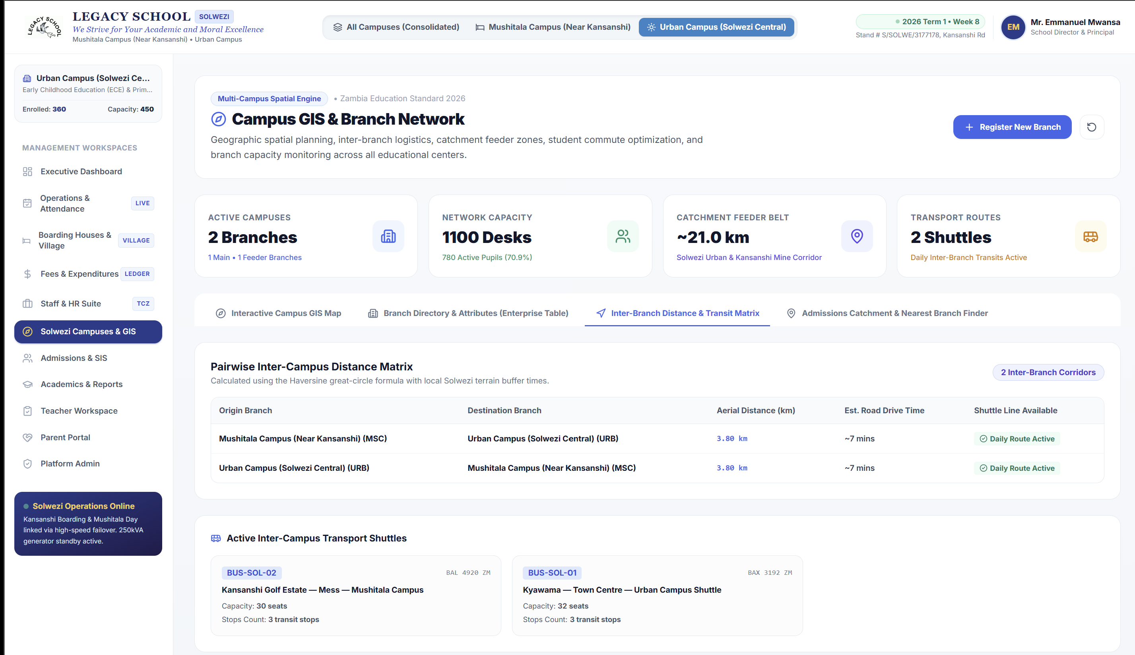
LEGACY SCHOOL SOLWEZI • EXECUTIVE STRATEGY & TECHNOLOGY DEPLOYMENT
Multi-Campus Spatial Network & Inter-Branch Distance Matrix
Sovereign GIS & Spatial Logistics
EduSphere embeds high-resolution satellite cartography to calculate exact Haversine distances, catchment feeder zones (21.0 km corridor), and transit buffer times between school centers:
• Mushitala Main Campus: Secondary & Boarding wing, Plot 889 Kansanshi Mine Road (Capacity: 650, Enrolled: 420).
• Urban Campus Central: ECE & Primary Day School, Solwezi Town Corridor (Capacity: 450, Enrolled: 360).
• Pairwise Transit Distance: 3.80 km road distance (~7 mins drive time), facilitating seamless inter-campus shuttle connections.
• Catchment Compliance: Auto-resolves applicant coordinates to determine nearest feeder branch during student enrollment.

Slide 4
LEGACY SCHOOL SOLWEZI • EXECUTIVE STRATEGY & TECHNOLOGY DEPLOYMENT
Smart Transport: Live Shuttle Tracking & Contactless Learner ID Card Boarding
Learner ID Card Bus Check-in: Technical Advisory
• Dual NFC / QR Student ID Cards: Learners carry durable PVC smart cards with embedded MIFARE 13.56MHz NFC chips and 2D QR fallback codes.
• In-Bus Telematics Tablet: Mounted 7-inch rugged Android tablet with 4G LTE and GPS validates card taps in under 0.3 seconds.
• Instant Parent SMS Alert: '[EduSphere] Bupe Mwewa boarded BUS-SOL-02 at Kansanshi Golf Estate at 06:46 AM. ETA School: 20 mins.'
• Wrong-Bus Lockout Protection: Tablet screen sounds audible warning if a learner attempts to board the wrong route or exits at the wrong stop.
• Offline Store-and-Forward: Pockets along Kansanshi Mine Road with low cellular coverage store taps locally in SQLite and auto-sync when reconnected.

Slide 5
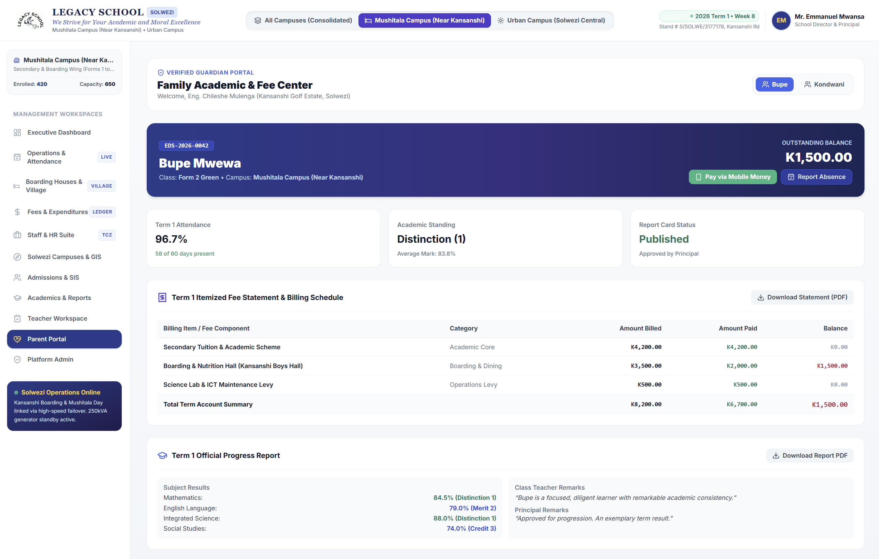
LEGACY SCHOOL SOLWEZI • EXECUTIVE STRATEGY & TECHNOLOGY DEPLOYMENT
Fees Management, Inflows Ledger & Complete Cashbook Control
Financial Governance & Multi-Channel Inflows
• Zero-Variance Reconciliation: All 780 student ledger accounts match official receipts with zero discrepancy across Zanaco, Stanbic, and Mobile Money.
• Multi-Campus Fee Isolation: Independent billing schedules for Urban Primary (Day Tuition K2,800) and Mushitala (Tuition + Boarding K10,400).
• Real-Time Transparent Receipts: 2,123 reconciled institutional receipts generated with audit trails and instant PDF receipt generation.
• Expenditure Control (Outflows): Strict authorization workflow for operational disbursements, fuel rations, food dining provisions, and payroll.
• Recovery Rate Optimization: Visual aged debtors ledger categorizing 30, 60, and 90+ day balances to systematically close out arrears.

Slide 6
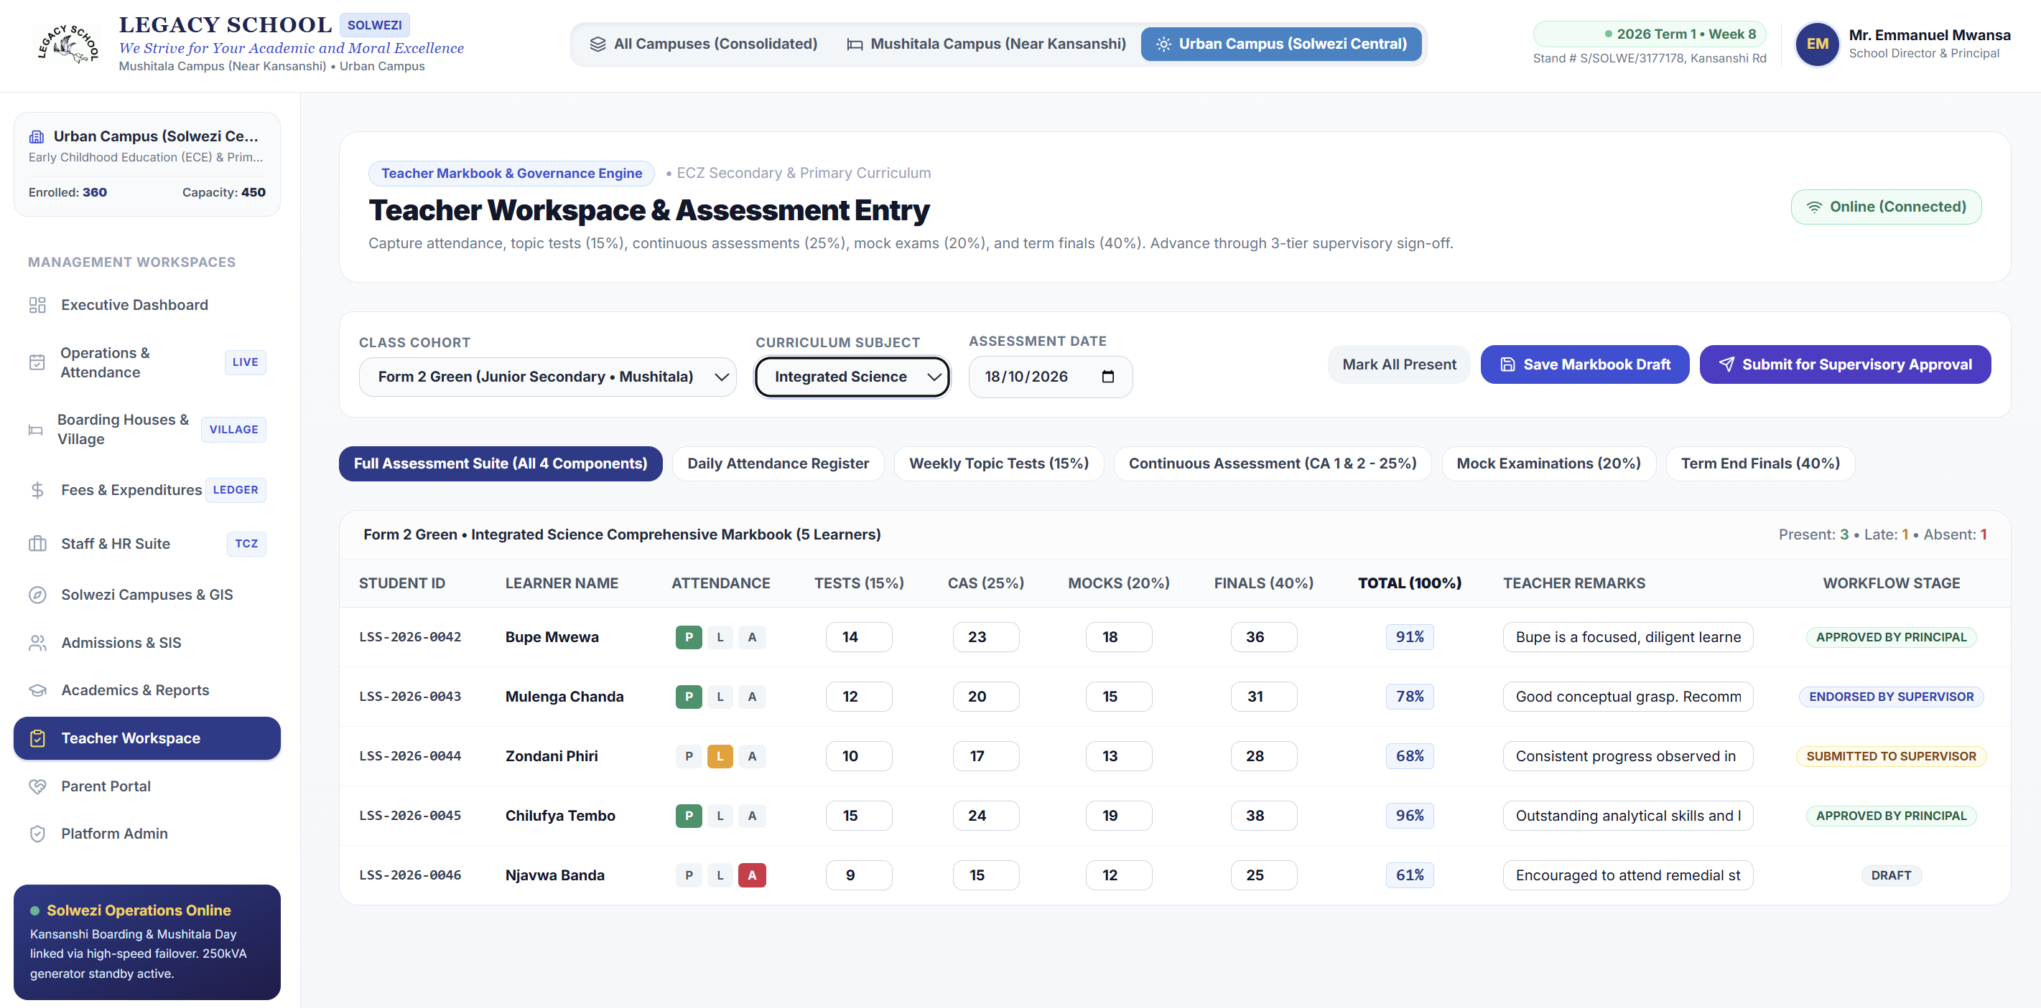
LEGACY SCHOOL SOLWEZI • EXECUTIVE STRATEGY & TECHNOLOGY DEPLOYMENT
Teacher Workspace: ECZ Assessment Suite & 3-Tier Supervisory Sign-Off
Standardized Scholastic Markbook
• All 16 Cohorts Selectable: Seamlessly switches between Early Years, Grades 1-7, and Forms 1-5 with full 30 to 44 student rosters loaded dynamically.
• Full ECZ Curriculum Spectrum: Captures all subjects: Sciences, Mathematics, English, ICT, Social Studies, Zambian Languages, and Commerce.
• 4-Tier Assessment Breakdown: Weekly Topic Tests (15%), Continuous Assessments (25%), Mock Exams (20%), and Term Finals (40%) = 100% total.
• 3-Tier Supervisory Workflow: Class Teacher submits -> Senior Teacher / HOD endorses -> Principal gives final approval before publication.
• Offline Markbook Entry: Teachers can grade test papers without active internet; marks store locally and auto-sync when Wi-Fi connects.

Slide 7
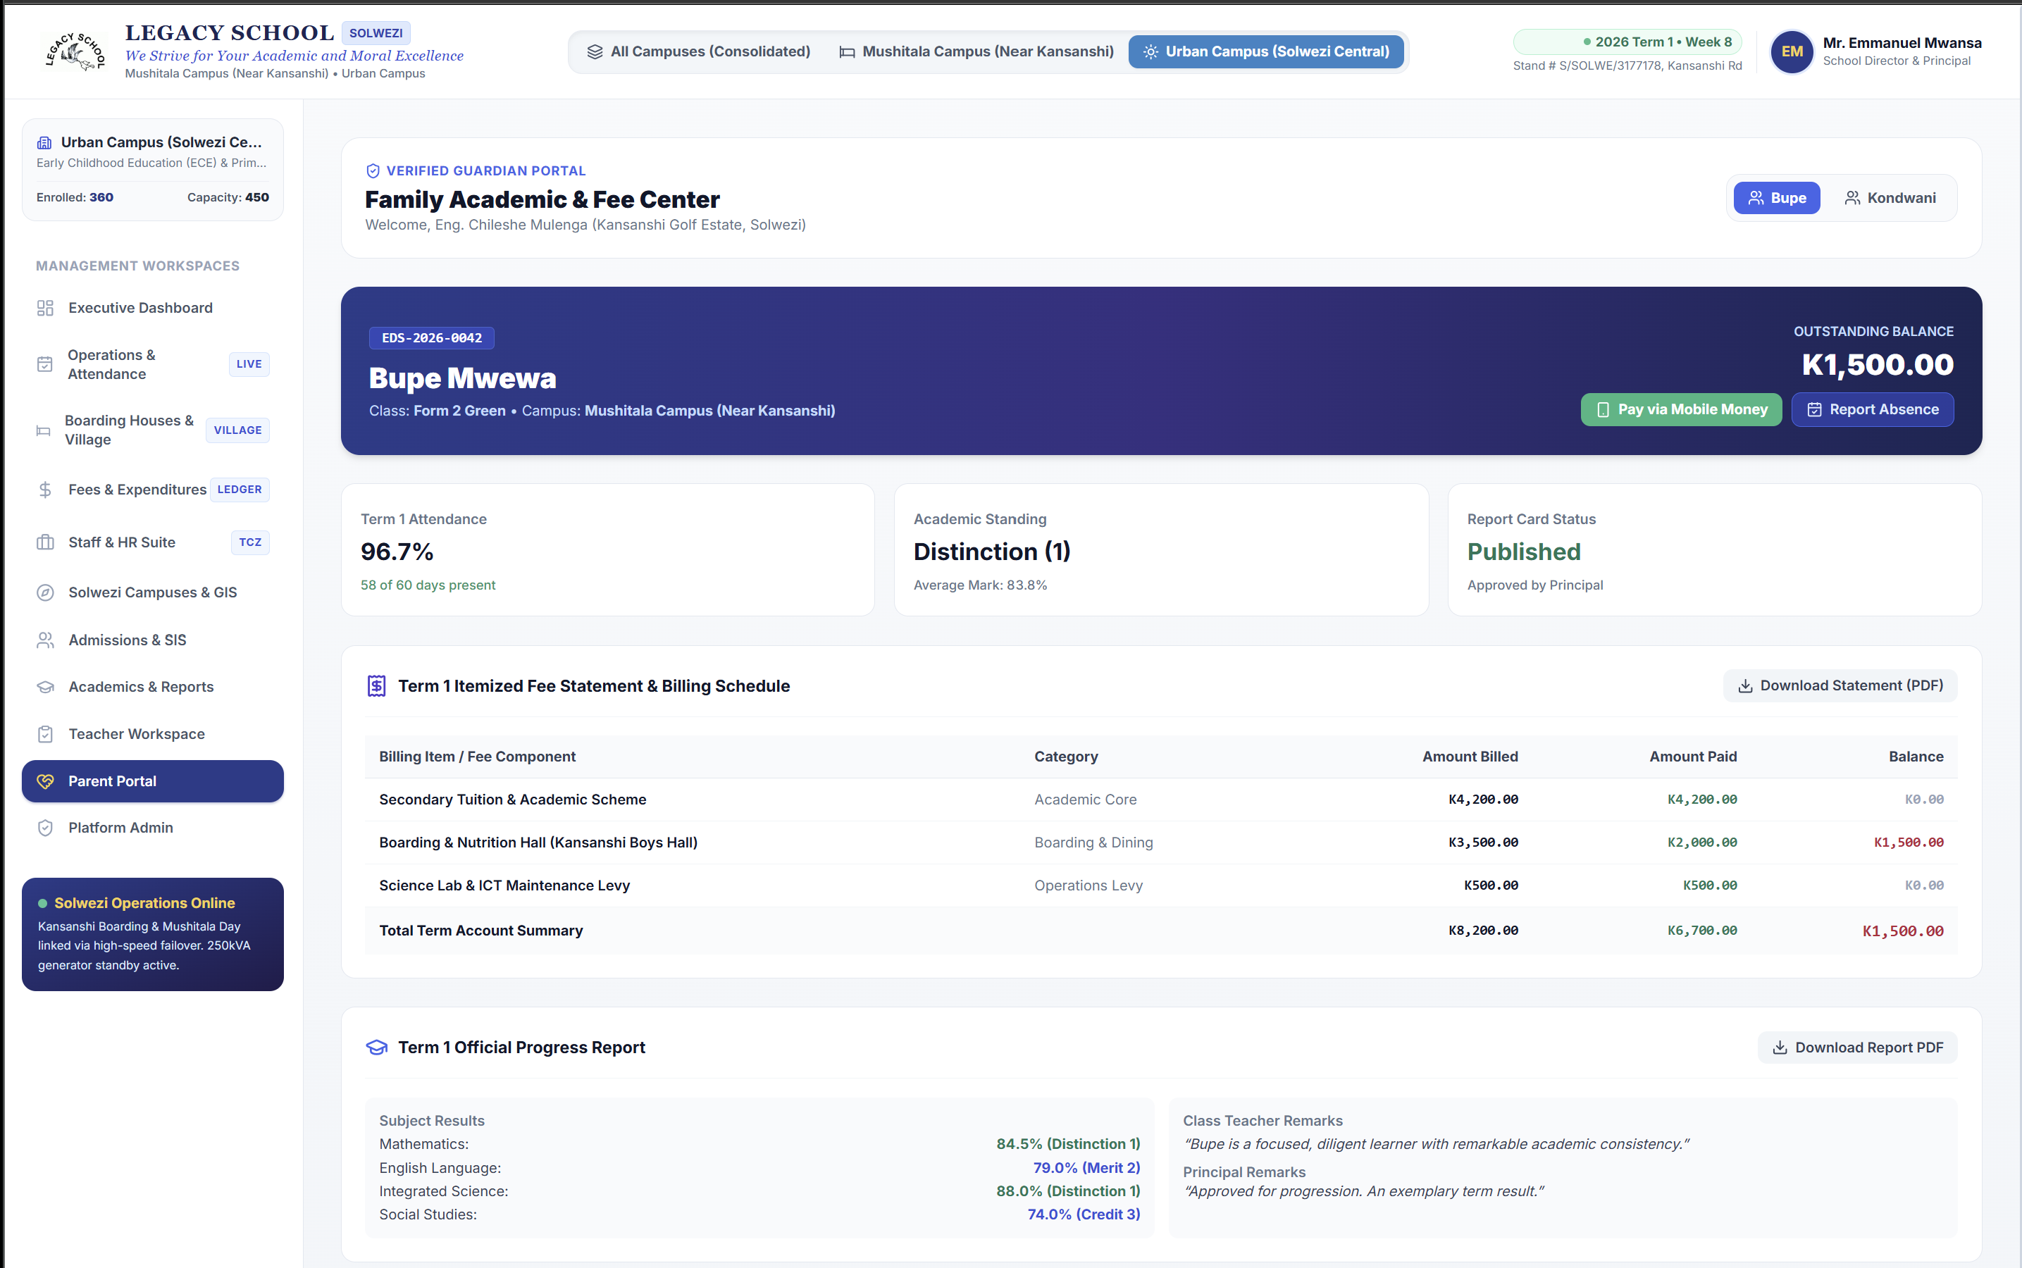
LEGACY SCHOOL SOLWEZI • EXECUTIVE STRATEGY & TECHNOLOGY DEPLOYMENT
Parent Portal: Multi-Child Family Academic, Attendance & Fee Center
Transparent Family Engagement
• Multi-Ward Switcher: Parents with multiple children (e.g. Bupe, Kondwani, Natasha, Chileshe) switch between all wards in one unified portal.
• Historical Performance Graphs: Multi-term trend charts (2024 to 2026) illustrate grade progression and classroom rankings over time.
• Complete ECZ Subject Breakdown: Itemized marks across all 10 to 12 subjects with personalized teacher remarks and conduct ratings.
• Instant Mobile Money Settlement: Direct push-prompt fee payment via Airtel Money and MTN MoMo with instant receipt generation.
• Official Printable Report Cards: Parents can download and print official Ministry-formatted report cards with digital school stamps and signatures.

Slide 8
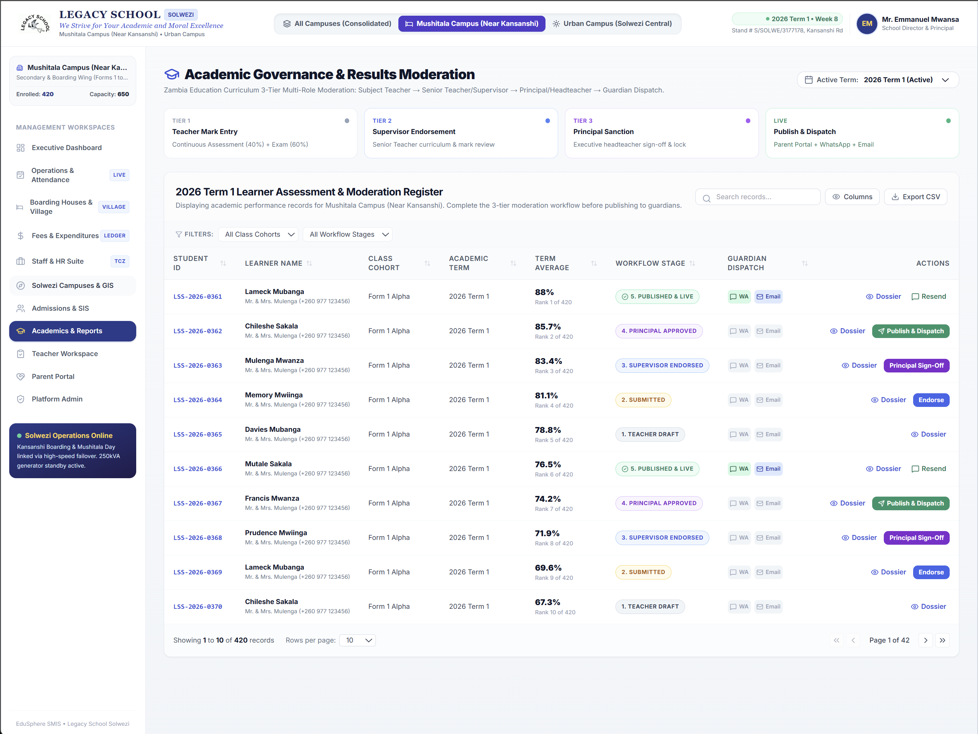
LEGACY SCHOOL SOLWEZI • EXECUTIVE STRATEGY & TECHNOLOGY DEPLOYMENT
Boarding Village & Student 360° Safeguarding Dossiers
Holistic Pastoral Care & Resident Welfare
• Accommodation Tracking: Real-time bed, wing, and dorm assignments for 315 boarders across Kansanshi Boys and Kalumbila Girls Halls.
• Multi-Year Residential History: Preserves records of dorm rooms, bed numbers, locker codes, and inspection ratings from Form 1 to Form 5.
• Digital Exeat Pass Workflow: Automated approval trail for weekend exeats, medical clinic visits, and sports travel with SMS verification.
• 24/7 Sickbay Health Records: Resident nurse incident logging, chronic condition medication monitoring, and emergency doctor referrals.
• Day Scholar Terminal Management: Separate locker and transit marshaling for day pupils, with one-click conversion to boarding status.

Slide 9
LEGACY SCHOOL SOLWEZI • EXECUTIVE STRATEGY & TECHNOLOGY DEPLOYMENT
Commercial Investment Breakdown: Turnkey Software, IoT Hardware & Support
Investment Component / Deliverable | Scope of Coverage & Specifications | Year 1 (ZMW) | USD Equiv.
EduSphere Sovereign Enterprise Platform Core | Multi-Campus License, Finance, SIS, Academics, GIS & Parent Portal (Unlimited Admin & Teacher Users) | K 65,000 | $ 2,500
Implementation, Historical Seeding & Setup | Data migration of 780 students, 48 staff profiles, database configuration, and backup server setup | K 28,000 | $ 1,075
Smart Bus Hardware (2 In-Vehicle Telematics Tablets) | 2x Rugged 7-inch Android In-Bus Tablets, NFC RFID readers, GPS mounts, and 4G SIM integration | K 19,500 | $ 750
Smart Student Contactless ID Cards (800 Cards) | 800 Dual-Frequency MIFARE 13.56MHz + QR printed PVC student smart identification badges | K 16,000 | $ 615
Staff Onboarding & Operational Training | Hands-on workshops for 48 staff (Bursars, HODs, Teachers, Matrons, Drivers, and Executive Management) | K 14,500 | $ 560
TOTAL YEAR 1 CAPITAL & IMPLEMENTATION INVESTMENT | Complete sovereign school digital ecosystem with full warranty, support, and backups | K 143,000 | $ 5,500
Return on Investment (ROI) Justification for Executive Management:
1. Immediate Arrears Recovery: Automating parent Mobile Money prompts captures ~15% of the K279,000 pending fee balances within 30 days (+K41,850 recovered).
2. Printing Cost Elimination: Eliminating physical carbon-copy paper receipts and printed report cards saves ~K22,000 annually.
3. Fuel & Route Optimization: Smart GPS route stop planning saves ~10-15% on diesel transport costs across both shuttles.

Slide 10
LEGACY SCHOOL SOLWEZI • EXECUTIVE STRATEGY & TECHNOLOGY DEPLOYMENT
Deployment Timeline: 4-Week Fast-Track Execution Schedule
Week 1: Sovereign Setup & Cloud Architecture
✔ Deploy Dockerized PostgreSQL & Next.js engine
✔ Configure automated nightly off-site database backups
✔ Migrate 780 legacy learner profiles and fee balances
✔ Finalize custom theme colors & school crest branding
Week 2: Smart Bus IoT & Hardware Deployment
✔ Procure and program 800 MIFARE NFC student ID cards
✔ Install 2x Android in-bus GPS telematics tablets
✔ Set up cellular 4G SIMs and offline store-and-forward
✔ Test driver route navigation and geofenced bus stops
Week 3: Staff Training & Academic Markbook Pilot
✔ Conduct workshops for 48 staff members across cadres
✔ Train teachers on topic test, CA, and mock exam entry
✔ Train bursar and finance staff on cashbook vouchers
✔ Conduct mock roll-call attendance on shuttle routes
Week 4: Parent Portal Launch & Full Go-Live
✔ Dispatch parent SMS credentials and onboarding guide
✔ Open Airtel & MTN Mobile Money payment channels
✔ Publish official Term 1 digital report cards
✔ Transition to 24/7 technical monitoring & SLA support
Enterprise Service Level Agreement (SLA): 99.9% Uptime Guarantee • Daily Encrypted Off-Site Backups • Dedicated On-Call Technical Support for Solwezi Operations

Slide 11
SUMMARY OF RECOMMENDATIONS FOR EXECUTIVE APPROVAL
1. Approve Sovereign SMIS Deployment: Authorize transition from manual spreadsheets to EduSphere across Mushitala and Urban campuses.
2. Greenlight Smart Bus Hardware Integration: Commission in-bus Android telematics tablets and 800 NFC learner ID cards for automated boarding verification and SMS parent alerts.
3. Activate Integrated Mobile Money Gateway: Formalize Airtel & MTN merchant aggregators to allow instant parent tuition settlements, reducing aged debt.
4. Authorize 4-Week Rollout Roadmap: Direct the ICT and Academic departments to commence staff training and data validation for full Term 1 operation.
Prepared with dedication for Legacy School Solwezi • We strive for your academic and moral excellence.

