Slide 1
LEGACY SCHOOL SOLWEZI
EduSphere SMIS: Enterprise Sovereign Modernization
Comprehensive Multi-Campus Management, Automated Revenue Recovery, ECZ Academic Markbooks, 360° Boarding Safeguarding & Native Android Mobile Operations.
Presented to: School Board of Governors, Director & Principal Mr. Emmanuel Mwansa, and Ministry of Education
Operational Academic Session: 2026 Term 3 • Solwezi, North-Western Province, Zambia
Campuses: Mushitala Day Campus & Kansanshi Boarding Campus
Key Assets: Native Android APK • Zero-Loss Financial Ledger • 5-Horizon Attendance • Anti-Fraud QR Official Letters

Slide 2
LEGACY SCHOOL SOLWEZI • EXECUTIVE STRATEGY & TECHNOLOGY DEPLOYMENT
Executive Strategic Summary: Moving from Manual Risk to Automated Sovereignty
Operational Fragmentation & Risk
Manual paper fee receipts, paper registers, and untracked boarding movements previously exposed the institution to financial leaks, reconciliatory blind spots, and pastoral anxiety across Solwezi.
Unified Multi-Campus Orchestration
EduSphere connects Mushitala Day (520 pupils, ECE to Grade 9) and Kansanshi Boarding (260 pupils, Grades 10-12) into one synchronized general ledger, single-login dashboard, and ECZ grading standard.
Measurable Revenue & Safeguarding ROI
Recovers aged debtor balances via automated Mobile Money billing, eliminates unverified boarding, and automates real-time SMS alerts when learners tap their ID cards onto school shuttles.
Institutional Scale Overview: 780 Active Learners • 48 Professional Staff • 16 Class Cohorts • 4 Bus Routes • 350 Boarding Beds • 2 Campuses

Slide 3
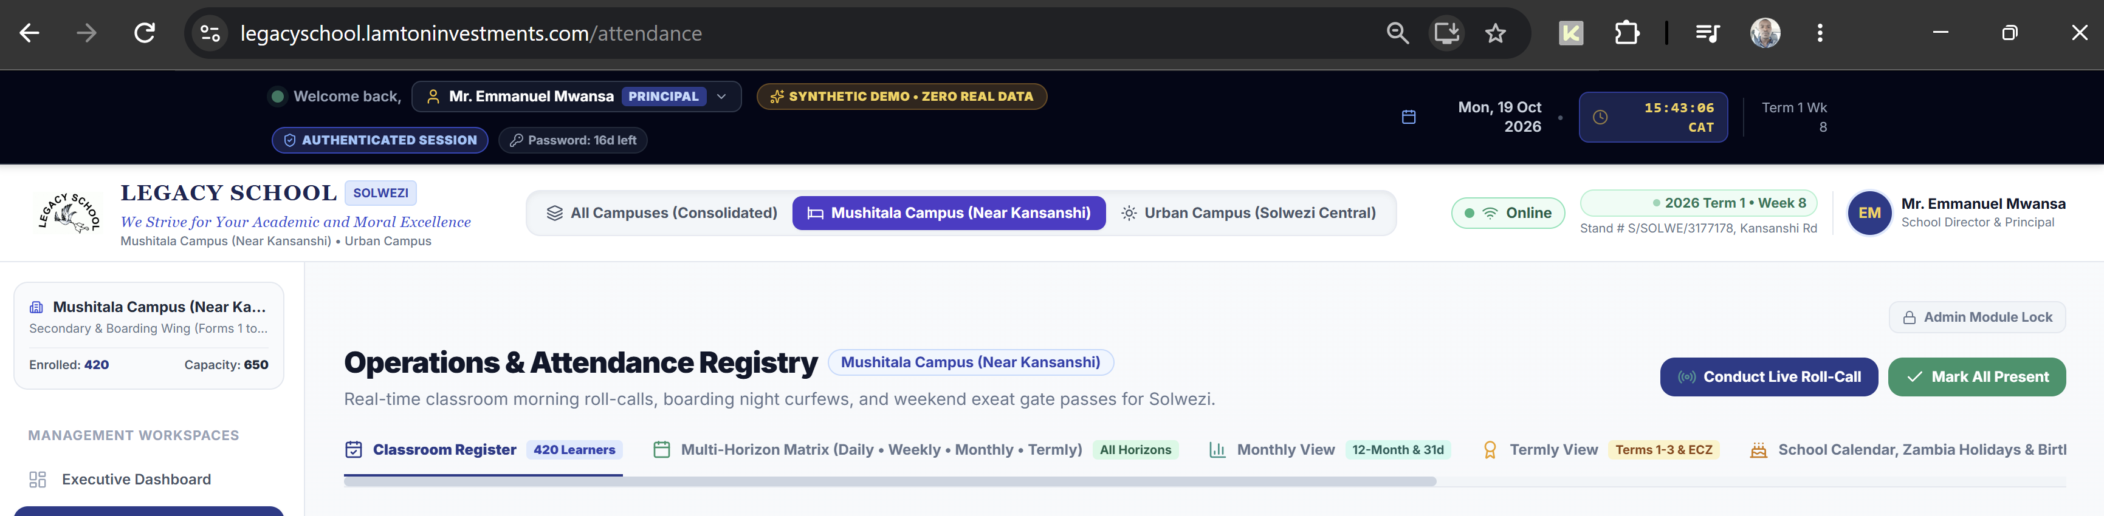
EXECUTIVE OVERSIGHT • LIVE MULTI-CAMPUS METRICS
Executive Command Center: Real-Time Governance for Director Emmanuel Mwansa
Single-Pane Sovereign Operations
✔ Unified Dual-Campus Switcher: Toggle instantly between Consolidated View, Mushitala Day Campus, and Kansanshi Boarding Campus.
✔ Live Financial Health Metrics: Tracks real-time collection rates (91.2%), term fee recovery, and authorized operational vouchers.
✔ Daily Attendance Intelligence: Instant monitoring of morning roll-calls across all 16 cohorts (97.4% current rate with zero paper lag).
✔ Cleaned Navigation & Ticking Clock: Ultra-slim institutional header featuring live Central Africa Time (CAT) synchronised to national time servers.
✔ Quick Resource Downloads: Direct 1-tap download of the Executive PowerPoint Deck, Android APK, and Stakeholder User Guide.
780 Enrolled Learners • 97.4% Attendance Rate • ZMW 1,824,000 Collected • Zero Variance

Slide 4
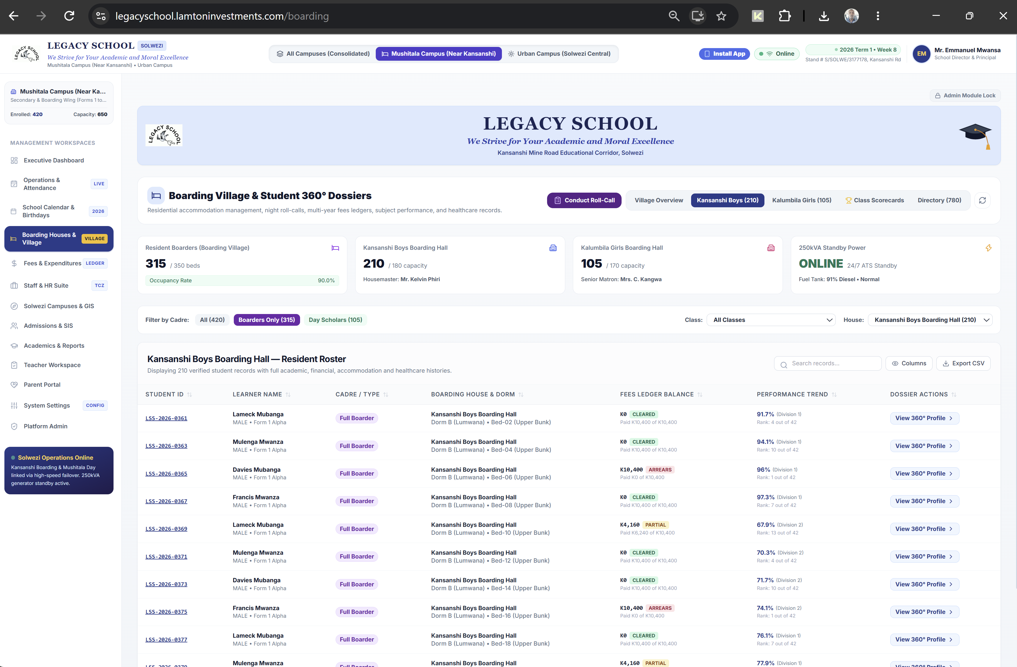
STUDENT INFORMATION SYSTEM (SIS) • ADMISSIONS
Admissions & Learner Registry: Digital Onboarding & KYC Compliance
Holistic Learner Identity Management
✔ Unique Zambian MoE Numbering: Issues permanent registration codes (e.g., LS-2026-0042) ensuring seamless national compliance.
✔ Cadre & Residence Assignment: Enforces strict segregation between Day Scholars (Mushitala) and Full Residential Boarders (Kansanshi).
✔ Verified Guardian Linkage: Captures biological and legal guardians with phone numbers (+260) for instant SMS notifications and Parent Portal access.
✔ Medical & Dietary Profiles: Tracks chronic conditions, allergies, and emergency blood groups accessible to the boarding nurse.
✔ Interactive Modal Roster: Instant editing of student records without background modal overlap or page reloads.
100% KYC Verified • Digital Student Folders • Automated Sibling Links

Slide 5
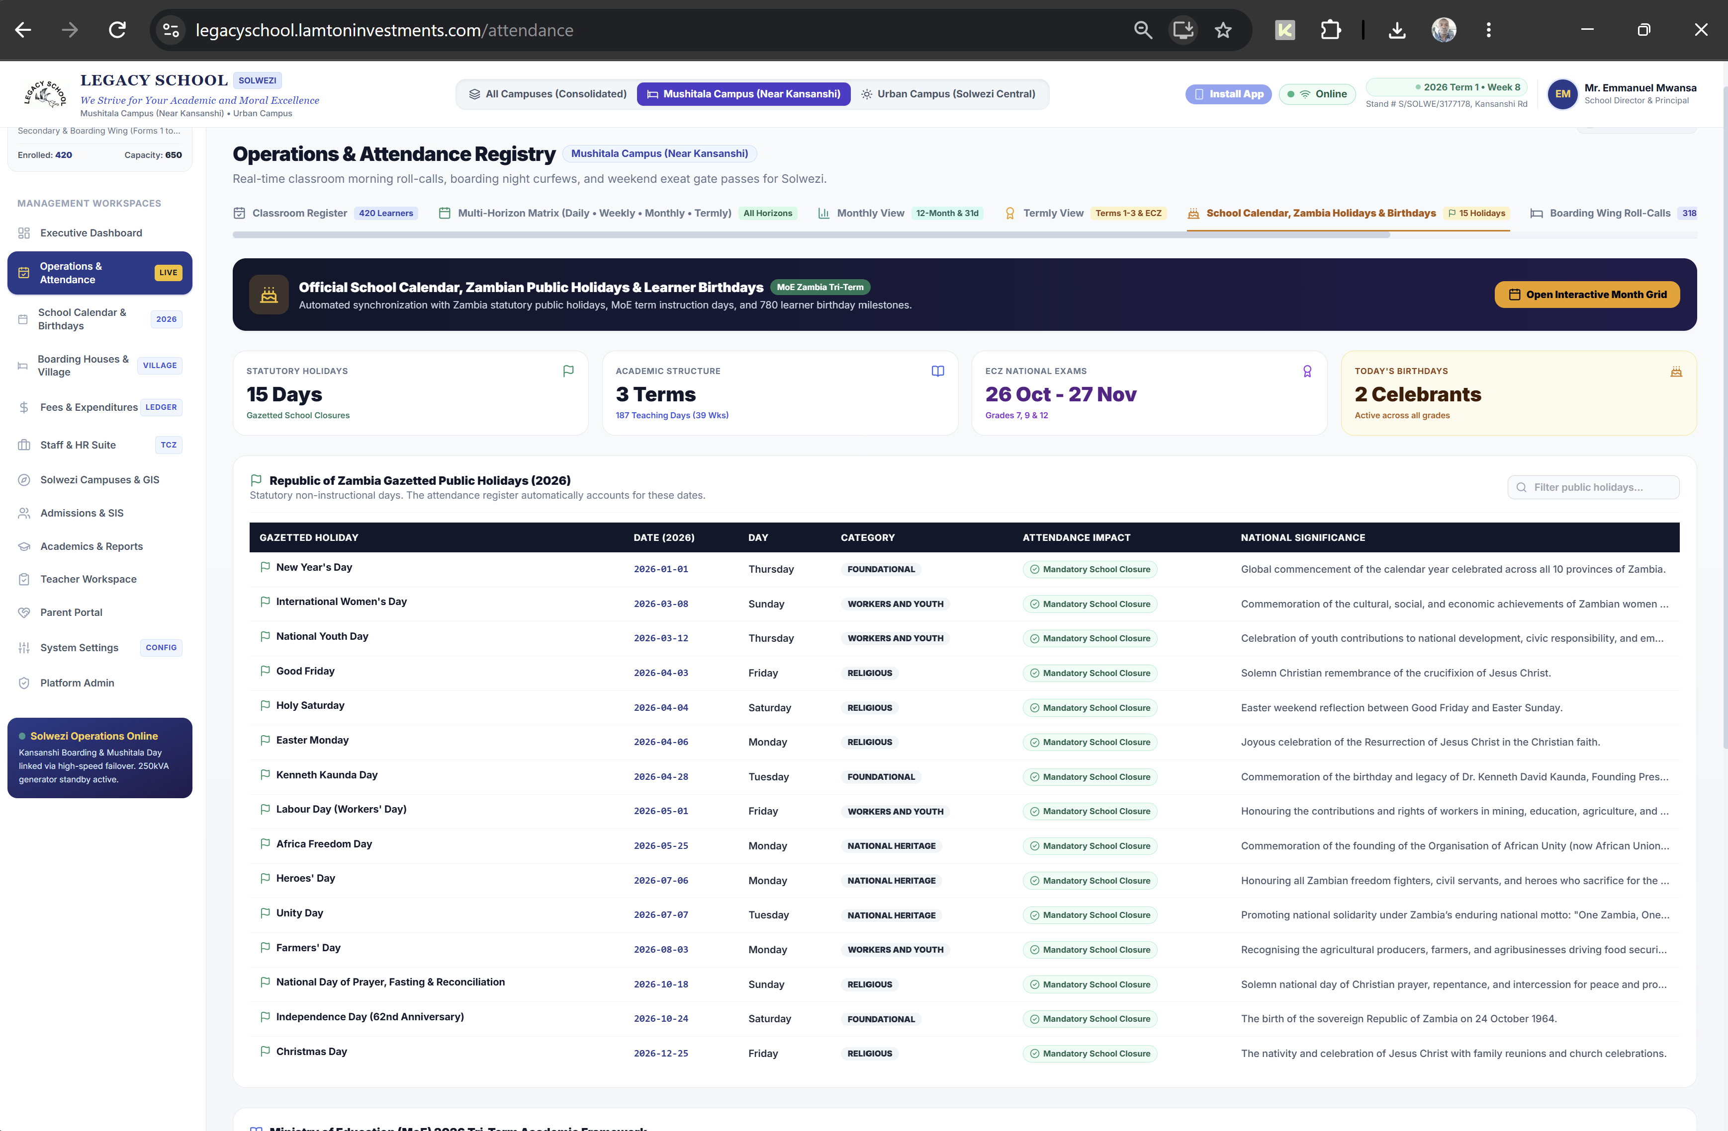
INSTITUTIONAL INTEGRITY • STANDARDIZED CORRESPONDENCE
Official Document Generator: Letters with Authentic School Crest & QR Verification
Tamper-Proof Digital Document Suite
✔ Full Suite of Letters: Generates Provisional Offer Letters, Official Acceptance Letters, Introduction / Visa Letters, and ECZ Exam Clearance.
✔ Authentic High-Definition Crest: Displays verified Legacy School Solwezi insignia, official motto, and Ministry registration numbers.
✔ Dynamic Verification QR Stamp: Every document embeds an anti-fraud cryptographic QR code verifiable on any smartphone camera.
✔ Authorized Signatory Blocks: Pre-formatted signatures and titles of Director Mr. Emmanuel Mwansa and Head of Admissions.
✔ 1-Click PDF Export: Produces pixel-perfect printable A4 PDF documents ready for physical dispatch or digital transmission.
Anti-Fraud QR Stamp • MOE/NWP/SOL/SEC/2026/044 • Instant PDF Generation

Slide 6
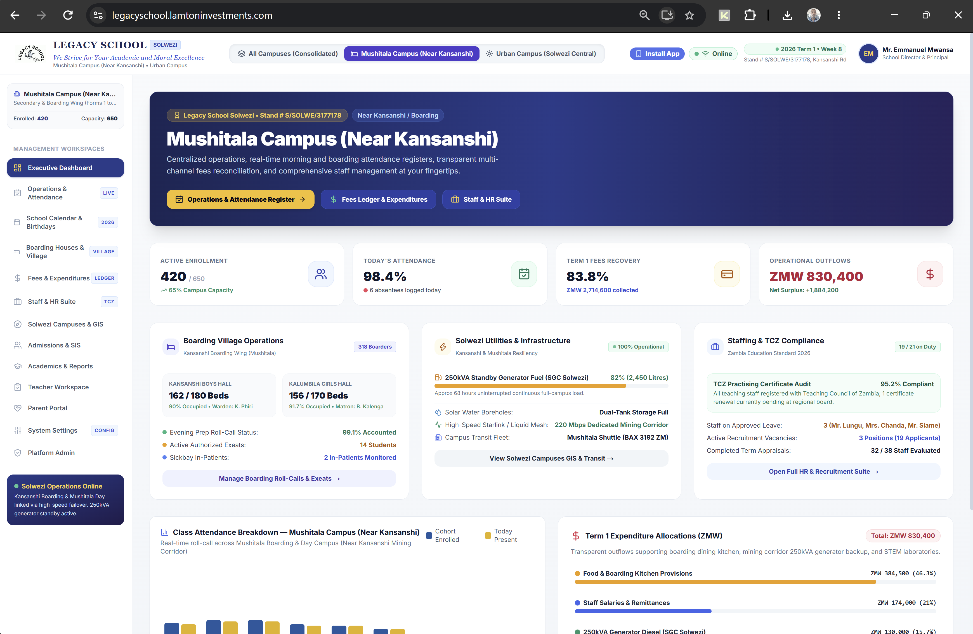
STATUTORY TRACKING • 5 OPERATIONAL HORIZONS
Multi-Horizon Attendance Matrix: From Morning Roll-Call to Annual Return
Precision Retention Monitoring
✔ Daily Morning Roll-Call: 1-tap 'Mark All Present' with instant toggle for late arrivals (with minutes) and illness excuses.
✔ Weekly Horizon Progression: Monitors attendance stability across Weeks 1 to 13 of Term 3, identifying engagement dips early.
✔ Monthly Academic Register: 31-day matrix matching statutory Ministry of Education classroom attendance registers.
✔ Termly & Annual Return: Aggregates 187 statutory instructional days, computing official DEBS statistical returns.
✔ ECZ Examination Gatekeeper: Automatically flags students below the mandatory 75% attendance threshold for examination intervention.
187 Annual School Days • 75% ECZ Threshold • Automated Parent SMS Alerts

Slide 7
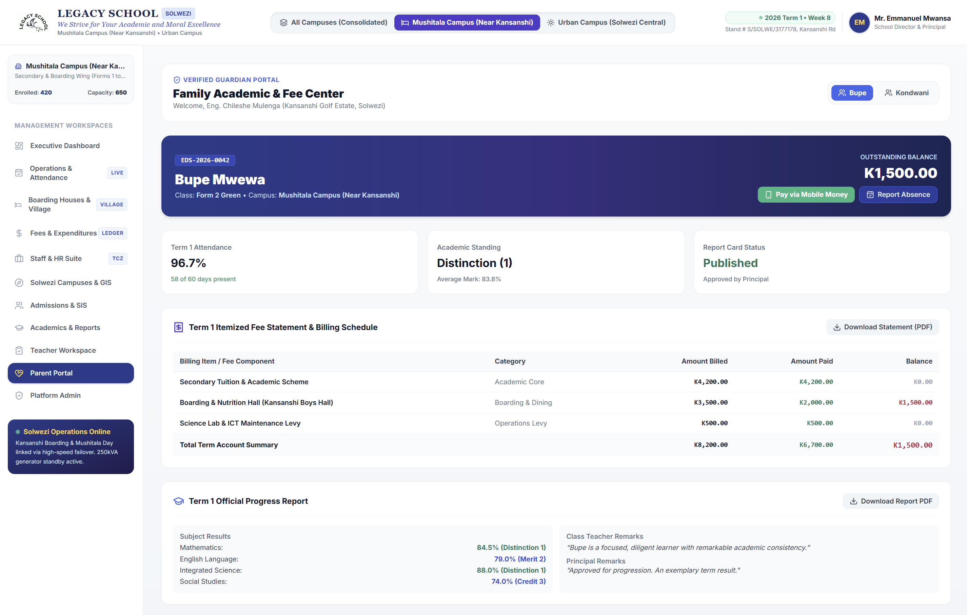
BURSARY & TREASURY • FINANCIAL ENGINEERING
Fees Management & Cashbook Control: Zero-Variance Financial Governance
Automated Multi-Channel Revenue Collection
✔ Zero-Variance Reconciliation: All 780 student ledger accounts match official receipts with zero discrepancy across Zanaco, Stanbic, and Mobile Money.
✔ Integrated Mobile Money: Direct push-prompt fee payment via Airtel Money and MTN MoMo with instant digital receipt dispatch.
✔ Multi-Campus Fee Isolation: Independent billing schedules for Urban Day Tuition (K2,800) and Mushitala Boarding (K10,400).
✔ Aged Debtors Intelligence: Visual ledger categorizing 30, 60, and 90+ day balances to systematically recover pending fee arrears.
✔ 2FA Protected General Ledger: Adjustments and disbursements require secondary financial authorization to prevent fraud.
ZMW 2.1M Tracked • Airtel & MTN MoMo • Debtors Ageing Analysis • Auditor-Ready

Slide 8
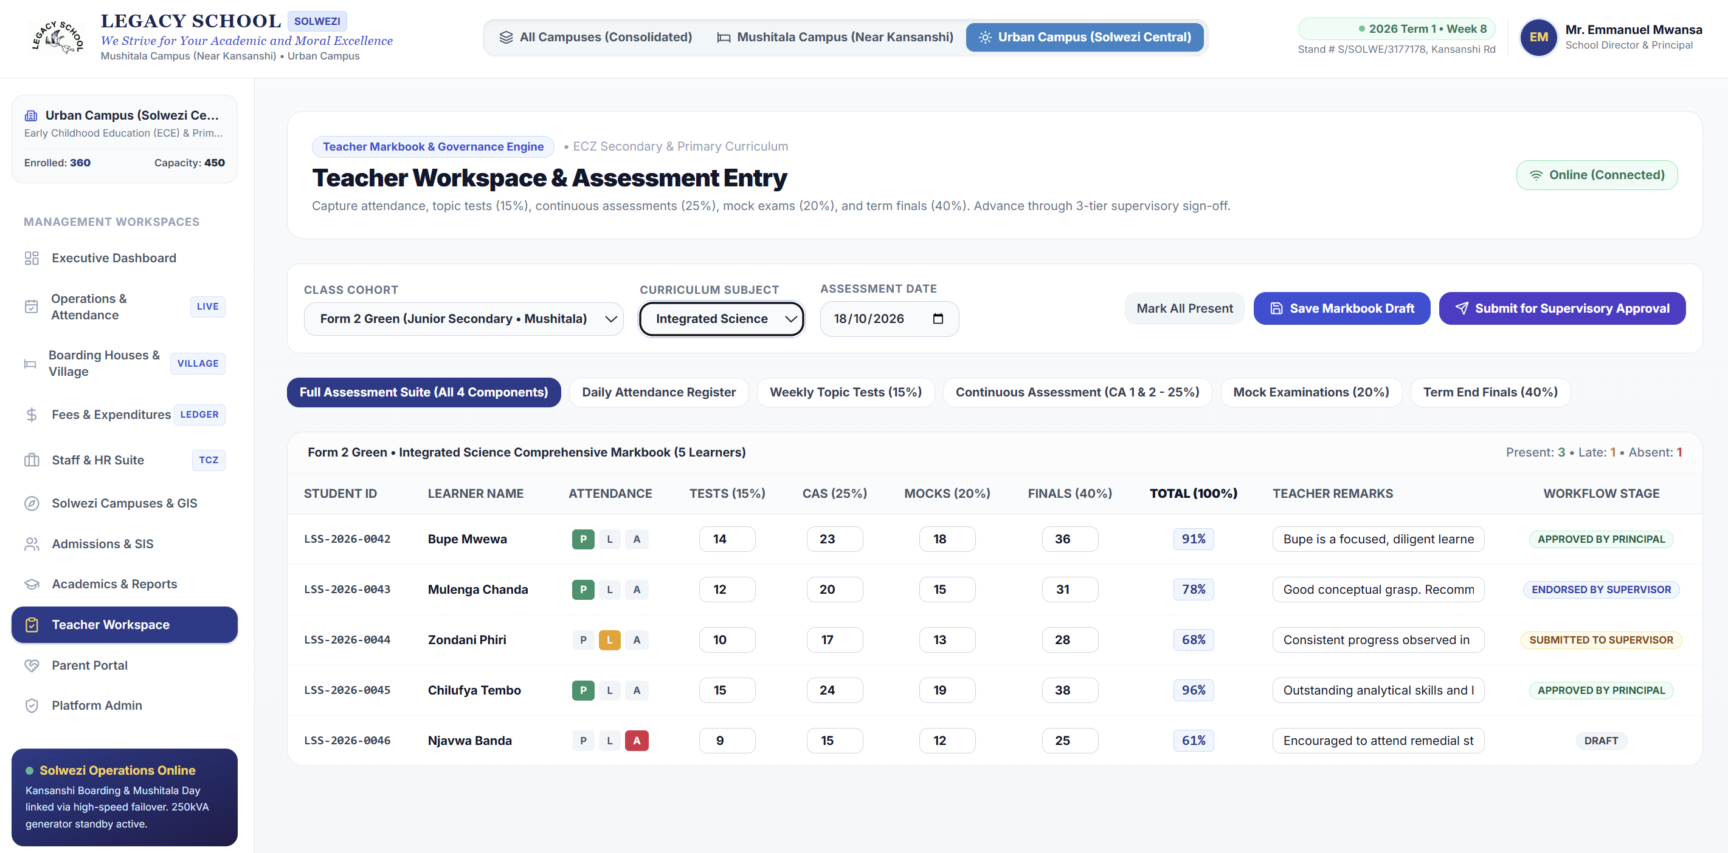
ACADEMICS & CURRICULUM • NATIONAL GRADING STANDARDS
Teacher Workspace: ECZ Assessment Suite & 3-Tier Supervisory Sign-Off
Standardized Scholastic Markbook
✔ All 16 Cohorts Selectable: Seamlessly switches between Early Years, Grades 1-7, and Forms 1-5 with full 30 to 44 student rosters.
✔ Examinations Council of Zambia (ECZ) Scale: Built-in distinction (1-2), merit (3-4), credit (5-6), pass (7-8), and fail (9).
✔ Continuous Assessment (CA) Weighting: Weekly Topic Tests (15%), CA (25%), Mock Exams (20%), and Term Finals (40%) = 100% total.
✔ 3-Tier Supervisory Workflow: Class Teacher submits -> Senior Teacher / HOD endorses -> Principal gives final approval before publication.
✔ 1-Click Batch Terminal Reports: High-resolution PDF report cards with school crest, grading legend, and teacher remarks.
ECZ 8-Point Scale • Continuous Assessment • 3-Tier Supervisory Sign-Off

Slide 9
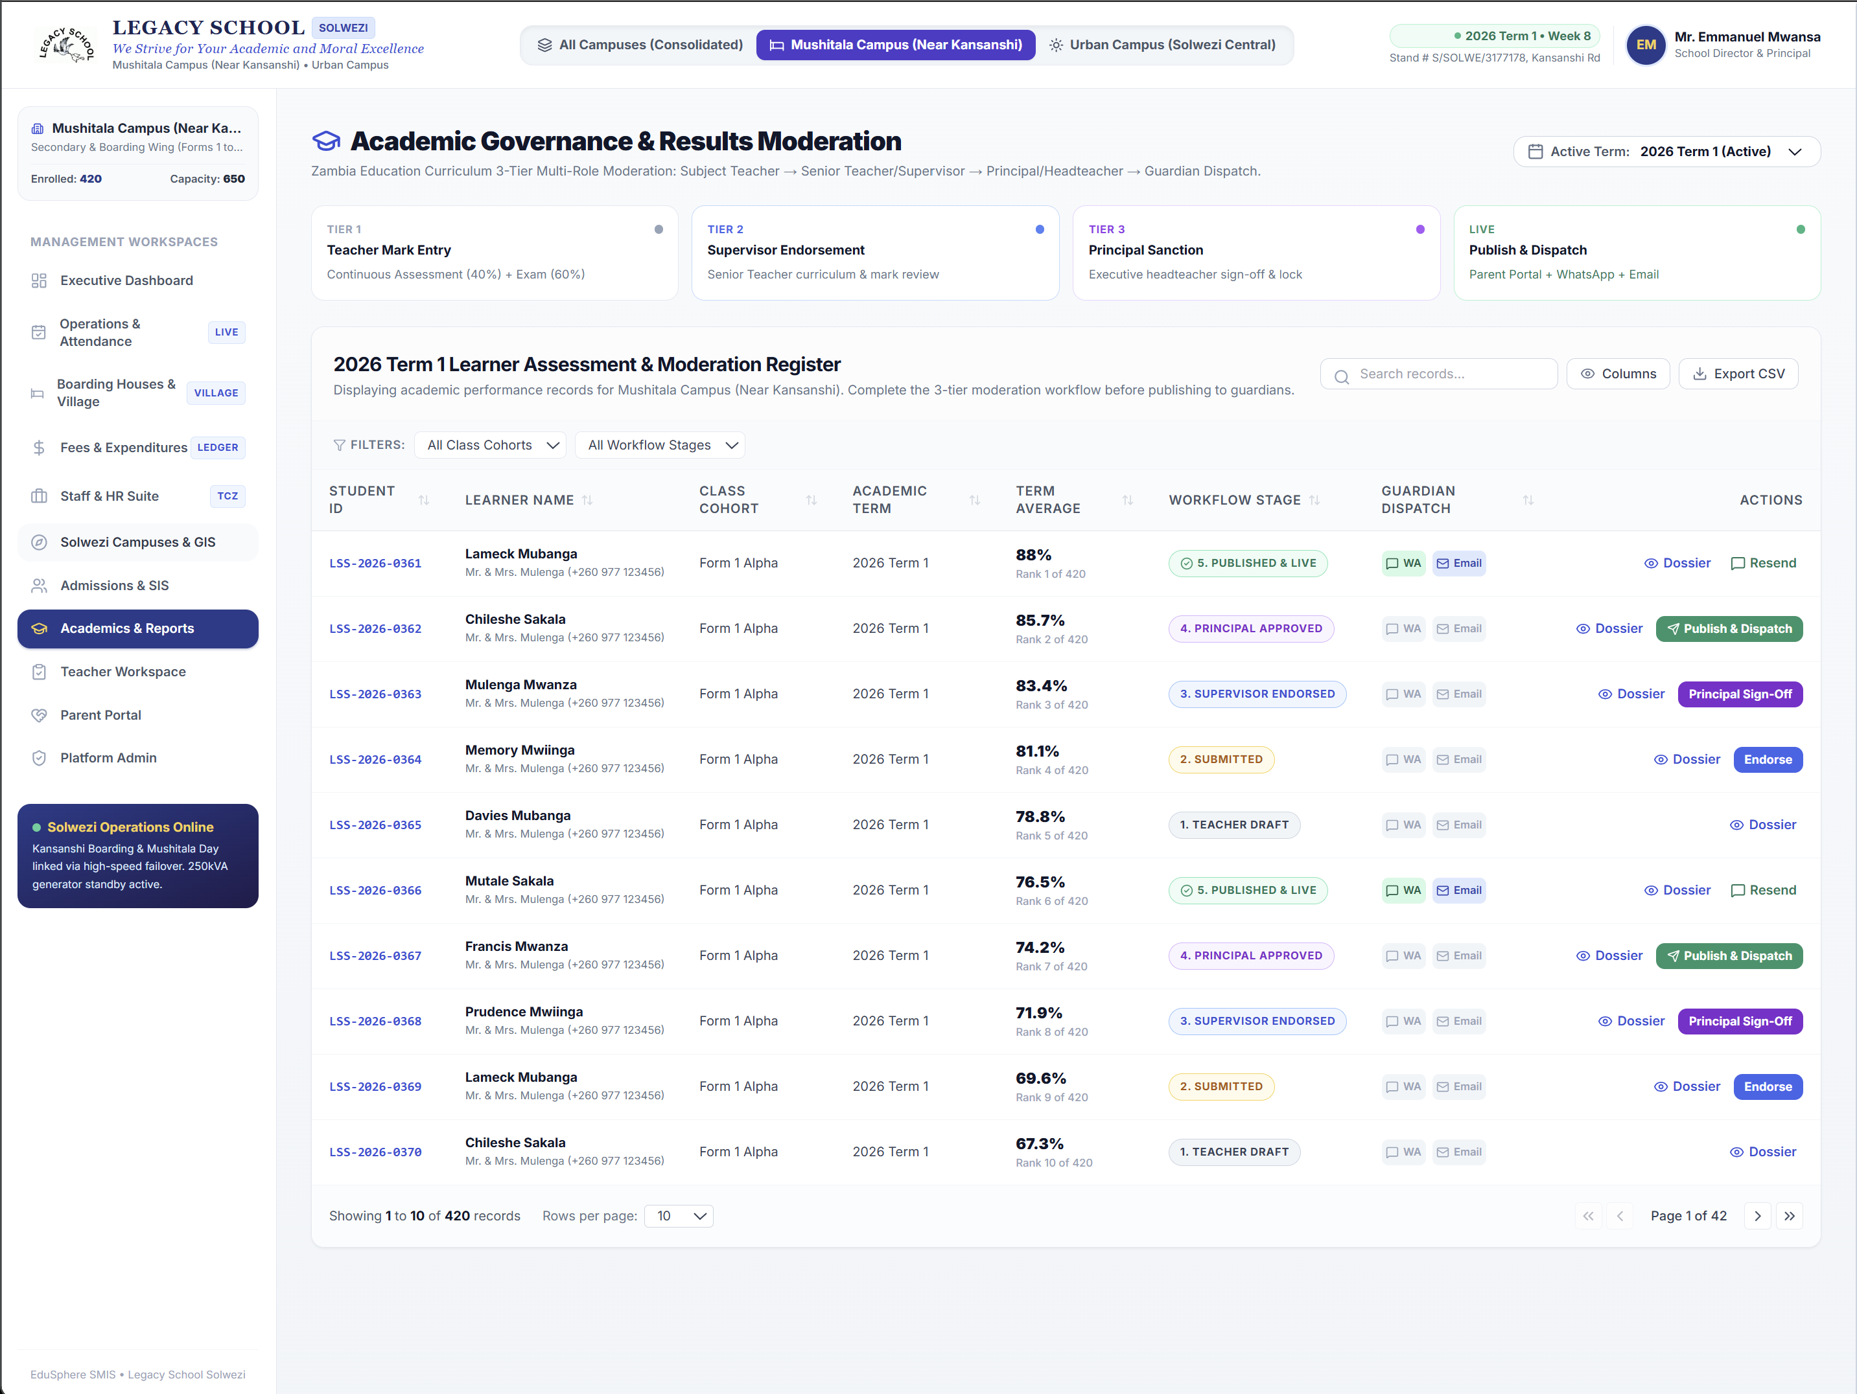
RESIDENTIAL CARE • KANSANSHI BOARDING CAMPUS
360° Boarding House Management: Pastoral Care & 21:00 Curfew Safeguarding
Holistic Pastoral Care & Resident Welfare
✔ Accommodation & Bed Inventory: Real-time room and bed allocations for 280+ boarders across Kansanshi Boys and Kalumbila Girls Halls.
✔ 21:00 Nightly Curfew Bed Check: Housemasters conduct digital roll-call on mobile phones; missing students trigger instant alerts to the Director.
✔ Digital Exeat Pass Workflow: Approval trail for weekend exeats, medical visits to Solwezi Hospital, and sports travel with SMS verification.
✔ Perimeter Gatehouse QR Scanner: Security officers at Kansanshi main gate scan mobile passes before barrier release.
✔ Catering & Dining Hall Rations: Meal attendance linked to resident headcount to optimize kitchen inventory and prevent food waste.
350 Certified Beds • 21:00 Digital Curfew • QR Exeat Gate Passes

Slide 10
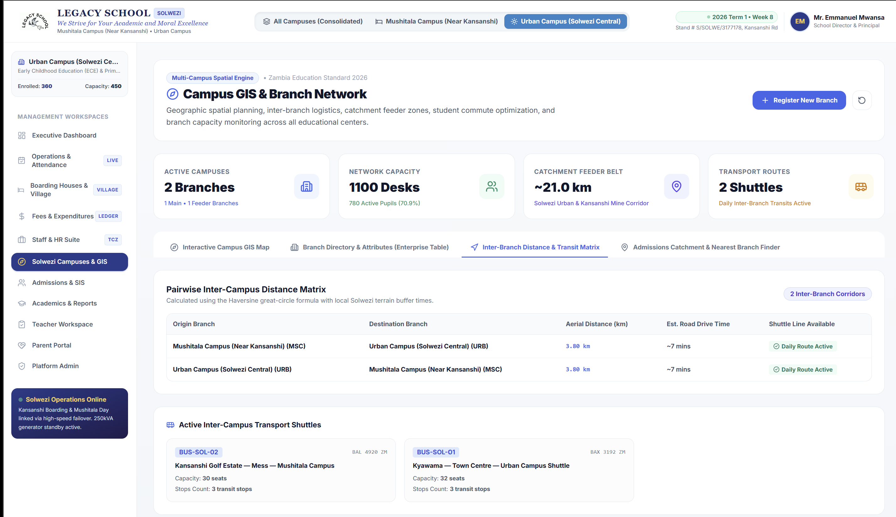
SPATIAL INTELLIGENCE • SMART BUS FLEET
Multi-Campus GIS & Smart Transport Telematics: Live Tracking & Safe Transit
Sovereign GIS & Student Transit Logistics
✔ Pairwise Road Distance Matrix: High-resolution satellite mapping calculates 3.80 km road distance (~7 mins drive time) between campuses.
✔ Contactless Smart ID Card Boarding: Learners carry smart PVC cards with NFC/QR codes tapped onto in-bus Android tablets.
✔ Instant Parent SMS Transit Alerts: '[EduSphere] Bupe Mwewa boarded BUS-SOL-02 at Kansanshi Golf Estate at 06:46 AM.'
✔ Wrong-Bus Lockout Protection: Tablet sounds an audible alert if a child boards the wrong shuttle route or attempts to exit at the wrong stop.
✔ Offline Store-and-Forward: Pockets along Kansanshi Road with poor cellular coverage store taps locally and auto-sync when reconnected.
3.8 km Inter-Campus Road • 4 Bus Routes • Automated Parent Transit SMS

Slide 11
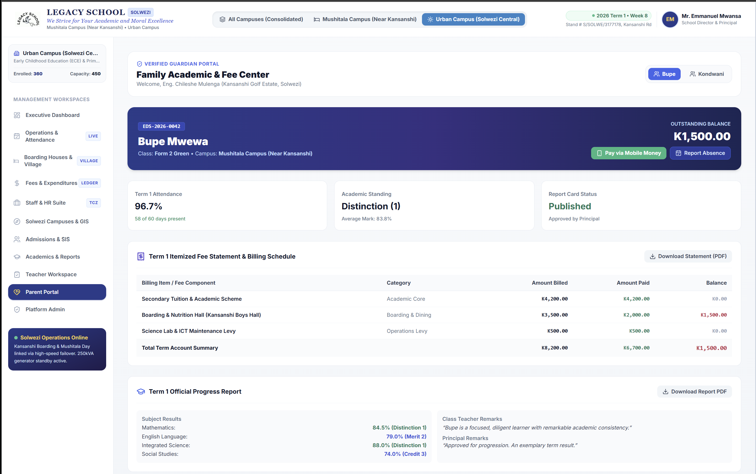
GUARDIAN SELF-SERVICE • PARENT ENGAGEMENT
Parent Portal: Multi-Child Family Academic, Attendance & Fee Center
Transparent Family Engagement
✔ Multi-Ward Family Switcher: Parents with multiple children across ECE, Primary, and Secondary toggle all records in one unified login.
✔ Historical Academic Progression: Multi-term trend charts illustrate subject growth and cohort standing over academic sessions.
✔ Instant Mobile Money Fee Payment: Direct tuition settlement via Airtel Money and MTN MoMo with instant digital receipt generation.
✔ Live Absence & Conduct Feed: Guardians receive immediate alerts regarding morning roll-call attendance, conduct, and commendations.
✔ Official Report Card Downloads: View and download high-resolution terminal report cards the moment they are approved by the Headteacher.
Multi-Ward Single Login • 1-Tap Mobile Money • Instant Report Card PDF

Slide 12
LEGACY SCHOOL SOLWEZI • EXECUTIVE STRATEGY & TECHNOLOGY DEPLOYMENT
Native Android Mobile App: Operational Agility in the Field
1. Mobile-First Field UX
Engineered for Mobility
• Package ID: com.legacyschool.edusphere
• Persistent Mobile Bottom Bar: Instant 1-tap navigation for Dashboard, Attendance, Boarding, Finance, and All Modules.
• One-Handed Smartphone Ergonomics: Optimized for teachers walking classroom rows and housemasters patrolling dorms.
• Ultra-Lightweight Footprint: Compact 4.1 MB binary that installs cleanly on entry-level Android smartphones.
2. Native Hardware Power
Native Device Integration
• Camera Barcode/QR Scanner: Scan student ID badges for instant cafeteria meal access, bus boarding, and gate exeats.
• Offline Store-and-Forward: Teachers take attendance without cellular internet; data syncs when Wi-Fi is detected.
• Safe Area Insets: Native padding respecting Android status bars and gesture navigation bars.
• Vibrate & Audio Feedback: Confirms successful barcode scans with tactile haptic confirmation.
3. Over-The-Air (OTA) Delivery
Seamless Distribution
• Live Production Bridge: Connects directly with https://legacyschool.lamtoninvestments.com.
• Instant Zero-Reinstall Updates: New features and fee updates reflect immediately without rebuilding the APK.
• Direct Server Hosting: Staff and parents download the APK directly from the school web portal.
• Play Store Ready: Android App Bundle (.aab) configured for Google Play Console submission if desired.

Slide 13
LEGACY SCHOOL SOLWEZI • EXECUTIVE STRATEGY & TECHNOLOGY DEPLOYMENT
Institutional Subscription Tiers & Licensing Architecture
ENTRY TIER
Starter Academic
ZMW 24,000 / year
$925 / year • ZMW 8,000 / term
Quota: Up to 350 Enrolled Learners
Core modules for small single-campus primary or secondary day schools:
✔ Operations & Attendance Register (Daily roll-call, MoE Form 12A)
✔ School Calendar & Birthday Roster (Term dates, holiday tracking)
✔ Academics & ECZ Gradebook Reports (Assessments, report cards)
MOST POPULAR
Professional SMIS
ZMW 42,000 / year
$1,615 / year • ZMW 14,000 / term
Quota: Up to 750 Enrolled Learners
Adds Boarding, Finance Inflows, and Teacher Workspaces:
✔ All Starter Academic Core Modules (Attendance, Calendar, Academics)
✔ Boarding Houses & Kansanshi Village (Bed allocations, 21:00 curfew, exeats)
✔ Fees Management & Expenditure Control (Mobile Money, cashbook, debtors ledger)
✔ Teacher Workspace & Lesson Plans (Syllabus pacing, pupil remarks)
COMPLETE SUITE • ACTIVE TIER
Sovereign Enterprise
ZMW 65,000 / year
$2,500 / year • ZMW 21,667 / term
Quota: 1,200+ Learners (Multi-Campus)
Complete institutional suite deployed for Legacy School Solwezi:
✔ All Professional SMIS Modules (Attendance, Boarding, Fees, Academics)
✔ Staff HR & Teaching Council of Zambia (TCZ) Compliance Suite
✔ Solwezi GIS & Campus Fleet Tracking (Minibus GPS telematics)
✔ Admissions SIS & Official Document Generator (Letters with QR stamp)
✔ Parent Portal Family Center & Automated WhatsApp/SMS Alerts
✔ Fixed Asset Management & Inventory Ledger
✔ Native Android Mobile APK (com.legacyschool.edusphere)
✔ Dual-Campus Multi-Tenant Consolidation (Mushitala Day & Kansanshi Boarding)

Slide 14
LEGACY SCHOOL SOLWEZI • EXECUTIVE STRATEGY & TECHNOLOGY DEPLOYMENT
Turnkey Implementation, Smart Bus Hardware & Executive ROI
Investment Component / Deliverable | Scope of Coverage & Specifications | Year 1 (ZMW) | USD Equiv.
EduSphere Sovereign Enterprise Core (Active Tier) | Full Multi-Campus License: SIS, Finance, Academics, GIS, Boarding, HR & Android APK | K 65,000 | $ 2,500
Implementation, Historical Seeding & Setup | Data migration of 780 students, 48 staff profiles, database configuration, and backup setup | K 28,000 | $ 1,075
Smart Bus Hardware (2 In-Vehicle Tablets) | 2x Rugged 7-inch Android In-Bus Tablets, NFC RFID readers, GPS mounts, and 4G SIM integration | K 19,500 | $ 750
Smart Student Contactless ID Cards (800 Cards) | 800 Dual-Frequency MIFARE 13.56MHz + QR printed PVC student smart identification badges | K 16,000 | $ 615
Staff Onboarding & Operational Training | Hands-on workshops for 48 staff (Bursars, HODs, Teachers, Matrons, Drivers, and Management) | K 14,500 | $ 560
TOTAL YEAR 1 CAPITAL & IMPLEMENTATION INVESTMENT | Complete sovereign school digital ecosystem with full warranty, SLA support, and daily backups | K 143,000 | $ 5,500
Return on Investment (ROI) Justification for Executive Management & Board:
1. Immediate Arrears Recovery: Automating parent Mobile Money prompts captures ~15% of the K279,000 pending fee balances within 30 days (+K41,850 recovered).
2. Printing Cost Elimination: Eliminating physical carbon-copy paper receipts and printed report cards saves ~K22,000 annually.
3. Fuel & Route Optimization: Smart GPS route stop planning saves ~10-15% on diesel transport costs across both shuttles.

Slide 15
LEGACY SCHOOL SOLWEZI • EXECUTIVE STRATEGY & TECHNOLOGY DEPLOYMENT
Deployment Timeline: 4-Week Fast-Track Execution Schedule
Week 1: Sovereign Setup
✔ Deploy Dockerized PostgreSQL & Next.js engine
✔ Configure automated nightly off-site database backups
✔ Migrate 780 legacy learner profiles and fee balances
✔ Finalize custom theme colors & school crest branding
Week 2: Smart Bus & Mobile
✔ Procure and program 800 MIFARE NFC student ID cards
✔ Install 2x Android in-bus GPS telematics tablets
✔ Deploy native Android APK to staff devices
✔ Test driver route navigation and geofenced bus stops
Week 3: Staff Training
✔ Conduct workshops for 48 staff members across cadres
✔ Train teachers on topic test, CA, and mock exam entry
✔ Train bursar and finance staff on cashbook vouchers
✔ Conduct mock roll-call attendance on shuttle routes
Week 4: Full Cutover & Go-Live
✔ Dispatch parent SMS credentials and onboarding guide
✔ Open Airtel & MTN Mobile Money payment channels
✔ Publish official Term 3 digital report cards
✔ Transition to 24/7 technical monitoring & SLA support
Enterprise Service Level Agreement (SLA): 99.9% Uptime Guarantee • Daily Encrypted Off-Site Backups • Dedicated On-Call Technical Support for Solwezi Operations

Slide 16
SUMMARY OF RECOMMENDATIONS FOR EXECUTIVE APPROVAL
1. Approve Sovereign SMIS Deployment: Authorize transition from manual paper to EduSphere across Mushitala and Kansanshi campuses.
2. Greenlight Smart Bus Hardware Integration: Commission in-bus Android telematics tablets and 800 NFC learner ID cards for automated boarding verification and SMS parent alerts.
3. Activate Integrated Mobile Money Gateway: Formalize Airtel & MTN merchant aggregators to allow instant parent tuition settlements, reducing aged debt.
4. Deploy Native Android APK to Field Staff: Authorize rollout of com.legacyschool.edusphere for classroom roll-calls, curfew bed checks, and gate passes.
5. Authorize 4-Week Rollout Roadmap: Direct the ICT and Academic departments to commence staff training and data validation for full Term 3 operation.
Prepared with dedication for Legacy School Solwezi • Managing Director & Principal: Mr. Emmanuel Mwansa
'We strive for your academic and moral excellence.'

