Slide 1


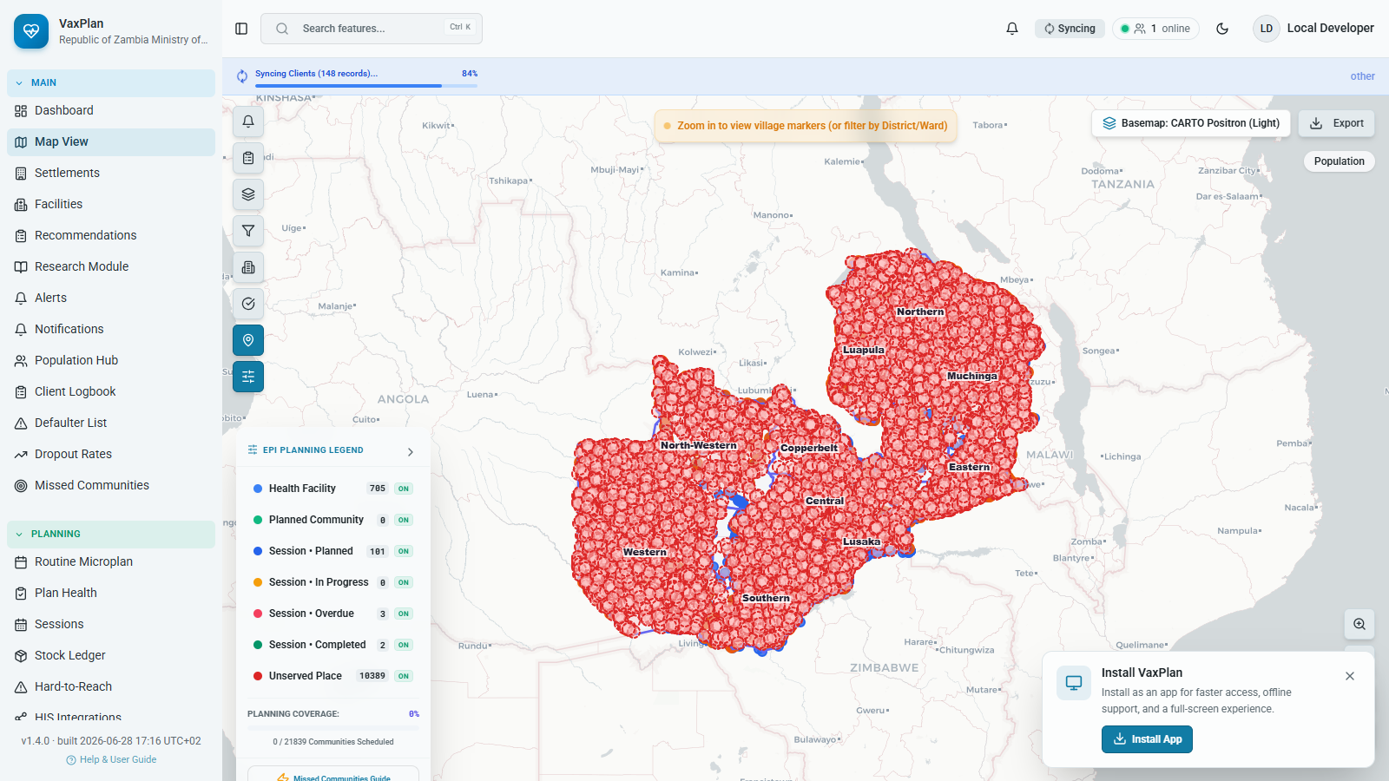
GIS-enabled Immunization Microplanning and Planning Platform
Digital Health Technical Working Group briefing
Zambia example screenshots | Republic of Zambia Ministry of Health
Live app evidence
Light-theme screenshot from the working VaxPlan Zambia planning context.
Notes:
Open by positioning VaxPlan as a planning and accountability platform, not simply a mapping tool.
The screenshot is intentionally shown on the title slide to signal that the briefing is grounded in working software and uses Zambia as the example country.

Slide 2
Why This Presentation
VaxPlan, 2026
Purpose for the Digital Health TWG
Explain VaxPlan in clear, non-specialist language.
1
Show how digital microplanning can improve visibility, coordination and follow-up.
Shared national planning workspace for teams and partners
Confirm alignment with WHO, UNICEF and Gavi immunization guidance.
3
Identify decisions needed for pilot readiness and governance.
Linked views: map, workflow, reporting
15
Slides for TWG review and decision
VaxPlan | Digital Health Technical Working Group
02
Notes:
This slide sets expectations: the TWG is being asked to review the platform as part of the digital health ecosystem.
Emphasize plain language: VaxPlan connects planning data, GIS evidence and workflow follow-up.

Slide 3
What Is Immunization Microplanning?
WHO, 2015; WHO and UNICEF, 2017
A bottom-up planning process that starts from the health-facility catchment area.
Identify
Plan
Monitor
Plain explanation
Which communities, settlements and population groups must be reached.
Where sessions happen, who is responsible, what resources are needed, and when teams go.
Whether sessions happened, drop-outs reduced, and missed communities were followed up.
Microplanning turns a national immunization goal into practical local tasks: villages to visit, staff to assign, vaccines to carry, sessions to run and gaps to close.
VaxPlan | Digital Health Technical Working Group
03
Notes:
Define microplanning as an operational planning process rather than a document.
For non-public-health technical officers, compare it to converting a national strategy into a facility-level workplan with geospatial evidence.

Slide 4
Global Guidance: What Good Microplans Do
WHO and UNICEF, 2017; UNICEF, 2023; Gavi, 2024
WHO RED approach
UNICEF guidance
Use district and facility microplans to improve access, reduce drop-outs, supervise regularly and monitor data.
Use local data to identify unreached and zero-dose children, map settlements and plan service delivery.
Gavi priorities
Digital health implication
Focus resources on equity, zero-dose communities, resilient systems and measurable implementation results.
Microplans should be visible, reviewable, reusable and linked to routine reporting and logistics.
Core message: guidance asks programmes to identify who is missed, plan how to reach them, monitor delivery and act on gaps.
VaxPlan | Digital Health Technical Working Group
04
Notes:
Summarize global guidance without using technical jargon.
Make clear that VaxPlan digitizes these steps; it does not replace policy or national standards.

Slide 5
The Current Problem
WHO and UNICEF, 2017; VaxPlan, 2026
Paper-based plans
Weak catchment visibility
Stock and logistics gaps
Hard to update, aggregate or audit.
Teams may not see settlements outside routine routes.
Session plans can be disconnected from vaccine and cold-chain readiness.
Missed settlements
Limited accountability
Fragmented reporting
Zero-dose and under-reached communities are not always visible.
Approvals, changes and follow-up actions are difficult to trace.
Maps, sessions, stock and dashboards often sit in separate files.
Planning quality is not only a data issue. It is also a workflow, visibility and accountability issue.
VaxPlan | Digital Health Technical Working Group
05
Notes:
Frame the problem in operational terms: a plan that cannot be seen, updated or verified becomes weak quickly.
Use this slide to connect public-health and ICT audiences around a shared systems problem.

Slide 6
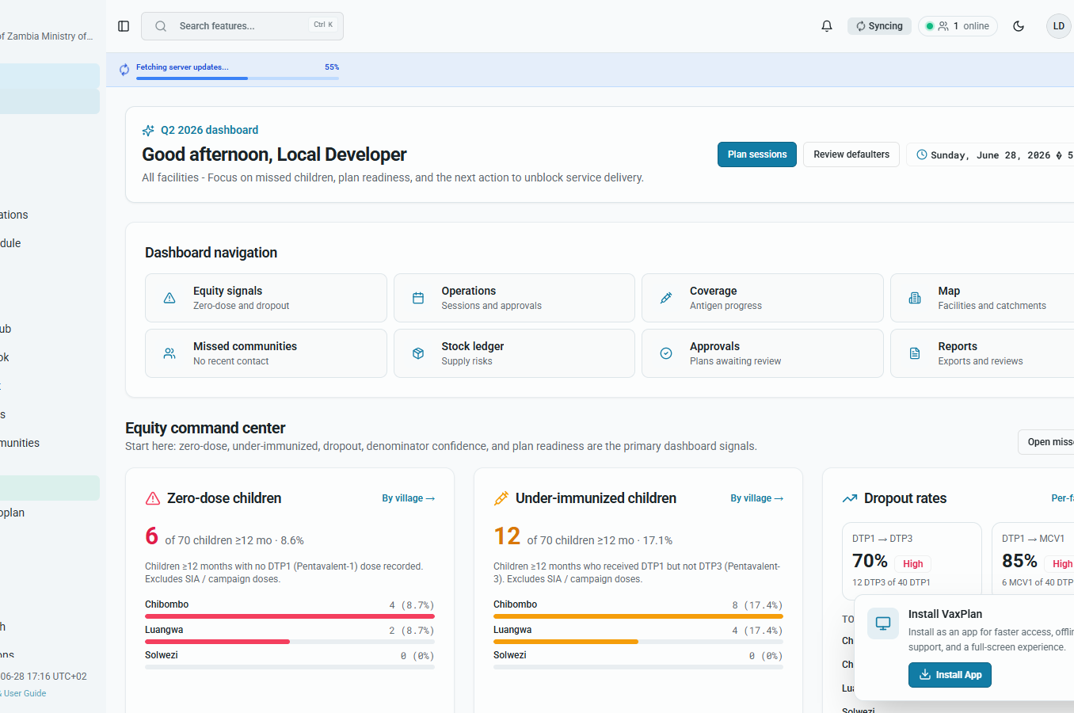
Why Digital Microplanning Is Needed Now
WHO, 2020; Gavi, 2024
Coverage gaps are increasingly local and require precise follow-up.
Teams need shared, up-to-date plans rather than static files.
Partners need a transparent view of priorities, progress and bottlenecks.
Digital systems can preserve an audit trail from plan creation to implementation review.
Dashboard evidence
A national workspace can show planning status, alerts and programme activity in one place.
VaxPlan | Digital Health Technical Working Group
06
Notes:
Explain that digital microplanning is about decision support, not technology for its own sake.
Point to the dashboard as evidence that VaxPlan creates a shared operational picture.

Slide 7
What VaxPlan Is and Who It Serves
VaxPlan, 2026
VaxPlan is a GIS-enabled planning, coordination, logistics, reporting and accountability platform for immunization teams.
Health facilities
District teams
National EPI
Build catchment-based microplans and session plans.
Review plans, coverage gaps, supervision and resource needs.
Coordinate standards, approvals, reporting and programme oversight.
Partners
ICT teams
M&E teams
Support evidence-based targeting, financing and implementation review.
Manage users, roles, integrations, data governance and deployment.
Track indicators, missed communities, sessions and follow-up actions.
VaxPlan | Digital Health Technical Working Group
07
Notes:
State clearly that VaxPlan serves multiple roles, not only GIS officers.
For ICT officers, highlight user roles, integrations and deployment; for programme teams, highlight planning and review.

Slide 8
How VaxPlan Addresses the Problem
VaxPlan, 2026
From paper plans
->
to structured digital microplans
From unknown catchments
->
to mapped facilities, settlements and service areas
From separate logistics files
->
to session and stock visibility
From late review
->
to approvals, notifications and dashboards
From missed settlements
->
to explicit missed-community and zero-dose follow-up
VaxPlan strengthens the microplanning cycle: identify, plan, resource, approve, implement, report and improve.
VaxPlan | Digital Health Technical Working Group
08
Notes:
Use this as the bridge from problem to product.
Describe the shift as a controlled workflow: data enters once and is reused for maps, sessions, logistics and reports.

Slide 9
Core Features and Functionality
VaxPlan, 2026
1
GIS facility and community mapping
2
Catchment area visibility
3
Outreach and session planning
4
Population and settlement planning
5
Vaccine stock and logistics linkage
6
Role-based access control
7
Dashboards and reporting
8
Microplan generation and review
9
Workflow notifications
VaxPlan | Digital Health Technical Working Group
09
Notes:
This slide is the feature catalogue. Keep the narration concise and connect each feature to a planning problem.
Mention that the platform links these features into one workflow rather than treating them as separate tools.

Slide 10
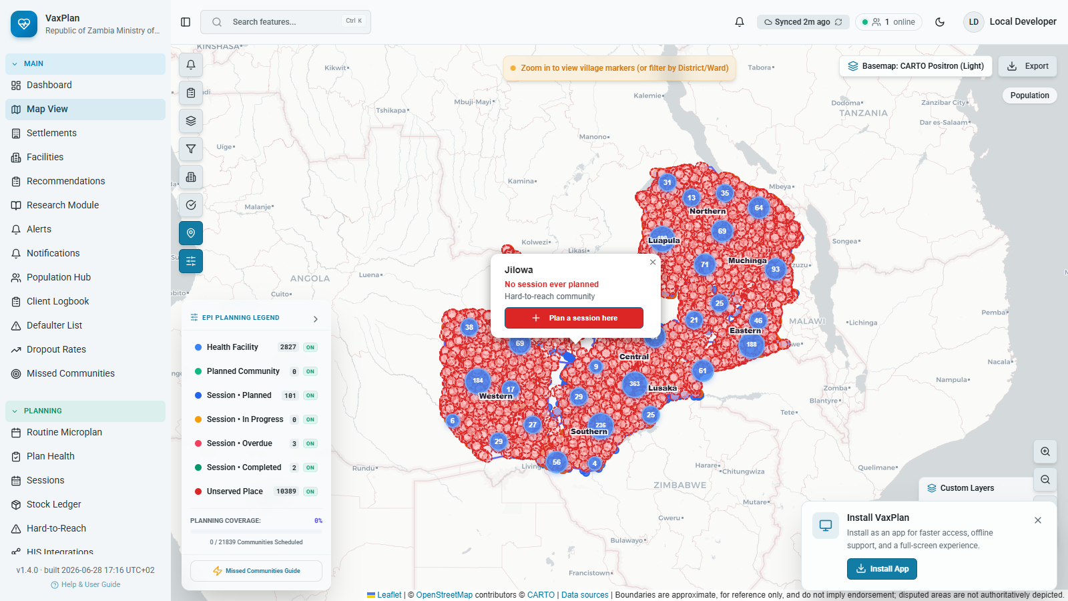
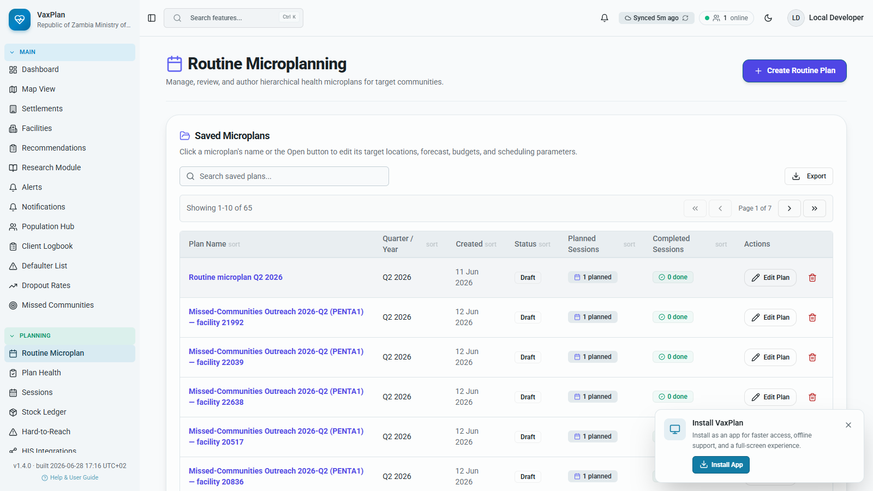
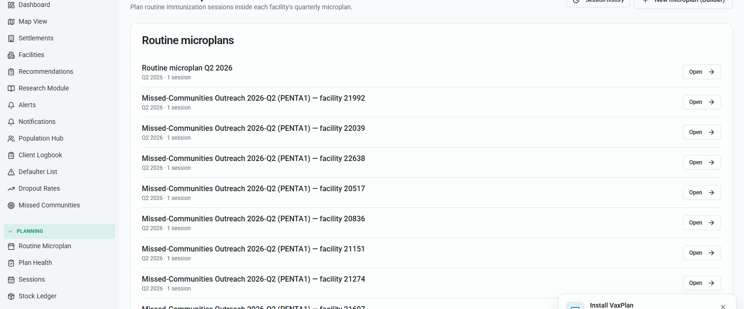
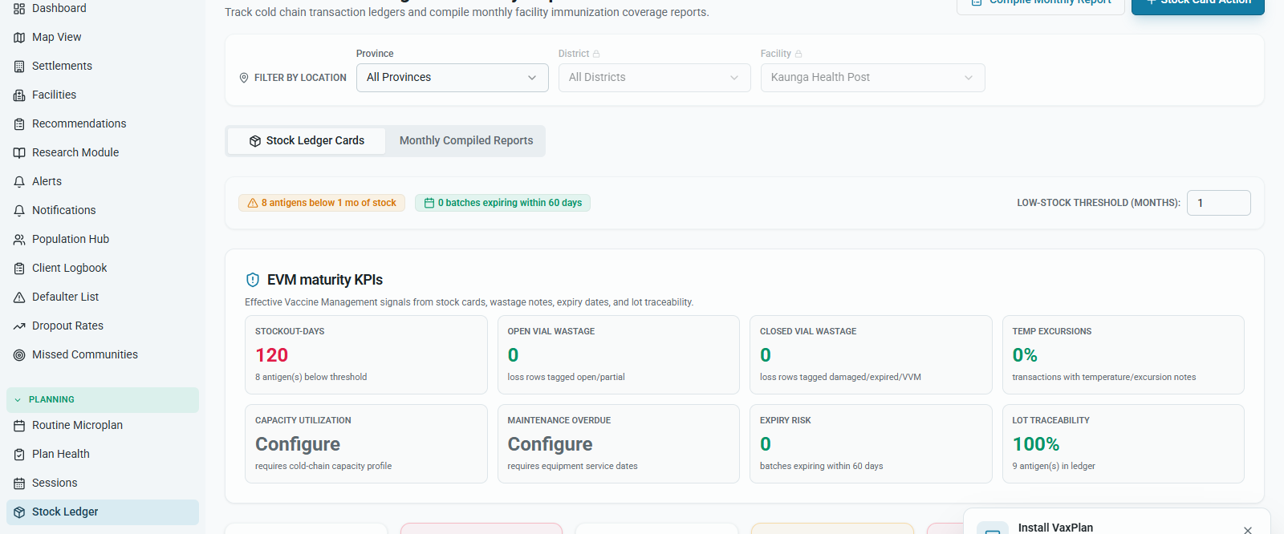
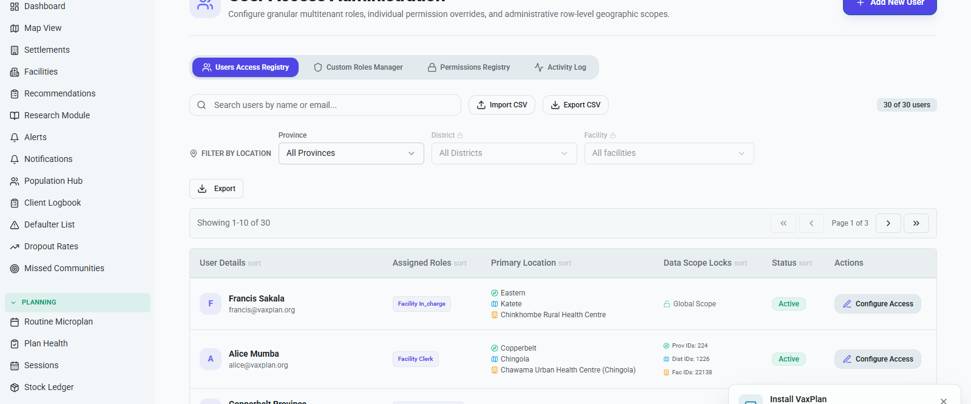
Demonstration Screenshots: Evidence From the App
VaxPlan, 2026
GIS map
Point intelligence
Microplan workspace
Shows mapped communities, facilities, boundaries and planning layers.
Shows location analysis for selected map points and service planning context.
Shows structured plan creation and review, not just map display.
Session planning
Stock/logistics linkage
Role-based user views
VaxPlan | Digital Health Technical Working Group
10
Notes:
Use the screenshots as proof points, not decoration.
Call out that each screenshot demonstrates a different operational function: GIS, intelligence, microplanning, sessions, logistics and role control.

Slide 11
Alignment to Global Standards
WHO and UNICEF, 2017; WHO, 2020; UNICEF, 2023; Gavi, 2024
WHO RED
UNICEF zero-dose guidance
Facility and district microplans; data use; supportive supervision; monitoring of drop-outs and coverage.
Identify missed communities, use local settlement evidence and plan outreach based on need.
Gavi equity priorities
Digital health practice
Target zero-dose children and missed communities; strengthen health systems and accountability.
Reusable data, role controls, review workflows and dashboards for decision-making.
Interpretation: VaxPlan operationalizes guidance by making facility-level planning data visible, reviewable and actionable.
VaxPlan | Digital Health Technical Working Group
11
Notes:
Clarify that alignment means VaxPlan supports recommended planning practices; it does not claim endorsement by WHO, UNICEF or Gavi.
Use simple terms: VaxPlan helps teams find the missed, plan the service, track the work and review the result.

Slide 12
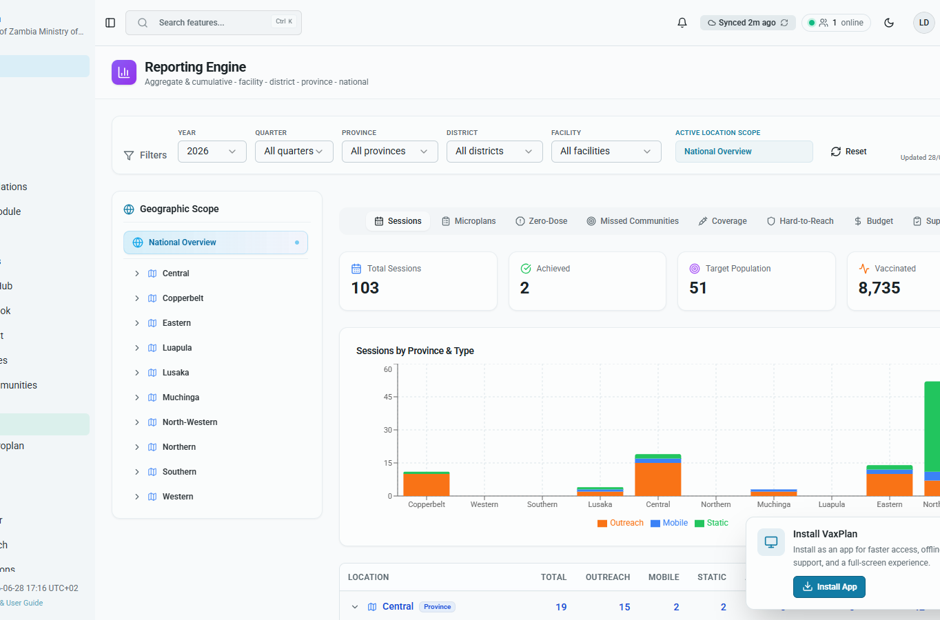
Value for Ministries of Health and Partners
VaxPlan, 2026
Improves visibility of facility catchments, populations and missed places.
Supports transparent planning review across facility, district and national levels.
Links microplans to sessions, stock readiness and implementation monitoring.
Creates evidence for partner coordination, resource allocation and accountability.
Reports evidence
Dashboards and exports help convert implementation activity into reviewable programme evidence.
VaxPlan | Digital Health Technical Working Group
12
Notes:
Speak to value by audience: MoH leadership gets visibility, districts get planning tools, partners get evidence, ICT gets governance controls.
Emphasize that value comes from integrated workflow, not from map display alone.

Slide 13
Implementation and Pilot Approach
VaxPlan, 2026
1
2
3
4
5
1. Prepare
2. Configure
3. Pilot
4. Review
5. Scale
Confirm governance, users, facilities, boundaries, population sources and integration needs.
Set country profile, vaccines, roles, reporting periods, modules and data access rules.
Select districts, digitize microplans, plan sessions and test reporting loops.
Assess usability, data quality, operational fit, training needs and sustainability.
Refine SOPs, onboarding, hosting, support model and national rollout plan.
Pilot principle: start small enough to learn, but complete enough to test the full microplanning workflow.
VaxPlan | Digital Health Technical Working Group
13
Notes:
Recommend a controlled pilot rather than an immediate full national deployment.
The pilot should test governance, data readiness, user training, reporting and technical support.

Slide 14
Risks, Assumptions and TWG Decision Points
VaxPlan, 2026
Data quality
User adoption
Validate facility lists, boundaries, population layers and community records before pilot decisions. Mitigation: data readiness checklist and district review.
Users may see digital microplans as extra work if workflows are not aligned. Mitigation: role-based training and simple SOPs.
Interoperability
Sustainability
Stock, DHIS2/HMIS or identity integrations may vary by country. Mitigation: phased integration plan.
Hosting, support and ownership must be clear before scale. Mitigation: MoH-led governance and partner support model.
Decision points
Approve pilot scope; confirm data governance; nominate technical and programme focal persons; agree success indicators; approve next implementation workshop.
VaxPlan | Digital Health Technical Working Group
14
Notes:
Close the main narrative by making the TWG ask explicit.
The key decisions are governance, pilot scope, focal persons, success indicators and next workshop timing.

Slide 15
References
Harvard style
Gavi (2024) Gavi 5.0 strategy and immunisation systems strengthening guidance. Geneva: Gavi, the Vaccine Alliance. Available at: https://www.gavi.org/.
UNICEF (2023) Immunization microplanning and zero-dose/missed communities guidance. New York: United Nations Children's Fund. Available at: https://www.unicef.org/immunization/.
WHO (2015) Immunization in practice: a practical guide for health staff. Geneva: World Health Organization.
WHO (2020) Immunization Agenda 2030: a global strategy to leave no one behind. Geneva: World Health Organization. Available at: https://www.immunizationagenda2030.org/.
WHO and UNICEF (2017) Reaching Every District: a guide to increasing coverage and equity in all communities in the African Region. Geneva/New York: World Health Organization and UNICEF.
VaxPlan (2026) VaxPlan local development instance, Zambia example screenshots and VaxPlan brand resources captured for Digital Health TWG briefing, 28 June 2026.
Note: screenshots are embedded from the working VaxPlan app and are used as product evidence.
VaxPlan | Digital Health Technical Working Group
15
Notes:
Use this slide to acknowledge the sources used for the briefing.
Clarify that screenshots are from the local VaxPlan working instance and global guidance references are used to frame alignment.

