Slide 1
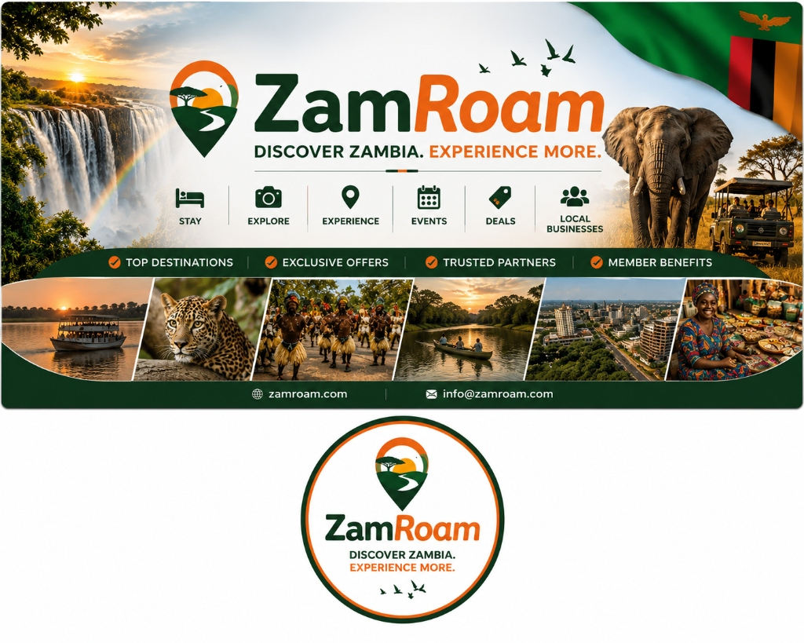
ZAMBIA TOURISM, CONNECTED
ZamRoam
Discover Zambia.
Plan with confidence.
Experience more.
A single digital platform for visitors, tourism businesses, communities and destination stakeholders.
01
Notes:
Open with the platform promise: one place to discover, prepare, book and participate in Zambia tourism.
[Sources]
Local application source and repository assets: C:/visitzambia

Slide 2

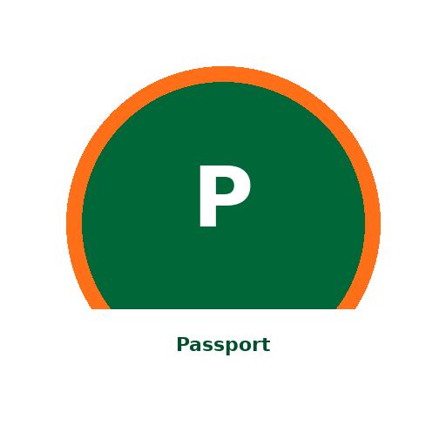


ZAMROAM PLATFORM
One app supports the whole tourism journey
ZamRoam connects inspiration, practical travel support and trusted participation in one responsive experience.
Explore
Prepare
Places, stays, experiences, categories and destination search
Maps, safety guidance, local phrases, permits and offline trails
Plan & transact
Operate
Saved lists, collaborative trips, bookings, reviews and member benefits
Provider registration, vetting, redemptions, content management and audit trails
02
Notes:
The product is intentionally multi-sided: it serves travellers while giving tourism operators and administrators the tools to keep the ecosystem useful and trusted.
[Sources]
Local application source and repository assets: C:/visitzambia

Slide 3
VISITOR EXPERIENCE
Discovery starts with Zambia
Destination-led search
Find places and stays by name, province, destination or experience category.
Rich local context
Move beyond listings into ceremonies, landmarks, safari trails and practical destination knowledge.
The result is a guide to the country, not just a storefront.
03
Notes:
The main Explore experience is Zambia-specific, with Victoria Falls, South Luangwa and local categories embedded in the product copy and data model.
[Sources]
Local application source and repository assets: C:/visitzambia

Slide 4


SMART TRAVEL SUPPORT
Preparation stays useful beyond connectivity
Interactive map
Safari AI
Select destinations visually and return directly to relevant places.
Get conversational help and move useful ideas into trip planning.
SafeTravel
Offline-ready tools
Surface practical security guidance within the same journey.
Carry phrase support, permits and downloadable trail packs into the field.
04
Notes:
Emphasize the practical layer: the app helps users navigate, communicate, understand risk and carry essential information beyond reliable mobile coverage.
[Sources]
Local application source and repository assets: C:/visitzambia

Slide 5
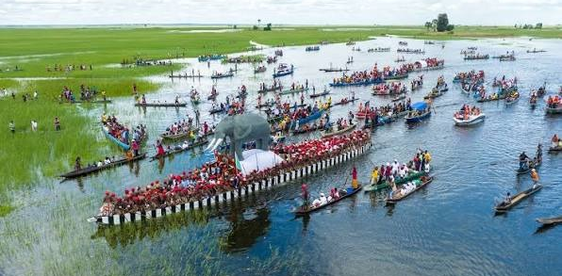
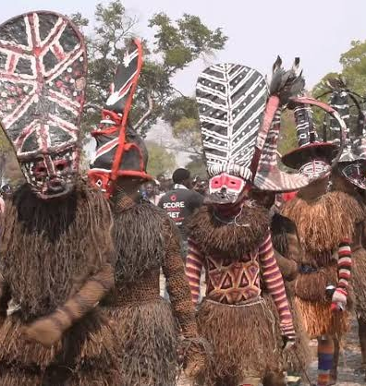
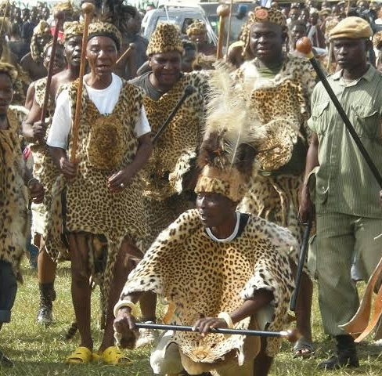
CEREMONIES & LOCAL KNOWLEDGE
Culture is presented as a living part of the journey
A dedicated ceremony calendar brings together verified dates, cultural etiquette and access information. Local phrase support adds pronunciation, literal meaning and respectful-use notes.
Tourism becomes easier to navigate—and more respectful to participate in.
05
Notes:
The ceremony and language modules frame culture as context for responsible participation, not simply as a gallery of attractions.
[Sources]
Local application source and repository assets: C:/visitzambia

Slide 6
CONNECTED TRIP FLOW
The journey continues from inspiration to action
01
02
03
Discover
Organise
Book & carry
Search destinations, listings and experiences.
Save favourites and build collaborative trips.
Create bookings, hold references, access permits and member benefits.
Discover
Organise
Book & carry
06
Notes:
Saved items, shared trip planning, bookings, permits and memberships turn discovery into an ongoing relationship rather than a one-time browse.
[Sources]
Local application source and repository assets: C:/visitzambia

Slide 7
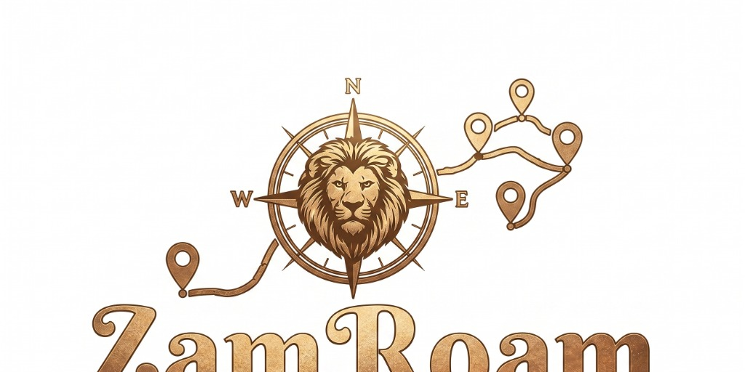
PARTNER ECOSYSTEM
Operators participate through a trusted layer
01
Register
Businesses submit identity, contact and tourism licence information.
02
Verify & publish
Administrators vet providers and manage listings, categories and content.
A marketplace is only as strong as the operators behind it.
03
Serve & redeem
Operators handle member redemptions while operations teams manage bookings, reviews and disputes.
07
Notes:
The partner and admin surfaces include provider applications, licence fields, vetting, publishing, redemption, audit history and customer-operations tooling.
[Sources]
Local application source and repository assets: C:/visitzambia

Slide 8
BUILT FOR THE NEXT STAGE OF ZAMBIA TOURISM
One platform.
More confident journeys.
More visible local value.
ZamRoam brings visitors, operators, culture and destination intelligence into a single scalable experience—ready to demonstrate, partner, pilot and grow.
Responsive web app · Next.js 16 · React 19 · Drizzle data layer
08
Notes:
Close by inviting the audience to experience the product, explore partnership opportunities or identify a pilot use case.
Technical foundation verified from package.json and the local data layer.
[Sources]
Local application source and repository assets: C:/visitzambia

