Slide 1
Principles and Methods of Program Design Lecture 7: Pointers & Arrays
Yuting Wang
John Hopcroft Center for Computer Science
2025.4.28

Slide 2
Road Map
Basics of Imperative Programming (C++)
Programming with Abstractions
Implementing Abstractions
Here!

Slide 3
Last Time
Designing ADT/Classes
Object Initialization and Finalization
Operator Overloading
Interface vs. Implementation
Concrete Data Types

Slide 4
This Time
Basics of Memory
L-values and R-values
Pointers
Arrays
C-Style Strings

Slide 5
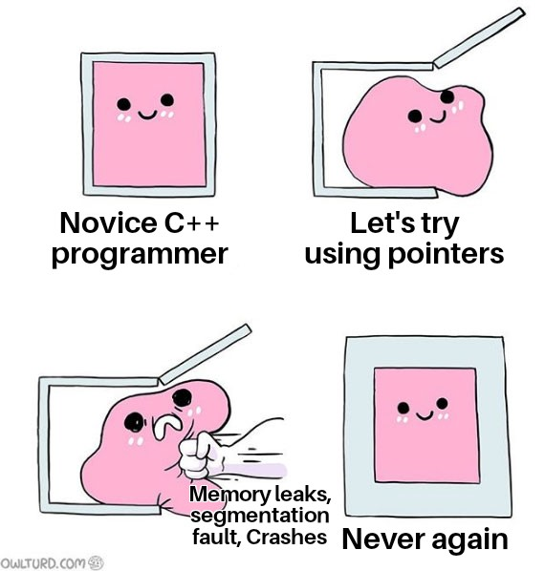
Basics of Memory

Slide 6
What Memory Looks Like?
The memory is a linear sequence of bits
We often talk about bits grouped into bytes
Different types of values may reside at a particular memory address
A value may span over multiple bytes
Memory State (4GB)
1 bytes
4 bytes
65
3.14159
0
0xC00000
0xC00001
0xC00005
0x100000000

Slide 7
Memory Layout
The concrete layout of memory is determined by the compiler
// Examples
int main()
int age=18;
double pi=3.14159, psi=4.2222, phi= 1.1111;
…
}
age
pi
psi
phi
Variables
18
3.14159
4.2222
1.1111
Mapped by Compiler
Memory State
18
3.14159
4.2222
1.1111
age
pi
psi
phi
0
0x300000
0x100000000
Notes:
Therefore, memory addresses of different variables cannot be predicted.
This has implications on comparing memory addresses discussed later. Basically, only the addresses of L-values residing in a continuous memory can be compared.

Slide 8




Abstraction of Memory
To simplify the discussion, we assumed that every variable has its independent memory space
// Examples
int main()
int age=18;
double pi=3.14159, psi=4.2222, phi= 1.1111;
…
}
age
pi
psi
phi
$$l_{1}$$
$$l_{2}$$
$$l_{3}$$
$$l_{4}$$
18
3.14159
4.2222
1.1111
Stack Memory:

Slide 9
Overview

Slide 10



Motivation
Sometimes, you must play multiple roles in life
Need security guard!!
I’m a programmer
New Job!!!

Slide 11
L-value/R-value Expressions
Are all expressions the same?
L-value expression: evaluated to values in memory
E.g., a
R-value expression: evaluated to pure values
E.g., 10 * 10
Questions:
Can L-value expressions play the role of R-value expressions?
Can programmers be security guards?
Can R-value expressions play the role of L-value expressions?
// Example 1
int a;
a = 10 * 10;
// Example 2
int a;
a = a + 1;

Slide 12
Composition of Expression
An expression is either an L-value or an R-value expression
A composite expression contains holes to be filled in
e1 + e2 is an R-value expression
It has two holes e1 and e2 for R-value expressions
However, e1 and e2 can also accept L-value expressions
// Example
e1 + e2

Slide 13
Another Example
It has two holes e1 and e2
e2 is for R-value expressions
e1 is for L-value expressions
Questions:
Can e1 and e2 accept both L-value and R-value expressions?
Is 10 = a + 1 valid?
Is e1 = e2 an L-value or R-value expression?
// Example
e1 = e2

Slide 14
L/R-Values and Expressions
L-value Expressions
R-value Expressions
Holes
L-value Positions
R-value Positions
Fill-in
L-value Expressions
R-value Expressions

Slide 15

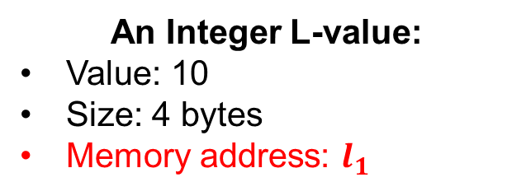
L-Values
An L-value occupies a piece of memory with
Data stored in this region
Type information that determines the size of data
e.g., 1 byte for char, 4 bytes for int
Notice: L-values have memory addresses
4 bytes
$$l_{1}$$
1010
binary form
An Integer L-value:
Value: 10
Size: 4 bytes
Memory address: $l_{1}$

Slide 16
R-Values
An R-value is a value NOT in memory
R-value also has a type and size
Notice: R-values have NO memory addresses
23
‘A’
a + 10
Notes:
R-values are intermediate results of computation

Slide 17
Evaluating Expressions
L-value expressions evaluate to L-value
R-value expressions evaluate to R-value
L-values can be converted into R-values (How?)
L-value Expressions
Evaluate
L-values
Implicit Conversion
R-value Expressions
Evaluate
R-values

Slide 18

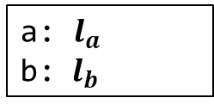

Variable Definitions Revisited
A variable definition:
By defining T p, we denote
An L-value of type T will be created at the right time
p will be mapped to memory address of that value
// Defines a variable
<type> <name>;
<type> <name> = <expr>;
$$l_{a}$$
$$l_{b}$$
int a = 10;
int main()
{
int b = 3;
a = b + 10;
return 0;
}
10
3
Created at the
start of program
Created at the
start of main function
PC
a: $l_{a}$
b: ${ l}_{b}$

Slide 19

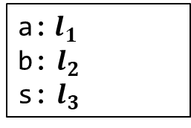


Memory States and Environments
Memory states: a collection of L-values
Environments: a mapping from variable names to memory addresses
int a = 10;
int main()
{
int b = 3;
string s = “ABC”;
…
return 0;
}
Global
Memory
Stack
Memory
$$l_{1}$$
$$l_{2}$$
10
3
$$l_{3}$$
…
‘A’
‘B’
‘C’
…
PC
a:$l_{1}$
b: $l_{2}$
s: $l_{3}$
Environment:

Slide 20
C++ Abstract Machine
A C++ program executes by running an abstract machine
A C++ abstract machine has the following components
The program being executing
The program state, including:
The program counter (points to the current command)
The environment
The memory state
I/O devices
The machine runs by executing the command pointed to by PC, which
Query the environment and memory state for evaluating expressions
Execute the commands and change the state (assignment, I/O etc)
Adjust PC (sequential execution, branching, loop, … etc)

Slide 21
L-Value and R-value Expressions

Slide 22
Summary of Common Expressions
<L-pos> (<R-pos>) denotes an L-value (R-value) position
Note: the argument to functions may be <L-pos> if passed by references
Expression | L-value or R-value | Formation | Examples
Variable | L-value expression | <variable name> | a, p, str
Constant | Mostly R-value | <literal> | 123, 0x11, “abc”, ‘f’
Arithmetic | R-value expression | <R-pos> <op> <R-pos> | a + 3, b / 3, c % 4
Relational and Logical | R-value expression | <R-pos> <rop> <R-pos> | a < 3, b > 3, c && 4
Assignment | L-value expression | <L-pos> = <R-pos> | a = a + 3, a += 3
Postfix Incr/Decr | R-value expression | <L-pos>++, <L-pos>-- | i++, i--, (a=a+3)++
Prefix Incr/Decr | L-value expression | ++<L-pos>, --<L-pos> | ++i, --i, ++(a=a+3)
Function call | R-value/L-value | f(<R-pos>,…,<R-pos>) | add(3, 4)

Slide 23
L-value Expressions
An L-value expression evaluates to an L-value
Denotes data in memory
The following are L-value expressions:
Variable expressions
Assignment expressions
Reference variables
… (not an exhaustive list)
b // a variable
Evaluate
$$l_{b}$$
3
Notes:
We have discussed how dynamic execution model (L/R-values) looks like.
Now describe how can we write programs (L/R-value expressions) to manipulate such dynamic execution

Slide 24
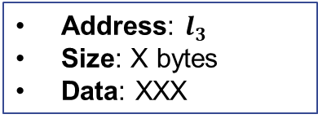

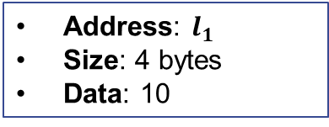
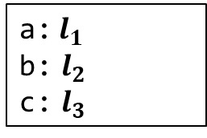


Variable Expressions
Evaluates to the L-value for the variable
int a = 10;
int main()
{
int b = 3;
vector<int> c = {a};
c.get(0);
return 0;
}
Global
Memory
Stack
Memory
$$l_{1}$$
$$l_{2}$$
10
3
PC
$$l_{3}$$
XXX
a:$l_{1}$
b: $l_{2}$
c: $l_{3}$
Address: $l_{1}$
Size: 4 bytes
Data: 10
Address: $l_{3}$
Size: X bytes
Data: XXX
Environment:

Slide 25
R-value Expressions
An R-value expression evaluates to an R-value
The following are R-value expressions:
Arithmetic expressions (e.g., expr1 + expr2, expr1 - expr2, expr1 * expr2, …)
Relational expressions(e.g., expr1 == expr2, expr1 != expr2, expr1 < expr2, …)
Logical expressions(e.g., expr1 && expr2, expr1 || expr2, !expr, …)
Function/method calls(e.g., add(expr1, expr2), c.get(0), …)
… (not an exhaustive list)
b + 10
Evaluate
13
Notes:
R-value expressions are used to compute intermediate results

Slide 26
L/R-values Positions
Question: How exactly are L/R-value expressions formed?
Answer: an L/R-value expression contains holes called L/R-value positions. Fill in these holes to form a complete expression.
Example: Addition has two holes which are both R-value positions
Key Idea: during execution, L-value (R-value) positions should contain L-value (R-value).
<R-pos> + <R-pos>
R-value expression
Notes:
Magically, you do not necessarily need R-value expressions for R-value positions.
L-value expressions can be filled into for R-value positions
An analogy would be overly qualifying for a job, i.e., a professor may very well do the job of a janitor

Slide 27
L-value Positions
L-value positions only accept L-value expressions
Left of assignments:
The initial value of reference definitions: T& <var> = <expr>
Operand of & operator (discussed later): &<expr>
… (not an exhaustive list)
<expr1> = <expr2>
// Error: cannot assign to an R-value
// because it is not in memory
a + b = c;
// Error: cannot bind a new name for a
// R-value because it is not in memory
int& a = 3;

Slide 28


R-value Positions
R-value positions accept both L-value and R-value expressions
Any position that is not an L-value position is an R-value position:
<expr1> + <expr2>
f(<expr_1>,…,<expr_n>)
T a = <expr>
… (and many others)
Global
Memory
Stack
Memory
int a = 10;
int main() {
cout << a << endl;
return 0;
}
$$l_{1}$$
10
L-value expression
Environment:
a:$l_{1}$

Slide 29

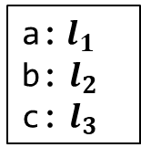


R-value Positions
Another example
Global
Memory
Stack
Memory
int a = 10;
int main()
{
int b = 3;
int c = a;
cout << a + b + c << endl;
return 0;
}
$$l_{1}$$
$$l_{2}$$
10
3
$$l_{3}$$
PC
10
a:$l_{1}$
b: $l_{2}$
c: $l_{3}$
Environment:

Slide 30
Implicit Conversion of L-values into R-values
Key idea: when an L-value expression occurs in an R-value position, the data stored in its L-value is used as an R-value
Global
Memory
Stack
Memory
int a = 10;
int main()
{
int b = 3;
int c = a;
cout << a + b + c << endl;
return 0;
}
$$l_{1}$$
$$l_{2}$$
10
3
$$l_{3}$$
PC
10
Converted to 10
a:$l_{1}$
b: $l_{2}$
c: $l_{3}$
Converted to 10
Environment:
Converted to 3

Slide 31
Key Points
The key points to remember so far…
An L-value (expression) represents data in memory
Can be assigned values
Can be taken its memory address
An R-value (expression) represents data NOT in memory
Cannot be assigned values
Cannot be taken address
The same expression may denote either an L or R-value depending on its positions
// The first ‘a’ evaluates to an L-value
// The second ‘a’ evaluates to an R-value
a = a + c;

Slide 32
Assignments Revisited

Slide 33



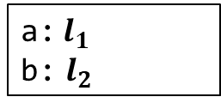
Evaluation of Assignments
Evaluation of the following assignment expression
Evaluate expr1 to an L-value with address $l$
Evaluate expr2 to an R-value $v$
Stores $v$ into the memory at address $l$
Data conversion happens if the types of expr1 and expr2 do not match
expr1 = expr2
int a = 10;
int main() {
int b;
b = a + 5;
return 0;
}
Global
Memory
Stack
Memory
$$l_{1}$$
$$l_{2}$$
10
?
PC
15
Environment:
a:$l_{1}$
b: $l_{2}$

Slide 34
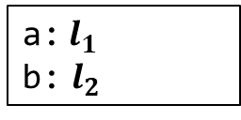


Assignment Revisited
Assignment expression is an L-value expression
Evaluates to the L-value of expr1
expr1 = expr2
Global
Memory
Stack
Memory
int a = 10;
int main() {
int b;
(b=a+5) = 7;
cout << b << endl;
return 0;
}
$$l_{1}$$
$$l_{2}$$
10
?
7
PC
Environment:
a:$l_{1}$
b: $l_{2}$

Slide 35
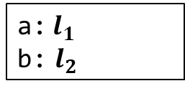
Other Forms
expr1 += expr2 is equivalent to expr1 = expr1 + expr2
similarly for -=, *=, etc.
int a = 10;
int main() {
int b = a;
b += 5;
return 0;
}
Global
Memory
Stack
Memory
$$l_{1}$$
$$l_{2}$$
10
10
PC
15
Environment:
a:$l_{1}$
b: $l_{2}$

Slide 36

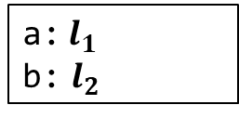
++ Operators
++expr is equivalent to expr = expr + 1
expr++ is an R-value expression:
expr must be an L-value expression (at some address $l$)
The whole expression is an R-value equal to the data stored at $l$ before increment
Increases the values stored at $l$ by 1
int a = 10;
int main() {
int b = a;
cout << b++ << endl;
return 0;
}
Global
Memory
Stack
Memory
$$l_{1}$$
$$l_{2}$$
10
10
PC
11
The R-value is 10
a:$l_{1}$
b: $l_{2}$
Environment:

Slide 37
Exercise
How many implicit conversions from L-values to R-values happen below?
a = a + b
a = b++
a = ++b
++b = a + 5
b++ = a + 5
++b = b + 5

Slide 38
References Revisited

Slide 39


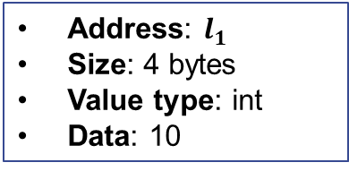
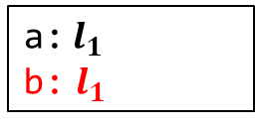
References and Evaluation
Syntax:
expr must be an L-value expression
The definition binds v to the address of evaluating expr
Introduce new mapping to environments
v behaves like expr after the definition
T& v = expr
Global
Memory
Stack
Memory
int a = 10;
int main() {
int& b = a;
cout << b << endl;
b = 12;
cout << a << endl;
return 0;
}
PC
$$l_{1}$$
10
12
a:$l_{1}$
Address: $l_{1}$
Size: 4 bytes
Value type: int
Data: 10
Environment:
a:$l_{1}$
b: $l_{1}$

Slide 40

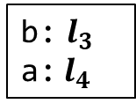
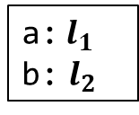



Evolution of Memory States and Environments
Environment mapping may change
Stack
Memory
// Example
void p(int b)
{
int a = 4;
cout << a << b << endl;
}
int main()
{
int a = 2, b = 3;
cout << a << b << endl;
p(b);
return 0;
}
$$l_{1}$$
main
Environment:
2
a:$l_{1}$
b: $l_{2}$
$$l_{2}$$
3
$$l_{3}$$
p
Environment:
3
b: $l_{3}$
a:$l_{4}$
$$l_{4}$$
PC
4

Slide 41


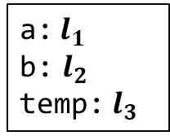

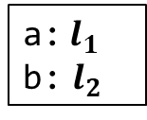
Evolution of Environments with References
Stack
Memory
// Swap two integers
void swap(int& a, int& b)
{
int temp = a;
a = b;
b = temp;
}
int main()
{
int a = 3, b = 5;
swap(a, b);
return 0;
}
$$l_{1}$$
main
3
Environment:
5
a:$l_{1}$
b: $l_{2}$
$$l_{2}$$
5
3
Environment:
PC
a:$l_{1}$
b: $l_{2}$
temp: $l_{3}$
$$l_{3}$$
swap
?
3

Slide 42

Pointers

Slide 43

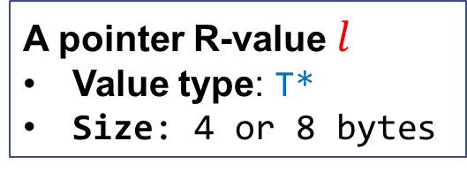
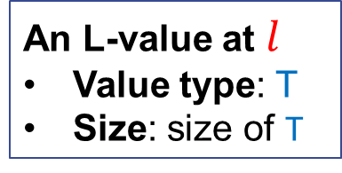

Pointers
Pointers: memory addresses as R-values
Value: $l$
Type: T* (the data value stored at $l$ is of type T)
Size: 4 bytes (32-bit machine) or 8 bytes (64-bit machine)
A pointer points to an L-value
size of T
$$l$$
A pointer R-value $l$
Value type: T*
Size: 4 or 8 bytes
An L-value at $l$
Value type: T
Size: size of T

Slide 44

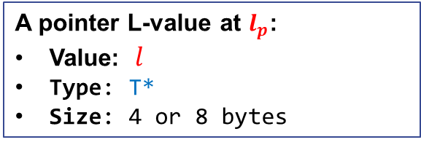
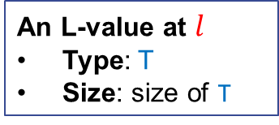


Pointer Variables
Syntax:
By defining T *p, we denote
an L-value storing pointers of type T* will be created at the right time
p will be mapped to address of that value
// Defines a pointer variable
<type> *<name1>, *<name2>, …;
$$l_{p}$$
$$l$$
$$l$$
A pointer L-value at $l_{p}$:
Value: $l$
Type: T*
Size: 4 or 8 bytes
An L-value at $l$
Type: T
Size: size of T

Slide 45

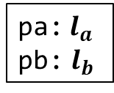

Examples
Pointer variables functions like regular variables
L-values being pointed to are determined by the variable types
May store addresses for integer L-values
May store addresses for double L-values
int *pa;
int main()
{
double *pb;
return 0;
}
$$l_{a}$$
$$l_{b}$$
?
?
Created at the
start of program
Created at the
start of main function
pa:$l_{a}$
pb: $l_{b}$

Slide 46
Why We Need Pointers?
Multiple references to the shared L-value
Passing references to memory without copying their data
Efficient navigation of memory (using pointer arithmetic)
Optional references (Some or None)
Reserve new memory during execution (dynamic allocation)
Describe relationship between data structures

Slide 47
Expressions for Manipulating Pointers
<L-pos> (<R-pos>) denotes an L-value (R-value) position
Expression | L-value or R-value | Formation | Examples
Variable | L-value expression | <variable name> | a, p, str
Constant | R-value expression | <literal> | 123, 0x11, “abc”, ‘f’
Arithmetic | R-value expression | <R-pos> <op> <R-pos> | a + 3, b / 3, c % 4
Relational and Logical | R-value expression | <R-pos> <rop> <R-pos> | a < 3, b > 3, c && 4
Assignment | L-value expression | <L-pos> = <R-pos> | a = a + 3, a += 3
Postfix Incr/Decr | R-value expression | <L-pos>++, <L-pos>-- | i++, i--, (a=a+3)++
Prefix Incr/Decr | L-value expression | ++<L-pos>, --<L-pos> | ++i, --i, ++(a=a+3)
Function call | R-value/L-value | f(<R-pos>,…,<R-pos>) | add(3, 4), str.erase(0, 3)
Address Of | R-value expression | &<L-pos> | &a, &(a = a+3)
Dereference | L-value expression | *<R-pos> | *a, *&a, *(++a)

Slide 48
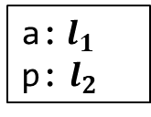



Address-of Operator
Syntax:
<expr> must be an L-value expression (i.e., <expr> is an L-value position)
This is an R-value expression
The R-value is a pointer to (memory address of) <expr>
The R-value’s type is T* where T is the type of <expr>
// Taking the address of expr
&<expr>
int a = 10;
int main()
{
int *p;
p = &a;
return 0;
}
Global
Memory
Stack
Memory
$$l_{1}$$
$$l_{2}$$
10
?
$$l_{1}$$
PC
Environment:
a:$l_{1}$
p: $l_{2}$

Slide 49



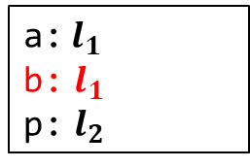
Address-of References
Uses of references are L-values
int a = 10;
int main() {
int& b = a;
int *p = &b;
return 0;
}
Global
Memory
Stack
Memory
$$l_{1}$$
$$l_{2}$$
PC
10
?
$$l_{1}$$
Environment:
a:$l_{1}$
b: $l_{1}$
p: $l_{2}$
Address: $l_{1}$
Size: 4 bytes
Value type: int
Data: 10

Slide 50
Exercises
Which of the following address-of expressions are invalid?
&3
&(a + b)
&(a || b)
&&p (suppose p is variable of type int)
&(a = a+b)
&(++x)
&(x++)
int id(int x) { return x; }
int main() {
int a;
int *p = &id(a);
return 0;
}
int& id(int& x) { return x; }
int main() {
int a;
int *p = &id(a);
return 0;
}

Slide 51



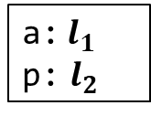
Dereference Operator
Syntax:
<expr> expects an R-value (i.e., <expr> is an R-value position)
The value of <expr> must be a pointer (of some type T*)
This is an L-value expression
It denotes the L-value of type T pointed by the pointer
// Dereference
*<expr>
int a = 10;
int main()
{
int *p;
p = &a;
*p = 3;
cout << *p << endl;
cout << a << endl;
return 0;
}
Global
Memory
Stack
Memory
$$l_{1}$$
$$l_{2}$$
10
3
$$l_{1}$$
PC
Environment:
a:$l_{1}$
p: $l_{2}$

Slide 52

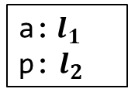
Implicit Conversion in Dereferencing
For example, in *p = 3;
The L-value p is implicitly converted to the pointer it contains
Then the dereference operator takes the pointer and convert it into an L-value
int a = 10;
int main()
{
int *p;
p = &a;
*p = 3;
cout << *p << endl;
cout << a << endl;
return 0;
}
Global
Memory
Stack
Memory
$$l_{1}$$
$$l_{2}$$
10
$$l_{1}$$
PC
Environment:
a:$l_{1}$
p: $l_{2}$
R-value positions

Slide 53

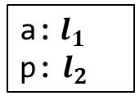
Pointer Variables as Containers
In essence, a pointer variable T *p is a container for pointers of type T*
Creation of the container: according to the definition (global or stack)
Write to the container: Assignment to p
Read from the container: Implicit conversion of the L-value p to R-value
int a = 10;
int main()
{
int *p;
p = &a;
*p = 3;
cout << *p << endl;
cout << a << endl;
return 0;
}
Global
Memory
Stack
Memory
$$l_{1}$$
$$l_{2}$$
10
?
PC
3
$$l_{1}$$
Environment:
a:$l_{1}$
p: $l_{2}$
Notes:
Questions: how many implicit conversion happens when executing each of the following statements:
p = &a;
*p = 3;
cout << *p << endl;

Slide 54



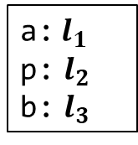
Why Need Pointer Containers?
Store and retrieve pointers (sometimes embedded in data structures)
Modify the contained pointers as the program goes
int a = 10;
int main() {
int *p;
p = &a;
*p = 3;
cout << *p << endl;
cout << a << endl;
int b = 5;
p = &b;
*p = *p + 1;
cout << *p << endl;
cout << b << endl;
return 0;
}
Global
Memory
Stack
Memory
$$l_{1}$$
$$l_{2}$$
3
$$l_{1}$$
$$l_{3}$$
$$l_{3}$$
5
6
PC
Environment:
a:$l_{1}$
p: $l_{2}$
b: $l_{3}$
Notes:
Question: how many implicit conversion happens when executing
*p = *p + 1;

Slide 55

Dereferencing References
References function like ordinary variables
int a = 10;
int main() {
int& b = a;
int *p = &b;
*p = 3;
cout << *p << endl;
cout << a << endl;
cout << b << endl;
return 0;
}
Global
Memory
Stack
Memory
$$l_{1}$$
$$l_{2}$$
PC
10
?
3
$$l_{1}$$
Environment:
a:$l_{1}$
b: $l_{1}$
p: $l_{2}$

Slide 56


References to Pointer Variables
References to Pointer Variables are ordinary references
int a = 10;
int main() {
int *p = &a;
int*& r = p;
*r = 3;
cout << *r << endl;
cout << *p << endl;
cout << a << endl;
return 0;
}
Global
Memory
Stack
Memory
$$l_{1}$$
$$l_{2}$$
PC
10
$$l_{1}$$
3
Environment:
a:$l_{1}$
p: $l_{2}$
r: $l_{2}$

Slide 57
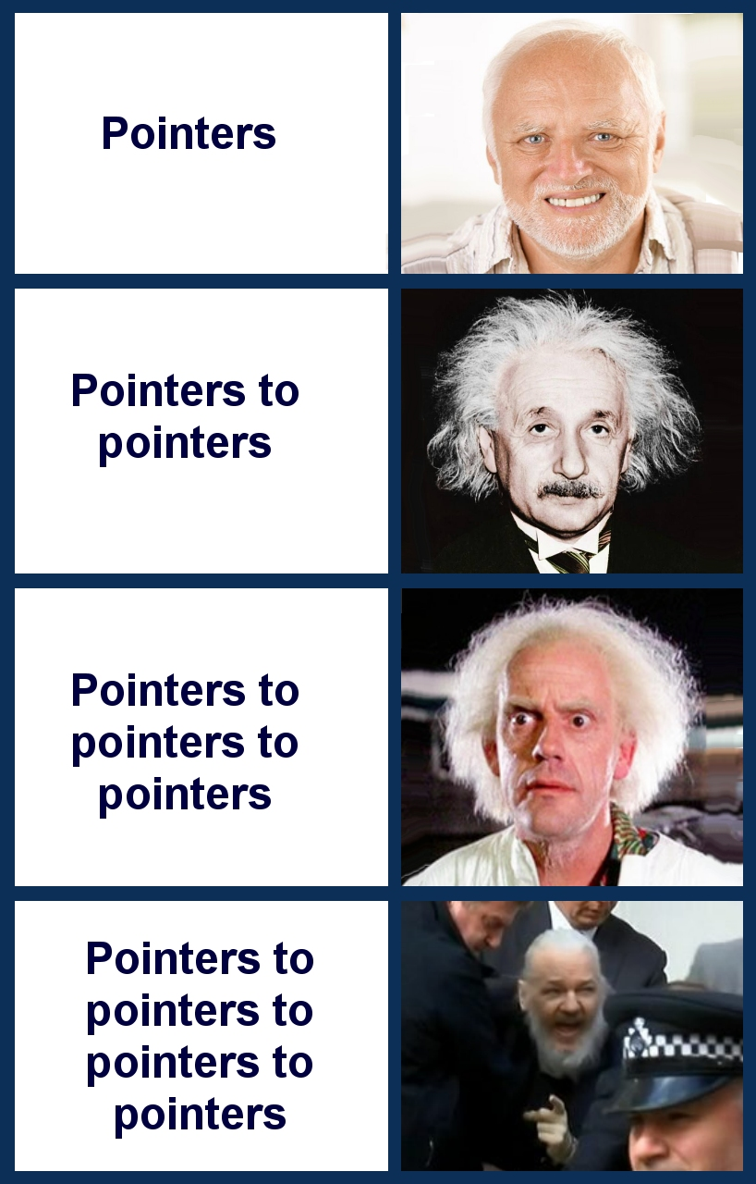
Pointers to Pointers

Slide 58


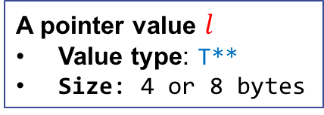


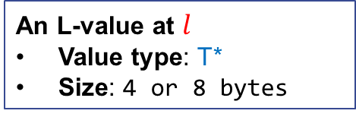
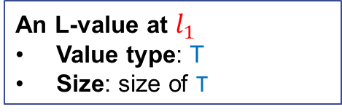
Pointers to Pointers
A pointer of type T** is a pointer to pointer
A variable holding a pointer to pointer is defined by T **p
$$l$$
$$l_{1}$$
$$l$$
$$l_{1}$$
A pointer value $l$
Value type: T**
Size: 4 or 8 bytes
An L-value at $l$
Value type: T*
Size: 4 or 8 bytes
An L-value at $l_{1}$
Value type: T
Size: size of T

Slide 59








Example
int main() {
int a = 10;
int *p = &a;
int **pp = &p;
**pp = 5;
cout << **pp << endl;
cout << a << endl;
int b = 7;
// Switch of address
p = &b;
**pp = 16;
cout << **pp << endl;
cout << b << endl;
return 0;
}
Global
Memory
Stack
Memory
PC
$$l_{1}$$
10
5
$$l_{2}$$
?
$$l_{1}$$
$$l_{4}$$
$$l_{3}$$
?
$$l_{2}$$
$$l_{4}$$
?
16
7
Environment:
a: $l_{1}$
p:$l_{2}$
pp:$l_{3}$
b: $l_{4}$
Notes:
Explain how **p works

Slide 60
Const Pointer
Syntax:
With const T *p, p holds a pointer to an L-value that cannot be modified
// Defines a const pointer variable
const <type> *<name1>, *<name2>, …;
const int a = 10;
int main() {
const int *p = &a;
cout << *p << endl;
// Error: modify a const L-value
*p = 11;
const int b = 5;
// p itself can be modified!
p = &b;
cout << *p << endl;
return 0;
}

Slide 61
Exercise
Which of the following dereference expressions are invalid?
*10
int a; *&a
int a; *&*&*&*&a
int a; **&a
int *a; **&a

Slide 62






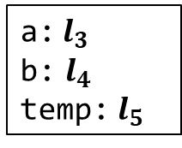
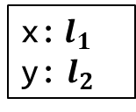

Pointers as Function Parameters
Pointers arguments are still passed using Call-By-Value
Stack
// Swap two integers
void swap(int* a, int* b) {
int temp = *a;
*a = *b;
*b = temp;
}
int main() {
int x = 3, y = 5;
swap(&x, &y);
cout << x << y << endl;
return 0;
}
$$l_{1}$$
3
main
Environment:
5
x:$l_{1}$
y: $l_{2}$
$$l_{2}$$
5
3
Environment:
$$l_{3}$$
a:$l_{3}$
b: $l_{4}$
temp: $l_{5}$
$$l_{1}$$
PC
$$l_{4}$$
$$l_{2}$$
$$l_{5}$$
swap
?
3

Slide 63
Invalid Pointers
Dereferencing an invalid pointer result in an undefined behavior
An invalid pointer may come from
Uninitialized pointer variable
Pointer to destroyed in-memory object
Out-of-bound pointers from pointer arithmetic
NULL pointer
...

Slide 64
Common Errors: Use of Invalid Pointers
Use pointers before they are initialized
Use pointers to dead L-values
Note: Always instantiate a pointer variable to nullptr if it is not given an initial value
// What is the problem here?
int main() {
int *p;
cout << *p << endl;
return 0;
}
// What is the problem here?
int* getX() {
int x;
return &x;
}
int main() {
cout << *getX() << endl;
return 0;
}

Slide 65
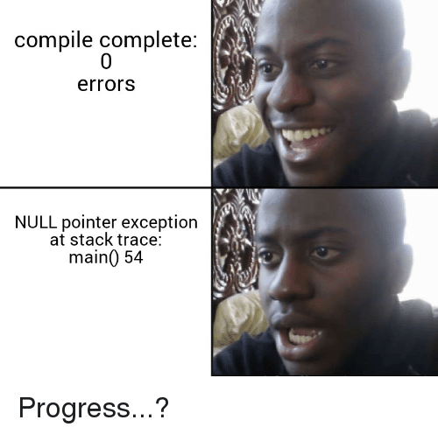
Null Pointer

Slide 66
NULL Pointer
nullptr: is the default invalid pointer
Usage of nullptr:
Initialize or reset pointer variables
Return nullptr pointer to indicate failure
Compare with nullptr pointer to guard against errors
// allocate space
int* allocate(int size) {
int *p = nullptr;
if (enough space) {
p = newly allocated space;
return p;
}
// make use of allocate
int main() {
int *spc = allocate(10);
if (spc == nullptr)
return -1;
// Otherwise, proceed
…
}

Slide 67
NULL Pointer was a Mistake
https://www.infoq.com/presentations/Null-References-The-Billion-Dollar-Mistake-Tony-Hoare/
Lesson: do not use a single type to represent distinct sets of values
I call it my billion-dollar mistake. At that time, I was designing the first comprehensive type system for references in an object-oriented language. My goal was to ensure that all use of references should be absolutely safe, with checking performed automatically by the compiler. But I couldn’t resist the temptation to put in a null reference, simply because it was so easy to implement. This has led to innumerable errors, vulnerabilities, and system crashes, which have probably caused a billion dollars of pain and damage in the last forty years.
-Tony Hoare

Slide 68

Pointers
vs.
References

Slide 69
Comparison
Pointers: a typed memory address
Is also a regular value
May be stored in variables
May be part of the memory state
Can be uninitialized
Can be modified
Usage:
Multiple references to the shared in-memory data
Passing references to memory without copying their data
Navigation of memory
Reserve new memory
Describe relationship between data
References: an aliasing of L-value
Is NOT a value (but a name binding)
CANNOT be stored in variables
NOT part of the memory
MUST be bound to some L-value
NO WAY to modify references
Usage:
Multiple references to the shared in-memory data
Passing references to memory without copying their data

Slide 70
When to use which
Use references if you need to
Describe aliases to L-values (variables, fields, etc)
Bind to some L-values throughout the entire execution
Use pointers if you ALSO need to
Have optional references (None or SOME reference)
Modify the pointer value during execution (navigate memory space)
Note: pointers exposes the underlying memory structure, be very careful when using them together with ADTs!
However, pointers are very useful for Concrete Data Types (CDT)

Slide 71
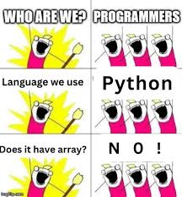
Arrays

Slide 72

Arrays
An array is a fixed-sized sequence of elements of the same type
Syntax:
The size expression must be constant
The index expression must be an integer value
// Define an array of a given size
<type> name[<size>]
// Access the element at the given index
name[<index>] // Note: an L-value
Stack
Memory
// Example
const int N = 5;
int a[N];
for (int i = 0; i < N; i++)
a[i] = rand();
for (int i = 0; i < N; i++)
cout << a[i] << " ";
$$l_{1}$$
?
?
?
?
?
Environment:
a:$l_{1}$
Notes:
Array is a concrete data type. Meaning its sizes and internal representation are known to users, unlike ADTs whose representation are unknown.

Slide 73
Initialization and Assignment
Array may be initialized with a sequence of elements
Use sizeof to get the sizes of arrays
An array is a non-modifiable l-value:
// Examples
int a[5] = {4, 2, 1, 3, 5};
// Do not need to specify a size
int a[] = {4, 2, 1, 3, 5}
int n = sizeof(a)/sizeof(a[0]);
cout << n << endl;
// Example
int a[5] = {4, 2, 1, 3, 5};
int b[5];
b = a; // Cannot assign to an array

Slide 74
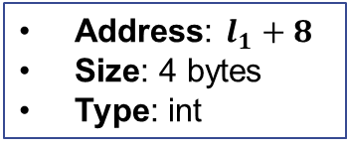
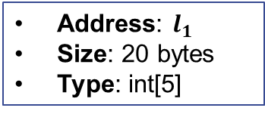

Arrays and Their Elements are L-values
Suppose we define int a[5]
The array a is an L-value of type int[5]
The element a[i] is an L-value of type int
$$l_{1}$$
$$l_{1}$$
?
?
?
?
?
?
?
?
?
?
a:$l_{1}$
a[2]
Address: $l_{1}$
Size: 20 bytes
Type: int[5]
Address: $l_{1}+8$
Size: 4 bytes
Type: int

Slide 75
Example: Bubble Sort
Bubble sort using an array
const int N = 7;
int main()
{
int vec[N] = {101, 42, 42, 9, 0, -13, -99};
// Bubble sort
for (int k = 0; k < N-1; k++) {
for (int i = 0; i < N-1; i++) {
if (vec[i] > vec[i+1])
swap(vec[i], vec[i+1]);
}
}
// Print the sorted array
for (int i = 0; i < N; i++)
cout << vec[i] << " ";
return 0;
}

Slide 76
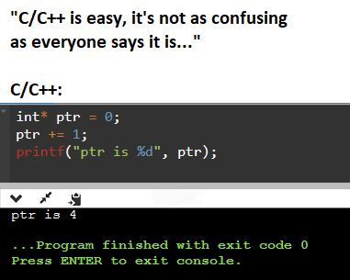
Navigate Arrays
with Pointers

Slide 77


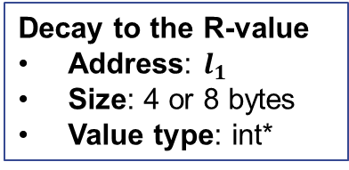
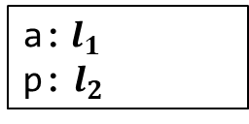
Decay to Pointers
An L-value of type T[] decays to a pointer of type T* at R-value positions
Stack
Memory
int main()
{
int a[5] = {4, 2, 1, 3, 5};
// Cannot write as int *p = &a;
int *p = a;
// Print 4
cout << *p << endl;
cout << *a << endl;
return 0;
}
$$l_{1}$$
4
2
1
3
5
$$l_{2}$$
?
PC
$$l_{1}$$
Environment:
a:$l_{1}$
p: $l_{2}$
Decay to the R-value
Address: $l_{1}$
Size: 4 or 8 bytes
Value type: int*
Notes:
Explain why we cannot write int *p = &a

Slide 78

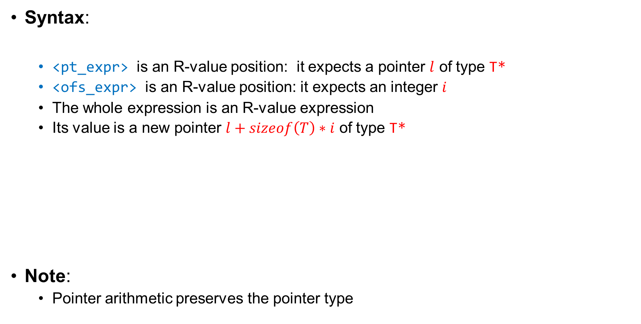


Pointer Arithmetic
Syntax:
<pt_expr> is an R-value position: it expects a pointer $l$ of type T*
<ofs_expr> is an R-value position: it expects an integer $i$
The whole expression is an R-value expression
Its value is a new pointer $l+sizeof\left(T\right)∗i$ of type T*
Note:
Pointer arithmetic preserves the pointer type
// Adjust pointers
<pt_expr> + <ofs_expr>
$$l$$
$l+sizeof\left(T\right)∗i$
$$sizeof\left(T\right)∗i$$

Slide 79

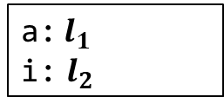
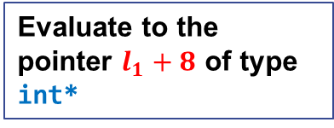
Pointer Arithmetic on Arrays
Pointer arithmetic is applicable to array variables
(a+i) is equivalent to &a[i]
*(a+i) is equivalent to a[i]
int main()
{
int a[5] = {4, 2, 1, 3, 5};
cout << *(a+2) << endl;
for (int i = 0; i < 5; i++)
cout << *(a+i) << “ ”;
return 0;
}
Stack
Memory
$$l_{1}$$
4
2
1
3
5
PC
$$l_{2}$$
0
Environment:
a:$l_{1}$
i: $l_{2}$
Evaluate to the pointer $l_{1}+8$ of type int*

Slide 80




Navigate Arrays with Pointer Variables
We can also use a pointer variable p to navigate arrays
(p+i) is equivalent to &a[i]
*(p+i) is equivalent to a[i]
Stack
Memory
int main()
{
int a[5] = {4, 2, 1, 3, 5};
int *p = a;
for (int i = 0; i < 5; i++)
cout << *(p+i) << “ ”;
return 0;
}
$$l_{1}$$
4
2
1
3
5
$$l_{2}$$
PC
$$l_{1}$$
$$l_{3}$$
0
Environment:
a:$l_{1}$
p: $l_{2}$
i: $l_{3}$

Slide 81
Essence of the Indexing Operator
An indexing operation on array and pointers is equivalent to dereferencing after pointer arithmetic
p[i] is equivalent to *(p+i)
(p can be a pointer or an array)
int main()
{
int a[5] = {4, 2, 1, 3, 5};
int *p = a;
for (int i = 0; i < 5; i++)
cout << p[i] << “ ”;
return 0;
}

Slide 82


Navigate Arrays with Pointer Variables
We can also use a pointer variable p to navigate arrays
p++ or ++p advances p to the next element
int main()
{
int a[5] = {4, 2, 1, 3, 5};
int *p;
for (p = a; p != a+5; p++)
cout << *p << “ ”;
return 0;
}
Stack
Memory
$$l_{1}$$
4
2
1
3
5
PC
$$l_{2}$$
$$l_{1}$$
Environment:
a:$l_{1}$
p: $l_{2}$

Slide 83

Question
Why arrays in C++ starts at offset 0?

Slide 84

Compare Pointers
The pointers may be compared by boolean operators
Let p1 and p2 denote two pointers $l_{1}$and $l_{2}$
p1 == p2 iff $l_{1}==l_{2}$
p1 != p2 iff !(p1 == p2)
p1 < p2 iff $l_{1}< l_{2}$ and they point to a continuous L-value
p1 <= p2 iff $l_{1}≤l_{2}$ and they point to a continuous L-value
p1 > p2 iff $l_{1}>l_{2}$ and they point to a continuous L-value
p1 >= p2 iff $l_{1}≥l_{2}$ and they point to a continuous L-value
Note: Positions in different L-values have no relative order
int main() {
int a, b;
if (&a < &b) // Undefined behavior
cout << “&a < &b” << endl;
return 0;
}

Slide 85



Pointer Arithemtic
The offset can also decrease
<pt_expr> - <ofs_expr> is equivalent to <pt_expr> + (-<ofs_expr>)
$l−sizeof\left(T\right)∗i$
$$l$$
$$sizeof\left(T\right)∗i$$

Slide 86




Distances between Pointers
Syntax:
<pt_expr1> and <pt_expr2> expects to be pointers $l_{1}$ and $l_{2}$ of type T*
The whole expression is an integer value $(l_{1}−l_{2})/sizeof(T)$
Note:
Distances only make sense for pointers to the continuous L-values
// Compute the distance between pointers
<pt_expr1> - <pt_expr2>
$l_{2}$
$$l_{1}$$
$$(l_{1}−l_{2})/sizeof(T)$$

Slide 87




Pointer Arithmetic
Reverse pointer arithmetic for array variables
Print the distances of pointers
Stack
Memory
int main()
{
int a[5] = {4, 2, 1, 3, 5};
int *p = a+5;
for (int i = 1; i <= 5; i++)
cout << *(p-i) << endl;
for (p = a; p != a+5; p++)
cout << (p - a) << " ";
return 0;
}
$$l_{1}$$
4
2
1
3
5
PC
$$l_{2}$$
$$l_{1}$$
$$l_{3}$$
1
Environment:
a:$l_{1}$
p: $l_{2}$
i: $l_{3}$

Slide 88
Bubble Sort using Pointers
Use pointer arithmetic to solve bubble sort
const int N = 7;
int main()
{
int vec[N] = {101, 42, 42, 9, 0, -13, -99};
// Bubble sort
for (int k = 0; k < N-1; k++) {
for (int *p = vec; p < vec+N-1; p++) {
if (*p > *(p+1))
swap(*p, *(p+1));
}
}
// Print the result
for (int i = 0; i < N; i++)
cout << vec[i] << " ";
return 0;
}

Slide 89



Arrays and Pointer Variables are Different
Pointer variables do not reserve space as arrays
int main()
{
int a[5] = {4, 2, 1, 3, 5};
int *p;
cout << p[0]; // Error
p = a;
cout << p[0]; // Print a[0]
return 0;
}
Stack
Memory
$$l_{1}$$
4
2
1
3
5
PC
$$l_{2}$$
?
$$l_{1}$$
Environment:
a:$l_{1}$
p: $l_{2}$

Slide 90




Common Error: Out-of-Bound Access
Use pointers that are out of bound
Stack
Memory
// What is the problem here?
int main()
{
int a[5] = {4, 2, 1, 3, 5};
int *p = a;
for (int i = 0; i <= 5; i++)
cout << *(p+i) << “ ”;
return 0;
}
$$l_{1}$$
4
2
1
3
5
$$l_{2}$$
$$l_{1}$$
PC
$$l_{3}$$
0
Environment:
a:$l_{1}$
p: $l_{2}$
i: $l_{3}$

Slide 91
Arrays as Function Arguments

Slide 92
Arrays as Function Parameters
Often pass the length of array as a second argument
Array may decay to a pointer
// Pass an array and its size
void printArray1(int a[], int n)
{
for (int i = 0; i < n; i++)
cout << a[i] << " ";
cout << endl;
}
// Pass the decayed pointer
void printArray2(int *a, int n)
{
for (int i = 0; i < n; i++)
cout << a[i] << " ";
cout << endl;
}
// Main
int main()
{
int a[5] = {4, 2, 1, 3, 5};
printArray1(a, 5);
printArray2(a, 5);
return 0;
}
In fact, int a[] is exactly the same as int *a

Slide 93
Example: Bubble Sort Function
Pass an array argument and its size
void bubble_sort(int *arr, int n)
{
for (int k = 0; k < n-1; k++) {
for (int i = 0; i < n-1; i++) {
if (arr[i] > arr[i+1])
swap(arr[i], arr[i+1]);
}
}
}

Slide 94
Exercise
Implement binary search using an array
int binary_search(int *arr, int n, int value)
{
// Fill in here
}

Slide 95
C-Style Strings

Slide 96
C-Style Strings
An array of characters ending with a NULL character ‘\0’ (ASCII value 0)
Example: (note the last NULL character)
‘H’
‘e’
‘l’
‘l’
‘o’
‘,’
‘ ’
‘w’
‘o’
‘r’
‘l’
‘d’
‘!’
‘\0’
0
1
2
3
4
5
6
7
8
9
10
11
12
13
// Example
int main()
{
char str[] = “Hello, world!”;
// const char *str = “Hello, world!”;
char *p = str;
cout << p << endl;
return 0;
}

Slide 97
Conversion between C and C++ strings
C++ string to C-String
C-String to C++ string
// Example
int main()
{
string str = “abc”;
const char *s = str.c_str();
cout << s << endl;
return 0;
}
const char* s = "abc";
string str = s;
cout << str << endl;

Slide 98
Functions for C-Strings
Functions for Manipulation in <cstring>:
Function | Effect
strcpy(dst, src) | Copy the string in src to dst
strcat(dst, src) | Append the string in src to dst
strlen(s) | Return the length of the string
strcmp(s1, s2) | Compare s1 and s2, return +/0/- if s1 > s2 / s1=s1 / s1<s2
strstr(s1, s2) | Find s2 in s1 and return a pointer to the first occurrence

Slide 99
Manipulating C-Strings
C-Strings can be manipulated like arrays
Note to preserve the ending ‘\0’
// Example: string copy
void strcpy(char *dest, char *src)
{
while (*src != 0)
*dest++ = *src++;
*dest = 0;
}
int main()
{
char str[] = "I feel good";
char buf[80];
strcpy(buf, str);
cout << buf << endl;
return 0;
}

Slide 100

Example: Reverse String
void reverse_string(char *str)
{
char *head = str;
if (*head == 0)
return;
char *tail = str;
while (*(tail+1) != 0)
tail++;
while (head < tail) {
swap(*head, *tail);
head++;
tail--;
}
}
Reverse of “hello, world!"

Slide 101
Exercises
Define the following functions
Find a sub string
Erase a sub string
Split a sentence into an array of strings (pointers to words)
char *find_str(char *str, char *substr)
void erase_str(char *str, char *substr)
void split_str(char *str, char **words, int n)

Slide 102
Common Error: Buffer Overflow
Be careful of overwriting beyond the end of C-style strings when copying
Q: what happens if you execute the above code?
A: Run-time error. In practice, much worse can happen. See:
https://www.eecs.umich.edu/courses/eecs588/static/stack_smashing.pdf
// Example of buffer overflow
int main()
{
int a = 10;
char dst[10];
char str[] = "beauty is only skin deep";
strcpy(dst, str);
cout << a << endl;
return 0;
}

Slide 103
Command Line Arguments

Slide 104
Full Declaration of main
Main function may take two arguments
argc denotes the number of arguments
argv (null-terminated) denotes the contents of arguments
// Example
int main(int argc, char **argv)
{
// Print all the arguments
for (int i = 0; i < argc; i++)
cout << argv[i] << endl;
return 0;
}

Slide 105








Example
If we run the command: g++.exe main.cpp lib.cpp -o prog.exe
argc and argv look like
‘g’
‘+’
‘+’
‘.’
‘e’
‘x’
‘e’
0
$$l_{1}$$
5
$$l_{4}$$
$$l_{2}$$
$$l_{5}$$
‘m’
‘a’
‘i’
‘n’
‘.’
‘c’
‘p’
‘p’
0
$$l_{3}$$
$$l_{6}$$
‘l’
‘i’
‘b’
‘.’
‘c’
‘p’
‘p’
0
$$l_{7}$$
$$l_{8}$$
‘-’
‘o’
0
Environment:
argc:$l_{1}$
argv: $l_{2}$
0
‘p’
‘r’
‘o’
‘g’
‘.’
‘e’
‘x’
‘e’
0

Slide 106
Process Arguments
Arguments come in as a sequence of options followed by file names.
Example: prog –a –b –c name1 name2 name3
int main(int argc, char *argv[]) {
char op;
int count = 0;
while (*++argv != nullptr && **argv == '-') {
cout << "Options " << ++count << ": ";
cout << (*argv + 1) << endl;
}
if (*argv == nullptr) {
cout << "No files to process!\n" << endl;;
return 0;
}
do {
cout << "Process file: '" << *argv << "'" << endl;
} while (*++argv != nullptr);
return 0;
}

Slide 107
Exercise
What if we would like to print letters in an option separately
For example, given prog –ab –cde name1 name2 name3
We should print
Modify the previous program to realize this functionality
Options 1: a b
Options 2: c d e
Process file: ‘name1'
Process file: ‘name2’
Process file: ‘name3'

Slide 108
Summary

Slide 109
L/R-Values and Expressions
L-value Expressions
Evaluate
L-values
R-value Expressions
Evaluate
R-values
Holes
Used by
L-value Positions
Fill-in
L-value Expressions
Evaluate
L-values
Fill-in
L-value Expressions
Evaluate
L-values
Implicit Conversion
R-value Positions
R-value Expressions
R-values
Evaluate

Slide 110


Implicit Conversion of L-values into R-values
Read: the data stored in the L-value is used as an R-value
Decay: an array L-value degrades into a pointer to its first element
L-values
Implicit Conversion
R-values
$$l_{1}$$
Value: 5
Size: 4 bytes
Type: int
5
Value: $l_{1}$
Size: 8 bytes
Type: int*
$$l_{1}$$
4
2
1
3
5

Slide 111
Formation of Common Expressions
<L-pos> (<R-pos>) denotes an L-value (R-value) position
Expression | L-value or R-value | Formation | Examples
Variable | L-value expression | <variable name> | a, p, str
Constant | R-value expression | <literal> | 123, 0x11, “abc”, ‘f’
Arithmetic | R-value expression | <R-pos> <op> <R-pos> | a + 3, b / 3, c % 4
Relational and Logical | R-value expression | <R-pos> <rop> <R-pos> | a < 3, b > 3, c && 4
Assignment | L-value expression | <L-pos> = <R-pos> | a = a + 3, a += 3
Postfix Incr/Decr | R-value expression | <L-pos>++, <L-pos>-- | i++, i--, (a=a+3)++
Prefix Incr/Decr | L-value expression | ++<L-pos>, --<L-pos> | ++i, --i, ++(a=a+3)
Function call | R-value/L-value | f(<R-pos>,…,<R-pos>) | add(3, 4), str.erase(0, 3)
Address Of | R-value expression | &<L-pos> | &a, &(a = a+3)
Dereference | L-value expression | *<R-pos> | *a, *&a, *(++a)

Slide 112
Formation of Common Expressions
<L-pos> (<R-pos>) denotes an L-value (R-value) position
Expression | L-value or R-value | Formation | Examples
Indexing | L-value expression | <R-pos> [ <R-pos> ] | p + 10
Insertion | L-value expression | cout << <R-pos> | cout << 123 << p << *p
Extraction | L-value expression | cin >> <L-pos> | cin >> x >> p >> *p;

