Slide 1
Principles and Methods of Program Design Lecture 9: OOP & Future Directions
Yuting Wang
SEIEE
John Hopcroft Center for Computer Science
2025.6.4

Slide 2
This Time
Object-Oriented Programming
Future Directions

Slide 3
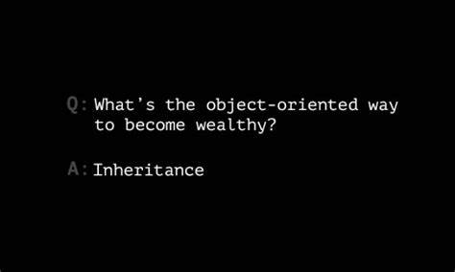
Inheritance

Slide 4
Subtyping
A type represents a collection of objects
A subtype represents a special kind of objects in this collection
Shape
CircleShape
RectShape
...

Slide 5
Inheritance
The relation between a class and its subclasses is called inheritance
Syntax:
// Inheritance
class <subclass> : public <parentclass> {
...
}
// Exmaples
class CircleShape: public Shape {
...
}
// Exmaples
class RectShape: public Shape {
...
}

Slide 6
Dynamic Dispatching

Slide 7
Dynamic Dispatching in C++
A class defines a collection of message interfaces (virtual functions)
Its different subclasses
Share the same interface
Give different implementation to these interfaces
Users dynamically dispatch messages through interfaces to sub-objects
Shape
CircleShape
RectShape
...

Slide 8
Virtual Functions
Overrided member functions that may be accessible from parent classes
Syntax:
Example:
class <classname> {
virtual <fundef>
...
};
// Draw is a virtual function
class Shape {
public:
...
virtual void draw() {}
...
};
// Draw is a virtual function
class CircleShape {
public:
...
virtual void draw();
...
};

Slide 9
Virtual Functions
Subclasses provide different implementations to parent virtual functions
// Circle
void CircleShape::draw()
{
int segments = 800;
float angle = getAngle();
Vector2 center = {centX, centY};
DrawCircleSector(center, radius, angle, angle+180, segments, WHITE);
DrawCircleSector(center, radius, angle+180, angle+360, segments, BLACK);
DrawCircleLines(centX, centY, radius, BLACK);
}

Slide 10
Invoking Virtual Functions
Dynamic dispatching is realized by
Binding sub-objects to a pointer or reference of their parent class
Call the virtual function through the pointer or reference
int main() {
vector<Shape*> shapes;
shapes.push_back(new CircleShape(centerX, centerY, radius, startAngle));
shapes.push_back(new RectShape(500, 300, 800, 500, startAngle));
// Main game loop
while (!WindowShouldClose()) {
...
for (Shape *s : shapes) {
s->setAngle(startAngle);
s->draw(); // Dynamic dispatched to CircleShape or RectShape
}
}
}

Slide 11
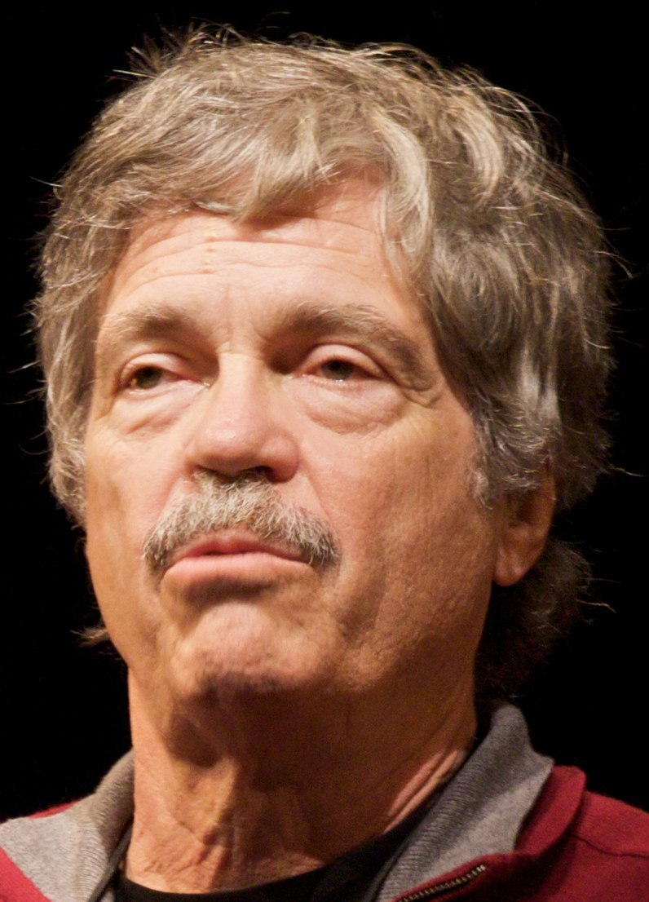
OOP by Alan Kay
OOP to me means only messaging, local retention and protection and hiding of state-process, and extreme late-binding of all things.

Slide 12
Future Direction

Slide 13
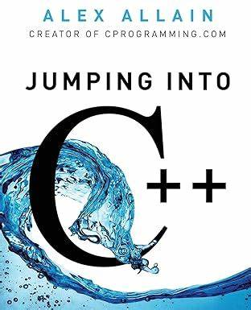
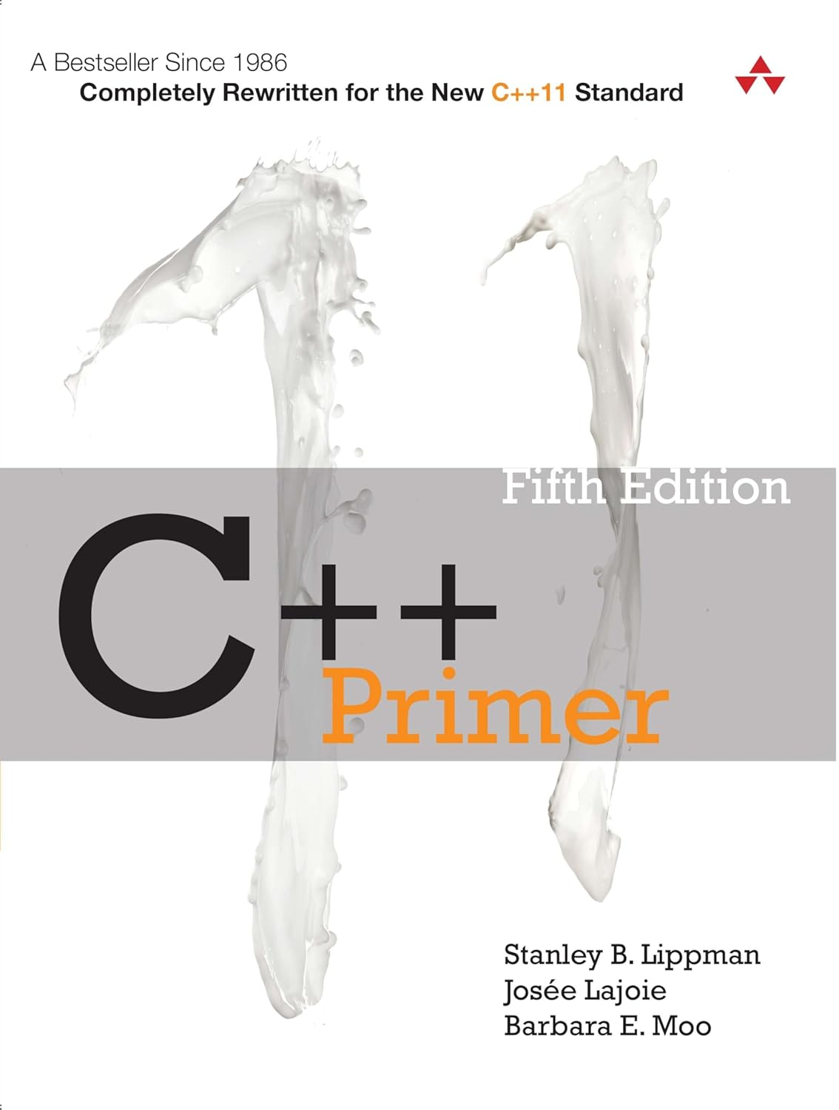
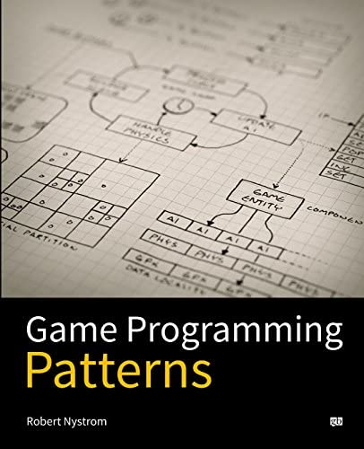
Become Good at C++
Do small projects (https://www.geeksforgeeks.org/top-50-cpp-project-ideas-for-beginners-advanced/)
Do big projects (Game, Compiler, LLM, OS kernel, etc.)
Learn underlying mechanisms

Slide 14
Most Importantly:
Have Fun Programming!

