Slide 1

Wechat Group

Slide 2
Principles and Methods of Program Design Lecture 1: Introduction
Yuting Wang
John Hopcroft Center for Computer Science
Shanghai Jiao Tong University
2025.2.17

Slide 3
Course Staff
Lecturer: 汪宇霆
John Hopcroft Center for Computer Science
Office: IEEE Building No.1, Room 203
Website：http://jhc.sjtu.edu.cn/~yutingwang/
Email：yuting.wang@sjtu.edu.cn
Teaching Assistants:
吴雨霏 (Yvonne2021@sjtu.edu.cn)
姚栋文 (1814080231@sjtu.edu.cn)
张令 (ling.zhang@sjtu.edu.cn)
吴进华 (jinhua.wu@sjtu.edu.cn)
毛逸洲 (Kelvin_MYYZJ@sjtu.edu.cn)
倪亦澄 (yicheng.ni@sjtu.edu.cn)

Slide 4
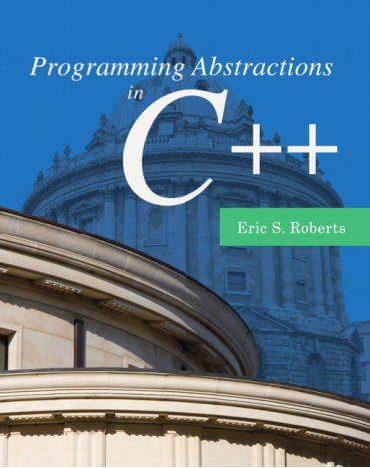
Course Information
Course Website:
https://oc.sjtu.edu.cn/courses/75883
Textbooks:
Programming Abstractions in C++ by Eric S. Roberts
《C++程序设计思想与方法》慕课版 第3版 翁惠玉 俞勇编著
Grading Policies
30% Homework Assignments
30% Mid-term Exam
30% Final Project
10% Participation

Slide 5
Assignments & Participation
Homework Assignments
Every odd week there are hands-on exercises (optional, no points)
Every even week there is homework assignment with one additional challenge
Final project will be published on week 14
Participation (10 pts):
Setup your environment (2 points)
Finish at least 2 challenges (Every challenge is worth 2 points)
Ask questions in the class, wechat or during Q&A sessions (2 points each question)

Slide 6

Important Notices
You are expected to complete assignments and projects on your own. Plagiarism is strictly prohibited!
You are expected to spend a fair amount of time to practice your programming skills and to solve the problems in assignments
Feel free to ask questions! It is a great way to understand and digest course materials

Slide 7
What is this Course about?
Goals:
Understand how C++ (imperative programming) works
Able to write medium size programs in C++ (100 – 5000 lines of code)
Learn to use abstractions to simplify your programs
Three aspects towards achieving this goal:
Programming Paradigm & Languages (C++)
Programming with Abstractions
Implementing Abstractions
Notice:
This is NOT a course about learning every aspects of C++!
We will make use of the core features of C++
We will left other complex mechanisms of C++ for you to explore

Slide 8
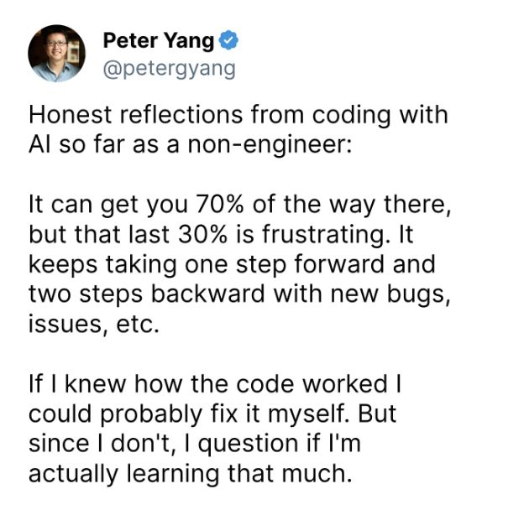
Can I use AI?
Questions:
Why do you need AI for programming?
What can AI do for you?
https://www.163.com/dy/article/JJI8QG570511FQO9.html

Slide 9
Course Outline
Basics of Imperative Programming (C++)
Programming with Abstractions
Implementing Abstractions

Slide 10


How machine works?
How to drive a car?
How to start a program?
Notes:
How real machines work? Initialize → Run Instructions
How computing machines work? Initialize → Run Instructions

Slide 11
Computing Machines
How Von Neumann Machine works?
Load program code and data
CPU interprets and executes the machine code
Memory
Input Devices
Code
Data
Output Devices
Interpret
Execute
CPU

Slide 12
Execution of Code
Code is a finite list of instructions
A pointer to the current instruction (Program Counter)
Program executes by running the instructions
Input Devices
Code
PC
1: read a
2: read b
3: add a and b to c
4: compare c with 0
5: if equal goto 1
6: halt
Affects
Code
Data
Output Devices

Slide 13
Computation as State Transitions
Machine
State 1
Machine
State 2
Machine
State 3
Input Devices
Input Devices
Input Devices
Execute Next
Instruction
Execute Next
Instruction
Initialize
Code
Code
Code
Data
Data
Data
Output Devices
Output Devices
Output Devices

Slide 14
What is a Programming Language?
A programming language is for writing instructions for computing machines
Instructions are also called
Programs
Code
Algorithms
Instructions are loaded into the machine when it is started
Execution continues by running the instructions

Slide 15
Hierarchy of Programming Languages
A programming language manipulates certain computing machines
High-Level
Programming
Languages
Work on
Source-Level
Virtual Machine
Compiles
Abstraction
Intermediate
Languages
Work on
Intermediate-Level
Virtual Machine
All of them have the Same Computational Power
Compiles
Abstraction
Machine Languages
Work on
Von Neumann
Machine
(Hardware)
Languages
Machines

Slide 16
Example
C++
Work on
C++
Abstract Machine
Clang
Abstraction
LLVM
Intermediate
Representation
Work on
LLVM
Virtual Machine
All of them have the Same Computational Power
LLVM
Abstraction
Machine Language
Work on
X86/ARM/RISC-V
(Hardware)
Languages
Machines

Slide 17
High-Level Programming Languages
We work with high-level programming languages (C++)
Why use C++?
Closer to natural languages (Simple)
No ambiguity (Precise)
Can do anything hardware does (Powerful)

Slide 18
Execution of C++ Programs
A C++ program is a finite list of commands
A program counter that points to the current command
Program executes by running the commands
Input/Output Events 1
Input/Output Events 2
Input/Output Events 3
Execute Next
Command
Execute Next
Command
Initialize
Memory
State 1
Memory
State 2
Memory
State 3

Slide 19
Important Notices
Of course, we have made drastic simplification!
In the real world
The structures of C++ programs are much more complex
The memory states have complicated structures
The events and interactions have variant forms
Nevertheless, the simplified picture
helps illustrate computation at a high level
Captures the essence of computation
Computation via effects on states: imperative programming

Slide 20
Course Outline
Basics of Imperative Programming (C++)
Programming with Abstractions
Implementation of Abstractions

Slide 21
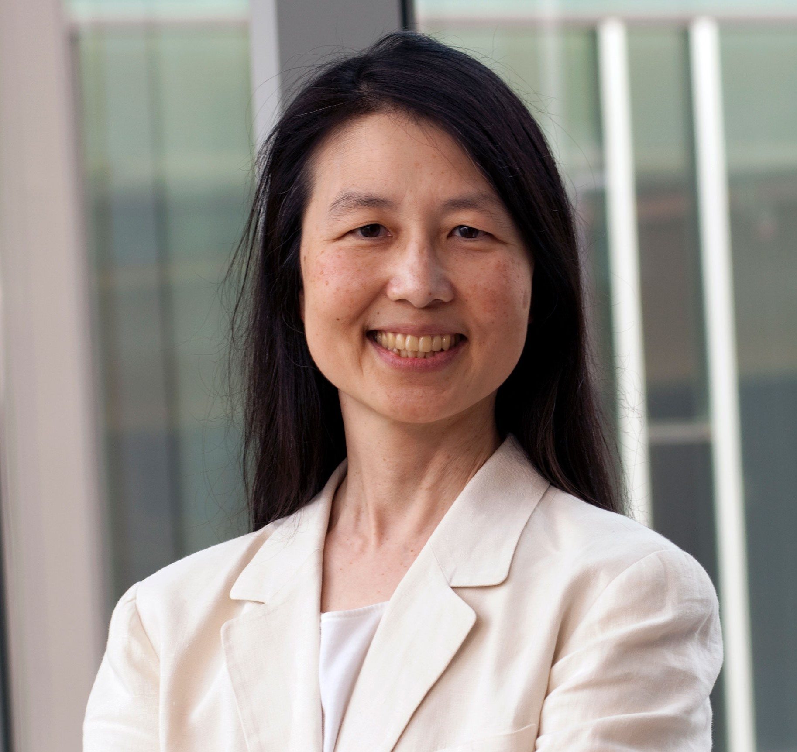

Computational Thinking
Proposed by Jeannette Wing (周以真)
Definition by Alfred V. Aho
(2020 Turing Award Laureate)
“The thought processes involved in formulating problems using abstractions so that their solutions can be represented as computational steps and algorithms.”
Computation and Computational Thinking, Alfred V. Aho
The Computer Journal, vol. 55, no. 7, pp 832-835, 2012

Slide 22

What is Abstraction?

Slide 23

Abstractions
Explore common abstractions for formulating problems
Beijing
Zhengzhou
Chengdu
Xi’an
Shanghai
Nanchang
Guilin

Slide 24
Computational Steps
Example: finding the smallest number in a finite list
Solution: Iteration or Recursion
Notice: Algorithms will NOT be the focus of this course
33
6
19
12
● ● ●
30

Slide 25
Course Outline
Basics of Imperative Programming (C++)
Programming with Abstractions
Implementation of Abstractions

Slide 26
Object-Oriented Programming
Central Programming Paradigm of C++
Classes for Abstraction and Implementation
Objects
Inheritance
Classes
OOP
Concepts
Encapsulation
Polymorphism

Slide 27
Why use C++ instead of Python?

Slide 28
Resource Management
Management of resources by programmers
Dynamic Allocation
Arrays & Pointers
Shared Memory
Memory
Management
Resource Ownership
Deep Copy

Slide 29
This concludes the discussion of course outline.
Now, let’s talk about programming in C++

Slide 30
What is C++?
A programming language developed by Bjarne Stroustrup
One of the world’s most widely used
Aimed for high efficiency for systems programming
Began with C + object-oriented programming
Continue to evolve until today (newest standard is C++23)
C++ is a complex language
Supports a lot of paradigms (structural, object-oriented, functional, generic)
Syntax is similar to C and Java but much more complicated
Requires explicit resource management by users
We will learn enough of C++ for our goals, but not for a complete coverage

Slide 31
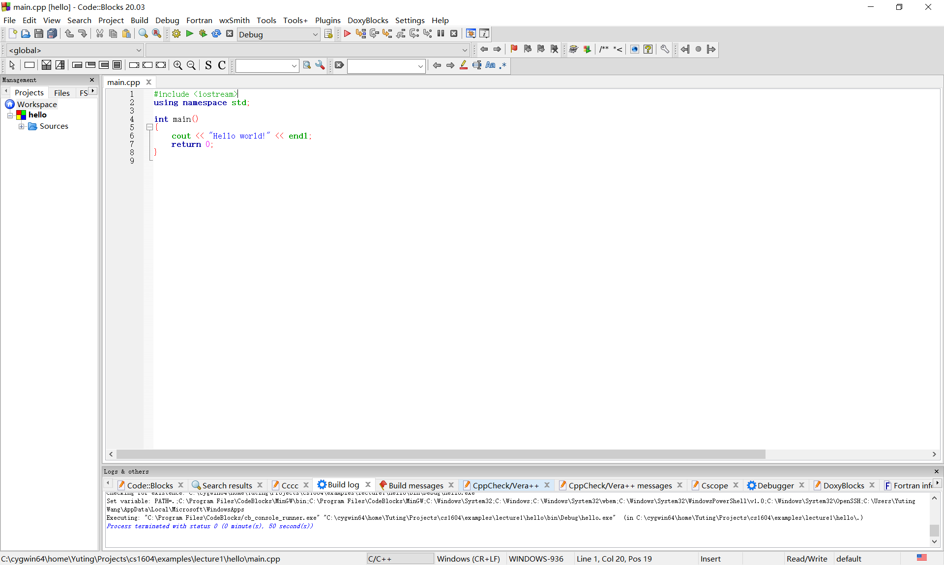
Programming Environment
Integrated Development Environment (IDE)
We use codeblocks (http://www.codeblocks.org/)
Typical Steps
Setup the C++ Compiler
Create C++ Projects
Add or Delete Files
Compile and Execute

Slide 32
The First C++ Program
Example: Hello World!
// File: hello.cpp
// this program prints the message
// “Hello world!” on the screen
#include <iostream>
using namespace std;
int main()
{
cout << “Hello world!” << endl;
return 0;
}
Comment
Pre-processing
Main function

Slide 33
Comments
Human-readable documents
C++ comments:
A line following “//”
Several lines between “/*” and “*/”
// File: hello.cpp
// this program prints the message
// “Hello world!” on the screen
/* File: hello.cpp
this program prints the message
“Hello world!” on the screen
*/

Slide 34
Main Function
main: the entry point of the whole program
Consists of a sequence of statements (commands)
Returns 0 if succeeds, or non-zero for failure.
int main()
{
cout << “Hello world!” << endl;
return 0;
}
int main()
{
<statement 1>
<statement 2>
…
<statement n>
return 0;
}
General Structure
The Example

Slide 35
Include Libraries
#include <libraryname> // A C++ system library
#include “libraryname.h” // A local user library
Common programming errors:
<> vs. “ ”
.h vs. no .h
Examples:
#include <iostream> // C++ standard input/output library
#include “mymath.h” // User-defined math library

Slide 36
Namespaces
Namespace: an area for holding identifiers (functions, variables, etc)
avoid conflicting names from different C++ files
Standard library identifiers are in the namespace “std”
using namespace xxx;
Makes the identifiers in the namespace xxx visible in the current file
namespace::identifier
Access identifier in namespace directly
std::cout << “Hello world!” << std::endl;

Slide 37
Compilation of C++
C++ source code lives in “*.cpp”
Every .cpp file is a module
A .h file provides declarations visible to other .cpp files
A .cpp file is compiled into a binary object file (.o)
Object files are linked to form an executable file
a.cpp
Compile
a.o
b.cpp
Compile
b.o
Link
prog.exe
library.o

Slide 38
Transition from Python to C++

Slide 39
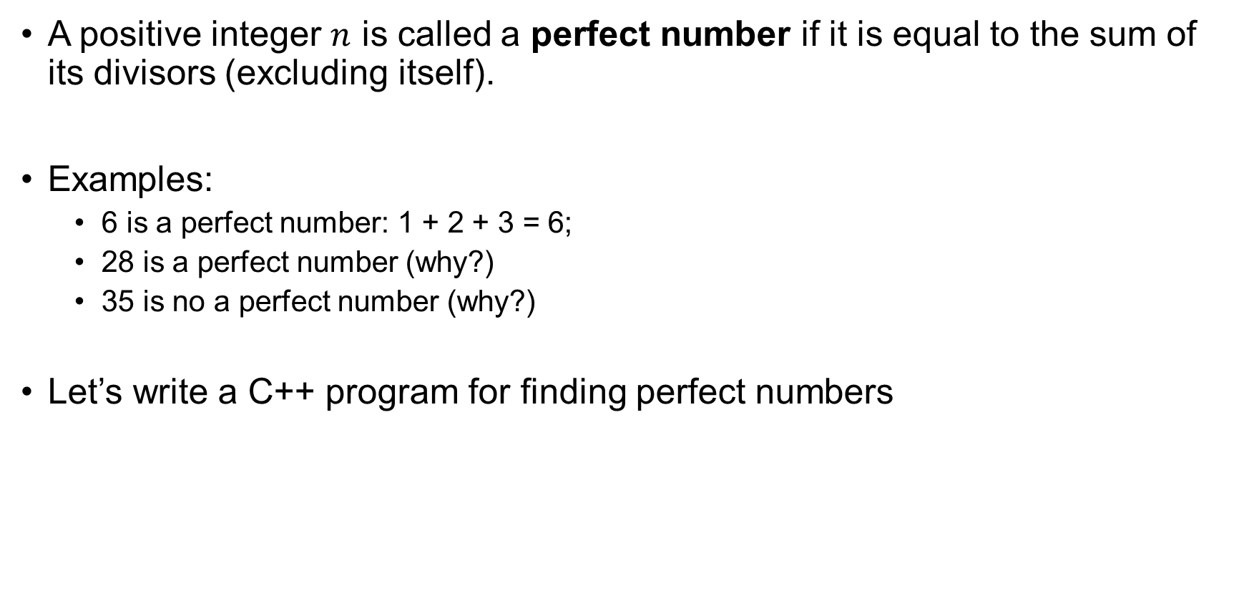
Example: Perfect Numbers
A positive integer $n$ is called a perfect number if it is equal to the sum of its divisors (excluding itself).
Examples:
6 is a perfect number: 1 + 2 + 3 = 6;
28 is a perfect number (why?)
35 is no a perfect number (why?)
Let’s write a C++ program for finding perfect numbers

Slide 40
#include <iostream>
using namespace std;
int main() {
int found = 0; // How many perfect numbers we've found
int number = 1; // Next number to test
/* Keep looking until we've found four perfect numbers. */
while (found < 4) {
/* Calculate the sum of the positive divisors of the number n >= 0. */
int total = 0;
for (int i = 1; i < number; i++) {
if (number % i == 0) { total += i; }
}
/* A number is perfect if the sum of its divisors is equal to it. */
if (total == number) {
cout << number << endl;
found++;
}
number++;
}
return 0;
}

Slide 41
#include <iostream>
using namespace std;
int main() {
int found = 0; // How many perfect numbers we've found
int number = 1; // Next number to test
/* Keep looking until we've found four perfect numbers. */
while (found < 4) {
/* Calculate the sum of the positive divisors of the number n >= 0. */
int total = 0;
for (int i = 1; i < number; i++) {
if (number % i == 0) { total += i; }
}
/* A number is perfect if the sum of its divisors is equal to it. */
if (total == number) {
cout << number << endl;
found++;
}
number++;
}
return 0;
}
In Python, indentation determines nesting
In C++, curly braces determine nesting

Slide 42
#include <iostream>
using namespace std;
int main() {
int found = 0; // How many perfect numbers we've found
int number = 1; // Next number to test
/* Keep looking until we've found four perfect numbers. */
while (found < 4) {
/* Calculate the sum of the positive divisors of the number n >= 0. */
int total = 0;
for (int i = 1; i < number; i++) {
if (number % i == 0) { total += i; }
}
/* A number is perfect if the sum of its divisors is equal to it. */
if (total == number) {
cout << number << endl;
found++;
}
number++;
}
return 0;
}
In Python, new lines mark the end of statements
In C++, semicolons mark the end of statements

Slide 43
#include <iostream>
using namespace std;
int main() {
int found = 0; // How many perfect numbers we've found
int number = 1; // Next number to test
/* Keep looking until we've found four perfect numbers. */
while (found < 4) {
/* Calculate the sum of the positive divisors of the number n >= 0. */
int total = 0;
for (int i = 1; i < number; i++) {
if (number % i == 0) { total += i; }
}
/* A number is perfect if the sum of its divisors is equal to it. */
if (total == number) {
cout << number << endl;
found++;
}
number++;
}
return 0;
}
In Python, you print output by using print()
In C++, you print by using string operators (<<)

Slide 44
#include <iostream>
using namespace std;
int main() {
int found = 0; // How many perfect numbers we've found
int number = 1; // Next number to test
/* Keep looking until we've found four perfect numbers. */
while (found < 4) {
/* Calculate the sum of the positive divisors of the number n >= 0. */
int total = 0;
for (int i = 1; i < number; i++) {
if (number % i == 0) { total += i; }
}
/* A number is perfect if the sum of its divisors is equal to it. */
if (total == number) {
cout << number << endl;
found++;
}
number++;
}
return 0;
}
In Python, conditions do not need parentheses
In C++, parentheses around conditions are mandatory

Slide 45
#include <iostream>
using namespace std;
int main() {
int found = 0; // How many perfect numbers we've found
int number = 1; // Next number to test
/* Keep looking until we've found four perfect numbers. */
while (found < 4) {
/* Calculate the sum of the positive divisors of the number n >= 0. */
int total = 0;
for (int i = 1; i < number; i++) {
if (number % i == 0) { total += i; }
}
/* A number is perfect if the sum of its divisors is equal to it. */
if (total == number) {
cout << number << endl;
found++;
}
number++;
}
return 0;
}
Both Python and C++ have for loops, but with different syntax

Slide 46
#include <iostream>
using namespace std;
int main() {
int found = 0; // How many perfect numbers we've found
int number = 1; // Next number to test
/* Keep looking until we've found four perfect numbers. */
while (found < 4) {
/* Calculate the sum of the positive divisors of the number n >= 0. */
int total = 0;
for (int i = 1; i < number; i++) {
if (number % i == 0) { total += i; }
}
/* A number is perfect if the sum of its divisors is equal to it. */
if (total == number) {
cout << number << endl;
found++;
}
number++;
}
return 0;
}
C++ has a “++” operator for addition. Python does not have this.

Slide 47
#include <iostream>
using namespace std;
int main() {
int found = 0; // How many perfect numbers we've found
int number = 1; // Next number to test
/* Keep looking until we've found four perfect numbers. */
while (found < 4) {
/* Calculate the sum of the positive divisors of the number n >= 0. */
int total = 0;
for (int i = 1; i < number; i++) {
if (number % i == 0) { total += i; }
}
/* A number is perfect if the sum of its divisors is equal to it. */
if (total == number) {
cout << number << endl;
found++;
}
number++;
}
return 0;
}
In Python, every variable has an implicit type
In C++, variables must be assigned explicit types

Slide 48
C++ and Python
Python is a great language for data processing and scripting
Dynamically typed
Programs are easy to modify
Programs are interpreted for execution
Programs run slower than compiled ones
C++ is a great language for writing high-performance code
Statically typed
Programs are less easy to modify
Programs are complied for execution
Programs run efficiently due to optimizations
Use the right language for the right task

Slide 49
Some Familiar and Unfamiliar Syntax
int x = 12*3 – 6/-2; // variables, types
char c = ‘A’;
bool b = false;
for (int i = 0; i < 10; i++) { // for loops
if (i % 2 == 0) { // if statement
x += i;
}
}
while (x > 0 && c == ‘A’ || b) { // while loop
x = x/2;
}
foo(x, 17, c); // function call
bar(“I have an apple”); // string argument

Slide 50
Corresponding Chapters
Basics of Imperative Programming (C++)
Chapter 1-2
Programming with Abstractions
Chapter 3-5, Chapter 7-8
Implementing Abstractions
Chapter 6, 11-14, 19

Slide 51
What to do
Read Chapter 1 of “Programming Abstractions in C++”
Install Codeblocks and test the “Hello World” program
Familiar with the coding style
https://web.stanford.edu/class/cs106b/resources/style_guide.html
Exercise (no the actual assignment yet!):
Write a C++ program computing Leibniz’s series (page 53, problem 11)
Get comfortable with C++ syntax

