Slide 1
Principles and Methods of Program Design Lecture 3: Functions & Libraries
Yuting Wang
SEIEE
John Hopcroft Center for Computer Science
2025.3.3

Slide 2
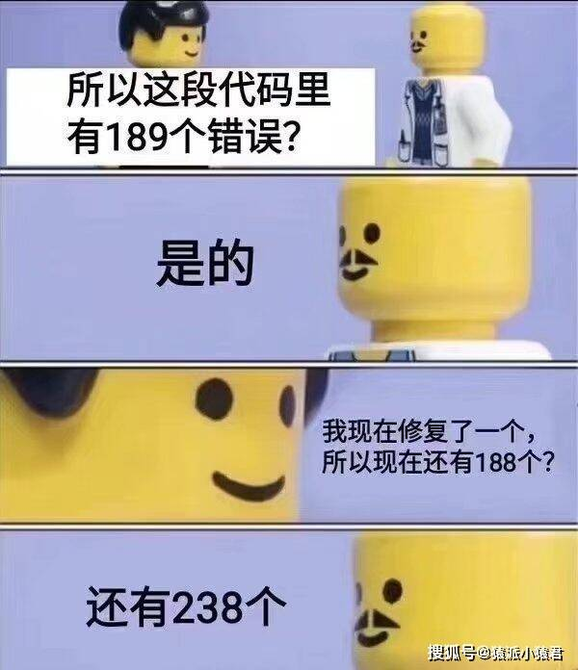

Slide 3
Last Time
Basics of Imperative Programming (C++)
Programming with Abstractions
Implementing Abstractions
Here!

Slide 4
Last Time
Overview of C++
Variables & Program States
Data Types
Expressions & Statements
Loop Invariants

Slide 5
This Time
Definition of Functions
Mechanics of Function Calls
Variable Scope
Recursion
Libraries & Interfaces

Slide 6
Computational Model
Execute the code inside the main function until it returns
However, programming with a monolithic piece of code is not scalable.
Question: How to divide the program into smaller components with well-defined roles?
Input/Output Events
main function
PC
1: statement;
2: statement;
3: statement;
……
n: return 0;
Manipulates
Memory
State

Slide 7
Functions

Slide 8
What is a C++ Function?
A procedure for incurring effects on program states
May take optional inputs
May return optional outputs
A function should independently carry out a well-defined task
Program
State
Program
State
C++ Function
Input
(Optional)
Output
(Optional)

Slide 9
Function Definitions
Syntax:
<name> is the name of function (must be valid identifiers)
<parameters> is a (possibly empty) list of declarations for input values
<type> is the type of output value (also called return type)
<body> is the statement for affecting the program state
<type> <name>(<parameters>) {
<body>
}
<type> <name>, …, <type> name

Slide 10
Return Statement
Syntax:
Immediately return with the value of the expression (if any)
The type of <expr> should match with the return type of the function
The return type may be void, indicating a function with no output
return <expr>;
return;
// Compare and return
// the max value
int max(int a, int b)
{
if (a > b)
return a;
else
return b;
}
// Print a value
void print(int a)
{
cout << “The value is ” << a << endl;
return; // This return may be omitted
}

Slide 11
Structures of Functions
A typical structure
Notes:
A function can only return one value
A function can have multiple return statements (sometimes even none)
function name
parameters
return type
int max(int a, int b)
{
int result;
if (a > b)
result = a;
else
result = b;
return result;
}
function body
local
variables
return statements

Slide 12
Main Function
Main function is a function that is the entry point of the whole program
Input: None
Output: Integer
// Example
int main()
{
cout << “Hello world!” << endl;
return 0;
}

Slide 13
Structure of C++ Programs
A C++ program contains a list of functions:
Each function implements a part of the program with a specific purpose
Functions may call each other
A main function is the entry point of the entire program
Main Function
Function 1
C++ Program:
● ● ●
Function n

Slide 14
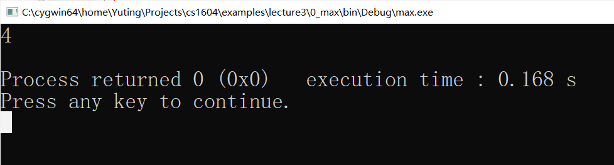
Function Call Expressions
Syntax:
Invoke <func_name> by copying the value of the i-th argument to the i-th parameter
<func_name> (<argument_1>, …, <argument_n>)
// Compare and return
// the max value
int max(int a, int b)
{
if (a > b)
return a;
else
return b;
}
// Main
int main()
{
cout << max(4,2) << endl;
return 0;
}

Slide 15
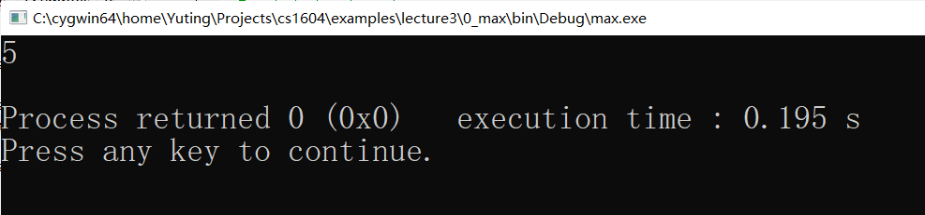
Function Call Expressions
Function calls may be embedded into other function calls
// Compare and return
// the max value
int max(int a, int b)
{
if (a > b)
return a;
else
return b;
}
// Increment
int incr(int a)
{ return a + 1; }
// Main
int main()
{
cout << incr(max(4,2)) << endl;
return 0;
}

Slide 16
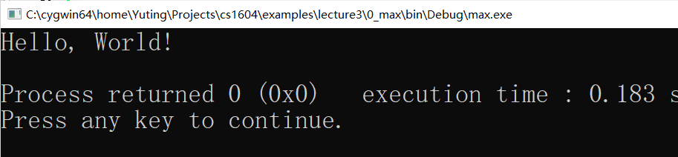
Function Call Statements
Function Call Statement (note the semicolon):
Execute the function as a standalone procedure
<func_name> (<argument_1>, …, <argument_n>);
// Example
void print_hello()
{
cout << “Hello, World!” << endl;
}
int main()
{
print_hello();
return 0;
}

Slide 17
Examples: Pure Math Functions
// Check leap years
bool is_leap_year(int year)
{
bool leapyear;
leapyear = ((year % 4 == 0) && (year % 100 != 0))
|| (year % 400 == 0);
return leapyear;
}

Slide 18
Examples: Pure Math Functions
Functions with loops
A key characteristic of imperative programming: even factorial represents a pure math function, the computation is done by modifying the value in s.
// Compute n!
int factorial(int n)
{
int s=1;
if (n < 0)
return -1;
for (int i = 1; i <= n; ++i)
s *= i;
return s;
}

Slide 19
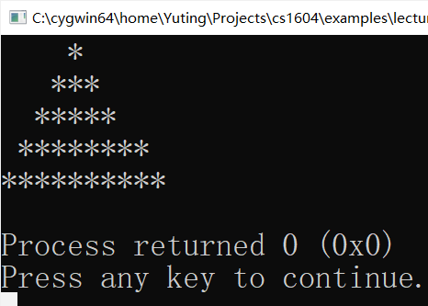
Examples: Procedures
Functions with no input and output
Example: print a pyramid of 5 lines of stars
void print_star()
{
cout << “ *\n”;
cout << “ ***\n”;
cout << “ *****\n”;
cout << “ ********\n”;
cout << “**********\n”;
}

Slide 20
Examples: Procedures
Functions with an input and no output
Example: print a pyramid of N lines of stars
// Print a pyramid of N lines of stars
void print_star_N (int numOfLines)
{
for (int i = 1; i <= numOfLines; ++i) {
// Start a new line
cout << endl;
// Print the space
for (int j = 1; j <= numOfLines-i; ++j)
cout << ‘ ‘;
// Print the stars
for (int j = 1; j <= 2 * i - 1; ++j)
cout << “*”;
}
}

Slide 21
Why Functions?
Divide a complex task into simpler ones
Reuse of code
Functions are black boxes
Users only need to know its interface:
The implementation is hidden from users
Input
Function
Output
Affects
Environment States

Slide 22
Exercise
Define a function for checking if a number is perfect?
What is a good name?
What are its input and output types?
What is its body?

Slide 23
We now have a basic understanding of function.
Now, how exactly does functions
change program states?

Slide 24
Mechanics of Function Calls

Slide 25
Local Variables
Variables declared inside a function
Including function parameters
// Example 1
void max(int a, int b)
{
int result;
if (a > b)
result = a;
else
result = b;
cout << result << endl;
}
// Example 2
int max()
{
int result, a, b;
cin >> a >> b;
if (a > b)
result = a;
else
result = b;
return result;
}
// Example 3
int factorial(int n)
{
int s=1;
if (n < 0)
return -1;
for (int i = 1; i <= n; ++i)
s *= i;
return s;
}

Slide 26
Stack Frames
Every function call creates a collection of memory block:
One memory block for each local variable
Reading and assignment of a local variable work on its block
The collection of memory blocks is called a stack frame
The stack frame is destroyed upon function return
// Example 1
void max(int a, int b)
{
int result;
if (a > b)
result = a;
else
result = b;
cout << result << endl;
}
a
b
result
Stack Frame for calls to max

Slide 27
Execution of a Single Function Call
Allocate frame
& copy arguments
Compute arguments at the call site
Allocate the stack frame for the called function
Copy the values of arguments to the frame
Execute the body of the function
When a return statement is hit:
Evaluate the returned value
Deallocate the stack frame
Return to right after the call site
(copy the value back if a value is returned)
Note: passing of arguments by copying is known as Call-By-Value
caller
call
callee
return
Destroy frame
& copy return value

Slide 28
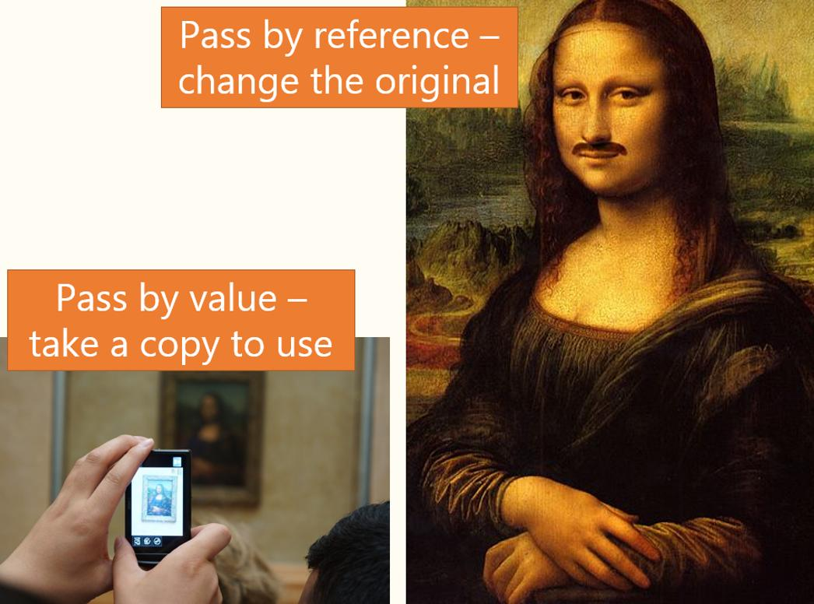

Slide 29
Example
// Compare and return
// the max value
int max(int a, int b)
{
int result;
if (a > b)
result = a;
else
result = b;
return result;
}
a
4
b
2
// Caller
int main()
{
cout << max(4,2) << endl;
return 0;
}
result
?
4
PC
Stack Frame for max(4,2)

Slide 30
Example
Compute arguments at the call site
Allocate the stack frame for the called function
Copy the values of arguments to the frame
a
10
b
20
ave
?
int main()
{
int a=10, b=20, ave;
…
ave = average(a, b);
…
return 0；
}
int average(int x, int y)
{
int result;
result = (x + y) / 2;
return result;
}
x
10
y
20
result
?

Slide 31
Example
Execute the body of the function
a
10
b
20
ave
?
int main()
{
int a=10, b=20, ave;
…
ave = average(a, b);
…
return 0；
}
int average(int x, int y)
{
int result;
result = (x + y) / 2;
return result;
}
x
10
y
20
result
15
?

Slide 32
Example
Deallocate the stack frame
Return from the call site and copy the value back
a
10
b
20
ave
15
?
int main()
{
int a=10, b=20, ave;
…
ave = average(a, b);
…
return 0；
}
int average(int x, int y)
{
int result;
result = (x + y) / 2;
return result;
}
x
10
y
20
result
15

Slide 33
Execution of Multiple Calls
Invocation of functions in programs generate a stack of frames
The history of function calls is like a tree
Frame for main
int main()
{
f(…);
g(…);
return 0;
}
Frame for f
Frame for g
void f()
{
h();
…
h();
}
Frame for h
Frame for h

Slide 34
Implication of Call-By-Value
Variables in callers and callees are in separate memory locations
Example: what are the outputs when running the following program?
// Swap the values of variables
void swap(int x, int y)
{
int temp;
temp=x;
x=y;
y=temp;
}
int main()
{
int a = 5, b = 8;
cout << “a="<<a<<", b="<<b<< endl;
swap(a,b);
cout << "a="<<a<<", b="<<b<< endl;
return 0;
}

Slide 35

Global Variables

Slide 36
Global Variables
Variables defined outside of functions
Occupy memory regions in the global memory
Initialized when the program starts running
// Example
int x = 2; int y = 3;
const double PI = 3.14159;
int main()
{
cout << x << “*” << y << “=“<< x*y << endl;
cout << “PI*” << x << “^2 = ” << PI*x*x << endl;
return 0;
}

Slide 37
Execution of a C++ Program
Given a C++ program, its execution follows the steps below:
Global memory for global variables are allocated
Execution begins by calling the main function
The execution continues, which may involve
Sequential execution of statements
Loops
Function calls which grow stack frames
Function returns which destroy stack frames
The execution ends when the main function returns
The global memory regions are destroyed

Slide 38
Example
How does the memory state evolve with the following program?
double g(double t)
{ return t*2.0; }
int f(int a, int b)
{
int c = a + b;
g(c);
return c;
}
int x = 2, y = 3;
const double PI = 3.14159;
int main()
{
f(x, y);
g(PI);
return 0;
}

Slide 39
C++ Computation Model Revisited
Global
Memory
Stack
Memory
Main Function
Manipulates
● ● ●
Function 1
● ● ●
Function n
● ● ●
● ● ●
Grows
C++ Program
C++ Memory State

Slide 40
Lifetime of Variables
A variable
Begins to live when its memory region is allocated
Dies when its memory region is destroyed
 | Global Variables | Local Variables
Begin to live | Program Starts | Function Calls
Die | Program Ends | Function Returns

Slide 41
Lifetime vs. Visibility
Two properties of variables:
Lifetime: when a variable has an associated memory region during execution
Visibility: whether a variable can be referred to at some place in the program
Lifetime is a dynamic property of variables
Visibility is a static property of variables
They are determined by the scopes of variables

Slide 42
Scopes of Variables

Slide 43
Determining Variable Scopes
Given a variable, its scope
starts at the declaration site
ends at the end of the block in which it is declared
may be overwritten by that of a variable with the same name in a nested block
Variables in different scopes but with the same name are DIFFERENT variables!
// Example
int main()
{
int a = 2, b = 3; // Scopes of a and b begin
cout << a << b << endl;
{
int a = 4; // Overwrite the scope of 1st a
cout << a << b << endl;
}
cout << a << b << endl;
return 0; // Scopes of a and b end
}
// Example
int main()
{
int a = 2, b = 3;
cout << a << b << endl;
{
int a = 4;
cout << a << b << endl;
}
cout << a << b << endl;
return 0;
}

Slide 44
Scopes of Function Parameters
The same rules apply to function parameters
They are declared at the beginning of the function body
// Example
void p(int b) // Scope of b begins
{
int a = 4; // Scope of a begins
cout << a << b << endl;
} // Scopes of a and b end
int main()
{
int a = 2, b = 3; // Scopes of a and b begin
cout << a << b << endl;
p(b);
cout << a << b << endl;
return 0; // Scopes of a and b end
}

Slide 45
Scope of Loop Variables
The same rules apply to loop variables
Their scope ends at the end of the loop body
// Example
int main()
{
int sum = 0;
for (int i=0; i<5; i++) { // Scope of i begins
sum = sum + m;
} // Scope of i ends
cout << "sum = "<< sum << endl;
return 0;
}

Slide 46
Scopes of Global Variables
The same rules apply to global variables
Treat the whole file as a top-level block
// Example
int b = 5; // Scope of global b begins
int main()
{
cout << b << endl;
int a = 2, b = 3; // Scopes of a and b begin
cout << a << b << endl;
{
int a = 4; // Overwrite the scope of 1st a
cout << a << b << endl;
}
cout << a << b << endl;
return 0; // Scopes of a and b end
}

Slide 47
Scopes of Functions
The same rules apply to function definitions
Question: what if area is defined after main?
int x = 2; int y = 3;
const double PI = 3.14159;
double area(double r) // Scope of area begins
{
return PI*r*r;
}
int main()
{
cout << x << “*” << y << “=“ << x*y << endl;
cout << “PI*” << x << “^2 = ” << area(x) << endl;
return 0;
} // Scope of area ends

Slide 48
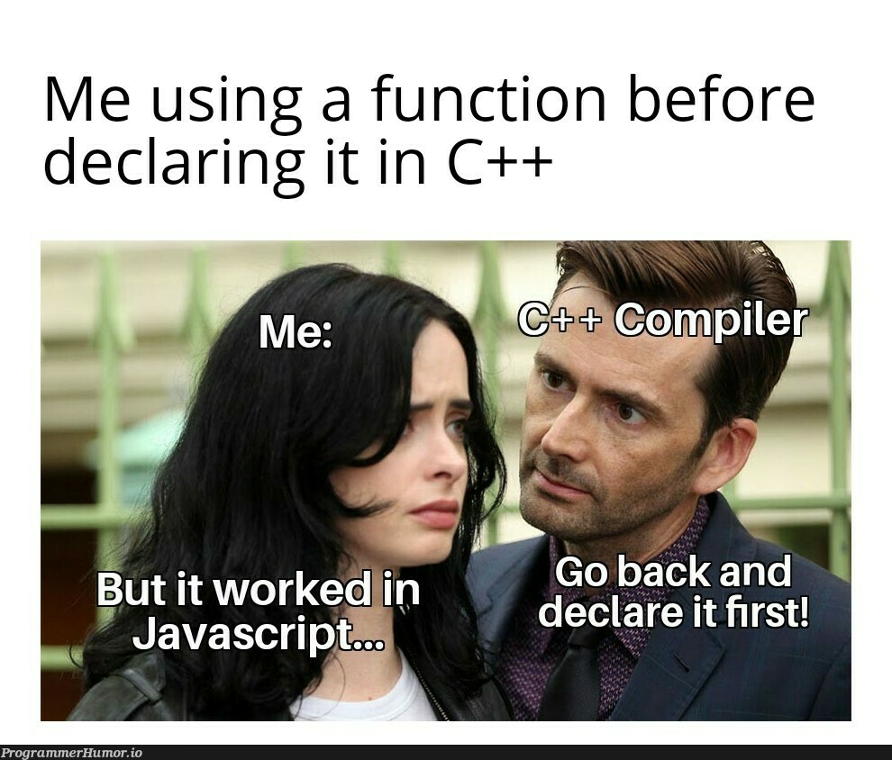

Slide 49
Function Prototypes
Declaration of functions (without body)
<type> <name>(<parameters>);
// Example
int x = 2; int y = 3;
const double PI = 3.14159;
double area(double r); // Scope of area begins
int main()
{
cout << x << “*” << y << “=“ << x*y << endl;
cout << “PI*” << x << “^2 = ” << area(x) << endl;
return 0;
}
double area(double r)
{
return PI*r*r;
} // Scope of area ends

Slide 50
Function Prototypes
The names of parameters may be ignored
A function may be declared several times
The actual definition of function must match their prototypes
// The same function prototype
int max(int a, int b);
int max(int, int);
// Same declaration and definition
int max(int a, int b);
int max(int a, int b)
{
…
}
// Different declaration and definition
int max(int a, int b);
double max(double a, double b)
{
…
}

Slide 51
Exercise
int p = 1, q = 5， r=3;
void f1(); void f2();
int main()
{
f1(); cout << “after f1: p,q,r=” << p << q << r;
f2(); cout << “after f2: p,q,r=” << p << q << r;
}
void f1()
{
int p = 3, r = 2;
q=p+q+r;
cout << “f1: p,q,r=“ << p << q << r;
}
void f2()
{
p=p+q+r;
cout << “f2: p,q,r=“<< p << q << r;
}

Slide 52
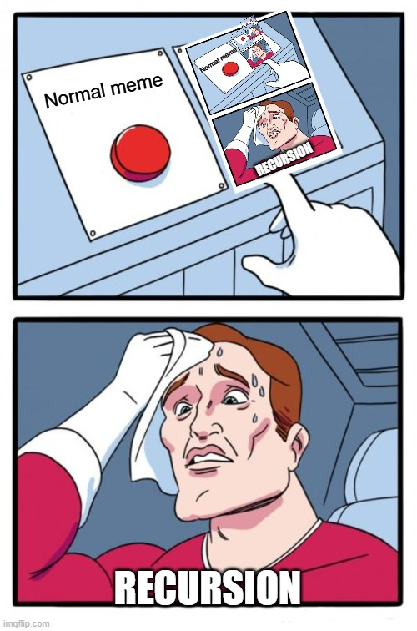

Slide 53
Thinking Recursively
To find a recursive solution to a problem
Experiment with its decomposition to smaller problems with the same shape
See if there are base cases that are easy to solve
Find a way to compose the results to form a solution to the original problem
Original Problem:
Decompose
Compose
Sub Problems:
● ● ●
● ● ●
Base Solutions
Base Cases:

Slide 54
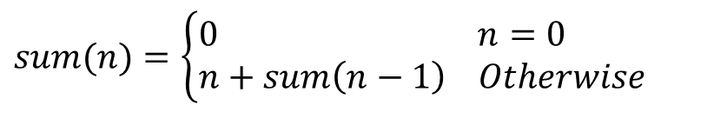
A Simple Example
Compute the sum of integers {1, 2, …, n}
Recursive solution:
sum(n) = 1+2+3+4+…+(n-1)+n
$$sum(n)=\left\{\begin{aligned}&0\begin{matrix} & & & \end{matrix} n=0 \\ &n+sum\left(n−1\right) Otherwise\end{aligned}\right.$$
sum(n-1)
// Compute the sum of 1 to n
int sum(int n)
{
int s;
if (n == 0)
s = 0;
else
s = n + sum(n-1); // recursive call
return s;
}

Slide 55
Recursive Paradigm
A recursive function often has the following form
Points to note:
The solution to base cases must be easy to determine
The test condition is called terminating condition
You must identify a recursive decomposition
Decompose the problem into less complex ones
Sub-problems must have the same form
if (test for base cases) {
Compute a simple solution without using recursion.
} else {
1. Break the problem down into subproblems of the same form.
2. Solve each of the subproblems by calling this function recursively.
3. Reassemble the subproblem solutions into a solution for the whole.
}

Slide 56
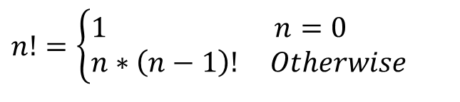
Example: Factorial
Terminating Condition
Given n, compute n!
Recursive function
n!=1*2*3*4*…*(n-1)*n
$$n!=\left\{\begin{aligned}&1\begin{matrix} & & & \end{matrix} n=0 \\ &n∗\left(n−1\right)! Otherwise\end{aligned}\right.$$
(n-1)!
// Compute n!
int factorial(int n)
{
if (n==0)
return 1;
else
return n * factorial(n-1);
}

Slide 57









Tracing Recursion
Recursion incurs nested call to the same function with decreasing values
Calling the same function over and over until reaching the base case
Later calls operate on smaller arguments
Example:
factorial(4)
Recursive Calls
$$f\left(0\right)=1$$
$$f\left(1\right)=$$
$$f\left(2\right)=$$
$$∗1$$
$$f\left(3\right)=$$
$$∗2$$
$$f\left(4\right)=$$
$$∗3$$
$$∗4$$
Return from Calls

Slide 58









Stack Frames in Recursion
In recursive computation
Stack frames are allocated as recursive calls happen
Stack frames stop to increase when base case is reached
Stack frames are destroyed as recursive calls return
Example:
Note: the number of stack frames is linear to function calls
Allocation of stack frames
$$f\left(0\right)=1$$
$$f\left(1\right)=$$
$$f\left(2\right)=$$
$$∗1$$
$$f\left(3\right)=$$
$$∗2$$
$$f\left(4\right)=$$
$$∗3$$
$$∗4$$
Destruction of stack frames

Slide 59

Exercise
What is a recursive solution to the Leibniz series?

Slide 60
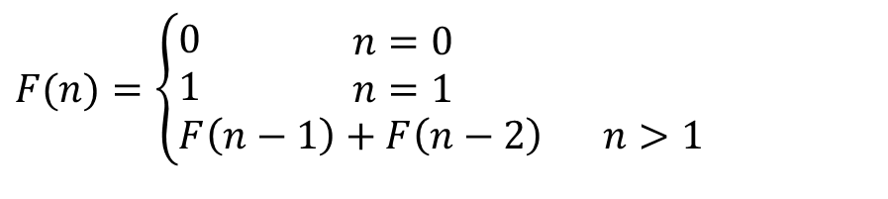
Example: Fibonacci Numbers
A sequence of numbers:
Note: More than one recursive calls in the body of the function fib
n
0
1
2
3
4
5
6
$$F(n)=\left\{\begin{aligned}&0\begin{matrix} & & & n=0\end{matrix} \\ &1\begin{matrix} & & & n=1\end{matrix} \\ &F\left(n−1\right)+F\left(n−2\right)\begin{matrix} & \end{matrix}n>1\end{aligned}\right.$$
F(n)
0
1
1
2
3
5
8
// Fibonacci Numbers
int fib(int n)
{
if (n == 0)
return 0;
else if (n == 1)
return 1;
else
return fib(n-1) + fib(n-2);
}

Slide 61
Mutual Recursion
Functions recursively call each other
Recursive calls happen at a deeper level
// Checking oddness and eveness
bool is_even(unsigned int n)
{
if (n == 0)
return true;
else
return is_odd(n-1);
}
bool is_odd(unsigned int n)
{
return !is_even(n);
}

Slide 62

Example: Exponentials
Given $n$ and $k$, compute $n^{k}$:
Q: Is there a more efficient solution?
// Exponentials
int power(int n, int k)
{
if (k == 0)
return 1;
else
return n * power(n, k-1);
}

Slide 63
Recursion vs. Iteration (Similarities)
Recursion and Iteration have the same computation power:
A language with either mechanism is Turing Complete
Example:
// Compute the sum of 1 to n
// by iteration
int sum(int n)
{
int s = 0;
for (int i = 1; i <= n; i++)
s = s + i;
return s;
}
// Compute the sum of 1 to n
// by recursion
int sum(int n)
{
if (n == 0)
return 0;
else
return n + sum(n-1);
}

Slide 64
Recursion vs. Iteration (Differences)
Comparison:
Problems to note:
Recursion may cause a lot of repetitive computation
Consume a lot of memory, and cause stack overflow
 | Iteration | Recursion
Clarity | Less | More
Efficiency | More | Less

Slide 65
Example: Space and Time Comparison
Recursive and iterative implementation of Fibonacci Numbers:
A lot of more repetitive computation for recursion
A lot more memory needed for recursion
// Fibonacci Numbers by Recursion
int fib(int n)
{
if (n == 0)
return 0;
else if (n == 1)
return 1;
else
return fib(n-1) + fib(n-2);
}
// Fibonacci Numbers by Iteration
int fib(int n)
{
int fn_1 = 0, fn_2 = 1;
if (n == 0) return 0;
if (n == 1) return 1;
for (int i = 2; i<=n; ++i) {
int fn = fn_1 + fn_2;
fn_1 = fn_2;
fn_2 = fn;
}
return fn_2;
}

Slide 66
Example: Towers of Hanoi
Goal: move disks on spire A to spire B
Rules:
You can only move one disk at a time
You are not allowed to move a larger disk on top of a smaller one.
A B C

Slide 67
Recursive Solution
Goal: move N disks on from a source spire (src) to a target spire (tgt) through an auxiliary spire (aux)
The problem with N disks can be decomposed into those with N-1 disks:
N disks
A B C

Slide 68
Recursive Solution
Step 1: Move N-1 disks from A (src) to C (tgt) through B (aux)
N-1 disks
A B C

Slide 69
Recursive Solution
Step 2: Move the disk at A to B
N-1 disks
A B C

Slide 70
Recursive Solution
Step 3: Move N-1 disks from C (src) to B (tgt) through A (aux)
N-1 disks
A B C

Slide 71
Recursive Solution
// Solution to the Towers of Hanoi
void hanoi(int n, char src, char tgt, char aux)
{
if (n <= 0) return;
if (n == 1)
cout << src << " -> " << tgt << endl;
else {
hanoi(n-1, src, aux, tgt); // Move n-1 disks
cout << src << " -> " << tgt << endl;
hanoi(n-1, aux, tgt, src); // Move n-1 disks
}
}
int main()
{
int n; cin >> n;
hanoi(n, 'A', 'B', 'C');
return 0;
}

Slide 72
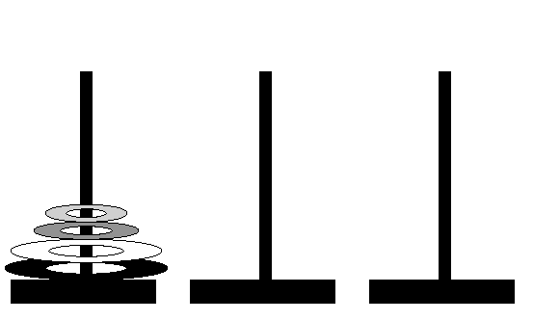
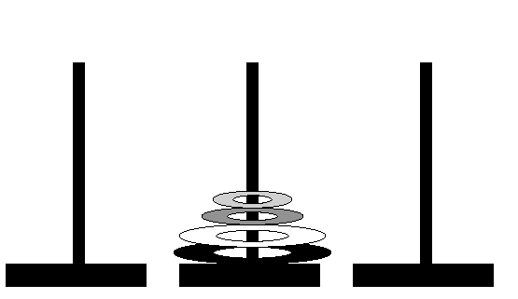
Example: 4 Disks
N=4 Initial State:
N=4 Final State:

Slide 73
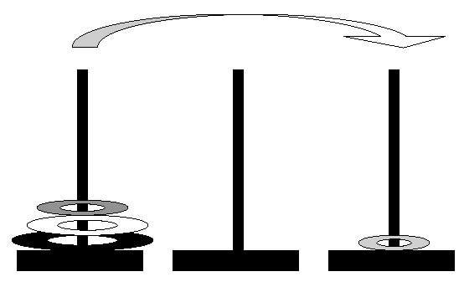
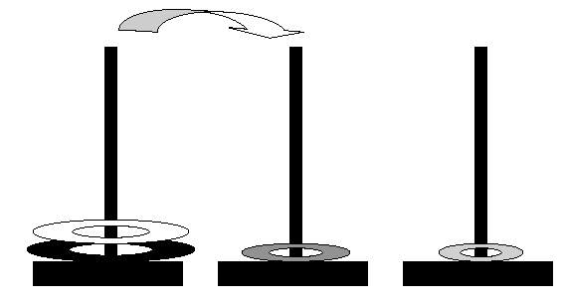
Example: 4 Disks
Step1: A -> C
Step 2: A -> B

Slide 74
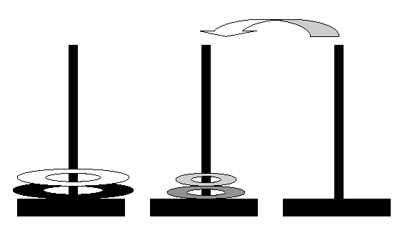
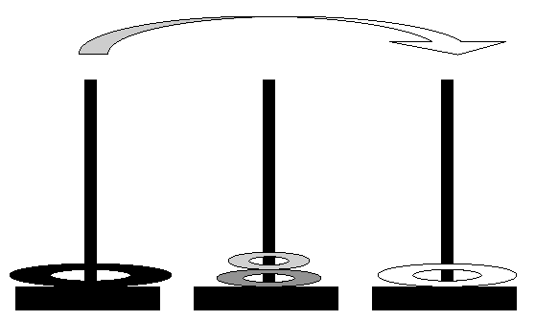
Example: 4 Disks
Step 3: C -> B
Step 4: A -> C

Slide 75
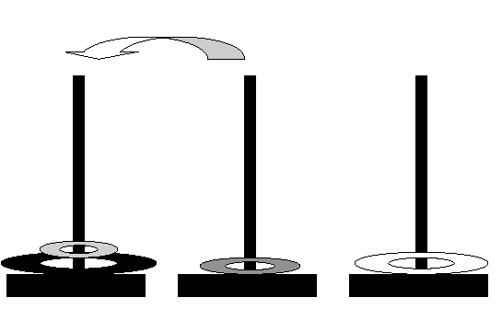
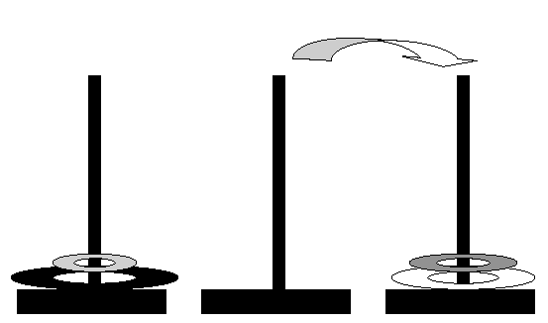
Example: 4 Disks
Step 5: B -> A
Step 6: B -> C

Slide 76
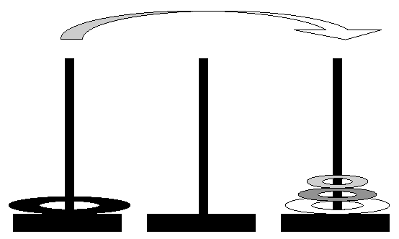
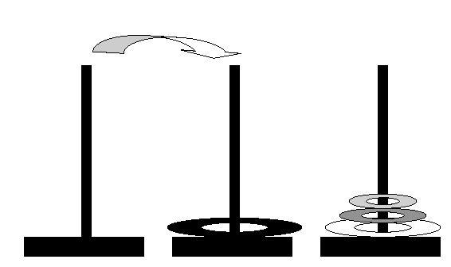
Example: 4 Disks
Step 7: A -> C
Step 8: A -> B

Slide 77
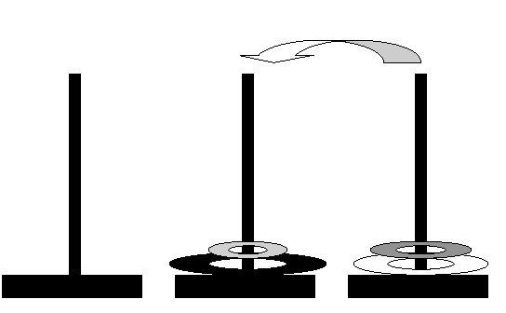
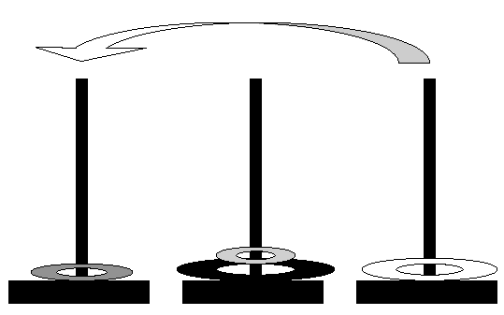
Example: 4 Disks
Step 9: C -> B
Step 10: C -> A

Slide 78
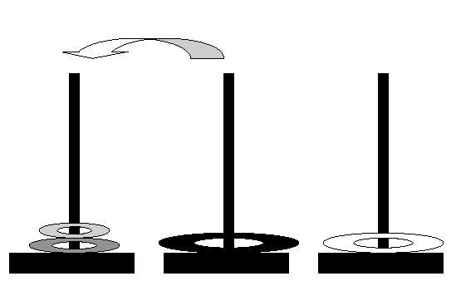
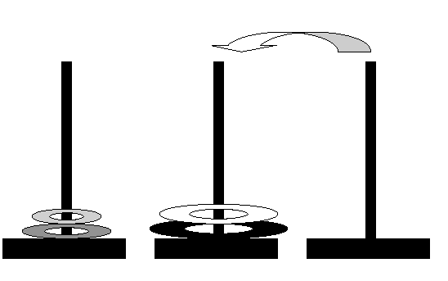
Example: 4 Disks
Step 11: B -> A
Step 12: C -> B

Slide 79
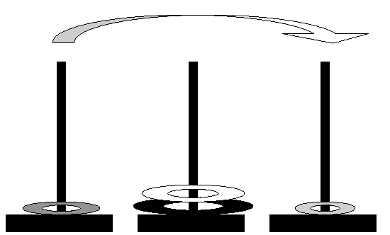
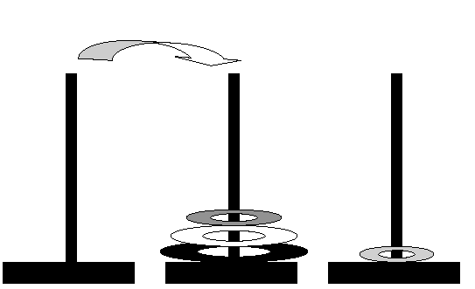
Example: 4 Disks
Step 13: A -> C
Step 14: A -> B

Slide 80
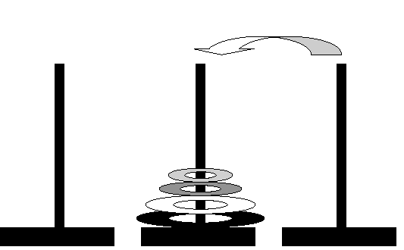
Example: 4 Disk
Step 15: C -> B

Slide 81
Functions support code reuse and information hiding at small scales
Are there program constructs for supporting them at large scales?

Slide 82
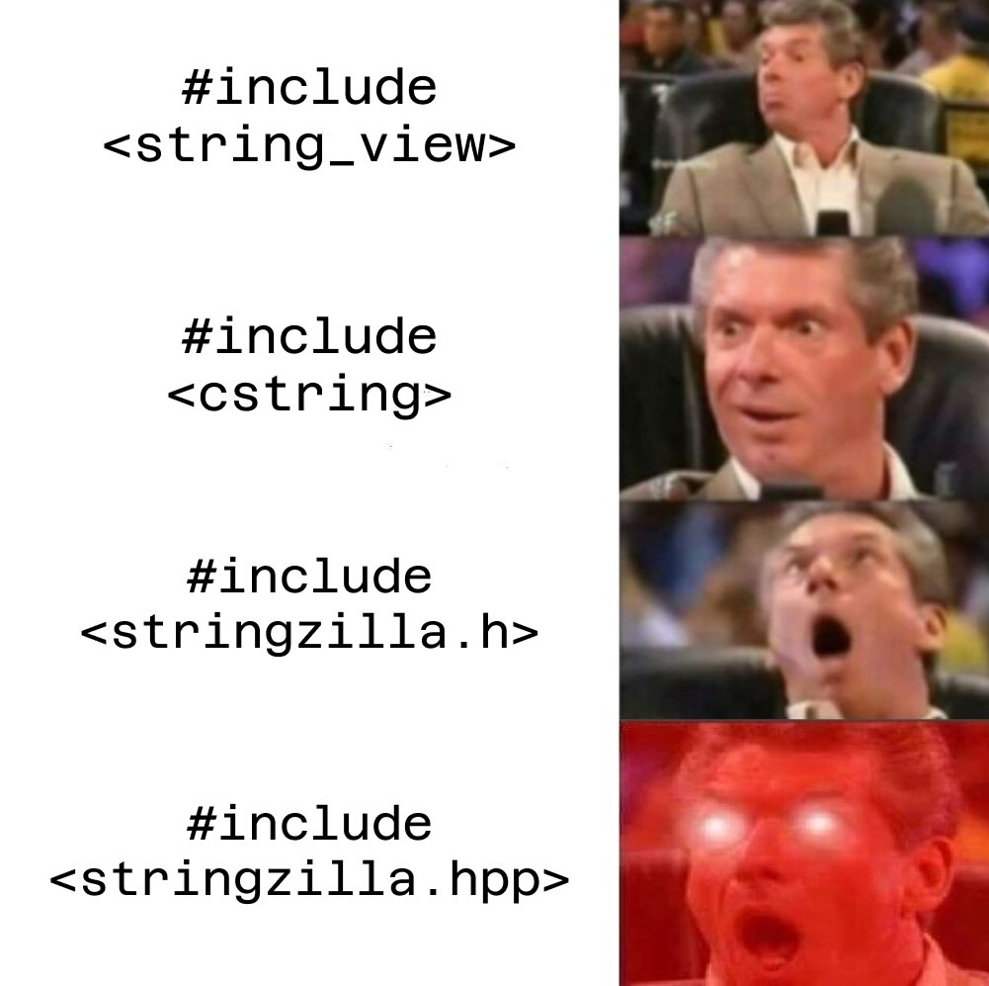
Modules & Interfaces

Slide 83
C/C++ Modules
A module is a collection of functions and global variables
In the most basic case, a source (.cpp) file is a module
A program consists of a collection of modules
There must be only one definition for every variable or function (One Definition Rule)
There must be ONLY ONE main function in some module
a.cpp
b.cpp
z.cpp
A C++ Program: where a definition is either
a function or
a global variable
Definition 1
Definition 1
Definition 1
● ● ●
● ● ●
● ● ●
● ● ●
Definition n
Definition m
Definition k

Slide 84

Interfaces of Modules
An interface for a module M a collection of declarations of definitions in M
In the most basic case, a header (.h) file is an interface
Principle:
Information hiding through restricted views
Benefits:
Simplicity & Stability for clients
Flexibility for implementors
Attention:
User-defined types may occur in interfaces
No definition should appear in an interface!
Interface
What Clients See
Implementation
What Implementors See

Slide 85
Libraries
A library is a set of modules together with their interfaces
Example: a counter library
/* Interface of the counter library */
#ifndef COUNTER_H_INCLUDED
#define COUNTER_H_INCLUDED
// Reset the counter to 0
void reset_counter();
// Get the value of the counter
int get_counter();
// Increase the value of the counter
void incr_counter();
#endif // COUNTER_H_INCLUDED
/* Implementation of the counter library */
int counter; // The value of the counter
// Reset the counter to 0
void reset_counter()
{ counter = 0; }
// Get the value of the counter
int get_counter()
{ return counter; }
// Increase the value of the counter
void incr_counter()
{ counter++; }
counter.h
counter.cpp

Slide 86
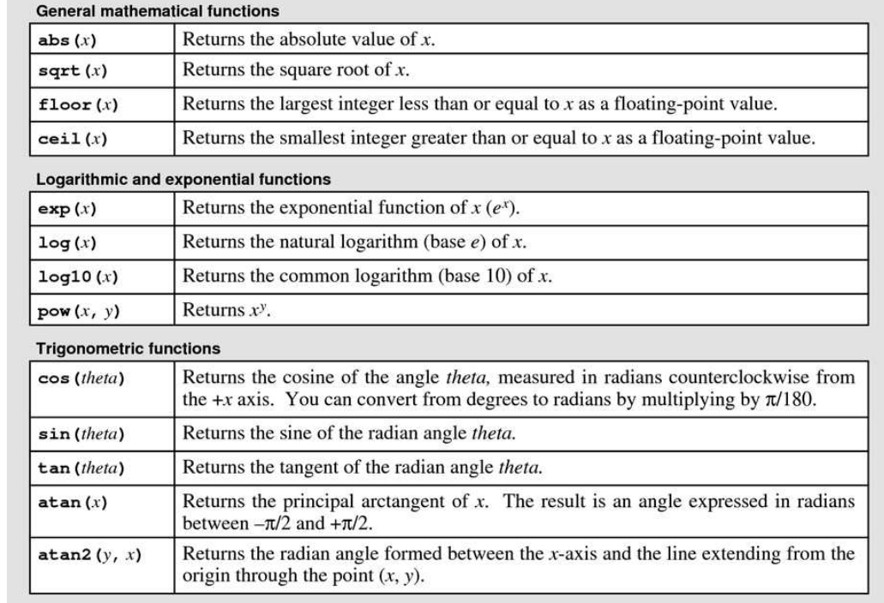
C++ Standard Libraries
Libraries defined by C++ Standard
Examples:
<iostream>: basic inputs and outputs
<cmath>: Math libraries
<algorithm>: Algorithms
<string>: Strings
Containers
Iterators
… (and many others)
Reference book: C++ Standard Library, A Tutorial And Reference (2nd Edition)
Selected Functions from <cmath>

Slide 87
Use Libraries
The #include command:
Copy the contents in a header file into the current file
Make the interface of a library visible
Standard Libraries:
User-defined Libraries
// Use the counter library
#include <iostream>
#include "counter.h"
using namespace std;
int main()
{
int n;
cin >> n;
reset_counter();
for (int i = 0; i < n; i++)
incr_counter();
cout << "The value of the counter is: “
<< get_counter() << endl;
return 0;
}
#include <libraryname>
#include “libraryname.h”

Slide 88
Notice
The modules and interfaces are ways to organizing programs
Dividing a program into modules DOES NOT affect the execution model
Global Memory
Stack Memory
Module 1
Module 2
Manipulates
● ● ●
● ● ●
● ● ●
Module n
● ● ●
Grows
C++ Program
C++ Memory State

Slide 89
Principles for Designing Libraries
A module is an implementation of a coherent set of functionalities, e.g.:
Basic math functions
Graphic algorithms
… (many others)
An interface is a restricted view of the module. It should be
Unified: provides a consistent and coherent abstraction
Simple: hide complexity of the implementation from clients
Sufficient: exposes enough functionalities to clients
General: meet the needs of many clients
Stable: remains unchanged even implementations evolve
Note: Libraries implement what are known as programming abstractions

Slide 90
Hierarchy of Libraries
Libraries may be used to implement other libraries
They form a hierarchy: (arrows indicates usage relations)
Library A
Library B
Library C
Library D
Library E
Library F

Slide 91
Example
Use the counter library to implement a clock library
#ifndef CLOCK_H_INCLUDED
#define CLOCK_H_INCLUDED
/* Clock Library for 24 hours */
// Reset the clock;
void reset_clock();
// Increase time by a second
void incr_second();
// Get the current hour
int get_hour();
// Get the current minute
int get_minute();
// Get the current second
int get_second();
#endif // CLOCK_H_INCLUDED
#include "counter.h"
// Reset the clock
void reset_clock()
{ reset_counter(); }
// Increase time by a second
void incr_second()
{ incr_counter(); }
// Get the current hour
int get_hour()
{
int s = get_counter();
return (s/(60*60))%24;
}
…
clock.h
clock.cpp

Slide 92
Example
Use the clock library
Clock header is included
Counter header is NOT included
Note:
Need to know its interface to use the clock library
No need to know how the clock is actually implemented
Key idea: When implementing a module, import the minimally needed interfaces!
#include <iostream>
#include "clock.h"
using namespace std;
int main()
{
int n;
cin >> n;
reset_clock(); // Initialize the clock
for (int i = 0; i < n; i++)
incr_second();
cout << "The time is " << get_hour()
<< ":" << get_minute()
<< ":" << get_second() <<endl;
return 0;
}

Slide 93
Bigger Examples
Rock, Paper and Scissors
Racing between the Rabbit and the Tortoise
Random Number Generators
See the example code

Slide 94
Visibility of Definitions across Modules

Slide 95
Classification of Global Definitions
A regular global definition is a global variable or function that
Can only be defined once in the whole program
Has a unique name in the whole program
A static global definition is a global variable or function that
Can only be defined once in this module
Has a unique name in the module it is defined
// a.cpp
int counter;
// b.cpp (Error: multiple definitions)
int counter;
// a.cpp
static int counter;
// b.cpp (Different from counter in a)
static int counter;

Slide 96
Visibility of Static Global Definitions
A static global definition is visible only in the module it is defined
// a.cpp
…
static int counter;
…
// a.cpp
…
static int get_counter()
{ … }
// b.cpp
int main()
{
// Error: Impossible to refer to
// counter in a.cpp
counter = 1;
…
}
// b.cpp
int main()
{
// Error: Impossible to refer to
// get_counter in a.cpp
cout << get_counter();
…
}
Static Variables
Static Functions

Slide 97
Visibility of Regular Global Definitions
A regular global definition becomes visible in a module with declarations
The declarations of functions are simply function prototypes
Two ways to introduce function declarations to a module
// 1. Include the header file of definitions
#include "counter.h"
int main()
{
int n; cin >> n;
reset_counter();
for (int i = 0; i < n; i++)
incr_counter();
…
}
// 2. Declare them explicitly
void reset_counter();
int get_counter();
void incr_counter();
int main()
{
int n; cin >> n;
reset_counter();
for (int i = 0; i < n; i++)
incr_counter();
…
}

Slide 98
Visibility of Regular Global Definitions
A regular global definition becomes visible in a module with declarations
The declaration of variables must use the extern keyword
Directly refer to variables in the implementation of libraries is BAD!
Define them as static variables to avoid this problem
// Directly modify the counter value
extern int counter;
int main()
{
int n; cin >> n;
counter = n;
…
}

Slide 99
Rules for Designing Libraries
When defining a module (.cpp file):
Put static keyword before definitions you do not want users see
The remaining (regular) definitions are visible to users
The implementation of regular definitions may use the static ones
When defining an interface (.h file):
Declare the regular definitions in the module
Use function prototypes for declaring functions
Use extern keyword for declaring variables

Slide 100
Notice
Again, the visibility of global definitions have no effect on execution
Every global variable (no matter regular or static) has its own global space
Every global variable (no matter regular or static) has the same lifetime
Global Memory
Stack Memory
Regular Variable
● ● ●
Static Variable
● ● ●
● ● ●
Grows
C++ Memory State

Slide 101
Next Time
We will discuss
Abstract Data Types
You should read Chapter 3 and 4 of the text book
Note that we will not make use of Stanford’s simple IO library, we shall use the C++ standard I/O instead

