Slide 1
Principles and Methods of Program Design Lecture 4: Abstract Data Types
Yuting Wang
SEIEE
John Hopcroft Center for Computer Science
2025.3.17

Slide 2
Last Time
Definition of Functions
Mechanics of Function Calls
Variable Scope
Basics of Recursion
Libraries & Interfaces

Slide 3
This Time
Abstract Data Types
Strings
Aliasing of Variables
Streams
Read Chapters 3 and 4 of the textbook

Slide 4
This Time
Basics of Imperative Programming (C++)
Programming with Abstractions
Implementing Abstractions
Here!

Slide 5

Abstract Data Types

Slide 6
Programming Abstractions
We have seen two ways of abstraction
Functions
Modules & Interfaces
We are now going to investigated the third one:
Attention: One of the most important idea in programming abstractions!
Abstract Data Type
Or
ADT

Slide 7
Data Types Revisited
A data type defines
Domain: a set of values belonging to the type
Operations: a set of operations defining the behavior of values
What we have seen are concrete data types (CDT)
We know the physical representation of their values
We know the exact sizes of values in memory
We know other properties about execution such as alignment, etc.
Example: int type
Domain: 32-bit or 64-bit integers
Operations:
Arithmetic (+, - , * , /)
Inspecting the exact bits of integers
01000101000…
32- or 64-bits

Slide 8
Abstract Data Types
An abstract data type is a data type with
Domain: a set of values with an abstract representation
The physical representation is not exposed
Operations: the only ways to access the abstract values
No way to directly inspect the physical values of an ADT
Store
read/write
Operations
Inputs
Outputs
Object

Slide 9
Example
Implementation of counter as an ADT
/* Interface of the counter library */
#ifndef COUNTER_H_INCLUDED
#define COUNTER_H_INCLUDED
// Reset the counter to 0
void reset_counter();
// Get the value of the counter
int get_counter();
// Increase the value of the counter
void incr_counter();
#endif // COUNTER_H_INCLUDED
/* Implementation of the counter library */
static int counter; // The counter’s value
// Reset the counter to 0
void reset_counter()
{ counter = 0; }
// Get the value of the counter
int get_counter()
{ return counter; }
// Increase the value of the counter
void incr_counter()
{ counter++; }
counter.h
counter.cpp

Slide 10

Definition via Behaviors
An ADT
is defined by its behaviors
is NOT defined by its representation
Idea:
The only observable part on an ADT
is their operations
Benefits:
Focus on the high-level concepts
Complete isolation of details
All flexibilities associated with modules

Slide 11
Classes and Objects
Classes: User-defined ADTs in C++
A class defines:
The representation of internal stores (called member data)
The operations for manipulating the store (called member functions or methods)
Objects: values of classes
Member Data
read/write
Member Functions
Inputs
Outputs
C++ Object

Slide 12
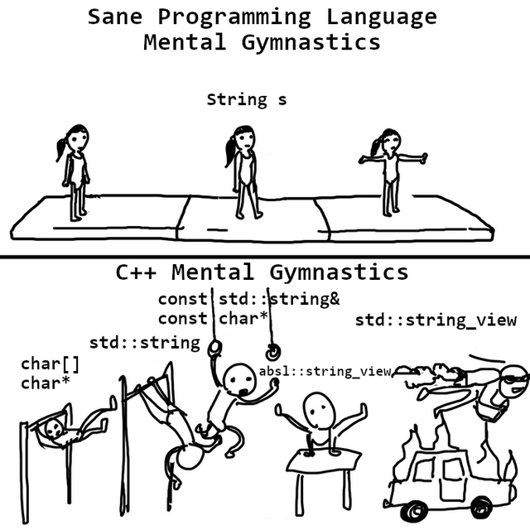
Strings

Slide 13
String Class
string: a C++ class (ADT) for representing sequences of characters
Provides operations for manipulating strings
Getter (read a character)
Setter (set a character)
Compare the strings
Search the strings
Concatenate strings
Erase, insert and replace characters
…
See Table 3-1 (Page 130) in the textbook for a complete list
Defined in the C++ standard library <string>

Slide 14
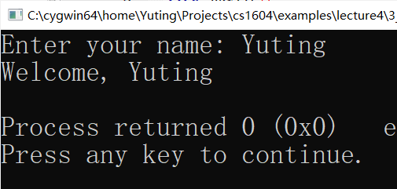
Example
Read and print names
#include <iostream>
// Include the string library to use the string class
#include <string>
// The string class is in the std namespace
using namespace std;
int main()
{
// Define a string variable
string name;
cout << "Enter your name: ";
// Write to the string variable
cin >> name;
// Print the string variable
cout << "Welcome, " << name << endl;
return 0;
}

Slide 15
Read Lines
The following operation cannot read whitespaces
Fix: use getline method
// Define a string variable
string name;
// Write to the string variable
cin >> name;
// Example
Input: “Yuting Wang”
Output: “Yuting”
// Define a string variable
string name;
// Write to the string variable
getline(cin, name);
// Example
Input: “Yuting Wang”
Output: “Yuting Wang”

Slide 16
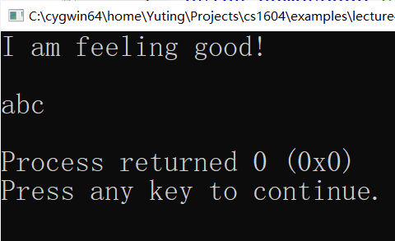
Initializing Strings
By default, a string variable contains an empty string
We can initialize the string with string literals
// Examples: Initializing strings
string abc = “abc”;
string sentence = “I am feeling good!\n”
cout << sentence << endl;
cout << abc << endl;

Slide 17
Object Variables
A object variable
refers to an object of a particular class
holds the internal store of that object
Definition of object variables:
Three component of an object variable:
Name: a reference to the object
Memory location: the place internal store is located
Type: the ADT/class of the object
<classname> <name1>, <name2>, …
// Examples
string s1, s2, s3;

Slide 18
Lifetime of Objects
Object variables have the same lifetime as ordinary variables
A object
Begins to live when its internal store is allocated
Dies when its internal store is destroyed
 | Global Object Variables | Local Object Variables
Begin to live | Program Starts | Function Calls
Die | Program Ends | Function Returns

Slide 19
Example: Global String Variables
// Constant and non-constant global strings
#include <iostream>
#include <string>
using namespace std;
const string ALPHABET =
"ABCDEFGHIJKLMNOPQRSTUVWXYZ";
string tk = "Tiktok";
int main()
{
cout << ALPHABET << endl;
cout << tk << endl;
return 0;
}
Global
Memory
Stack
Memory
ALPHABET
main
tk
PC
● ● ●
Memory State

Slide 20
Example: Local String Variables
#include <iostream>
#include <string>
using namespace std;
void print_nlines(int n, string s)
{
for (int i = 0; i < n; i++)
cout << s << endl;
}
int main()
{
string str;
int n;
cin >> str >> n;
cout << endl;
print_nlines(n, str);
return 0;
}
Global
Memory
Stack
Memory
str
● ● ●
n
n
PC
s
i
Memory State

Slide 21
Temporary Objects
Constructors may be used to create temporary objects:
Example: String objects
Temporary objects are not stored in memory
// A temporary object of type <classname>
// <arguments> are the inputs to the constructor
<classname>(<arguments>)
// Examples
cout << string(“Hello, world!”) << endl;
cout << string(“Hello,”) + “ world!” << endl;
// Error: reference to objects not in memory
string& s = string(“Hello, world!”);

Slide 22
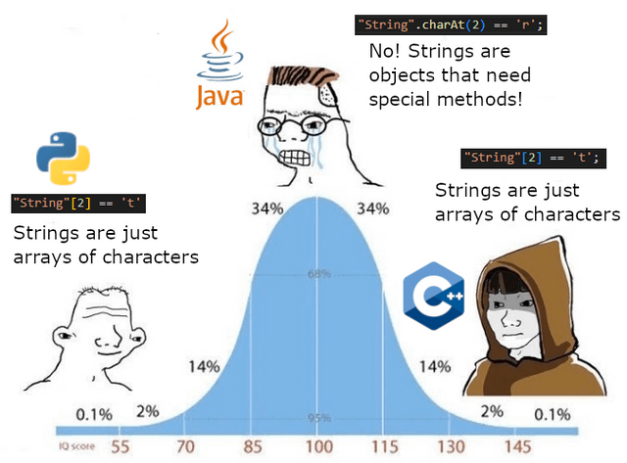
Operations of
Strings

Slide 23
Method Calls
Recall operations of classes are also called member functions or methods
Invocation of class operations are known as method calls
Syntax:
<variable>: object variable of a class C
<method>: operation provided by the class C
<arguments>: a list of input arguments to <method>
A method call is an expression
Its value is its output, type its output type
<variable>.<method>(<arguments>)

Slide 24
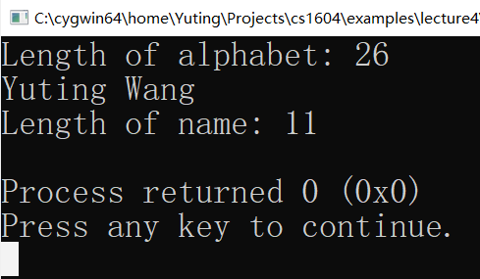
String Length
length: method for getting the length of a string object:
Example:
// Get the length of str
str.length()
// Print lengths of strings
const string ALPHABET = "ABCDEFGHIJKLMNOPQRSTUVWXYZ";
int main()
{
cout << "Length of alphabet: " << ALPHABET.length() << endl;
string name;
getline(cin, name);
cout << "Length of name: " << name.length() << endl;
return 0;
}

Slide 25
Operator Overloading
Key idea: the same operator have different meanings
Examples:
+ operator:
<< operator:
>> operator
(and many others)
// Addition of int
int a, b;
a + b;
// Addition of doubles
double a, b;
a + b;
// Output integers
int a;
cout << a << endl;
// Output strings
string s;
cout << s << endl;
// Input integers
int a;
cin >> a;
// Input strings
string s;
cin >> s;

Slide 26
Operators are Methods
Operators become methods of classes via overloading
Example: String has the following operators as methods
+, +=: concatenation
==, !=, <, >, <=, >=: comparison
>>, <<: input and output
[ ]: getter & setter
… (many others)

Slide 27
Concatenation Operators
+, +=: String concatenation operator
Concatenation also works for characters
// String concatenation
string line1, line2;
getline(cin, line1);
getline(cin, line2);
cout << line1 + line2 << endl;
// String concatenation
string line1, line2;
getline(cin, line1);
getline(cin, line2);
line1 += line2;
cout << line1 << endl;
// Concatenating characters
string str;
char c;
getline(cin, str);
cin >> c;
cout << str + c << endl;
// Concatenating characters
string str;
char c;
getline(cin, str); cin >> c;
str += c;
cout << str << endl;

Slide 28
Compare Operators
==, !=, <, >, <=, >=: Comparison using lexicographic order
// String comparison
string line1, line2;
getline(cin, line1);
getline(cin, line2);
cout << “Equal: “ << (line1 == line2) << endl;
cout << “Not equal: “ << (line1 != line2) << endl;
cout << "Less than: " << (line1 < line2) << endl;
cout << "Less than or equal: " << (line1 <= line2) << endl;
cout << "Greater than: " << (line1 > line2) << endl;
cout << "Greater than or equal: " << (line1 >= line2) << endl;

Slide 29
Get Characters
[<index>]: Select the character at <index> in a string
The index starts from 0
Example:
h
e
l
l
o
,
w
o
r
l
d
0
1
2
3
4
5
6
7
8
9
10
11
// Character selection
string s = "hello, world";
int i;
cin >> i;
cout << "The " << i << "-th character of \"" << s
<< "\" is: `" << s[i] << "`" << endl;

Slide 30
Set Characters
Assignment to the selected character:
Example:
<variable>[<index>] = <expr>
h
e
l
l
o
,
w
o
r
l
d
0
1
2
3
4
5
6
7
8
9
10
11
// Character selection
string s = "hello, world";
int i;
char c;
cin >> i >> c;
s[i] = c;
cout << "The new string is \"" << s << "\"" << endl;

Slide 31
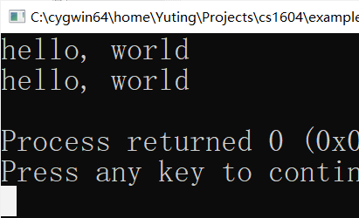
String Assignments
Overwrite the internal store of strings
Note: str1 and str2 remain independent
Q: How to exchange the contents in two string objects?
str1:
xxx
str1:
yyy
Execute:
str1 = str2
str2:
yyy
str2:
yyy
// Character selection
string s1 = “hello, world”, s2 = “alpha centauri”;
s2 = s1;
cout << s1 << endl
<< s2 << endl;

Slide 32
Extracting Sub-Strings
Create a new string by extracting all of the characters starting from pos:
Creates a new string by extracting n characters starting from pos:
Note: the substr method is overloaded.
str.substr(pos)
// Example
string s1 = “Hello, world!”;
cout << s1.substr(7) << endl;
str.substr(pos, n)
// Example
string s1 = “Hello, world!”;
cout << s1.substr(7, 5) << endl;

Slide 33
Search in Strings
Find the starting position a string or a character occurs in str:
string::npos is returned if the search fails
Search in str starting at pos:
str.find(str1) // Search a string str1 in str
str.find(c) // Search a character c in str
str.find(str1, pos) // Search for the string str1 starting at pos
str.find(c, pos) // Search for the character c starting at pos
// Examples
string s1 = “Hello, world!”;
cout << s1.find(‘o’) << endl;
cout << s1.find(‘o’,5) << endl;
cout << s1.find(‘x’) << endl;
cout << s1.find(“wo”) << endl;

Slide 34
Delete/Insert/Replace
Delete n characters from str starting at pos:
Insert a copy of str1 into str starting at pos:
Replace the n characters in str starting at pos with a copy of str1:
// Example: Delete
string s = "Hello, world!";
s.erase(5, 2);
cout << s << endl;
str.erase(pos, n)
// Example: Insert
string s = "Hello, world!";
s.insert(6, "the beautiful");
cout << s << endl;
str.insert(pos, str1)
// Example: Replace
string s = "Hello, world!";
s.replace(7, 5, "friend");
cout << s << endl;
str.replace(pos, n, str1)

Slide 35
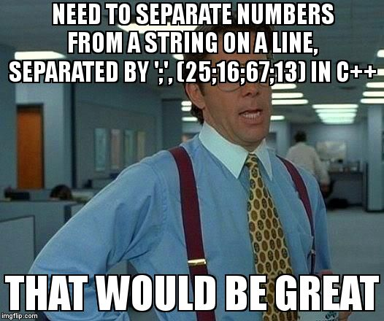
Programming
with Strings

Slide 36

Iterating through Characters
Patterns for iterating through the characters in a string
Examples:
// Pattern for iterating through characters in str
for (int i = 0; i < str.length(); i++) {
body of the loop that manipulates str[i]
}
// Encode and output string
string str = "Hello world!";
for (int i = 0; i < str.length(); i++){
char c = str[i] + 1;
cout << c;
}
// Count spaces
string str = "Hello world!";
int nSpaces = 0;
for (int i = 0; i < str.length(); i++) {
if (str[i] == ' ') nSpaces++;
}

Slide 37

Iterating in a Different Order
Iteration can go from another direction
Example:
// Pattern for iterating from the end of str to start
for (int i = str.length()-1; i >= 0; i--) {
body of the loop that manipulates str[i]
}
// Encode and output string in reversed order
string str = "Hello world!";
for (int i = str.length()-1; i >= 0; i--){
char c = str[i] + 1;
cout << c;
}

Slide 38
Early Exit From Iteration
Sometime, an iteration may ends early by executing break or return.
Early Exit:
When a difference is found, the iteration ends immediately
We will see this pattern over and over
// Example: Find the character c in the string s
bool find_char(string s, char c)
{
bool result = false;
for (int i = 0; i < s.length(); i++) {
if (s[i] == c) {
result = true;
break; // Early Exit
}
}
return result;
}

Slide 39
Partial Iteration
Sometimes, we only need to iterate through parts of strings
This example shows the usage of early return
Q: How to check postfixes of strings?
// Example: Check prefixes of strings
bool startsWith(string str, string prefix) {
if (str.length() < prefix.length())
return false;
for (int i = 0; i < prefix.length(); i++) {
if (str[i] != prefix[i])
return false; // Early return
}
return true;
}

Slide 40
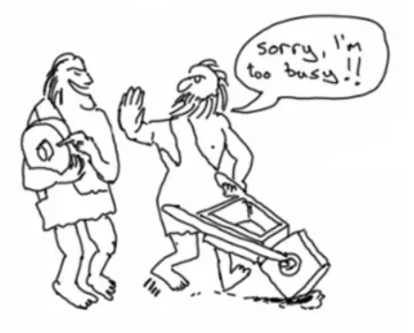
Reuse Iteration Patterns
Real-world programs are rarely written from scratch nowadays
Infrastructure has been built by experts
Reinvent the wheel is time consuming and may result in flawed programs
Note: Always reuse tried-and-true patterns for programming
Reduce your effort
Improve the reliability of programs
Better readability for others

Slide 41
Iterative Concatenation
Pattern for creating new strings through iterative concatenation
Examples:
for (loop condition) {
str += the next substring or character
}
// Repeat Characters
string repeatChar(int n, char ch) {
string str;
for (int i = 0; i < n; i++) {
str += ch;
}
return str;
}
// Repeat Strings
string repeatString(int n, string s) {
string str;
for (int i = 0; i < n; i++) {
str += s;
}
return str;
}

Slide 42
Modification of Strings
Strings provides operations for in-place modification: insert,erase,+=,…
To have modification across functions, return a transformed string.
Example：
Q: What is the loop invariant for reverse?
// Reverse of strings
string reverse(string str) {
string rev;
for (int i = str.length() - 1; i >= 0; i--) {
rev += str[i];
}
return rev;
}

Slide 43
Modification of Strings
Example: remove a word from a sentence
Q: Is the above solution good enough?
Input: “A big dog is chasing a big cat”
Remove: “big”
Output: “A dog is chasing a cat”
// Remove all occurrence of r from str
string removeWord(string str, string r)
{
int l = r.length();
size_t n = str.find(r);
while (n != string::npos) {
str.erase(n, l);
n = str.find(r);
}
return str;
}
Notes:
No. Because we need to collapse the white spaces

Slide 44
Exercise
In every iteration of removeWord, str.find restart search from the beginning. Build an alternative implementation for removeWord so that it searches only the part of str not yet visited.
Yet another solution for removeWord is to copy the characters not removed to a string variable. Realize this implementation.
Implement a function reverseWord for reversing the words in a sentence. An example run is shown below:
string reverseWord(string str);
Input: “A big dog is chasing a big cat”
Output: “cat big a chasing is dog big A”

Slide 45
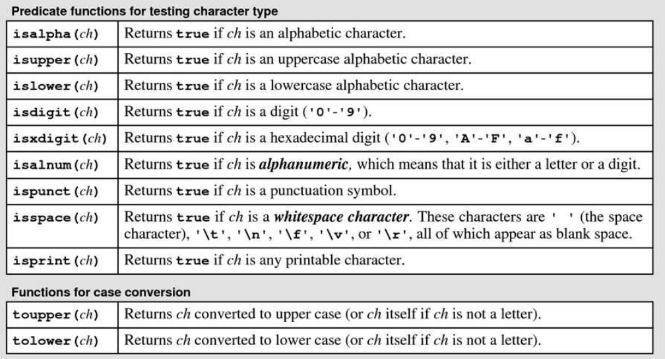
<cctype> Library
<cctype> contains a list of functions that work with characters

Slide 46
Examples
// Example 1: Checking Digit Strings
bool isDigitString(string str) {
if (str.length() == 0) return false;
for (int i = 0; i < str.length(); i++) {
if (!isdigit(str[i])) return false;
}
return true;
}
// Example 2: Equality ignoring cases
bool equalsIgnoreCase(string s1, string s2) {
if (s1.length() != s2.length()) return false;
for (int i = 0; i < s1.length(); i++) {
if (tolower(s1[i]) != tolower(s2[i])) return false;
}
return true;
}

Slide 47
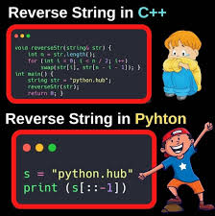
Recursion over Strings

Slide 48



Recursion over Strings
Many problems of strings can be solved by recursion:
Divide the original problem into smaller ones of the same form
Directly solve the base cases
Combine the results to form the final solution
Original Problem:
$$S$$
Sub Problems:
$$S_{1}$$
$$S_{2}$$
● ● ●
$$S_{n}$$
Base Cases:
● ● ●

Slide 49







Example: Reverse Strings
Step 1: Divide a non-empty string $S$ into a head $H$ and a tail $T$
Step 2: Reverse the tail $T$
Step 3: Append the head $H$ to end of the reversed tail
$$S$$
$$S′$$
Original Problem:
H
E L L O
O L L E
H
$$H$$
$$T$$
$$T′$$
$$H$$
divide
compose
Sub Problem:
E
L L O
O L L
E
Recursive call

Slide 50
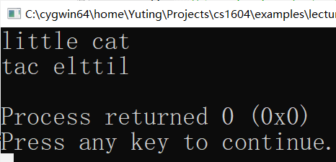
Example: Reverse Strings
Step 1: Divide a non-empty string $S$ into a head $H$ and a tail $T$
Step 2: Reverse the tail $T$
Step 3: Append the head $H$ to end of the reversed tail
// Reverse of strings
string reverse(string str) {
if (str.length() == 0) {
return "";
} else {
string rt = reverse(str.substr(1));
return rt + str[0];
}
}

Slide 51
Recursion vs. Iteration
Both implementations can be proven correct
Iteration is correct by loop invariant (what is it?)
Recursion is correct by induction (why?)
// Iteration
string reverse(string str) {
string rev;
for (int i = str.length() - 1;
i >= 0; i--) {
rev += str[i];
}
return rev;
}
// Recursion
string reverse(string str) {
if (str.length() == 0) {
return "";
} else {
string rt = reverse(str.substr(1));
return rt + str[0];
}
}

Slide 52
Recursion vs. Iteration
Comparison of Efficiency
 | Iteration | Recursion
Stack Consumption | Constant (1 frame) | Linear to Length (n frames)
Iteration Times | Linear to Length (n times) | Linear to Length (n times)
// Iteration
string reverse(string str) {
string rev;
for (int i = str.length() - 1;
i >= 0; i--) {
rev += str[i];
}
return rev;
}
// Recursion
string reverse(string str) {
if (str.length() == 0) {
return "";
} else {
string rt = reverse(str.substr(1));
return rt + str[0];
}
}

Slide 53






Division of Problems
There may be multiple ways to recursively divide a problem
Example: reverse a string by recursively dividing it in half
$$S$$
$$S′$$
Original Problem:
S O U N
D W A V E
E V A W D
N U O S
$$H$$
$$T$$
$$T′$$
$$H′$$
divide
compose
Sub Problem:
S O U N
D W A V E
E V A W D
N U O S
Recursive calls

Slide 54



Tail Recursion
A tail recursion immediately returns from the only recursive call
Tail recursions do not have a composing phase
In essence, they behave like iteration
Original Problem:
$$S$$
if (test for base cases) {
Returns the accumulated result
} else {
1. Break down to one subproblem
2. Solve this subproblem by recursion
3. Immediately return the result
}
Sub Problem:
$$S_{1}$$
Base Cases:
$$S_{n}$$
Function Body

Slide 55

Example: Palindrome
A palindrome is a word that reads identically forward and backward
Examples: mom, noon, level, racecar
Recursive solution to recognize a palindrome:
Step 1: Check if the head and tail characters are the same
Step 2: If not, the string is not a palindrome
Step 3: If so, recursively check the remaining string
R
A C E C A
Original String:
R
C E C
Sub String:
A
A
Base Case:
E

Slide 56
Example: Palindrome
The following function recognize palindromes
// Recognize if str is a palindrome
bool isPalindrome(string str)
{
if (str.length() <= 1)
return true;
else if (str[0] != str[str.length()-1])
return false;
else
return isPalindrome(str.substr(1, str.length()-2));
}
Tail recursive call

Slide 57
Example: Palindrome
isPalindrome can be translated into an iteration
At beginning of every loop, the remaining computation of the loop corresponds to a tail recursive call
return statements corresponds to base cases
// Recognize if str is a palindrome
bool isPalindrome(string str)
{
int n = str.length();
for (int i = 0; i < n/2; i++) {
if (str[i] != str[n-i-1])
return false;
}
return true;
}

Slide 58
More Examples: Encode Strings
Encode strings by adding offests
// Encode a string by adding an offset to its characters
void encode_string(string str, int ofs)
{
if (str.length() == 0)
return;
else {
char c = str[0] + ofs;
cout << c;
encode_string(str.substr(1), ofs);
}
}
Tail recursive call

Slide 59
More Examples: Find Characters
Recursive solution to find a character
// Example: Find the character c in the string s
bool find_char(string s, char c)
{
if (s.length() == 0)
return false;
else {
if (s[0] == c)
return true;
else
return find_char(s.substr(1), c);
}
}
Tail recursive call

Slide 60
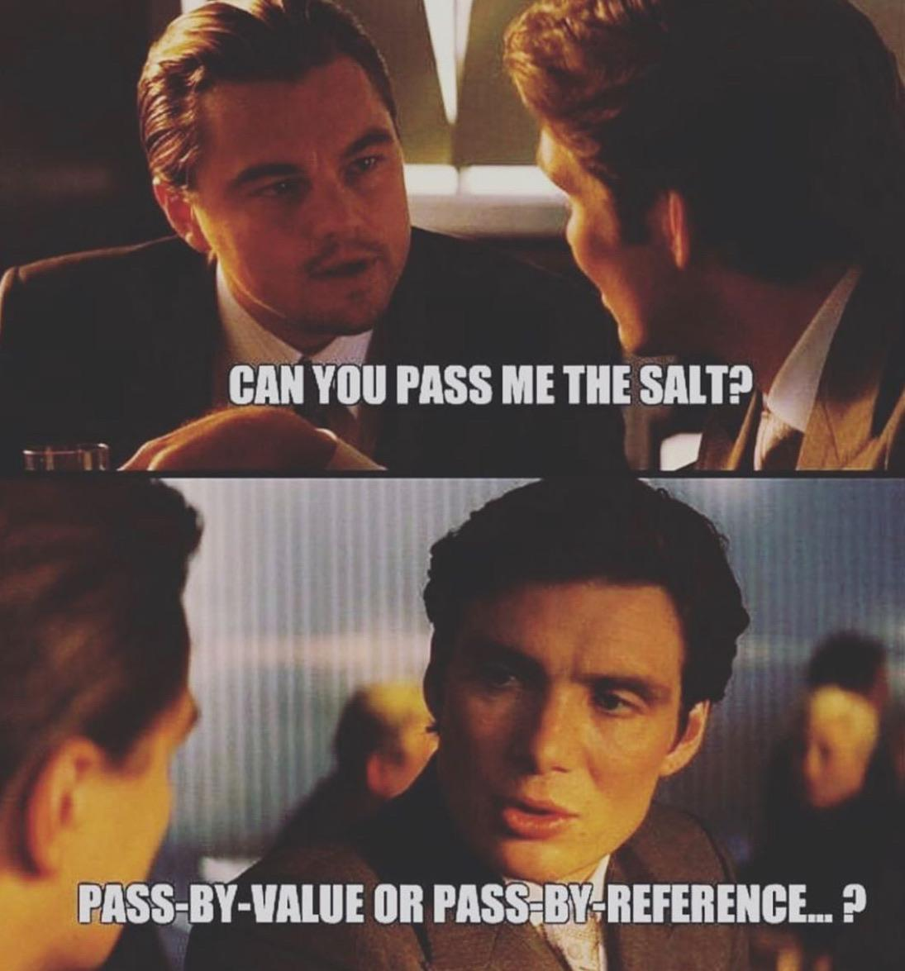
References
==
Aliases

Slide 61
Aliases
In essence, a variable consists of two parts:
The store (object) holding its value
A name that points to this store
At some point of execution:
Multiple names may refer to the same store (object) in the memory
They are called aliases of the store (object)
Example:
name and id are aliases of the same string object
name
id
● ● ●
Memory
State

Slide 62
References
Aliases in C++ are called references
Notes:
<exp> MUST evaluate to a value in memory (e.g., variables or other references)
<name> is a new name bound to the store of <exp>
<type> must match with the type of <exp>
After the binding, <name> behaves like a regular variable
The const keyword is used if modification through <name> is prohibited
Scopes of references are resolved like variables
// Syntax
<type>& <name> = <exp>;
const <type>& <name> = <exp>;
// Example
string name = “Yuting Wang”;
string& id = name;
id.erase(0, 7);
cout << name << endl;

Slide 63
Call-by-Name
By declaring a function parameter as a reference:
A new name is bound to the argument upon function call
This way of passing arguments is known as Call-By-Name, with which
No copying of values happen
The argument and parameter points to the same object
Modification to the parameter applies directly to the argument
// References as parameters
<type> <name>(…, <type>& id, …) {
the function body may read or write id
}
// Const references as parameters
<type> <name>(…, const <type>& id, …) {
the function body may only read id
}

Slide 64
Example
// Example: increment of values
void incr(int& v)
{
v++;
}
int main()
{
int a = 10;
incr(a);
cout << a << endl;
return 0;
}
Global
Memory
Stack
Memory
Note:
The stack frame for incr is empty!
The mapping from names to stores is called a symbol table or an environment
Take away: the symbol table is part of the program state during execution!
10
a
11
main
● ● ●
v
incr
PC
Memory State

Slide 65
Multiple Reference Parameters
Q: How to define a function that swaps the value of two variables?
Stack
Memory
// Swap two integers
void swap(int& a, int& b)
{
int temp = a;
a = b;
b = temp;
}
int main()
{
int x = 3, y = 5;
swap(x, y);
return 0;
}
3
main
x
5
5
y
3
a
PC
swap
?
b
3
temp

Slide 66
Multiple Reference Parameters
Swapping object variables:
// Swap two strings
void swap(string& a, string& b)
{
string temp = a;
a = b;
b = temp;
}

Slide 67
Return Multiple Values
Reference parameters provide a way to return multiple values
// Add and Subtract
void add_and_sub(int a, int b, int& av, int& sv)
{
av = a + b;
sv = a – b;
}
int main()
{
int a = 3, b = 5;
int av, sv;
add_and_sub(a, b, av, sv);
cout << a << “ + ” << b << “ = ” << av << endl;
cout << a << “ – ” << b << “ = ” << sv << endl;
return 0;
}

Slide 68
Modification of Objects
References are useful for modification of objects across function calls
Recall the example of removing words:
// Remove all occurrence of r from str
string removeWord(string str, string r)
{
int l = r.length();
size_t n = str.find(r);
while (n != string::npos) {
str.erase(n, l);
n = str.find(r);
}
return str;
}
// Remove all occurrence of r from str
void removeWord(string& str, string r)
{
int l = r.length();
size_t n = str.find(r);
while (n != string::npos) {
str.erase(n, l);
n = str.find(r);
}
}
Return the modified string
Modify a reference

Slide 69
Efficiency of Call-By-Name
CBN is more efficient for passing large objects than Call-By-Value:
Comparison:
The right function is more efficient than the left
The left function is safer than the right (why?)
// Remove all occurrence of r from str
string removeWord(string str, string r)
{
int l = r.length();
size_t n = str.find(r);
while (n != string::npos) {
str.erase(n, l);
n = str.find(r);
}
return str;
}
// Remove all occurrence of r from str
void removeWord(string& str, string r)
{
int l = r.length();
size_t n = str.find(r);
while (n != string::npos) {
str.erase(n, l);
n = str.find(r);
}
}

Slide 70
Constant Reference Parameters
Use constant reference parameters when the function does not modify the arguments
Benefit: save the cost of copying values (objects)
We will see constant reference parameters A LOT!
// Recognize if str is a palindrome
bool isPalindrome(string str)
{
if (str.length() <= 1)
return true;
else if (str[0] != str[str.length()-1])
return false;
else
return isPalindrome(str.substr(1, str.length()-2));
}
(const string& str)

Slide 71
Constructors & Destructors

Slide 72
Constructors
Constructor: a setter for initializing the store of an object upon its creation
No output
Automatically invoked when the object is created
May be overloaded
Store
write
Constructor
Inputs
Object

Slide 73
Constructors
Calls to constructors may appear when object variables are defined:
<arguments> are inputs to the constructor of the class <classname>
When (<arguments>) does not appear, the default constructor is called
Initialization with a value is equivalent to calling the constructor with one argument
// Syntax
<classname> <varname>(<arguments>);
// The following are equivalent
<classname> <varname>;
<classname> <varname>();
// The following are equivalent
<classname> <varname> = <exp>;
<classname> <varname>(<exp>);

Slide 74
String Constructors
The string class has the following constructors (not a complete list):
string str(cstr); create a string from a C-style string cstr
Equivalent to string str = cstr;
string str(n, c); create a n times repetition of character c
string str(str1, pos); create a substring by taking the characters in str1 starting from pos
string str(str1, pos, n); create a substring by taking the n characters in str1 starting from pos
// Input: C-style string
string s("Hello, world!");
string s = "Hello, world!";
// Repeat ‘x’ 10 times
string s1(10, ‘x’);
// Input: substring
string s2(s, 7); // “world!”
string s3(s, 7, 5); // “world”

Slide 75
Temporary Objects
Constructors may be used to create temporary objects:
Example: String objects
Temporary objects are not stored in memory
// A temporary object of type <classname>
// <arguments> are the inputs to the constructor
<classname>(<arguments>)
// Examples
cout << string(“Hello, world!”) << endl;
cout << string(“Hello,”) + “ world!” << endl;
// Error: reference to objects not in memory
string& s = string(“Hello, world!”);

Slide 76
Destructor
Destructor: setter for cleaning up an object at the end of its lifetime
No input and output
Automatically invoked when the object is destroyed
NEVER overloaded
Store
write
Destructor
Object

Slide 77
Lifetime of an Object
1. Allocate Memory
2. Initialize
3. Operations
Store
Store
Store
write
read/write
inputs
Initializer
inputs
Operations
outputs
Object
Object
Object
5. Deallocate Memory
4. Finalize
Store
Store
write
Finalizer
Object
Object

Slide 78
Notes on Constructors/Destructors
The name of constructors and destructors is confusing!
Constructors DO NOT actually allocate the store!
Destructors DO NOT deallocate the store!
Construction of store is carried out either automatically or manually.
Automatic construction: global objects and local objects
Manual construction: dynamic memory allocator
Manual management of stores is a most important feature of C++!
Also a big source of errors and bugs (we shall see later!)

Slide 79
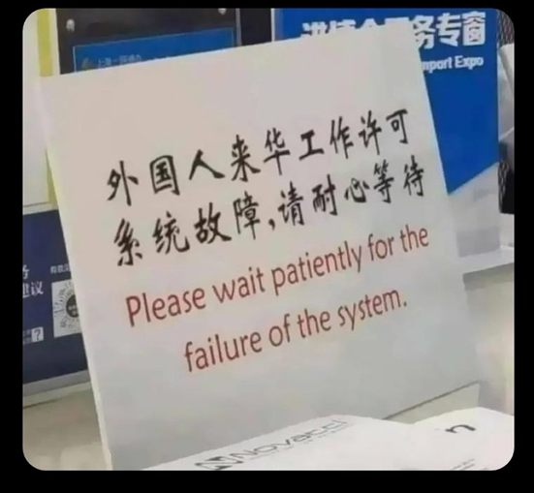
Bringing
Everything
Together

Slide 80
Problem
Implement the natural number library using strings
The library contains the following methods
Converting an integer value to natural numbers:
Adding two natural numbers:
Print natural numbers:
// Convert a to a natural number
nat from_int(int a);
// a + b
nat add(nat a, nat b);
// Print b to standard output
void print_nat(nat b);

Slide 81
Aliasing of Types
Syntax:
We use nat to denote the string class for representing natural numbers:
Note: string and nat are interchangeable
// Introduce an alias <name> for <type>
typedef <type> <name>;
typedef string nat;

Slide 82
Implementing Natural Numbers using String
The library interface (nat.h) is as follows:
Do NOT use “using namespace std” in the interface!
/* An ADT for natural numbers */
#include <string>
// Declare an abstract type for natural numbers
typedef std::string nat;
// Operations for natural numbers
nat from_int(int a); // Convert a to a natural number
nat add(nat a, nat b); // a + b
void print_nat(nat b); // Print the natural numbers

Slide 83
Natural Numbers as Strings
Represent a natural number as a sequence of characters
Preferable to reverse the representation for arithmetic
INT_MAX: 2147483647
‘2’
‘1’
‘4’
‘7’
‘4’
‘8’
‘3’
‘6’
‘4’
‘7’
0
1
2
3
4
5
6
7
8
9
‘7’
‘4’
‘6’
‘3’
‘8’
‘4’
‘7’
‘4’
‘1’
‘2’
0
1
2
3
4
5
6
7
8
9

Slide 84
Addition of Natural Numbers
Addition with carry in elementary arithemtics
Example: INT_MAX + 655333
‘7’
‘4’
‘6’
‘3’
‘8’
‘4’
‘7’
‘4’
‘1’
‘2’
+
‘3’
‘3’
‘3’
‘5’
‘5’
‘6’
=
‘0’
‘8’
‘9’
‘8’
‘3’
‘1’
‘8’
‘4’
‘1’
‘2’

Slide 85
Implementation: Auxiliary Functions
The implementation file (nat.cpp) begins with:
#include "nat.h"
#include <iostream>
using namespace std;
// Convert a char to a digit
int char_to_digit(char a)
{
return a - '0';
}
// Convert a digit to a char
char digit_to_char(int a)
{
return a + '0';
}

Slide 86
Convert from Integers
Note the pattern for iterative concatenation
// Create natural numbers from integers
nat from_int(int a)
{
string s;
if (a <= 0)
s = "0";
else {
while (a != 0) {
int h = a%10;
s += digit_to_char(h);
a = a/10;
}
}
return s;
}

Slide 87
Addition of Natural Numbers
Overall structure:
// a + b
nat add(nat a, nat b)
{
int maxlen = max(a.length(), b.length());
int carry = 0; // the current carry
string result; // final result
for (int i = 0; i < maxlen; i++) {
// 1. Compute (v, c) = a[i] + b[i] + carry
// 2. Append v to result
// 3. Set c to be the new carry
}
if (carry != 0)
// Append carry to result
return result;
}

Slide 88
Addition of Digits
An auxiliary function for adding two digits with a carry
Note the use of references to return multiple values
// Compute the value and carry of a + b + c
void add_digits(int a, int b, int c, int& sv, int& sc)
{
int v = a + b + c;
sv = v%10;
sc = v/10;
}

Slide 89
Main Loop
for (int i = 0; i < maxlen; i++) {
int av, bv;
// Get the current digit from a
if (i < a.length()) av = char_to_digit(a[i]);
else av = 0;
// Get the current digit from b
if (i < b.length()) bv = char_to_digit(b[i]);
else bv = 0;
// 1. Compute (v, c) = a[i] + b[i] + carry
int v, c;
add_digits(av, bv, carry, v, c);
// 2. Append v to result
result += digit_to_char(v);
// 3. Set cv to be the new carry
carry = c;
}
if (carry != 0) result += digit_to_char(carry);
Again we use the pattern for iterative concatenation

Slide 90
Print Natural Numbers
Reverse the string and print it out
// Reverse of strings
string reverse(string str) {
string rev;
for (int i = str.length() - 1; i >= 0; i--) {
rev += str[i];
}
return rev;
}
// Print the natural number
void print_nat(nat b)
{
cout << reverse(b);
}

Slide 91
A Recursive Solution
How to divide the addition of two natural numbers into a smaller problem?
‘7’
‘4’
‘6’
‘3’
‘8’
‘4’
‘7’
‘4’
‘1’
‘2’
+
‘3’
‘3’
‘3’
‘5’
‘5’
‘6’
‘7’
‘4’
‘6’
‘3’
‘8’
‘4’
‘7’
‘4’
‘1’
‘2’
+
+
‘3’
‘3’
‘3’
‘5’
‘5’
‘6’
=
+
‘0’
‘1’
‘1’

Slide 92
Addition with Carry
Addition of two natural numbers with a carry
Function above only works for a and b of the same length.
However, it is easy to generalize it to work for arbitrary a and b
// Recursive addition of a and b with a carry c
nat add_with_carry(nat a, nat b, int c)
{
int sv, sc;
// (sv, sc) = a[0] + b[0] + c
add_digits(char_to_digit(a[0]), char_to_digit(b[0]), c, sv, sc);
// head = sv
string head(1, digit_to_char(sv));
// tail = a[1..n] + b[1..n] + sc
string tail = add_with_carry(a.substr(1), b.substr(1), sc);
return head + tail;
}

Slide 93
Addition
Addition of natural numbers is a special case of add_with_carry
// Addition using add_with_carry
nat add(nat a, nat b)
{
return add_with_carry(a, b, 0);
}

Slide 94
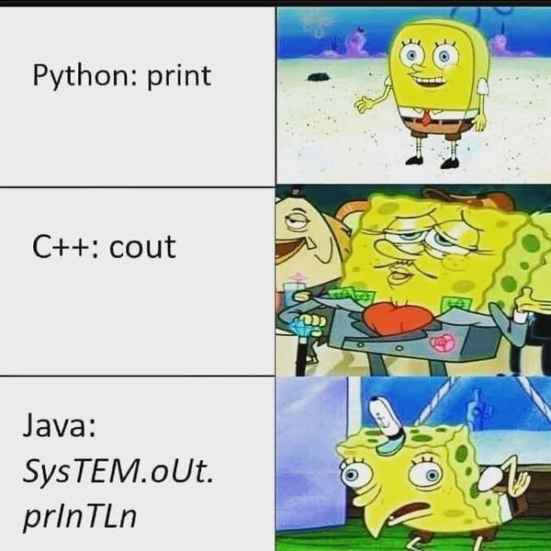
Streams

Slide 95











Output Streams
An output stream is an possibly infinite list of values with the operation:
Push a new value to the head of the stream
An output stream may be linked to output hardware (e.g., screens)
● ● ● ● ● ● ● ● ●
$$V_{4}$$
$$V_{3}$$
$$V_{2}$$
$$V_{1}$$
Head
Push $V_{0}$
● ● ● ● ● ● ● ● ●
$$V_{4}$$
$$V_{3}$$
$$V_{2}$$
$$V_{1}$$
$$V_{0}$$
Head

Slide 96
C++ Output Streams
Represented as an ADT/class ostream in the standard library <ostream>
An ostream object is an output stream of characters
cout is an ostream object
Method for pushing a value for ostream os
Example:
// push a character ch onto os
os.put(ch)
// Output a string using put
string str = "Hello world!";
for (int i = 0; i < str.length(); i++)
cout.put(str[i]);

Slide 97
Insertion (<<) Operator
Overloaded for pushing different kinds of values to ostream:
Convert values to sequences of characters before pushing
push
$$V_{3}$$
$$V_{2}$$
$$V_{1}$$
Value
● ● ● ● ● ● ● ● ●
// Examples:
cout << ‘x’;
cout << “Hello, word”;
cout << 123456;
cout << 3.1415926;
……

Slide 98
Manipulators
Special values used to control formatting (in the <iomanip> library)
endl: insert end-of-line character to ostream and flush the buffer
left: align the output to the left
right: align the output to the right
setw(n): set the width of the next field to n characters
The effects of manipulators may be transient or permanent:
Transient: endl, setw(n)
Permanent: left, right
More manipulators: See Table 4-1 in the textbook (Page 162)

Slide 99
Example
Set widths of outputs
#include <iostream>
#include <iomanip>
using namespace std;
// Compute x^y
int power(int x, unsigned int y)
{
int res = 1;
for (int i = 0; i < y; i++)
res *= x;
return res;
}
int main()
{
int n = 16;
for (int i = 0; i < n; i++)
cout << right << setw(2) << i
<< setw(8) << power(2, i) << endl;
return 0;
}

Slide 100
Set Precisions
Manipulator for setting floating-point formats:
fixed: always display floating-point numbers in full
scientific: always display floating-point numbers in scientific notation (with E)
Default format: use appropriate compact forms
Manipulators for setting precsisions:
setprecision(n): set the precision of floating-point numbers
For fixed and scientific formats, display n digits after the decimal point
For default format, display n significant digits
All of the above manipulators have persistent effect.
Example: Figure 4-1 of the text book (Page 164)

Slide 101





Input Streams
An input stream is a possibly infinite list of values with the operation:
Pop a new value from the head of the stream
An input stream may be linked to input hardware (e.g., keyboard)
● ● ● ● ● ● ● ● ●
$$V_{4}$$
$$V_{3}$$
$$V_{2}$$
$$V_{1}$$
Head
Pop $V_{1}$
● ● ● ● ● ● ● ● ●
$$V_{4}$$
$$V_{3}$$
$$V_{2}$$
Head

Slide 102
C++ Input Streams
Represented as an ADT/class istream in the standard library <istream>
An istream object is an input stream of characters
cin is an istream object
Method for poping a value for istream is
Example:
// Popping a character from is
// and store it in ch
is.get(ch)
// Pop and print 10 characters from cin
for (int i = 0; i < 10; i++) {
char ch;
cin.get(ch);
cout << "`" << ch << "`" << endl;
}

Slide 103
Extraction (>>) Operator
Overloaded for reading different kinds of values from istream:
Convert sequences of characters to values before popping
pop
$$V_{3}$$
$$V_{2}$$
$$V_{1}$$
Value
● ● ● ● ● ● ● ● ●
// Examples:
char ch; cin >> ch;
string str; cin >> str;
int i; cin >> i;
double d; cin >> d;
……

Slide 104
Traversing Input Stream (1)
Get character method returns the stream itself
is interpreted as true if get succeeds
is interpreted as false it get fails
Read from the input stream character-by-character until the end:
// Popping a character from is
// and return is itself
is.get(ch)
// Read all characters in the input
void read_input(istream& is)
{
char ch;
// Loop ends if is.get fails
while (is.get(ch)) {
cout << ch;
}
}

Slide 105
Traversing Input Stream (2)
Another way to pop a character from input streams:
Why integer? Because it may return EOF, a value marking the end of input
Read character-by-character until the end:
// Popping a character from is (if any)
// and returns an integer
is.get()
// Method 1:
void read_input(istream& is)
{
while (true) {
int ch = is.get();
if (ch == EOF) break;
cout << char(ch);
}
}
// Method 2:
void read_input(istream& is)
{
int ch;
while ((ch = is.get()) != EOF) {
cout << char(ch);
}
}

Slide 106
Traversing Input Stream (3)
Recall the method for getting a line of strings from input stream
Read line-by-line until the end:
// Reading a line from is
// and return is itself
getline(is, line)
void read_input(istream& is)
{
string line;
int count = 0;
while (getline(is, line)) {
count++;
cout << "Line " << count << ": " << line << endl;
}
}

Slide 107
Data File I/O
We use input and output file streams classes (ifstream and ofstream):
Defined in <fstream> library
ifstream and ofstream behaves like istream and ostream, respectively
How to use file streams to read and write files?
Declare a file stream variable
Open the file
// Declare file stream variables
ifstream infile;
ofstream outfile;
// File name is a string literal
infile.open(“filename”)
// File name is a string object
String filename = “abc.txt”;
infile.open(filename.c_str());

Slide 108
Data File I/O
Check if the file has been opened successfully
Read or write the file stream like they are regular input/output streams
Close the stream
Note: the close step may be omitted because file stream finalizers will take care of the job.
ifstream infile;
infile.open("abc.txt");
if (!infile) {
cout << "Failed to open the file" << endl;
return -1;
}
// Close the file related to the stream
infile.close()

Slide 109
Reading Input Files
Read files character-by-character or line-by-line as usual
Example: read and print lines
int main()
{
string filename;
cin >> filename;
// Open file stream
ifstream infile;
infile.open(filename.c_str());
if (!infile) {
cout << "Failed to open the file"
<< endl;
return -1;
}
read_input(infile); // Read file
infile.close(); // Close file
return 0;
}
// Read input stream line-by-line
void read_input(istream& is)
{
string line;
int count = 0;
while (getline(is, line)) {
count++;
cout << "Line " << count
<< ": " << line << endl;
}
}

Slide 110
Writing to Output Files
Write to output files using insertion (<<) operator
int main()
{
string infilename, outfilename;
cout << "Enter the input file: ";
cin >> infilename;
cout << "Enter the output file: ";
cin >> outfilename;
ifstream infile;
infile.open(infilename.c_str());
if (!infile) { return -1; }
ofstream outfile;
outfile.open(outfilename.c_str());
if (!outfile) { return -1; }
// Invoke the output function
from_input_to_output(infile, outfile);
infile.close(); outfile.close();
return 0;
}
// Read from is and write to os
void from_input_to_output(istream& is,
ostream& os)
{
string line;
int count = 0;
while (getline(is, line)) {
count++;
os << "Line " << count
<< ": " << line << endl;
}
}

Slide 111
Recommended Practices
When best to use >> operators?
Use to read data with a uniform type and with clear separation between data entries
E.g., a list of integers (floating points, strings, etc) separated by spaces
Be careful when using >> for reading data with complex formats
E.g. (mixes of strings, integers, characters, floating points…)
Easy to get erroneous results because of mismatching of data types
A common practice for processing complex data formats?
Use getline or get method to read data into strings
Extract information from strings using functions/libraries for analyzing the formats
Input Stream
read
Format Analysis
$$V_{3}$$
$$V_{2}$$
$$V_{1}$$
Strings
Values
● ● ● ● ● ● ● ● ●

Slide 112
Hierarchy of Stream ADTs
In the following diagram, the children of every node are its subclasses
A subclass behaves like its parent class
A subclass may have more operations
We shall have a more in-depth discussion about subclasses later.
ios
istream
ostream
ifstream
ofstream

Slide 113
Next Time
We will discuss
Parametric Polymorphism (C++ Templates)
Polymorphic Abstract Data Types
Computation with Polymorphic ADTs
You should read Chapter 5 the text book
We will make use of C++ standard library instead of Stanford’s library

