Slide 1
Principles and Methods of Program Design Lecture 6: Designing ADTs
Yuting Wang
SEIEE
John Hopcroft Center for Computer Science
2025.4.13

Slide 2
Road Map
Basics of Imperative Programming (C++)
Programming with Abstractions
Implementing Abstractions
Here!

Slide 3
Last Time
Parametric Polymorphism
C++ Templates (Generics)
Polymorphic ADT
Collections

Slide 4
This Time
Designing ADT/Classes
Object Initialization and Finalization
Operator Overloading
Interface vs. Implementation
Concrete Data Types

Slide 5
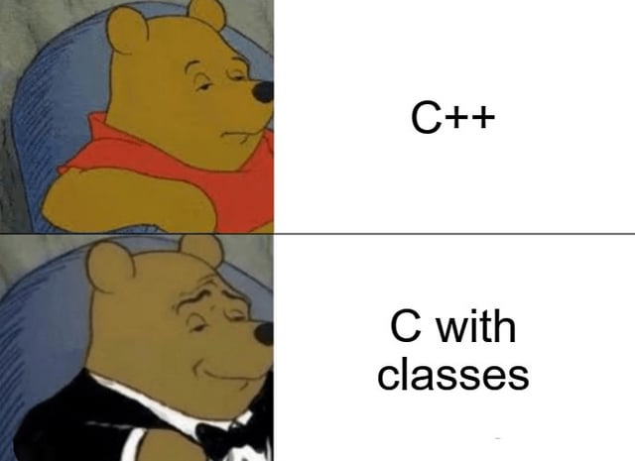
Classes

Slide 6
Abstract Data Values
A value belong to an ADT has
An internal store containing the value’s state (i.e., internal memory state)
A set of operations for reading or writing the store
Store
read/write
Operations
Inputs
Outputs
ADT Values

Slide 7
ADT in C++
C++ provides a built-in device for this purpose:
We have studied how to use ADT/Classes
We now study how to design ADT/Classes
Classes

Slide 8
Objects
Objects: values of classes
Note: member functions are bound to an object
Member Variables
read/write
Member Functions
Inputs
Outputs
C++ Object

Slide 9
A Running Example
Design a counter class
Abstract representation is an integer counter starting from 0
Provide the following methods:
// Reset the counter to 0
void reset();
// Get the value of the counter
int get();
// Increase the value of the counter
void incr();

Slide 10
Class Definitions
Syntax:
Design Principles:
Member variables (internal stores) should be put in private sections
Member functions representing operations should be put in public sections
// Definition of a class
class <classname> {
public:
declaration/definition of member functions/variables
private:
declaration/definition of member functions/variables
};
Public section
(Visible to Users)
Private section
(Not visible)

Slide 11
Counter Class
Design the counter class
Give it a name
Decide its interface (operations)
Choose an internal representation
Implement its interface
Note:
Member function/variables are similar to regular definitions
Member functions may read or modify internal store (member variables)
The only way to read or modify private data is to use member functions
// Counters
class Counter {
public:
void reset()
{ cnt = 0; }
int get()
{ return cnt; }
void incr()
{ cnt++; }
private:
int cnt;
};
Don’t forget the semicolon!

Slide 12
Object Variables
An object variable refers to an object of a particular class
Definition of object variables:
Objects associated with variables have lifetime like ordinary variables
More to be discussed later
<classname> <name1>, <name2>, …
// Examples
Counter c1, c2, c3;

Slide 13
Access Class Members
Method Call Syntax:
<variable>: object variable of a class
<method>: operation provided by the class
<arguments>: a list of input arguments to <method>
A method call is an expression
Its value is its output, type its output type
Member Variable Access:
Attention: Direct memory access should only happen for Concrete Data Types!
NOT possible for ADT!
<variable>.<method>(<arguments>)
<variable>.<member_variable>

Slide 14
Define and Use Counter Variables
Define a local counter variable
Invoke methods to alter the state of the object
Invoke methods to access the state of object
Direct access of private data is impossible:
int main()
{
Counter c;
c.reset();
int n;
cin >> n;
for (int i = 0; i < n; i++)
c.incr();
cout << "The value of the counter is: "
<< c.get() << endl;
// Errors
cout << c.cnt << endl;
c.cnt = 10;
return 0;
}

Slide 15
Assignment of Objects Variables
Syntax:
Effect: the internal store of <var> is overwritten by the value
// Evaluate <exp> to an object value and
// assign the value to <var>
<var> = <exp>
c:
10
c:
10
Execute:
c1 = c
c1:
0
c1:
10

Slide 16

Visibility of Members
Users’ Perspective:
Only functions/variables in public sections are accessible
// Counters
class Counter {
public:
void reset()
{ cnt = 0; }
int get()
{ return cnt; }
void incr()
{ cnt++; }
private:
int cnt;
};
I can only see the prototypes in public section
User

Slide 17
Visibility of Members
Member Functions’ Perspective:
All member functions/variables are accessible!
// Counters
class Counter {
public:
void reset()
{ cnt = 0; }
int get()
{ return cnt; }
void incr()
{ cnt++; }
void bar()
{ … }
private:
int cnt;
void foo()
{ … }
};
I see everything in Counter! (including myself)
Member functions

Slide 18
Private Member Functions
Member functions in private sections
Carries out tasks internal to the ADT
Not visible to users
Design Principle:
Move any operation that should not be part of the ADT interface to private section
// Counter
class Counter {
public:
…
void incr() {
cnt++;
log(); // log the counter value
}
private:
void log()
{
ofstream ofs("log.txt");
ofs << "Counter is " << cnt << endl;
}
int cnt;
};

Slide 19
Lifetime of Objects
Objects have the same lifetime as ordinary variables
An object
Begins to live when its internal store is allocated
Dies when its internal store is destroyed
 | Global Object Variables | Local Object Variables
Begin to live | Program Starts | Function Calls
Die | Program Ends | Function Returns

Slide 20
Example: Global Object Variable
class Counter {…};
Counter c;
int main()
{
c.reset();
int n;
cin >> n;
for (int i = 0; i < 10; i++)
c.incr();
cout << "The value of the counter is:”
<< c.get() << endl;
return 0;
}
Global
Memory
Stack
Memory
Stack frame for main
PC
c
n
● ● ●
Memory State

Slide 21
Example: Local Object Variables
class Counter {…};
int main()
{
Counter c;
c.reset();
int n;
cin >> n;
for (int i = 0; i < n; i++)
c.incr();
cout << "The value of the counter is:”
<< c.get() << endl;
return 0;
}
Global
Memory
Stack
Memory
PC
Stack frame for main
c
● ● ●
n
Memory State

Slide 22
Example: Local Object Variables
void incrCounter(int n, Counter c)
{
if (n > 0) {
c.incr();
incrCounter(n-1, c);
} else
cout << "The value of the counter is: "
<< c.get() << endl;
}
int main()
{
Counter c;
c.reset();
int n;
cin >> n;
incrCounter(n, c);
return 0;
}
Global
Memory
Stack
Memory
PC
c
Stack frame for main
● ● ●
n
n
Stack frame for incrCounter
c
Memory State

Slide 23
Const Member Functions
Member functions that do not modify the internal store
Syntax:
Note:
You can only add const keyword to member functions
Regular functions do not apply (why?)
// Counters
class Counter {
public:
void reset()
{ cnt = 0; }
// Const member function
int get() const
{ return cnt; }
void incr()
{ cnt++; }
private:
int cnt;
};
<type> <fname>(<args>) const
{ … }

Slide 24

Rules for Using Const Members
Non-constant object variable may invoke both regular and const member functions
Constant object variable can only invoke constant member functions
int main()
{
const Counter c;
// Fine
c.get();
// Errors
c.reset();
c.incr();
return 0;
}

Slide 25
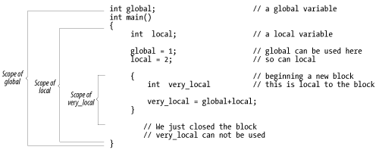
Scopes for
Members

Slide 26
Scopes of Class Members
A member function/variable is visible to all other members
Examples:
// Counters
class Counter {
public:
void reset()
{ cnt = 0; }
void incr()
{ cnt++; }
void incrAndReset() {
incr();
reset();
}
private:
…
};
// Counters
class Counter {
public:
void reset()
{ cnt = 0; }
int get() const
{ return cnt; }
void incr()
{ cnt++; }
private:
int cnt;
};

Slide 27
Scope of Class Members
The order of class members makes no difference to their scopes
// Counters
class Counter {
public:
void reset()
{ cnt = 0; }
void incr()
{ cnt++; }
void incrAndReset() {
incr();
reset();
}
private:
…
};
// Counters
class Counter {
public:
void incrAndReset() {
incr();
reset();
}
void reset()
{ cnt = 0; }
void incr()
{ cnt++; }
private:
…
};

Slide 28
Determining Scopes
Scopes of variables with same names may be overwritten in member functions
Rules for Overwriting:
Member variables/functions overwrite global variables
Local variables in member functions overwrite member variables/functions
For determining scopes of non-class members, follow the rules in Lecture 3

Slide 29
Members Overwrite Globals
What are the outputs for the following programs?
int a = 10;
class Foo {
public:
Foo(int v) : { b = v; }
void print() const
{ cout << a << endl; }
private:
int b;
};
int main()
{
Foo f(3);
f.print();
return 0;
}
int a = 10;
class Foo {
public:
Foo(int v) : { a = v}
void print() const
{ cout << a << endl; }
private:
int a;
};
int main()
{
Foo f(3);
f.print();
return 0;
}

Slide 30
Locals Overwrites Members
What are the outputs of the following programs?
class Foo {
public:
Foo(int v) : i(v) {}
void print() const {
for (int j = 0; j < 3; j++)
cout << i << endl;
}
private:
int i;
};
int main()
{
Foo f(10);
f.print();
return 0;
}
class Foo {
public:
Foo(int v) : i(v) {}
void print() const {
for (int i = 0; i < 3; i++)
cout << i << endl;
}
private:
int i;
};
int main()
{
Foo f(10);
f.print();
return 0;
}

Slide 31
Switching Implementation

Slide 32

ADT Revisited
An ADT
is defined by its behaviors
is NOT defined by its representation
Benefits:
Focus on the high-level concepts
Complete isolation of details
Easy to reason about correctness
“Batman Begins, 2005”

Slide 33
Alternative Counter Class
Implementor’s perspective:
Use negative counter values
User’s perspective:
Behaves exactly the same as before
Question: Can you come up with other implementations of counters?
// Counter
class Counter {
public:
void reset() {
cnt = 0;
}
int get() {
return -cnt;
}
void incr() {
cnt--;
}
private:
int cnt;
};

Slide 34
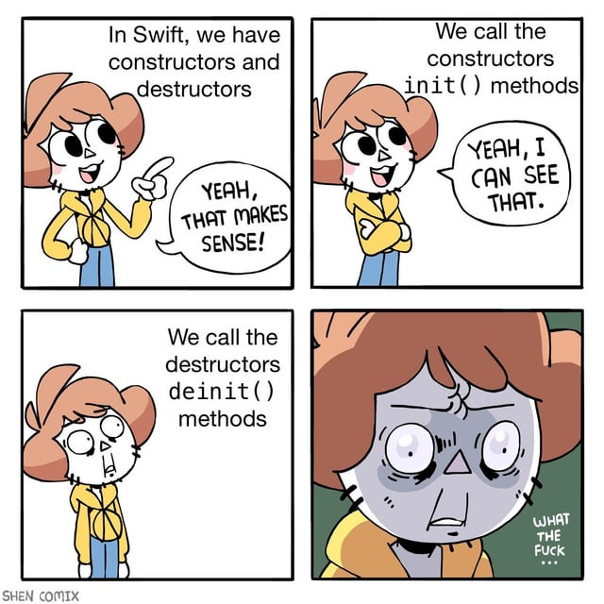
Initialization
&
Finalization

Slide 35
Life Cycle of an Object
1. Allocate Memory
2. Initialize
3. Operations
Store
Store
Store
write
read/write
inputs
Constructor
inputs
Operations
outputs
Object
Object
Object
5. Deallocate Memory
4. Finalize
Store
Store
write
Destructor
Object
Object

Slide 36
Constructors
Initialize C++ objects upon their creation
No output
Automatically invoked when the object is created
Store
write
Constructor
Inputs
Object

Slide 37
Constructors
Syntax:
No return type!
May be overloaded
Usually in public sections
Default constructor
Constructor with no parameters
// Counter
class Counter {
public:
// The default constructor
Counter() {
cnt = 0;
}
// The regular constructor
Counter(int n) {
cnt = n;
}
…
private:
int cnt;
};
<classname>(<parameters>)
{ … }

Slide 38
Use Constructors
Use default constructor when no argument is provided at definition
Use the regular constructor when arguments are provided
int main()
{
// Call the default constructor
Counter c;
// The printed value is 0
cout << “Value: "
<< c.get() << endl;
return 0;
}
int main()
{
// Call the regular constructor
Counter c(10);
// The printed value is 10
cout << “Value: "
<< c.get() << endl;
return 0;
}

Slide 39
Initialization List
Syntax:
Assign member variables with values
Executed before the body
// Counter
class Counter {
public:
Counter() : cnt(0)
{ }
Counter(int n) : cnt(n)
{ }
…
private:
int cnt;
};
<classname>(<parameters>)
: <mem_var_1>(<exp_1>),
<mem_var_2>(<exp_2>),
…
<mem_var_n>(<exp_n>)
{ … }
Don’t forget
the colon!
Separated
by commas

Slide 40
Destructors
Finalizers for C++ objects upon their destruction
No input and output
Automatically invoked when the object is destroyed
Store
write
Destructor
Object

Slide 41
Destructors
Note the wave symbol
Syntax:
No return type!
No input!
Usually in public sections
There is only ONE destructor!
// Counter
class Counter {
public:
Counter() {
cnt = 0;
}
Counter(int n) {
cnt = n;
}
~Counter()
{
cout << "Destructed!" << endl;
}
…
private:
int cnt;
};
~<classname>()
{ … }

Slide 42
Exercise
How many “Destructed!” message will be printed?
void incrCounter(int n, Counter c)
{
if (n > 0) {
c.incr();
incrCounter(n-1, c);
} else
cout << "The value of the counter is: "
<< c.get() << endl;
}
int main()
{
Counter c;
int n;
cin >> n;
incrCounter(n, c);
return 0;
}

Slide 43
Another Example
Define a class of lines
Abstract Representation:
Operations:
Set the starting and end points
Calculate the distance between two points
(x1, y1)
(x2, y2)

Slide 44
Exercise
How to define the constructor and member functions of Line?
class Line {
public:
// Constructors
Line();
Line(int px1, int py1, int px2, int py2);
// Member functions
void setStartPoint(int px1, int py1);
void setEndPoint(int px2, int py2);
double getDistance() const;
private:
double x1, y1, x2, y2;
};

Slide 45
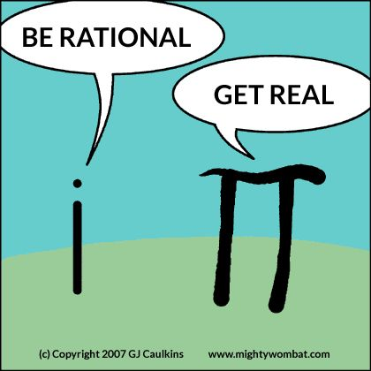
Bring Everything Together

Slide 46
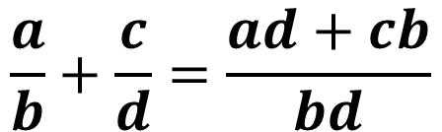



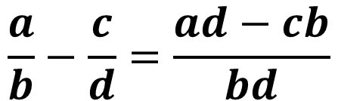
Rational Numbers
Define a rational number class
Abstract Representation:
Operations:
$$\frac{a}{b}$$
Numerator
Denominator
$$\frac{a}{b}+\frac{c}{d}=\frac{ad+cb}{bd}$$
$$\frac{a}{b}−\frac{c}{d}=\frac{ad−cb}{bd}$$
Addition
Subtraction
$$\frac{a}{b}×\frac{c}{d}=\frac{ac}{bd}$$
$$\frac{a}{b}÷\frac{c}{d}=\frac{ad}{bc}$$
Multiplication
Division

Slide 47
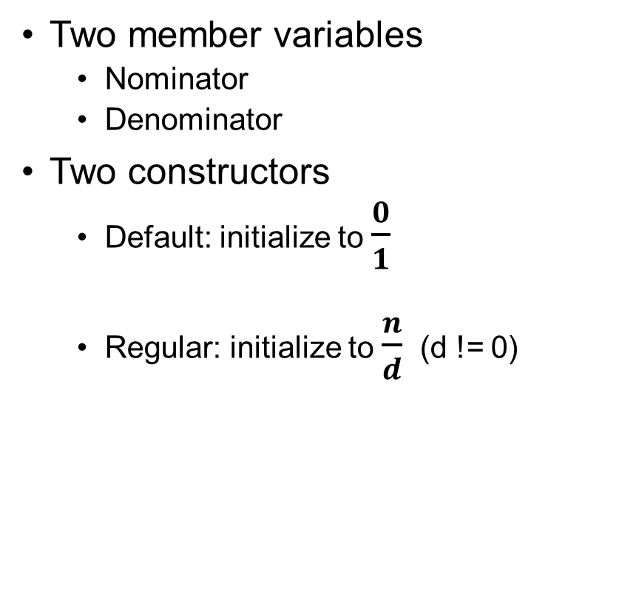
Data and Constructors
Two member variables
Nominator
Denominator
Two constructors
Default: initialize to $\frac{0}{1}$
Regular: initialize to $\frac{n}{d}$ (d != 0)
// Rational Numbers
class Rational {
public:
Rational()
: num(0), den(1)
{ }
Rational(int n, int d)
: num(n), den(d)
{ assert(d != 0); }
// Other member functions
…
private:
// numerator and denominator
int num, den;
};

Slide 48
Getters
Member functions for getting nominator and denominator
// Rational Numbers
class Rational {
public:
…
int getNum() const
{ return num; }
int getDen() const
{ return den; }
void print() const
{ cout << num << "/" << den << endl; }
private:
// numerator and denominator
int num, den;
};

Slide 49
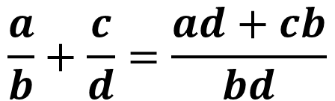
Addition
Given another rational number, returns the result of addition
$$\frac{a}{b}+\frac{c}{d}=\frac{ad+cb}{bd}$$
Addition
// Rational Numbers
class Rational {
public:
…
Rational add(const Rational& r) const
{
int rnum = num * r.getDen() + den * r.getNum();
int rden = den * r.getDen();
return Rational(rnum, rden);
}
…
};

Slide 50
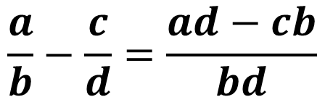
Subtraction
Given another rational number, returns the result of subtraction
$$\frac{a}{b}−\frac{c}{d}=\frac{ad−cb}{bd}$$
Subtraction
// Rational Numbers
class Rational {
public:
…
Rational sub(const Rational& r) const
{
int rnum = num * r.getDen() - den * r.getNum();
int rden = den * r.getDen();
return Rational(rnum, rden);
}
…
};

Slide 51

Multiplication
Given another rational number, returns the result of multiplication
$$\frac{a}{b}×\frac{c}{d}=\frac{ac}{bd}$$
Multiplication
// Rational Numbers
class Rational {
public:
…
Rational mult(const Rational& r) const
{
int rnum = num * r.getNum();
int rden = den * r.getDen();
return Rational(rnum, rden);
}
…
};

Slide 52

Division
Given another rational number, returns the result of division
$$\frac{a}{b}÷\frac{c}{d}=\frac{ad}{bc}$$
Division
// Rational Numbers
class Rational {
public:
…
Rational div(const Rational& r) const
{
int rnum = num * r.getDen();
int rden = den * r.getNum();
return Rational(rnum, rden);
}
…
};

Slide 53
Use the Rational Class
int main()
{
Rational r1(2, 3), r2(7, 4), r3;
r1.print();
r2.print();
r3.print();
r3 = r1.add(r2); // 2/3 + 7/4
r3.print();
r3 = r1.sub(r2); // 2/3 – 7/4
r3.print();
r3 = r1.mult(r2); // 2/3 * 7/4
r3.print();
r3 = r1.div(r2); // 2/3 / 7/4
r3.print();
return 0;
}

Slide 54


Problem
Rational numbers are not shown in their normal form
How to normalize rational numbers?
$$\frac{2}{3}×\frac{7}{4}=\frac{14}{12}$$
Multiplication
$$\frac{2}{3}×\frac{7}{4}=\frac{7}{6}$$
We want

Slide 55
Define a Normalization Function
Put it in private section as it should not be visible to users
Find the greatest common divisor of nominator and denominator
Divide them both by the gcd
class Rational {
public:
…
private:
void normalize()
{
int r = gcd(abs(num), abs(den));
num = num/r;
den = den/r;
}
…
};

Slide 56
Question
When should we call the normalize function?

Slide 57
Wrappers
The operations over rational number seems a bit unnatural
For r1 + r2, we expect
Instead, we get
Solution: define wrapper functions for those operations
add(r1, r2);
r1.add(r2);
// Wrapper functions
Rational add(const Rational& r1, const Rational& r2)
{
return r1.add(r2);
}

Slide 58
Usage
int main()
{
Rational r1(2, 3), r2(7, 4), r3;
r1.print();
r2.print();
r3.print();
r3 = add(r1, r2); // 2/3 + 7/4
r3.print();
r3 = sub(r1, r2); // 2/3 – 7/4
r3.print();
r3 = mult(r1, r2); // 2/3 * 7/4
r3.print();
r3 = div(r1, r2); // 2/3 / 7/4
r3.print();
return 0;
}
// Wrapper functions
Rational add(const Rational& r1,
const Rational& r2)
{ return r1.add(r2); }
Rational sub(const Rational& r1,
const Rational& r2)
{ return r1.sub(r2); }
Rational mult(const Rational& r1,
const Rational& r2)
{ return r1.mult(r2); }
Rational div(const Rational& r1,
const Rational& r2)
{ return r1.div(r2); }

Slide 59

Composite
Classes

Slide 60
Composition of Classes
Composite class: class built on top of other classes
Composite objects:
Member Variables
read/write
Member Variables
Inputs
Member Functions
Outputs
read/write
Object
Member Functions
Inputs
Outputs
Composite Object

Slide 61
Design a Clock
Use the counter class to design a clock class
Abstract representation:
Operations:
HH:MM:SS
// Reset the clock;
void reset_clock();
// Increase time by a second
void incr_second();
// Get the current hour
int get_hour();
// Get the current minute
int get_minute();
// Get the current second
int get_second();

Slide 62
Clock Class
Use Counter to represent seconds
Default Constructor
Regular Constructor
Nested construction via initialization list
Member functions
Use the embedded counter object
// Clock
class Clock {
public:
// Default Constructor
Clock() {}
// Set initial seconds
Clock(int seconds) : secs(seconds) {}
// Reset the clock
void reset_clock()
{ secs.reset(); }
// Increase time by a second
void incr_second()
{ secs.incr(); }
// Other member functions
…
private:
Counter secs;
};

Slide 63
Clock Class (Cont’d)
// Clock
class Clock {
public:
// Get the current hour
int get_hour() {
int s = secs.get();
return (s/(60*60))%24;
}
// Get the current minute
int get_minute() {
int s = secs.get();
return (s/60)%60;
}
// Get the current second
int get_second() {
int s = secs.get();
return s%60;
}
…
};
Member functions
Use the embedded counter object

Slide 64
Classes using Collections
Composite classes using collections: A common practice
Example: implement your own string class using Vector
Abstract representation: a sequence of characters
Operations:
// Get the length
int length()
// Get the i-th character
char at(int i)
// Add a character to the end of the string
void add(char ch)
// Get substrings
String substr(int i)
String substr(int i, int n)
// Remove n characters starting from n
void remove(int i, int n)
// Insert a string at position i
void insert(int i, const String& s)

Slide 65
MyString Class
Use vectors of characters to store the string internally
Default constructor
Constructor using strings as input
Q: how to write the constructor from standard strings?
// MyString
class MyString {
public:
// Default constructor
MyString() {}
// Construct a mystring from
// a standard string
MyString(const string& s) {
// Fill in your code
}
// Other members functions
…
private:
vector<char> str;
};

Slide 66
Member Functions
Define basic operations using the underlying vector
Note:
length and at are constant functions
add is not a constant function
// Get the length
int length() const {
return str.size();
}
// Get the i-th character
char at(int i) const {
return str[i];
}
// Add a character
// to the end of the string
void add(char ch) {
str.push_back(ch);
}

Slide 67
Member Functions
Overloaded member function:
j-i<n ensures the right number of characters are returned
Ther is a bug in substr. Could you find it?
// Get the substring starting at i
MyString substr(int i) const {
MyString res;
for (int j = i; j < str.size(); j++)
res.add(str[j]);
return res;
}
// Get the n characters starting at i
MyString substr(int i, int n) const {
MyString res;
for (int j = i;
j < str.size();
j++)
res.add(str[j]);
return res;
}
substr

Slide 68
Exercise
How to define the following functions?
Remove characters
Insert strings
// Remove n characters starting from n
void remove(int i, int n) {
// Fill in your code
}
// Insert a string at position i
void insert(int i, const MyString& s) {
// Fill in your code
}

Slide 69
Use MyString
Define a printer function
Examples:
Substrings
Remove
Insert
int main()
{
MyString str("Hello world!");
printMyString(str);
// Get substrings
printMyString(str.substr(6));
printMyString(str.substr(6,5));
printMyString(str.substr(6,20));
// Remove characters
str.remove(6,5);
printMyString(str);
// Insert strings
MyString f("friend");
str.insert(6, f);
printMyString(str);
return 0;
}
void printMyString(const MyString& s)
{
// Convert back to standard string
string res;
for (int i = 0; i < s.length(); i++)
res += s.at(i);
cout << "\"" << res << "\"" << endl;
}

Slide 70

Operator
Overloading

Slide 71
Key Ideas
C++ supports extension of standard operators s.t. they apply to classes
This is called Operator Overloading
Examples:
// String concatenation
string line1, line2;
getline(cin, line1);
getline(cin, line2);
cout << (line1 + line2) << endl;
// Testing for equality
string line1, line2;
getline(cin, line1);
getline(cin, line2);
cout << (line1 == line2) << endl;
// Vector concatenation
Vector<int> v1, v2;
…
cout << (v1 + v2) << endl;
// Testing for equality
Vector<int> v1, v2;
…
cout << (v1 == v2) << endl;

Slide 72
Overload Operators for Classes
Define operators like regular functions
Given operands, the compiler would select the right operator:
Note: the overloaded operators are usually used in infix forms
// Overload the + operator for rationals
Rational operator+(const Rational& r1, const Rational& r2)
{ return r1.add(r2); }
// Use the overloaded + operator for rationals
Rational r1(2, 3), r2(7, 4), r3;
r3 = r1 + r2;
r3.print();
string s1 = “hello”, s2 = “world”;
cout << (s1 + s2) << endl;

Slide 73
Overloading Arithmetic Operators
int main()
{
Rational r1(2, 3), r2(7, 4), r3;
r1.print();
r2.print();
r3.print();
r3 = r1 + r2; // 2/3 + 7/4
r3.print();
r3 = r1 - r2; // 2/3 – 7/4
r3.print();
r3 = r1 * r2; // 2/3 * 7/4
r3.print();
r3 = r1 / r2; // 2/3 / 7/4
r3.print();
return 0;
}
// Overloaded arithmetic operators
Rational operator+(const Rational& r1,
const Rational& r2)
{ return r1.add(r2); }
Rational operator-(const Rational& r1,
const Rational& r2)
{ return r1.sub(r2); }
Rational operator*(const Rational& r1,
const Rational& r2)
{ return r1.mult(r2); }
Rational operator/(const Rational& r1,
const Rational& r2)
{ return r1.div(r2); }

Slide 74
Overloading Comparison Operators
Overload equality and inequality operators for rationals
Usage:
bool operator==(const Rational& r1,
const Rational& r2)
{
return r1.getDen() == r2.getDen()
&& r1.getNum() == r2.getNum();
}
bool operator!=(const Rational& r1,
const Rational& r2)
{
return !(r1 == r2);
}
Rational r1(2, 3), r2(7, 4);
cout << (r1 == r2) << endl;
cout << (r1 != r2) << endl;

Slide 75
Exercise
How to overload <, >, <= and >= operators for rationals?

Slide 76
Overloading Insertion Operators
Syntax:
Allow for direct use of << on objects of the type <classname>
Make sure to always return the updated output stream
Example:
Now you can write cout << r instead of r.print()
ostream& operator<<(ostream& os, const <classname>& arg)
ostream& operator<<(ostream& os, const Rational& r)
{
os << r.getNum() << "/" << r.getDen();
return os;
}

Slide 77
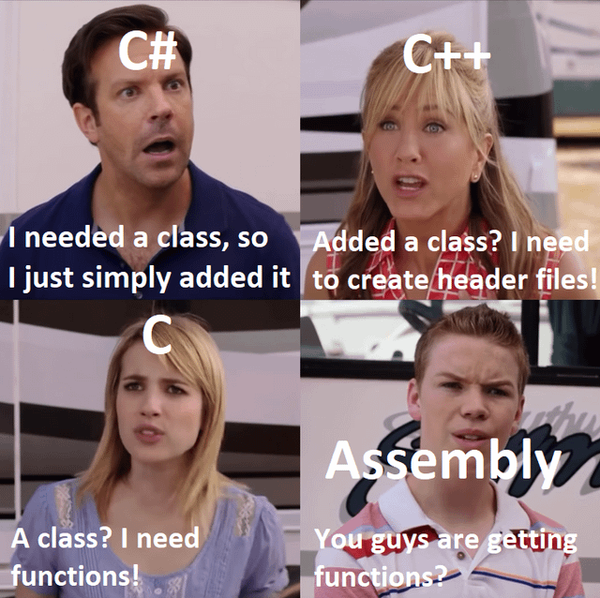
Interface
vs.
Implementation

Slide 78

Motivation
In previous examples:
We have provided membership functions together with their implementations all at once
It is often desirable to separate the interface from implementation
Benefits:
Protocol between users and designers
Hide the details of implementations
Independent evolution of implementations
Interface
What Clients See
Implementation
What Implementors See

Slide 79
Separate Interface from Implemenation
Designers:
Define a class with only declarations in a .h file
Define the implementation of member functions in a .cpp file
Users:
Only need to include the .h file to use the class
DOES NOT care how the class is implemented

Slide 80
Counter Revisited
Separate Counter class from its member function definitions
#ifndef COUNTER_H_INCLUDED
#define COUNTER_H_INCLUDED
// Counter
class Counter {
public:
void reset();
int get() const;
void incr();
private:
int cnt;
};
#endif // COUNTER_H_INCLUDED
#include "counter.h"
void Counter::reset()
{
cnt = 0;
}
int Counter::get() const
{
return cnt;
}
void Counter::incr()
{
cnt++;
}
Remember to include the header file!
Implementations
Types must match
Counter:: is a qualifier denoting these functions are member functions of Counter
Only declarations!
Don’t forget the semicolons at the end!
counter.cpp
counter.h

Slide 81
Counter Revisited
Constructors & destructors are defined in a similar way
// Counter
class Counter {
public:
Counter ();
Counter (int n);
~Counter();
void reset();
int get() const;
void incr();
private:
int cnt;
};
#include "counter.h"
#include <iostream>
using namespace std;
Counter::Counter()
: cnt(0)
{}
Counter::Counter(int n)
: cnt(n)
{}
Counter::~Counter()
{
cout << "Destructed" << endl;
}
…
counter.h
counter.cpp

Slide 82
Structure of C++ Programs
a.h
b.h
z.h
interfaces: where a declaration is either
a function or
a global variable
a class definition
Declaration 1
Declaration 1
Declaration 1
● ● ●
● ● ●
● ● ●
● ● ●
Declaration n
Declaration m
Declaration k
a.cpp
a.cpp
a.cpp
include
implementations: where a definition is either
a function or
a global variable
a class member
a.cpp
b.cpp
z.cpp
Definition 1
Definition 1
Definition 1
● ● ●
● ● ●
● ● ●
● ● ●
Definition n
Definition m
Definition k
a.cpp
a.cpp
a.cpp

Slide 83
Exercise
How to separate the implementation of Rational from its interface?
How to separate the implementation of Clock from its interface?

Slide 84
Organize Programs with Classes

Slide 85
Designing Modules
Designing a C++ program is an art more than science
Some Guidelines:
Encapsulate functionalities into ADTs
Class headers
Class files
A collection of driver functions using the ADTs
Driver headers
Driver files
A main file as the entry point (if not a library)

Slide 86

Whack-A-Mole
We use the whack-a-mole (打地鼠) game as an example

Slide 87
Rules
A N x N field with moles whose heads pop out every so often
The game proceed in rounds, every round
The moles randomly pop up at some square
The user indicates which square he would like to whack (enter the coordinate (x, y))
The user gets scores according to the following rules:
Gets 300 points if a big mole is at (x, y)
Gets 100 points if a small mole is at (x, y)
Gets -100 points if no mole is at (x, y)
A mole disappears if it is whacked
The game ends if there is no mole in the field.

Slide 88
Design the Game
An ADT for moles
Interface: mole.h
Implementation: mole.cpp
An ADT for fields
Interface: field.h
Implementation: field.cpp
A module for driver (game engine)
Interface: engine.h
Implementation: engine.cpp
The entry point
main.cpp

Slide 89

Concrete Data Types

Slide 90
Concrete Data Types
Data types whose internal representations are exposed to users
They are called structures in C++
Syntax:
Design Principle:
All the variables and functions should be exposed to users
Users should be free to inspect and modify the concrete values
// Definition of a structure
struct <name> {
declaration/definition of member variables
declaration/definition of member functions
};
Public section
(Visible to Users)

Slide 91
Access CDT Members
Member Variable Access:
This is the primary operation for CDT
Method Call Syntax:
<variable>: object variable of a class
<method>: operation provided by the class
<arguments>: a list of input arguments to <method>
<variable>.<member_variable>
<variable>.<method>(<arguments>)

Slide 92
Example: Points
Define a point structure
Two member variables:
x and y coordinates
One member function:
Shift the coordinate
// Point structure
struct Point {
int x;
int y;
void shift(int sx, int sy)
{
x += sx;
y += sy;
}
};
We see everything in Point!
We see everything in Point!
Users
Member
functions

Slide 93
Example: Points
Use the point structure
int main()
{
Point p;
p.x = 1;
p.y = 2;
p.shift(3, 5);
cout << "The coordinate is at ("
<< p.x << ", " << p.y << ")" << endl;
return 0;
}
// Point structure
struct Point {
int x;
int y;
void shift(int sx, int sy)
{
x += sx;
y += sy;
}
};

Slide 94
ADT vs. CDT
ADT
Internal representation hidden
Member functions are the only way to access internal data
Defined by their behaviors
CDT
Internal representation exposed
Member functions are convienent tools for manipulating data
Defined by their representations
// Point class
class Point {
public:
void shift(int sx, int sy)
{
x += sx;
y += sy;
}
private:
int x;
int y;
};
// Point structure
struct Point {
int x;
int y;
void shift(int sx, int sy)
{
x += sx;
y += sy;
}
};

Slide 95
Define CDT using Classes
We can use class to represent structures
Question: what is the difference between class and struct?
// Point structure using class
class Point {
public:
int x;
int y;
void shift(int sx, int sy)
{
x += sx;
y += sy;
}
};
// Point structure using struct
struct Point {
int x;
int y;
void shift(int sx, int sy)
{
x += sx;
y += sy;
}
};

Slide 96
Class vs. Struct
class and struct keywords both defines a new data type
The only difference:
Members in structs are public by default
Members in classes are private by default:
// All members are private
class Point {
int x;
int y;
void shift(int sx, int sy)
{
x += sx;
y += sy;
}
};
// All members are public
struct Point {
int x;
int y;
void shift(int sx, int sy)
{
x += sx;
y += sy;
}
};

Slide 97
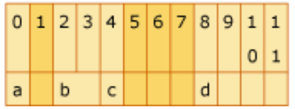
Usage of CDT
When are CDTs useful?
When internal representations are useful for implementation of ADTs
Example: use points to implement geometries
When internal representations are protocols for communication
Example: data structures as part of application binary interfaces (ABI)
https://docs.microsoft.com/en-us/cpp/build/x64-software-conventions?view=msvc-170
// Total size = 12 bytes, alignment = 4 bytes
struct cdt {
char a; // +0; size = 1 byte
short b; // +2; size = 2 bytes
char c; // +4; size = 1 byte
int d; // +8; size = 4 bytes
}
structure
concrete bytes

Slide 98
Next Time
Pointers & Arrays
Read Chapters 11 of the text book

