Slide 1
Principles and Methods of Program Design Lecture 8: Dynamic Memory
Yuting Wang
SEIEE
John Hopcroft Center for Computer Science
2025.5.24

Slide 2
Road Map
Basics of Imperative Programming (C++)
Programming with Abstractions
Implementing Abstractions
Here!

Slide 3
Last Time
Basics of Memory
L-value & R-value
Pointers
Arrays
C-Style Strings

Slide 4
This Time
Heap and Dynamic Allocation
Dynamic Resource Management
Designing ADTs

Slide 5
Pointers to Objects

Slide 6
Pointers to Object Variables
Pointer and pointer variables for ADT/CDT objects work as usual
// Point structure
struct Point {
int x;
int y;
};
int main() {
Point p;
Point *pp = &p;
(*pp).x = 3;
(*pp).y = 5;
cout << (*pp).x << (*pp).y;
return 0;
}
// Counter as defined previously
class Counter { … };
int main()
{
Counter c;
Counter *p = &c;
for (int i = 0; i < 10; i++)
(*p).incr();
cout << (*p).get() << endl;
return 0;
}

Slide 7
Syntactic Sugar
Special syntax for accessing members through pointers
p->var is equivalent to (*p).var
p->f(…) is equivalent to (*p).f(…)
// Point structure
struct Point {
int x;
int y;
};
int main() {
Point p;
Point *pp = &p;
pp->x = 3;
pp->y = 5;
cout << pp->x << pp->y;
return 0;
}
// Counter as defined previously
class Counter { … };
int main()
{
Counter c;
Counter *p = &c;
for (int i = 0; i < 10; i++)
p->incr();
cout << p->get() << endl;
return 0;
}

Slide 8
This Pointer
A special pointer called this is used to refer to the current object
References to member variables implicitly refer to the this pointer
// Counters
class Counter {
public:
void reset()
{ cnt = 0; }
int get()
{ return cnt; }
void incr()
{ cnt++; }
private:
int cnt;
};
// Counters
class Counter {
public:
void reset()
{ this->cnt = 0; }
int get()
{ return this->cnt; }
void incr()
{ this->cnt++; }
private:
int cnt;
};
Expands

Slide 9
This Pointer
Definitions of member function contains the implicit this parameter
void Counter::reset()
{
cnt = 0;
}
int Counter::get() const
{
return cnt;
}
void Counter::incr()
{
cnt++;
}
void reset(Counter *this)
{
this->cnt = 0;
}
int get(const Counter *this)
{
return this->cnt;
}
void incr(Counter *this)
{
this->cnt++;
}
Compiles

Slide 10
This Pointer
Calls to member functions implicitly passes the this pointer
int main()
{
Counter c;
c.reset();
int n;
cin >> n;
for (int i = 0; i < n; i++)
c.incr();
cout << c.get() << endl;
return 0;
}
int main()
{
Counter c;
reset(&c);
int n;
cin >> n;
for (int i = 0; i < n; i++)
incr(&c);
cout << get(&c) << endl;
return 0;
}
Compiles

Slide 11

Heap and
Dynamic Allocation

Slide 12



Heap Memory
Heap memory is a third memory region besides global and stack memory
Objects must be explicitly allocated and released from heap
known as dynamic (de-)allocation
Every in-memory objects in heap has a unique location
Heap allocation may fail if there is not enough free space
Global
Memory
Stack
Memory
Heap
Memory
$$l_{1}$$
$$l_{3}$$
$$l_{2}$$
● ● ●
● ● ●
● ● ●
Grows

Slide 13



An Analogy
Memory are managed resources (by operating systems or hardware)
Like seats in a restaurant
Global memories are reserved for all the time
Stack memory are a stack of seats
Heap memory are open seats
Reserved Seats
A Stack of Seats
Open Seats
Notes:
All valid memory are managed. It is illegal to access memory randomly.

Slide 14

Dynamic Allocation and Deallocation
Syntax for Allocation:
Returns a pointer to the allocated object
Syntax for Deallocation:
<expr> must evaluate to a pointer $l$
Remove the in-memory object with location $l$
// Allocate an in-memory object of type T on heap
new T
// Remove the in-memory object from the heap
delete <expr>

Slide 15




A First Example
Note:
Remember to deallocate heap objects before exiting (o.w., memory leaks occur)
The value in variable p is an invalid pointer after deallocation
Reset the value of those pointer variables to nullptr if it will be reused later!
int main()
{
int *p = new int;
*p = 10;
cout << *p << endl;
delete p;
return 0;
}
Heap
Memory
Stack
Memory
PC
$$l_{2}$$
$$l_{1}$$
?
?
10
$$l_{2}$$
Environment:
p:$l_{1}$

Slide 16




Allocation of ADT Objects
int main()
{
Counter* c = new Counter;
c->reset();
int n;
cin >> n;
for (int i = 0; i < n; i++)
c->incr();
cout << "The value of the counter is: "
<< c->get() << endl;
delete c;
return 0;
}
Heap
Memory
Stack
Memory
PC
$$l_{2}$$
$$l_{1}$$
?
?
0
$$l_{2}$$
Environment:
c:$l_{1}$

Slide 17
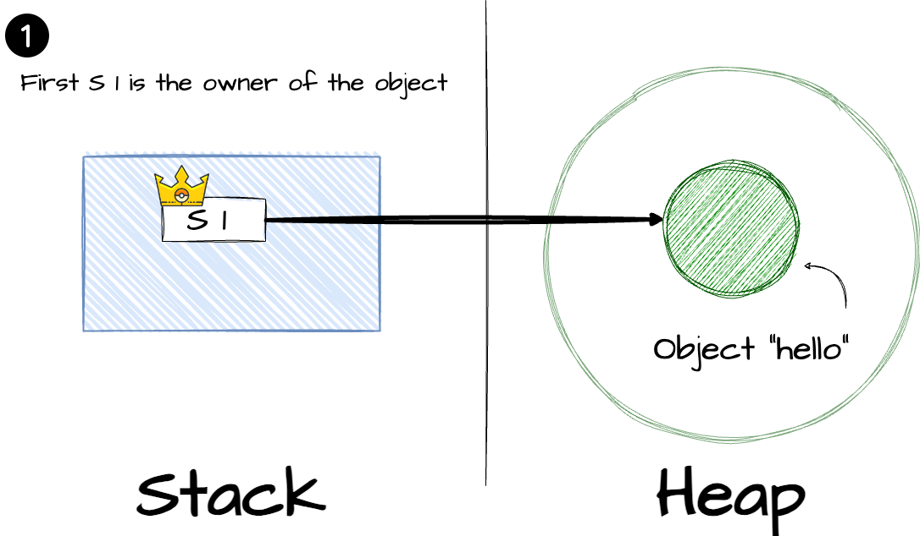
Stack Memory Pointing to Heap

Slide 18
Whack-A-Mole Revisited
// The field where moles happily live
class Field {
public:
// Constructor
Field(int sz);
// Get the information of a mole (if any)
const Mole* getMole(int row, int col) const;
// Add a mole
const Mole* addMole(int row, int col, bool big);
// Remove mole
bool removeMole(int row, int col);
...
private:
// Size (n x n) of the filed
int size;
// Moles in the field
Grid<Mole*> moles;
};

Slide 19

Dynamic Arrays
Syntax for Allocation:
Returns a pointer to the allocated array
Syntax for Deallocation:
<expr> must evaluate to a pointer $l$ to a dynamic array
Remove the array with location $l$
// Allocate an dynamic array of T on heap
new T[<size>]
// Example
new int[5];
$$l_{1}$$
?
?
?
?
?
// Remove the in-memory object from the heap
delete[] <expr>

Slide 20
Example: Sorting Dynamic Arrays
Bubble sort on dynamic arrays:
int main()
{
int n;
cin >> n;
// Allocate an dynamic array of size 4*n bytes
int *arr = new int[n];
for (int i = 0; i < n; i++)
cin >> arr[i];
// Sort the array using bubble sort
bubble_sort(arr, n);
// Print the result
for (int i = 0; i < n; i++)
cout << arr[i] << " ";
// Deallocate the array
delete [] arr;
return 0;
}

Slide 21
Fixed-Length Vector
We can define a vector of integers with fixed length using a dynamic array
// Vectors with a fixed length
class FVector {
public:
// Constructors and destructors
FVector(int n);
~FVector();
int length() const;
void set(int i, int v);
int at(int i) const;
private:
int n;
int* arr;
};
FVector::FVector(int l) : n(l)
{ arr = new int[l]; }
FVector::~FVector()
{ delete[] arr; }
int FVector::at(int i) const {
if (i >= 0 && i < n)
return arr[i];
return -1;
}
void FVector::set(int i, int v) {
if (i >= 0 && i < n)
{ arr[i] = v; }
}

Slide 22

Memory Leak

Slide 23
What is Wrong?
Bubble sort on dynamic arrays:
int main()
{
int n;
cin >> n;
// Allocate an dynamic array of size 4*n bytes
int *arr = new int[n];
for (int i = 0; i < n; i++)
cin >> arr[i];
// Sort the array using bubble sort
bubble_sort(arr, n);
// Print the result
for (int i = 0; i < n; i++)
cout << arr[i] << " ";
// Deallocate the array
delete arr;
return 0;
}

Slide 24
What is Wrong?
We can define a vector of integers with fixed length using a dynamic array
// Vectors with a fixed length
class FVector {
public:
// Constructors and destructors
FVector(int n);
~FVector();
int length() const;
void set(int i, int v);
int at(int i) const;
private:
int n;
int* arr;
};
FVector::FVector(int l) : n(l)
{ arr = new int[l]; }
FVector::~FVector()
{}
int FVector::at(int i) const {
if (i >= 0 && i < n)
return arr[i];
return -1;
}
void FVector::set(int i, int v) {
if (i >= 0 && i < n)
{ arr[i] = v; }
}

Slide 25
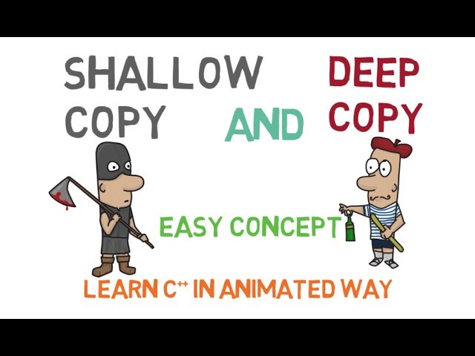
Memory Ownership

Slide 26
Ownership of Dynamic Memory
An object owns a piece of memory if it is responsible for its destruction
This memory may be created by its constructor and other methods
Or transferred over by another owner
The internal structure of the memory is usually not visible outside
Examples: An FVector owns its dynamic array
// Vectors with a fixed length
class FVector {
public:
...
private:
int n;
int* arr;
};
// Allocation and deallocation
FVector::FVector(int l) : n(l)
{ arr = new int[l]; }
FVector::~FVector()
{ delete[] arr; }

Slide 27
Resource Acquisition is Initialization
RAII is a programming idiom
Lifetime of resource is tied to the lifetime of objects
Resources are acquired during object initialization (constructor)
Resources are released during object finalization (destructor)
Slogan: No object leaks, No memory leaks
When resources are memory, RAII ensures ownership of memory
Resources may also be anything other than memory
File handlers
Internet sockets
Process identifiers
...

Slide 28
Shallow Copying
Copying of objects copies their member variables by default
This is called shallow copying
// What goes wrong with the following code?
void test()
{
FVector vec(5);
for (int i = 0; i < vec.length(); i++)
vec.set(i, randomInteger(1, 100));
FVector vec1(3);
vec1 = vec;
}
int main()
{
test();
return 0;
}

Slide 29
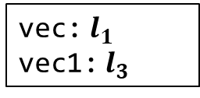



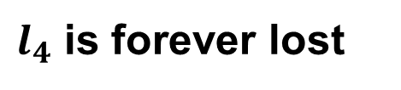




Problems with Shallow Copying
Unclear Duty: two structures are responsible for managing memory
Memory Leak: heap memory may never be freed after assignment
FVector vec1(3);
vec1 = vec;
Stack
Memory
Heap
Memory
$$l_{1}$$
$$l_{2}$$
5
$$l_{2}$$
1
2
3
4
5
Shallow Copying
$$l_{3}$$
$$l_{4}$$
3
$$l_{4}$$
0
0
0
5
$$l_{2}$$
$l_{4}$ is forever lost
Environment:
vec:$l_{1}$
vec1:$l_{3}$
Notes:
An bad consequence: double free of l_2

Slide 30


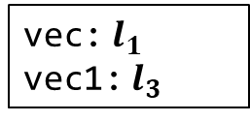






Deep Copying
Release the owned resources when overwriting objects
Make a copy of owned resources when duplicating objects
Stack
Memory
Heap
Memory
$$l_{1}$$
$$l_{2}$$
5
$$l_{2}$$
1
2
3
4
5
Deep Copying
Deep Copying
$$l_{3}$$
$$l_{5}$$
3
$$l_{4}$$
1
2
3
4
5
5
$$l_{5}$$
Environment:
vec:$l_{1}$
vec1:$l_{3}$
$$l_{4}$$
0
0
0

Slide 31
Deep Copying Method
Define a function for deep copying
Define a function for releasing memory
// Deep copy of FVector
void FVector::deepCopy(const FVector& vec)
{
arr = new int[vec.n];
for (int i = 0; i < vec.n; i++)
arr[i] = vec.arr[i];
n = vec.n;
}
// Clear the vector
void FVector::clear()
{
delete [] arr;
}
// Vectors with a fixed length
class FVector {
public:
...
private:
void deepCopy(const FVector& vec);
void clear();
int n;
int* arr;
};
Notes:
Note that the member fields of other objects of the same type is publicly visible

Slide 32
Correcting the Assignment
An assignment is translated to the following steps
Release the owned memory
Deep copying of the target program
void test()
{
FVector vec(5);
for (int i = 0; i < vec.size(); i++)
vec.set(i, randomInteger(1, 100));
FVector vec1(3);
// vec1.clear(); // Release memory
// vec1.deepCopy(vec); // Deep Copying
vec1 = vec;
}
Notes:
However, this is not satisfying

Slide 33
Assignment Overloading
Overload the assignment operator for the objects
This will overwrite default assignment
Note:
Release the resources before copying
Return itself as a reference
Is there still a problem?
class FVector {
public:
...
// Overloaded Assignment
FVector& operator=(const FVector& vec);
private:
...
};
FVector& FVector::operator=(const FVector& vec)
{
clear();
deepCopy(vec);
return *this;
}

Slide 34
Copy Constructors
A copy constructor is for creating objects using deep copying
class FVector {
public:
...
// Copy constructor
FVector(const FVector& vec);
private:
...
};
FVector::FVector(const FVector& vec)
{
deepCopy(vec);
}

Slide 35
Using Copy Constructors
Use another object as an argument to the constructor
void test()
{
FVector vec(5);
for (int i = 0; i < vec.size(); i++)
vec.set(i, randomInteger(1, 100));
FVector vec1(3);
// 1. Release the memory owned by vec1
// 2. Deep copying of vec
vec1 = vec;
// Deep copying of vec1 to initialize vec2
Fvector vec2(vec1);
}

Slide 36

Holy Trinity of C++
Destructor, copy constructor and assignment overloading

Slide 37
Other Methods for Managing Heap Memory
Smart Pointers
Reference Counting
Keep a counter of references/pointers to a heap object
When the counter drops to 0, delete the object
Need to break cycles of references
No run-time needed
Garbage Collection (GC)
Garbage refers to heap memory allocated but no longer referenced
A garbage collector scans the memory to reclaim garbage
Need run-time to support GC
High-overhead and hard-to-control performance

Slide 38

Relations between
Data Structures

Slide 39
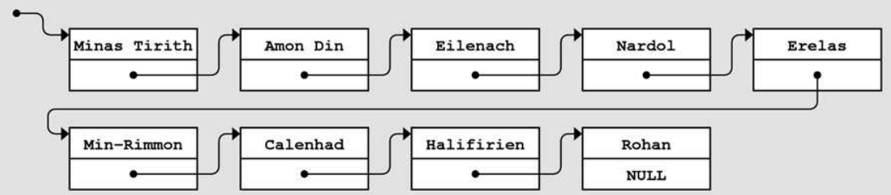
Linked Lists
A data structure representing a sequence of values linked by pointers
// Linked lists of integers
struct LinkedList{
LinkedList() : value(0), next(nullptr) {}
int value;
LinkedList* next;
};

Slide 40
Basic Operations
We define the following operations for using linked lists
// Print the values
void print(LinkedList* root);
// Push to the head of linked lists
LinkedList* push(LinkedList* root, int value);
// Pop the head of the linked lists
LinkedList* pop(LinkedList* root);
// Destroy the whole list
void destroy(LinkedList* root);

Slide 41







Print a Linked List
// Traverse and print the values in the linked list
void print(LinkedList* root) {
for (LinkedList* p = root; p != nullptr; p = p->next)
cout << p->value << " ";
cout << endl;
}
PC
Heap
Memory
Stack
Memory
$$l_{2}$$
$$l_{3}$$
3
$$l_{3}$$
10
NULL
root
$$l_{2}$$
?
$$l_{3}$$
$$l_{2}$$
$$\text{p}$$
NULL

Slide 42



Push a Node
// Add a node to the head of a linked list
LinkedList* push(LinkedList* root, int value) {
LinkedList* newl = new LinkedList;
newl->value = value;
newl->next = root;
return newl;
}
PC
Heap
Memory
Stack
Memory
$$l_{2}$$
$$l_{3}$$
3
$$l_{3}$$
10
NULL
root
$$l_{2}$$
value
5
$$l_{5}$$
0
NULL
newl
?
5
$$l_{2}$$
$$l_{5}$$

Slide 43








Pop a Node
// Remove a node in the front
LinkedList* pop(LinkedList* root) {
if (root == nullptr)
return nullptr;
LinkedList* next = root->next; // Notice the order
delete root; // of delete
return next;
}
PC
Heap
Memory
Stack
Memory
$$l_{5}$$
$$l_{2}$$
$$l_{3}$$
root
$$l_{5}$$
5
$$l_{2}$$
3
$$l_{3}$$
10
NULL
?
$$\text{next}$$
$$l_{2}$$

Slide 44
Basic Operations
The following operations traverses the lists using iterations
Q: How to destroy and print lists by using recursion?
void destroy(LinkedList* root) {
while (root != nullptr)
root = pop(root);
}

Slide 45
Exercise
Which of the following code works correctly?
int main()
{
LinkedList *list1 = nullptr;
push(list1, 10);
push(list1, 3);
push(list1, 5);
print(list1);
destroy(list1);
return 0;
}
int main()
{
LinkedList *list1 = nullptr;
list1 = push(list1, 10);
list1 = push(list1, 3);
list1 = push(list1, 5);
print(list1);
destroy(list1);
return 0;
}

Slide 46
Copying Linked Lists
Follow the pointers to performed a deep copy
Exercise: write a version of copy that uses iteration instead of recursion
// Deep copy using recursion
LinkedList* copy(LinkedList* l)
{
if (l == nullptr)
return nullptr;
LinkedList* newl = new LinkedList;
newl->value = l->value;
newl->next = copy(l->next);
return newl;
}

Slide 47
Get the I-th Element
It is convenient to get both the i-th element in its predecessor
pair<LinkedList*, LinkedList*> getIthPrev(LinkedList* l, int i)
{
assert(i >= 0);
LinkedList* prev = nullptr;
while (l != nullptr && i != 0) {
prev = l;
l = l->next;
i--;
}
return make_pair(prev, l);
}
LinkedList* getIth(LinkedList* l, int i) {
return getIthPrev(l, i).second;
}

Slide 48
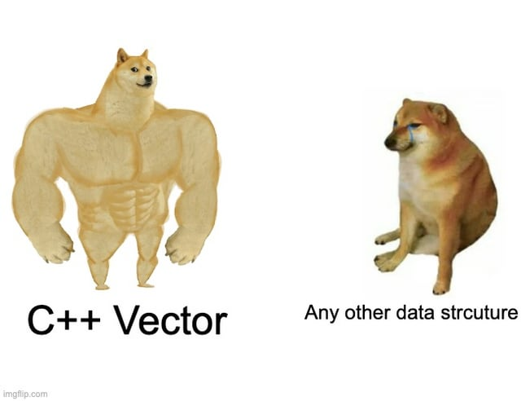
Designing
Collections

Slide 49
Design Collections
Define collections by using dynamic memory
Elements in collections are resources owned by collections
We use vectors of integers as an example and discuss two approaches
Vectors implemented using linked lists

Slide 50
Vector of Integers
Class definition
class IVector{
public:
IVector();
~IVector();
int size() const;
bool isEmpty() const;
void clear();
int get(int i) const;
void set(int i, int v);
void add(int v);
void insert(int i, int v);
void remove(int i);
private:
LinkedList* lst;
};

Slide 51
Add Elements
Append elements to the end
Navigate to the last element
Create a new last element
Append it
void IVector::add(int v)
{
LinkedList *prev = nullptr,
*cur = lst;
while (cur != nullptr) {
prev = cur;
cur = cur->next;
}
LinkedList* newl = new LinkedList;
newl->value = v;
if (prev != nullptr)
prev->next = newl;
else
lst = newl;
}

Slide 52
Insert Elements
Insert an element to i-th position
Find the i-th element and its predecessor
Create a new element
Insert it into between the i-th element and its predecessor
Note: if i >= size, then insert functions like add
void IVector::insert(int i, int v)
{
if (i < 0) return;
std::pair<LinkedList*, LinkedList*>
p = getIthPrev(lst, i);
LinkedList *prev = p.first,
*cur = p.second;
LinkedList* newl = new LinkedList;
newl->value = v;
newl->next = cur;
if (prev != nullptr)
prev->next = newl;
else
lst = newl;
}

Slide 53
Remove Elements
Remove the i-th element
Find the i-th element and its predecessor
Remove the i-th element and adjust the next pointer of the predecessor
Note: if i >= size, then remove has no effect
Q: there is a bug here. What is it?
void IVector::remove(int i)
{
if (i < 0) return;
std::pair<LinkedList*, LinkedList*> p = getIthPrev(lst, i);
LinkedList *prev = p.first, *cur = p.second;
if (cur == nullptr) return;
delete cur;
if (prev != nullptr)
prev->next = cur->next;
else
lst = cur->next;
}

Slide 54
Constructors and Destructors
void IVector::clear()
{
destroy(lst);
lst = nullptr;
}
IVector::IVector() : lst(nullptr) {}
IVector::~IVector()
{
clear();
}
int IVector::size() const
{
int i = 0;
LinkedList* l = lst;
while (l != nullptr) {
i++;
l = l->next;
}
return i;
}
bool IVector::isEmpty() const
{
return lst == nullptr;
}

Slide 55
Copying and Assignment
Perform deep copying for copy construction and assignment
Release the memory before copying in assignments
//Copy constructor
IVector::IVector(const IVector& vec)
{
lst = copy(vec.lst);
}
//Assignment operator
IVector& IVector::operator=(const IVector& vec)
{
if (this != &vec) {
clear();
lst = copy(vec.lst);
}
return *this;
}

Slide 56
Generic Collections

Slide 57
Template Classes
Define a collection of classes parameterized by type variables
Syntax:
Examples: Vector, Stack, Map, ..., etc
Note: The definitions and declarations must be in the same header files
Template functions/classes are patterns for generating code (not the code themselves)
The users of templates must see ALL the definitions for instantiation
Programming using templates is known as Generic Programming
template <class T1, ..., class Tn>
class <name>{
...
}

Slide 58
Generic Linked Lists
Similar to previous definition but with a type parameter
By instantiating T, we get linked lists containing different types of values
// Definition of generic linked lists
template <class T>
struct LinkedList{
LinkedList(T v) : value(v), next(nullptr) {}
T value;
LinkedList* next;
};
// Different instances of linked list
LinkedList<int>
LinkedList<double>
LinkedList<LinkedList<int>>
...

Slide 59
Generic Operations
Some operations:
template <class T>
LinkedList<T>* push(LinkedList<T>* l,
T value) {
LinkedList<T>* newl =
new LinkedList<T>;
newl->value = value;
newl->next = l;
return newl;
}
template <class T>
LinkedList<T>* pop(LinkedList<T>* l) {
if (l == nullptr) return nullptr;
LinkedList<T>* next = l->next;
delete l;
return next;
}
template <class T>
T peek(LinkedList<T>* l) {
if (l == nullptr) return 0;
return l->value;
}
template <class T>
LinkedList<T>* copy(LinkedList<T>* l) {
if (l == nullptr)
return nullptr;
LinkedList<T>* newl =
new LinkedList<T>(l->value);
newl->next = copy(l->next);
return newl;
}

Slide 60
Generic Vectors
Similar to IVector but with a type parameter
template <class T>
class Vector{
public:
Vector() : lst(nullptr) {}
~Vector() { clear(); }
//Copy constructor
Vector(const Vector& vec) {
lst = copy(vec.lst);
}
...
private:
LinkedList<T>* lst;
};

Slide 61
Generic Member Functions
T get(int i) const{
if (i < 0) return 0;
LinkedList<T>* l = getIth(lst, i);
if (l == nullptr)
return T();
else
return l->value;
}
void set(int i, T v)
{
if (i < 0) return;
LinkedList<T>* l = getIth(lst, i);
if (l != nullptr)
l->value = v;
}
void insert(int i, T v)
{
if (i < 0) return;
std::pair<LinkedList<T>*, LinkedList<T>*>
p = getIthPrev(lst, i);
LinkedList<T> *prev = p.first,
*cur = p.second;
LinkedList<T>* newl =
new LinkedList<T>(v);
newl->next = cur;
if (prev != nullptr)
prev->next = newl;
else
lst = newl;
}

