Slide 1
An Effective Transition-based Model for Discontinuous NER [ACL2020]
Xiang Dai(1,2) Sarvnaz Karimi(1) Ben Hachey(3) Cecile Paris(1)
1.CSIRO Data61, Sydney, Australia
2.University of Sydney, Sydney, Australia
3.Harrison.ai, Sydney, Australia
shen liu

Slide 2

Contents
1.Continuous NER
2.Discontinuous NER
3.Transitional-based model
4.Experiments

Slide 3

Continuous
NER
0 1

Slide 4
1.1 Assumptions
mentions do not nest or overlap, therefore each token can belong to at most one mention
mentions comprise continuous sequences of tokens

Slide 5
Discontinuous
NER
0 2

Slide 6
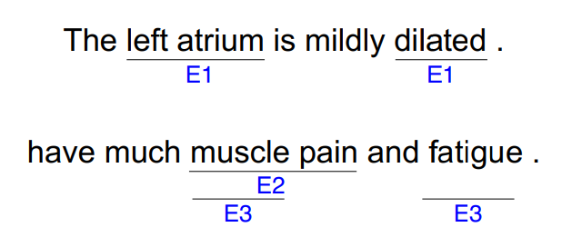
2.1 characteristics
discontinuous mentions are usually longer than continuous mentions
usually overlap

Slide 7
2.1Discontinuous NER vs Nested NER
two mentions overlap
discontinuous NER
comp-arsion
add fine-grained entity types into the schema
one is completely contained by the other
nested NER

Slide 8
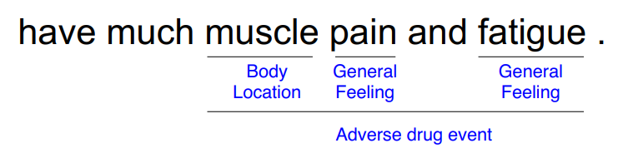
2.2 an demo of DisNER
fine-grained entity:
Body Location, General Feeling
discontinuous entity: Adverse drug event

Slide 9
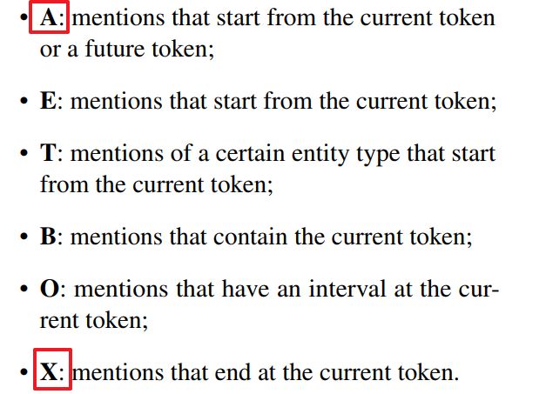
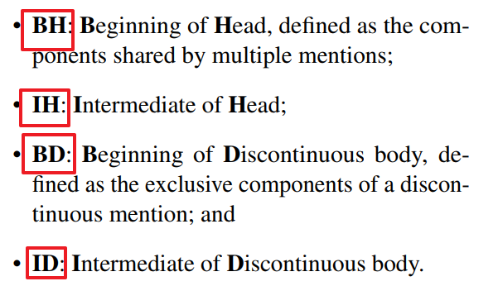
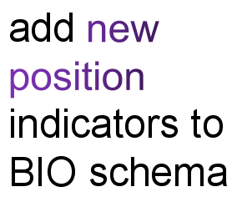
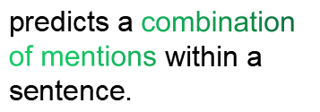
2.3 Solutions
Token level approach
ambiguity issue
solutions
Setence level approach
use multi-label classification,
flexible but high time complexity
Ohter methods

Slide 10
Transition-based Model
0 3

Slide 11

Transition-based Model
0 3

Slide 12
3.Transitional-based model
3.1 Algorithm
3.2 Example
3.3 Contribution

Slide 13
3.1 Algorithm
a stack to store partially processed spans
Transition-based models
a buffer to store unprocessed tokens.
SHIFT, OUT
REDUCE, LEFT-REDUCE, RIGHT-REDUCE
COMPLETE
ACTIONS

Slide 14
3.2 Example

Slide 15


Buffer
predicted
action
Stack
have
much
muscle
pain
and
fatigue
OUT
much
muscle
pain
and
fatigue
OUT
muscle
pain
and
fatigue
SHIFT
muscle
pain
and
fatigue
SHIFT
muscle
pain
and
fatigue
LEFT-REDUCE
muscle
muscle pain
and
fatigue
muscle
and
fatigue
OUT
muscle
fatigue
fatigue
SHIFT
SHIFT
muscle
fatigue
REDUCE
muscle fatigue

Slide 16
3.3 Contribution
an end-to-end transition-based model with generic neural encoding
use attention mechanism

Slide 17
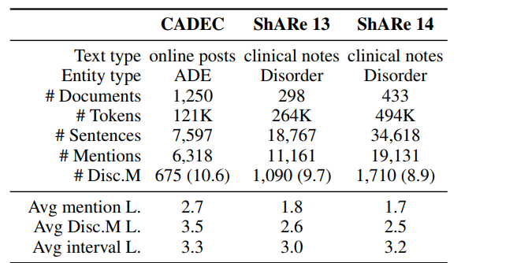
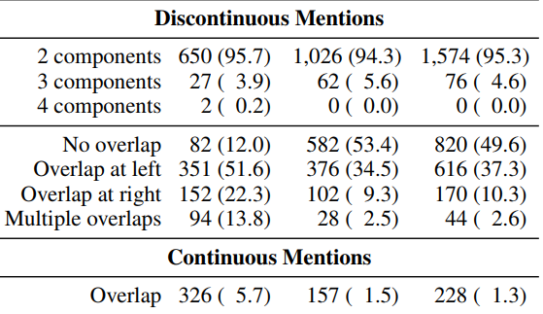
4.1 Data sets
CADEC (Karimi et al., 2015a)
ShARe 13 (Pradhan et al., 2013)
ShARe 14 (Mowery et al.,2014)

Slide 18
4.1 Experimental
Baseline Methods
  Flat Model
  BIO extension model
  Graph-based model

Slide 19
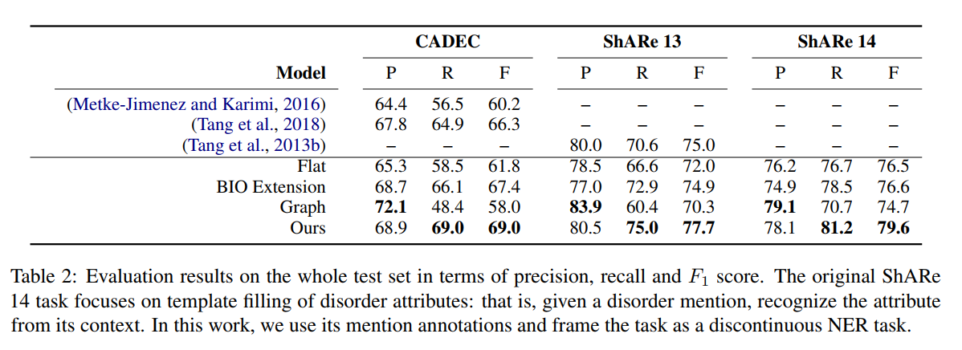

Slide 20
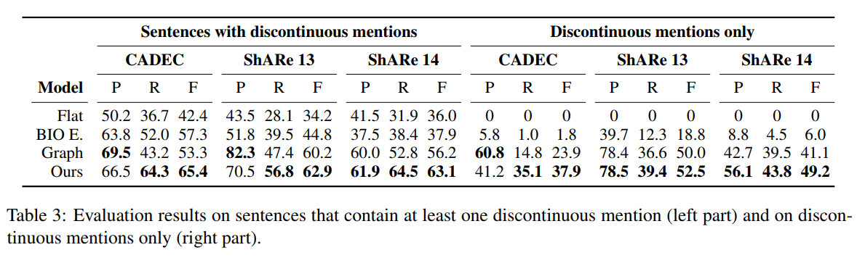

Slide 21
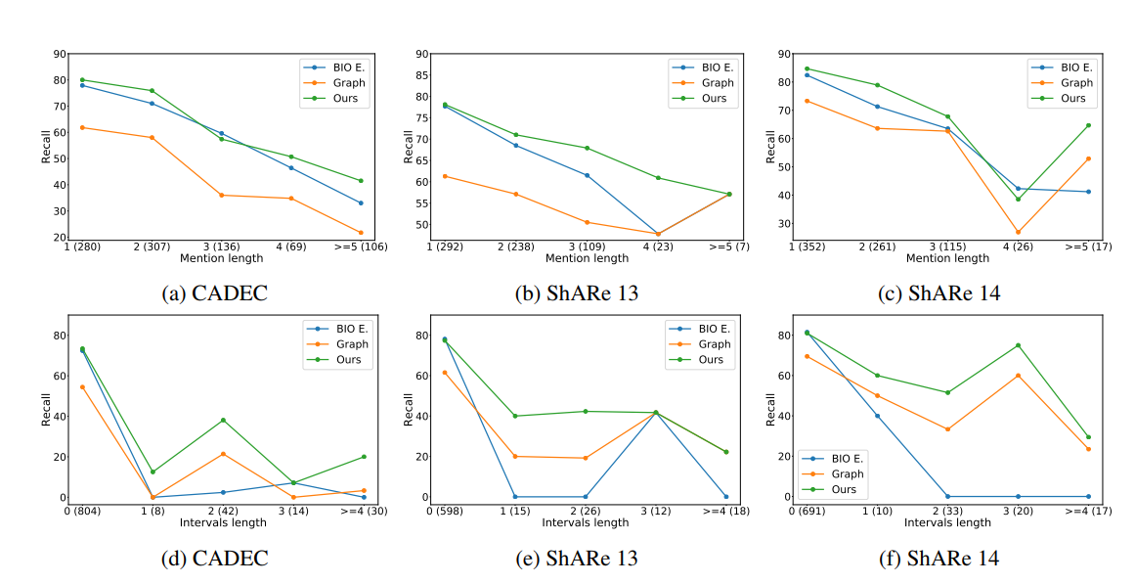
4.2 Analysis
Imapct of Overlapping Structure
Imapct of Mention and Interval Length

Slide 22
Thank you!

