Slide 1




Attack Workshop 05-06-19
Tithnara Nicolas SUN
Philippe Dhaussy (Lab-STICC)
Lionel Van Aertryck (DGA-MI)
Ciprian Teodorov (Lab-STICC)

Slide 2



Table of contents
Introduction
Context
Research questions
Approach
Target System Modeling
Requirements
PimCA/Openflexo
Top 20
Conclusion

Slide 3
Introduction Context
Executable attack modeling on industrial control systems
Some characteristics :
Cyber-physical interfaces
Dynamical systems
Semantic heterogeneity
Large number of specification and implementation languages
Large number of execution platforms
Attack modeling
Attack trees, DAGs, graphs
Embedded attack strategies (embedded malicious code)
Either very abstract -> decoupled from the technical domain
Or very concrete -> coupled with the technical domain but low-level
Difficult to perform « execution-based » analysis

Slide 4
Introduction Research questions
How to capture an abstract operational semantics of the targeted system and compose it with executable attack modeling ?
How to steer the focus towards architecture independent attack modeling ?
How to capture the attack surface of the system-under attack (SUA) ?
How to handle the semantic heterogeneity in the targeted system.

Slide 5
Introduction Research questions
Opportunism – The modeling language should allow an opportunism-based iterative refinement approach. The user should be able to detail only the points of interest, and provide very abstract (generic) implementation for the other parts.
Cyber-separation – Ideally, the functional system model should be decoupled from the attack/defense actor modeling aspects. Which will enable focused reasoning both on the system aspects, and attack/defense models
Attack surface reification – The attack surface should be exposed explicitly to ease the specification of attack/defense strategies
Incomplete knowledge – The attack/defense actors act on the system having a limited knowledge. As opposed to specification languages which strive to provide an omniscient view on the system, attack discovery and modeling formalism should enable restricting the access to the « system model » to the attack surface.
Execution support -- The formalism should provide the mechanisms for representing the system dynamics, even in the presence of partial behavior specification.
Multi-level abstraction : mix abstraction levels
Semantic heterogeneity : mix different languages

Slide 6
Introduction Approach
Methodology based on the integration of two correlated processes :
Target system modeling process – TSM - (captures the « situation »)
Executable attack modeling process – EAM
The TSM process enables capturing the semantics of the SUA
The EAM process focuses on the specification of attack scenarios
The TSM and EAM link is established at the semantic level through the formal definition of attack surface operations (operations exposed from the TSM semantics).

Slide 7
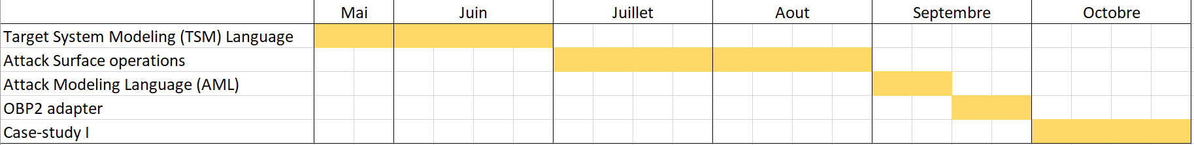
Introduction Approach
Target System Modeling Language [30/06/19]
Attack surface operations [1/09/19]
Attack modeling language [15/09/19]
OBP2 adapter, or hand-made simulator [30/09/19]
Case-study I - [30/10/19]

Slide 8
Target System Modeling Requirements
System modeling for cybersecurity purposes:
Based on PimCA
Step-by-step attack scenario execution
Along with cases study

Slide 9
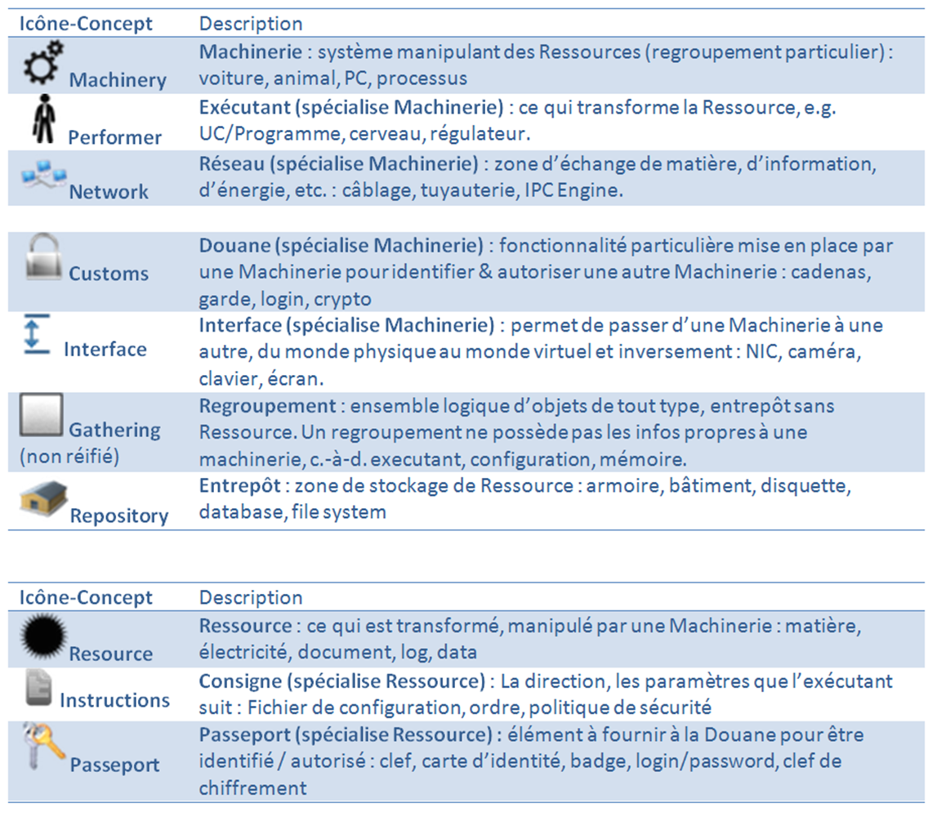
Target System Modeling PimCA/Openflexo

Slide 10
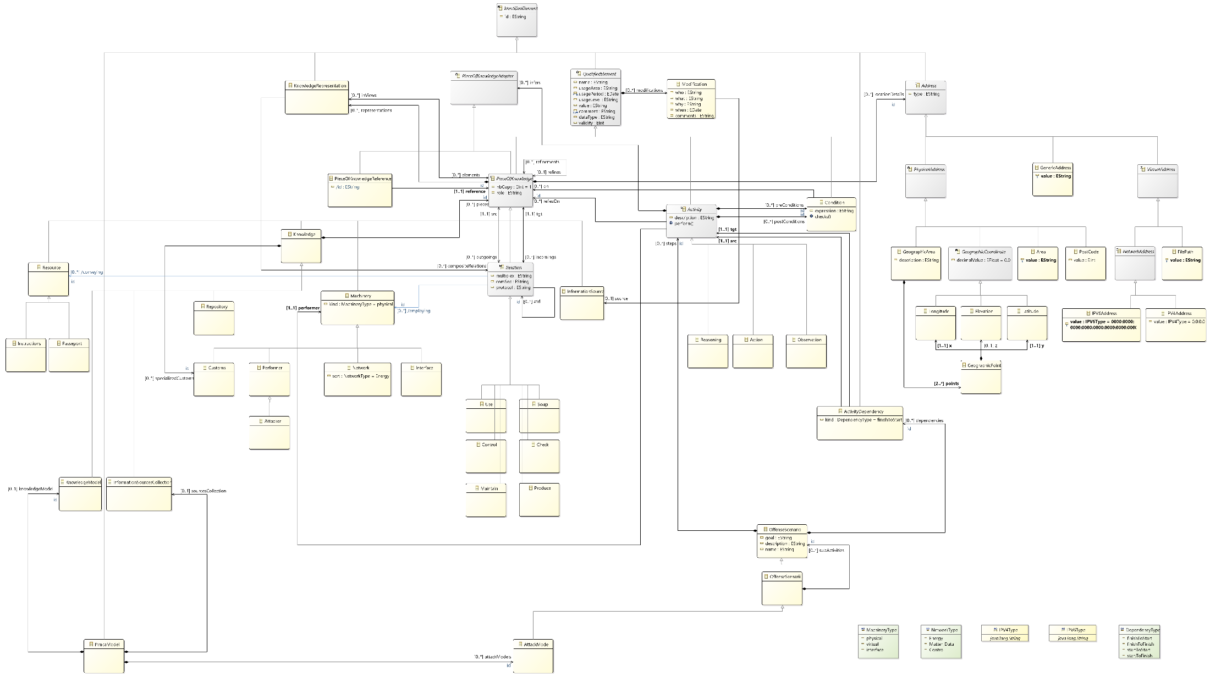
Target System Modeling PimCA/Openflexo

Slide 11
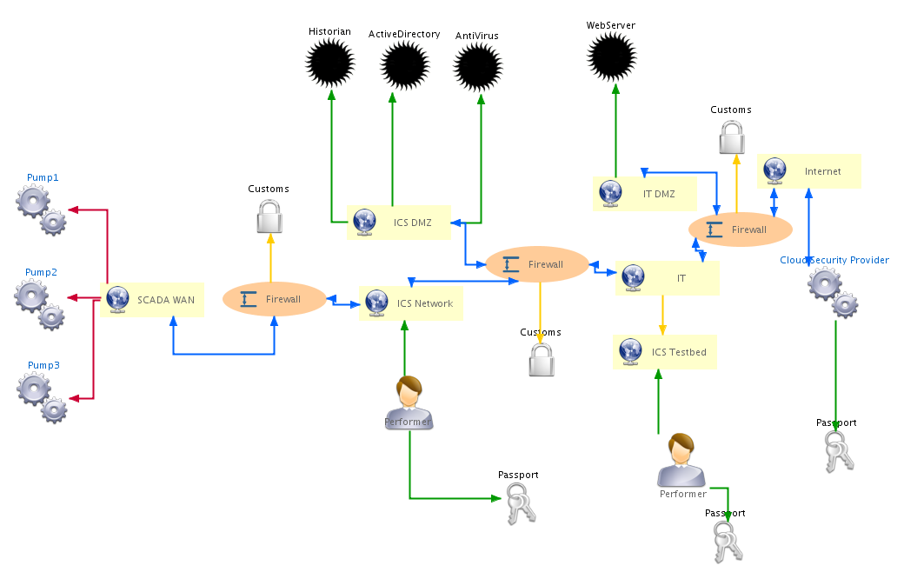
Target System Modeling PimCA/Openflexo

Slide 12
Target System Modeling Top 20
The Top 20 Cyber Attacks Against Industrial Control Systems, https://static.waterfall-security.com/Top-20-ICS-Attacks.pdf

Slide 13
Target System Modeling Top 20
The Top 20 Cyber Attacks Against Industrial Control Systems, https://static.waterfall-security.com/Top-20-ICS-Attacks.pdf

Slide 14
Target System Modeling Top 20
The Top 20 Cyber Attacks Against Industrial Control Systems, https://static.waterfall-security.com/Top-20-ICS-Attacks.pdf

Slide 15
Target System Modeling Top 20
The Top 20 Cyber Attacks Against Industrial Control Systems, https://static.waterfall-security.com/Top-20-ICS-Attacks.pdf

Slide 16
Target System Modeling Top 20
The Top 20 Cyber Attacks Against Industrial Control Systems, https://static.waterfall-security.com/Top-20-ICS-Attacks.pdf

Slide 17
Target System Modeling Top 20
The Top 20 Cyber Attacks Against Industrial Control Systems, https://static.waterfall-security.com/Top-20-ICS-Attacks.pdf

Slide 18
Target System Modeling Top 20
The Top 20 Cyber Attacks Against Industrial Control Systems, https://static.waterfall-security.com/Top-20-ICS-Attacks.pdf

Slide 19
Target System Modeling Top 20
The Top 20 Cyber Attacks Against Industrial Control Systems, https://static.waterfall-security.com/Top-20-ICS-Attacks.pdf
Première approche (à raffiner/faire évoluer)
Chaque type implique des guards/actions différentes

Slide 20
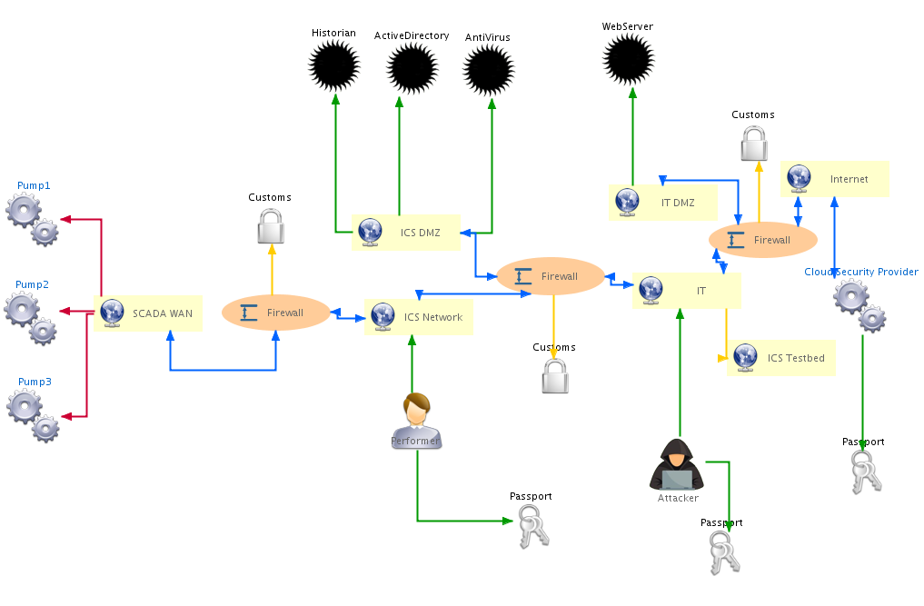
Target System Modeling IT Insider

Slide 21
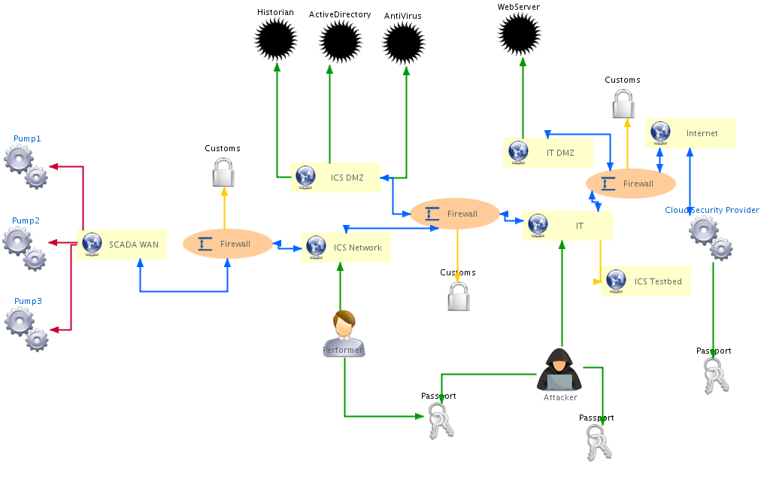
Target System Modeling IT Insider

Slide 22
Target System Modeling IT Insider

Slide 23
Target System Modeling IT Insider
X

Slide 24
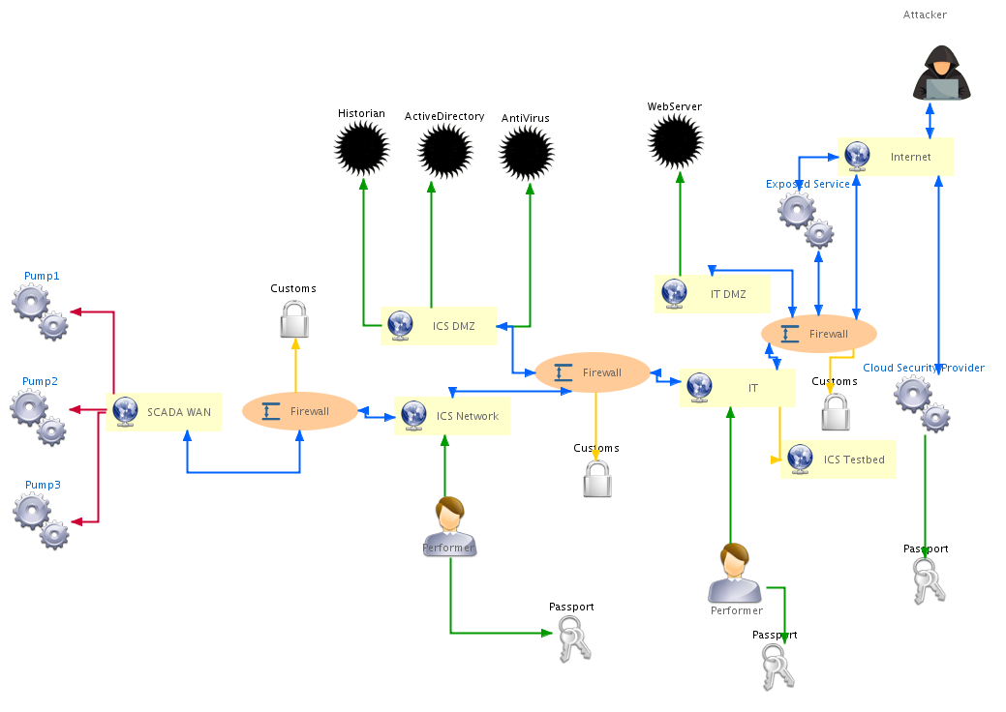
Target System Modeling Market Manipulation

Slide 25
Target System Modeling Market Manipulation

Slide 26
Target System Modeling Market Manipulation

Slide 27

Target System Modeling Market Manipulation

Slide 28
Target System Modeling Market Manipulation

Slide 29
Target System Modeling Market Manipulation

Slide 30
Target System Modeling Market Manipulation

Slide 31
Target System Modeling Market Manipulation

Slide 32
Target System Modeling Market Manipulation
X

Slide 33
Target System Modeling Market Manipulation
X

Slide 34

Target System Modeling Market Manipulation
X

Slide 35
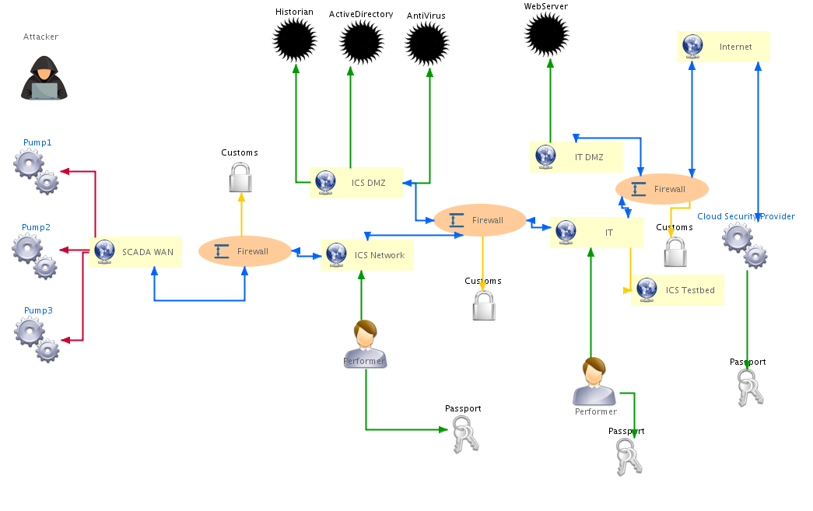
Target System Modeling Compromised Remote Site

Slide 36
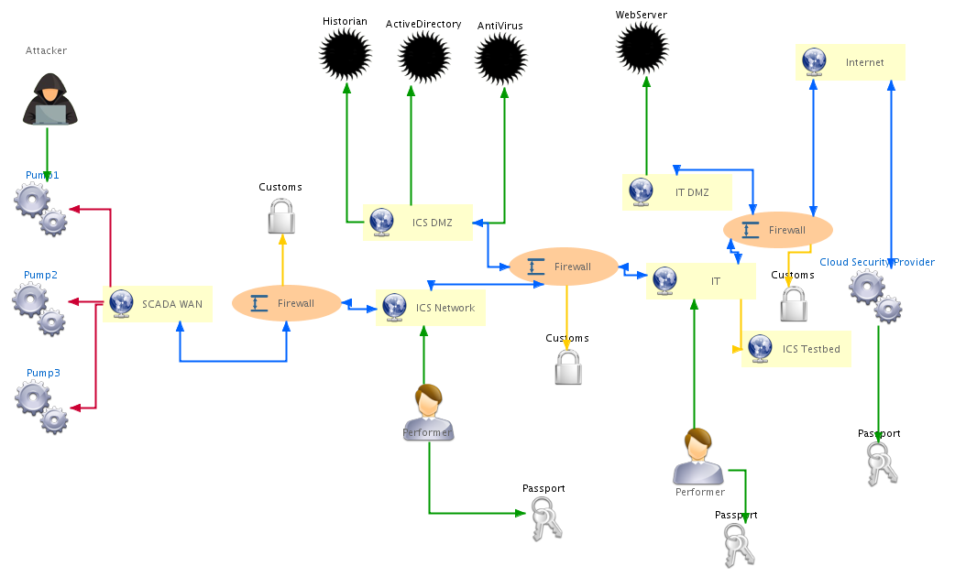
Target System Modeling Compromised Remote Site

Slide 37
Target System Modeling Compromised Remote Site

Slide 38
Target System Modeling Compromised Remote Site

Slide 39
Target System Modeling Compromised Remote Site

Slide 40
Target System Modeling Compromised Remote Site
X
X
X

Slide 41
Target System Modeling Stuxnet
W32.Stuxnet Dossier, https://nsarchive2.gwu.edu//NSAEBB/NSAEBB424/docs/Cyber-044.pdf

Slide 42
Conclusion
Attack types
Cases study

Slide 43
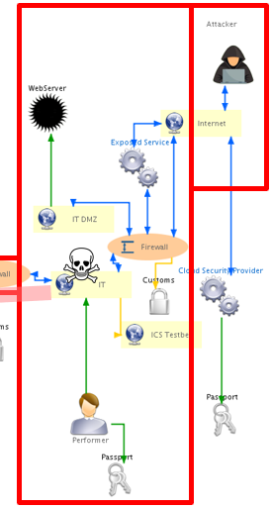
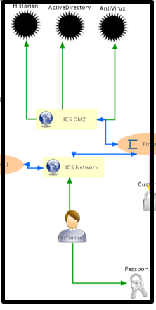
Conclusion
To-be-added features
Export feature
Delete feature

