Slide 1




Workshop 01/07/2019
Tithnara Nicolas SUN
Philippe Dhaussy (Lab-STICC)
Lionel Van Aertryck (DGA-MI)
Ciprian Teodorov (Lab-STICC)

Slide 2



Table of contents
Introduction
Context
Research questions
Approach
Target System Modeling
SCADA Systems Cybersecurity
Conclusion

Slide 3
Introduction Context
Executable attack modeling on industrial control systems
Some characteristics :
Cyber-physical interfaces
Dynamical systems
Semantic heterogeneity
Large number of specification and implementation languages
Large number of execution platforms
Attack modeling
Attack trees, DAGs, graphs
Embedded attack strategies (embedded malicious code)
Either very abstract -> decoupled from the technical domain
Or very concrete -> coupled with the technical domain but low-level
Difficult to perform « execution-based » analysis

Slide 4
Introduction Research questions
How to capture an abstract operational semantics of the targeted system and compose it with executable attack modeling ?
How to steer the focus towards architecture independent attack modeling ?
How to capture the attack surface of the system-under attack (SUA) ?
How to handle the semantic heterogeneity in the targeted system.

Slide 5
Introduction Research questions
Opportunism – The modeling language should allow an opportunism-based iterative refinement approach. The user should be able to detail only the points of interest, and provide very abstract (generic) implementation for the other parts.
Cyber-separation – Ideally, the functional system model should be decoupled from the attack/defense actor modeling aspects. Which will enable focused reasoning both on the system aspects, and attack/defense models
Attack surface reification – The attack surface should be exposed explicitly to ease the specification of attack/defense strategies
Incomplete knowledge – The attack/defense actors act on the system having a limited knowledge. As opposed to specification languages which strive to provide an omniscient view on the system, attack discovery and modeling formalism should enable restricting the access to the « system model » to the attack surface.
Execution support -- The formalism should provide the mechanisms for representing the system dynamics, even in the presence of partial behavior specification.
Multi-level abstraction : mix abstraction levels
Semantic heterogeneity : mix different languages

Slide 6
Introduction Approach
Methodology based on the integration of two correlated processes :
Target system modeling process – TSM - (captures the « situation »)
Executable attack modeling process – EAM
The TSM process enables capturing the semantics of the SUA
The EAM process focuses on the specification of attack scenarios
The TSM and EAM link is established at the semantic level through the formal definition of attack surface operations (operations exposed from the TSM semantics).

Slide 7
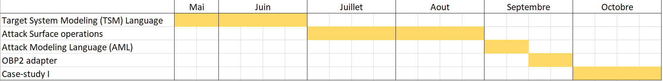
Introduction Approach
Target System Modeling Language [30/06/19]
Attack surface operations [1/09/19]
Attack modeling language [15/09/19]
OBP2 adapter, or hand-made simulator [30/09/19]
Case-study I - [30/10/19]

Slide 8
Target System Modeling Requirements
System modeling for cybersecurity purposes:
Based on PimCA
Step-by-step attack scenario execution
Along with cases study

Slide 9
Target System Modeling Progress

Slide 10
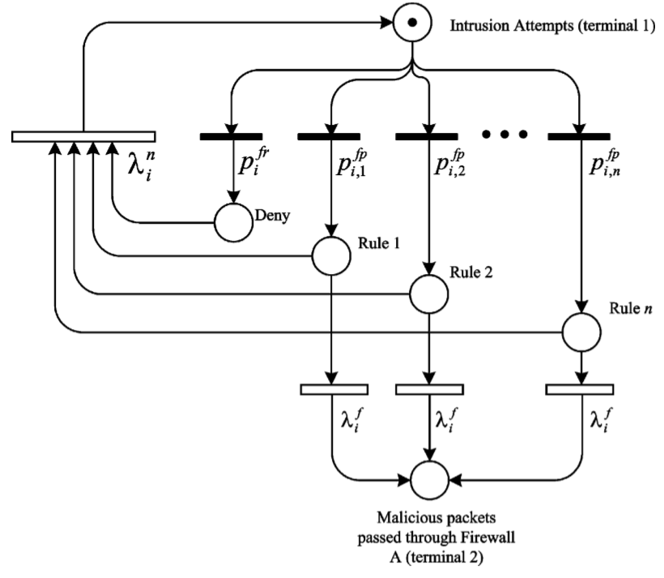
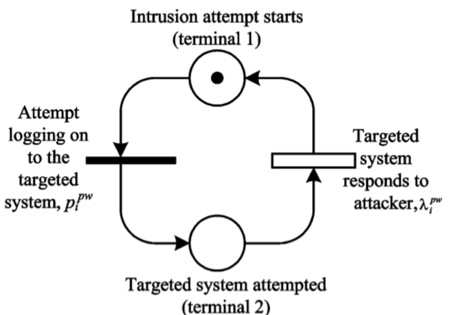
SCADA Systems Cybersecurity
Password
Firewall
"Vulnerability Assessment of Cybersecurity for SCADA Systems“ C. Ten, C. Liu and G. Manimaran : https://ieeexplore.ieee.org/stamp/stamp.jsp?tp=&arnumber=4652578&isnumber=4652575

Slide 11
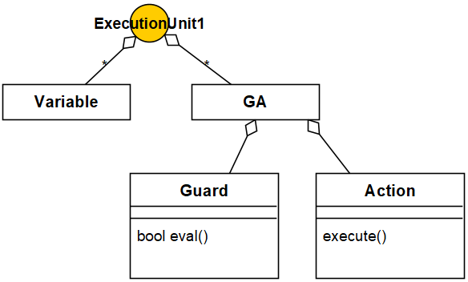
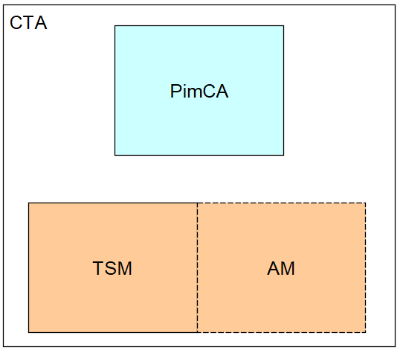
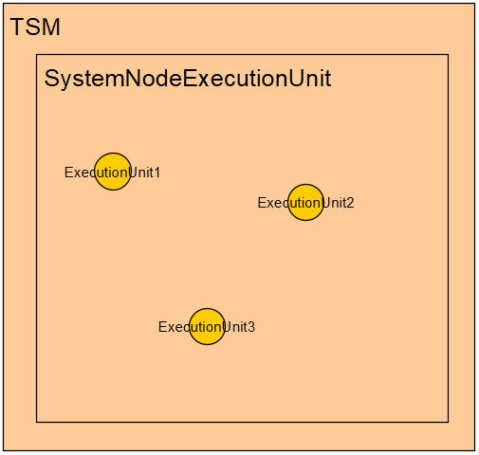
Conclusion
OpenFlexo
Guard\Action
ExecutionUnit

Slide 12
Conclusion
To do (short-term)
Objectives?
Attack scenario showcase
Market manipulation scenario/ Openflexo
To do (mid-term)
Objectives?
New attack scenario discovery
System nominal behavior
Market manipulation scenario/ Openflexo

Slide 13
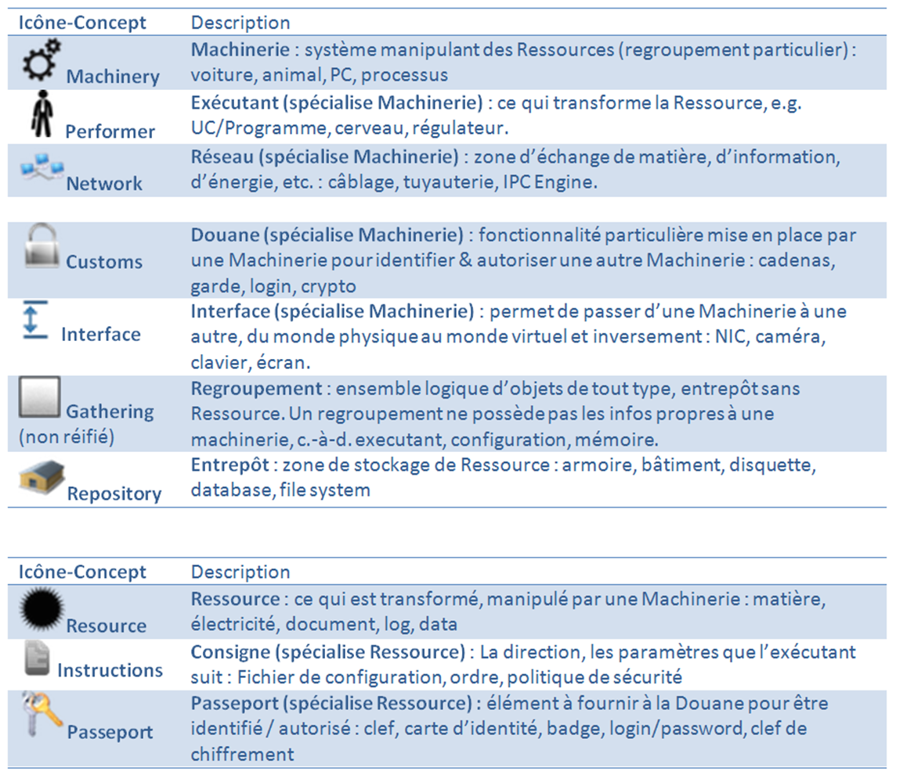
Target System Modeling PimCA/Openflexo

Slide 14
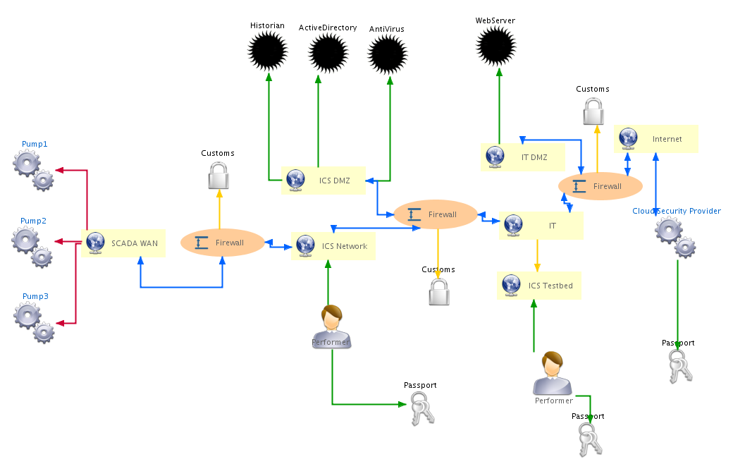
Target System Modeling Top 20
The Top 20 Cyber Attacks Against Industrial Control Systems, https://static.waterfall-security.com/Top-20-ICS-Attacks.pdf

Slide 15
Target System Modeling Top 20
The Top 20 Cyber Attacks Against Industrial Control Systems, https://static.waterfall-security.com/Top-20-ICS-Attacks.pdf
Première approche (à raffiner/faire évoluer)
Chaque type implique des guards/actions différentes

Slide 16
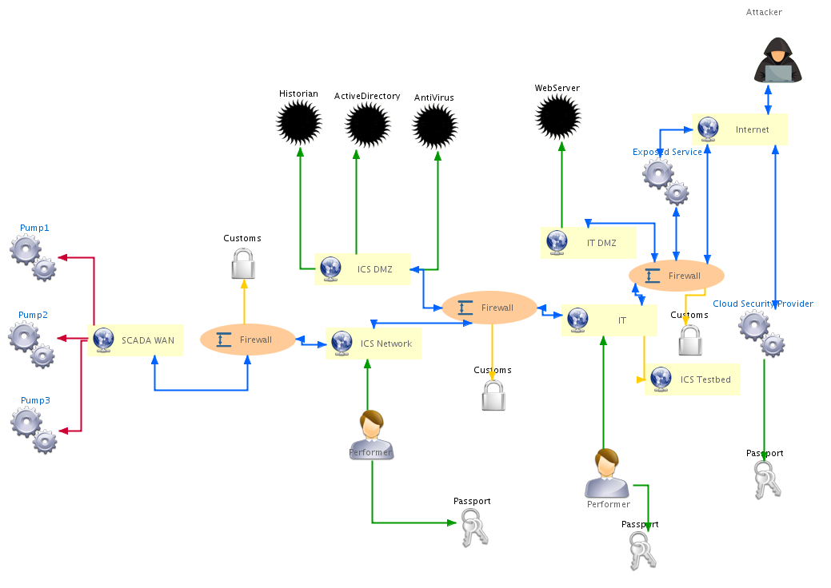
Target System Modeling Market Manipulation

Slide 17
Target System Modeling Market Manipulation

Slide 18
Target System Modeling Market Manipulation

Slide 19

Target System Modeling Market Manipulation

Slide 20
Target System Modeling Market Manipulation

Slide 21
Target System Modeling Market Manipulation

Slide 22
Target System Modeling Market Manipulation

Slide 23
Target System Modeling Market Manipulation

Slide 24
Target System Modeling Market Manipulation
X

Slide 25
Target System Modeling Market Manipulation
X

Slide 26

Target System Modeling Market Manipulation
X

