Slide 1






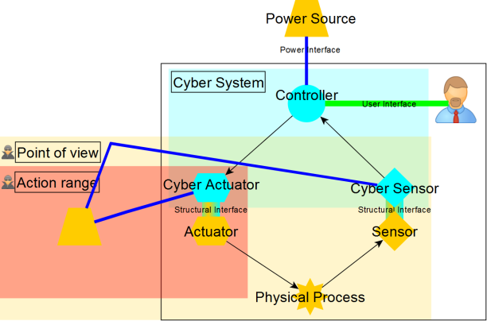
Dynamic System Modeling for Threat Analysis
Tithnara N. SUN, Ciprian TEODOROV, Joël CHAMPEAU & Philippe DHAUSSY
ENSTA Bretagne
Context
Threat-Driven Cyber Security
Approach
Dynamic Attack-Defense System Model
Attack Surface Reification
Dynamic Model
Implementation Simulation

