Slide 1
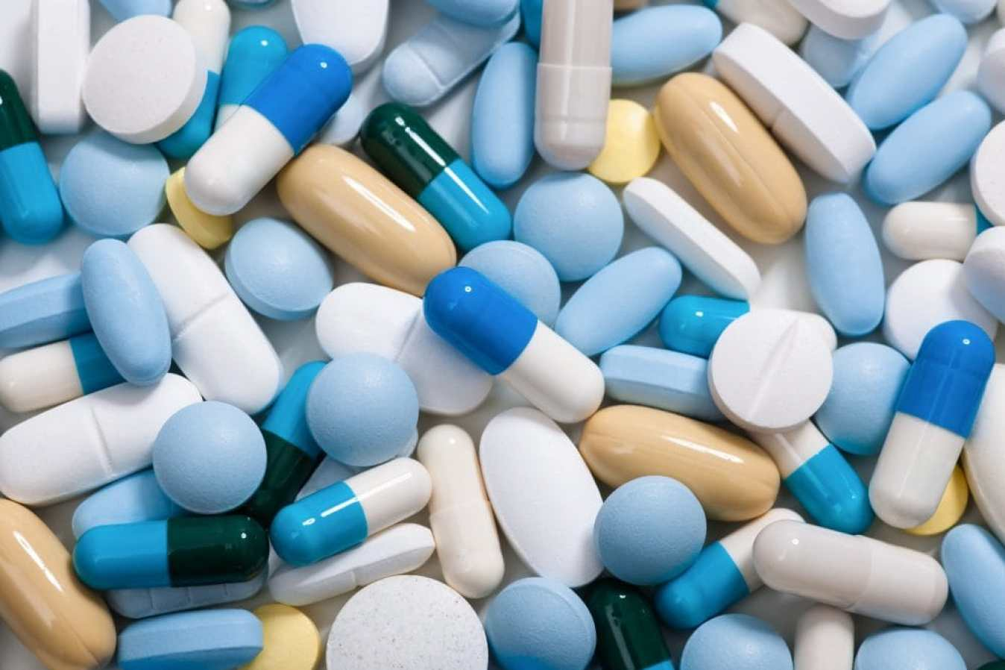
Analysis of Drug review data
IST 736 TEXT MINING
PROFESSOR YINGYA LI
TEAM MEMBERS:
HARSHITA ASNANI | LAXMAN KUMAR | HITESH THADHANI

Slide 2
About the data
This data contains the reviews of different Drugs which are prescribed for different condition. The data also consists rating for different combination of drug and condition along with the count of users who found the review useful.
We have total 1,60,000 reviews with 3436 different drugs and 885 different conditions.
Data Attributes
uniqueID - Unique ID
drugName - Name of drug
condition - Name of condition
reviewPatient – review text
rating - 10 star patient rating
date - Date of review entry
usefulCount - Number of users who found review useful

Slide 3
Data Cleaning Process
Rows with unstructured information were removed. In condition column, rows with “Not Listed” and some garbage html data were removed from the column
Unnecessary columns like Unique Id and index were dropped.
All the rows with drug count less than 2 were dropped.
All the rows with condition count less than 2 were dropped.
At the end review data were cleaned using regex.
Notes:
-> Some of the rows were having data without any relevance like.. In condition column the data was not properly structured.

Slide 4
Findings of Exploratory and Explanatory Data Analysis
About 18% of reviews are of ‘Birth Control’ condition followed by ‘Depression’ and ‘Pain’ with 5% and 3% respectively.
Condition marked as ‘Others’ have the highest number of unique drugs count - 210. ‘Pain’ has the second highest number of alternative drugs available with count 183 followed by ‘Birth Control’ with count 155.
Data is left-skewed w.r.t to Rating column with more than 30% of the data have the ‘rating 10’ followed by ‘rating 9’ with more than 16% of the total reviews.
Dataset is balance w.r.t to month but slight left-skewed w.r.t to year. All the months contain approximately equal amount of reviews. But as the year increases the reviews also increases with highest peak in 2016 and again dropped in 2017.

Slide 5
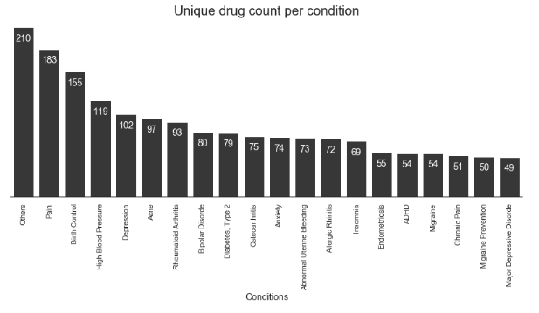
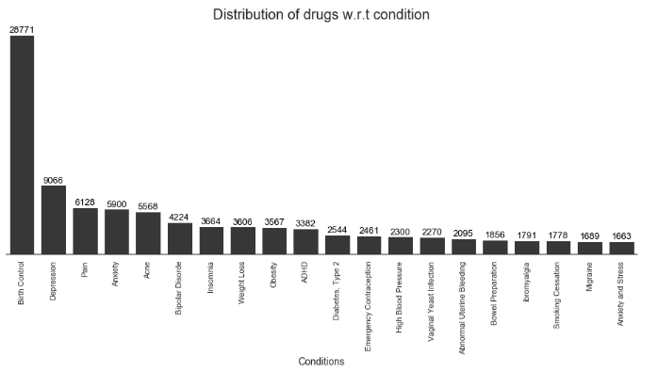
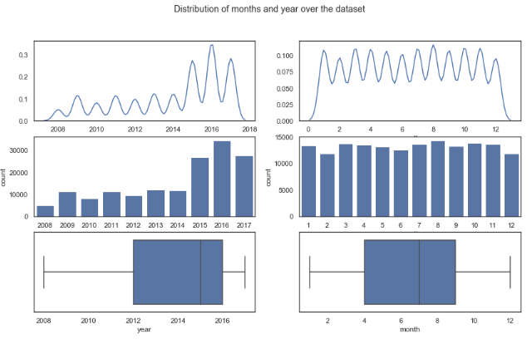

Slide 6
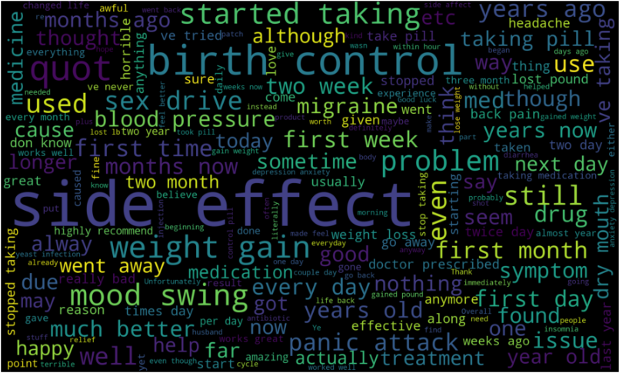
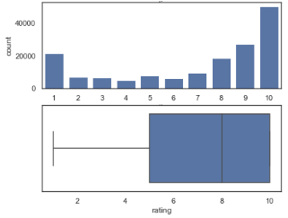
WORD CLOUD
Notes:
From the above wordcloud, we can notice that the word "Side Effect" is the largest followed by 'birth control' and 'started taking'. The word 'Side effect' is quite contradictory since we have more than 50% of reviews with 8 or greater than 8 rating (30% revies with 10 rating). Despite the data with higher number of positive rating, the word 'side effect' is the largest in the worcloud which means side effect has higher frequency than any other word. The word 'birth control' seems to be in proper place since birth control has about 18% of total reviews and third highest unique drug available. Words like 'started taking', 'mood swing', 'two week' are also relevant to the drugs reviews.

Slide 7
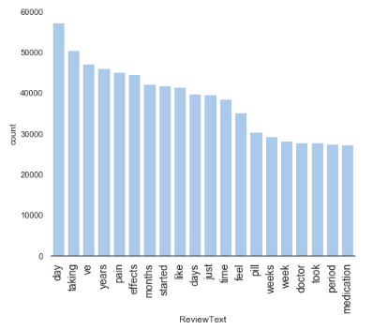
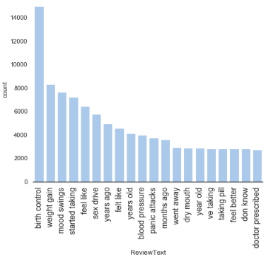
Findings from unigrams and bigrams

Slide 8

Problem Statement -1
While buying drugs from a store, it is difficult to decide and chose a drug that would be most effective for a given condition. Since there are hundreds of alternative drugs present for a condition
Generating a overall rating for a drug per condition will help consumers to choose a better drug
This will be our Regression problem.

Slide 9
Models
Model Name | NGramRange | Vectorizer | Accuracy
LinearSVC() | (1,1) | CountVectorizer | 54%
LinearSVC() | (1,2) | CountVectorizer | 67%
LinearSVC() | (1,3) | CountVectorizer | 68%
MultinomialNB() | (1,1) | CountVectorizer | 43%
MultinomialNB() | (1,2) | CountVectorizer | 50%
MultinomialNB() | (1,3) | CountVectorizer | 53%
BernoulliNB() | (1,1) | CountVectorizer | 42%
BernoulliNB() | (1,2) | CountVectorizer | 44%
BernoulliNB() | (1,3) | CountVectorizer | 39%
Neural Net | (1,3) | CountVectorizer | 66%
Notes:
I had prepared 5 models

Slide 10
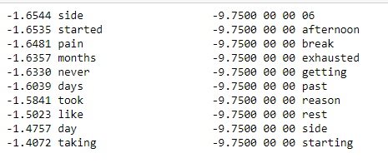
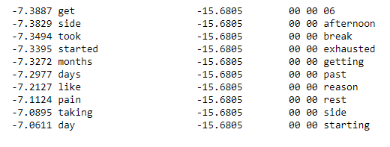
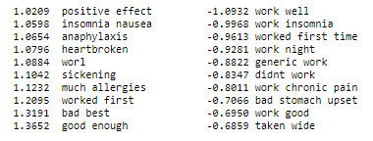
Comparing features of SVM Bernoulli NB and Multinomial Naïve Bayes
Bernoulli NB
Multinomial NB
Linear SVM

Slide 11
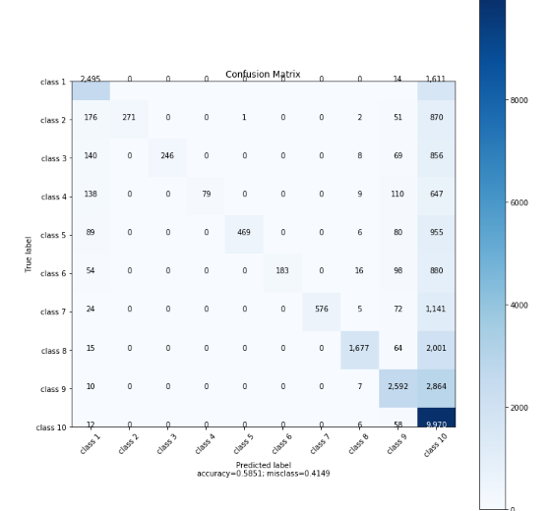
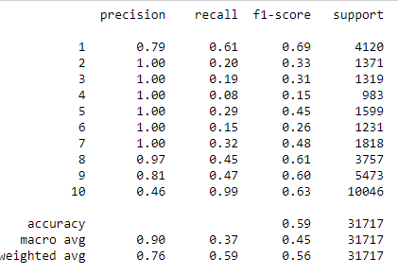
Evaluation of Linear SVM

Slide 12
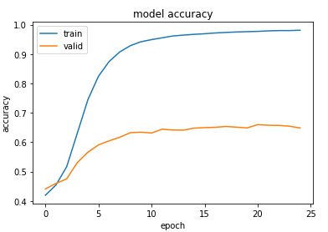
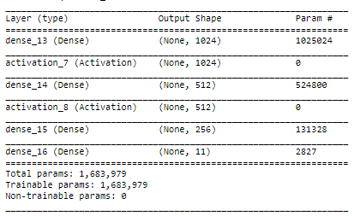
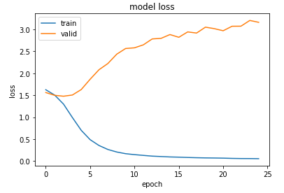
Neural Network

Slide 13
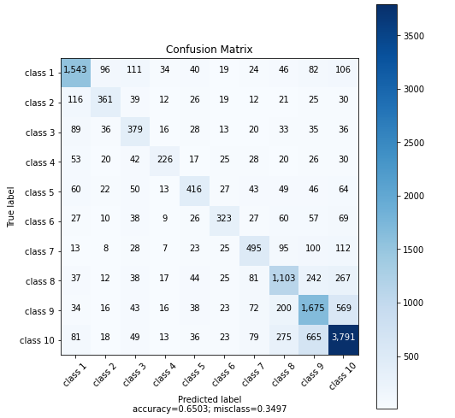
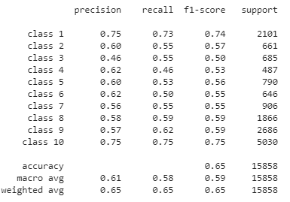
Evaluation of Neural Net

Slide 14
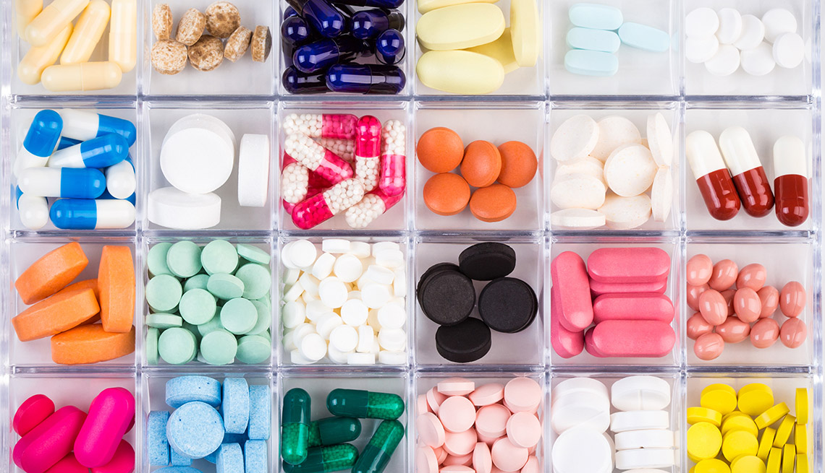
Problem Statement -2
Our second problem statement will be predicting the patient’s condition based on the reviews.
This will be our classification problem.

Slide 15
Patient’s Condition Prediction
For classification problem of predicting conditions based on reviews, we had a challenge of handling 885 unique conditions to be predicted for which we lower it to top 10 conditions.
A subset of dataset was created based on top 10 conditions along with their reviews.
We used both Hold out test where we kept ratio of 80 and 20% for training and testing. Cross validation was also used to evaluate the model.
We used CountVectorizer, TFIDF Vectorizer, Boolean, TF, TFIDF Inputs along with varying the Minimum document frequency with Ngrams range from Unigram to Trigram to find the best model based on the scores and what the model has learnt.
Stemmed the reviews to see the effect of it over normal usage which caused the increase in Vocabulary size but increased the accuracy of prediction by a small amount.

Slide 16
Algorithms and Parameters Used
For this task, we used Naïve Bayes including Multinomial and Bernoulli NB along with SVM and Random Forest.
For Naïve Bayes and SVM, used Count Vectorizer and TFIDF respectively, tuned the parameters to find best models with Minimum Document Frequency, Ngram Range using English Stop Words.
Cross Validation of 3,5 and 10 fold was performed to build more generalized model.
For SVM, the value of parameter C(penality) was also tuned to get best performing model.
Random Forest with the number of trees, tree depth was tuned with other parameters used in Naïve Bayes and SVM.

Slide 17
Results
Model | Input Given | Best Model Parameters | Hold Out Test | Cross Validation
MNB | TF(CountVectorizer) | Ngram_range=(1,2) Min_df=5 | 0.84 | 0.84(5 fold)
BNB | Boolean(CountVectorizer) | Ngram_range=(1,1) Min_df=5 | 0.83 | 0.80(10 fold)
SVM | Boolean, TF, TFIDF(CountVectorizer & TFIDF Vectorizer) | TFIDF Vectorizer Ngram_range=(1,3) Min_df=5 C=0.2 | 0.85 | 0.85(5 fold)
Random Forest | Boolean, TF, TFIDF | Boolean, 80 Trees, MaxDepth 10, Min_df=20, Ngram_range=(1,2) | 0.42 | 0.40(3 fold)

Slide 18
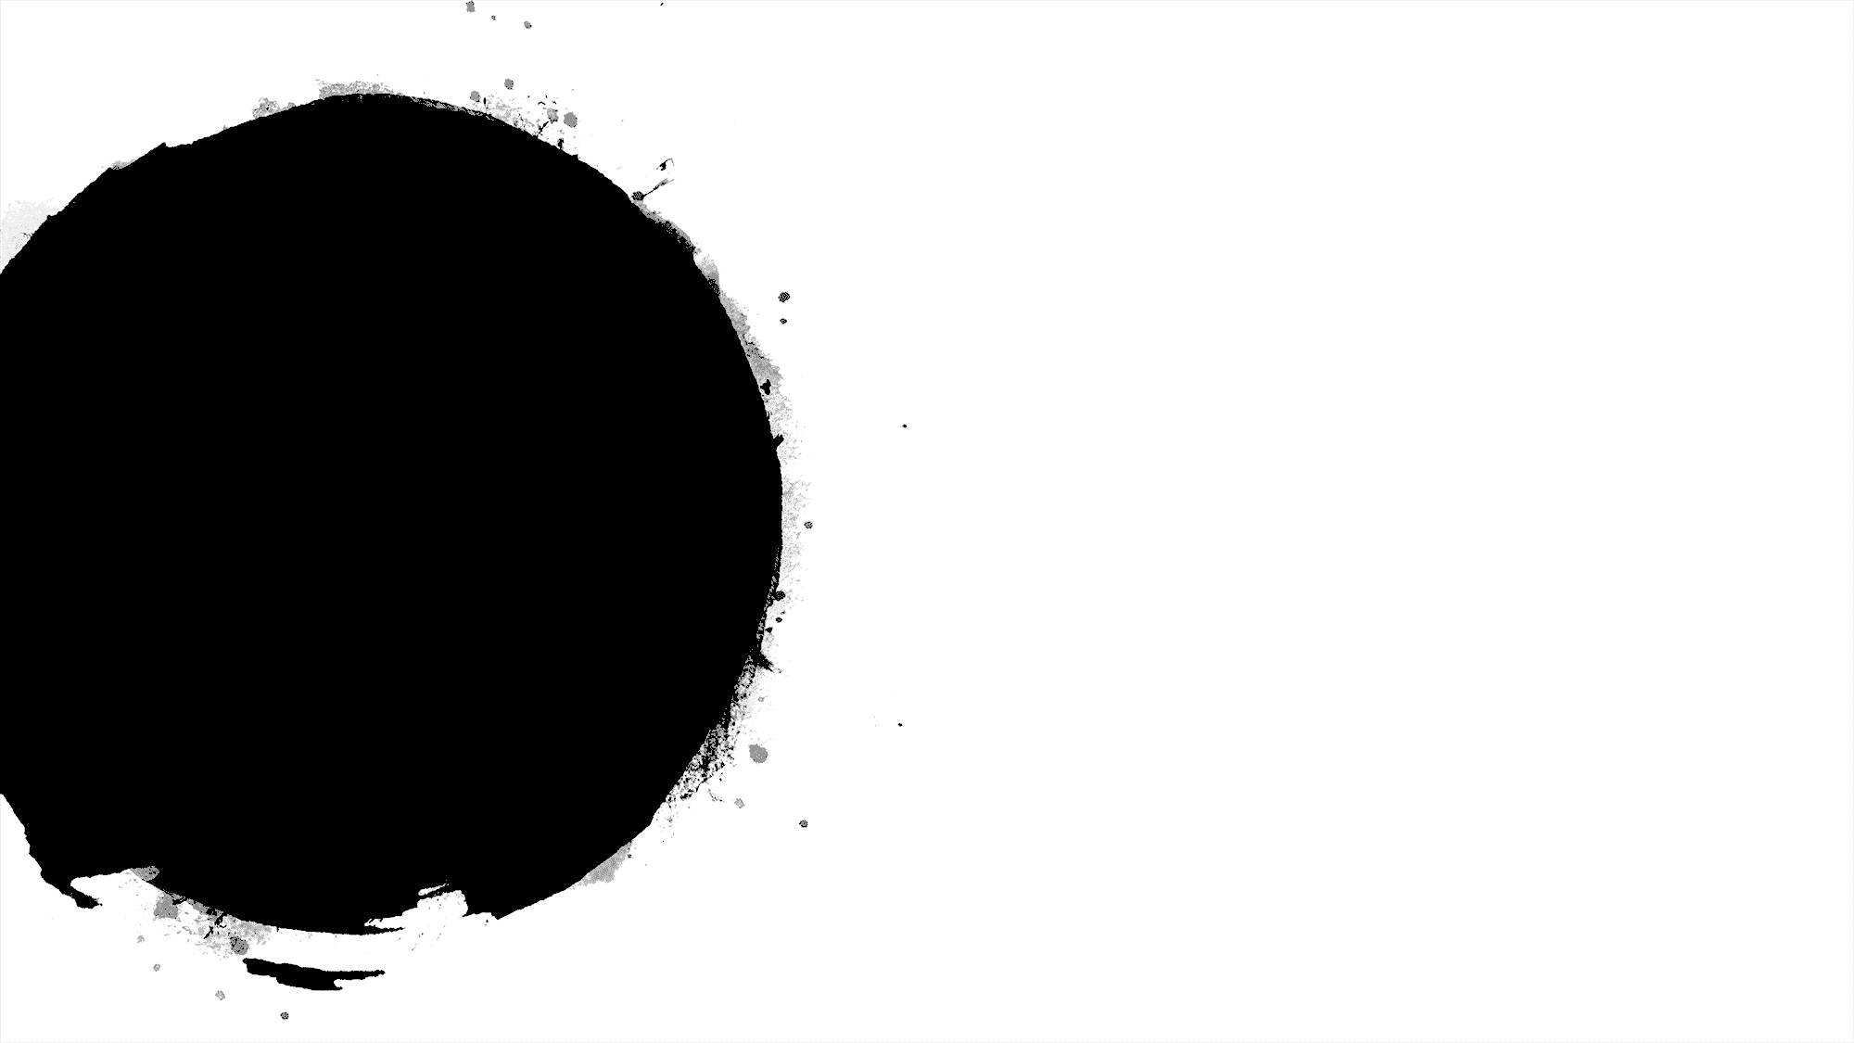
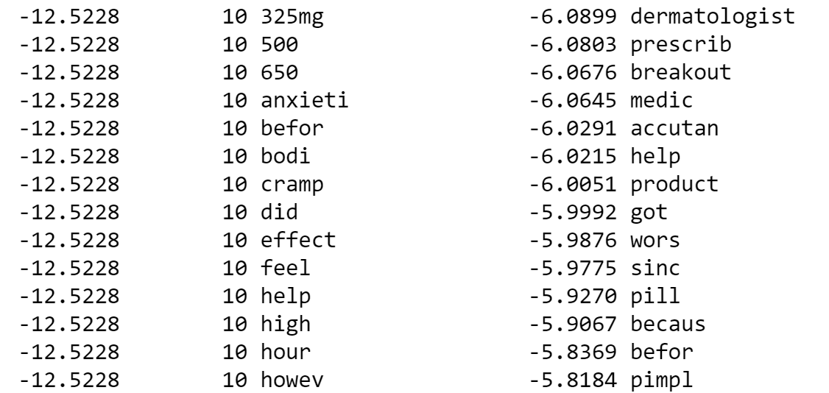
Features Learnt by the models
For Multinomial NB, the model learnt features for each of the condition being predicted. For Acne, the most important features were Dermatologist, pimpl, cream, cystic acn, skin, face, dri.
For Bernoulli NB, the model learnt features recommend, dermatologist, pimpl, prescribe, face, clear, skin using only Unigrams helped to figure out condition easily.
For SVM, using Boolean input gave meaningless words even though the accuracy was around 80%. The best performing model using TFIDF gave words product, cream, Epiduo, pimpl, lip, face, accutan, skin, dermatologist while using Unigrams & Bigrams CountVectorizer the features learnt were less useful not as effective as TFIDF Trigrams.
For SVM and MNB, Bigrams were more useful in predicting the condition based on the features learnt from the reviews.

Slide 19

Problem Statement -3
What elements of a review make it more helpful to others? Which patients tend to have more negative reviews? Can you determine if a review is positive, neutral, or negative?
This will be our sentimental analysis problem

Slide 20


Tokenization and preprocessing
Text Expansion - using pyContractions.
Minimum and Opinionated
Great for syntactic analysis
Builds syntax trees for tokenization thus, high execution time
Provides additional facilities like NER , Word Vectors .
Own set of stop words
Uses delimiters for tokenization, thus less execution time.
Great for training data which is not necessarily syntactically correct and noise free
Choice for this task:
ScikitLearn

Slide 21
Models and Vectorizing Method
Unigram Count Vectorizer
Unigram TfIDF Vectorizer
Model | MNB | BNB | SVC
Accuracy | 69.8 | 70.4 | 76.02
Model | MNB | SVC
Accuracy | 71.7 | 76.4
Model Choice : SVC
Vectorizer Choice : Tfidf

Slide 22
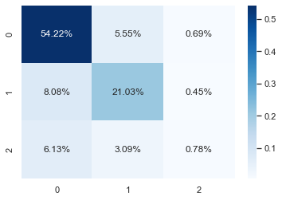

Effect of Stop Words and min doc frequency
Effect of Stop Words and min doc frequency
With stop words and min_df = 10
Without stop words and min_df=1
Accuracy: 76.02
Accuracy: 77.51

Slide 23
N-Gram Range
N-Gram Range
ngram_range = (1,2)
ngram_range = (1,3)
Accuracy: 80.7
Accuracy: 80.5

Slide 24
Bigrams and Trigrams
Bigrams and Trigrams
Trigrams
Bigrams
Accuracy : 79.3%
Accuracy : 76.39%

Slide 25
Best model
Best model
Best Regularization Parameter for LinearSVC = 1
 | Precision | Recall | F1-Score | Support
Negative | 0.84 | 0.86 | 0.85 | 9429
Neutral | 0.81 | 0.36 | 0.50 | 3188
Positive | 0.88 | 0.95 | 0.91 | 19283
Accuracy : 86.1%

Slide 26
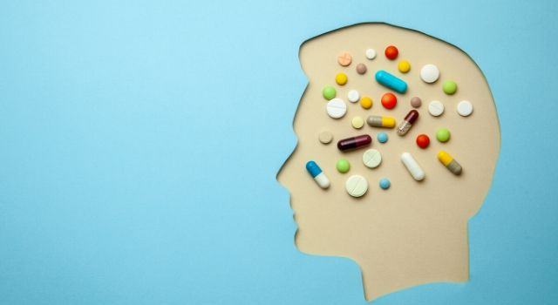
Thank you

