Slide 1
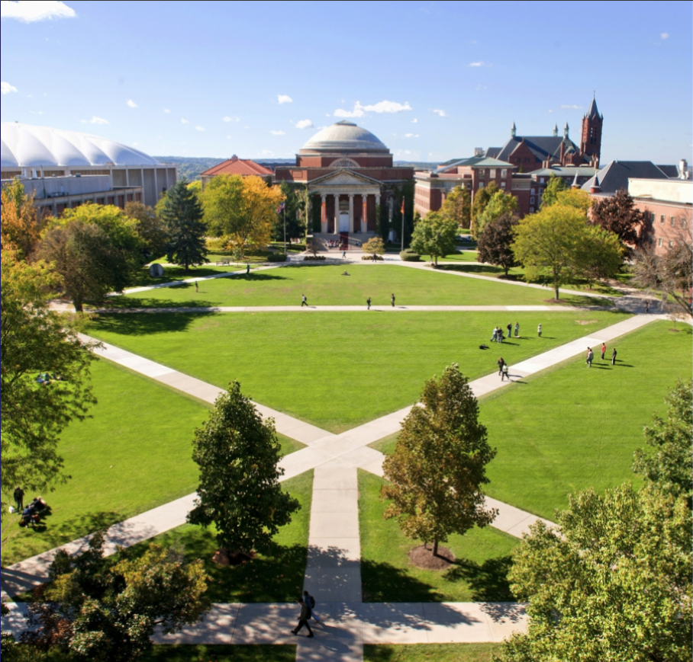

School of Information Studies
Master of Science in APPLIED DATA SCIENCE PORTFOLIO
Laxman Kumar
SUID : 419347153

Slide 2
ABOUT ME
Laxman Kumar
Undergraduate Degree: B.Tech in Computer Science and Engineering ‘19.
Masters Degree: MS in Applied Data Science
Skills: Data Analysis, Machine Learning, Deep Learning, Mobile Application Development
M

Slide 3
Program Overview
Master of Science in Applied Data Science
Fall 2019 – May 2021
Learning Outcome: Using data science skills to solve real world problem in different domains such as finance, education. Handling different types of data and preprocessing the data for modeling. How to use descriptive statistics to answer different business questions?
M

Slide 4
IST 687 INTRODUCTION TO DATA SCIENCE
Taught by :
Prof Jeff Saltz
Prof Erik Anderson
basics of R and descriptive statistics
different methods of sampling
concepts of data analysis process
data cleaning and exploratory data analysis
association rule mining and SVM
Scripting in R and R- Studio
School of Information Studies, Syracuse University

Slide 5
PROJECT TOPIC CUSTOMER CHURN IN THE AIRLINE INDUSTRY
PROBLEM STATEMENT : Reduce Southeast Airline’s customer churn by improving their Net Promoter Score (NPS)
DATASET : 10,282 Customer Surveys capturing Likelihood to Recommend score of each customer along with other customer and flight attributes 14 partner airlines
MODELS : Linear Model, SVM and Association Rule Mining
PROCESS: Data Cleaning -> EDA -> Preprocessing -> Modeling
RESULT
School of Information Studies, Syracuse University

Slide 6
IST 659 DATA ADMINISTRATION AND DATABASE MANAGEMENT
Taught by :
Prof Hernando Hoyos
Data modeling
Entity relationship diagram
Data normalization
SQL CRUD operations
Triggers and UDFs
MS Visio and MS Access
School of Information Studies, Syracuse University

Slide 7
PROJECT TOPIC MISSING PEOPLE DATABASE MANAGEMENT SYSTEM
PROBLEM STATEMENT : Building a database system for reporting and tracking missing people.
STEPS:
We defined the problem statement, project outline, functions and possible solution
After numerous transformation we finally built a normalized ER diagram
We created our database and all the necessary tables
Designed our forms and connected with the database in MS Access
We started entering the dummy data using forms
We created several functions and triggers and attached with the necessary operations
School of Information Studies, Syracuse University

Slide 8
IST 736 TEXT MINING
Taught by :
Prof Yingya Li
Preprocessing corpus
Tokenization, Vectorization, Lemmatization
Naïve Bayes, SVM
Human Annotation – Crowd Sourcing
Document Clustering
Topic Modeling
School of Information Studies, Syracuse University

Slide 9
PROJECT TOPIC SENTIMENTAL ANALYSIS OF DRUG REVIEWS DATA
PROBLEM STATEMENT : The purpose of the project described below was to predict ratings for drugs and sentimental analysis of reviews.
DATASET: Dataset consists of reviews of different drugs with their condition and a 10-start patient rating which reflects the overall efficiency of drug. Dataset contains more than 160k reviews.
MODELS: Prediction of Rating (Naïve Bayes, SVM, Deep Learning), Sentimental Analysis
RESULT
School of Information Studies, Syracuse University

Slide 10
CIS 700 Machine Learning for IoT devices
Taught by :
Prof Asif Salekin
Paper reading
Transfer learning
Few shot learning
Encoding and decoding
Preprocessing sensor based data
Different sensors used for human reading
School of Information Studies, Syracuse University

Slide 11
PROJECT TOPIC RESEARCH ON SPEED PREDICTION USING ACCELEROMETER DATA
PROBLEM STATEMENT : The goal was to research on predicting speed using accelerometer data.
DATASET: The dataset was collected at Syracuse University. The dataset contains the data from two accelerometer one tied at wrist and other at waist from 14 different people. The dataset was collected in a controlled environment. We recorded the data on treadmill from 0.5 miles/hr to 7 miles/hr with increment of 0.5 miles/hr.
MODELS: CNN, Transfer learning, Prototypical learning, Few-shot learning
RESULT: 96% Accuracy for a 14 class speed prediction problem.
School of Information Studies, Syracuse University

Slide 12
IST 718 BIG DATA ANALYTICS
Taught by :
Prof Willard Williamson
Probability, Statistics, Algebra
Spark and MapReduce
Spark Dataframe
Addressing model accuracy
Sentimental Analysis case study
Predicting Credit Score case study
School of Information Studies, Syracuse University

Slide 13
PROJECT TOPIC HOSPITAL READMISSION OF DIABTES PATIENTS
PROBLEM STATEMENT : The goal of the project is to predict if a diabetes patient is going to get readmitted after getting discharged.
DATASET: It is a patient level dataset with a total of 101,766 rows representing 101,766 patients along with 53 columns representing 53 different patient attributes for each patient.
MODELS: Logistics Regression, Decision Tree, Random Forest, Gradient Boosted Tree, SVM, Multi-Layer Perceptron
RESULT: For our hospital readmission dataset, Gradient boosting tree and Naïve Bayes performed best with an accuracy of 64 % and 62 %.
School of Information Studies, Syracuse University

Slide 14
CIS731 Artificial Neural Network
Taught by :
Prof Mohan
Fundamentals of neural network
Feedforward network
Backtracking
Optimization of a network
CNN
Transfer Learning
Image processing
LSTM and GRU
School of Information Studies, Syracuse University

Slide 15
PROJECT TOPIC FOOD DISH PREDICTION
PROBLEM STATEMENT: The goal of this project is to build a system that accepts an image of a food dish as input and can generate the possible name of the dish and if possible, its
ingredients.
DATASET: We used Food 101 dataset, contains 101,000 images belonging to 101 categories of food.
MODELS: ResNet101, DenseNet121, AlexNet, CNN
RESULT: We were able to achieve 95% accuracy for a 3-class problem, 80% accuracy for 5 class problem and 65% accuracy for 7 class problem.
School of Information Studies, Syracuse University

Slide 16
Other Courses Taken
Fall 2019
MBC 638 Data Analysis and Decision Making
Spring 2020
IST 718 Big Data Analytics
Fall 2020
FIN 654 Financial Analytics
IST 707 Data Analytics
Spring 2021
IST 652 Scripting for Data Analysis
IST 719 Information Visualization
M

Slide 17
THANK YOU

