Slide 1
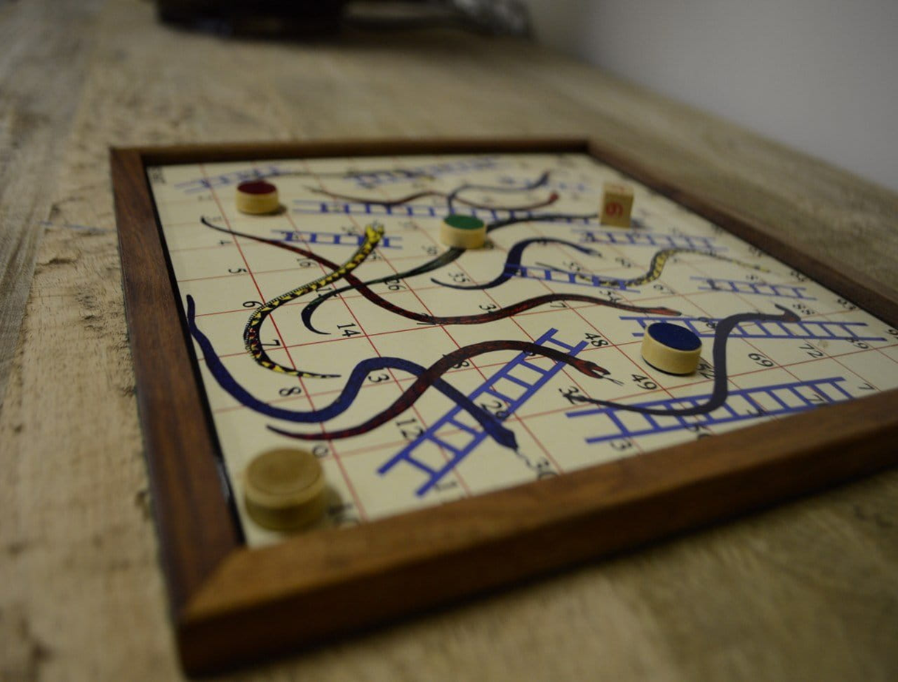
PARAMAPADHAM

Slide 2


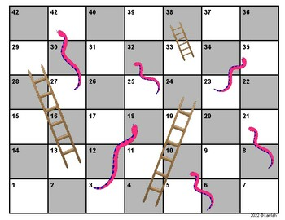



PAramapadham Algorithm -Mudapaka Sailaxman
For rolling the . I created a Function named “rolldie()” to generate random numbers from 1 to 6.
If player click <Enter> then Dice will roll.
Initialized player1 and player2 to ‘0’.
When ever the players rolls the dice the position will change by adding the value generated by the function to the current position of the player.
I’ve used ‘if’ Statement to check whether the player bitten by snake or climbed ladder.
If the player climbs ladder then “Hurray you’ve climbed ladder”.

Slide 3

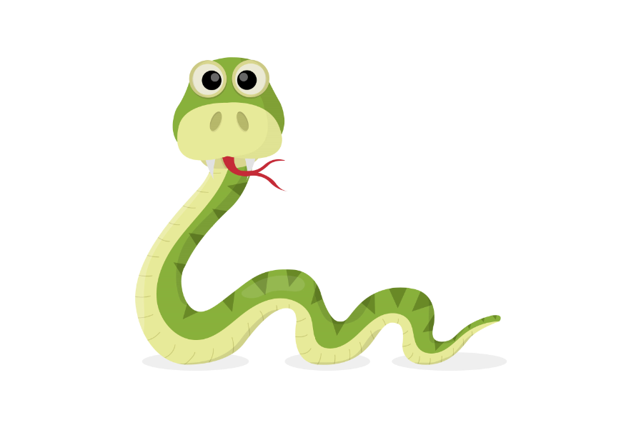




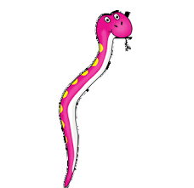

.
I’ve used ‘while’ Loop to repeat function calling until any one player win
If the player bitten by it “uff you’ve bitten by snake ”.
If any player reaches 25th position, the function will return 0 to exit game.

Slide 4

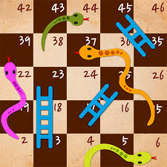
C CODE TO PLAY PARAMAPADHAM

Slide 5
THANK YOU

