Slide 1

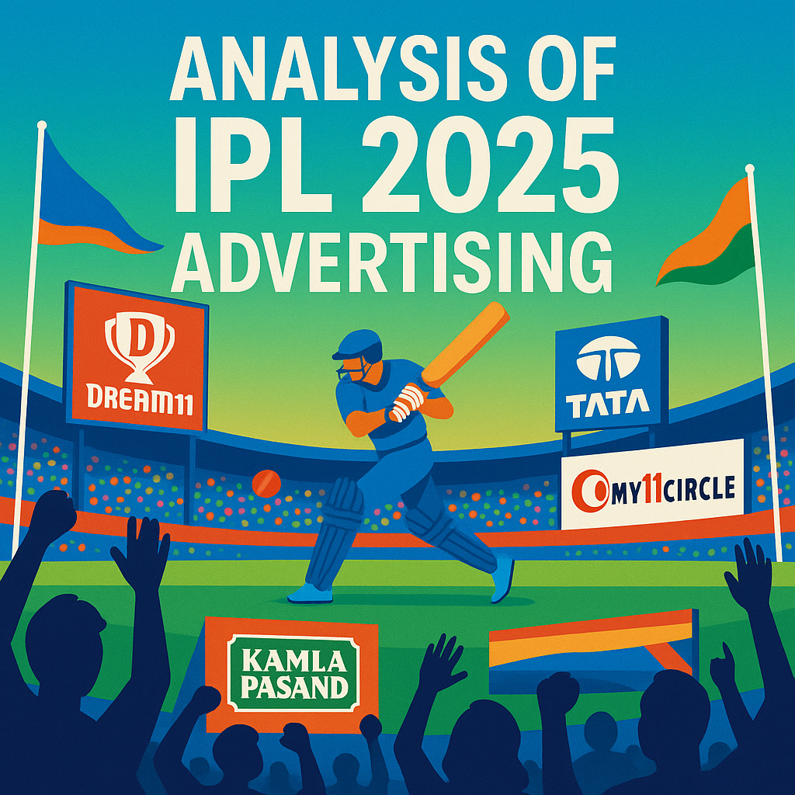
Notes:
Hi every one! I welcome you all to the analysis of IPL 2025 advertising. It is part of rpc 15th edition conducted by codebasics. Where I had to Provide insights to a business magazine by analysing the economic and social impact of the ipl. So lets delve into it.

Slide 2
PROBLEM STATEMENT
In response to rising negative sentiment around IPL 2025 advertising – over 50% of which is dominated by fantasy gaming and pan masala brands.
Business Basics, a leading business blogging company plans to release an edition focusing on the dual impact of IPL 2025: its massive economic footprint and its potential social/ health implications.
The magazine aims to provide a balanced analysis of IPL’ s commercial success versus it’s impact on public well-being.

Slide 3
PRIMARY ANALYSIS

Slide 4
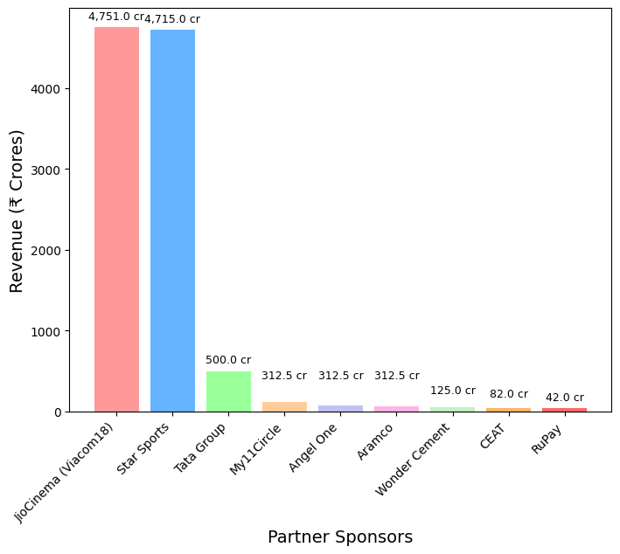
Revenue Contribution by Partner Sponsors' - 2025
Partner sponsor | Revenue Contribution (in cr.) | Revenue Contribution (in %)
Jio Cinema (Viacom18) | 4751.0 | 45.78
Star Sports | 4715.0 | 45.43
Tata Group | 500.0 | 4.82
My11Circle | 125.0 | 1.20
Angel One | 82.0 | 0.79
Aramco | 65.0 | 0.63
Wonder Cement | 50.0 | 0.48
CEAT | 48.0 | 0.46
Total revenue from central contracts in 2025 is 10,378 cr.
Major chunk of revenue about 91.21 % contributed by Viacom 18 and Star Sports.

Slide 5
Health / Social Risk Index for Advertisers
Advertiser Brand | Category | Risk index
Vishnu Packaging (Vimal Elaichi) | Pan Masala/Mouth Freshener | 10
Rajshree Silver Coated Elaichi | Pan Masala/Mouth Freshener | 10
Kamla Pasand | Pan Masala/Mouth Freshener | 10
Sporta Technologies (Dream11) | Fantasy Gaming / Betting | 9
PokerBaazi | Fantasy Gaming / Betting | 9
My11Circle | Fantasy Gaming / Betting | 9
Parle Biscuits | FMCG (Biscuits & Snacks) | 5
Reliance Consumer Products | FMCG / Beverages | 5
Britannia 50-50 | FMCG (Biscuits & Snacks) | 5
Amazon Prime | OTT/Entertainment | 1
Pan Masala and Fantasy Gaming brands topped the Social Risk Index.

Slide 6
Projected CAGR for FY2030
S. No. | company | Risk Index | FY22_revenue | FY24_revenue | Projected revenue FY30 | CAGR
1. | Kamla Pasand | 10 | 800.00 | 882.25 | 1182.0 | 5.0%
2. | Vimal Pan Masala | 10 | 1080.00 | 1328.00 | 2489.0 | 11.0%
3. | Rajshree | 10 | 560.00 | 617.50 | 827.0 | 5.0%
4. | Dream11 | 9 | 3841.00 | 5107.20 | 11750.0 | 15.0%
5. | My11Circle | 9 | 404.74 | 566.45 | 1521.0 | 18.0%
6. | PokerBaazi | 9 | 70.55 | 352.75 | 882.0 | 16.5%
The top five high risk brands are Kamla Pasand, Vimal, Rajshree, Dream 11 and My11Circle.

Slide 7
Total Population Negatively Affected by High-Risk Brands
S. No. | Company | Estimated Users (in millions) | Est. Neg. Impacted Users (in millions)
1. | Dream11 | 150.0 | 7.500
2. | PokerBaazi | 5.0 | 0.250
3. | My11Circle | 15.0 | 0.750
4. | Vimal Pan Masala | 8.4 | 2.352
5. | Kamla Pasand | 9.6 | 2.688
6. | Rajshree | 12.0 | 3.360
Estimated Total Users: 200 million
Estimated Total Population Negatively Impacted: 16 million (8% of Total Users)

Slide 8
Top 5 Celebrities Endorsing High Social Risk Brands in 2025
Rank | Brand Ambassadors | Brands | No. of Brands
1 | Ajay Devgan | Vimal Elaichi, Junglee Rummy | 2
2 | Shah Rukh Khan | Vimal Elaichi | 1
3 | Tiger Shroff | Vimal Elaichi | 1
4 | Shahid Kapoor | PokerBaazi | 1
5 | Shubman Gill and Sourav Ganguly | My11 circle | 1
The public backlash against Bollywood A-listers for pan masala ads places them at the center of this "high social risk" analysis.

Slide 9
SECONDARY ANALYSIS

Slide 10
Estimating Public Health Costs of Heavily Advertised IPL Products
 | Pan Masala Products | Fantasy Gaming/ Betting | Sugar Content Products
IPL viewership | 1,166 Mn | 1,166 Mn | 1,166 Mn
Ad impressions | 1,166 Mn * 10 Ad = 11B | 1,166 Mn * 12 Ad = 13B | 1,166 Mn * 15 Ad = 17B
Behavioural Change (rate of change per 100 ad impressions) | (11B/ 100) * 0.5% = 5,50,000 people | (13B/ 100) * 1% = 13,00,000 people | (17B/ 100) * 1.5% = 25,50,000 people
Serious Health outcome | 5,50,000 * 28% = 1,54,000 people | 13,00,000 * 5% = 65,000 people | 25,50,000 * 10% = 2,55,000 people
Cost Estimation | 1,54,000 * 1,50,000 = 2,310 crore/ year | 65,000 * 20,000 = 130 crore/ year | 2,55,000 * 25,000 = 637 crore/ year
Total estimated public health costs due to heavily advertised IPL products is 3,077 Crores/ year

Slide 11
Impact of Fantasy Sports and Betting Ads on Gambling Behavior
According to reports, fantasy sports and betting platforms now reach a staggering 300 million users across India.
According to the Indian Psychiatric Society, 20% of gamers in India show signs of addiction. i. e., 60 million.
30% (i.e., 90 million) of gamers spend over 20 hours per week playing, while 40% (i.e., 120 million) report feelings of loneliness and emotional distress.
Gambling among college students shows a prevalence rate of 19.5% (i. e., 58.5 million), with 7.4% (i. e., 22.2 million) meeting criteria for addiction.
Financial harm is severe, with cases reporting losses up to ₹1.25 lakh - leading to debt, family strain, and even suicide.

Slide 12
Benchmarking IPL Advertising Regulations Against Global Events
India (IPL): Lenient regulations with loopholes between fantasy sports and gambling; weak enforcement and rampant surrogate branding.
UK & EU: Strict controls – age-gating, addiction warnings, and limited celebrity endorsements.
USA: Fragmented regulation – fantasy sports widely accepted; betting regulated at the state level.
FIFA/UEFA/Olympics: Unified global code; direct betting ads are prohibited; aligns with host country laws.
Recommendations for IPL Regulators
Ban surrogate ads and ensure full disclosure of real-money gaming affiliations.
Enforce mandatory disclaimers, time-bound ad placements, and restrictions on celebrity promotions.
Adopt global best practices (UK ASA, FIFA) to safeguard youth and vulnerable audiences.

Slide 13
Seasonal Employment Generation by the IPL Advertising Ecosystem
Category | Data Point
Total Employment Generated | Over 1.2 million direct and indirect jobs created across India
Stadium & Operations Staff | Approx. 250,000 jobs (security, operations, on-ground logistics)
Advertising & Marketing Ecosystem | Approx. 350,000 jobs in merchandising, logistics, and marketing
Tourism & Hospitality Sector | Over 180,000 jobs created; 35% spike in seasonal hiring
Small Business & Startups | 75,000+ new jobs via startups leveraging IPL fanbase
Digital & Tech Sector | 65,000 professionals hired (developers, data analysts, AR/VR engineers)
Artisans & Craftspeople | 45,000+ jobs for traditional artists (pottery, weaving, merchandise decor)

Slide 14
IPL Advertising’s Contribution to Tax Revenue
The IPL’s 2025 advertising ecosystem is set to generate ₹6,000–7,000 crore across TV, digital, and sponsorships. With advertising taxed at 18% GST, this could contribute an estimated ₹1,080–1,260 crore to government revenue.
Tax Stream | Estimated Revenue (2025)
GST on Advertising | ₹1,080 – 1,260 crore
TDS from Player Salaries | ₹89.49 crore
Corporate Tax from BCCI | ₹0 (exemption)

Slide 15
EXPECTED OUTCOME

Slide 16
IPL Advertiser Balanced Scorecard
Partner Rating Categories
Elite
4.5 – 5.0
Premium
3.5 – 4.4
Standard
2.5 – 3.4
Developing
1.5 – 2.4
At-Risk
1.0 – 1.4
Total Score = (Financial * 35%) + (Social * 25%) + (Brand * 25%) + (Operational * 15%)
Key perspectives | Contribution | Components
Financial Performance | 35% | Revenue contribution, ROI & Efficiency, Payment Reliability and Long-term commitment
Social Responsibility | 25% | CSR Investment, Community Impact, Environmental Initiatives and Youth Development
Brand & Market Impact | 25% | Brand Recognition, Campaign Innovation, Audience Engagement and Market Growth
Operational Excellence | 15% | Partnership Quality, Content Compliance, Innovation Adoption and Crisis Management

Slide 17
Advertising Ethics Index (AEI)
Comprehensive KPI for Sports Event Advertising Ethics (0 – 100 scale)
AEI Framework – 7 Core Components | Points
Content Ethics & Standards 25pts Truthfulness, Cultural sensitivity, Age-appropriate content, Harmful product, Restrictions | Social Responsibility 20pts Community impact, Environmental consciousness, Social cause integration
Transparency & Disclosure 15pts Sponsorship clarity, Financial transparency, Data privacy | Industry Compliance 15pts Regulatory adherence, Self-regulation, Complaint resolution
Innovation & Best Practices 12pts Ethical innovation, Industry leadership, Continuous improvement | Stakeholder Relations 8pts Fan respect, Athlete welfare, Media relations
Industry Benchmarking
English Premier League | 75
NFL | 72
NBA | 71
IPL | 68
La Liga | 65
Formula 1 | 63
Improvement Areas
Social responsibility initiatives
Financial transparency gaps
Limited industry leadership
Crisis Management
5pts
Crisis response, Accountability mechanisms

Slide 18
IPL Framework for Maximizing Economic Benefits while Minimizing Social Impact
Economic Enhancement
Revenue Diversification: Year-round academies, esports, tourism packages, museums
Local Integration: Mandatory local sourcing, business incubation, apprenticeship programs
Infrastructure Investment: Shared fund for nationwide cricket infrastructure development
Social Impact Mitigation
Gambling Prevention: Strict advertising guidelines, addiction counselling, match-fixing oversight
Regional Inclusion: Talent quotas, satellite leagues, mentorship programs
Social Responsibility: Community investment mandates, sustainability standards, gender equality
Governance & Accountability
Transparency: Annual impact reports, independent monitoring committees
Stakeholder Engagement: Community consultation, regular feedback systems
Sustainability: Leadership succession planning, independent endowment funds
Outcome: Sustainable engine for economic development and positive social change in Indian cricket and society

Slide 19
Responsible Advertising Policy for IPL
Balancing Revenue Generation with Public Health
Restrictions & Controls
Complete Prohibitions: Tobacco, hard liquor, unregulated betting and unsafe health products
Controlled Categories: Beer/ Wine: only after 9PM with health warnings Fantasy Sports: 15% screen time for risk warnings Fast Food: Equal airtime for healthy alternatives Limited During family hours (6-9 PM)
Revenue Enhancement
Premium wellness Partnerships: Health brands, fitness, healthcare providers get priority
Dynamic Pricing: 15-20% premium for compliant brands
New Revenue Streams: IPL health certification programs Wellness tourism & fitness camps Educational content partnerships
Strategic Outcome: Pioneer in sports entertainment ethics while maintaining commercial viability through innovation, premium partnerships and long-term brand building aligned with societal values.

Slide 20
Social Impact Strategies for Player Endorsements
Create a Personal Values Filter System Develop a clear “values compass” reflecting your core beliefs (education, health, environment, equality). Use this as your primary screening tool to ensure authenticity and build genuine fan connections.
Conduct Deep Due Diligence on Brand Ethics Research ESG ratings, sustainability reports, labour practices and actual community impact over 3-5 years. Look for consistent action, not just recent PR campaigns to avoid greenwashing associations.
Negotiate Social Impact Requirements Include contract clauses mandating measurable outcomes (e.g., ’10% of budget for youth programs’) and ethical breach exit clauses. Ensure quarterly impact reporting requirements.
Co-design Purpose-Driven Campaigns Actively collaborate to create initiatives driving real change. Partner to build cricket academies, mental wellness programs or community development projects rather than just lending your image.
Establish Transparent Impact Tracking Set up systems to measure concrete outcomes and share results publicly through social media, interviews or annual reports. Build credibility and inspire other players to follow suit.

