Slide 1
Network Intrusion Detection System (NIDS)
Minor Project — MSc Cyber Security
Student: Laxman Raghoba Shet Narvenkar
Guide: <Your Guide Name>
Institute: NFSU

Slide 2
Problem Statement
Networks face scans, spoofing, and DoS attempts.
Perimeter controls alone may miss stealthy behavior.
Build a lightweight NIDS to detect common attacks in real time.

Slide 3
Objectives
Capture and analyze packets (Scapy)
Detect port scans, SYN floods, ARP/DNS spoofing, ICMP sweeps
Generate alerts (JSONL/CSV) and evaluate performance

Slide 4
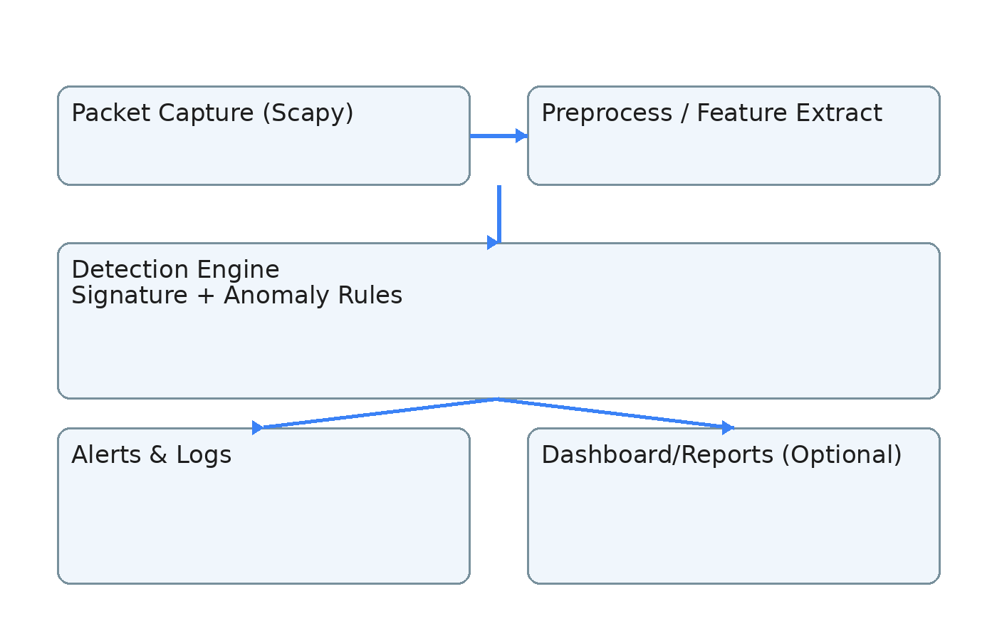
System Architecture

Slide 5
Detection Logic (High-level)
Port scan: many distinct destination ports per source within time window
SYN flood: high SYN rate with low ACK ratio
ARP spoof: multiple MACs observed for the same IP + gratuitous ARP bursts
DNS spoof: responses from unauthorized DNS servers + TTL anomalies
ICMP sweep: one source pings many targets quickly

Slide 6
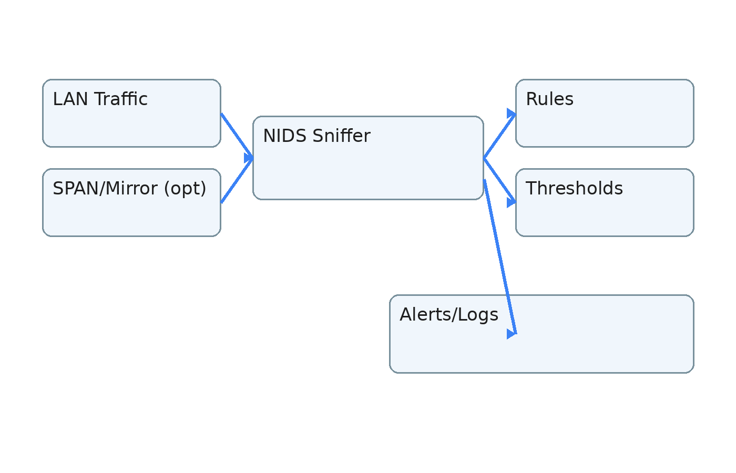
Data Flow

Slide 7
Lab Setup
Kali (attacker), Windows/Linux (victim), NIDS host
Promiscuous mode / SPAN if available
Tools: Nmap, hping3, arpspoof, Wireshark

Slide 8
Evaluation Metrics
True/False positives, false negatives
CPU/RAM usage & throughput
Alert latency

Slide 9
Conclusion & Future Work
Modular lightweight NIDS implemented in Python
Future: flow-based ML, TLS fingerprinting, SIEM integration, auto-blocking

