Slide 1
Flask and API

Slide 2
What is a Flask API?
API Stands for Application Programming Interface
Flask is a micro web framework written in Python. It is classified as a microframework because it does not require particular tools or libraries.

Slide 3
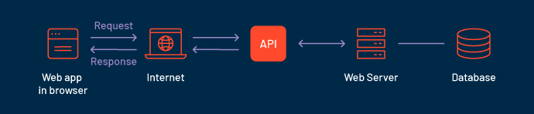
How does an API work?

Slide 4
What is entry point for an API?
URL’s (Uniform Resource Locator) is/are entry point for API
What is end point of an API?
The "endpoint" is an identifier that is used in determining what logical unit of your code should handle the request.

Slide 5
Difference Between Get and Post Method
Get | Post
In Case of Get request, only limited amount of data can be sent because the data is in the header | In post large amount of data can be sent because the data is sent in the body
Get request is not secured as the data get exposed in URL bar | Post is secured because the data is not exposed in the bar
Get request can be bookmarked | Post request cannot be bookmarked
Get request is idempotent, It means second request will be ignored until response of the first request is delivered | Post request is non - idempotent
Get request is more efficient and used more than post | Post is not as efficient as Get

Slide 6
What is RestAPI
Flask is based on RestAPI architecture which accepts json input and returns json output
JSON input and output can be easily handled by the front end developers
So it is advised to take input as json and return output as json

Slide 7
Flask interview question
You don’t need to prepare all of these question, but it is good if you could absorb few of the easy answers
https://www.softwaretestinghelp.com/flask-interview-questions-with-answers/

