Slide 1
Exploring venues in Hyderabad, India using Foursquare and Zomato API

Slide 2
1. Introduction
Whenever a person searches for a venue in a new city, they’re highly interested in the best places that the city has to offer. The person might want to know how good a given restaurant is or the price range it falls under. This extra information would help decide which venue to choose amongst the many venues in the city.

Slide 3
Data Collection
We will have a look at Hyderabad Map. As most of the people will be staying at places near by ameerpet.In this use case i will be concentrating on the places near by Ameerpet(17.4375° N, 78.4482° E) So that a lot people will be getting benefitted.
We will fetch data from 2 APIs:
FourSquare API : We will use the Foursquare API to fetch venues in Hyderabad starting from Ameerpet to 20Kms in each direction.
Zomato API : The Zomato API provides details about various venues including the address, ratings, average proce for two poeple etc..,

Slide 4
Methodology and EDA
Here we aim at identifying the venues in chandigarh based on their rating and average cost. This would enable any visitor to identify the venue he want to visit based on their and budget preference.
1) At first I retrieved the data from FourSquare and Zomato API's. Extracted venue information from Ameerpet upto a distance of 4Km . The lat and longitude values are used to fetch venue rating and price from Zomato.
2) I have explored the data retrieved from 2 API's on the MAP for identifying TOP category types. The data from 2 sources is combined based on the lat and lng values.Make sure that final dataset include ratings and price values for each venue.

Slide 5
3) Have analysed the data that have been created based on ratings and price of each venue. Also places where many venues are located so that visitor can go to one place where he will be having many choice of venues. Also explored places that are highly rated and low rated and plot them.
4) Finally we will cluster the venues based on available information of each venue. Which allows us to recommend the venues and their characteristics.

Slide 6
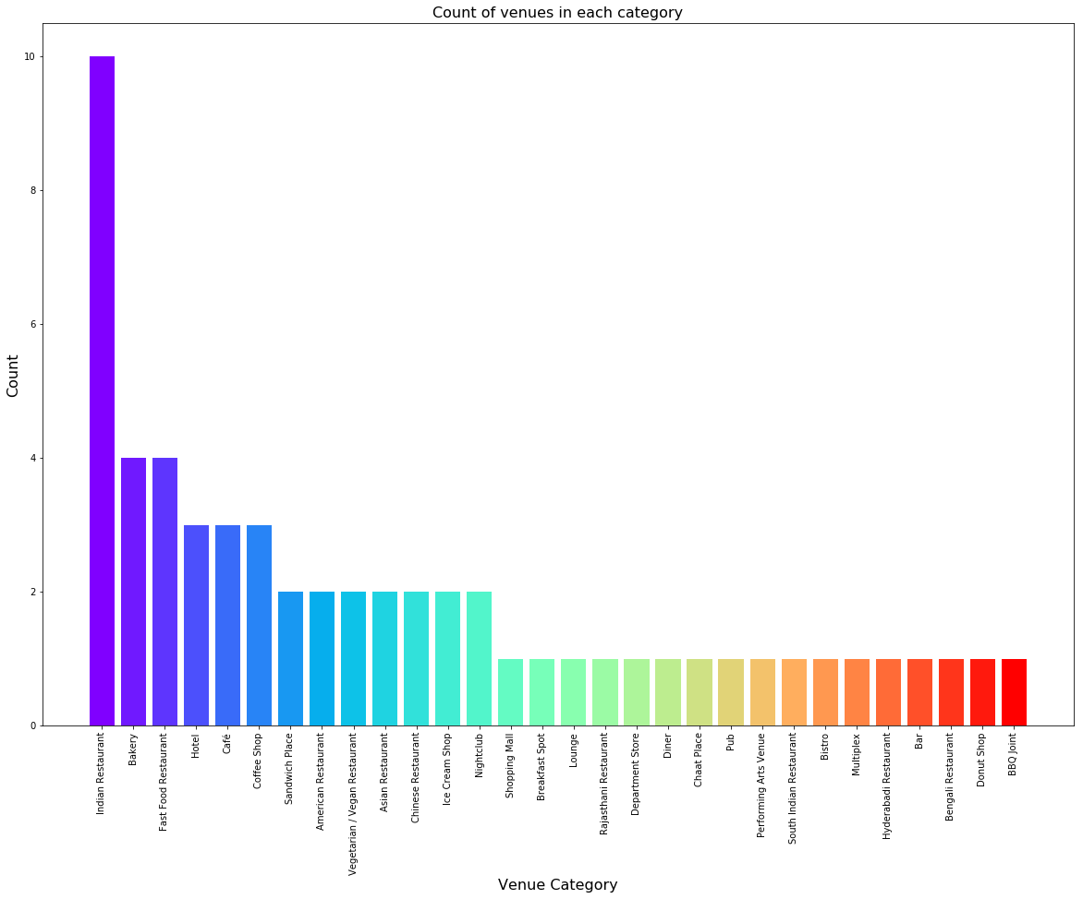
Based on Venue Category
From figure, we see that the majority venues are actually Indian Restaurants. This is closely followed by Bakery and Fast food Restaurants. For someone who is visiting Ameerpet and loves either Fast foods or Indian Restaurants, they’d surely love their stay.

Slide 7
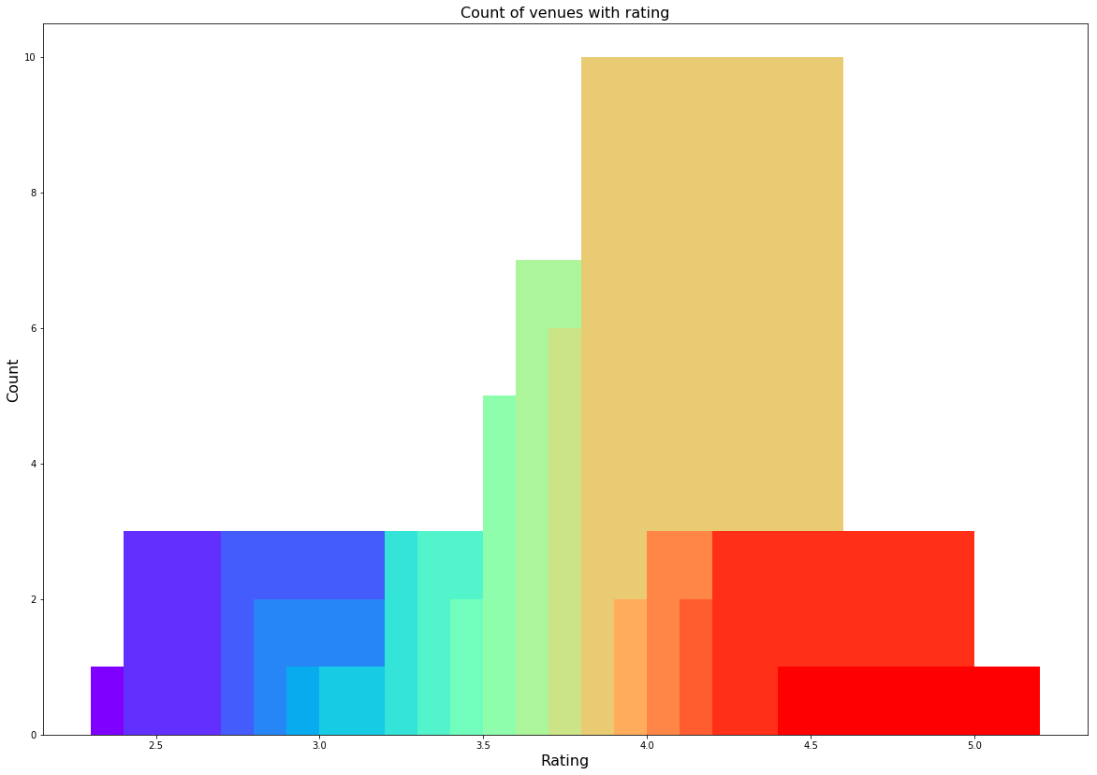
Based on Venue Ratings:
While the whole range of rating of venues might stretch from 1 to 5, the average rating is spread across 4 with maximum number of venues scoring between 3 and 5.

Slide 8
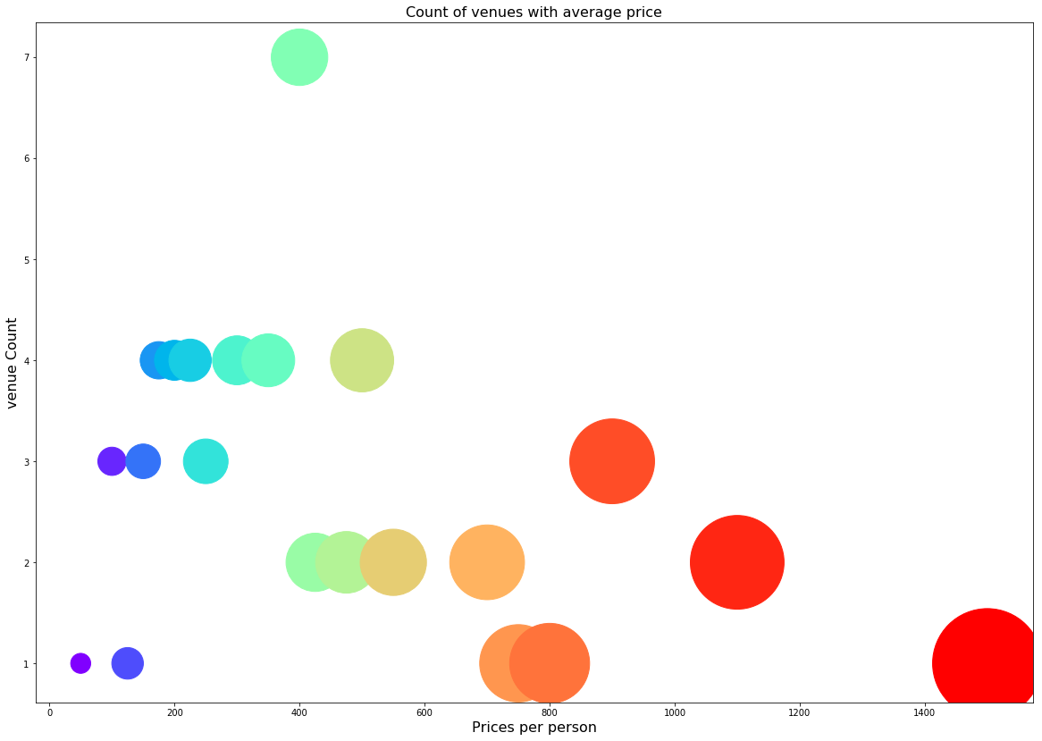
Based on Price Range
The majority venues have an average cost of Rs 200 to Rs 400 for one person. Even though the maximum venues lie in that range, the actual range of prices is very different. There are places with average price even as high as Rs 1400+ for one person.

Slide 9
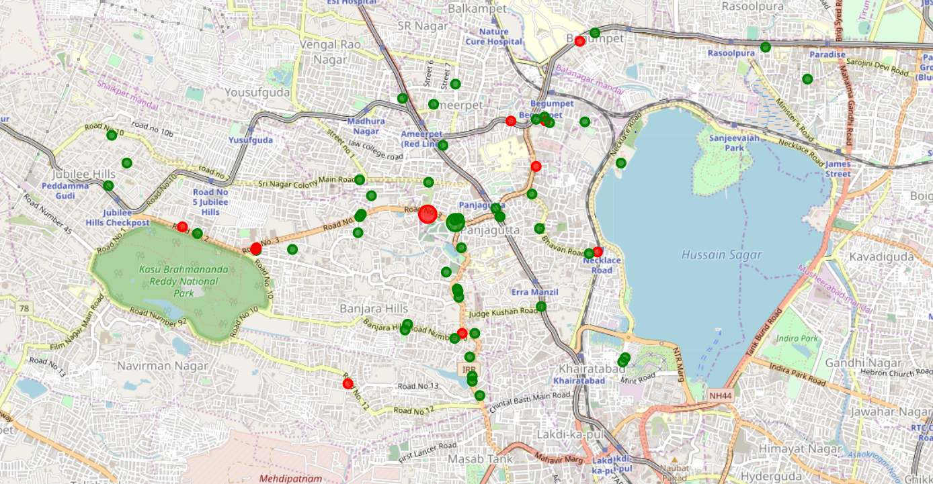
Clustering
We used KMeans clustering and decided to cluster the venues into two separate groups.
1. The first cluster (green) is spread across the whole city and includes the majority venues. These venues have mean price range of 1.71 and rating spread around 3.85.
2. The second cluster (red) is very sparsely spread and has very limited venues. These venues have mean price range of 3.3 and rating spread around 4.15.

Slide 10
Results
By analysing all the venues we observed that majority of venues are Indian Restaurants Fast food centers and Bakery A visitor who is searching for items fried fast food items like fried rice or noodles can get food easily and also we have many Indian Restaurants here.
The majority of venues are with rating of 4 which means that majority of restaurants are providing good quality of food. We also observed that there are cluster of venues in Road no.3 banjara hills, Begumpet, and Road no.1 Banjara hills near punjagutta with ratings which are Good.
Based on the price range there are many restaurants with average price range of 200-400 in the city. Also, the price range varies from 100 - 3000. on plotting the map of this venues we observed costlier venues in Begumpet, Necklace Road and Near Lv Prasad eye hospital Road no 3. Near punjagutta we can observe many restaurants with low prices.

Slide 11
Conclusion
The purpose of this project is to explore restaurants near Ameerpet for the people who are visiting Hyderabad. Also, to taste good food. The venues have been identified using Foursquare and Zomato API and have been plotted on the map. The map reveals that there are three major areas a person can visit: Road no.3 banjara hills, Begumpet, and Road no.1 Banjara hills near punjagutta.

