Slide 1
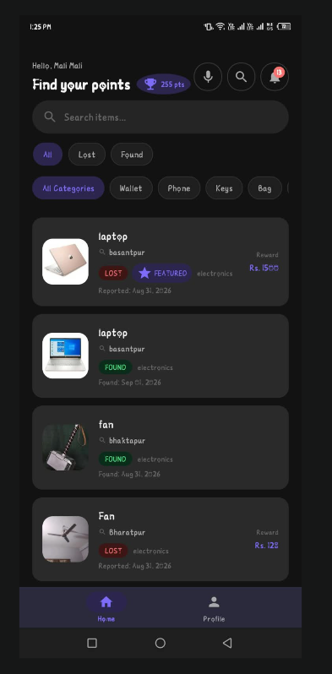
POKHARA UNIVERSITY • BCA 8TH SEMESTER PROJECT DEFENSE
FINDORA
Community-Driven Lost and Found Platform
A secure, verified digital ecosystem uniting item owners, honest finders, and platform administrators with secret question claim verification, real-time in-app chat, dual-confirmation return handshakes, and karma reputation incentives.
College: Oxford College of Engineering and Management, Gaidakot
Project Supervisors: Mr. Anil Thapaliya | Mr. Shiva Pathak
Submitted By: Laxman Rawat(22530204) , Bibek Kafle(225302 )

Slide 2
TOPIC 01 • PROBLEM STATEMENT
FINDORA • BCA 8TH SEMESTER DEFENSE
02 / 15
The Crisis of Lost Valuables & Broken Traditional Channels
❌ Fragmented & Chaotic Channels
• Buried Social Posts: Posts in Facebook or Viber groups are quickly buried by new feeds within minutes.
• Physical Desks Siloed: Lost items at university departments or reception desks remain isolated with no digital registry.
• No Search Mechanism: Victims cannot filter by category, date, or location, making recovery heavily dependent on luck.
⚠️ False Claims & Identity Fraud
• Zero Verification: Traditional methods allow anyone to falsely claim high-value items without ownership proof.
• Privacy Exposure: Owners and finders are forced to post personal phone numbers publicly, attracting spam and scams.
• Unverifiable Handover: No records exist to prove whether an item was successfully returned or stolen.
📉 Lack of Finder Motivation
• High Effort, Zero Reward: Finders spend personal time searching for owners with no social recognition or reward.
• Social Friction: Awkward cold calls and meeting strangers without an in-app secure coordination channel.
• Passive Neglect: Valuable items remain unreturned in drawers because finding the owner is too tedious.

Slide 3
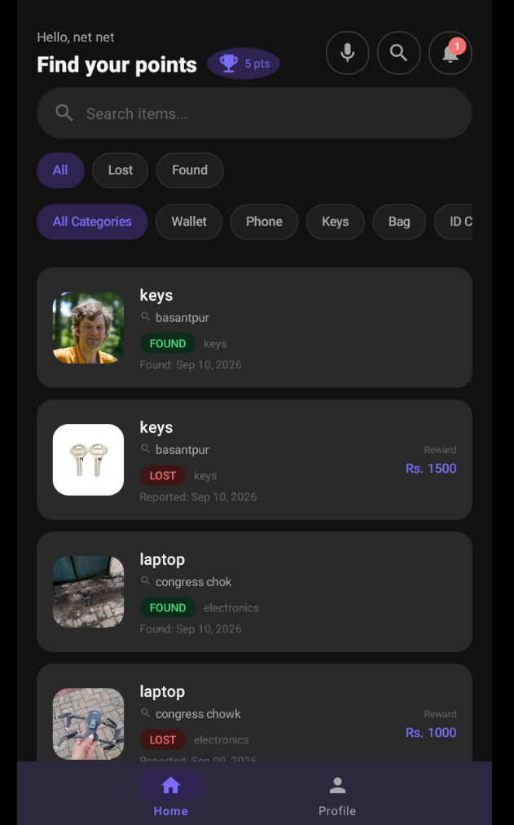
TOPIC 02 • PROPOSED SOLUTION
FINDORA • BCA 8TH SEMESTER DEFENSE
03 / 15
Findora: The Smart, Verified Lost & Found Platform
4 Core Solution Pillars
• 1. Centralized Digital Repository: Categorized feed with instant keyword search, category chips, status tags (LOST/FOUND), and GPS map pinning.
• 2. Secret Question Proof Verification: Finders configure a secret verification question (e.g. lockscreen wallpaper, serial digit) that only the authentic owner can answer.
• 3. Dual-Confirmation Handshake: Eliminates false recovery claims. Both Owner AND Finder must tap 'Confirm Return' in-app during physical handover.
• 4. Gamified Reputation System: Rewards honest finders with +50 Karma Points, 5-Star Ratings, and Tiered Badges (Good Samaritan, Top Finder, Trusted Finder).

Slide 4
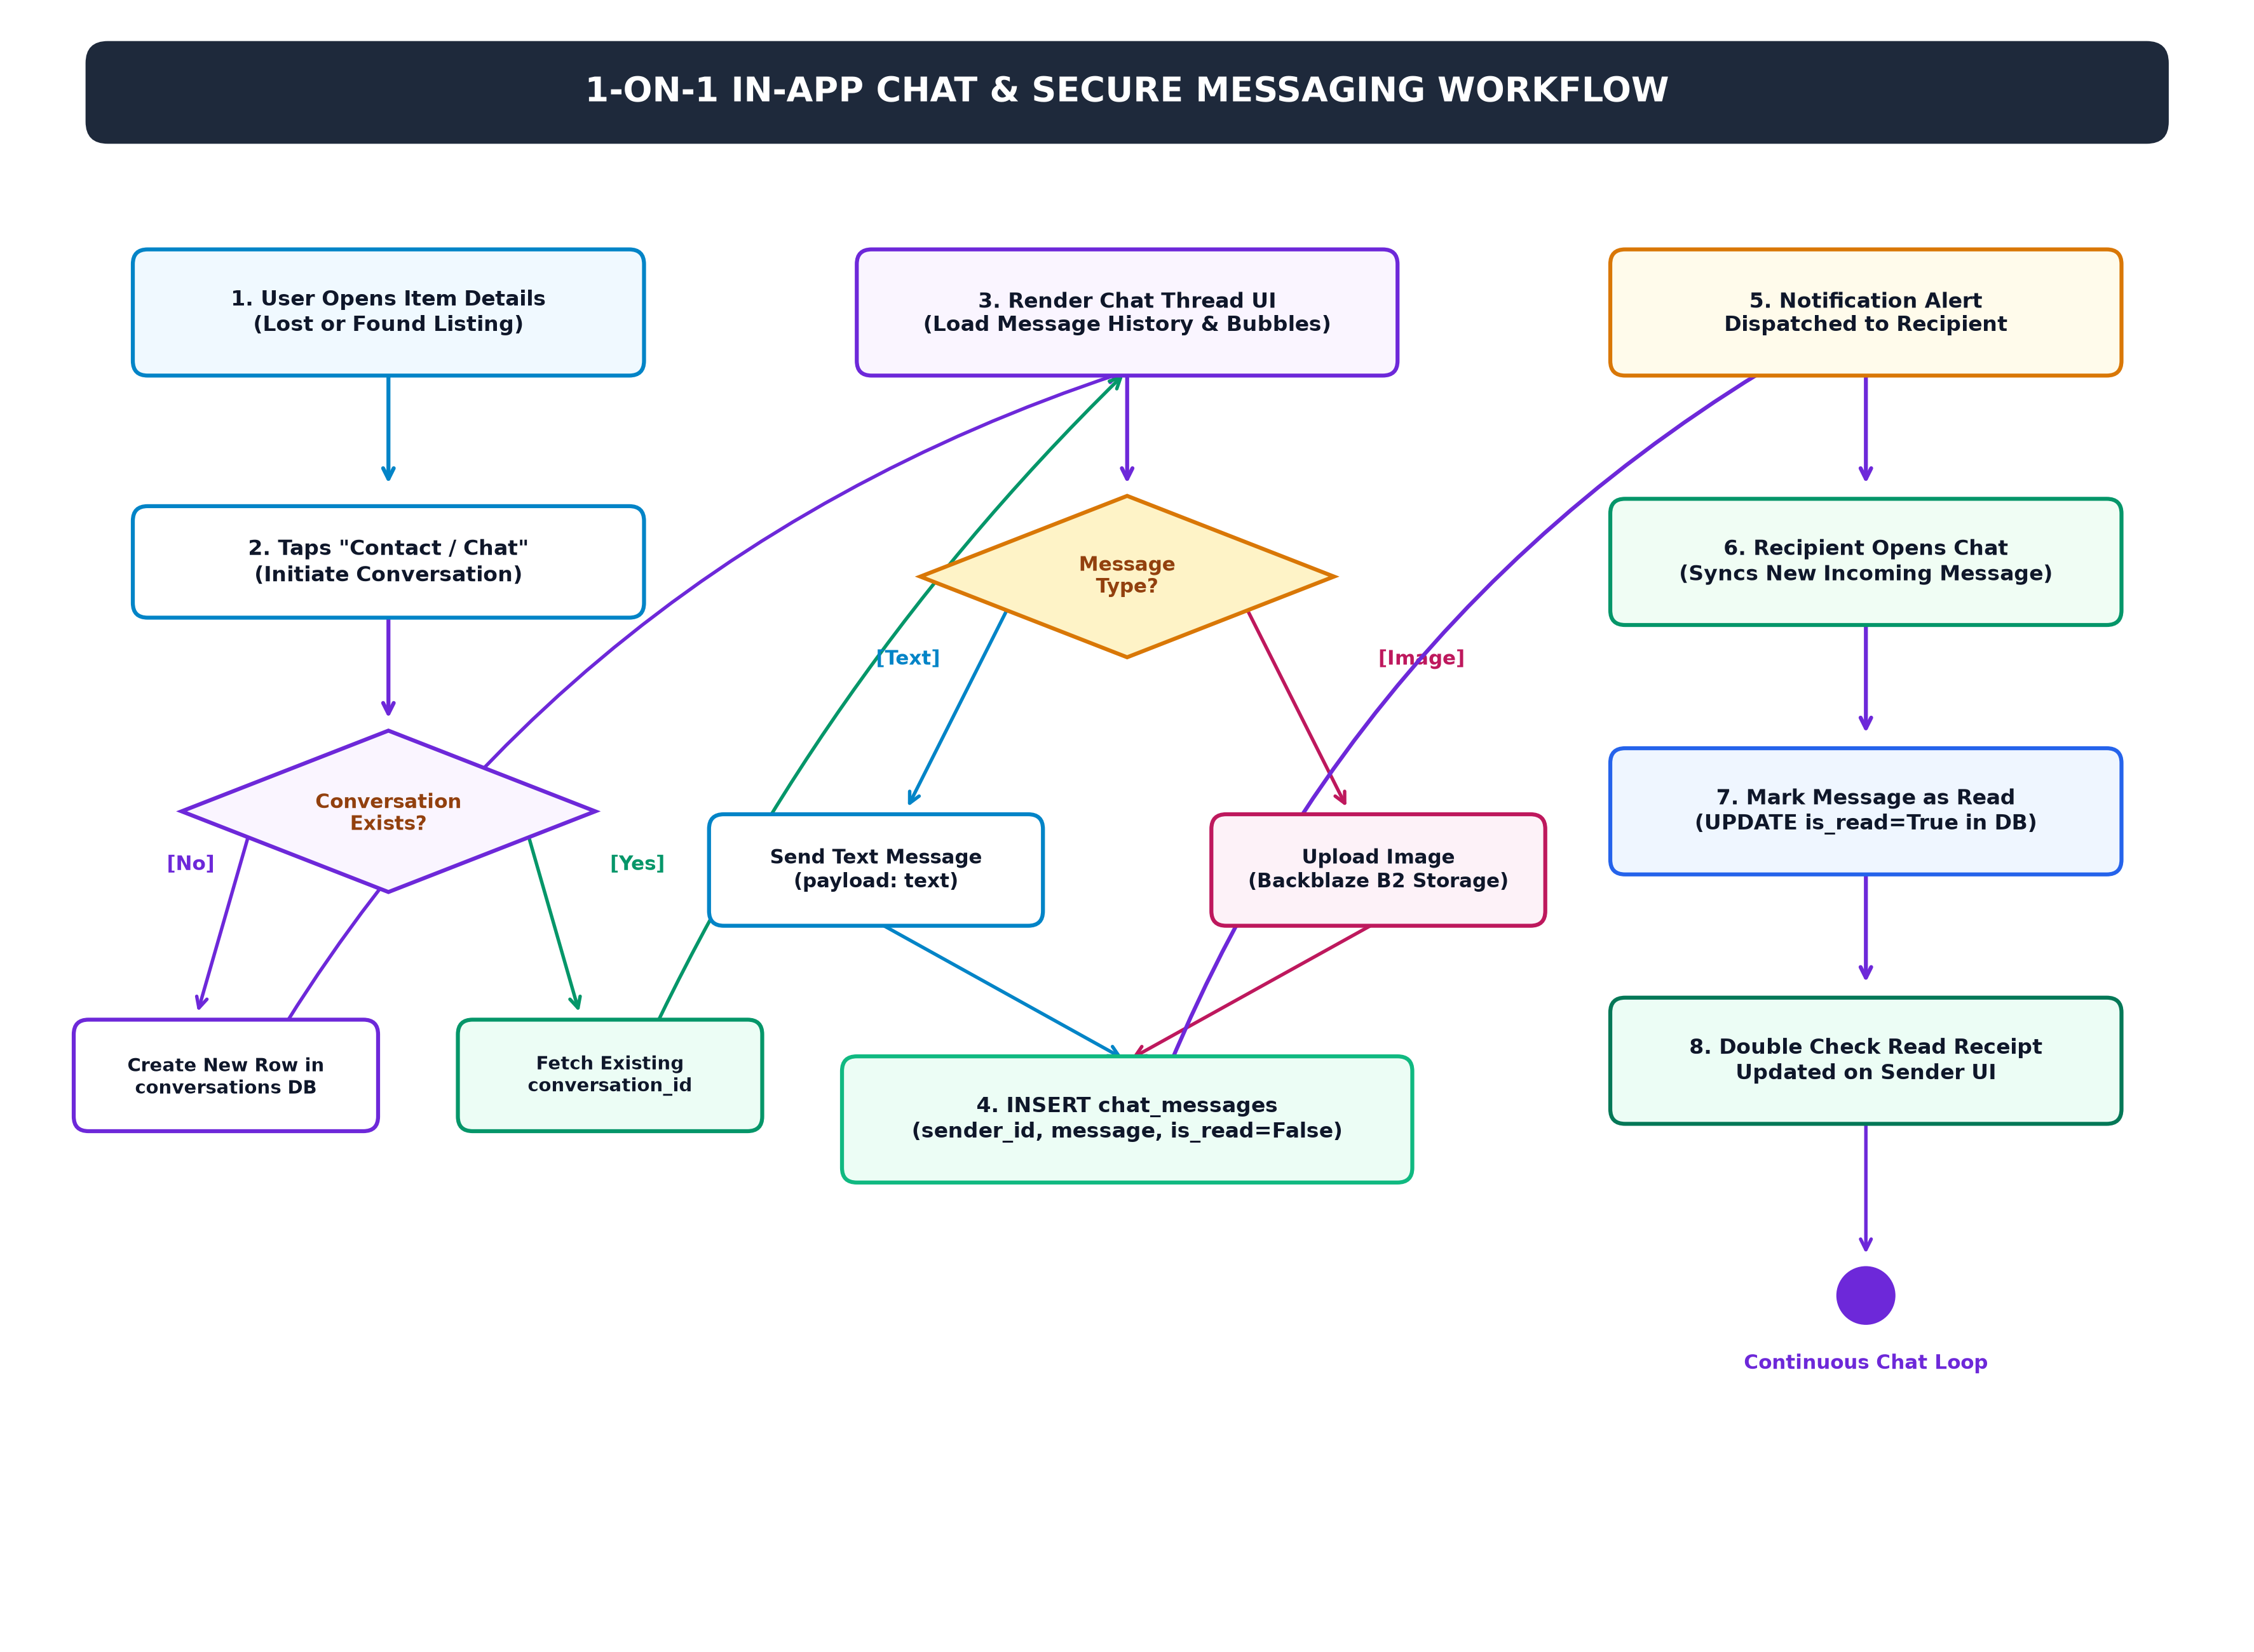
TOPIC 03 • SYSTEM ARCHITECTURE
FINDORA • BCA 8TH SEMESTER DEFENSE
04 / 15
Multi-Tiered Architectural Blueprint & Data Flow
Architectural Layers
• Presentation Tier: Native Android Java client with Material 3 UI, ViewBinding, and 0ms in-memory cache.
• Application Tier: Django REST Framework backend running on Gunicorn WSGI server handling stateless JSON APIs.
• Data Tier: PostgreSQL relational database normalized to 3NF ensuring ACID-compliant transactional integrity.
• Cloud Storage & Media: Backblaze B2 Object Storage (S3-compatible) storing encrypted high-resolution photos.
• Authentication & OTP: HMAC-SHA256 JWT bearer tokens & Brevo transactional email OTP gateway.

Slide 5
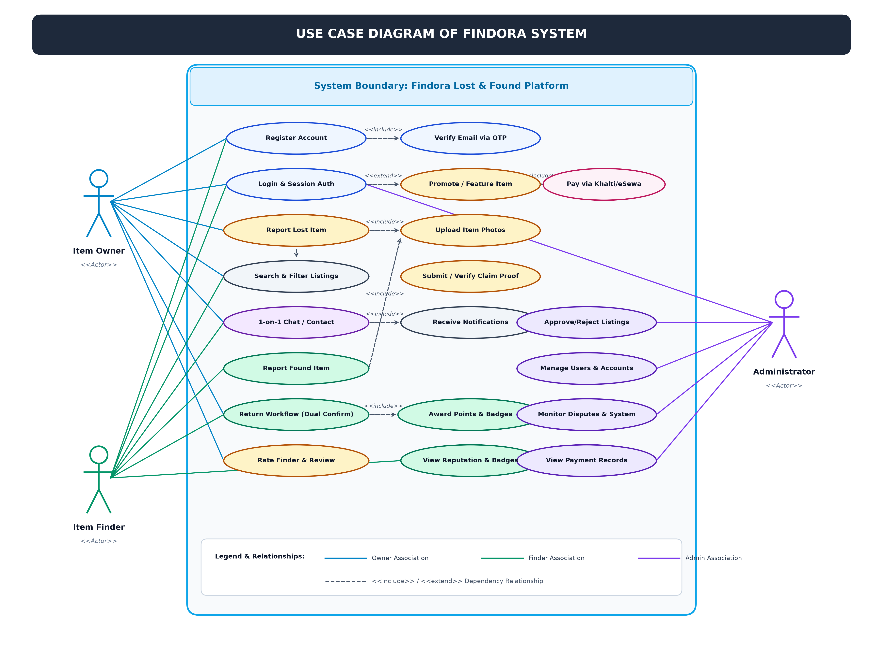
TOPIC 04 • CONCEPTUAL MODELS
FINDORA • BCA 8TH SEMESTER DEFENSE
05 / 15
System Actors, Roles & Use Case Flow
3 Primary User Roles
• 👤 Item Owner: Posts lost item reports, searches feed, answers secret proof questions, confirms return, and rates finders.
• 🔍 Item Finder: Posts discovered items with mandatory photo, sets secret ownership question, chats in-app, confirms handover, and earns Karma Points.
• 🛡️ Platform Administrator: Moderates reported items, inspects evidence photos, resolves disputed claims, oversees user trust scores, and audits transactions.

Slide 6
TOPIC 05 • TECHNOLOGY STACK
FINDORA • BCA 8TH SEMESTER DEFENSE
06 / 15
Proven, Modern & Scalable Technology Stack
📱 Native Android Frontend
• Java 17 (Native): Native performance, zero bridge overhead, 60 FPS UI.
• ViewBinding & Material 3: Type-safe view access, modern dark theme components.
• Retrofit 2 & OkHttp 3: Type-safe asynchronous REST networking with token interceptors.
• Glide Image Loader: Hardware bitmap decoding with L1 memory & L2 disk caching.
⚙️ Backend & API Services
• Python 3.12 & Django 5.1/6.0: Robust enterprise web framework with built-in ORM.
• Django REST Framework: Stateless JSON serializers, viewsets, and permissions.
• SimpleJWT Authentication: Stateless HMAC-SHA256 access & refresh bearer tokens.
• Gunicorn & Whitenoise: High-concurrency WSGI application server with static asset engine.
🗄️ Database & Cloud Infrastructure
• PostgreSQL Database: ACID-compliant relational database normalized to 3NF.
• Backblaze B2 Cloud Storage: S3-compatible encrypted cloud bucket for user photos.
• Brevo (Sendinblue) API: High-deliverability transactional email service for OTP verification.
🛠️ Payments & DevOps Pipeline
• eSewa Payment Gateway: Digital wallet integration for optional paid featured listings.
• Render Cloud Platform: Managed automated continuous deployment with health checks.
• Git, GitHub & Postman: Branch-based team version control and automated API test collections.

Slide 7
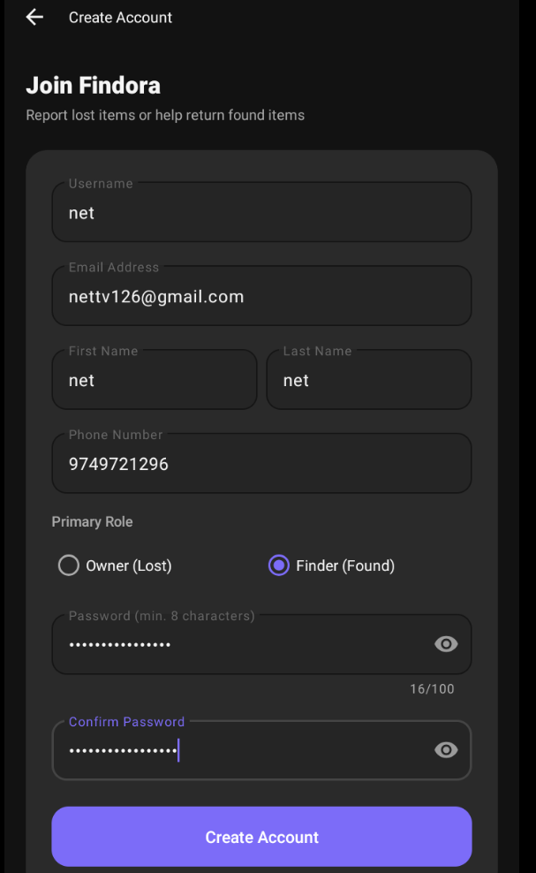
TOPIC 06 • APP WALKTHROUGH
FINDORA • BCA 8TH SEMESTER DEFENSE
07 / 15
Mobile Experience: Discovery, Search & Item Details
Key UI & Functional Features
• Instant Live Search: Real-time search filtering listings dynamically by title, keyword, or landmark.
• Category Filter Chips: Quick toggles for Electronics, Wallets, Documents, Keys, Books, and Others.
• Status Badges: High-contrast visual tags indicating 'LOST' (red) and 'FOUND' (green) states.
• Google Maps Pinning: 'View Map' button opening external Google Maps at exact item coordinates.
• Contact & Claim Actions: Direct triggers for 1-on-1 private chat and secret question verification.

Slide 8
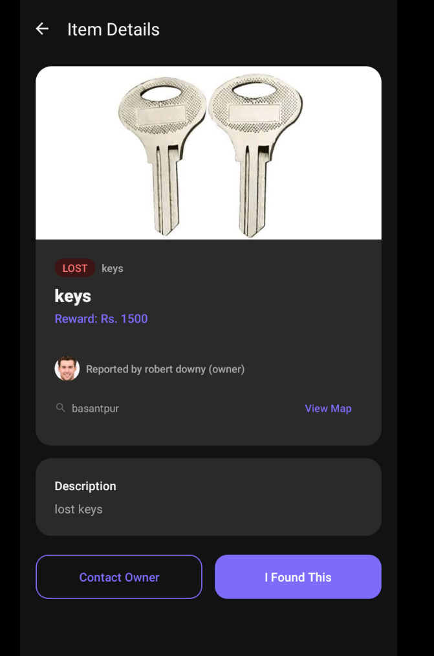
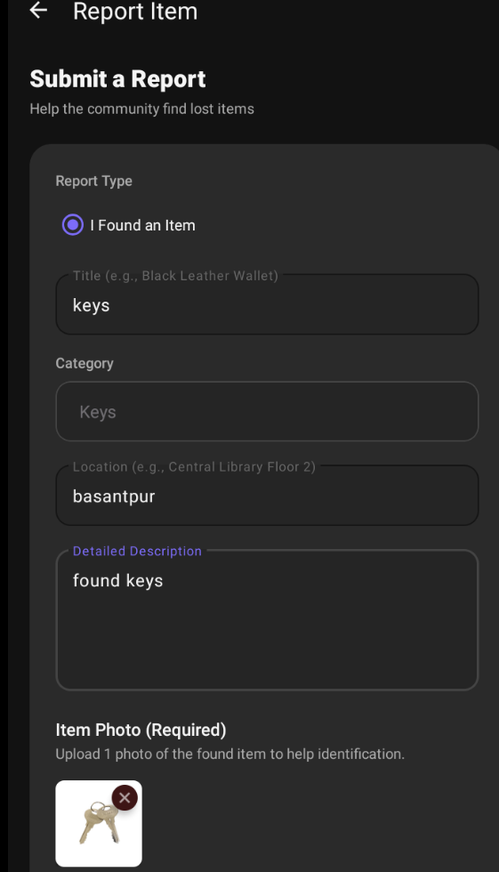
TOPIC 07 • APP WALKTHROUGH
FINDORA • BCA 8TH SEMESTER DEFENSE
08 / 15
Mobile Experience: Lost & Found Item Reporting
Structured Reporting Workflows
• Report Lost Item: Capture category, distinct descriptors, date/time lost, location context, and optional photos.
• Report Found Item: Mandatory clear photo capture with camera/gallery image compression.
• Secret Proof Question: Finder sets a custom validation question (e.g. 'What is written on the back of the card?') to stop false claims.
• 0ms Cache Sync: Instant in-memory cache update ensures newly created items appear on the feed without latency.

Slide 9
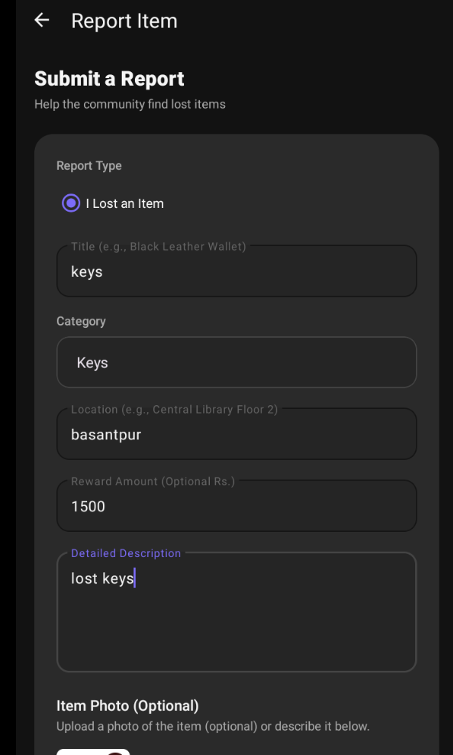
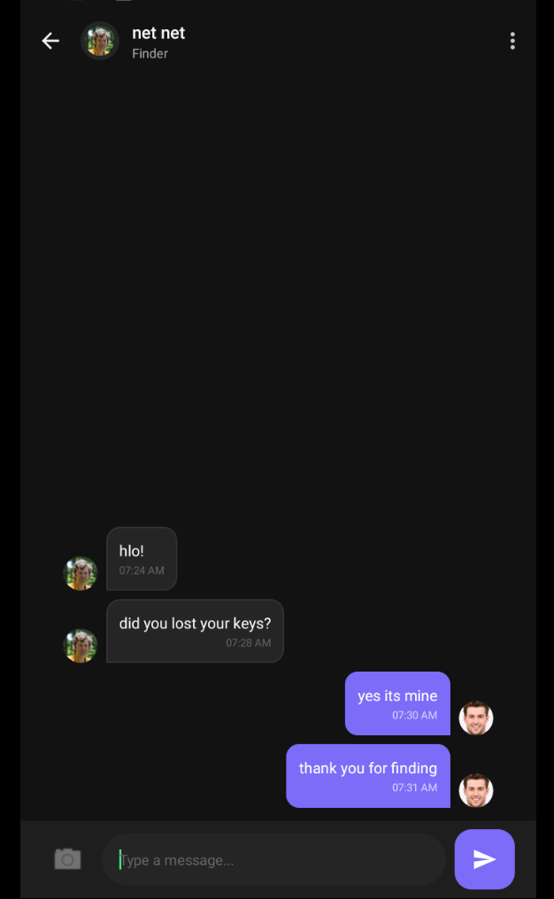
TOPIC 08 • APP WALKTHROUGH
FINDORA • BCA 8TH SEMESTER DEFENSE
09 / 15
Mobile Experience: Claiming, Real-Time Chat & Return
Safe Communication & Handover
• Secret Proof Claiming: Claimant submits private answer to secret question along with optional receipts or ID proof.
• 1-on-1 In-App Messaging: Real-time chat with sent/received bubbles, photo attachment, and edit/delete context options.
• Dual Confirmation Handshake: Both Owner & Finder tap 'Confirm Return' in-app during physical handover to resolve item.
• Karma Points & Rating: Finder automatically receives +50 Karma Points and public 5-Star Rating upon resolution.

Slide 10
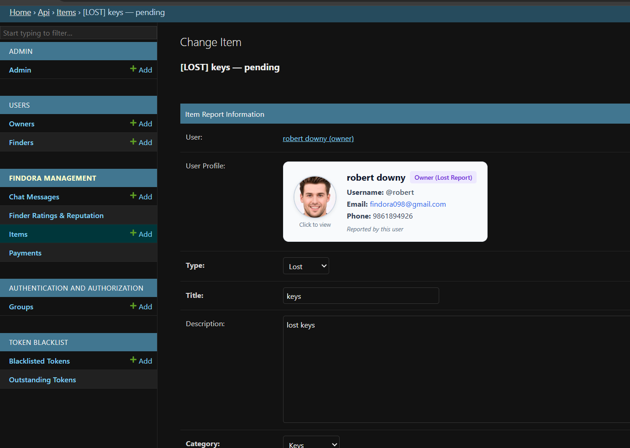
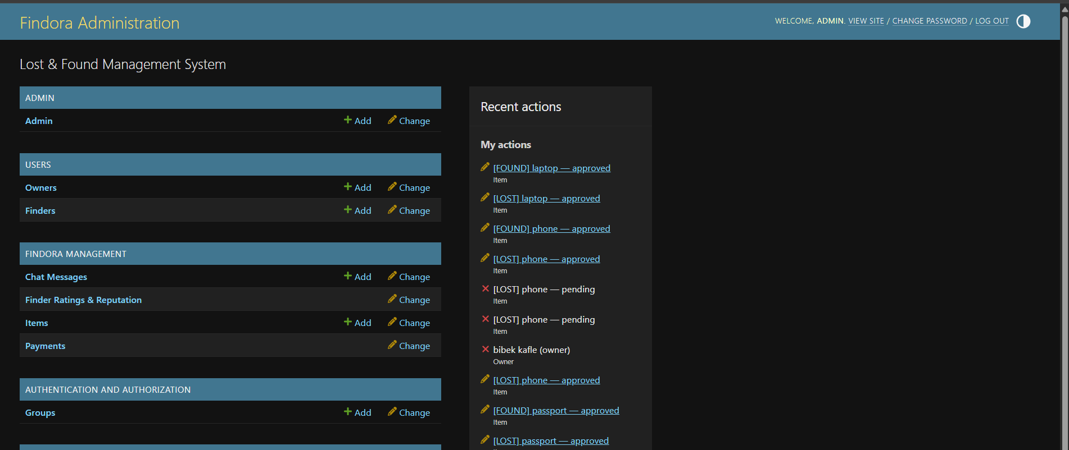
TOPIC 09 • ADMIN CONSOLE
FINDORA • BCA 8TH SEMESTER DEFENSE
10 / 15
Web Administrator: Moderation, Dispute & Analytics
Centralized Platform Oversight
• Item Moderation Registry: Comprehensive table of all reports with filters (Pending, Approved, Flagged, Resolved).
• Evidence & Proof Audit: Side-by-side inspection of found item photos, claimant proofs, and secret answers.
• Dispute Resolution Override: Administrative controls to mediate conflicting claims and prevent fraudulent takeovers.
• Platform Health & Analytics: Real-time metrics on registered users, active reports, return rates, and server latency.

Slide 11
TOPIC 10 • INNOVATIONS & USPS
FINDORA • BCA 8TH SEMESTER DEFENSE
11 / 15
Key Architectural Innovations & Competitive Edge
🔄 Linked Parent-Child Reports
• Direct Association: Finders report directly against an owner's lost listing, creating an immediate linked match dialogue.
• Zero Duplication: Prevents multiple disconnected reports for the exact same lost property.
🤝 Dual-Confirmation Return Handshake
• Mutual Verification: Both Owner AND Finder must tap 'Confirm Return' in-app during physical handover.
• Eliminates False Claims: Guarantees no party can falsely claim an item was returned or stolen.
🏆 Gamified Karma Reputation
• Immutable Ledger: Earn +50 Karma Points for every verified return, building a transparent public score.
• Tiered Badges: Unlock Good Samaritan, Top Finder, and Trusted Finder status badges.
🔒 Zero-Exposure Private In-App Chat
• Privacy Protection: Coordinate safe handover meetups without sharing private phone numbers or personal emails.
• Rich Controls: Real-time message status, image sharing, edit message, and delete options.

Slide 12
TOPIC 11 • MONETIZATION MODEL
FINDORA • BCA 8TH SEMESTER DEFENSE
12 / 15
Ethical Revenue Model: Free Utility + Paid Featured Listings
🆓 100% Free Core Functionality
• Free Lost & Found Posting: Anyone can report missing or discovered goods at zero cost.
• Free In-App Chat: Unlimited 1-on-1 private messaging for all active items.
• Free Search & Maps: Full access to category search, status filters, and GPS location.
• Free Verification & Handshake: Dual-confirmation return flow is always completely free.
🚀 Optional Paid Featured Listings
• Top Feed Placement: Pinned to the very top of home feed and search queries for maximum visibility.
• Urgent Recovery Boost: Ideal for critical personal items (passports, laptops, wallets, keys).
• Visual 'FEATURED' Badge: Highlighted purple badge instantly catches community finder attention.
• eSewa Wallet Integration: Instant, secure digital payment checkout with server-side token verification.

Slide 13
TOPIC 12 • TESTING & QA
FINDORA • BCA 8TH SEMESTER DEFENSE
13 / 15
Comprehensive Testing Strategy & Verification Results
🧪 Automated Test Suite
• 100% Pass Rate: 45 Automated Unit & Integration tests executed successfully via Django test runner.
• Auth & Security Tests: JWT token lifecycle, password hashing, and role permission enforcement.
• Workflow Tests: Item creation, claim submission, secret answer checks, and dual confirmation.
⚡ Performance & Scale
• < 180ms Latency: Average API server response time under 180 ms for all standard REST endpoints.
• 200+ Concurrency: Stress-tested with up to 200 concurrent active users with zero connection drops.
• Zero DB Deadlocks: ACID transactions maintained zero locking contention during simultaneous claims.
📱 Device Compatibility
• Physical Devices: Smooth touch gestures, camera capture, and push alerts across Android 7.0 to 15.
• Emulator & PC Mode: Full mouse hover, 3-dots quick actions, and right-click context menu on BlueStacks 5.
• Offline Cache: 0ms immediate feed rendering from L1 memory & L2 disk cache on weak networks.

Slide 14
TOPIC 13 • CONCLUSION & ROADMAP
FINDORA • BCA 8TH SEMESTER DEFENSE
14 / 15
Project Summary & Future Innovation Roadmap
🎯 Key Project Achievements
• Full-Stack System Delivered: Fully functional native Android app, Django REST API, and PostgreSQL database.
• Structured Recovery Workflow: Replaced chaotic social media posts with categorized, geo-tagged, and searchable listings.
• Fraud-Proof Security: Engineered secret proof questions and dual-confirmation return handshakes.
• Community Incentives: Implemented gamified Karma Points (+50 pts), Tiered Badges, and 5-Star Ratings.
🔮 Future Innovation Roadmap
• AI Visual Image Matching: Automated image similarity matching using deep learning visual embeddings.
• Interactive Geofencing Alerts: Radius-based background push notifications when lost items are reported nearby.
• Dynamic QR Item Tags: Printable QR stickers for laptops/wallets enabling instant scan-to-report for finders.
• Multilingual Localization: Complete Nepali language support to broaden community adoption across Nepal.

Slide 15
FINDORA • COMMUNITY-DRIVEN LOST AND FOUND PLATFORM
THANK YOU!
Questions, Suggestions & Feedback are Welcome
Bibek Poudel • Pratikshya Maske • Sumina Pokhrel Supervised By: Mr. Anil Thapaliya | Mr. Shiva Pathak Oxford College of Engineering and Management, Gaidakot, Nawalpur

