Slide 1
FINDORA • BCA 8TH SEMESTER PROJECT DEFENSE
03 / 12
TOPIC 02 • PROBLEM STATEMENT
The Crisis of Lost Valuables & Broken Traditional Channels
Losing phones, wallets, IDs, or keys leads to severe anxiety, financial loss, and privacy exposure.
📯 Fragmented & Chaotic Channels
Relying on manual paper registers, physical notice boards, and scattered Facebook/Viber groups leads to posts getting buried within hours.
🔍 Lack of Centralized Search
No structured categorization, location filtering, or digital indexing makes discovering matching items almost impossible.
THE LOST ITEM DILEMMA
😰 Reality of Losing Valuables Today:
1. Realize wallet/keys/ID are gone 😱
2. Post panic messages in 12 Facebook groups 📱
3. Phone flooded with spam calls 📞
4. Visit 5 front desks; all shrug 🤷‍♂️
5. Hope drops to zero... 📉
💡 Enter Findora:
One unified search, direct secure chat, verified return & 100% peace of mind! 🚀
🛡️ Privacy & Harassment Risks
Broadcasting personal phone numbers on public social media invites spam calls, impersonation attempts, and security threats.
❌ Zero Structured Verification
No mechanism to verify true ownership before meetup; lack of mutual return confirmation causes fraudulent claims.

Slide 2

POKHARA UNIVERSITY • BCA 8TH SEMESTER PROJECT DEFENSE
FINDORA
Lost and Found Made Simple
A Community-Driven Mobile Platform for Verified Item Recovery
Findora Android App
SUBMITTED BY:
• Bibek Poudel
PU Symbol No: 22530187
• Pratikshya Maske
PU Symbol No: 22530255
• Sumina Pokhrel
PU Symbol No: 22530256
PROJECT SUPERVISORS:
• Mr. Anil Thapaliya | Mr. Shiva Pathak
Faculty, Department of Computer Application
SUBMITTED TO:
Department of Computer Application
Oxford College of Engineering and Management (OCEM) Gaidakot, Nawalpur, Nepal | September 2026

Slide 3
FINDORA • BCA 8TH SEMESTER PROJECT DEFENSE
02 / 12
TOPIC 01 • INTRODUCTION
Connecting Communities for Fast, Secure Item Recovery
Findora bridges the gap between individuals who lost valuables, people who found them, and administrators.
👤 ITEM OWNER
Who Lost Valuables
⚡ FINDORA PLATFORM
Core Digital Hub
🤝 ITEM FINDER
Who Discovered Items
✓ Instant Item Reporting: Upload photos, set item category, location & reward bounty.
✓ Discover & Search: Filter by category, status, keyword & location radius.
✓ 1-on-1 Secure Chat: Coordinate directly with finder without public phone leakage.
✓ Handover & Rating: Confirm physical return and award 5-star rating to finder.
✓ Native Android Client: Responsive Java & Material user interface on mobile.
✓ Django REST Application: Stateless SimpleJWT authentication & business logic.
✓ Parent-Child Linking: Direct linking of found reports against original lost posts.
✓ Karma & Points Engine: Rewards honest finders with gamified badges and points.
✓ Found Item Logging: Post found items or link directly to an existing lost post.
✓ Safe Communication: Chat with owner privately to confirm proof of ownership.
✓ Mutual Confirmation: Tap 'Confirm Return' in-app during physical handover.
✓ Reputation Accrual: Receive +50 Karma Points, unlock badges & build trusted score.
🛡️ ADMINISTRATIVE OVERSIGHT & PLATFORM GOVERNANCE
Django Admin oversees the entire ecosystem: moderates newly submitted listings, prevents fraudulent spam, validates ownership claims, audits payment transactions, and ensures a secure environment for all community participants.

Slide 4
FINDORA • BCA 8TH SEMESTER PROJECT DEFENSE
04 / 12
TOPIC 03 • LITERATURE SURVEY
Comparative Analysis of Existing Recovery Methods
How Findora addresses the fundamental flaws of legacy lost-and-found practices.
EXISTING APPROACH
CRITICAL LIMITATIONS
FINDORA'S TECHNOLOGICAL SOLUTION
Traditional Paper Registers & Physical Boards
• Confined to a single physical location
• Zero search capability; manual log reading
• High decay rate; discarded after weeks
✓ Cloud-backed centralized database
✓ Instant full-text search & category filtering
✓ Accessible anywhere via Android mobile app
Social Media Groups (Facebook / Viber / WhatsApp)
• Unindexed chronological feeds (buried fast)
• Public exposure of phone numbers & identity
• Prone to fraud and fake claim scammers
✓ Structured parent-child item reporting
✓ In-app 1-on-1 private encrypted chat
✓ Zero personal phone number leakage
Generic Marketplaces & Classifieds (Hamrobazar / OLX)
• Optimized for sales, not lost recovery
• No ownership verification or claim workflow
• No return confirmation or incentive system
✓ Dedicated Lost & Found lifecycle
✓ Admin listing moderation & verification
✓ Dual-confirmation handover workflow
Basic Google Forms / Static Web Forms
• Static tabular data without interactivity
• Requires manual admin matching & emails
• No real-time chat, notifications, or rewards
✓ Automated matching & push/email notifications
✓ Real-time direct chat between Owner & Finder
✓ Finder Karma Points, Badges & 5-Star Ratings
🎯 Core Finding: Existing platforms lack structured return verification, privacy preservation, and finder incentives — exactly what Findora builds.

Slide 5
FINDORA • BCA 8TH SEMESTER PROJECT DEFENSE
05 / 12
TOPIC 04 • OBJECTIVES
Primary Engineering Objectives of Findora
Targeted architectural and functional goals engineered into the platform.
📱 1. Simplify Item Reporting
💬 2. Secure In-App Communication
🤝 3. Dual-Confirmation Handover
Enable instant reporting of lost and found items with photo attachments, category taxonomy (wallets, phones, keys, IDs), and location metadata.
Provide private 1-on-1 real-time messaging between Owners and Finders, eliminating the need to expose personal phone numbers.
Implement a cryptographically sound dual-verification process where both Owner and Finder must confirm item handover to resolve cases.
⭐ 4. Reputation & Karma Incentives
🔔 5. Automated Contextual Alerts
🛡️ 6. Centralized Administration
Build a gamified Karma points ledger, badge milestones (Bronze to Platinum), and 5-star rating system to motivate community honesty.
Deliver instantaneous multi-channel notifications for matching reports, admin verification statuses, and incoming chat messages.
Equip platform administrators with Django Admin tooling for content moderation, fraud prevention, claim arbitration, and audit oversight.

Slide 6
FINDORA • BCA 8TH SEMESTER PROJECT DEFENSE
06 / 12
TOPIC 05 • SYSTEM ARCHITECTURE
Multi-Tier Client-Server Architecture
Clean decoupling between Native Android Client, Django REST Application Tier, and Cloud Services.
📱 PRESENTATION TIER
⚙️ APPLICATION LOGIC TIER
🗄️ PERSISTENCE TIER
☁️ EXTERNAL CLOUD SERVICES
• Native Android Client
Java 17 + XML layouts
• Retrofit 2 HTTP Client
REST API communication
• SimpleJWT Token Store
Secure Bearer token auth
• Glide Image Engine
Optimized media caching
• Django REST Framework
Modular viewsets & serializers
• JWT Auth & Security Filters
Role-based access control
• Business Logic Engine
Parent-child item linking
• Reputation & Karma Service
Points & badge ledger engine
• PostgreSQL Database
ACID transactional relational DB
• Normalized 3NF Schema
Referential integrity & constraints
• Django ORM Abstraction
Optimized queries & migrations
• Audit & Ledger Tables
Immutable point transactions
• Backblaze B2 Storage
S3-compatible persistent media
• Brevo (Sendinblue)
SMTP & API 6-digit OTP delivery
• eSewa Payment Gateway
Secure digital wallet checkout
• Render Cloud Hosting
Gunicorn WSGI deployment
FLOW: Android App ──(HTTPS / JSON REST)──> Django Backend ──(SQL / ORM)──> PostgreSQL DB ──(boto3 / S3)──> Backblaze B2

Slide 7
FINDORA • BCA 8TH SEMESTER PROJECT DEFENSE
07 / 12
TOPIC 06 • TECH STACK
Proven, Modern Technologies Across the Entire Stack
Carefully selected frameworks for reliability, performance, and security.
📱 ANDROID FRONTEND
⚙️ BACKEND & APIS
🗄️ DATABASE & STORAGE
🛠️ DEVOPS & TOOLS
• Java 17 (Native)
Core Android programming language
• Android XML Layouts
Material 3 responsive UI components
• Retrofit 2 & OkHttp 3
Type-safe asynchronous HTTP client
• Glide Image Loader
High-performance disk/memory caching
• Android Studio IDE
Official native development suite
• Python 3.12+
Robust backend scripting language
• Django 6.0 Web Framework
Enterprise MVT web architecture
• Django REST Framework
Stateless JSON API serialization
• SimpleJWT
HMAC-SHA256 bearer token security
• Gunicorn & Whitenoise
WSGI application server & static host
• PostgreSQL
Production relational database engine
• Django ORM
Type-safe object-relational mapping
• Backblaze B2
Cloud Object Storage via Boto3 / S3
• Brevo (Sendinblue)
Transactional SMTP / REST OTP API
• eSewa SDK
Digital payment checkout integration
• Git & GitHub
Distributed version control & workflow
• Render Cloud Platform
Managed backend web service hosting
• Postman
Automated API test suites & mocks
• DB Visualizer / DBeaver
Relational schema management
• Figma
UI/UX wireframes & user flows

Slide 8
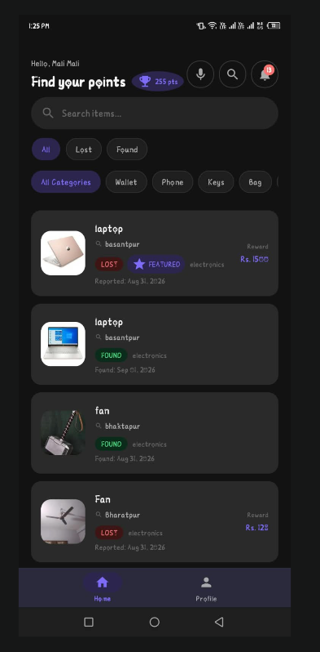
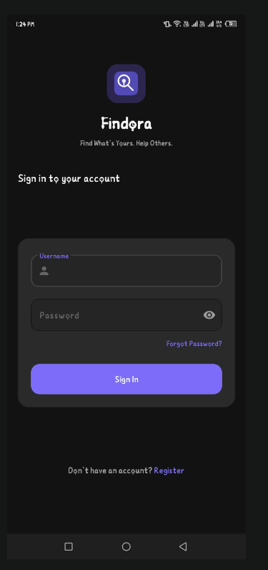
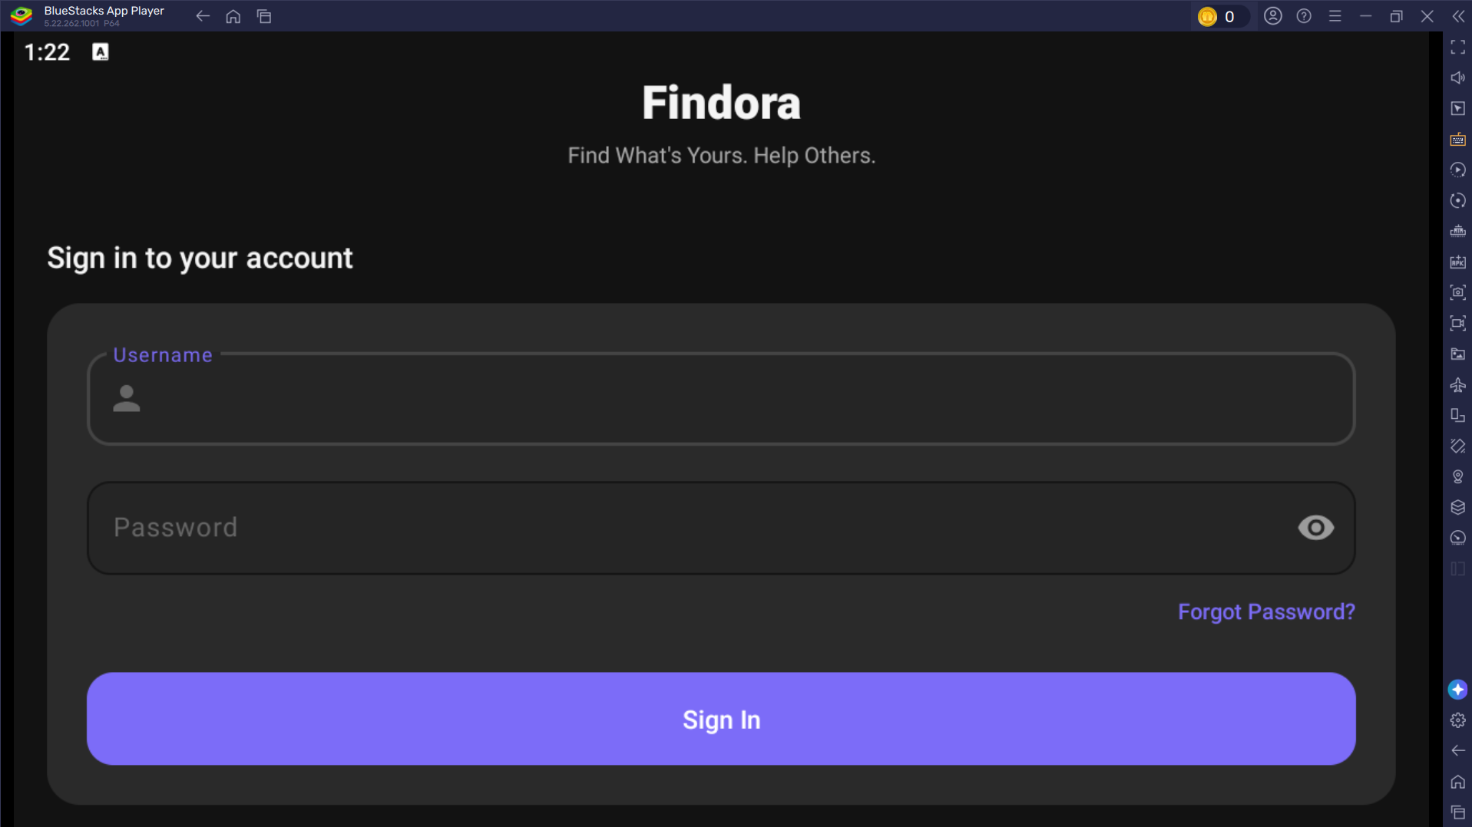
FINDORA • BCA 8TH SEMESTER PROJECT DEFENSE
08 / 12
TOPIC 07 • APP SCREENSHOTS
Native Android Application & Admin Interfaces
Real screenshots demonstrating Findora's responsive user experience and moderation portal.
📱 Feed & Category Search
🔍 Item Details & Actions
🛡️ Django Admin Moderation & Audit Console
Categorized item cards with filter chips, status badges & instant search.
Detailed photos, location tag, reward bounty & direct 1-on-1 chat.
Comprehensive moderation table: approve listings, resolve disputes, track point transactions, and audit payment records.

Slide 9
FINDORA • BCA 8TH SEMESTER PROJECT DEFENSE
09 / 12
TOPIC 08 • INNOVATION & USP
WHAT MAKES FINDORA DIFFERENT?
Key architectural innovations that set Findora apart from existing lost-and-found practices.
🔄 Linked Parent-Child Reports
When a Finder spots an item, they report directly against the Owner's existing lost listing, automatically associating records and alerting the owner instantly.
🤝 Dual-Confirmation Handover
Eliminates false recovery claims. Both Owner AND Finder must tap 'Confirm Handover' in their app before the item transitions to 'Resolved' status.
⭐ THE COMMUNITY TRUST FACTOR
Why Do Finders Return Items?
• 🏆 Verified Recognition
Finders earn public badges and 5-star ratings displayed on their profile.
• ⚡ Frictionless Process
No awkward phone calls or negotiations; structured in-app chat handles details.
• 🛡️ Safety & Privacy
Zero risk of false accusations thanks to dual confirmation.
• 😊 'Faith in Humanity'
Turning stressful losses into rewarding community moments!
🎖️ Karma Points & Tiered Badges
Immutable points ledger rewards honest community members (+50 pts on return). Earn badges: Good Samaritan, Silver Finder, Gold Finder & Top Contributor.
🔒 Zero-Exposure Private Chat
Direct real-time 1-on-1 messaging scoped to each specific item. Chat and share photos securely without broadcasting phone numbers or emails.

Slide 10
FINDORA • BCA 8TH SEMESTER PROJECT DEFENSE
10 / 12
TOPIC 09 • REVENUE MODEL
Ethical & Transparent Monetization: Featured Listings
100% Free Core Functionality with Optional Paid Promotion via eSewa Digital Wallet.
🆓 CORE SERVICE: 100% FREE
🚀 ➕ OPTIONAL PAID PROMOTION
💳 ═ SEAMLESS PAYMENT FLOW
• Free Lost & Found Posting
Anyone can report lost or found items at zero cost.
• Free In-App Chat
Unlimited 1-on-1 private messaging for all active items.
• Free Search & Filtering
Full access to category search, status filters & location.
• Free Verification & Ratings
Dual-confirmation return flow is always completely free.
• Featured Placement
Pinned to the top of feed and search results for higher visibility.
• Urgent Recovery Boost
Ideal for critical items (passports, laptops, keys, wallets).
• Highlighted Badge
Visual 'FEATURED' badge attracts immediate finder attention.
• Flexible Durations
Tiered promotion plans (e.g., 24 Hours, 3 Days, 7 Days).
• eSewa Digital Wallet
Integrated local payment gateway for instant secure checkout.
• Server-Side Verification
Django backend verifies transaction token via eSewa API.
• Instant Activation
Item automatically promoted to Featured upon payment success.
• Audited Ledger
Every transaction logged with unique ID in Django Admin.
BUSINESS PRINCIPLE: Free Core Utility (High User Adoption) + Optional Paid Feature Promotion (Sustainable Revenue)

Slide 11
FINDORA • BCA 8TH SEMESTER PROJECT DEFENSE
11 / 12
SUPPORTING FLOW • ITEM LIFECYCLE
The Complete End-to-End Recovery Journey
Step-by-step progression from initial loss report to successful physical return and reputation reward.
📱 1. Report Filed
🛡️ 2. Admin Review
🔍 3. Match & Link
💬 4. Secure Chat
🤝 5. Dual Confirm
⭐ 6. Karma & Rate
Owner posts lost item report with description, photos, location & optional reward.
Django Admin validates listing for safety and approves it for public visibility.
Finder discovers item and submits linked report or initiates in-app chat.
Owner & Finder verify proof details via 1-on-1 in-app chat & arrange meetup.
Both parties tap 'Confirm Return' in-app during physical handover.
Item is marked 'Resolved'; Finder earns +50 Karma Points & 5-Star Rating.
🔒 WHY THE DUAL-CONFIRMATION WORKFLOW MATTERS:
In conventional systems, one party can falsely claim an item was returned or stolen. Findora's dual-confirmation requirement guarantees transactional integrity: the Django backend only awards Karma points, updates status to 'Resolved', and triggers rating prompts when BOTH cryptographic confirmation flags are set to True.

Slide 12
FINDORA • BCA 8TH SEMESTER PROJECT DEFENSE
12 / 12
TOPIC 10 • CONCLUSION
Conclusion & Future Innovations
Summarizing project achievements and outlining the roadmap for Findora.
🎯 PROJECT ACHIEVEMENTS
✓ Delivered a fully functional native Android app & Django REST API.
✓ Solved traditional lost-and-found chaos with structured workflows.
✓ Engineered dual-confirmation handover eliminating false claims.
✓ Implemented gamified Karma Points, Badges & 5-Star Ratings.
✓ Integrated Backblaze B2, Brevo OTP & eSewa payment gateway.
🔮 FUTURE ENHANCEMENTS
🚀 AI Image Matching: Automated similarity matching using visual vectors.
🚀 Interactive Geofencing: Radius-based map push alerts for lost items.
🚀 Dynamic QR Item Tags: Printable QR stickers for personal belongings.
🚀 Multi-lingual Localization: Full Nepali language support for wider reach.
🚀 Voice Search Integration: Hands-free speech recognition for item queries.
OWNER + FINDER + ADMIN ───▶ FINDORA ───▶ SUCCESSFUL RECOVERY
THANK YOU!
Questions & Feedback are Welcome

