Slide 1

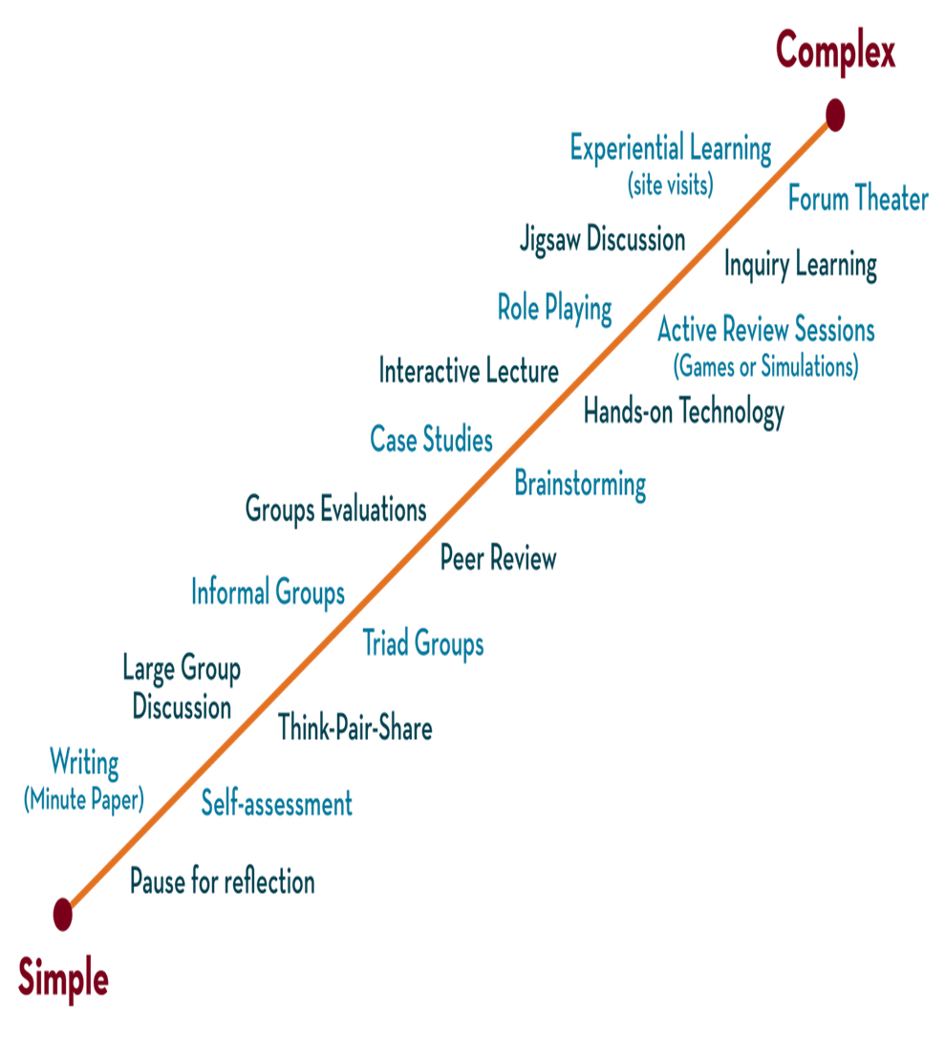
Department of CSE
COURSE NAME : Operating Systems
COURSE CODE: 25CS2102
Topic:
Page replacement: FIFO, LRU, and the clock algorithm.
Session – 18

Slide 2
AIM OF THE SESSION
To understand FIFO, LRU, and Clock page replacement algorithms used in virtual memory management.
INSTRUCTIONAL OBJECTIVES
This Session is Designed to:
Explain the need for page replacement algorithms.
Describe the FIFO page replacement algorithm.
Explain the LRU page replacement algorithm.
Discuss the Clock (Second Chance) algorithm.
Compare the performance of FIFO, LRU, and Clock algorithms.
LEARNING OUTCOMES
At the end of this session, you should be able to:
Define page replacement in virtual memory.
Explain the working of FIFO page replacement.
Describe the LRU page replacement algorithm.
Explain the Clock (Second Chance) algorithm.
Compare FIFO, LRU, and Clock algorithms based on their advantages and limitations.

Slide 3
Page Replacement Algorithms
If new page is brought in, need to chose a page to evict
Don’t want to evict heavily used pages
If page has been written to, need to copy it to disk.
Otherwise, a good copy is on the disk=>can write over it

Slide 4
Page Replacement Algorithms-the Laundry List
Optimal page replacement algorithm
Not recently used page replacement
First-in, first-out page replacement
Second chance page replacement
Clock page replacement
Least recently used page replacement
Working set page replacement
WSClock page replacement

Slide 5
Optimal Page Replacement
Pick the one which will not used before the longest time
Not possible unless know when pages will be referenced (crystal ball)
Used as ideal reference algorithm

Slide 6
Not recently used
Use R and M bits
Periodically clear R bit
  Class 0: not referenced, not modified
  Class 1: not referenced, modified
  Class 2: referenced, not modified
  Class 3: referenced, modified
Pick lowest priority page to evict

Slide 7
FIFO
Keep list ordered by time (latest to arrive at the end of the list)
Evict the oldest, i.e. head of the line
Easy to implement
Oldest might be most heavily used! No knowledge of use is included in FIFO

Slide 8
First-In-First-Out (FIFO) Algorithm
Reference string: 1, 2, 3, 4, 1, 2, 5, 1, 2, 3, 4, 5
3 frames (3 pages can be in memory at a time per process)
1
2
1
2
3
4 5
1 3 9 page faults
3
2 4
4 frames
1
2
3
4
Belady’s Anomaly: more frames ⇒ more page faults
1
2
3
4
5 | 4
1 | 5 | 10 page faults
2
3

Slide 9
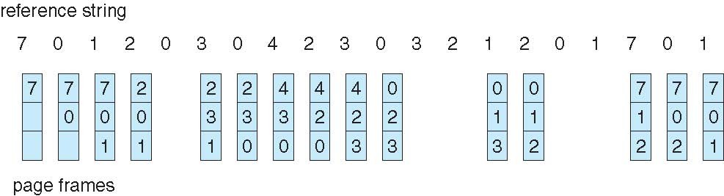
FIFO Page Replacement

Slide 10
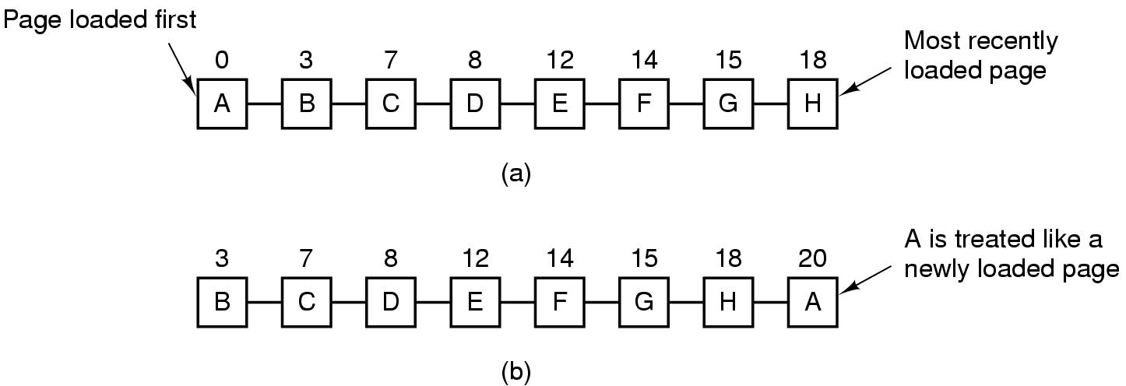
Second Chance Algorithm
Pages sorted in FIFO order by arrival time.
Examine R bit. If zero, evict. If one, put page at end of list and R is set to zero.
If change value of R bit frequently, might still evict a heavily used page
Tanenbaum, Modern Operating Systems 3 e, (c) 2008 Prentice-Hall, Inc. All rights reserved. 0-13-6006639

Slide 11
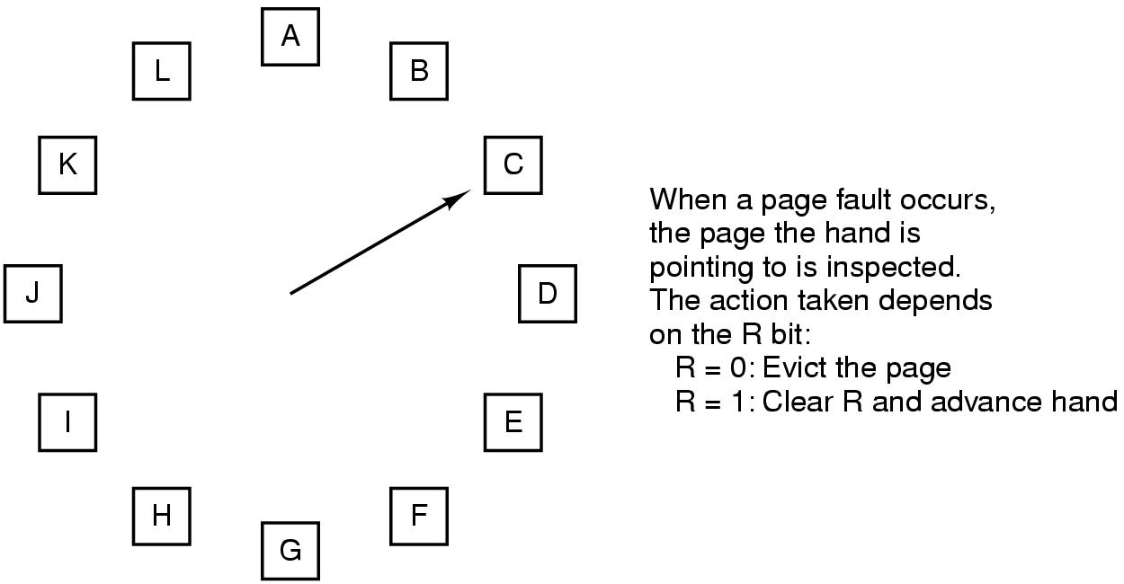
The Clock Page Replacement Algorithm

Slide 12
Clock
Doesn’t use age as a reason to evict page
Faster-doesn’t manipulate a list
Doesn’t distinguish between how long pages have not been referenced

Slide 13
LRU
Approximate LRU by assuming that recent page usage approximates long term page usage
Could associate counters with each page and examine them but this is expensive

Slide 14
LRU-the hardware array
Associate counter with each page.
  At each reference increment counter.
  Evict page with lowest counter
Keep n x n array for n pages.Upon reference page k, put 1’s in row k and 0’s in column k.
  Row with smallest binary value corresponds to LRU page. Evict k!
  Easy hardware implementation

Slide 15
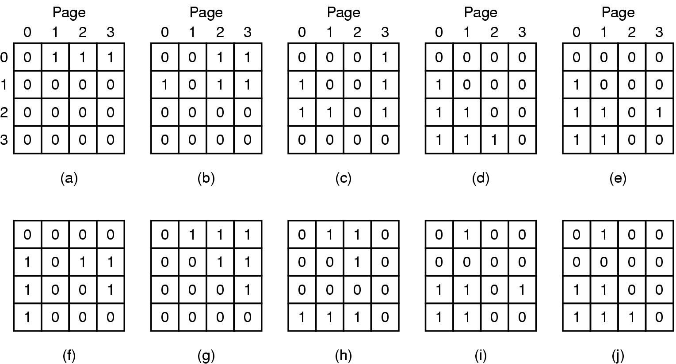
LRU-hardware
LRU using a matrix when pages are referenced in the order 0, 1, 2, 3, 2, 1, 0, 3, 2, 3.

Slide 16
LRU-software
Hardware uses space=> software implementation
Make use of software counters

Slide 17
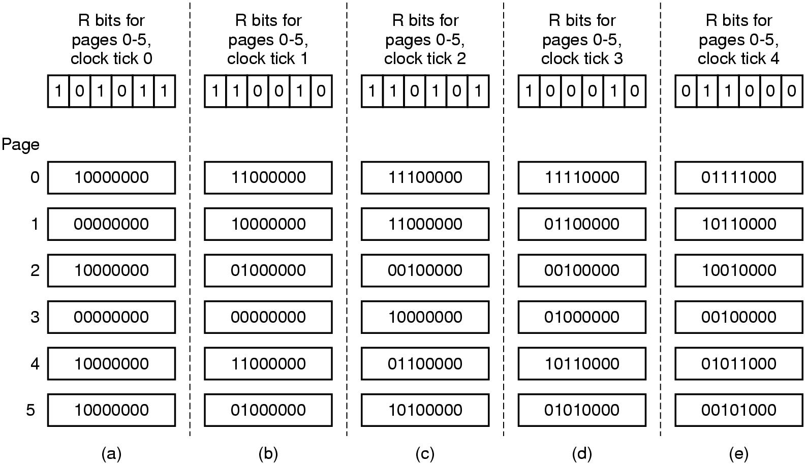
LRU in Software

Slide 18
LRU-software
  “aging” algorithm
  Keep a string of values of the R bits for each clock tick (up to some limit)
  After tick, shift bits right and add new R values on the left
  On page fault, evict page with lowest counter
  Size of the counter determines the history

Slide 19
THANK YOU
Team – Operating Systems

