Slide 1
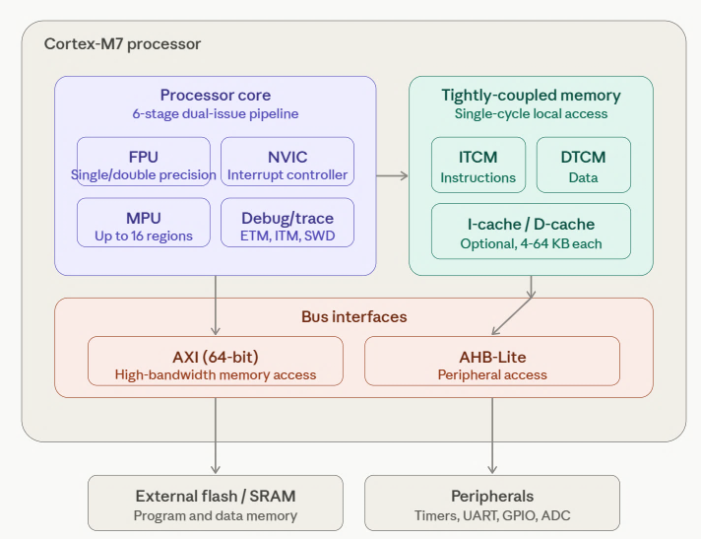
ARM Cortex-M7

Slide 2
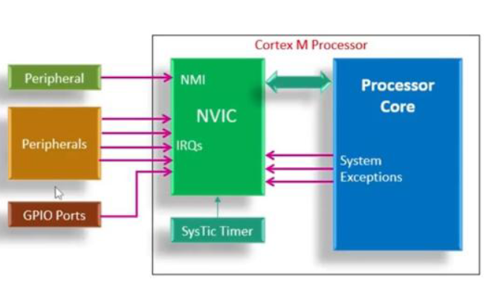
Nested Vectored Interrupt Controller

Slide 3
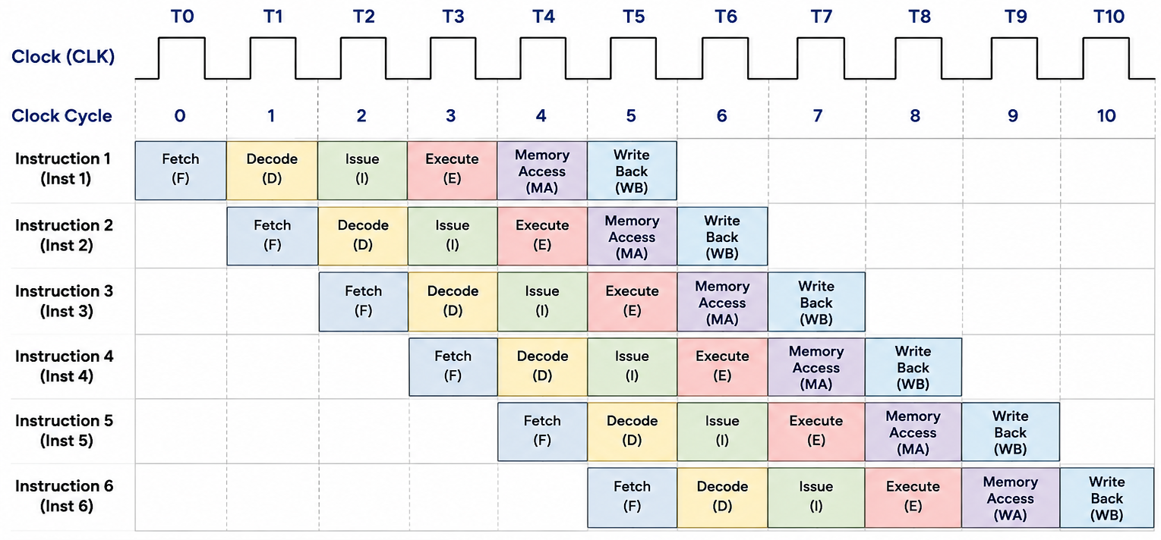
LDR R0, [R1]
Six Stage Pipeline

Slide 4
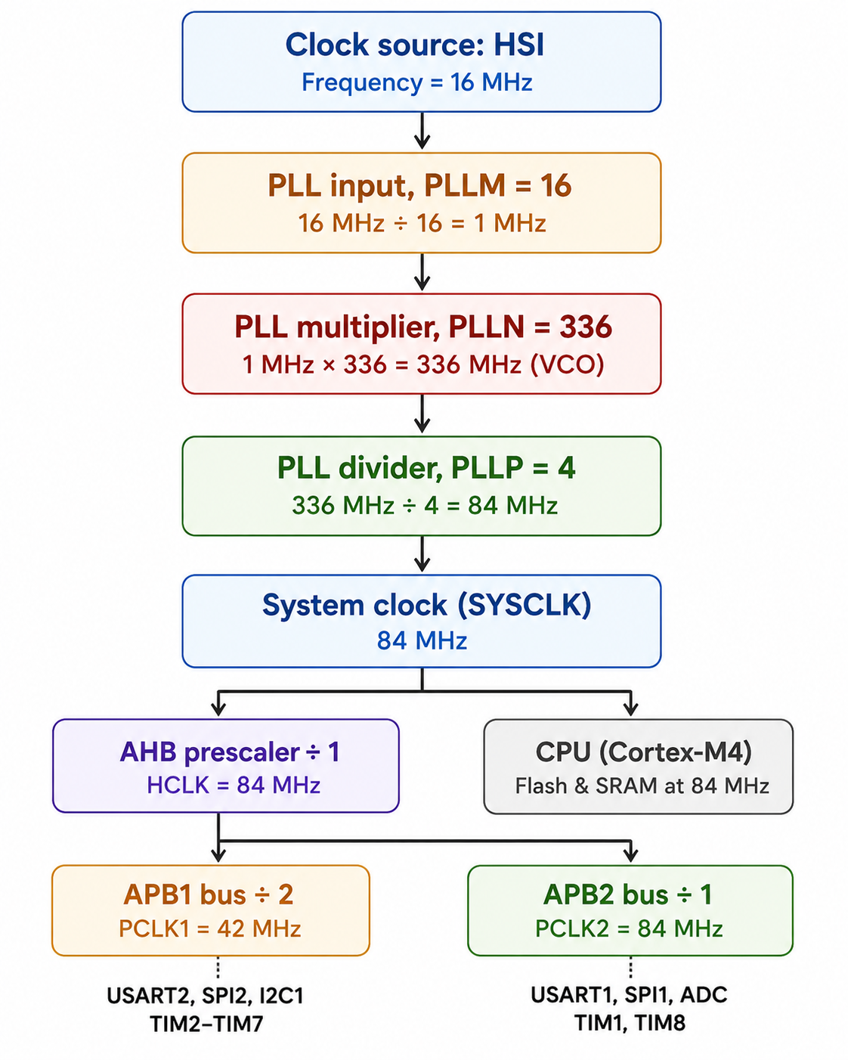
CLK Configuration

Slide 5
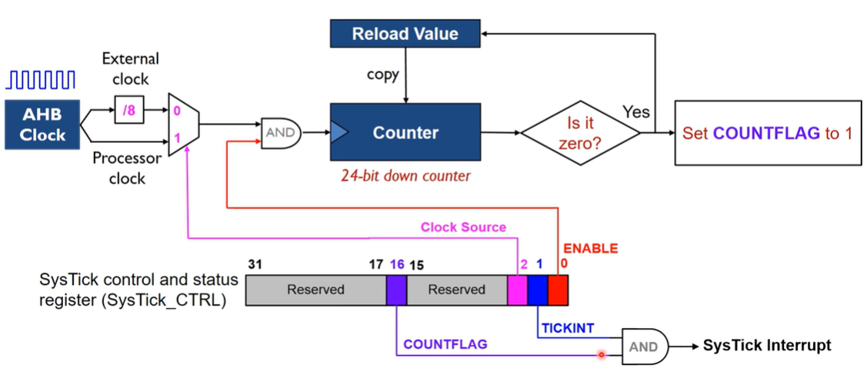
SysTick Timer (System Timer)

Slide 6
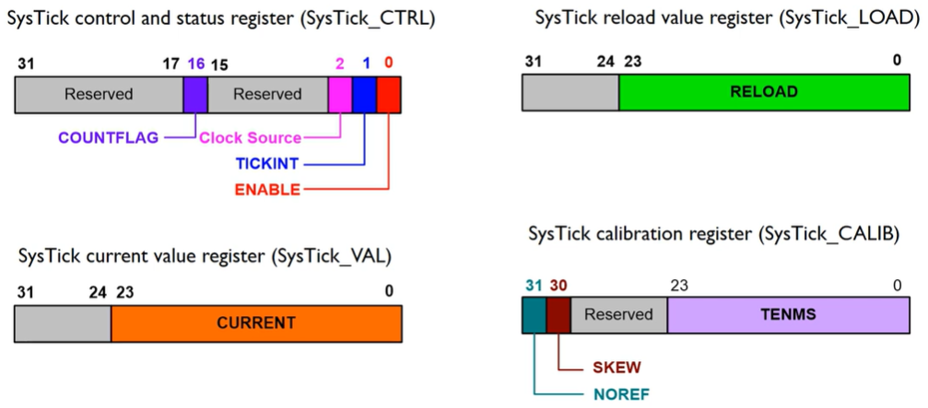

Slide 7
SysTick->LOAD = 16000000 - 1; // Reload value (example: 1 second @ 16 MHz)
SysTick->VAL = 0; // Clear current value
SysTick->CTRL = (1 << 2) | (1 << 0); // Processor clock + Enable SysTick
while(1)
{ // Wait until SysTick reaches zero
if(SysTick->CTRL & (1 << 16)) // Check COUNTFLAG bit
{
// Toggle PA5 LED
HAL_GPIO_TogglePin(GPIOA, GPIO_PIN_5);
}
}

Slide 8
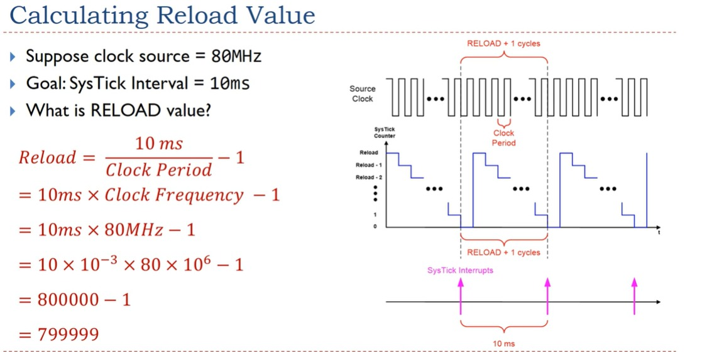

Slide 9
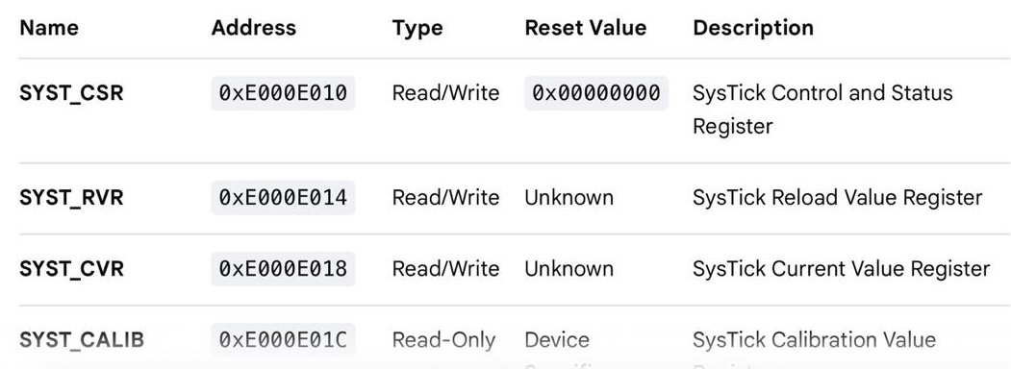
SysTick Address

Slide 10
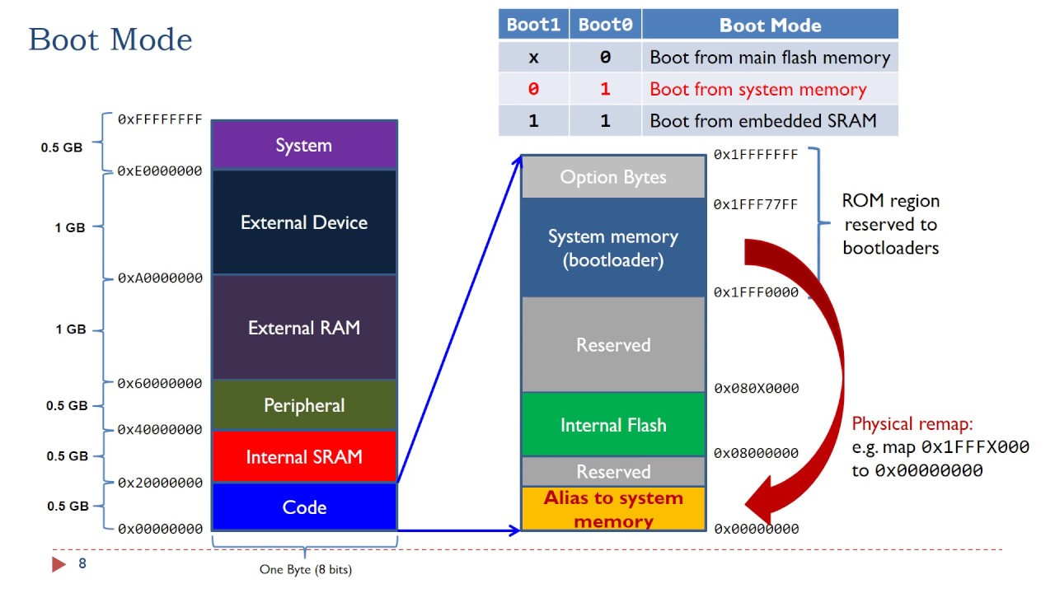
STM32 memory organizations

Slide 11
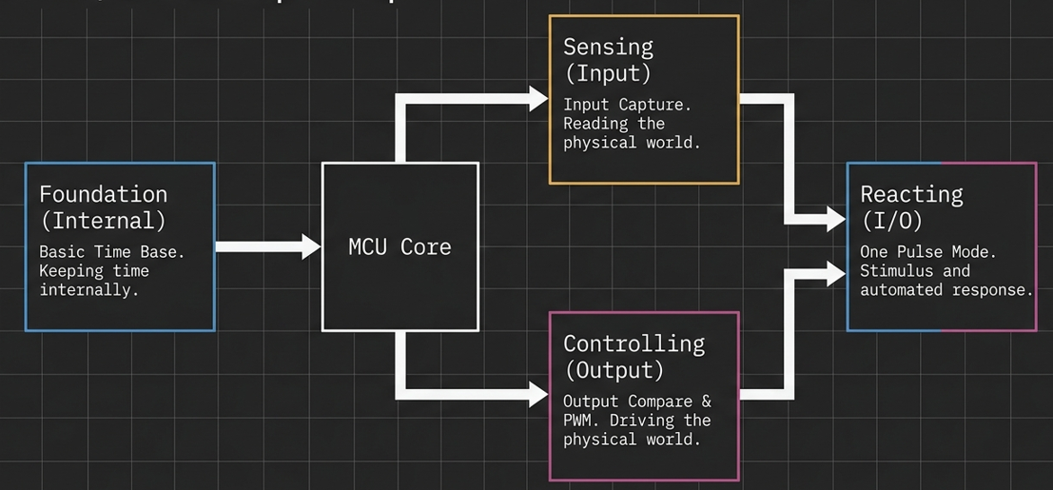
I/O Concept Map

Slide 12
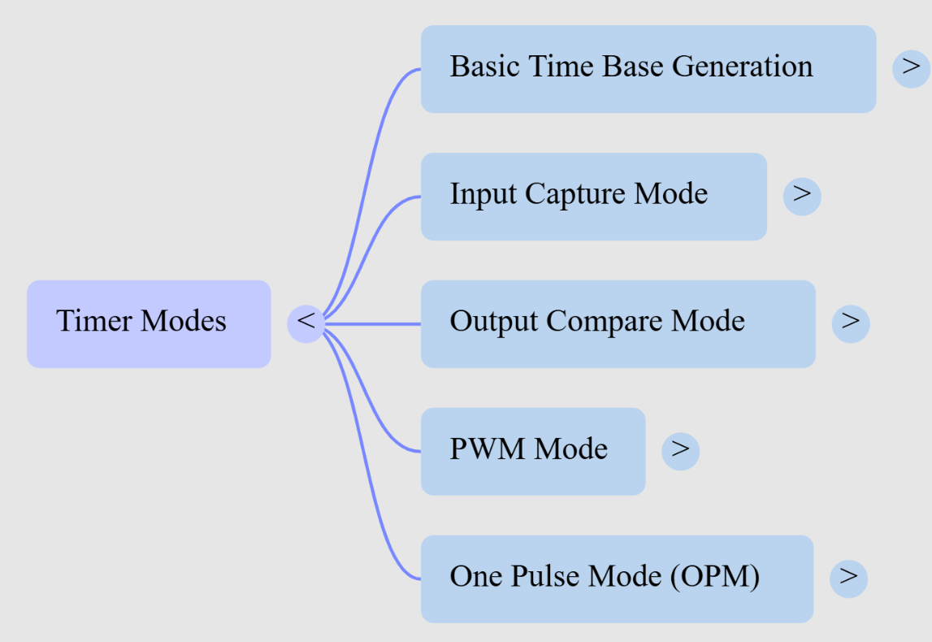
Timer Modes

Slide 13
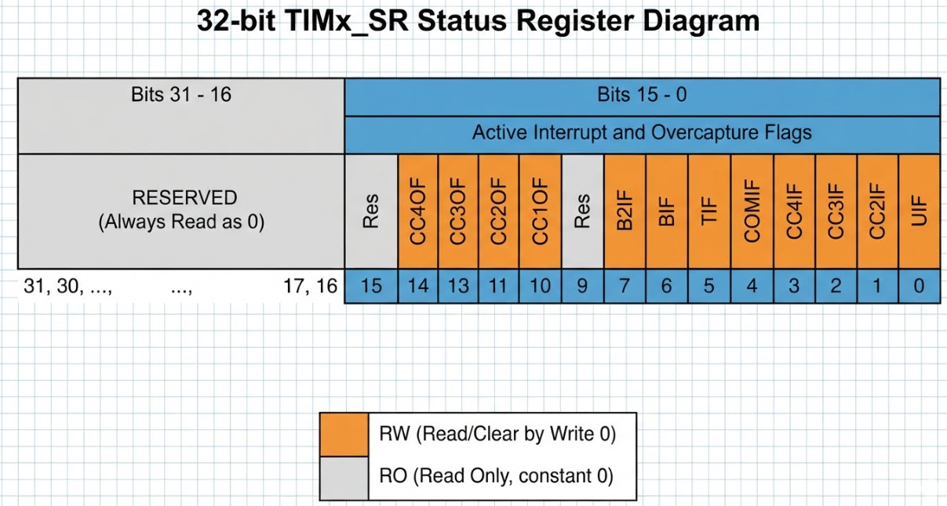
TIMER STATUS REGISTER

Slide 14
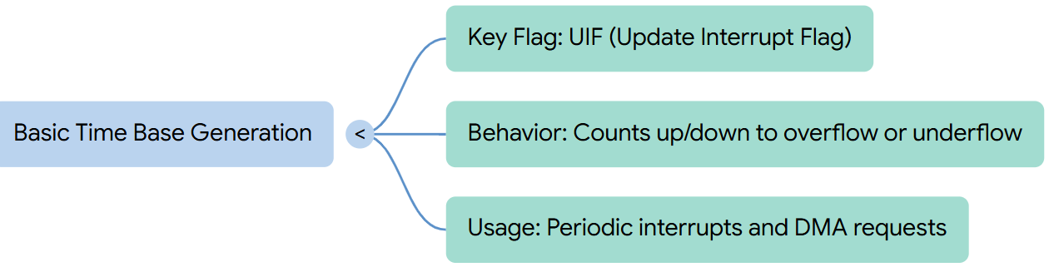
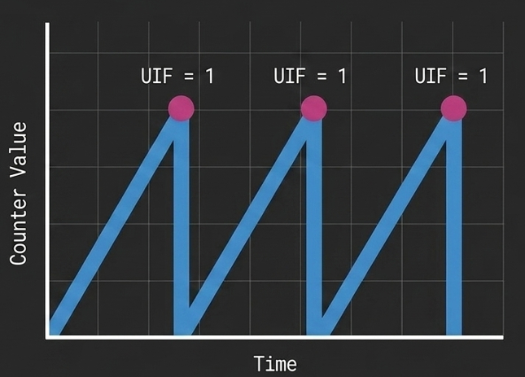
Basic Time Base Generation Mode

Slide 15
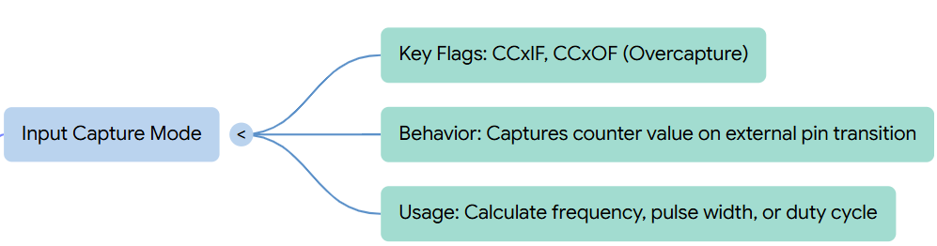
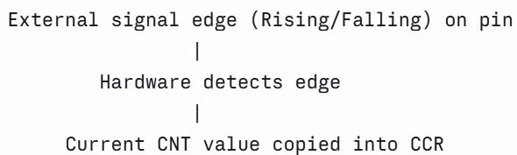
Input Capture Mode

Slide 16
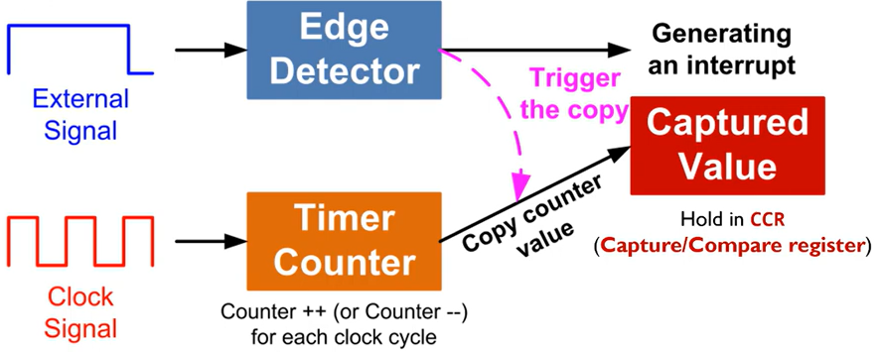
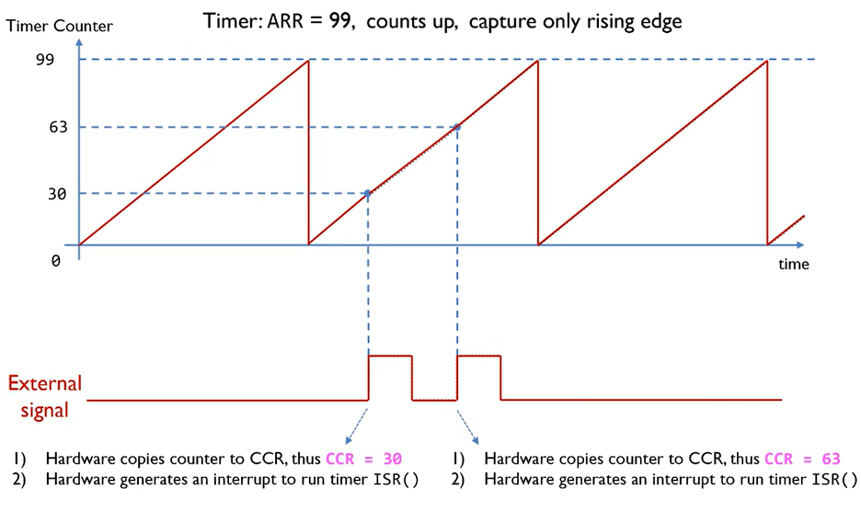
Input Capture Mode

Slide 17
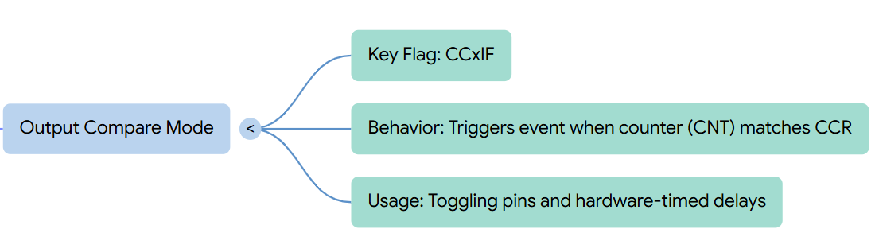
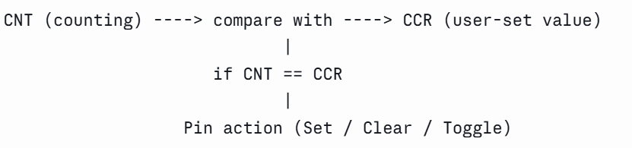
Output Compare Mode

Slide 18
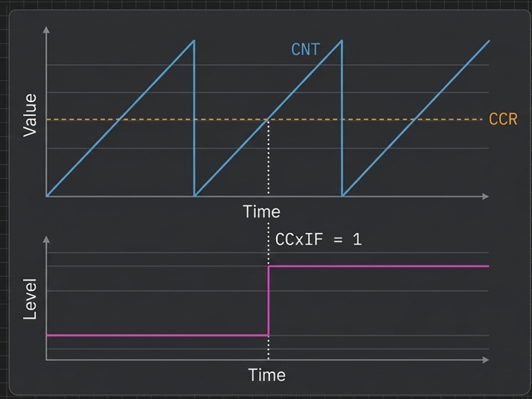
Output Compare Mode

Slide 19
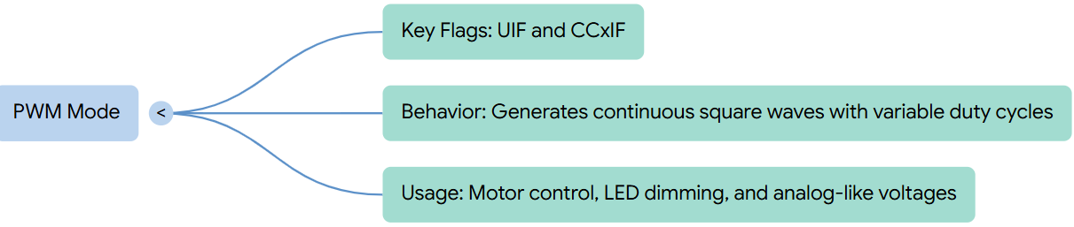
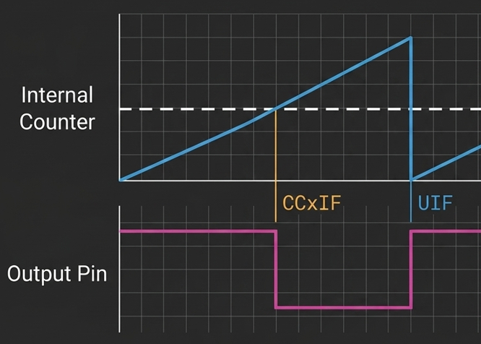
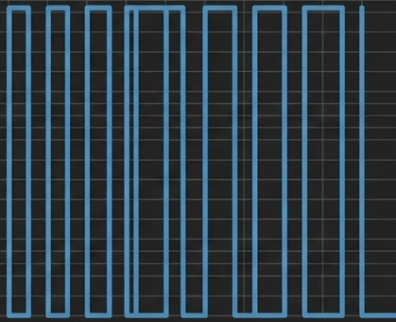
Continue Square Wave Pulses
PWM Mode

Slide 20
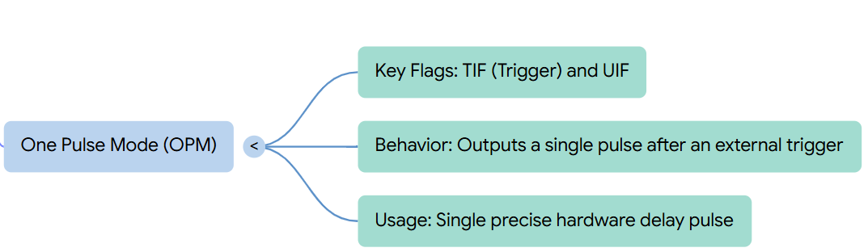
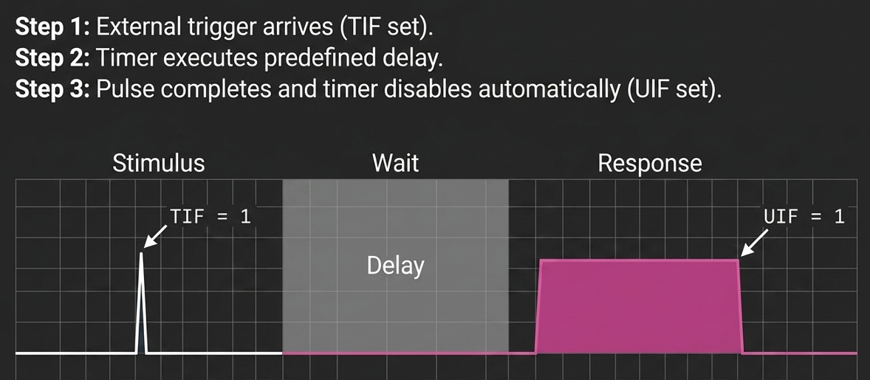

A combination of Input Capture and Output Compare
Behavior: TIF sets to 1 when the external stimulus arrives to start the pulse. UIF sets to 1 when the pulse finishes and the timer automatically disables itself.
Usage: Generating a single, precise hardware delay pulse after an external sensor or button event
OPM Modes

Slide 21
Timer to generate a 1 ms time base by selecting appropriate prescaler and auto-reload values.
Timer to generate a periodic interrupt every 1 ms
To generate a PWM signal of 2 kHz with a duty cycle of 50%.
PWM signal of 10 kHz with a duty cycle of 75%
Timer configuration procedure to generate a 1 kHz PWM waveform with a duty cycle of 60% using an STM32 microcontroller.

Slide 22
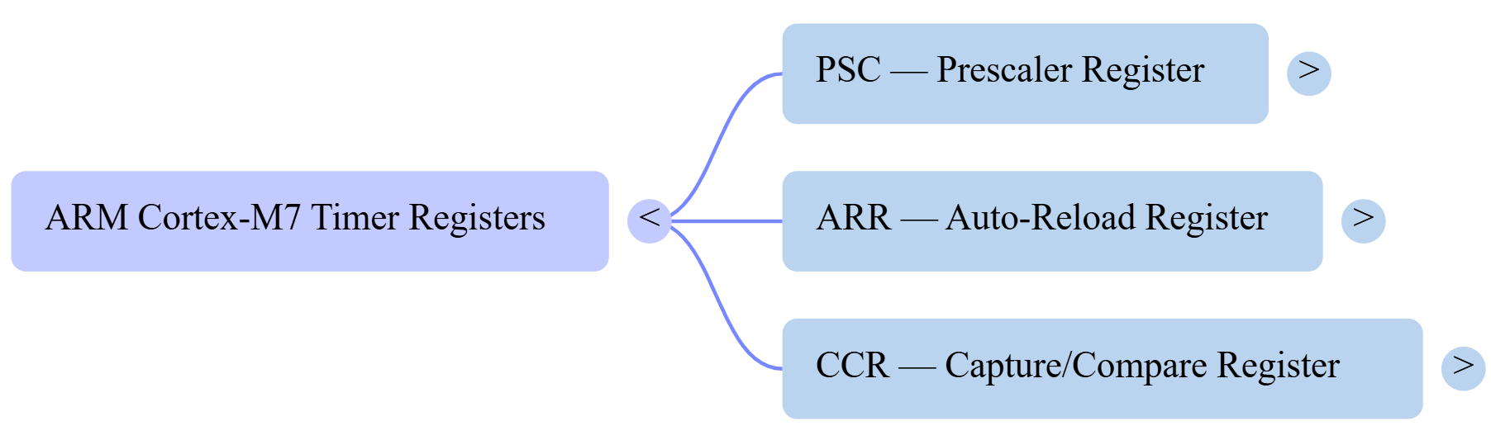




Slide 23
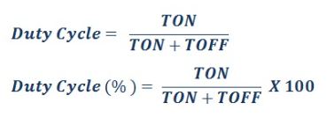
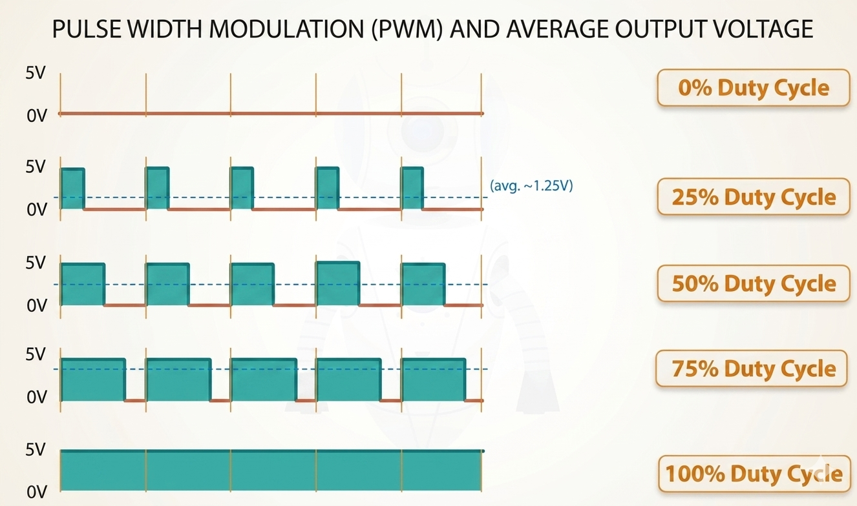
Duty Cycle
Duty Cycle | Time ON | Time OFF
25% | 2.5 mins | 7.5 mins
50% | 5.0 mins | 5.0 mins
75% | 7.5 mins | 2.5 mins
100% | 10.0 mins | 0.0 mins

Slide 24
Function | Meaning
HAL_TIM_Base_Start(&htim2) | Start TIM2 without interrupt
HAL_TIM_Base_Start_IT(&htim2) | Start TIM2 with interrupt
HAL_TIM_PWM_Start(&htim2, TIM_CHANNEL_1) | Start TIM2 PWM output
HAL_TIM_PWM_Start_IT(...) | Start PWM with interrupt
HAL Functions for Timer modes

Slide 25
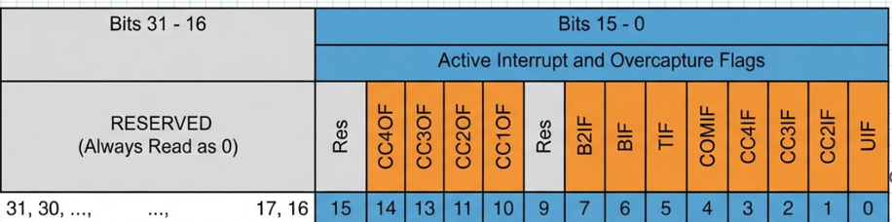
HAL_TIM_Base_Start(&htim2);
while (1)
{
if (__HAL_TIM_GET_FLAG(&htim2, TIM_FLAG_UPDATE))
{
__HAL_TIM_CLEAR_FLAG(&htim2, TIM_FLAG_UPDATE);
HAL_GPIO_TogglePin(GPIOA, GPIO_PIN_5);
}
}
Blinking of LED with out Interrupt

Slide 26
STM32CubeMX configuration
Open:
Timers → TIM2
Select:
TIM2 → Clock Source → Internal Clock
Parameter Settings
Parameter | Value
Prescaler | 83
Counter Mode | Up
Counter Period (ARR) | 999
Auto-reload preload | Disable

Slide 27
HAL_TIM_Base_Start_IT(&htim2);
while (1)
{
…..
}
void HAL_TIM_PeriodElapsedCallback(TIM_HandleTypeDef *htim)
{
if (htim->Instance == TIM2)
{
HAL_GPIO_TogglePin(GPIOA, GPIO_PIN_5);
}
}
Blinking of LED with Interrupt

Slide 28
STM32CubeMX configuration
Open:
Timers → TIM2
Select:
TIM2 → Clock Source → Internal Clock
NVIC └── TIM2 global interrupt = Enabled
Parameter Settings
Parameter | Value
Prescaler | 83
Counter Mode | Up
Counter Period (ARR) | 999
NVIC | TIM2 global interrupt = Enabled
Auto-reload preload | Enable

Slide 29
__HAL_TIM_SET_COMPARE(&htim2, TIM_CHANNEL_1, 600);
HAL_TIM_PWM_Start(&htim2, TIM_CHANNEL_1);
while (1)
{
}
1 kHz PWM, 60% duty cycle
  TIM1 clock = 84 MHz
  PSC = 83
  ARR = 999
  CCR1 = 600
1 kHz PWM, 60% duty cycle

Slide 30
STM32CubeMX configuration
Open:
Timers → TIM2
Select:
TIM2 → Clock Source → Internal Clock
For PWM, select:
TIM2 → Channel 1 → PWM Generation CH1
Parameter Settings
Parameter | Value
Prescaler | 83
Counter Mode | Up
Counter Period (ARR) | 999
Clock Division | DIV1
Auto-reload preload | Enable/Disable as required
PWM Pulse (CCR1) | 600
PWM Mode | PWM mode 1

Slide 31
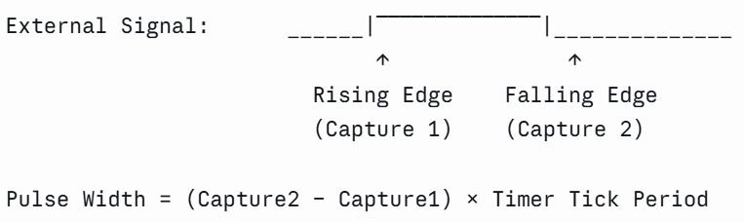
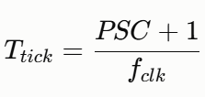
Timer Tick Period
Example:
Timer clock = 84 MHz
Prescaler (PSC) = 8399
Rising edge captured at CNT = 200
Falling edge captured at CNT = 700
Determining Pulse Width of an External Signal Using Timer Capture/Compare Mode

