Slide 1
Electric Vehicle Market Analysis
Problem Statement – KPIs & Charts Requirement

Slide 2
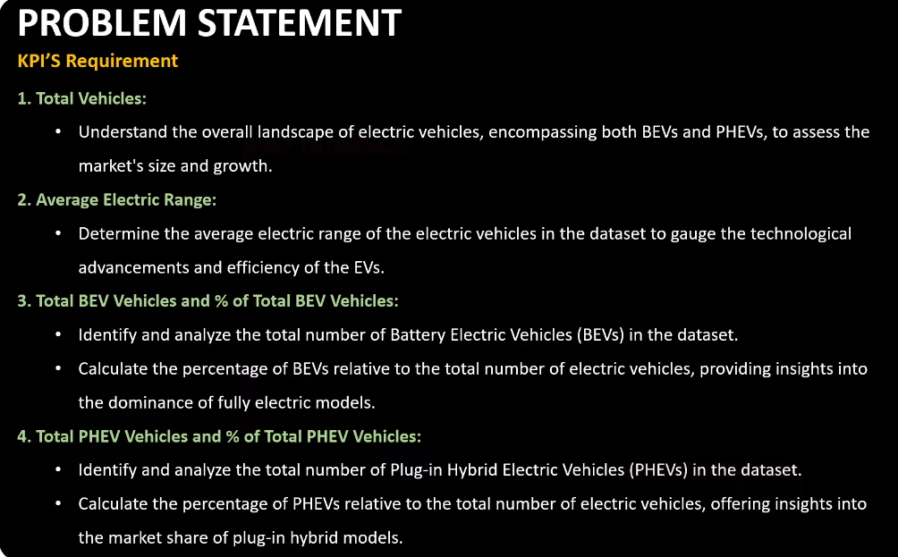

Slide 3
