Slide 1

BAN 240 - Financial Industry Group
Credit worthiness classification
Srijith Leelakrishnan - 165893215
Pulathis Perera - 168207215
Keerthana Shreepal Urs - 161390216
Ramya Tallapudi - 165068214
Laxmikant Mukkawar - 168554210
Monish Aitha Vignasai - 117519215

Slide 2
Table of contents
1. Introduction
2. IndustryOverview
2.1. IndustryOverview
2.2. IndustryOverview-2
3. LiteratureReview
3.1. LiteratureReview-1
3.2. LiteratureReview-2
3.3. LiteratureReview-3
3.4. LiteratureReview-4
4. DataDescription
4.1. AttributeDescription
5. Conclusion

Slide 3
Industry Overview
Financial industry is a major sector of business that consists of the firms that provide financial services to commercial and retail client. The primary business of these firms is to generate commissions by offering services like banking, loan, insurance, mutual funds, stock market, mortgages and other financial services. In other words, this industry is the funding window for any industry.
A country's development and economy relies on how well financial companies in that country is performing. It consists of three interlinked areas as follows:
Ø Money and credit markets, which deals with the security markets and financial institutions.
Ø Investments, which focuses on the decisions made by both individuals and institutional investors.
Ø Financial management, which involves decisions made within the firm regarding the acquisition and use of funds.

Slide 4
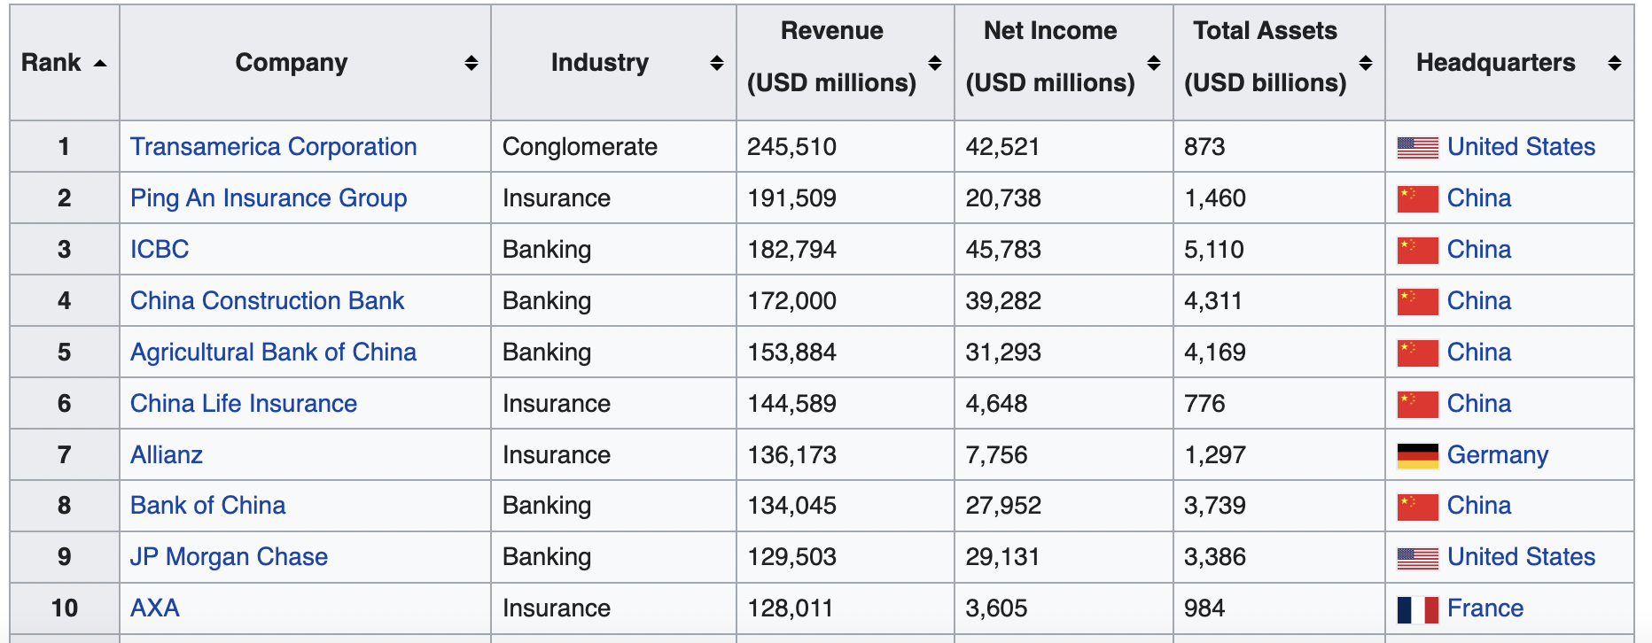
Key Players in the Financial Industry

Slide 5
Key Success Factors in Financial Industry
Measuring Marketing efforts
Communicating Brand
Focus on Needs
Utilization of Technology

Slide 6
Introduction
WHAT?
The main goal of this project is to analyse the past data and classifying the credit card holders’ profile as good or bad based on factors such as Age, income, annual expense estimates, previous loan repayment behaviour, existing loans and payment schedule, net worth
WHY?
to understand which category of customers defaults the most
HOW?
Using the Machine Learning model by

Slide 7
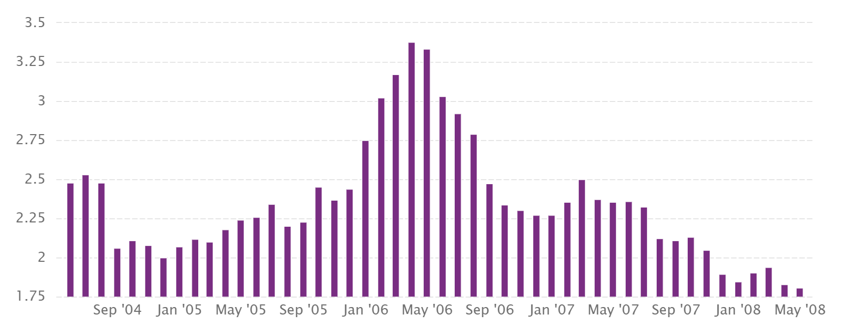
Taiwan’s Credit Card: Delinquency Ratio

Slide 8
Research Questions
What are the weightage of the factors mentioned in introduction to calculate credit worthiness?
What are the strategies for risk management ?
How to do they work with bad credit and unrecovered loans.?

Slide 9
Literature Review-1
Journal Name: A survey of credit and behavioral scoring: forecasting financial risk of lending to consumers
Authors: Lyn C. Thomas
Year Published: 2000
Highlights:
Some characteristics such as race, sex and religion are illegal to be used in scoring. However, these variable do have an indirect impact on credit score.
Accounting for economic effects has prolonged life time of models
Through this modelling, society will be categorized into two main segments: those who can borrow from all and those who cannot borrow from any. This may result in unfavorable conditions for the latter.
https://www.sciencedirect.com/science/article/abs/pii/S0169207000000340

Slide 10
Literature Review-2
Journal Name: Using data mining to improve assessment of credit worthiness via credit scoring models
Authors: Bee Wah Yap, Seng Huat Ong, Nor Huselina Mohamed Husain
Year published: 2011
Highlights:
Main techniques used are predictive modelling, cluster analysis, classification and association analysis. They have been useful in credit scoring, customer segmentation and profiling.
Two of the biggest limitations are unavailability of accurate data due to errors in recording, missing entries, etc. and in determining a sample.
The study indicated that there is no specific best model but the effectiveness of any model depends on data quality, and the purpose of classification.
Advanced techniques such as ANNs, MARS and SVM did not result in drastic accuracy improvements.
Most users preferred methods such as scorecards and decision trees.
https://wwwsciencedirectcom.libaccess.senecacollege.ca/science/article/pii/S0957417411006749#s0115

Slide 11
Literature Review-3
Article Name: Credit allocation, risk management and loan portfolio performance of MFIs—A case of Ugandan firms (MFI – Microfinance Institution)
Authors: Bob Ssekiziyivu, Rogers Mwesigwa, Mayengo Joseph, Isaac Nkote Nabeta
Year Published: 2017
Highlights:
Objective was to determine the connections between credit allocation, risk management and loan portfolio performance of MFIs in Uganda.
Credit allocation and risk management were seen to have significant effect on loan portfolio performance.
Study recommends that managers should educate loan takers on how to utilize loan facilities to reduce default rates
https://www-tandfonline-com.libaccess.senecacollege.ca/doi/full/10.1080/23311975.2017.1374921

Slide 12
Literature Review-4
Article Name: Can machine learning paradigm improve attribute noise problem in credit risk classification?
Authors: Lean Yu, Xiaowen Huang, Hang Yin
Year Published: 2020
Highlights:
Measuring the noise level of attributes in the data
To process and denoise the data, they follow a three step strategy.
To measure the noise level of attributes in the data
Set a threshold to identify high and medium noise levels in attributes. High noise attributes are deleted while medium ones are denoised using ML algorithms. Aim of the step is to preserve as much attributes as possible.
CART method is used to classify the credit worthiness of the consumer
Improved accuracy and reduces error statistics
https://www-sciencedirect-com.libaccess.senecacollege.ca/science/article/pii/S1059056020301969#sec4

Slide 13
Data Description
This dataset consists of a total of 23 fields and 30,000 observations. By analyzing and performing data audit, we observed that all the 23 fields can be used to establish pattern and then classify a new customer with the similar profile as a defaulter or not.
The data shared by the business consists of information like :-
Current outstanding credit of the applicant and immediate family.
Gender.
Education.
Marital status.
Age.
Past payments YTD
Past usage trends of last 5 months.
Past payments of last 5 months.
Customer defaulter Report.

Slide 14
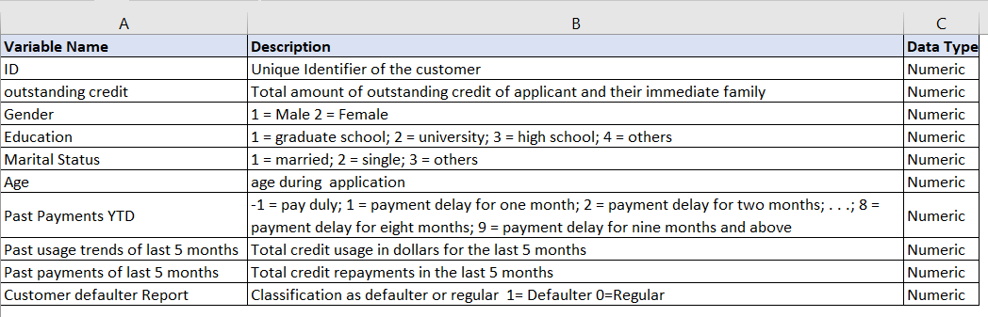
Attribute Description

Slide 15
Conclusion
Though there are a few researches in the credit risk scope, our analysis is aimed at building a model that analyses various financial factors and identifies a good credit customer and a bad credit customer.
This is a pure classification model that does not involve credit scoring or ranking.

Slide 16
THANK YOU!

