Slide 1

Note: The data and information in this document is reflective of a hypothetical situation and client. This document is to be used for KPMG Virtual Internship purposes only.
Sprocket Central Pty Ltd
Data analytics approach
[Division Name] - [Engagement Manager], [Senior Consultant], [Junior Consultant]

Slide 2
Note: The data and information in this document is reflective of a hypothetical situation and client. This document is to be used for KPMG Virtual Internship purposes only.
Agenda
Introduction
Data Exploration
Model Development
Interpretation

Slide 3

Note: The data and information in this document is reflective of a hypothetical situation and client. This document is to be used for KPMG Virtual Internship purposes only.
Introduction
Data Analysis path for targeted marketing
In this presentation, we will go through the pathway that we will follow to get insights from the given data that will help to target the new customers from the dataset given.

Slide 4
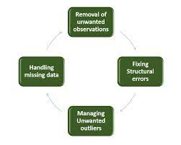
Note: The data and information in this document is reflective of a hypothetical situation and client. This document is to be used for KPMG Virtual Internship purposes only.
Data Exploration
Getting Familiar With The Data.
In this data we will explore what data is about, what attributes it has its data types and use appropriate feature engineering techniques to transform the data. So that the transformed data will be clean and we can perform further actions on it.
Place any supporting images, graphs, data or extra text here.

Slide 5
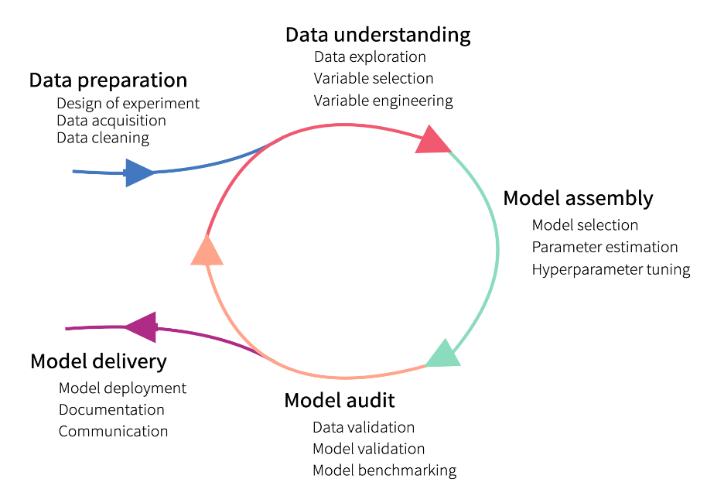
Note: The data and information in this document is reflective of a hypothetical situation and client. This document is to be used for KPMG Virtual Internship purposes only.
Model Development
Building Model
In this phase, we will build a model based on our data which will help get us results on our data. The model building includes.
Data Extraction.
Data Cleaning.
Exploratory Data Analysis.
Feature Selection.
Incorporating Machine Learning Algorithms.
Testing and deploying Model.
Place any supporting images, graphs, data or extra text here.

Slide 6
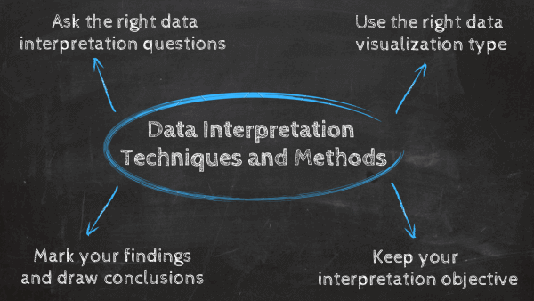
Note: The data and information in this document is reflective of a hypothetical situation and client. This document is to be used for KPMG Virtual Internship purposes only.
Interpretation
Interpretation and Reporting
In this phase, we will analyze the results obtained from the model that we developed. And report the finding on which customers to target from the given dataset of 1000 customers.
Place any supporting images, graphs, data or extra text here.

Slide 7
Note: The data and information in this document is reflective of a hypothetical situation and client. This document is to be used for KPMG Virtual Internship purposes only.
Thank You

