Slide 1
Algebra Game (Graspable Math)
Laxmi Bhavani Malkareddy
Liping Sun
Prasandeep Singh
Rohith Nedunuri
Sameedha Bairagi
Shree Harsha Sridharamurthy
CSCI-P632 Object Oriented Software Management

Slide 2
Agenda
Understanding Requirements
Hands-On for GM APIs
Technologies Used
Game Ideas
Game Features
Next steps

Slide 3
Understanding Requirements
1. Goal of the project is to make the process of learning algebraic math fun through interactive game, thereby serving a better learning curve for 5th Graders.
2. Provide a cool and suave game which can be used as demo for corporate clients to make them visualize the use of GM APIs
3. Identify issues with existing GM APIs and their usage.

Slide 4
Technologies Used
Javascript
HTML
CSS

Slide 5
Hands on demo for GM APIs
Demo

Slide 6
Game Ideas
Save Dino Eggs
MathVille
Maze
Travelling Penguin
Tic Tac Toe

Slide 7
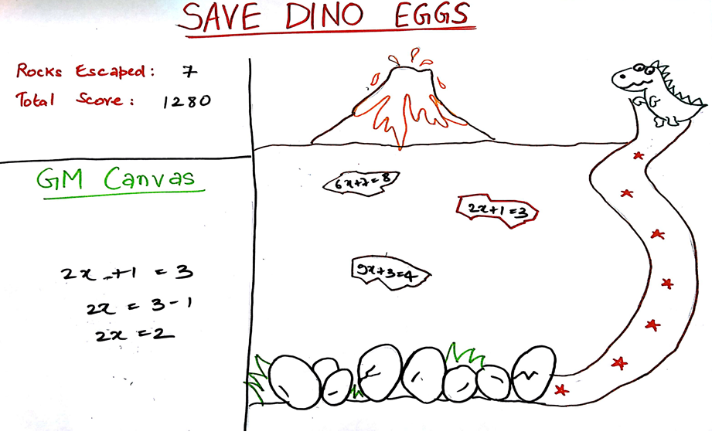
Idea 1 – Save Dino Eggs
Expressions in form of volcanic rocks fall over dinosaur eggs.
Parent dinosaur gets one step closer towards the egg after solving each equation.
Player wins and proceeds to the next level upon helping the dinosaur reach its eggs.

Slide 8
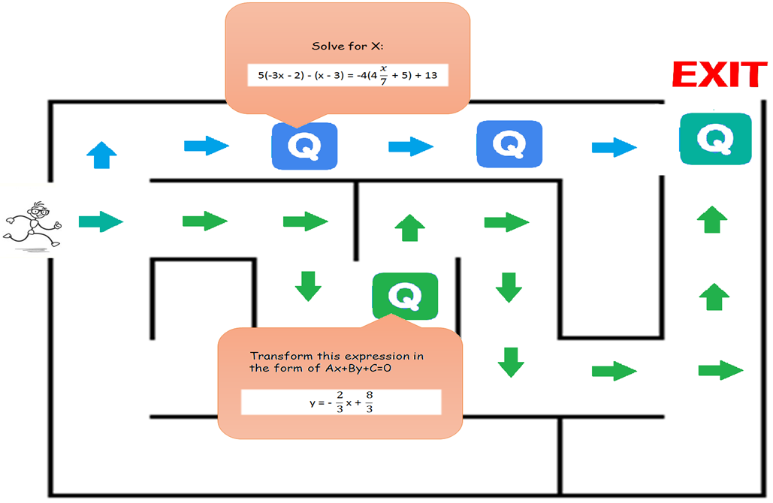
Idea 2 – Maze
Maze with equations as hurdles.
Longer paths will have easier equations to solve.
Equations to be solved using Graspable Math canvas.
Player’s goal is to find their way through the maze to the exit.

Slide 9
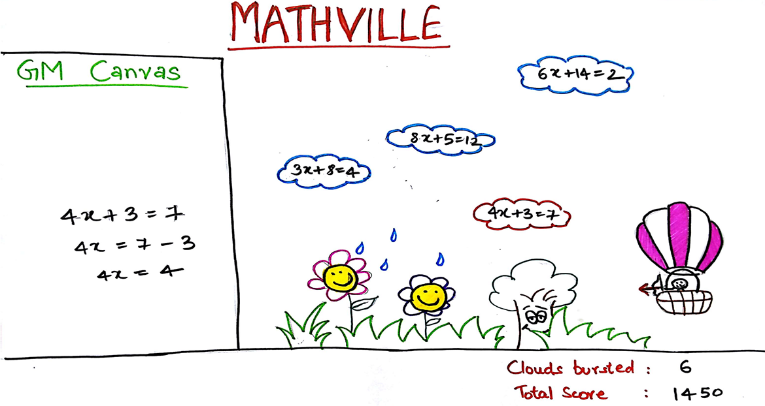
Idea 3 – Mathville
Moving clouds contain math expressions.
Once an expression is solved, it turns into an arrow for the user to aim at the cloud.
Cloud bursts to pour rain over the garden.
Aim is to have a blooming garden with flowers, trees, fruits etc.
Harder levels can have rodents eating up the garden if user misses more than five clouds.

Slide 10
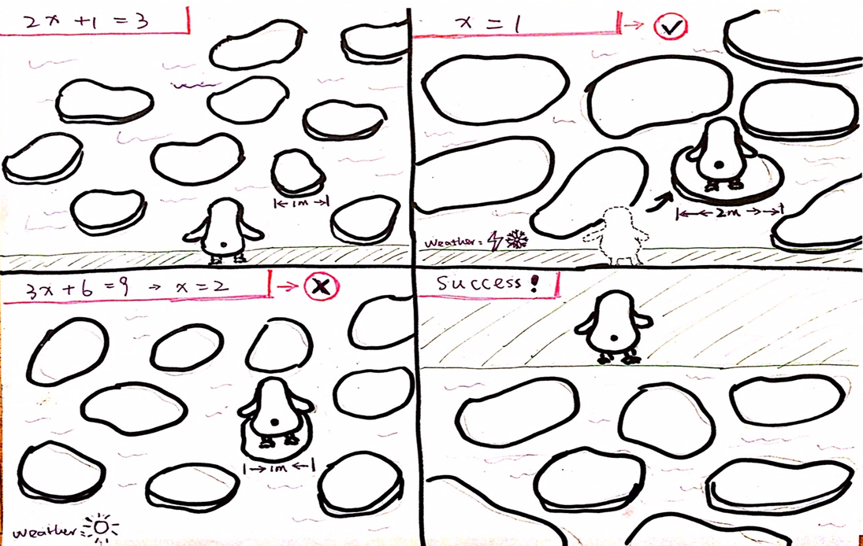
Idea 4 – Travelling Penguin
Penguin jumps across stones
Melting icebergs
Power ups to add extra ice/snow to the melting iceberg
Player wins if the penguin is successfully moved to the end stone in time

Slide 11
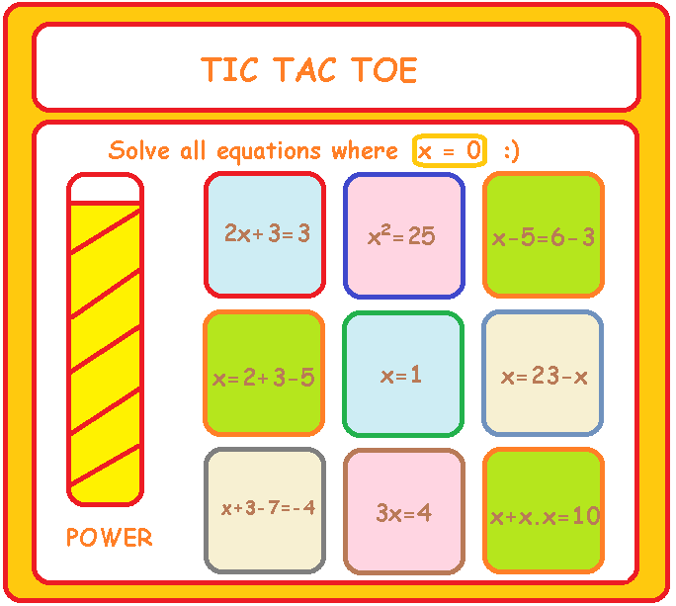
Idea 5 – Tic Tac Toe
Tic tac toe based game
Player needs to complete a line of equations – horizontal, vertical or diagonal
All equations are shown and a task is given at the beginning of every level
There is only one line of equations which is correct
Power bar increases for correct answers and helps obtain a power up which solves an equation automatically to aid in faster solving

Slide 12
Game Features
Level Control
speed
number of expressions visible at a time
difficulty of expressions
Power Ups
Freezing the game
Increasing speed
Bonus levels
Special power up which allows user to create and solve own expressions to increase their score
Miscellaneous
Substitution action in equations
High scores
Higher algebra

Slide 13
Next Steps
Meet clients with proposed ideas
Finalize the idea to be implemented
Start work on the finalized idea

Slide 14
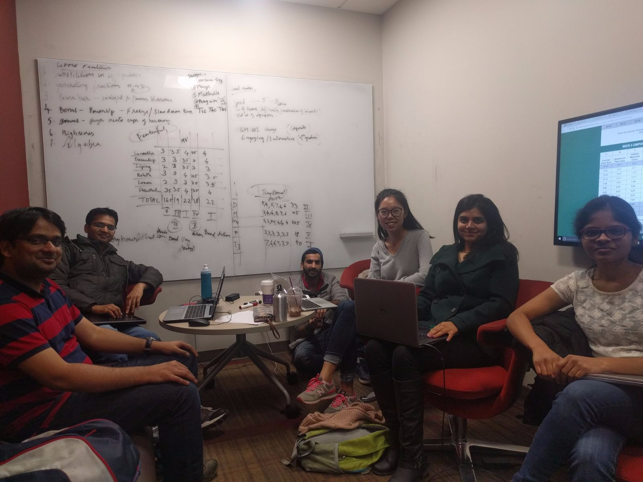
Brainstorming session

Slide 15
Thank you! ☺

