Slide 1

Project Title : RaktaSetu - A Real-Time Blood & Organ Matching Network
Principal Investigator: Laxmi Chandrahaas Donthula
Co-Principal Investigator: Vivekanand Reddy Dandu
Mentor: Dr. Rakesh Salakapuri
Department of Computer Science and Engineering (III Semester)

Slide 2
Plan of Presentation
Introduction
Related work
Methodology
Results
Future scope
Conclusion
References

Slide 3


Introduction
The Problem: The "Golden Hour" is lost due to manual phone calls and static databases.
The Solution: A cloud-native platform that instantly matches donors using WebSockets and Geospatial search.

Slide 4
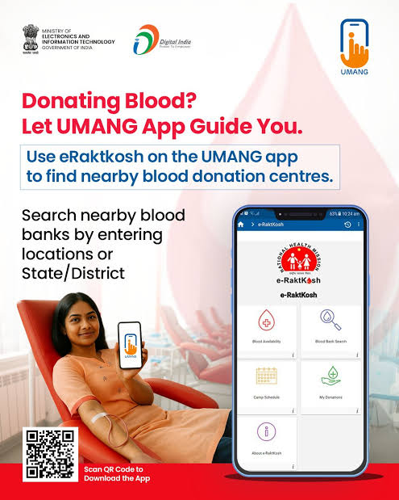
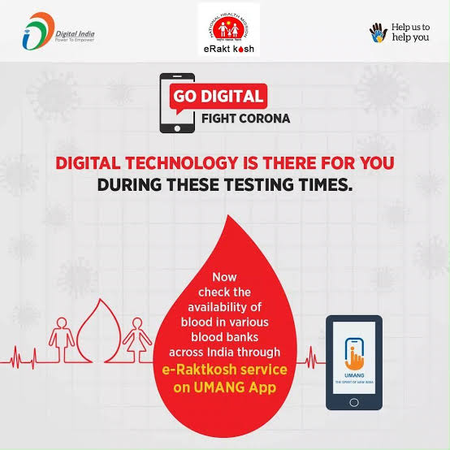
Related work
Existing Systems: Government portals like e-RaktKosh act as passive directories.
Limitations:
  No real-time "push" notifications.
  No distance-based ranking (contacting donors 50km away).
  Requires manual page refreshes.

Slide 5
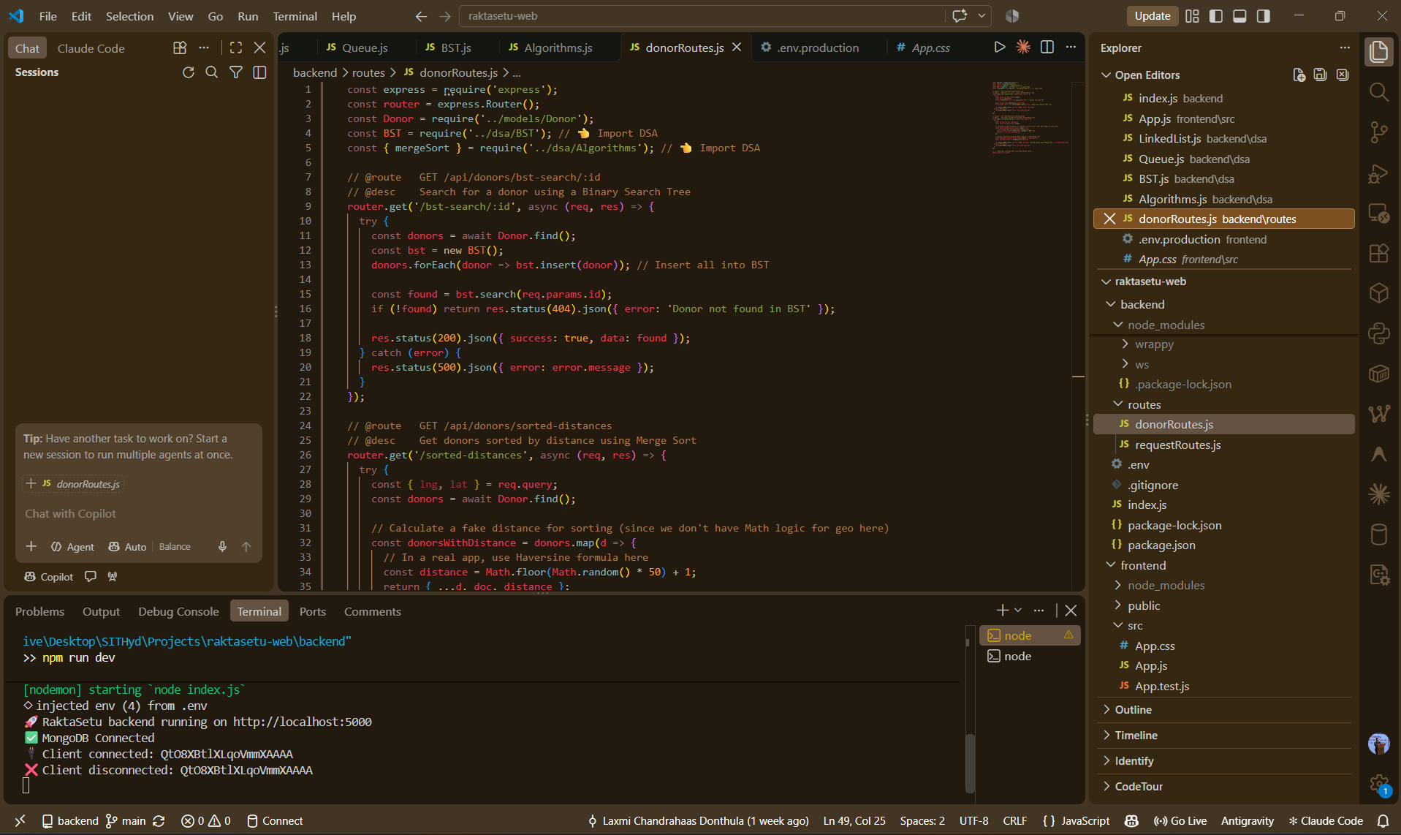
Methodology (System Architecture)
Frontend: React.js (Deployed on Vercel)
Backend: Node.js & Express (Deployed on Render)
Database: MongoDB Atlas (Cloud)
Real-Time Engine: Socket.IO (WebSockets)
Flow: React UI → REST API → MongoDB → WebSocket Broadcast.

Slide 6
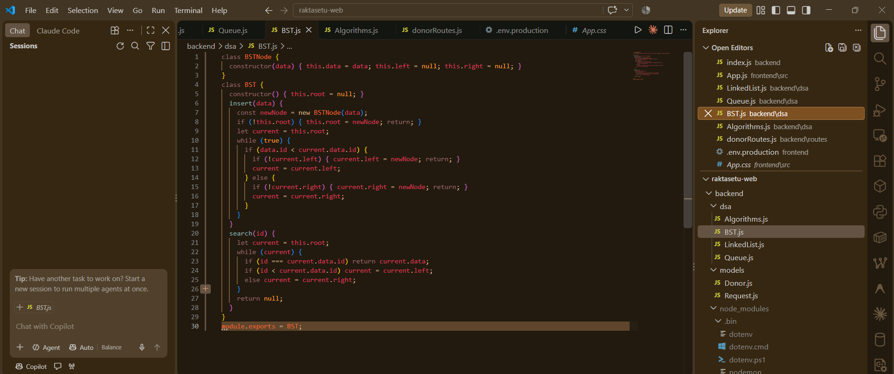
Methodology (DSA Integration)
Min-Heap: O(log N) emergency triage (Critical issues bubble to top)
Hash Map: O(1) blood compatibility checking
Binary Search Tree: O(log N) donor lookup by ID
Graphs (BFS): MongoDB 2dSphere spatial index for radius-based matching
[Request] ➡️ [Hash Map (O(1))] ➡️ [Min-Heap (O(log N))] ➡️ [MongoDB (Graph/BFS)] ➡️ [Socket.io Alert]

Slide 7
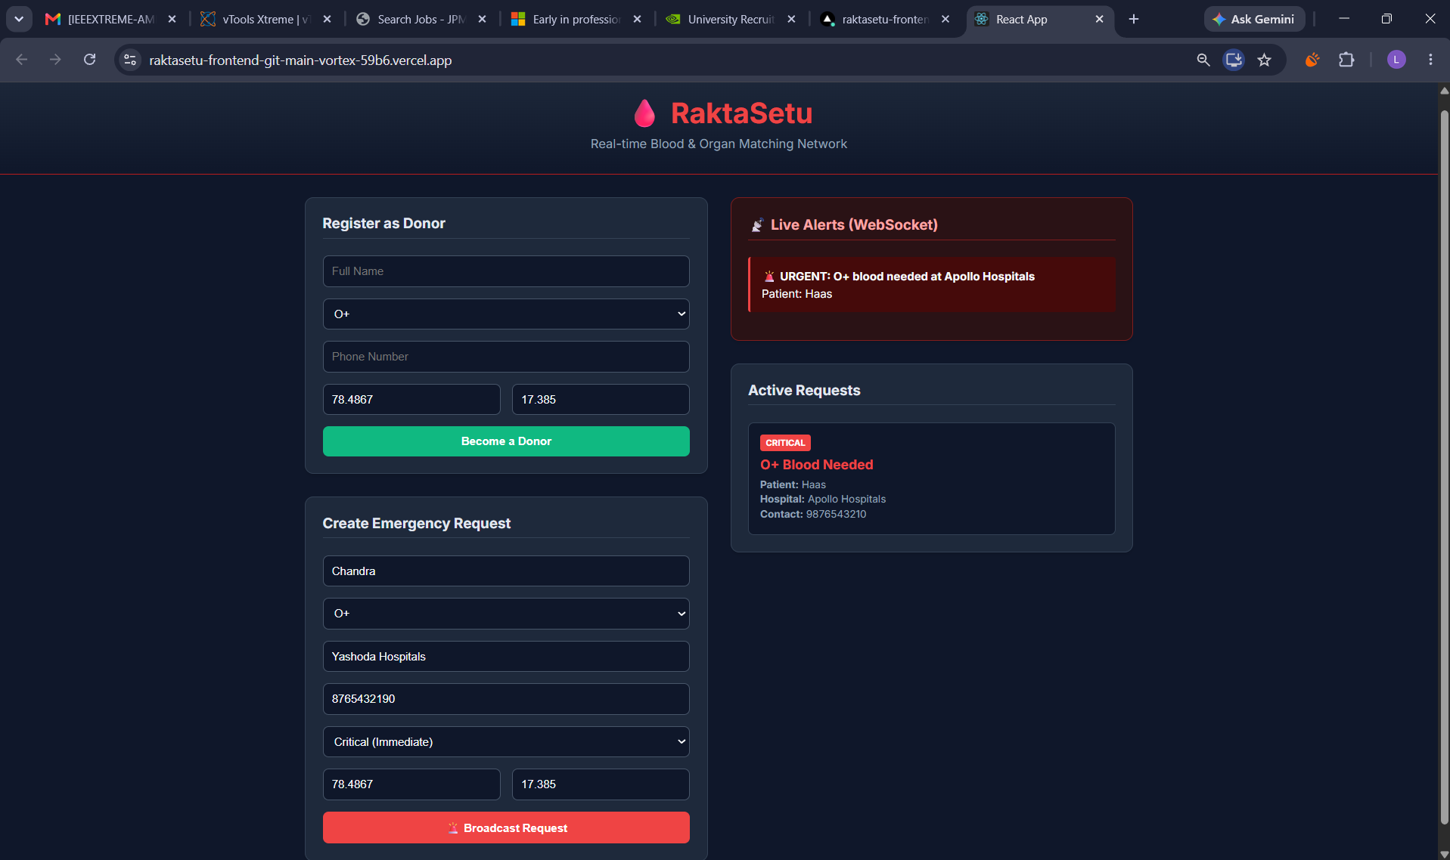
Results

Slide 8


Future scope
SMS Fallback: Integration with Twilio for offline donors.
e-RaktKosh API: Linking with the national database.
Machine Learning: Predicting blood demand spikes during disasters.

Slide 9
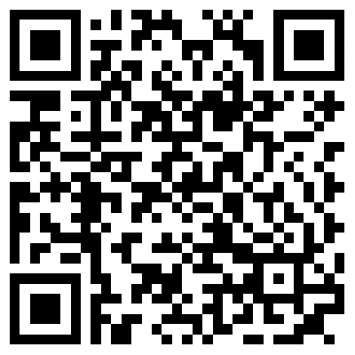
Conclusion
Successfully bridged a life-saving real-world problem with core DSA principles and cloud deployment.
References:
MongoDB Geospatial Query Docs (2dsphere).
Socket.IO Real-Time Engine Docs.
Cormen et al., Introduction to Algorithms.
Scan to test the Live Application

Slide 10
Thank you!!

