Slide 1
KeyLogger
Presented by:
Chitrala Laxmidevi(160122737317)
Chenu Vaishnavi(160122737318)

Slide 2

Agenda
1.Introduction
2.Technologies and Methodologies
3.System flow Diagram
4.Implementation and Results
5.Challenges In Internship
6.Outcome of the Internship
7.Conclusion and Future scope
8.Biblography

Slide 3
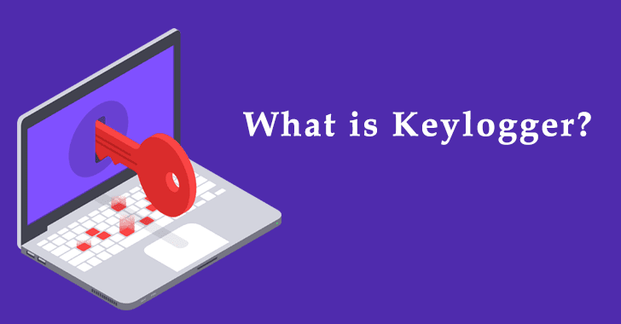

Slide 4
Introduction
Purpose: This project focuses on creating an automated data collection system using various sensors like a keyboard (keylogging), webcam, microphone, and screenshots. The data collected is automatically processed and sent via email.
Objective: To collect information from a target system (such as keystrokes, webcam images, audio, and screenshots) and securely send the data to a predefined email address for analysis or monitoring.
Outcome: This system can be utilized for security purposes (e.g., parental controls, corporate monitoring) or for legitimate research purposes with consent.

Slide 5
2. Technologies Used
Programming Language: Python (due to simplicity, extensive libraries, and community support).
Libraries/Modules:Pynput: For capturing keystrokes in real time (keylogger).
Pillow (PIL): For capturing screenshots.
OpenCV: For webcam image capture.
Sounddevice: For microphone recording.
SMTP (Gmail API): For email integration to send collected data.
Logging: For maintaining keylogs securely and efficiently.
Platform: Primarily developed on Windows (can be modified for other OS).External Tools: Gmail for email service.

Slide 6
System Architecture
Data Collection: Keyboard events are logged through Pynput (Keylogger).
Webcam images are captured using OpenCV.
Microphone audio is recorded using Sounddevice.
Screenshots are periodically captured using PIL.
Data Processing: All collected data (keystrokes, images, audio files) is stored temporarily on the system.
Data Transfer: Once data is collected, it is bundled into an email and sent to the predefined Gmail address using SMTP.

Slide 7
Methodology
Data Collection:Keylogging: Each keypress is logged in a text file using the Pynput library.
Screenshot Capturing: Screenshots of the desktop screen are captured every 5 seconds using PIL (Python Imaging Library).
Webcam Images: Webcam images are captured periodically using OpenCV.

Slide 8
Methodology
Audio Recording: Audio is recorded in chunks of 10 seconds using Sounddevice and saved in WAV format.
Data Handling:The collected data is stored locally in designated folders (e.g., "Keylogs", "Screenshots").
Email Sending:Once all data is collected, the program compiles all files into a single email and sends it to a Gmail address.

Slide 9
System Flow Diagram
Step-by-Step Flow:Data
Collection:
Keylogger captures keystrokes.
Webcam captures images.
Microphone records audio.
Screenshots are taken periodically.
Data Storage:
All collected files are stored in a temporary directory.

Slide 10
System Flow Diagram
Data Processing:
The files are attached to an email.
Email Sending:
Email is sent with the collected data.
Cleanup:
Temporary files are deleted after sending the email

Slide 11
SYSTEM FLOW DIAGRAM
a
start
Initialize System
Start Keylogging
Prepare Email
Data collection complete
Start webcam Capturing
Send Email
Clean Up

Slide 12
Implementation and Results
Code Structure:
The code consists of several functions for each task:
Keylogging: Logs keypresses to a text file using Pynput.
Screenshot Capture: Captures the desktop every 5 seconds.
Audio Recording: Records audio for 10 seconds every iteration.
Webcam Capture: Captures an image every 5 seconds using OpenCV.

Slide 13
Sample Results:
Keylogs: A text file containing the recorded keystrokes.
Screenshots: Images stored as PNG files.
Audio Files: Recorded WAV files.
Webcam Pictures: JPG files showing captured images from the webcam.

Slide 14
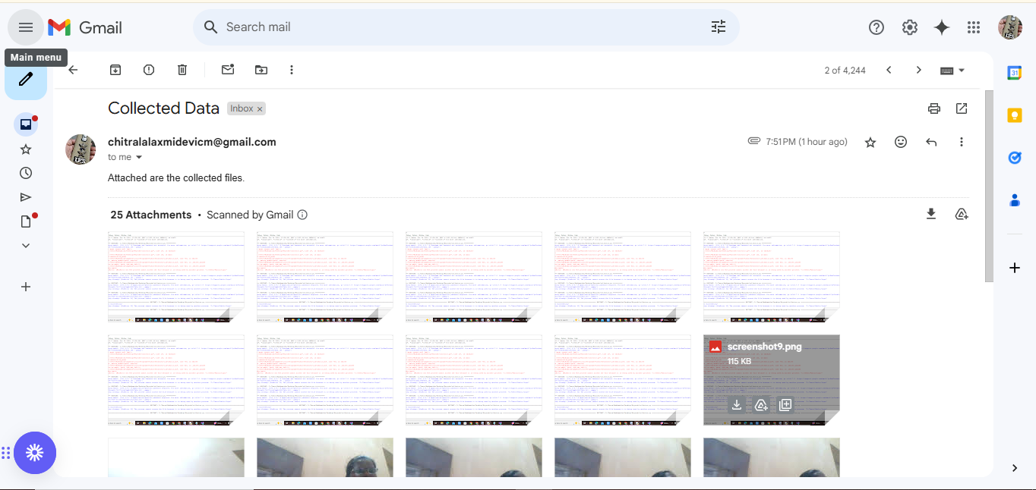
Results

Slide 15
Challenges in Internship
Technical Challenges:
Integrating various sensors (keyboard, microphone, camera) into a single program.
Dealing with OS-level restrictions on accessing the webcam and microphone.
Debugging synchronization issues between multiple processes running in parallel.
Security and Ethical Issues:
Ensuring data privacy while implementing keylogging.
Adhering to ethical guidelines for data collection, especially on sensitive devices.

Slide 16
Outcomes of Internship
Skills Gained:Technical skills in Python programming.
Experience working with various Python libraries for system monitoring.
Understanding the intricacies of real-time data collection and processing.
Personal Growth:Improved problem-solving skills through debugging and testing.
Enhanced knowledge in ethical hacking and understanding of data privacy.

Slide 17
Learning Outcomes:Practical exposure to working with real-time data from hardware devices.
Developed a system that balances system security with functionality.

Slide 18
Conclusion Summary of Work: The internship project involved developing a system that can collect data from multiple sources on a device (keyboard, webcam, microphone, and screenshots). The collected data is processed and sent via email automatically. Significance: This project demonstrates the integration of various technologies and libraries to create a functional data collection system. The system can be useful for legitimate purposes (e.g., security monitoring) if implemented ethically. Achievements: Successfully built and implemented a system to collect data from multiple sources. Ensured data was securely transmitted to a specified email address.

Slide 19
Future Scope Improvements: Adding more sophisticated data encryption for security during transmission. Implementing AI-based image recognition for webcam captures. New Features: Real-time alerts (e.g., email notifications when specific keywords are typed). Cloud-based storage for better management and scalability of the collected data. Expanding the System: Adding support for additional sensors (e.g., motion detectors, GPS tracking for mobile devices).

Slide 20
Bibliography
Books/Articles:"Python for Data Science Handbook" by Jake VanderPlas
"Automate the Boring Stuff with Python" by Al Sweigart
Online Resources:Python Documentation
Pynput Documentation
OpenCV Documentation

Slide 21
THANKS!

