Slide 1
Customer Retention
By : Laxmikant deepak

Slide 2
Objective of the study
The objective of the project is to apply analytical skills to give findings and conclusions in detailed data analysis of E-retail factors for customer activation and retention.

Slide 3
BUSINESS MODEL
. Customer satisfaction has emerged as one of the most important factors that guarantee the success of online store; it has been posited as a key stimulant of purchase, repurchase intentions and customer loyalty. A comprehensive review of the literature, theories and models have been carried out to propose the models for customer activation and customer retention. Five major factors that contributed to the success of an e-commerce store have been identified as: service quality, system quality, information quality, trust and net benefit. The research furthermore investigated the factors that influence the online customers repeat purchase intention. The combination of both utilitarian value and hedonistic values are needed to affect the repeat purchase intention (loyalty) positively. The data is collected from the Indian online shoppers. Results indicate the e-retail success factors, which are very much critical for customer satisfaction.

Slide 4
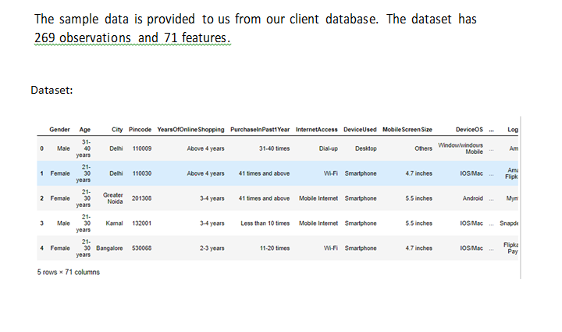
DATA SOURCES

Slide 5
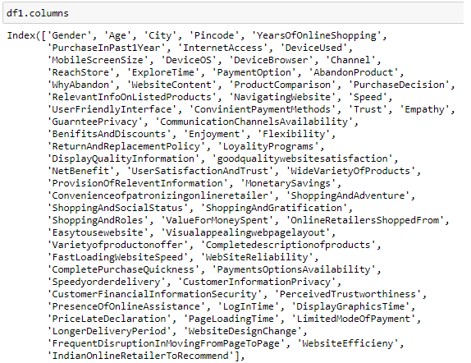
DATA PREPROCESSING
Replacing columns

Slide 6
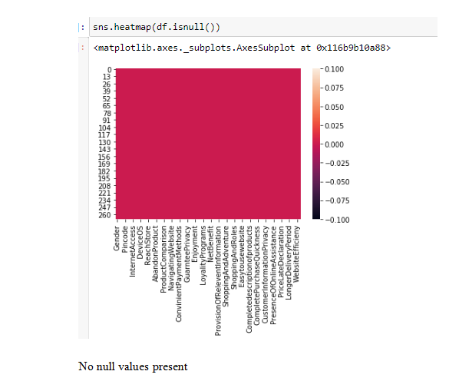
DATA PREPROCESSING
Dealing with null values

Slide 7
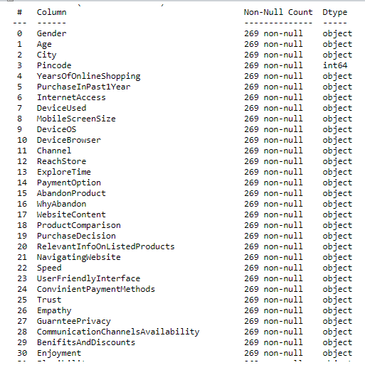
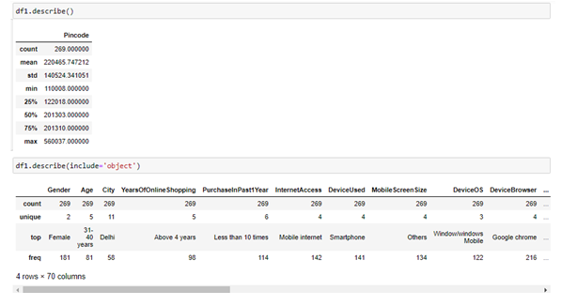
DATA PREPROCESSING
Data Info And Description

Slide 8
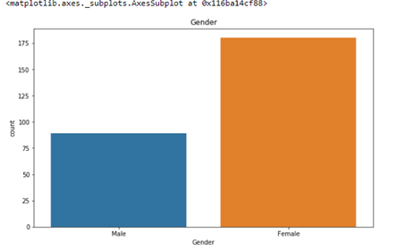
DATA VISUALIZATION
1. CountPlot -Gender

Slide 9
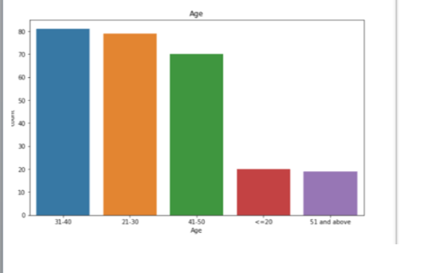
DATA VISUALIZATION
Age

Slide 10
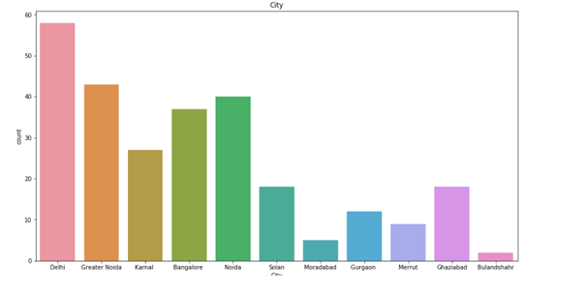
DATA VISUALIZATION
City

Slide 11
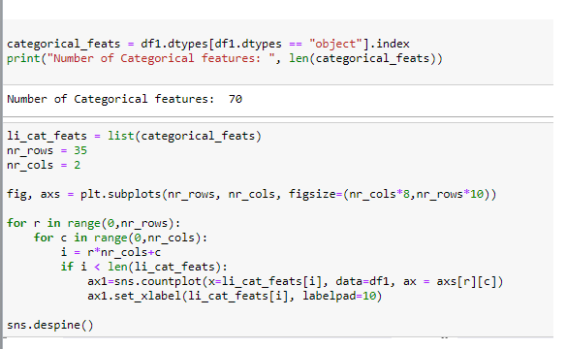
DATA VISUALIZATION
For All Variables

Slide 12
DATA VISUALIZATION
Relationship of Hedonic Values with Gender and Age
Hedonic Values:
'UserFriendlyInterface
'Trust
Empathy
Enjoyment
LoyalityPrograms
'UserSatisfactionAndTrust
'Convenienceofpatronizingonlineretailer
ShoppingAndAdventure'
ShoppingAndSocialStatus
ShoppingAndGratification'
ShoppingAndRoles
ValueForMoneySpent

Slide 13
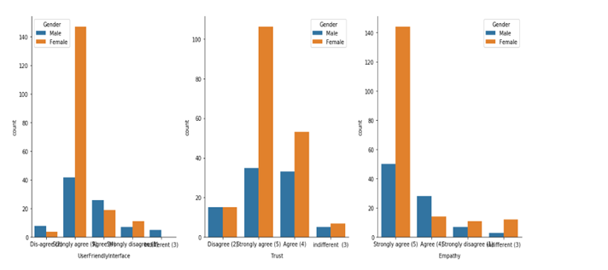
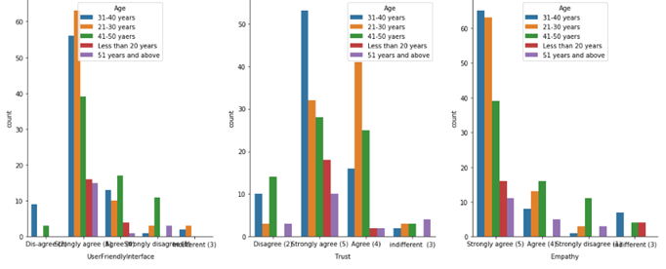
DATA VISUALIZATION

Slide 14
DATA VISUALIZATION
Relationship of Utilitarian Values with Gender and Age
Utilitarian Values:
WebsiteContent
ProductComparison
RelevantInfoOnListedProducts
NavigatingWebsite
ConvinientPaymentMethods
GuarnteePrivacy
CommunicationChannelsAvailability
Flexibility
DisplayQualityInformation
goodqualitywebsitesatisfaction
WideVarietyOfProducts
ProvisionOfReleventInformation
MonetarySavings

Slide 15
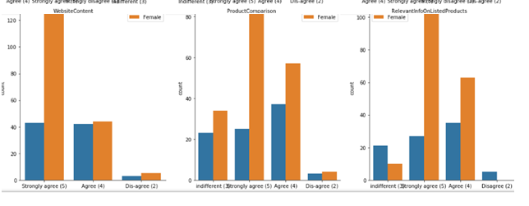
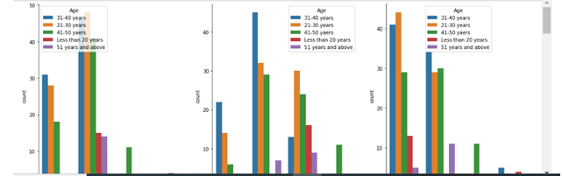
DATA VISUALIZATION

Slide 16
CONCLUSION
Results of the data analysis performed indicates the e-retail success factors, which are very much critical for customer satisfaction. It is concluded that combination of both utilitarian and hedonistic value are needed to affect the repeat purchase intention positively

