Slide 1
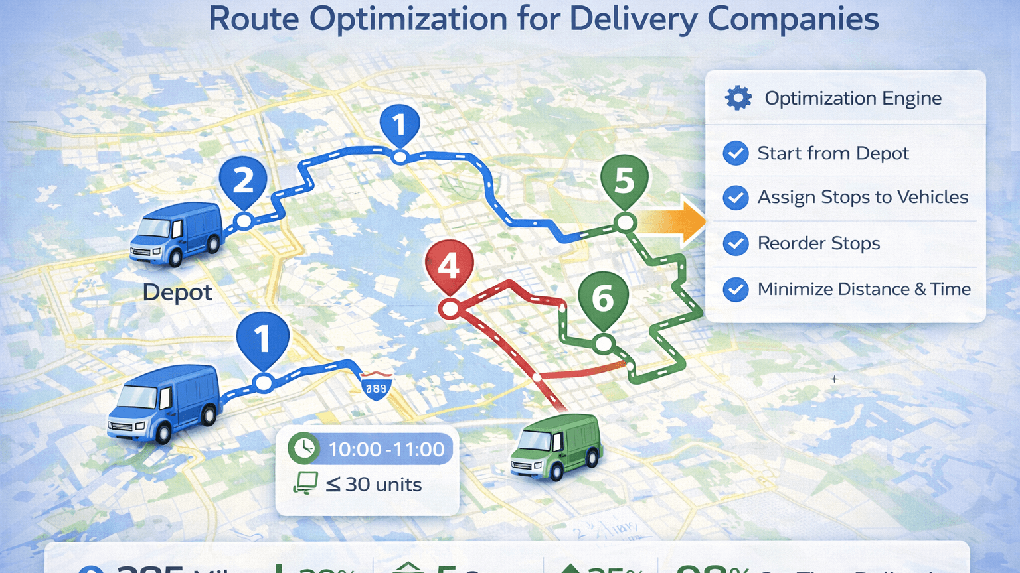

DHL Logistics Optimization for Delivery Routes
SQL Analytics Project | MySQL Workbench 8.0

Slide 2
1. Project Overview
Analyze DHL logistics data using SQL.
Identify shipment delays and inefficient routes.
Evaluate warehouse and delivery agent performance.
Track shipment status.
Generate logistics KPIs.
Recommend improvements for operational efficiency.
Video Link

Slide 3

2. Dataset & Database Structure
Orders:
order-level delivery details.
Routes:
source, destination, distance, transit time.
Warehouses:
hub location and capacity.
Delivery Agents:
experience and ratings.
Shipments:
pickup, delivery, status, and delays.

Slide 4
3. Task 1 – Data Cleaning & Preparation
Remove duplicate Order_ID and Shipmen_ID records.
Handle missing Delay_Hours using route-level averages.
Standardize date fields and validate pickup/delivery dates.
Check referential integrity across related tables.

Slide 5
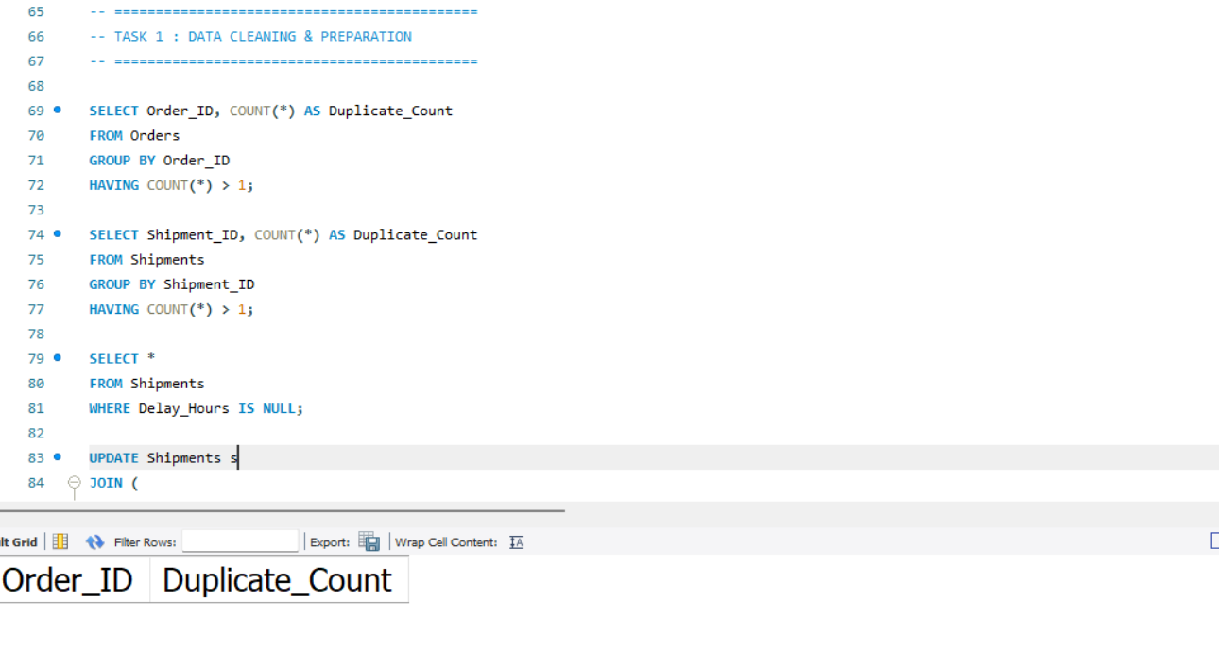

Slide 6
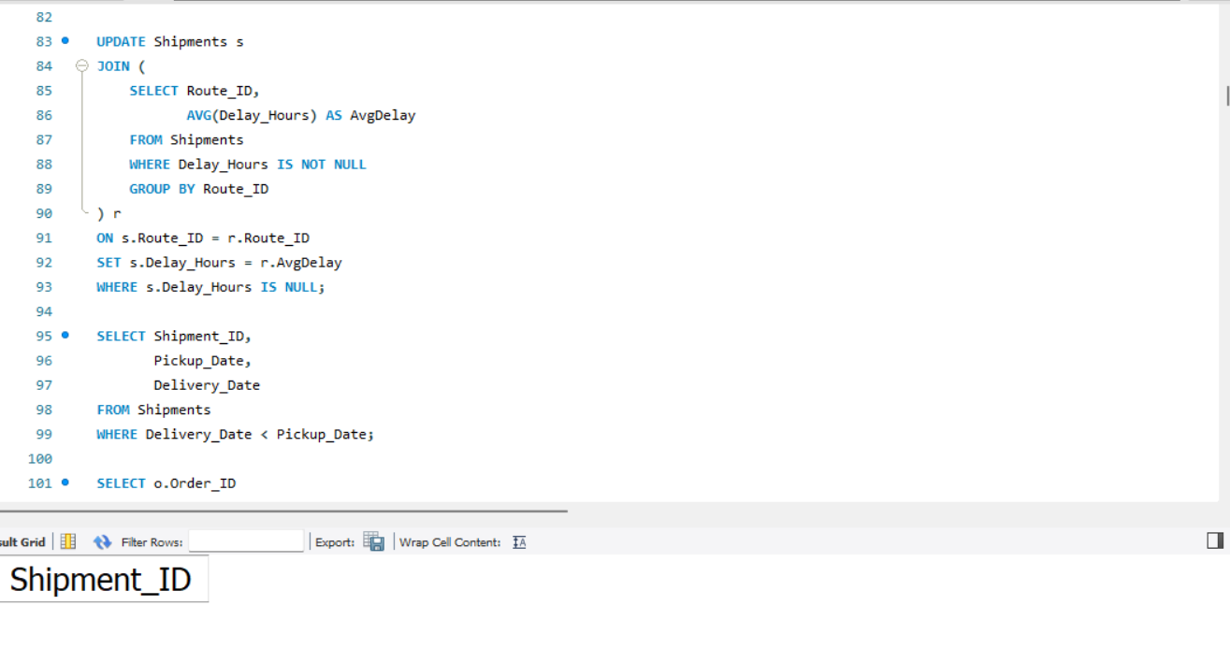
Full SQL query available in the project SQL script.
Insight:
The data cleaning process improved data quality and ensured that subsequent logistics analysis was based on reliable records.

Slide 7
4. Task 2 – Delivery Delay Analysis
Calculate delivery duration and delay.
Find Top 10 delayed routes.
Rank shipments within warehouses.
Compare Express and Standard delivery delays.
Insight: High-delay routes need operational intervention.

Slide 8
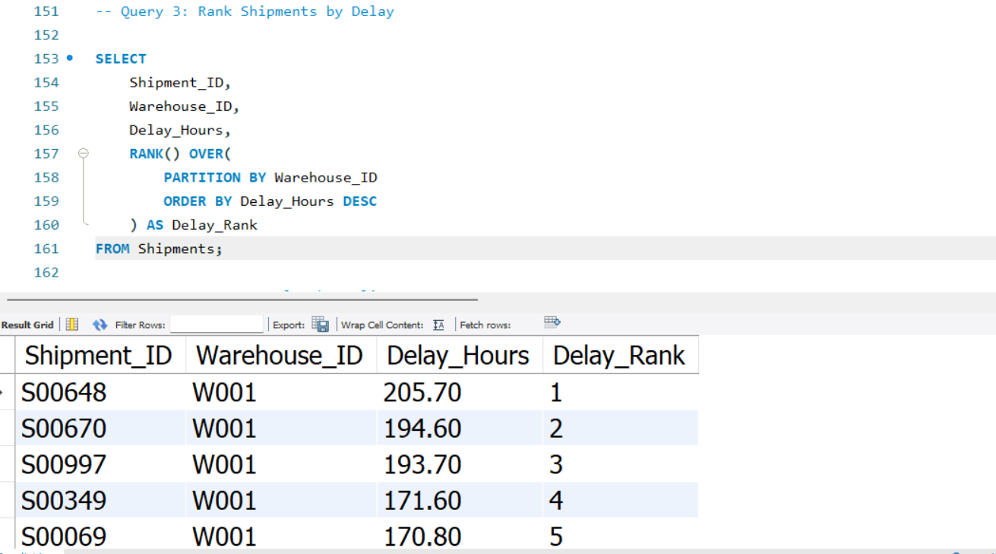
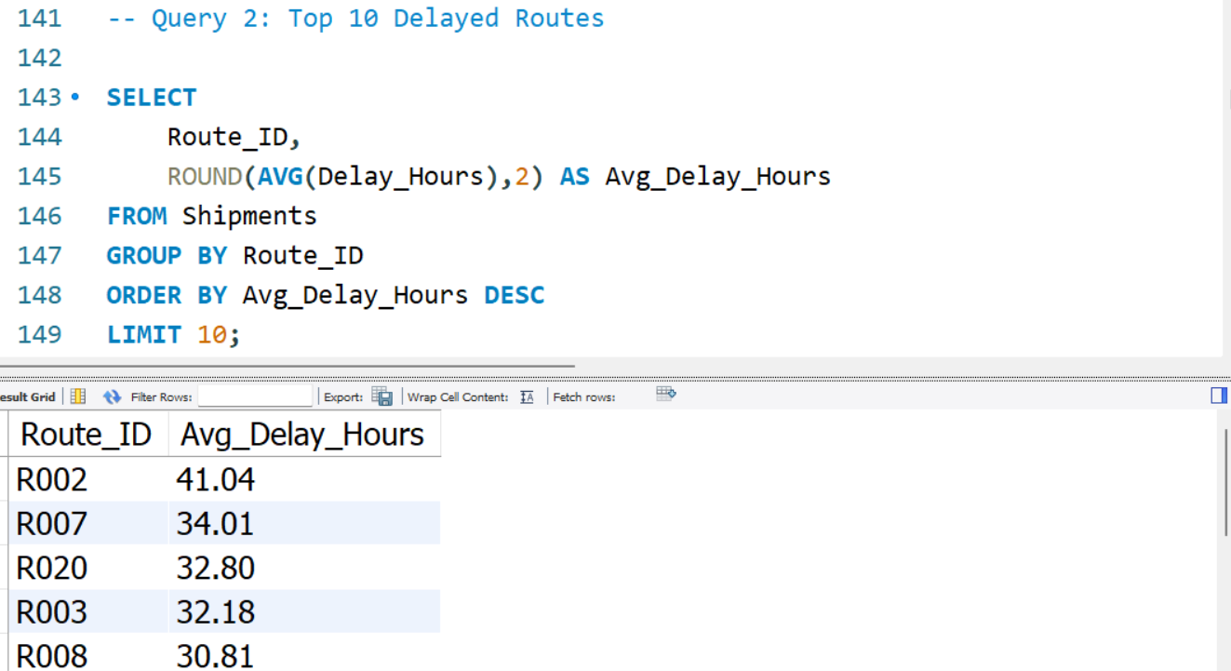

Slide 9
Insight: Routes with higher average delays should be prioritized for route optimization and operational review.

Slide 10
Average transit time
Average delay
Efficiency ratio
Worst-performing routes
Delayed shipment percentage
5. Task 3 – Route Optimization

Slide 11
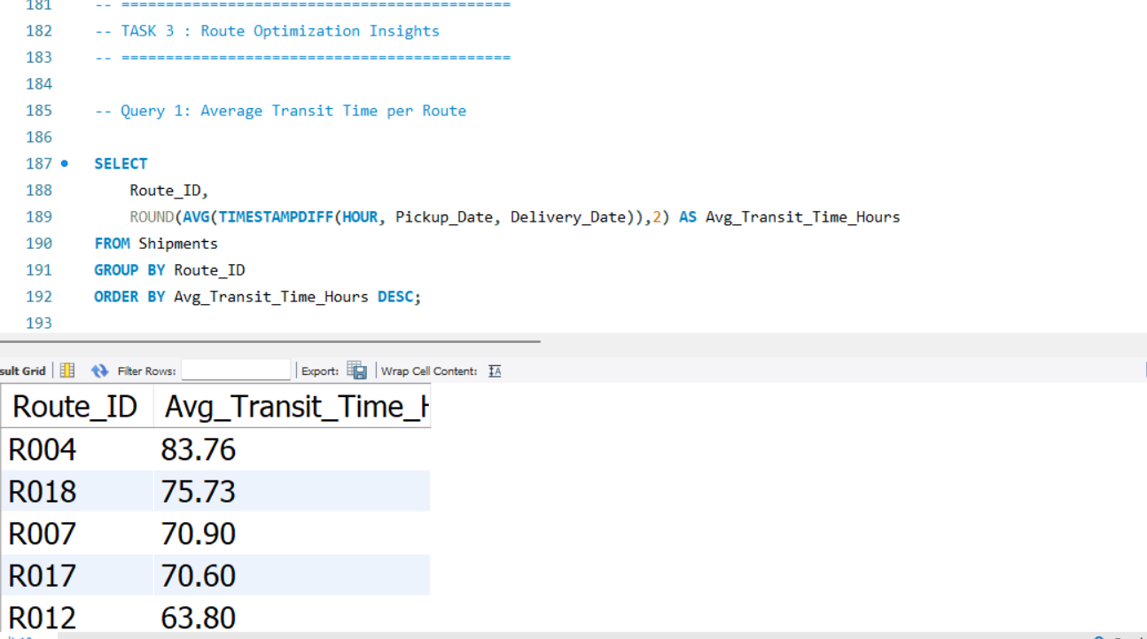
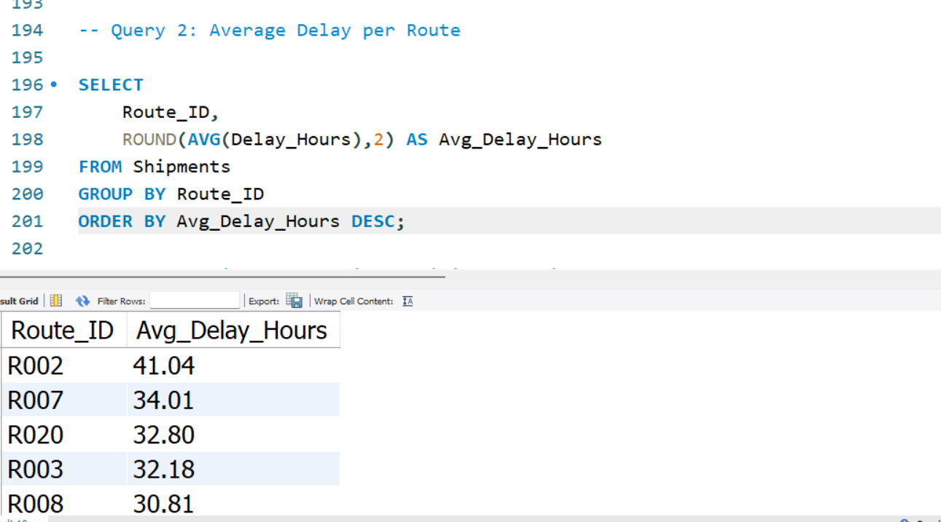

Slide 13

route-based visual.
Warehouse A
↓
Route R001
↓
Warehouse B
↓
Route R002
↓
Warehouse C
↓
Route R003

Slide 14

6. Task 4 – Warehouse Performance
Find top warehouses by average delay.
Compare total versus delayed shipments.
Compare warehouse delay with global average.
Rank warehouses by on-time delivery.

Slide 15
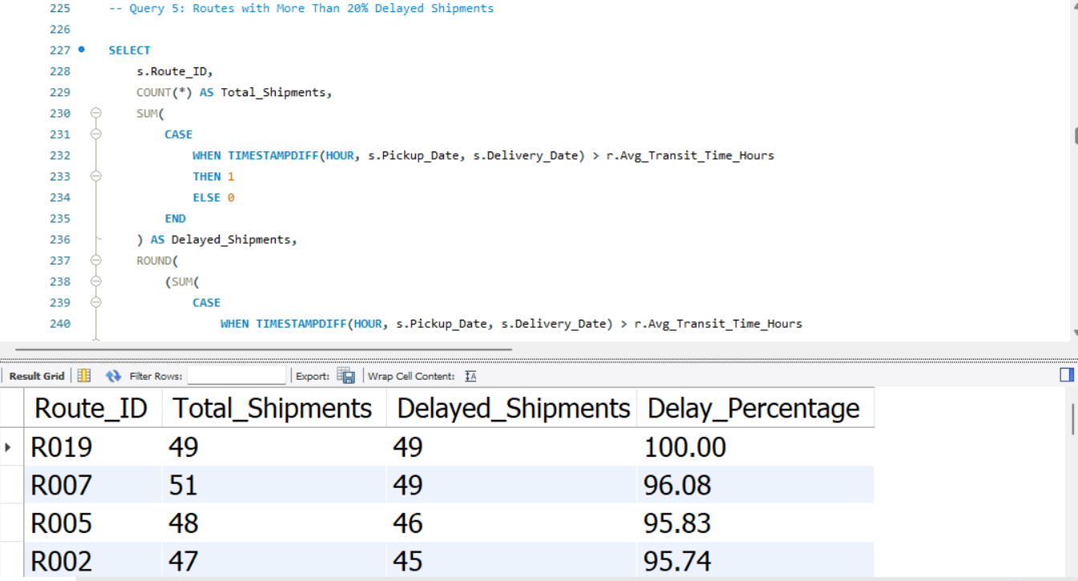
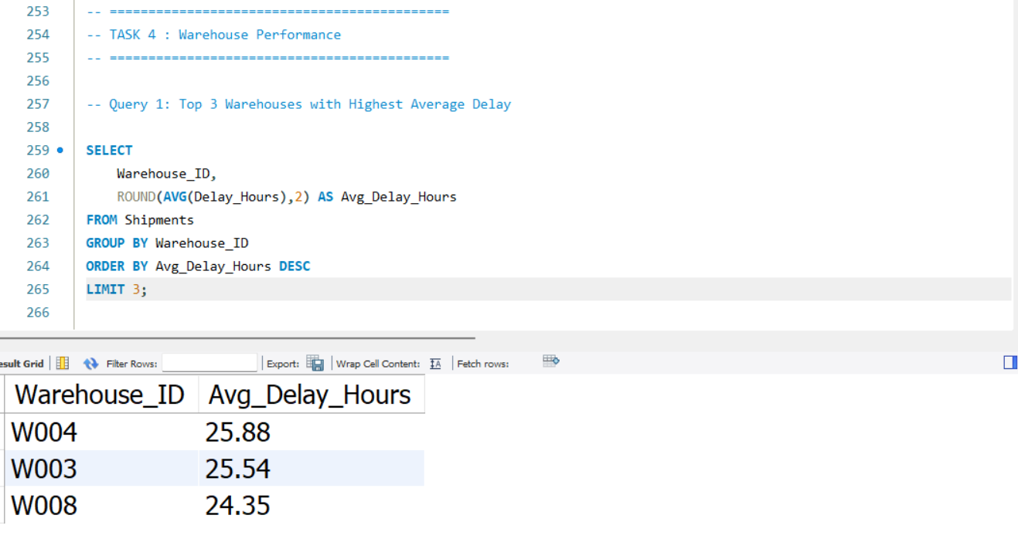
Insight: Weak warehouses require process and resource improvements.

Slide 16
Insight: Warehouses with higher delays or lower on-time performance require process optimization, improved scheduling, and resource allocation.

Slide 17

7. Task 5 – Delivery Agent Performance
Rank
Rank agents by on-time delivery within routes.
Identify
Identify agents below 85% on-time.
Compare
Compare top and bottom performers.
Recommend
Recommend training and workload balancing.

Slide 18
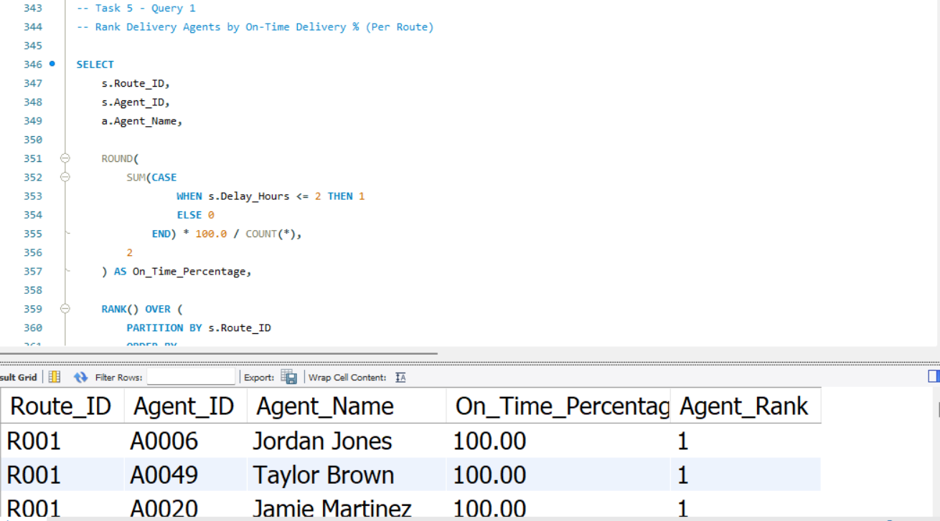
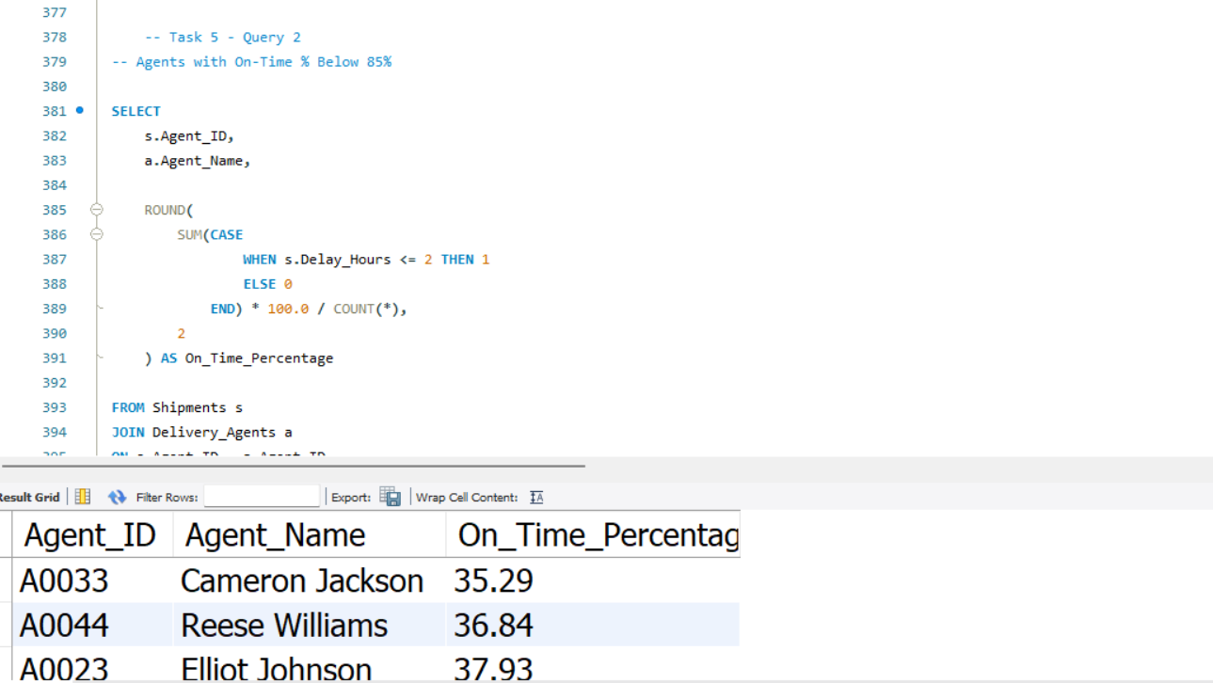
Insight: High performers can provide benchmarks for improvement.

Slide 20
8. Task 6 – Shipment Tracking Analytics
Review latest shipment status and delivery date.
Identify routes dominated by In Transit or Returned shipments.
Review delay indicators.
Investigate delays above 120 hours.

Slide 21
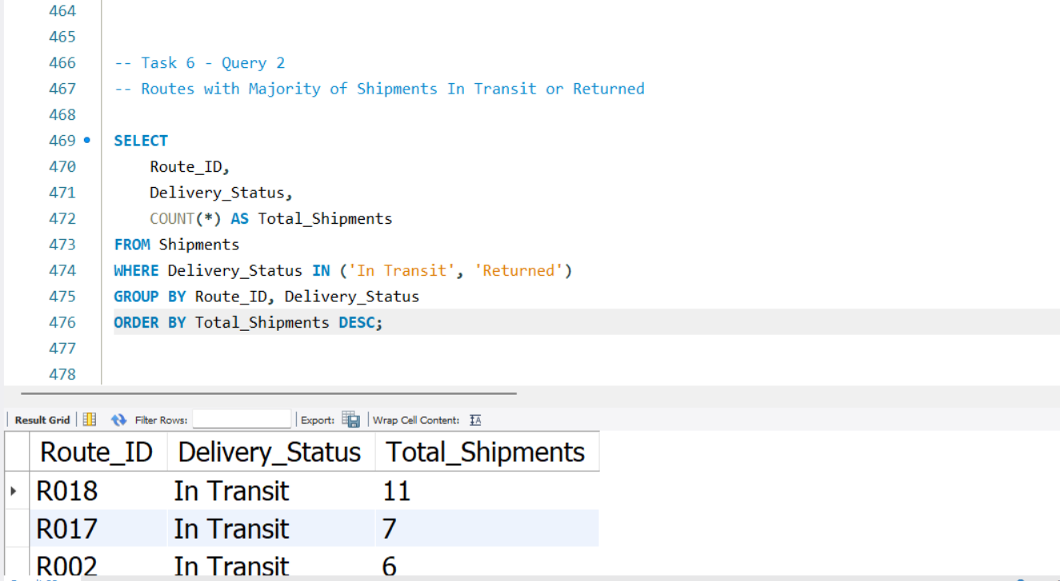
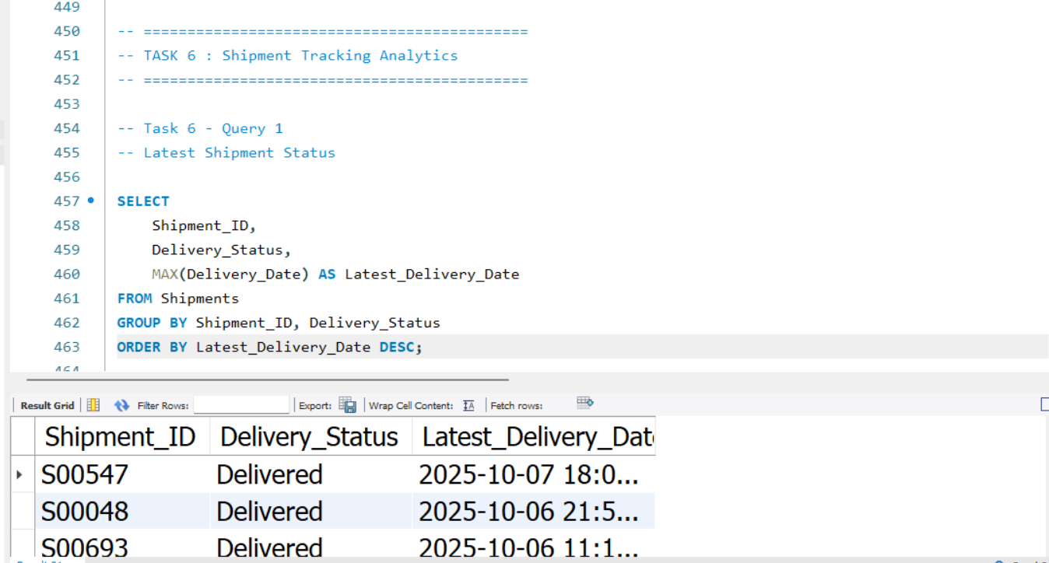
Insight: Extreme delays require escalation and bottleneck analysis.

Slide 22
9. Task 7 – Advanced KPI Reporting
Average delay by Source_Country.
On-Time Delivery Percentage.
Average delay per Route_ID.
Warehouse utilization.

Slide 23
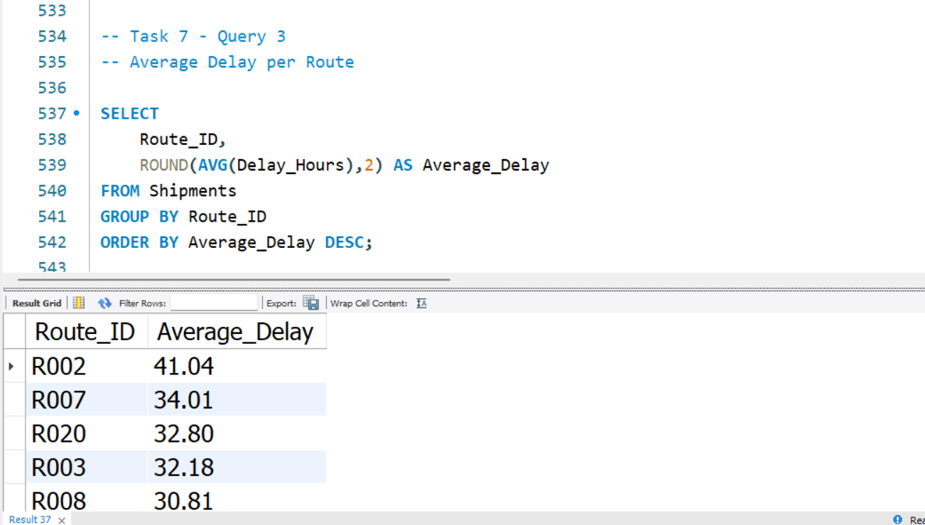
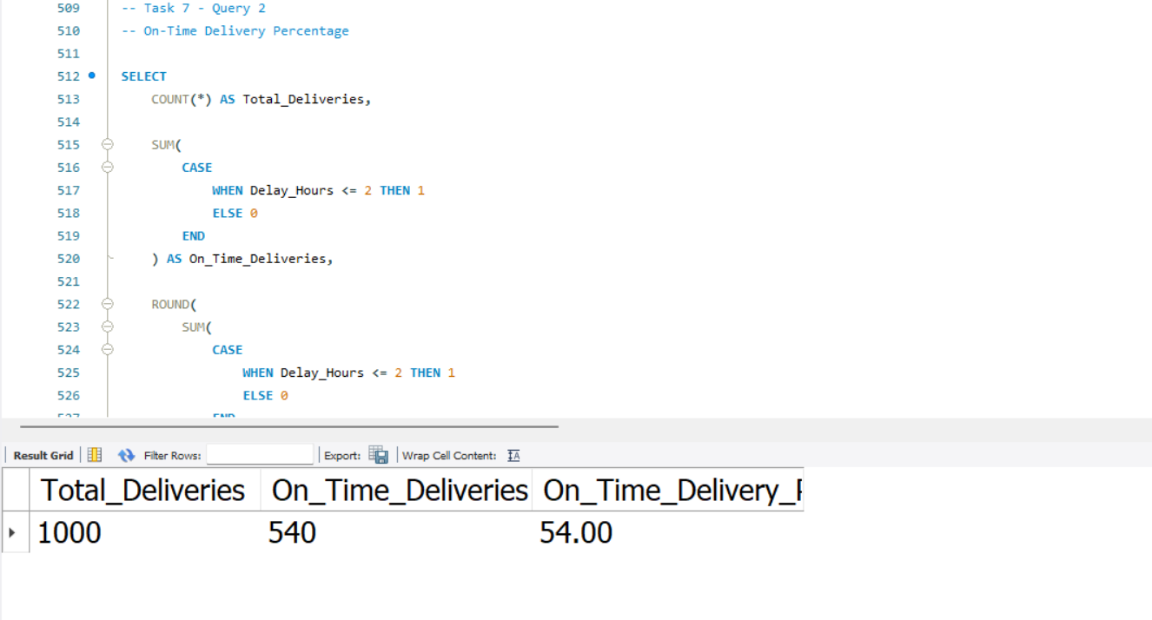
Insight: KPIs provide management with a concise performance view.

Slide 26
10. Overall Business Insights
SQL analysis identifies delays, route inefficiencies, warehouse bottlenecks, agent performance gaps, and shipment risks.
Route and warehouse rankings help management prioritize resources.
On-time delivery and utilization KPIs support continuous performance monitoring.

Slide 27

11. Business Recommendations
Optimize high-delay routes and improve hub combinations.
Balance warehouse workloads and staffing during peak periods.
Train and rebalance workloads for agents below 85% on-time.
Use predictive analytics to forecast delays.
Improve shipment visibility and escalation for extreme delays.
Monitor KPIs regularly through SQL dashboards.

Slide 28

12. Conclusion
The SQL-driven analysis supports data-based logistics decisions.
The findings provide practical opportunities to reduce delays and improve delivery reliability.
Implementing the recommendations can improve operational efficiency, reduce costs, and increase customer satisfaction.

Slide 29
Video Link
https://www.loom.com/share/5e39c96a29c346688257563b73dacd9d

Slide 30

Thank You

